Slide 1
ECONOMIC BUSINESS CYCLE

Slide 2
SOCIETY’S ECONOMIC GOAL
Every Society has three economic goals;
Promote economic growth
Prevent unemployment
Limit inflation- price stability

Slide 3
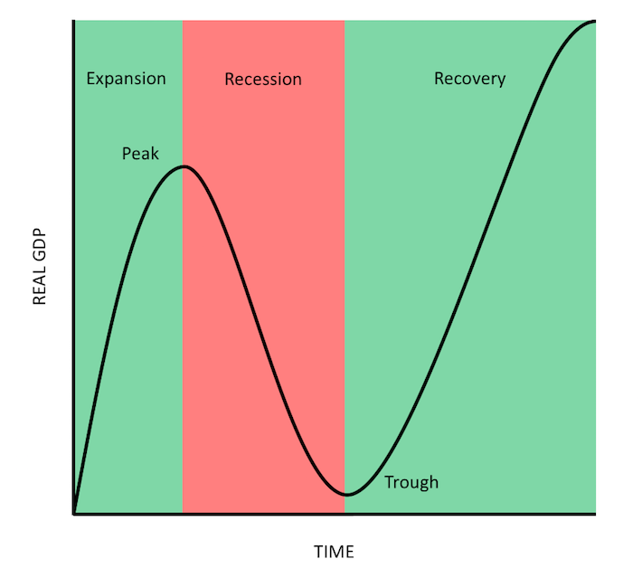
STAGES OF ECONOMIC BUSINESS CYCLE
Notes:
Business Cycle is the visualisation of the economic conditions, a graph showing us how businesses are meeting society goals
Economic business cycle is measured by two components, GDP(Total output produced by an economy) and Time
Fluctuations in the economy(ups and downs)
GDP increase-economy is growing(Expansion)
GDP Decrease- economy is shrinking(Contraction/Recession)
Fluctuations continue overtime for months, quarters or years

Slide 4
PROSPERITY(EXPANSION)
CHARACTERISTICS
Unemployment is low
Aggregate income is relatively high
Assuming a low inflation rate- this combination causes buying power to be high

Slide 5
The economic outlook remains prosperous, consumers generally are willing to buy
Organisations respond by expanding their product/services mixes to take advantage of the increased buying power
Capture a larger market share by intensifying distribution and promotion efforts

Slide 6
RECESSION
CHARACTERISTICS
Unemployment rises during recession
Total buying power decline-many consumers become more price and value conscious
People ordinarily reduce their consumption of the more expensive convenience foods and save their money (e.g. grow own food, discount purchasing)
Organisations would consider some revision to their marketing activities
  Reducing the size of their product line
  Increasing promotional outlays to stimulate demand.
Promotional efforts should emphasize value and utility.

Slide 7
DEPRESSION(TROUGH)
CHARACTERISTICS
Extremely high unemployment
Wages are very low, total disposable income is at a minimum, and consumer spending is lowest
Consumers lack confidence in the economy.
Governments use both monetary and fiscal policies in an attempt to offset the effects of recession, depression and inflation

Slide 8
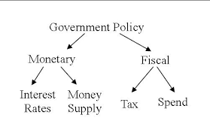
Monetary policies are employed to control the money supply which in turn influences spending, saving and investment by both individuals and business
Through fiscal policies, the government can influence the amount of savings and expenditures by altering the tax structure and by changing the levels of government expenditure

Slide 9
Recovery
The economy moves from recession to prosperity
During this period:
  High unemployment rate begins to decline
  Total disposable income increases
  Consumers ability to buy increases, but their willingness to buy is more cautious
  They may be more likely to save than spend or buy on credit
As the recovery strengthens:
  Consumers start spending more, buying higher-priced goods and services such as house cleaning and lawn care
Recovery is a difficult stage for marketers. Because of the difficulty to ascertain:
  How quickly prosperity will return
  How quickly consumers will make the psychological transition from recession to prosperity
Organizations should maintain a high flexibility in their strategies in order to be able to make the needed adjustments as the economy stabilises

Slide 10
END

