Slide 1
THE BUSINESS ENVIRONMENT

Slide 2
WHAT IS BUSINESS ENVIRONMENT?
The term ‘business environment’ connotes external forces, factors and institutions that are beyond the control of the business and they affect the functioning of a business enterprise.
The business environment poses threats to a firm or offers immense opportunities for potential market exploitation.

Slide 3
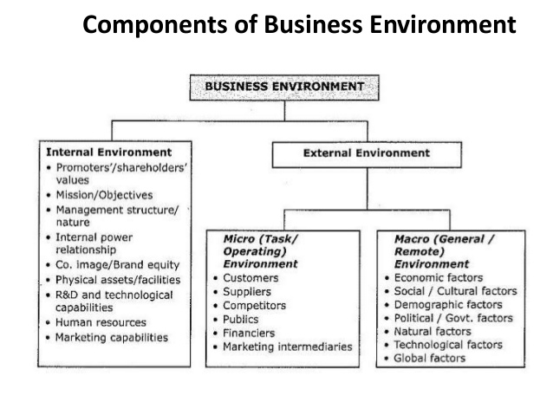

Slide 4
WHY STUDY THE BUSINESS ENVIRONMENT
Development of broad strategies and long-term policies of the firm
Development of action plans to deal with technological advancements
Foresee the impact of socio-economic changes at the national and international levels on the firm’s stability
Analysis of competitor’s strategies and formulation of effective counter-measures
Keep business flexible and dynamic

Slide 5
THE MEANINING OF THE EXTERNAL ENVIRONMENT
The external environment is everything outside an organization that might affect it. An organization's external environment consists of two layers:
The general environment - refers to those nonspecific dimensions and forces in an organization's surroundings that might affect its activities. It includes Political, Economic, Social-cultural and Technological (PEST) factors.
The task environment - refers to those specific organizations or groups that are likely to influence an organization. It consists of competitors, customers, suppliers, regulators, unions and owners.

Slide 6
THE GENERAL ENVIRONMENT
1. The Political/legal Environment
The political/legal environment consists of the law and interpretation of laws that require firms to comply with.
Ignorance or noncompliance with the laws, could result in fines.
Operating within the legal framework is both socially responsible and ethical.

Slide 7
The Political/legal Environment Cont’d
Organizations must be aware of state and local laws that influence their activities.
(12/08/2018-GRZ Pronouncements on, Tariff on internet phone calls, The Food Reserve (Amendment) Bill, 2018 and Cyber Security and Cybercrime Bill, 2018)
The central and local government have established regulatory agencies to enforce laws i.e. CCPC, ZRA, NAPSA etc

Slide 8
2. Economic Environment
The economic and competitive forces in the general environment influence business organizations and customers' decision and activities.
The overall state of the economy fluctuates in all countries.
The health of the economy influences how much consumers spend and what they buy.
Therefore, present-day economic conditions and changes in economy have a broad impact on the success of organization

Slide 9
Economic Environment Cont’d
The consumption patterns of their potential customers are affected by economic forces such as
The rate of inflation,
Interest rests,
The availability of credit for consumer purchases or investment purposes,
The rate of unemployment, and
The size of disposable personal income.

Slide 10
3.Technological Forces
The technological environment represents the application of knowledge based on discoveries in science, inventions and innovations.
New technology results in new products and services for consumers, improved existing products and often lower prices through the development of more cost-efficient production and distribution methods.
Technology affects the types of products that organizations can offer.

Slide 11
Monitoring the Technological environment
Reasons for monitoring the technological environment include;
Adopting technology may be the means by which a firm remains competitive.
Applying new technology also gives organizations the opportunity to improve customer service e.g 24 hours banking due to ATMs.
New technology can lead to increased productivity and operating efficiency e.g. CAD and CAM speed up the production process in manufacturing companies.

Slide 12
4. Social/cultural Environment
Analysis of the social environment is concerned with understanding the potential impacts of society and social changes on a business, its industry and markets.
This may include changes in Tastes, fashion, lifestyle, preferences etc.

Slide 13
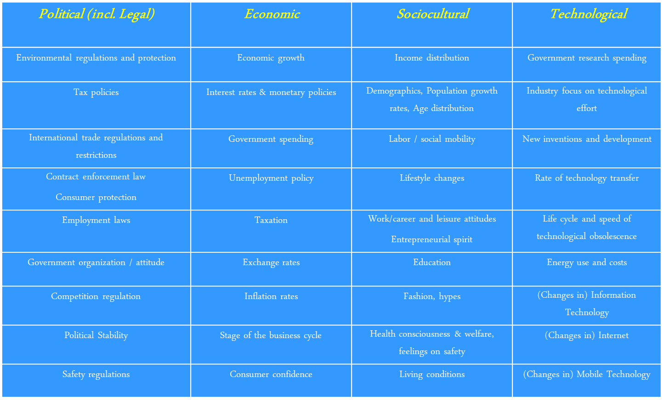

Slide 14
International Forces
Environment forces within the international business include
  language differences,
  changing currency exchange rates,
  different national laws affecting economic activity, political risks and stability,
  tax laws of different nations, and
  social/cultural differences between nations.

Slide 15
THE TASK ENVIRONMENT
The task environment consist of seven dimensions
1. Competitors
An organization's competitors are other organizations that compete with it for resources.
The most obvious resources that competitors vie for are customers. Customers include whomever pays money to acquire an organization's products or services.
Other competitors include those who produce similar or substitutes products that perform a similar function or solve the problem or eliminate it in a dissimilar way.

Slide 16
2. Customers
Customers can be individuals or organizations.
Understanding customers is an important factor in the success of any business organization.
Consumers have rights and they include:
The right to choose freely –variety of goods
The right to be informed-Education on product information.
The right to be heard –Express displeasure
The right to be safe- Product safety

Slide 17
3. Suppliers
Suppliers are organizations or individuals that provide resources for other organizations.
Suppliers for manufacturing firms include the suppliers of raw materials and those that sell machinery and other equipment.
Banks and lending agencies are both suppliers of capital for businesses.
Other suppliers provide human resources for the organization.

Slide 18
4. Regulators
Regulators are units that have the potential to control, regulate, or influence an organization's policies and practices.
There are two important kinds:
Regulatory agencies that are created by the government, and
Interest groups formed by their own individual members to attempt to influence business.

Slide 19
5. External labour
Organizations must also concern themselves with labour especially when it is organized into unions.
The Industrial Relations Act requires organizations to recognize and bargain with a union.
That union has to be legally established and should be a mother body of the organization's employees.

Slide 20
6.Owners
Owners (shareholders) are also becoming a major concern of managers in many businesses.
Until recently, stockholders of major corporations were generally happy to sit on the sidelines and let top management run their organizations.
Lately, however, more and more of them are taking active roles in Influencing the management of companies they hold stock in.

Slide 21
7. Strategic Allies
Strategic allies are two or more organizations working together in a joint venture or similar arrangement.
Strategic alliances help companies get from other companies the expertise they may lack.
They also spread the risk. Managers must be careful, however, not to give away sensible competitive information.

Slide 22
THE INTERNAL ENVIRONMENT
An organization's internal environment consists of conditions and forces within the organization.
Its major components include:
1. Board of Directors
2. Employees
3. Culture

Slide 23
1. Board of Directors
A board of directors is elected by the stockholders and is charged with overseeing the general management of the firm to ensure that it is being run in a way that best serves the stockholder's interests.
The board plays a major role in helping set corporate strategy and seeing that it is implemented properly.
The board also reviews all important decisions made by top management and determines compensation for top managers.

Slide 24
2. Employees
Employees do exert a lot of influence on organizations by way of demanding for good conditions of service.
If employees demand more high pay and other benefits than they produce, an organization will be affected.
A second challenge for business is harnessing human skills and talents for productive work while protecting human dignity and health at the same time.

Slide 25
3. Culture
The culture of an organization is the set of values that help its members understand what the organization stands for, how it does things and what it considers important.
Culture plays a major role in shaping managerial behavior.
Most successful foreign firms, such as Toyota are known to have strong and clear cultures that contribute to their effectiveness.
Culture is a powerful force in organizations, one that can shape the firm's overall effectiveness and long-term success.

