Slide 1
BUSINESS ENVIRONMENT
INTERNAL AND EXTERNAL
ENVIRONMENTAL ANALYSIS TOOLS

Slide 2
SWOT ANALYSIS
SWOT is an acronym which stands for Strengths, Weaknesses, Opportunities and Threats. It is used to analyse both the internal and external environment
Strengths and weaknesses are internal to the company, meaning they’re things that you as a business owner have the power to change.
Opportunities and threats are external issues that are outside the scope of your control but which can impact your operation for better or worse.

Slide 3
APPLICATION OF SWOT ANALYSIS
Helps to conduct quick analysis of a business’s current position in the market.
Used to analyze possible internal advantages and problems that business has.
Helps determine the external factors of the business which may affect its strategy.

Slide 4
SWOT Analysis
Strengths: Internal attributes and resources that support a successful outcome.
Weaknesses: Internal attributes and resources that work against a successful outcome.
Opportunities: External factors that the entity can capitalize on or use to its advantage.
Threats: External factors that could jeopardize the entity's success.

Slide 5
-Illustration for SWOT Analysis Models
Good brand image
Well-known name
Good reputation
Cost advantage in production
High market share
Confidence in the market
Customer loyalty or repeat business
More advanced technology and R & D
Strengths

Slide 6
-Illustrations for SWOT Analysis Models
Ineffective in production
Falling profit
Falling sales of the product
Declining age of the life cycle of a product
Poor reputation
Lack of innovation and change
Lack of adequate capital or having some financial problems
Customers’ losing confidence or increasing complaints on the business
Poor management or inefficient organizational structure
Weaknesses

Slide 7
-Illustrations for SWOT Analysis Models
Possible development of new products
Expansion into new markets
Development of a global brand
Joint –development with other companies
Possible growing demand for a product in the market
Possible government policies encouraging the growth of the business and its certain products
New sources of profit or income
Opportunities

Slide 8
-Illustrations for SWOT Analysis Models
Changes in law or regulations.
Growing competition from local companies
Increasing competition from foreign competitors
New products developed by other companies which may replace the product of the business
Marketing activities or strategies which will be implemented by competitors
Threats

Slide 9
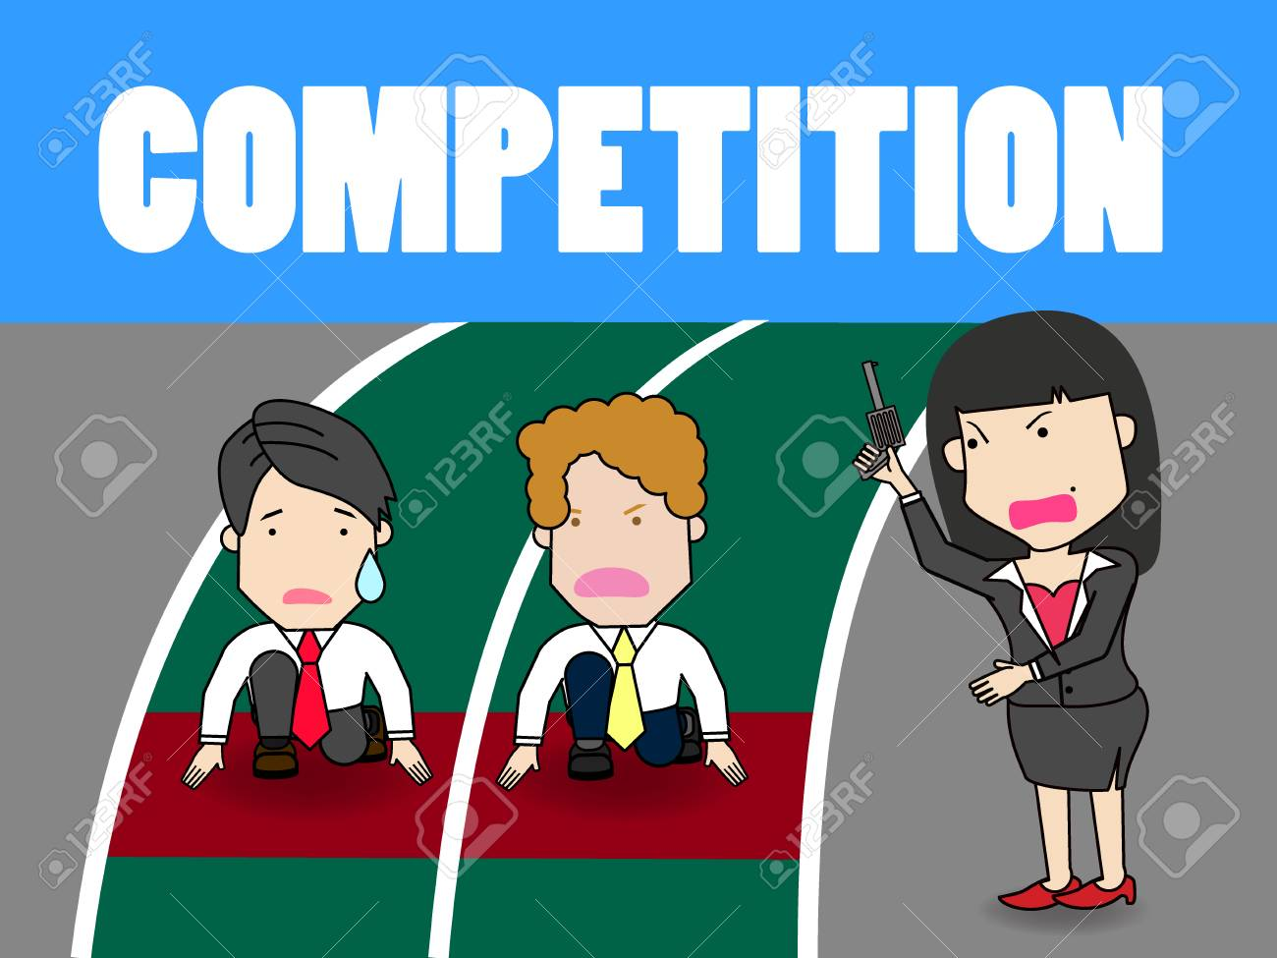
IS COMPETITION GOOD OR BAD?

Slide 10
PROTECTING MARKET SHARE
POSITION DEFENSE – Build fortifications around its current position.
FLANKING DEFENSE – Check all flanks and protect the weaker ones.
PRE-EMPTIVE DEFENSE – striking competitors before they can move against the company.
COUNTER OFFENSIVE DEFENSE – When attacked despite its flanking or pre-emptive efforts.
CONTRACTION DEFENSE – when resources are spread too thinly and competitors are nibbling away on several fronts.

Slide 11
CHOOSING AN ATTACK STRATEGY
How can the market challenger best attack the chosen competitor and achieve its strategic objective?
1.FRONTAL ATTACK
The Challenger matches the competitor’s product; advertising, price and distribution efforts. It attacks competitor’s strengths rather than weaknesses.
The outcome depends on who has the greater strength and endurance. If the market challenger has fewer resources than the competitors, a frontal attack makes little sense. Even great size and strength may not be enough to challenge a firmly entrenched, resourceful competitor successfully.

Slide 12
2. FLANKING ATTACK
Rather than attacking head on, the challenger can concentrate its strength against the competitor’s weaker flanks or on gaps in the competitor’s market coverage .
Flank attacks make good sense when the company has fewer resources than the competitor.

Slide 13
3. ENCIRCLEMENT ATTACK
This involves attacking from the front, sides and rear at the same time.
Makes sense when Challenger has superior resources and believes that can break competitor’s hold on market quickly.

Slide 14
4. BYPASS ATTACK
Challenger bypasses competitor and targets easier markets. It might diversify into un related products, move into new geographic markets, or leapfrog into new technologies to replace existing products.
With technological leap-frogging, instead of copying the competitors products and mounting a costly frontal attack, the challenger passes by the competitor with the next technology.

Slide 15
5. GUERRILLA ATTACKS
For smaller or poorly financed challengers, this attack is ideal. These are small, periodic attacks to harass and demoralize the competitor, with the goal of eventually establishing permanent footholds.
Challenger might use selective promotional out bursts, or assorted legal actions. Specific guerrilla actions can be cheap, but continuous guerilla campaigns can be expensive. And they eventually must be followed up by stronger attacks if the challenger wishes to gain ground against competitors.

Slide 16
CONCLUSION
For an organization to maintain market leadership, it needs to:-
Prevent or fix weaknesses that provide opportunities for competitors
Keep Costs down
Keep its prices in line with the value the customers see in their brands
Leaders should “plug holes” so that competitors do not jump in
Best response is continuous innovation
Leader should refuse to be content with status quo and always lead in new products, customer service and distribution effectiveness.

Slide 17
COMPETITIVE ANALYSIS TOOL-PORTER’S FIVE FORCES

Slide 18
Michael Porter’s Five Forces
Competitive Analysis tool developed by Michael Porter in 1979
Theory is based on concept that there are five forces that determine;
  Competitive intensity and attractiveness of a market,
  Where power lies in a business situation,
  Whether or not a business can be profitable, based on other businesses in the industry.
  Competitive strength and position of business organisations
  Whether new products or services are potentially profitable.

Slide 19
APPLICATION OF PORTERS’ FIVE FORCE THEORY
Actions to take / Dos | Actions to Avoid / Don'ts
Use this model where there are at least three competitors in the market Consider the impact that government has or may have on the industry Consider the industry lifecycle stage – earlier stages will be more turbulent Consider the dynamic/changing characteristics of the industryBBA140 2015 semester 2 Final exam.pdf | Avoid using the model for an individual firm; it is designed for use on an industry basis

Slide 20
Porter Competitive Model
Potential
New Entrants
Bargaining
Power
of Suppliers
Intra-Industry
Rivalry
Strategic Business Unit
Bargaining
Power
of Buyers
Substitute
Products
and Services
Source: Michael E. Porter
“Forces Governing Competition in Industry
Harvard Business Review, Mar.-Apr. 1979

Slide 21
THREAT OF NEW ENTRANTS
Examines how easy or difficult it is for competitors to join the marketplace in the industry being examined.
The easier it is for a competitor to join the marketplace, the greater the risk of a business's market share being depleted.

Slide 22
Profitable markets attract new entrants, which erodes profitability.
Unless incumbents have strong and durable barriers to entry, for example;
        patents
        economies of scale
        capital requirements
        access to inputs
        government policies

Slide 23
Threat of substitute products
A substitute good is a good that can be used in place of another.
Consumer perceives substitutes as similar or comparable, so that having more of one product makes them desire less of the other product.
Examines how easy it is for consumers to switch from a business's product or service to that of a competitor.
Where close substitute products exist in a market, it increases the likelihood of customers switching to alternatives in response to price increases.
This reduces both the power of suppliers and the attractiveness of the market.

Slide 24
Bargaining power of Buyers
Analyses the power of the consumer to affect pricing and quality, how easy is it to drive down prices.
Consumers have power when there are not many of them, but lots of sellers, as well as when it is easy to switch from one business's products or services to another.
Buying power is low when consumers purchase products in small amounts.
If a business has just a few powerful buyers, they are often able to dictate terms.

Slide 25
Bargaining power of suppliers
Analyses how much power a business's supplier has and how much control it has over the potential to raise its prices, which, in turn, would lower a business's profitability.
The fewer the suppliers , the more power they have.
Businesses are in a better position when there are a multitude of suppliers.

Slide 26
Competitive Rivalry
Examines how intense the competition is in the market
Main driver is the number and capability of competitors in the market.
Many competitors, offering undifferentiated products and services, will reduce market attractiveness.

Slide 27
END

