Slide 1
BUSINESS ENVIRONMENT
INTERNAL AND EXTERNAL
ENVIRONMENTAL ANALYSIS TOOLS

Slide 2
SWOT ANALYSIS
SWOT is an acronym which stands for Strengths, Weaknesses, Opportunities and Threats. It is used to analyse both the internal and external environment
Strengths and weaknesses are internal to the company, meaning they’re things that you as a business owner have the power to change.
Opportunities and threats are external issues that are outside the scope of your control but which can impact your operation for better or worse.

Slide 3
APPLICATION OF SWOT ANALYSIS
A SWOT analysis helps to conduct a quick analysis of a business’s current position so that it can help the business to develop or plan a direction of development or a proper strategy in future.
It is used to analyze the possible internal advantages and problems that a business has, and helps determine the external factors of the business which may affect its strategy
  Complete an objective analysis
  Allows business owners to evaluate their position in the marketplace
  Identify sources of competitive advantage as well as potential liabilities
  Evaluate investment worthiness of the company

Slide 4
STRENGTHS
Internal attributes and resources that support a successful outcome
What advantages does your organization have?
What do you do better than anyone else?
What unique or lowest-cost resources can you draw upon that others can't?
What do people in your market see as your strengths?
What factors mean that you "get the sale"?
What is your unique selling point?

Slide 5
WEAKNESSES
Internal attributes and resources that work against a successful outcome
What could you improve?
What should you avoid?
What are people in your market likely to see as weaknesses?
What factors make you lose sales?

Slide 6
OPPORTUNITIES
External factors that the entity can capitalize on or use to its advantage
What good opportunities can you spot?
What interesting trends are you aware of?

Slide 7
THREATS
External factors that could jeopardize the entity's success
What obstacles do you face?
What are your competitors doing?
Are quality standards or specifications for your job, products or services changing?
Is changing technology threatening your position?
Do you have bad debt or cash-flow problems?
Could any of your weaknesses seriously threaten your business?

Slide 8
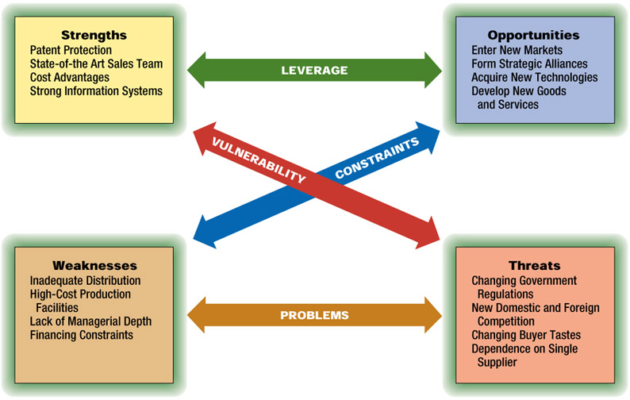
Elements of SWOT Analysis

Slide 9
Business Analysis Models
-Examples or Illustrations for SWOT Analysis Models
Good brand image
Well-known name
Good reputation
Cost advantage in production
High market share
Confidence in the market
Customer loyalty or repeat business
More advanced technology and R & D
Strengths

Slide 10
Business Analysis Models
-Examples or Illustrations for SWOT Analysis Models
Ineffective in production
Falling profit
Falling sales of the product
Declining age of the life cycle of a product
Poor reputation
Lack of innovation and change
Lack of adequate capital or having some financial problems
Customers’ losing confidence or increasing complaints on the business
Poor management or inefficient organizational structure
Weaknesses

Slide 11
Business Analysis Models
-Examples or Illustrations for SWOT Analysis Models
Possible development of new products
Expansion into new markets
Development of a global brand
Joint –development with other companies
Possible growing demand for a product in the market
Possible government policies encouraging the growth of the business and its certain products
New sources of profit or income
Opportunities

Slide 12
Business Analysis Models
-Examples or Illustrations for SWOT Analysis Models
Changes in law or regulations.
Growing competition from local companies
Increasing competition from foreign competitors
New products developed by other companies which may replace the product of the business
Marketing activities or strategies which will be implemented by competitors
Threats

Slide 13
PERSONAL ASSESSMENT USING SWOT
Question for your critical thinking:
Based on the Analysis Model discussed, in 10 minutes, Conduct a brief SWOT analysis on yourself.

Slide 14
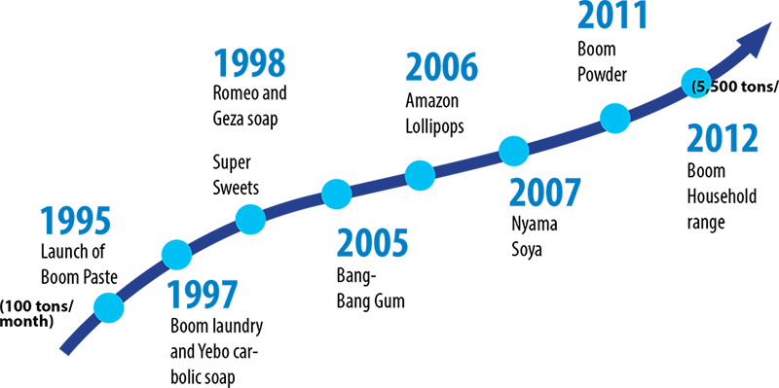
TRADE KINGS STORY

Slide 15
CLASS EXERCISE
Trade Kings Zambia, has recruited you as a management trainee. The Business Development Manager working with Production Department is thinking of introducing a new product on to the market. As the newly recruited management trainee, under his jurisdiction, he has tasked you with the responsibility of conducting a SWOT analysis to ascertain the organisation’s readiness for this new product and how this new product will impact on the business performance.

Slide 16
GROUP EXERCISE
In smaller groups of six conduct a swot analysis on the following companies;
Shoprite
Lafarge
ZNBC
Zambeef
Protea Hotels
UTH
Small grocery store outside Unilus gate
Airtel

Slide 17
END

Slide 18
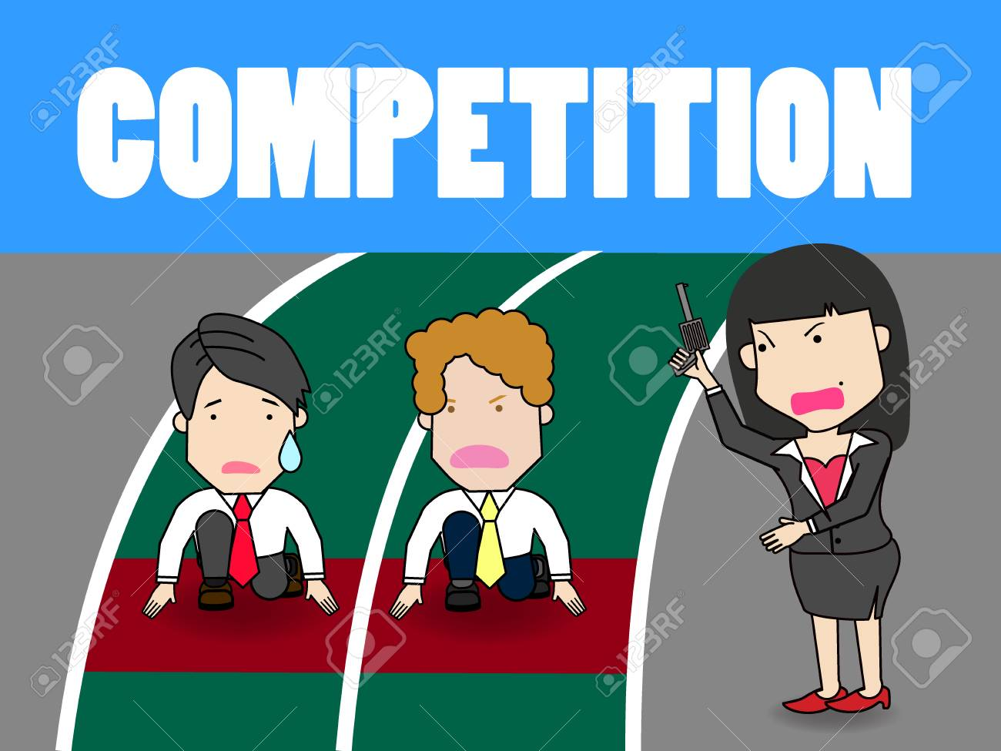
IS COMPETITION GOOD OR BAD?

Slide 19
The competitor to be feared is one who never bothers about you at all, but goes on making his own business better all the time. Henry Ford

Slide 20
Competition is all around and affects virtually all businesses as well as individuals;
            Interviews
            Promotion
            Awards

Slide 21
Competitive Analysis
Competition is one of the biggest threats to businesses be it a start up or established.
Who is your competition?
How are their actions in the marketplace going to affect your current bottom line and future planning?
How do you as a business counter your competitors move?

Slide 22
REMEMBER…….
No one strategy is best for all companies – each company must determine what makes the most sense given its position in the industry and its objectives, opportunities, and resources.
In a market there will be the following;
      Market leader- this is the firm with the biggest market share in an industry.
      Market challengers – a runner-up firm in an industry that is fighting hard to increase its market share.
      Market follower – a runner-up firm in an industry that wants to hold its share without rocking the boat.
      Market nicher – A firm in an Industry that serves small segments that the other firms over look or ignore.

Slide 23
PROTECTING MARKET SHARE
POSITION DEFENSE – Build fortifications around its current position. (rarely works)
FLANKING DEFENSE – Check all flanks and protect the weaker ones.
PRE-EMPTIVE DEFENSE – striking competitors before they can move against the company.
COUNTER OFFENSIVE DEFENSE – When attacked despite its flanking or pre-emptive efforts.
CONTRACTION DEFENSE – when resources are spread too thinly and competitors are nibbling away on several fronts.

Slide 24
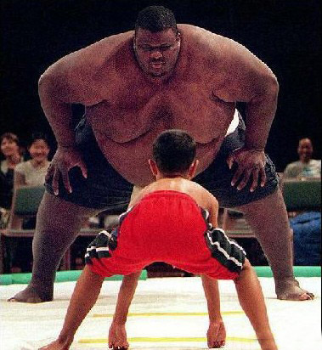
What strategies should this little boy use to win the fight?

Slide 25
Competitor attack strategies
4 Bypass attack
2 Flanking attack
C
O
M
P
A
N
Y
C
O
M
P
E
T
I
T
O
R
1 Frontal attack
5
Guerilla attack
3 Encirclement
attack

Slide 26
CHOOSING AN ATTACK STRATEGY
How can the market challenger best attack the chosen competitor and achieve its strategic objective?
1.FRONTAL ATTACK
The Challenger matches the competitor’s product; advertising, price and distribution efforts. It attacks competitor’s strengths rather than weaknesses.
The outcome depends on who has the greater strength and endurance. If the market challenger has fewer resources than the competitors, a frontal attack makes little sense. Even great size and strength may not be enough to challenge a firmly entrenched, resourceful competitor successfully.

Slide 27
2. FLANKING ATTACK
Rather than attacking head on, the challenger can concentrate its strength against the competitor’s weaker flanks or on gaps in the competitor’s market coverage .
Flank attacks make good sense when the company has fewer resources than the competitor.

Slide 28
3. ENCIRCLEMENT ATTACK
This involves attacking from the front, sides and rear at the same time.
The encirclement strategy makes sense when Challenger has superior resources and believes that it can break the competitor’s hold on the market quickly.

Slide 29
4. BYPASS ATTACK
Here, the challenger bypasses the competitor and targets easier markets. It might diversify into un related products, move into new geographic markets, or leapfrog into new technologies to replace existing products.
With technological leap-frogging, instead of copying the competitors products and mounting a costly frontal attack, the challenger passes by the competitor with the next technology.

Slide 30
5. GUERRILLA ATTACKS
For smaller or poorly financed challengers, this attack is ideal. These are small, periodic attacks to harass and demoralize the competitor, with the goal of eventually establishing permanent footholds.
The Challenger might use selective promotional out bursts, or assorted legal actions. Specific guerrilla actions can be cheap, but continuous guerilla campaigns can be expensive. And they eventually must be followed up by stronger attacks if the challenger wishes to gain ground against competitors.

Slide 31
CONCLUSION
For an organization to maintain market leadership, it needs to:-
Prevent or fix weaknesses that provide opportunities for competitors
Keep Costs down
Keep its prices in line with the value the customers see in their brands
Leaders should “plug holes” so that competitors do not jump in
Best defense is a good offense
Best response is continuous innovation
The leader should refuse to be content with status quo and always lead in new products, customer service and distribution effectiveness.

Slide 32
COMPETITIVE ANALYSIS TOOL-PORTER’S FIVE FORCES

Slide 33
Michael Porter’s Five Forces
Competitive Analysis tool developed by Michael Porter in 1979
This theory is based on the concept that there are five forces that determine;
  Competitive intensity and attractiveness of a market,
  Where power lies in a business situation,
  Whether or not a business can be profitable, based on other businesses in the industry.
  Competitive strength and position of business organisations
  Whether new products or services are potentially profitable.

Slide 34
APPLICATION OF PORTERS’ FIVE FORCE THEORY
Actions to take / Dos | Actions to Avoid / Don'ts
Use this model where there are at least three competitors in the market Consider the impact that government has or may have on the industry Consider the industry lifecycle stage – earlier stages will be more turbulent Consider the dynamic/changing characteristics of the industry | Avoid using the model for an individual firm; it is designed for use on an industry basis

Slide 35
Porter Competitive Model
Potential
New Entrants
Bargaining
Power
of Suppliers
Intra-Industry
Rivalry
Strategic Business Unit
Bargaining
Power
of Buyers
Substitute
Products
and Services
Source: Michael E. Porter
“Forces Governing Competition in Industry
Harvard Business Review, Mar.-Apr. 1979

Slide 36
THREAT OF NEW ENTRANTS
Examines how easy or difficult it is for competitors to join the marketplace in the industry being examined.
The easier it is for a competitor to join the marketplace, the greater the risk of a business's market share being depleted.

Slide 37
Profitable markets attract new entrants, which erodes profitability.
Unless incumbents have strong and durable barriers to entry, for example;
        patents
        economies of scale
        capital requirements
        access to inputs
        government policies

Slide 38
Questions Asked….
How much does it cost and how long does it take to enter your market?
What are the barriers to entry (e.g. patents, rights, etc.)?
What does it take to make the business scalable?
Have you protected your key technologies?
How strictly is your market regulated?
If competitors can enter your market with little money and effort, you will need to adapt your strategy to handle any potential rivals.

Slide 39
Threat of substitute products
A substitute good is a good that can be used in place of another.
Consumer perceives substitutes as similar or comparable, so that having more of one product makes them desire less of the other product.
Examines how easy it is for consumers to switch from a business's product or service to that of a competitor.
Where close substitute products exist in a market, it increases the likelihood of customers switching to alternatives in response to price increases.
This reduces both the power of suppliers and the attractiveness of the market.

Slide 40
Substitute is high when;
Consumer switching costs are low
Substitute product is cheaper than industry product
Substitute product quality is equal or superior to industry product quality
Substitute performance is equal or superior to industry product performance

Slide 41
Questions Asked……
What are the differentiators between your product/service and the substitute?
How many substitute products are available in this market?
What is the cost of switching to a substitute product?
How difficult would it be to make the switch?
What products or services can you offer that might substitute a market leader?

Slide 42
Bargaining power of Buyers
Analyses the power of the consumer to affect pricing and quality, how easy is it to drive down prices.
Consumers have power when there are not many of them, but lots of sellers, as well as when it is easy to switch from one business's products or services to another.
Buying power is low when consumers purchase products in small amounts.
If a business has just a few powerful buyers, they are often able to dictate terms.

Slide 43
Questions Asked……
How many buyers control your sales?
How large are the orders you receive?
Could your buyers switch suppliers—and how much would it cost for them to switch?
How important is your product/service to your buyers (i.e. what is the ROI of your product/service)?

Slide 44
Bargaining power of suppliers
Analyses how much power a business's supplier has and how much control it has over the potential to raise its prices, which, in turn, would lower a business's profitability.
The fewer the suppliers , the more power they have.
Businesses are in a better position when there are a multitude of suppliers.

Slide 45
Questions Asked……
How many suppliers does your business have?
How unique is the product or service that they provide?
How many alternative suppliers can you find? How do their prices compare to your current supplier? How expensive would it be to switch from one supplier to another?

Slide 46
COMPETITIVE RIVALRY
Examines how intense the competition is in the market
Main driver is the number and capability of competitors in the market.
Many competitors, offering undifferentiated products and services, will reduce market attractiveness.

Slide 47
Rivalry competition is high when;
there are just a few businesses equally selling a product or service,
when the industry is growing
when consumers can easily switch to a competitor's offering for little cost.
When rivalry competition is high, advertising and price wars can ensue, which can hurt a business's bottom line.

Slide 48
Questions Asked……
How many competitors do you have?
Who are your biggest competitors?
How does the quality of their products or services compare with yours?
What distinguishes your company from the competition?
What will it cost one of your customers to switch to a competitor?

Slide 49
END

Slide 50
MANAGING ENVIRONMENTAL ELEMENTS
Managers have three major options in attempting to manage environmental uncertainty and its potential impact:
1 Adapt to the existing environmental elements
2 Attempt to influence environmental favorability
3 Shift the domain of operations away from threatening environmental elements towards more beneficial ones.

Slide 51
1. Adaptation
The adaptation approach involves changing internal operations and activities-.to- make the organization more compatible with its environment.
Four common approaches used by organizations to adapt to environmental fluctuations are:
  Buffering
  Smoothing
  Forecasting
  Rationing

Slide 52
Adaptation Techniques
Buffering
The use of buffering involves stockpiling either inputs into or outputs from a production or service process in order to cope with environmental fluctuations (demand).
Smoothing
Smoothing involves taking actions aimed at reducing the impact of fluctuation given the market. For example, utilities often, discount their energy rates in designated slow-demand periods.
Forecasting
Forecasting is the systematic effort to estimate future conditions. For example, grocery stores frequently hire part-time cashiers to supplement regular staff during busy periods.

Slide 53
Adaptation Techniques Cont’d
Rationing
Rationing involves providing limited access to a product or service that is in high demand. For example, many universities and colleges ration slots for popular programs by establishing program pre-requisites.
Rationing has the advantage of allowing the organization to avoid costs of expanding capacity.
Rationing has the disadvantage of denying a consumer a product or service, while the organization is forced to turn away potential business.

Slide 54
2. Favorability Influence
The favorability influence approach involves attempting to alter environmental elements in order to make them more compatible with the needs of the organization.
Major methods that the organization uses in attempting to influence significant elements in the environment are:
Advertising and Public Relations
Negotiating contracts, co-opting
Joint ventures, joining Trade associations and engaging in political activities.

Slide 55
Advertising and Public Relations
Advertising is the use of communications media to gain favourable publicity for particular products and services.
Public Relations involves the use of communications media and related activities to create a favourable overall impression of the organisation among the public.

Slide 56
Boundary Spanning
Boundary spanning involves creating roles within the organization that interface with important elements in the environment.
Examples of boundary spanning roles include:
  Salespersons
  Purchasing specialists
  Personnel recruiters
  Admissions officers
  Shipping and receiving
  Agents, receptionists, scientists and Lawyers.

Slide 57
Recruiting
Recruiting involves attracting skilled and qualified job candidates who meet the needs of the organization.
This tool can be used for environmental influence when organizations seek job candidates who have a knowledge of and close ties to a significant element of the environment.
For example, companies often hire executives from specific companies because of their environmental knowledge and connection.

Slide 58
Negotiating contracts
Negotiating contracts aims at seeking favorable agreements on matters of importance to the organization.
Specific agreements with customers and suppliers are common means of creating environmental favorability

Slide 59
Co-opting
Co-opting is the process of absorbing key members of important environmental elements into the leadership or policy-making structure of an organization.
A common example of co-opting is the addition of key members of the environment to boards of directors.
For instance, some universities have prominent individuals on the council.
These individuals often help the universities deal more effectively with environmental elements, particularly in the area of raising funds from business.

Slide 60
Trade Associations
Trade associations are organizations composed of individuals or firms with common business concerns.
Because they represent the pooled resources of many organizations, trade associations are frequently in an enhanced position for conducting public relations campaigns affecting favorability of the environment within which their members operate.

Slide 61
Political Activity
The use of political activity involves attempts by organizations to enhance their competitive situation.
This is achieved through influencing the legislator or the behavior of government regulatory agencies.

Slide 62
3. Domain Shifts
Domain shifts involve making changes in the mix of products and services offered.
One major approach is to move out of a current product, service or geographic area into a more favorable domain.
A second domain shift approach is to expand current domains through diversification, i.e. the expansion of products and services offered or the development of new and different products or services.

