Slide 1

COPORATE SOCIAL RESPONSIBILITY
Ms. Faith Moono Simwami
Email: mo.simwami@gmail.com

Slide 2
Social Responsibility: Definition and Perspectives
  The idea that business has social obligations above and beyond making a profit.
  Business has an obligation to constituent groups in society other than stockholders and beyond that prescribed by law.
  (CSR) can be defined as the "economic, legal, ethical, and discretionary expectations that society has of organizations at a given point in time" (Carroll and Buchholtz 2003, p. 36)

Slide 3
Social Responsibility: Definition and Perspectives (cont’d)
What Does Social Responsibility Involve?
  Voluntary action
    Action before lawsuits or other actions that are taken to force a firm to take action on a matter.
  An emphasis on means, not ends
    How the decision to act was reached, not the decision itself.

Slide 4
What Is the Role of
Business in Society?
The Classical Economic Model
(Adam Smith)
  An “invisible hand” (i.e., the efforts of competing entrepreneurs) promoted the public welfare when individuals tried to maximize short-run profits in pursuit of their own economic self-interests.
    Equates short-run profitability to social responsibility.
The Socioeconomic Model
  Business has an obligation to meet the needs of the many groups in society besides stockholders in its pursuit of profit.
    Stakeholder Audit: systematically identifying all the parties that could possibly be impacted by the company’s performance

Slide 5

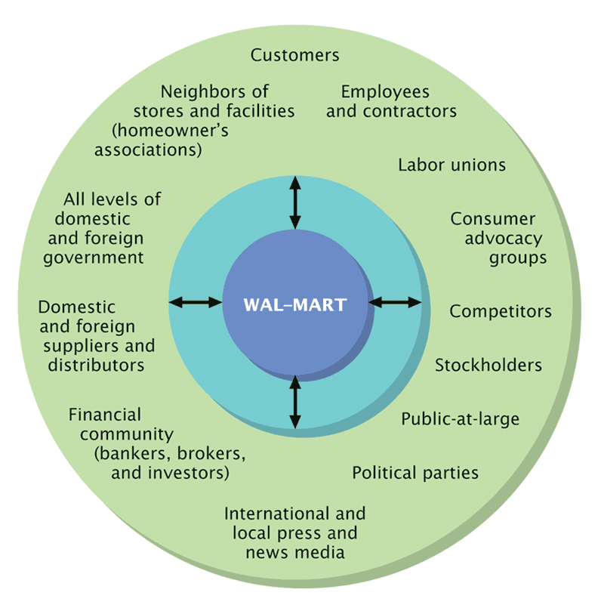
Figure 5.1
A Sample Stakeholder Audit for Wal-Mart, the
World’s Largest ReTailer
Notes:
TAKE NOTE!!

Slide 6
Arguments For and Against
Social Responsibility
Arguments For
  Business is unavoidably involved in social issues.
  Business has the resources to tackle today’s complex societal problems.
  A better society means a better environment for doing business.
  Corporate social action will prevent government action.
Arguments Against
  Profit maximization ensures the efficient use of society’s resources.
  As an economic institution, business lacks the ability to pursue social goals.
  Business already has enough power.
  Because business managers are not elected, they are not directly accountable to the people.
Notes:
TAKE NOTE!!!

Slide 7
Toward Greater Social Responsibility
Iron Law of Responsibility
  Those who do not use power in a socially responsible way will eventually lose it.
  If business does not meet the challenge of social responsibility, then government reform legislation will force it to meet its obligations.

Slide 8
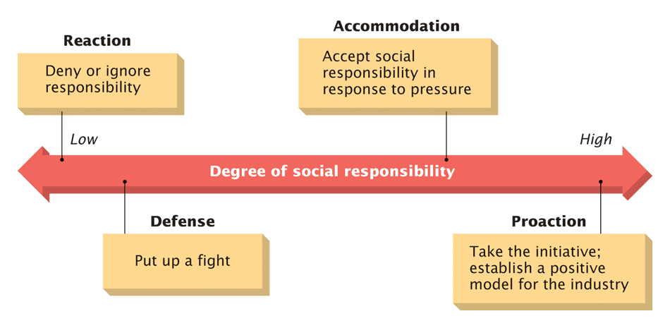
Figure 5.2
A Continuum of Social Responsibility Strategies
Notes:
TAKE NOTE!!!

Slide 9
Social Responsibility Strategies
Reactive Strategy
  Denying responsibility while striving to maintain the status quo by resisting change.
Defensive Strategy
  Resisting additional social responsibilities with legal and public relations tactics.
Accommodation Strategy
  Assuming social responsibility only in response to pressure from interest groups or the government.
Proactive Strategy
  Taking the initiative in formulating and putting in place new programs that serve as role models for industry.

Slide 10
Who Benefits from Corporate
Social Responsibility
Altruism
  The unselfish devotion to the interests of others.
Research Findings
  There is a positive correlation between industry leadership on a socially responsible issue (pollution control) and profitability.
  Corporate social responsibility is a competitive advantage.
Enlightened Self-Interest
  A business ultimately helps itself by helping solve social problems.
An Array of Benefits for the Organization
  Tax-free incentives to employees.
  Retention of talented employees.
  Help in recruiting the talented and socially conscious.
  Help in swaying public opinion.
  Improved community living standards.
  …Others.

Slide 11
Implications for Enterprises:
CSR Management
How do companies address socio-environmental & legal compliance issues?
Policies - Code of Conduct
Systems - Compliance Management
Reporting - Accounting and Reporting

Slide 12
CSR Management:
Management structure
Example
Board of Directors
Audit Committee of Board
President & CEO
Group Presidents
Chief Financial Officer
VP of Human Resources
General Counsel
Corporate Responsibility Officer
Steering Committee

Slide 13
CSR Management:
Plan, Do, Check, Act method
Plan
Consult stakeholders
Establish code of conduct
Set targets
Do
Establish management systems and personnel
Promote code compliance
Check
Measure progress
Audit
Report
Act
Corrective action
Reform of systems
Notes:
TAKE NOTE!!

Slide 14
QUESTIONS…?
…THANK YOU…

Slide 15
BUSINESS ENVIRONMENT
BUSINESS ETHICS
CORPORATE GOVERNANCE
Ms. Faith Moono Simwami
Email: mo.simwami@gmail.com

Slide 16
Chapter Outline
Three Models of Management Ethics
Making Moral Management Actionable
Developing Moral Judgment
Elements of Moral Judgment
Summary
Business Ethics and Public Opinion
What Does Business Ethics Mean?
Ethics, Economics and Law: Venn Model
Four Important Ethics Questions
Notes:
Business Ethics and Public Opinion
The Gallup Poll
Has Business Ethics Really Deteriorated?
Are the Media Reporting Ethical Problems More Vigorously?
Is It Society That Is Actually Changing?
What Does Business Ethics Mean?
The Conventional Approach to Business Ethics
Ethics and the Law
Making Ethical Judgments
Four Important Ethics Questions
What Is?
What Ought to Be?
How Do We Get from What Is to What Ought to Be?
What Is Our Motivation in All This?
Three Models of Management Ethics
Immoral Management
Moral Management
Amoral Management
Two Hypotheses
Making Moral Management Actionable
Developing Moral Judgment
Levels of Moral Development
Sources of a Manager’s Values
Elements of Moral Judgment
Moral Imagination
Moral Identification and Ordering
Moral Evaluation
Tolerance of Moral Disagreement
Integration of Managerial and Moral Competence
A Sense of Moral Obligation
Summary

Slide 17
Introduction
Business Ethics
Public’s interest in business ethics increased during the last four decades
Public’s interest in business ethics spurred by the media

Slide 18
Introduction
Inventory of Ethical Issues in Business
Employee-Employer Relations
Employer-Employee Relations
Company-Customer Relations
Company-Shareholder Relations
Company-Community/Public Interest

Slide 19
BUSINESS ETHICS
Ethics
  The study of moral obligation involving the distinction between right and wrong.
Business Ethics
  The study of the complex business practices and behaviors that give rise to ethical issues in organizations.

Slide 20
Business Ethics: What Does It Really Mean?
Definitions
Ethics involves a discipline that examines good or bad practices within the context of a moral duty
Moral conduct is behavior that is right or wrong
Business ethics includes practices and behaviors that are good or bad

Slide 21
Concern for Ethical
and Societal Issues
Business Ethics
The standards of conduct and moral values governing actions and decisions in the work environment.
  Social responsibility.
  Balance between what’s right and what’s profitable.
  Often no clear-cut choices.
  Often shaped by the organization’s ethical climate.
Sarbanes-Oxley Act
2002 law that added oversight for the nation’s major companies and a special oversight board to regulate public accounting firms that audit the financial records of these corporations.

Slide 22
Personal Values as
Ethical Anchors
Values
  Abstract ideals that shape one’s thinking and behavior – a moral compass
    Instrumental value: enduring belief in a certain way (mode) of behaving is appropriate in all situations. “means”
    Terminal value: enduring belief in that a certain end-state of existence (being admired) is worth striving for. “ends”.
Identifying Your Own Values
  Basic personal values are taken.
  They are not arranged consciously in order of priority

Slide 23
Instrumental values
As the means to an end they become the ingrained ways of behavior:
  Rituals
  Politeness
  Good habits
    Honest
    Responsible
    Capable
    Ambitious
    Independent

Slide 24
Terminal values
With the end always in sight:
  Heaven
  Respect
  Financial Success
  Personal Independence
  Power
    Self-respect
    Family security
    Freedom
    A sense of accomplishment
    Happiness

Slide 25

A moral compass
These abstract ideals can result from
  Religion
  Philosophy
  Family teachings

Slide 26
General Ethical Principles
Self-Interests
Personal virtues
Religious injunctions
Government requirements
Utilitarian benefits
Universal rules
Individual rights
Economic efficiency
Distributive justice
Contributive justice

Slide 27
Common Misconduct in Organizations
Misrepresenting hours worked
Employees lying to supervisors
Management lying to employees, customers, vendors or the public
Misuse of organizational assets
Lying on reports/falsifying records
Sexual harassment
Stealing/theft
Accepting or giving bribes or kickbacks
Withholding needed information from employees, customers, vendors or public

Slide 28

Common Causes of Unethical Behavior
Pressure
Fear
Greed
Convenience

Slide 29
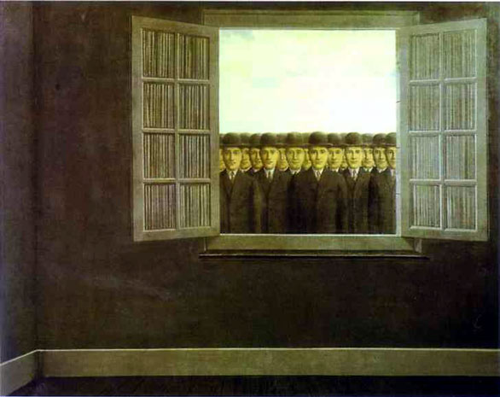
Causes of Unethical Behavior (cont’d)
Following boss’s directives
Meeting overly aggressive business/financial objectives
Helping the organization survive
Meeting schedule pressures
Be a team player (group think)
Rationalizing that others do it
Resisting competitive threats
Advancing own career

Slide 30
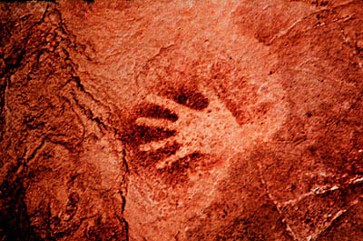
Business Ethics Myths
Business ethics is a new fad.
Business ethics – religion vs. management.
Business ethics is obvious – “do good!”
Business ethics is good guys preaching to bad guys.

Slide 31

Business Ethics Myths (cont’d)
Ethics can’t be managed.
Being legal = being ethical.
Managing ethics has little practical relevance.

Slide 32
Encouraging Ethical Conduct
Ethics Training
  Amoral managers: managers who are neither moral or immoral, but ethically lazy.
  Key features of effective ethics programs
    Top management support.
    Open discussion.
    A clear focus on ethical issues.
    Integration of ethics into the organization.
    A mechanism for anonymously reporting ethical violations.
    Reward ethical conduct.

Slide 33
Encouraging Ethical Conduct (cont’d)
Ethical Advocate
  An ethics specialist who plays a role in top-management’s decision-making.
Code of Ethics
  Requirements for an effective code
    Must describe specific events.
    Firmly supported ethics in 1990.
Whistle-Blowing
  The reporting of perceived unethical matters.

Slide 34

“Whistleblower’s” Reluctance
Didn’t believe action would be taken.
Feared retaliation from mgmt.
Didn’t trust confidentiality.
Feared not being a team player.
Feared retaliation from co-workers.
Didn’t know who to contact.
Nobody cares, why should I?

Slide 35
Ethical Tips for Organizations
Develop a code of ethics.
Communicate code and bake it into culture top-down.
Treat ethics as a process.
Create open lines of communication.
Set good examples.
Educate employees – frame issues through storytelling.
Value forgiveness.

Slide 36
Benefits of Managing Ethics in the Workplace
Improves society.
Maintains a moral course in turbulent times.
Cultivates employee teamwork, productivity, morale and development.
Acts as an insurance policy.

Slide 37
Benefits of Managing Ethics in the Workplace (cont’d)
Establishes values for quality management, strategic planning and diversity management.
Promotes strong public image.
It is the RIGHT thing to do!

Slide 38

Ethical Tips for Individuals
Establish personal values.
Be aware of ethical events.
Develop critical thinking techniques.
Be reflective.
Make it a priority every day.

Slide 39
Public’s Opinion of Business Ethics
Gallup Poll finds that only 17 percent to 20 percent of the public thought the business ethics of executives to be very high or high
To understand public sentiment towards business ethics, ask three questions
  Has business ethics really deteriorated?
  Are the media reporting ethical problems more frequently and vigorously?
  Are practices that once were socially acceptable no longer socially acceptable?

Slide 40
Business Ethics: What Does It Really Mean?
Business Ethics: Today vs. Earlier Period
Expected and Actual Levels
of Business Ethics
Society’s Expectations of Business Ethics
Ethical Problem
Actual Business Ethics
Ethical Problem
1950s
Time
Early 2000s

Slide 41
Business Ethics: What Does It Really Mean?
Two Key Branches of Ethics
Descriptive ethics involves describing, characterizing and studying morality
  “What is”
Normative ethics involves supplying and justifying moral systems
  “What should be”

Slide 42
Conventional Approach to Business Ethics
Conventional approach to business ethics involves a comparison of a decision or practice to prevailing societal norms
  Pitfall: ethical relativism
Decision or Practice Prevailing Norms

Slide 43
Sources of Ethical Norms
Fellow Workers
Fellow Workers
Regions of Country
Family
Profession
The Individual
Conscience
Friends
Employer
The Law
Religious Beliefs
Society at Large

Slide 44
Ethics and the Law
Law often represents an ethical minimum
Ethics often represents a standard that exceeds the legal minimum
Frequent Overlap
Ethics
Law

Slide 45
Making Ethical Judgments
Behavior or act that has been committed
Prevailing norms of acceptability
compared with
Value judgments and perceptions of the observer

Slide 46
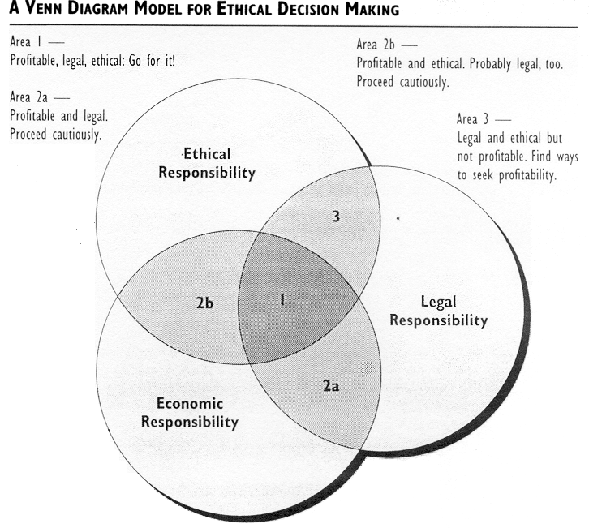
Ethics, Economics, and Law
6-14

Slide 47
Four Important Ethical Questions
What is?
What ought to be?
How to we get from what is to what ought to be?
What is our motivation for acting ethically?

Slide 48
3 Models of Management Ethics
Three Types Of Management Ethics
Moral
Amoral
Immoral

Slide 49
3 Models of Management Ethics
Immoral Management—A style devoid of ethical principles and active opposition to what is ethical.
Moral Management—Conforms to high standards of ethical behavior.
Amoral Management
  Intentional - does not consider ethical factors
  Unintentional - casual or careless about ethical considerations in business

Slide 50
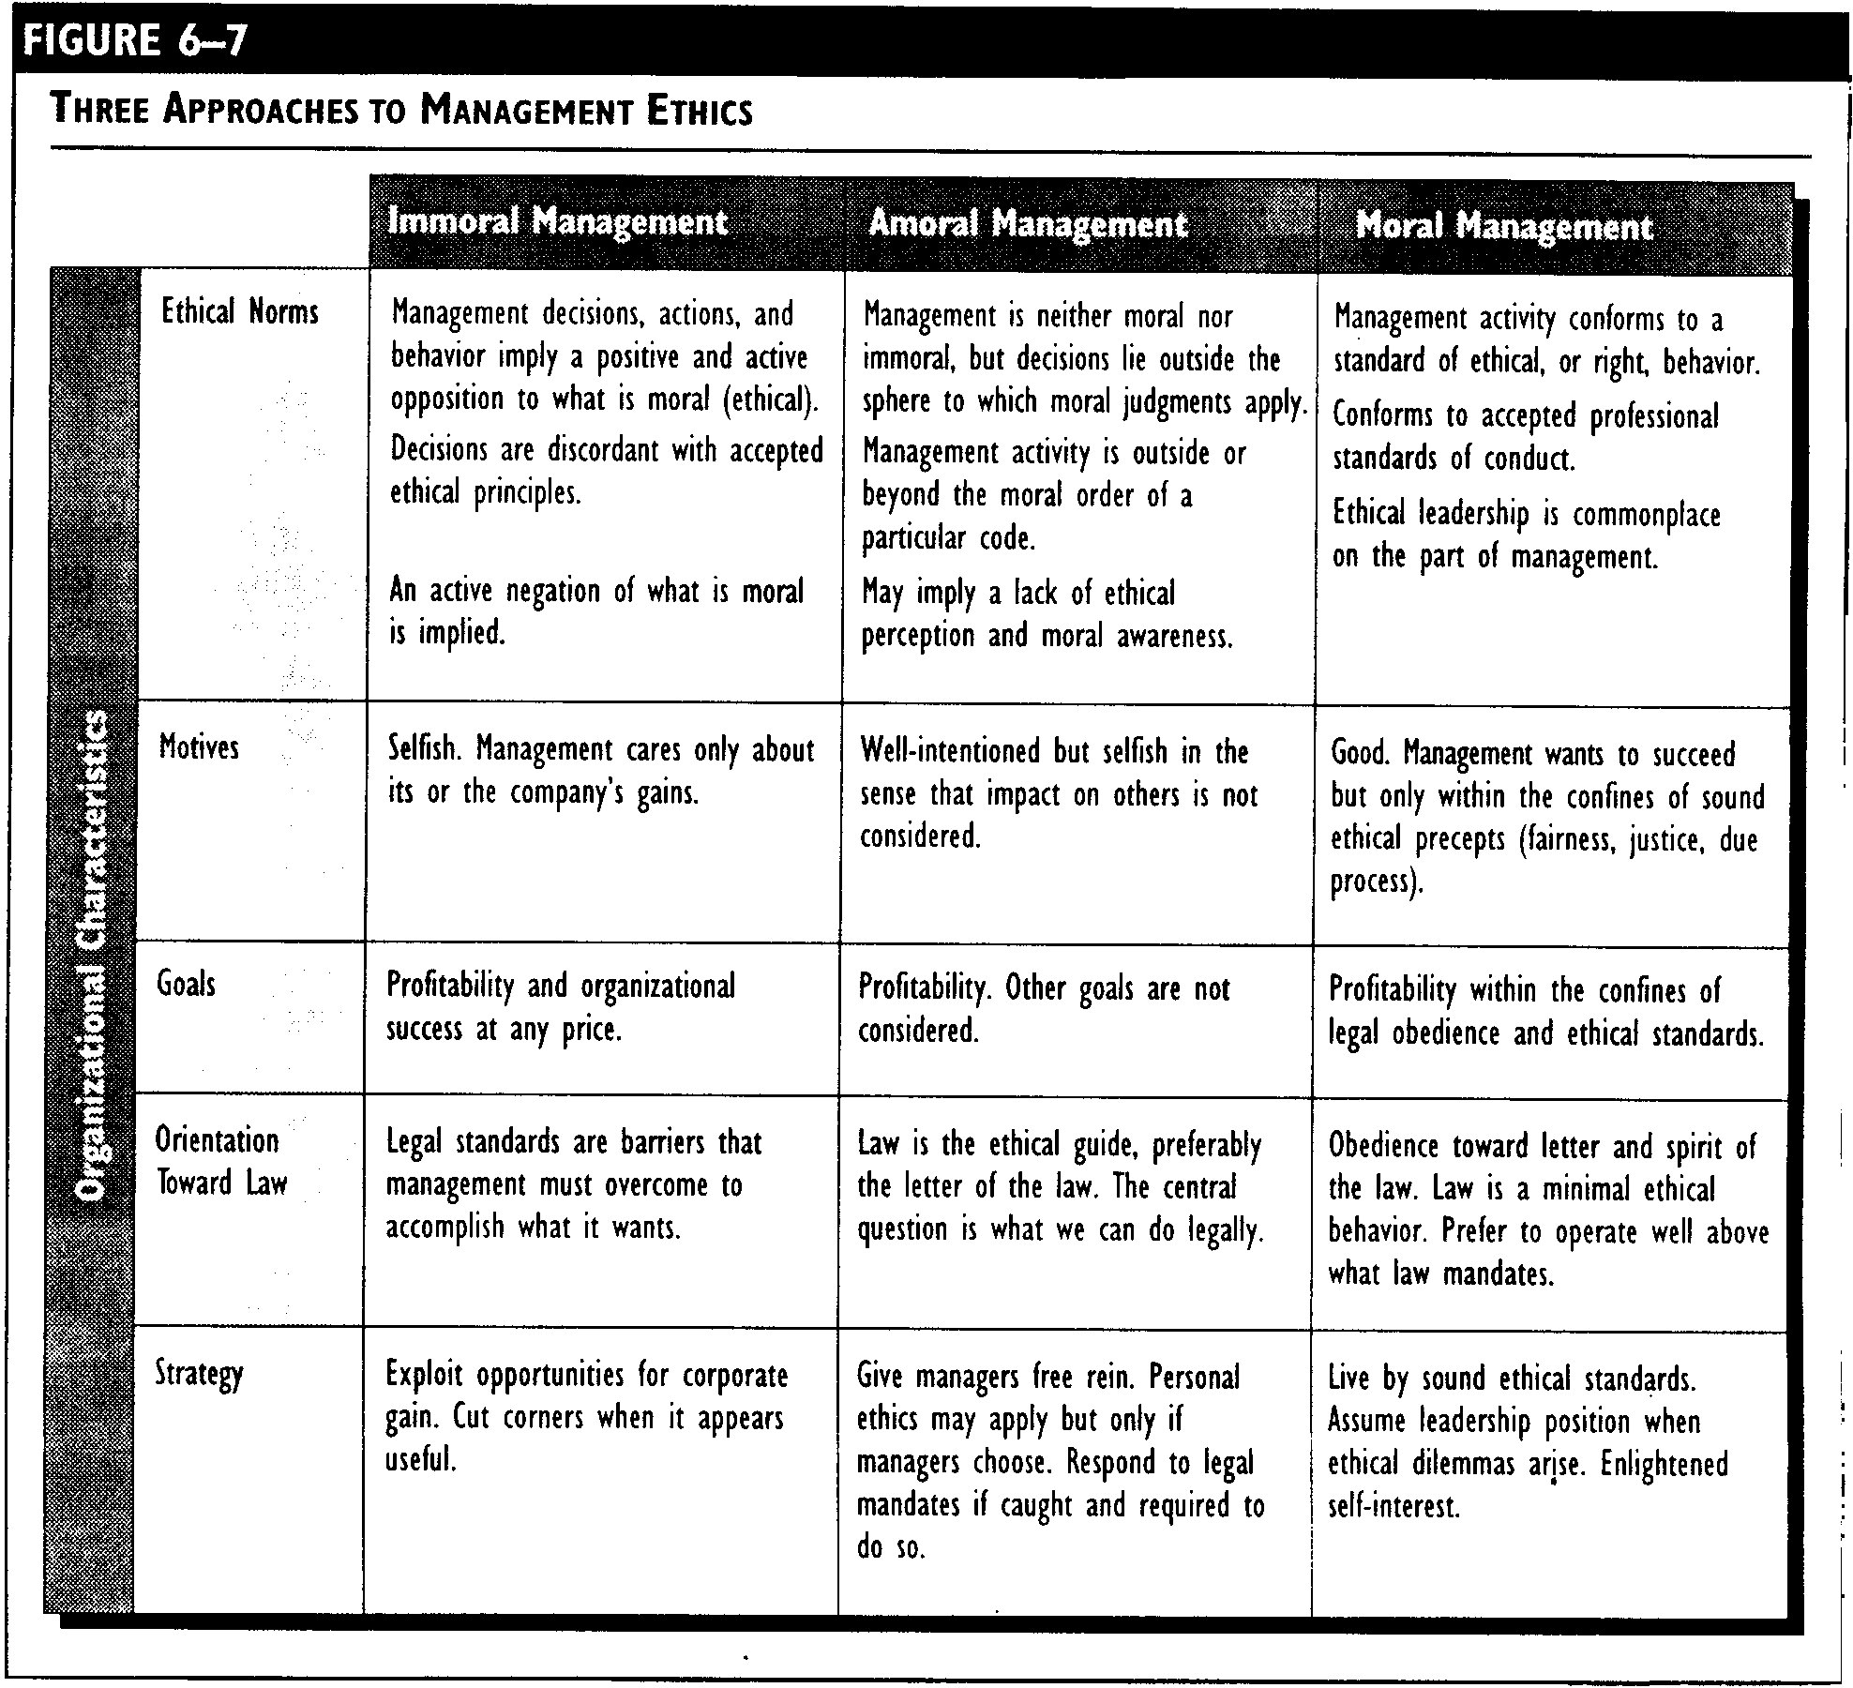
Three Approaches to Management Ethics
6-18

Slide 51
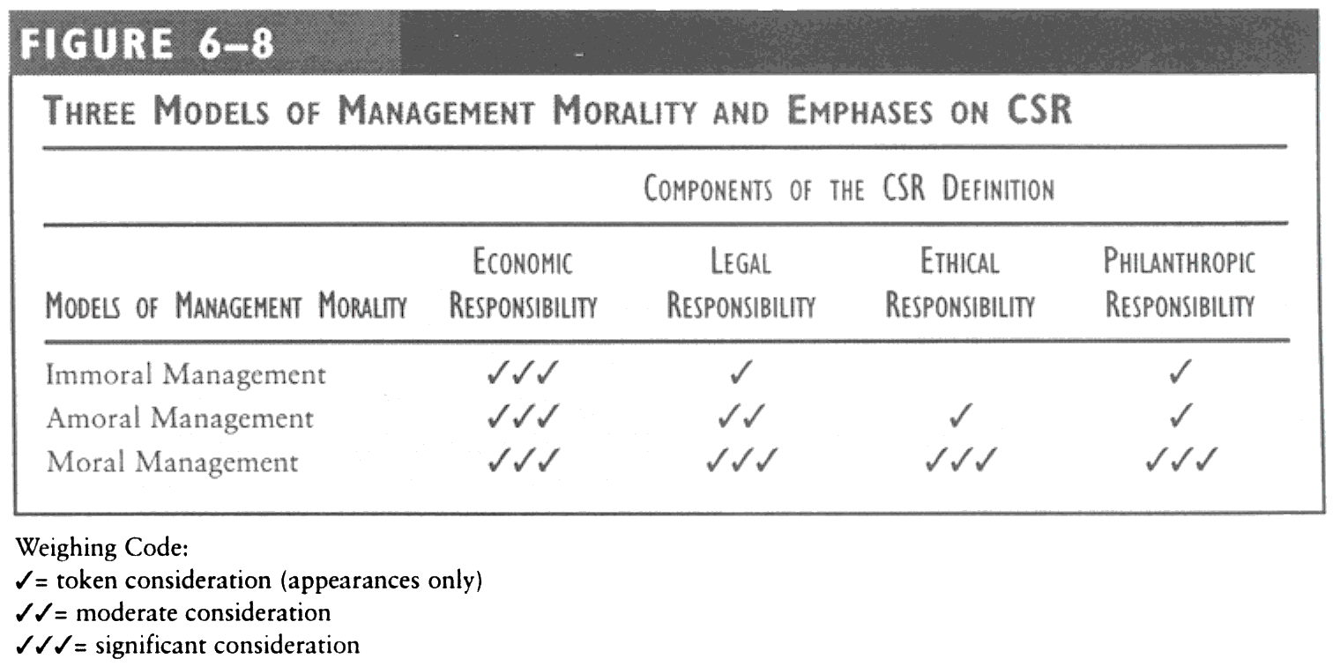
Three Models of Management Morality and Emphasis on CSR
6-19

Slide 52
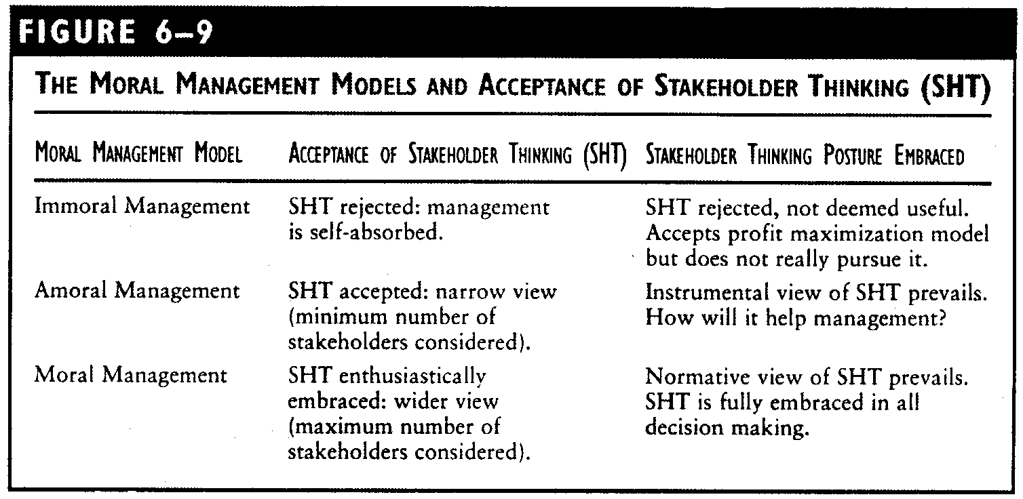
Moral Management Models and Acceptable Stakeholder Thinking
6-20

Slide 53
Making Moral Management Actionable
Important Factors
Senior management
Ethics training
Self-analysis

Slide 54
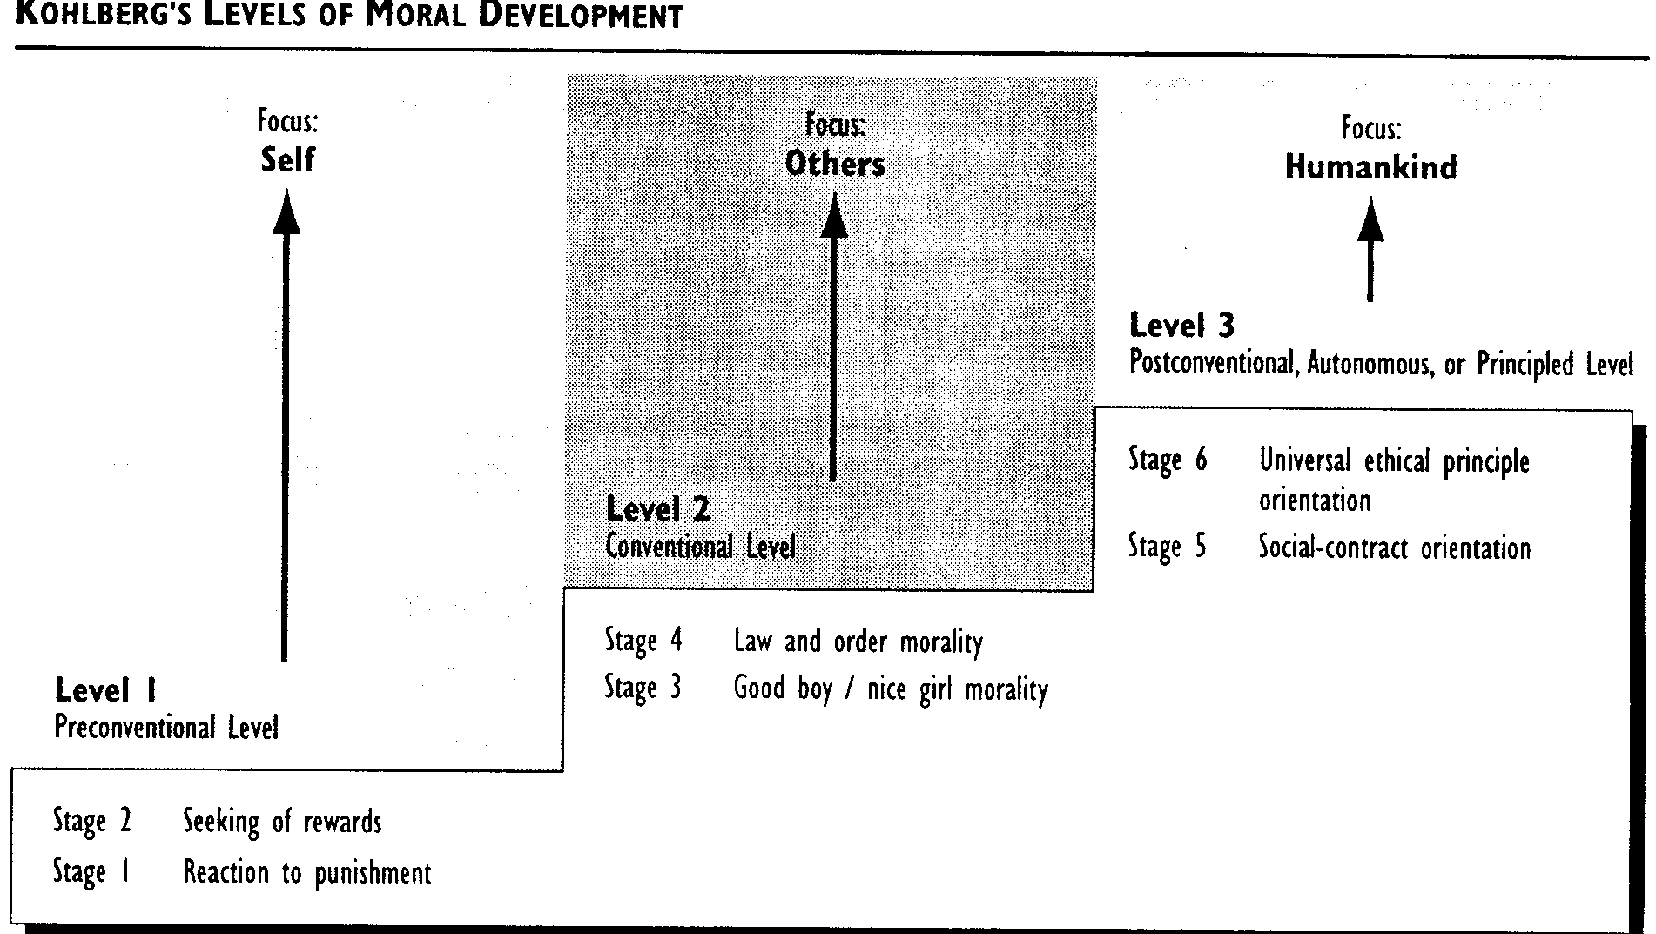
Developing Moral Judgment
6-22

Slide 55
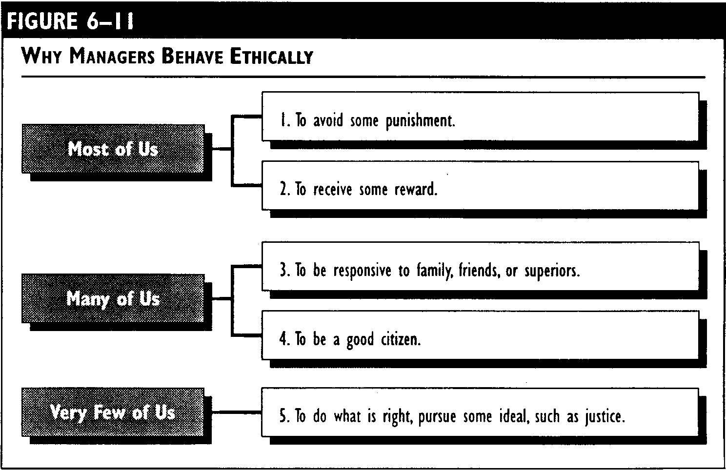
Developing Moral Judgment
6-23

Slide 56
Developing Moral Judgment
External Sources of a Manager’s Values
Religious values
Philosophical values
Cultural values
Legal values
Professional values

Slide 57
Developing Moral Judgment
Internal Sources of a Manager’s Values
Respect for the authority structure
Loyalty
Conformity
Performance
Results

Slide 58
Elements of Moral Judgment
Moral imagination
Moral identification and ordering
Moral evaluation
Tolerance of moral disagreement and ambiguity
Integration of managerial and moral competence
A sense of moral obligation

Slide 59
Elements of Moral Judgment
Amoral Managers
Moral Managers
Moral Imagination
Moral Identification
Moral Evaluation
Tolerance of Moral Disagreement and Ambiguity
Integration of Managerial and Moral Competence
A Senses of Moral Obligation

Slide 60
Selected Key Terms
Amoral management
Business ethics
Compliance strategy
Conventional approach to business ethics
Descriptive ethics
Ethical relativism
Ethics
Feminist Ethics
Immoral management
Integrity strategy
Intentional amoral management
Kohlberg’s levels of moral development
Moral development
Moral management
Normative ethics
Unintentional amoral management

Slide 61
Selected Key Terms
Amoral management
Business ethics
Ethics
Immoral management
Levels of moral development
Moral management
Morality

Slide 62

“The simple step of a simple courageous man is to not take part in the lie, not to support deceit. Let the lie come into the world, even dominate the world, but not through me.”
-- Alexander Solzhenitsyn

