Slide 1

FUNDAMENTALS OF ACCOUNTING
BFA 1101
BY
D. SIKALUMBI
Cert. in Primary Teaching
Cert. in Entrepreneurship for Economics
Bachelor of Business Studies
ZICA – CA
Professional Diploma in NGO Project Management
Master of Business Administration
PhD in Business Administration

Slide 2
ACCOUNTING TOPICS
UNITS
Introduction to Accounting.
Business Transaction
Business Documents
Books of Original Entry
Ledger
The trial balance.
Preparation of the Balance Sheet.
Preparation of the Income Statement
Salaries and wages
Bank reconciliation statement

Slide 3
UNIT 1: INTRODUCTION TO ACCOUNTING
Accounting is the process of gathering, analyzing, recording, summarizing and reporting the economic value of the business to the stakeholders. An accountant (or bookkeeper) collects documentation, analyses and records this information, categorizes it (i.e. organizes the different bits of information under certain categories), and presents it in specific formats. Accounting information is finally presented in the form of financial statements which are the key reports of a business.
Bookkeepers are usually involved more in data collection and entry. Accountants can fulfill this role too, but more often these days are involved in preparing and presenting financial statements, and fulfilling an advisory or consulting role. Accountants have even become business strategists, intimately involved in guiding the operations of a business. Accounting in general deals with identifying business activities, like sales to customers, recording these activities, like journalizing, and communicating these activities with people outside the organization with financial statements.

Slide 4
Financial accounting, however, is a subsection of the general field of accounting that focuses on gathering and compiling data in order to present it to external users in a usable form.
Basically, financial accounting's main purpose is to provide useful, financial information to people or groups outside of companies often called external users.
Financial accounting is the periodic reporting of a company's financial position and the results of operations to external parties through financial statements, which ordinarily include;
the balance sheet (statement of financial condition),
income statement (the trading, profit and loss statement, or P & L),
statement of cash flows and
the statement of changes in owners' equity.

Slide 5
Users of the Accounting information/Financial statements
suppliers of capital - e.g., shareholders,
Lenders like bondholders and banks
Customers
Suppliers
Government agencies (e.g. Z.R.A for tax, PACRA) and policymakers.
Employees
The key concept here is that external users must be able to understand and use this financial information when they are making decisions about the company.
If the information cannot be used, it is worthless.

Slide 6
DOUBLE ENTRY ACCOUNTING
Double entry literally means two entries being made in one transaction and we literally make two entries; a debit entry and a credit entry.
Double entry accounting, also called double entry bookkeeping, is the accounting system that requires every business transaction or event to be recorded in at least two accounts. This is the same concept behind the accounting equation. Every debit that is recorded must be matched with a credit entry.
In other words, debits and credits must always be equal in every accounting transaction and in their total.
Every modern accounting system is built on the double entry bookkeeping concept because every business transaction affects at least two different accounts.
For example, when a company takes out a loan from a bank, it receives cash from the loan and also creates a liability that it must repay in the future. This single transaction affects both the asset accounts and the liabilities accounts

Slide 7
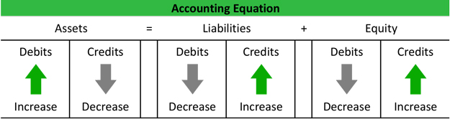
Accounting Equation
Example
Let's take a look at the accounting equation to illustrate the double entry system. Here is the equation with examples of how debits and credits affect all of the accounts.

Slide 8
As you can see from the equation, assets always have to equal liabilities plus equity (capital). In other words, overall debits must always equal overall credits. For example, if an asset account is increased (debited), either a liability or equity account must be increased (credited) for the same amount.
This is always the case except for when a business transaction only affects one side of the accounting equation. For example, if a restaurant purchases a new delivery vehicle for cash, the cash account is decreased by the cash disbursement and increased by the receipt of the new vehicle. This transaction does not affect the liability or equity accounts, but it does affect two different assets accounts. Thus, assets are decreased and immediately increased resulting in a net effect of zero. The concept of double entry accounting is the basis for recording business transaction and journal entries.
Now that we have talked about the double entry bookkeeping system, let's move on to recording journal entries.

Slide 9
UNIT 2: BUSINESS TRANSACTIONS
OBJECTIVES:
Define business transactions.
State three types of business transactions.
Discuss the three types of business transactions.

Slide 10
INTRODUCTION
Business transaction refers to the legal process of exchanging goods with goods and services. It is the process of buying and selling goods and services. For transaction to take place, there must be a seller who has goods or services and then a buyer who wants the goods or services. The two must agree to make the contract binding.
TYPES OF BUSINESS TRANSACTIONS
Barter Transaction
This is the exchange of goods with goods or services. It is the oldest type of business transaction in the world. In this type of transaction, people are able to exchange goats with pigs, beans with clothes, chickens with a service of cultivating a piece of land etc. No currency is involved. However, there is no proper way of measuring the value of products or services hence there is high level of compromise.

Slide 11
B. Credit Transaction
This is the type of transaction where the services/goods are collected and payment is made later.
In this type of transaction, an invoice is used to prove that a debt exists.
In credit transaction, goods are sold within a short period of time which is so advantageous to perishable goods and those near the expiry date.
However, it increases bad debts and can make the business bankrupt or go into liquidation if not properly managed.

Slide 12
C. Cash Transaction
This is the type of transaction where services/goods are collected and payment is made immediately. With the coming of technology, there are many ways of participating in cash transactions. These include;
Payment by hard cash.
Payment by cheque
Payment by the debit card/Credit card/Visa card.
Internet banking
Mobile banking.

Slide 13
REVISION QUESTION
State and discuss the types of business transactions available. Clearly state the advantages and disadvantages of each. (20 marks)

Slide 14
UNIT 3: BUSINESS DOCUMENTS
OBJECTIVES
Define business documents.
State the significance of business documents.
Explain the main features of the business documents.
List and describe at least 15 business documents.
INTRODUCTION
Business documents are documents that are used in business transactions. Some documents are used in business registration with PACRA and ZRA which were discussed earlier. Here we will discuss business documents that are used in the transaction process.
Business documents make the business transaction legal and binding. In the exchange of goods and services, there are many documents that are used for the smooth running of the business. Documents are written records of transactions that take place between different persons or parties.

Slide 15
SIGNIFICANCE OF BUSINESS DOCUMENTS
To prove that a business activity has taken place.
To provide future reference in case it becomes necessary.
To provide information that is useful for various purposes such as making business decisions and payment.
To work as a source form which other business records can be made such as book keeping records.
To provide back ground information about the business.
To provide detailed information about the goods and services available for sale e.g. catalogue, quotation, price list and many more others.
To acknowledge receipt or payment of money e.g. cash sale slip and receipt.
To know the customers who have taken goods on credit (debtors), e.g. invoice.
To help in proper assessment of taxes such as VAT basing on the volume of sales, purchases and many more.

Slide 16
CONTENT/FEATURES OF BUSINESS DOCUMENTS
Name and address of the business originating the document (seller/buyer).
Name and address of the business receiving the document (seller/buyer).
Name of the document e.g. quotation, receipt etc.
Document number (serial number)
Date when the document is written.
Types/description of goods/services in question; e.g. dozens, boxes, colour, size etc.
Quantity of goods
Unit price and total amount.
Terms and conditions of the transaction.
Name/signature of the person who prepared/received.

Slide 17
TYPES OF BUSINESS DOCUMENTS
CATALOGUE
It is a business document which is more like a pamphlet or booklet that displays pictures and prices of the goods on sale. It may also be used for advertising.
2. PRICE LIST
It is a list of items sold by the person to whom an Inquiry is sent, together with the price at which each item is sold. It can serve the purpose of the catalogue.
3. INQUIRY NOTE
This is a letter sent by a potential buyer to the supplier/seller seeking information about the goods or services offered for sale, the prices pertaining them and the terms of sale and delivery of goods.
4. INVITATION TO TENDER
This is a document that is similar to an inquiry note but it is addressed to more than one seller or buyer of good or services requiring them to state the conditions under which they are willing to sell or buy the goods. Invitation to tender are usually advertised in newspapers, radios and televisions.

Slide 18
5. QUOTATION
This is a business document prepared in response to an Inquiry by the potential seller to the possible buyer containing terms and conditions under which goods can be sold. It describes the goods/services, unit price and total, and the terms and conditions for the transactions.
6. ORDER FORM
It is a business document which is sent by a prospective buyer to the seller requesting him to supply the specified goods. It is also termed as Local Purchase Order (L.P.O). It authorizes the seller to supply the goods/services requested.
7. PROFORMA INVOICE
It is a business document sent by the seller to the buyer showing the quantity sent and the prospective prices. It shows the terms and conditions under which the goods have been supplied. It is similar to an invoice but it does not guarantee credit. It may be sent together with the goods.

Slide 19
8. INVOICE
It is a summary of the details concerning goods supplied on credit. It is usually written in duplicate where by the seller retains a copy and the original is sent to the buyer. It acts as notification of the amount owed by the buyer for the goods and services bought and evidence of the debt to the seller.
9. ADVICE/DISPATCH NOTE
It is a document sent by the supplier/seller to the buyer informing him/her that the goods ordered are on the way. It shows the exact time the goods should be expected. This gives the buyer ample time to prepare transport and storage for the goods.
10. DELIVERY NOTE/CONSIGNMENT NOTE
It is a document sent by the seller to the buyer along with the goods being delivered. Its purpose is to serve as evidence of physical transfer of the goods from the seller to the buyer. The buyer signs on it confirming that the goods ordered have been received in good condition and as ordered. If there is any error noticed, the buyer has to notify the supplier as soon as possible for correction to be made. In a consignment, the supplier/sender is called a consigner and the receiver/buyer is termed as the consignee.

Slide 20
11. CREDIT NOTE
It is a business document sent by the seller to the buyer to adjust an overcharge or if part of the goods supplied are returned to the supplier. A credit note can be sent if wrong description or quantities or qualities of goods are sent, if the goods are damaged or expired e.t.c.
12. DEBIT NOTE
It is a business document prepared by the seller to the buyer adjusting the undercharge in the invoice which could be wrong price in the quotation, errors in calculating, omissions etc. it means that the buyer has to pay more than the initial amount.
13. CASH SALE SLIP
It is a business document prepared by the seller to the buyer who pays cash at the time of purchasing the goods. It serves as evidence of receipt of money in cash and is only issued for cash transactions.

Slide 21
14. RECEIPT
It is a business document prepared by the seller to the buyer acknowledging payment of debt by the buyer and concludes a credit transaction.
15. CHEQUE
It is a business document or an order from an account holder to his/her bank, requesting the bank to pay the stated amount of money to the named person or bearer. The cheque book must officially be issued by the bank, should have a cheque number, account number from which the money should be withdrawn, the bank name where the account is operated and space where the payee is named, amount stated and for the signature. Moreever, it has the counterfoil which remains in the cheque book, showing the details of the cheque being given out.
16. STATEMENT OF ACCOUNT
It is a document issued by the seller to the buyer indicating a summary of transactions between the seller and buyer for a particular period of time. It is issued periodically, usually monthly, quarterly or semi-annually. It usually starts with the balance brought forward followed by entries relating to transactions and ends with a closing balance which the supplier expects to be paid.

Slide 22
REVISION QUESTIONS
Define business documents.
Outline the significance of business documents (at least 10).
Explain the main features of the business document.
List and describe at least 15 business documents.

Slide 23
UNIT 4: BOOKS OF ORIGINAL ENTRY (THE ACCOUNTING JOURNALS)
Books of original (first) entry, also called Accounting Journals are books where transactions are first entered before transferring the entries to other books of accounts (the Ledger).
An accounting journal is a record of business transactions and events for a specific account. In other words, a journal chronologically stores all the journal entries for a specific account or group of account in one place, so that management and bookkeepers can analyze the data.
Accounting journals are often called the book of first entry because this is where journal entries are made.
Once a business transaction is made, the bookkeeper records that event in the form of a journal entry in one of the accounting journals.
Then, at the end of a period, the journals are posted to accounting ledgers for reporting purposes. Companies use many different journals depending on their accounting system and industry, but all companies use the general journal.
There are basically seven books of original entry (Journals).

Slide 24
TYPES OF BOOKS OF ORIGINAL ENTRY
These are;
The Purchases Day Book; where all the purchases bought for sale are recorded.
The Sales Day Book; where all the goods sold to customers are recorded.
The Purchases Returns Day Book; where the returned purchases to suppliers are entered.
The Sales Returns Day Book; where the sales returned by the customers are entered.
The Cash Book; where cash transactions (receipts and payments) are entered.
General Journal; where purchases of fixed assets, expenses etc. are recorded.
The Petty Cash Book; where cash payment for petty (small) daily expenses like fuel, transport, cleaning materials, postage, communication etc. are recorded under the imprest system.

Slide 25
FEATURES/COLUMNS OF THE FIRST 4 JOURNALS
DATE: when the transaction took place.
DESCRIPTION: Details of the transaction/ account/name involved in the transaction.
FOLIO: The reference for the corresponding entry where the transaction will be posted e.g. Ledger page number.
INVOICE: the number on the business document (Invoice) which was issued or received.
AMOUNT: The total amount indicated on the business document.

Slide 26
TASK: Prepare the necessary Books of Original entry for the following transactions.
June 1: bought goods on credit from B. Banda at K 4000.00, invoice no. 10201.
June 2: sold goods on credit to J. Mary for K 5000.00, invoice no. 20012.
June 4: returned goods to B. Banda for K1000.00, Debit Note no. 202.
June 5: J. Mary returned goods for K 2000.00, credit note no. 4002
June 7: Bought goods from B. Jane for K5000, invoice 2003

Slide 27
The format for the Purchases Journal – (Day Book).
Name of the Business: JK
Name of the book:
Period of preparing:
DATE | DESCRIPTION/SUPPLIERS | FOLIO | INVOICE no. | AMOUNT
JUNE 1 | B. Banda | L23 | 10201 | K 4000.00
JUNE 7 | B. Jane | L23 | 2003 | K5000.00
 | TOTAL |  |  | K9,000

Slide 28
The format for the Sales Journal (Day Book).
Name of the Business: JK
Name of the book:
Period of preparing:
DATE | DESCRIPTION/CUSTOMERS | FOLIO | INVOICE no. | AMOUNT
June 2 | J. Mary | L34 | 20012 | K 5000.00
 | TOTAL |  |  | K5000.00

Slide 29
The format for the Purchases Returns Day Book (Journal).
Name of the Business:
Name of the book:
Period of preparing:
DATE | DESCRIPTION/DETAILS | FOLIO | DEBIT NOTE | AMOUNT
June 4 | B. Banda | L38 | 202 | K1000.00
 | TOTAL |  |  | K1000.00

Slide 30
The format for the Sales Returns Day Book (Journal).
Name of the Business:
Name of the book:
Period of preparing:
DATE | DETAILS | FOLIO | CREDIT NOTE | AMOUNT
June 5 | J. Mary | L 40 | 4002 | K 2000.00
 | TOTAL |  |  | K2000.00

Slide 31
THE CASH BOOK
It is a book where receipts and payments of cash and cheque are recorded. There are three types of cash books. These are;
Single column cash book: it records receipts and payments of cash or bank only.
Two (Double) column cash book: records receipts and payment of both cash and bank (cheque). It has the column for cash and another for bank.
Three Column Cash Book: records receipts and payments of cash, bank, and discounts received and allowed.

Slide 32
RULES WHEN ENTERING IN THE BOOKS OF ACCOUNTS
All receipts of cash are debited in the cash book.
All payments of cash are credited in the cash book.
Debit every increase in assets and receivables, and credit every decrease in assets.
Credit all increase in capital and liabilities (loans and notes payables) and debit any decrease.
Debit any expense incurred.
Debit any losses made.
Credit any revenue, sales and profits made.
Debit all the discounts allowed and credit all the discounts received.

Slide 33
TASK 1: SINGLE COLUMN CASH BOOK
Prepare the Cash Book for the following transactions.
June 1: Started the business with K20000 cash
June 2: bought land at K 14000.00 cash.
June 3: sold a motor vehicle for K 5000.00 cash.
June 4: paid salaries and wages for K1000.00 cash
June 5: paid K2000 for rent by cash
DATE | DETAILS | FOLIO | DEBIT | CREDIT
June 1 | Capital | L | 20,000
June 2 | Land | L |  | 14,000
June 3 | Motor Vehicle | L | 5,000
June 4 | Salaries and Wages | L |  | 1,000
June 5 | Rent |  |  | 2,000
June 30 | Balance | c/d |  | 8,000
 |  |  | 25,000 | 25,000
July 1 | Balance | b/d | 8,000

Slide 34
TASK 2: DOUBLE COLUMN CASH BOOK
Prepare the Cash Book for the following transactions.
June 1: Started the business with K20000 cash and K10000 in the bank
June 2: bought land at K 14000.00 cash.
June 3: sold a motor vehicle for K 5000.00 cheque.
June 4: paid salaries and wages for K1000.00 cash
June 5: withdrew K5000 from the bank for business use.
DATE | DETAILS | FOLIO | CASH | BANK
 |  |  | DEBIT CREDIT | DEBIT CREDIT
June 1 | Capital | L | 20,000 | 10,000
June 2 | Land | L | 14,000
June 3 | Motor Vehicle | L |  | 5,000
June 4 | Salaries and Wages |  | 1,000
June 5 | Bank/Cash |  | 5,000 | 5,000
Balance |  | Carried down (c/d) | 10,000 | 10,000
 |  |  | 25,000 25,000 | 15,000 15,000
Balance |  | Brought down (b/d) | 10,000 | 10,000

Slide 35
TASK 3: 3 COLUMN CASH BOOK
Prepare the Cash Book for the following transactions.
June 1: Started the business with K30000 cash and K10000 in the bank
June 2: bought land at K 14000.00 cash.
June 3: sold goods for K20,000.00 cheque with 5% discount.
June 4: paid salaries and wages for K1000.00 cash
June 5: bought goods for K10,000.00 cash with 10% discount.
DATE | DETAILS | FOLIO | DISCOUNTS | CASH | BANK
 |  |  | ALLOWED RECEIVED | DEBIT CREDIT | DEBIT CREDIT
June 1 | Capital | L |  | 30000 | 10000
June 2 | Land |  |  | 14000
June 3 | Sales |  | 1000 |  | 19000
June 4 | Salaries and Wages |  |  | 1000
June 5 | Purchases |  | 1000 | 9000
Balance |  | Carried down (c/d)
 |  |  | 1000 1000
Balance |  | Brought down (b/d)

Slide 36
TASK 4: GENERAL JOURNAL/JOURNAL PROPER
Prepare the General journal for the following transactions.
June 1: Started the business with K20000 cash and K10000 in the bank
June 2: bought land at K 14000.00 cash.
June 3: sold a motor vehicle for K 5000.00 cheque.
June 4: paid salaries and wages for K1000.00 cash
June 5: withdrew K5000 from the bank for business use.
DATE | DETAILS | FOLIO | DEBIT | CREDIT
June 1 | Cash Bank Capital - To record investment of capital by cash and bank |  | 20,000 10,000 | 30,000
June 2 | Land Cash - To record purchase of land by cash |  | 14000 | 14000
June 3 | Bank Motor vehicle - To record sole of motor vehicle by cheque. |  | 5,000 | 5,000

Slide 37
LEDGER
A Ledger is a book where all ledger accounts are maintained in a summarized way. All accounts combined together make a ledger book. Predominantly, there are 3 different types of ledgers; Sales, Purchase and General ledger.
A ledger is also known as the principal book of accounts and it forms a permanent record of all business transactions.
1. Sales Ledger or Debtors’ Ledger
First among different types of ledgers is “Sales or Debtors’ ledger”. It is a grouping of all accounts related to customers to whom goods have been sold to on credit (Credit Sales). Sum of all the money owed to a business by their customers is shown here and is termed as Accounts Receivable, Trade Debtors or Sundry Debtors.
The accounts are mostly arranged in alphabetical order, however, nowadays all the ledger accounts are maintained with the help of accounting systems.

Slide 38
2. Purchase Ledger or Creditors’ Ledger
It is a grouping of all accounts related to sellers from whom goods have been purchased on credit (Credit Purchases). Sum of all the money owed by a business to their sellers is shown here and is termed as Accounts Payable, Trade Creditors or Sundry Creditors.
The total monetary amount inside the purchase ledger is shown in the Trial balance and the balance sheet at its appropriate place.
Cash Sales and Cash Purchases are recorded in the Cash Book.

Slide 39
3. General Ledger
A general ledger or GL is a permanently centralized compilation for all the ledger accounts of a business. It contains all the 5 types/sets of accounts which can be found in an organization namely; assets, liabilities, capital or equity, revenues and expenses.
As per traditional or UK style accounting, GL consists of all nominal & real accounts necessary to prepare financials for a company. E.g. Building, Office equipment, Furniture and so on.
Nominal Ledger – As the name suggests it contains all nominal accounts i.e. expense, losses, incomes and gains. Examples – Salaries, Sales, Purchases, Returns Inward/Outward, Rent, Stationery, Insurance, Depreciation, etc.
Private Ledger – Private ledger consists of accounts which are confidential in nature such as capital, drawings, salaries, etc. These accounts are only accessible by selected individuals.
Entry rules to apply are;
Debit what comes in, Credit what goes out.
Debit the receiver, Credit the giver.
Debit all expenses, Credit all income.

Slide 40
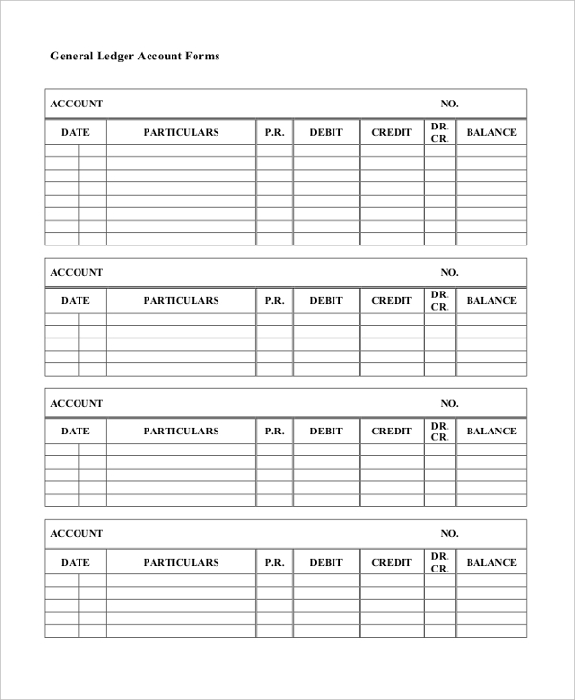
EXAMPLES OF LEDGER ACCOUNTS

Slide 41
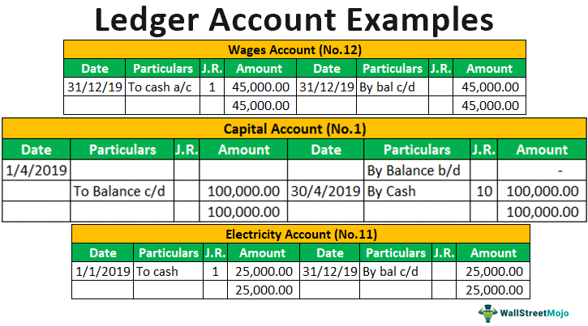
EXAMPLES OF LEDGER ACCOUNTS

Slide 42
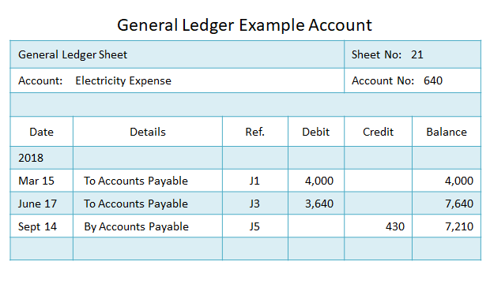
EXAMPLES OF LEDGER ACCOUNTS

Slide 43
TASK
Prepare the necessary accounts for the month of May from the following information
relating to a small printing firm. Then balance off the accounts and extract a trial balance as at 31 May 2020.
May 1 Started in business with capital in cash of £800 and £2,200 in the bank.
== 2 Bought goods on credit from the following: J Ward £610; P Green £214;
M Taylor £174; S Gemmill £345; P Tone £542.
== 4 Sold goods on credit to: J Sharpe £340; G Boycott £720; F Titmus £1,152.
== 6 Paid rent by cash £180.
== 9 J Sharpe paid us his account by cheque £340.
== 10 F Titmus paid us £1,000 by cheque.
== 12 We paid the following by cheque: M Taylor £174; J Ward £610.
== 15 Paid carriage by cash £38.
== 18 Bought goods on credit from P Green £291; S Gemmill £940.
== 21 Sold goods on credit to G Boycott £810.
== 31 Paid rent by cheque £230.

Slide 44
TRIAL BALANCE (TB)
A trial balance is a report that lists the ending balances of each account in the chart of accounts.
Bookkeepers and accountants use this report to consolidate all of the T-accounts into one document and double check that all transactions were recorded in proper journal entry format.
Bookkeepers typically scan the year-end trial balance for posting errors to ensure that the proper accounts were debited and credited while posting journal entries.
Internal accountants, on the other hand, tend to look at global trends of each account. For instance, they might notice that accounts receivable increased drastically over the year and look into the details to see why.
Tax accountants and auditors also use this report to prepare tax returns and begin the audit process.

Slide 45
What are the errors that do not affect trial balance?
Trial balance is prepared when transactions posted into the accounts are balanced up. It is prepared to check the accuracy of those posted transaction. It is normal sometimes that some errors may be apparent but despite this, they may not affect the trial balance. Different types of errors which don t affect the trial balance are;
i. Error of omission: Where in the full transaction is omitted from the books of accounts.
ii. Error of commission: Where we have entered the correct amounts but in wrong person’s account.
iii. Error of principle: This type of error takes place when an item is entered in wrong head or class of accounts.
iv. Error of compensation: Are errors which cancel the effects of each other.
v. Error of complete reversal of entries: These errors occur when we debit and credit the two or more aspects of a transaction wrongly using correct figures or amounts.
vi. Error of original entry: Entering wrong original figure or amount in an accounts.

Slide 46
EXAMPLES OF ERRORS
Constructing a journal entry and including a suitable narrative and posting the journal entries to the ledger accounts is the best way to correct the errors. Examples of errors;
Error of omission: A sale of K59 000 worth of goods to E. George has been completely omitted from the books
Error of commission: A purchase of K44 000 worth of goods from C. Simons on 4 September was entered in error in C. Simpson’s account. The error was found on 30 September.
Error of principle: The purchase of a machine for K200 000 is debited to the purchases account instead of being debited to a machinery account.
Compensating error: In the cash book, the amount of cash sales transferred to the sales account was overstated by K20 000 and the amount transferred to the wages account was also overstated by K20 000.
Error of original entry: A sale of K38 000 to A. Smailes was entered in the books as K28 000.
Complete reversal of entries: A payment of cash of K16 000 to M. Dickson was entered on the receipts side of the cash book in error and credited to M. Dickson’s account.
Transposition error: A credit purchase from P. Maclaran costing K56 000 was entered in the books as K65 000.

Slide 47
PREPARARTION OF THE TRIAL BALANCE
Guiding points
TYPE | ACCOUNTS | DEBIT | CREDIT
ASSETS | CASH (in hand and bank) | ***
ASSETS | SUPPLIERS (Purchases/stock) | ***
ASSETS | PLANT & EQUIPMENT (Anything bought for business use) | ***
EXPENSES | COST OF SALES & LAUNDRY COSTS | ***
LIABILITIES | ACCOUNTS/LOANS PAYABLE |  | ***
OWNER’S EQUITY/REVENUE | OWNER’S EQUITY & REVENUES/SALES |  | ***

Slide 48
DEMO: PREPARATION OF THE TRIAL BALANCE
Example: From the following list of balances extracted from the ledger,
prepare the Trial Balance (TB).
Cash $ 32,800
Accounts receivable 300
Inventory 39,800
Leasehold Improvement 100,000
Accounts Payable 49,000
Long-term liabilities 99,500
Common Stock 10,000
Dividends 1,000
Revenues 27,800
Cost of goods sold 10,200
Rent Expenses 500
Supplies Expenses 500
Utilities Expenses 200
Wages Expenses 500
Interest Expenses 500

Slide 49
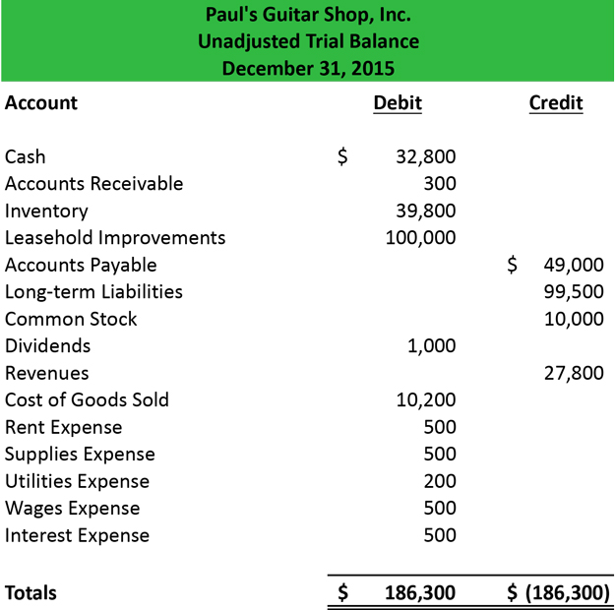
SOLUTION: Here’s an example of a trial balance. As you can see, the report has a heading that identifies the company reporting, name of the company, and date when it was prepared. The accounts (details/description) are listed on the left with the balances under the debit and credit columns. The debit and credit columns must equal each other totaling a zero balance.

Slide 50
ACTIVITY (DEMO)
ARONZO ENTERPRISES traded from July, 2019 to June, 2020 and below is the list of the balances. K
Capital at start 1 July 2019 121,900
Trade payables 19,000
Sales 280,000
Returns outwards 13,000
Discounts allowed 2,000
Discounts received 1,500
Fixtures and fittings @ cost 120,000
Depreciation fixtures & fittings 12,000
Trade receivables 24,000
Inventory 1 July 2019 50,000
Purchases 135,000
Returns inwards 5,000
Carriage outwards 4,000
Drawings 18,000
Carriage inwards 11,000

Slide 51
Rent 7,000
Rates 8,000
Insurance 10,000
Heating & lighting 12,000
Postage 500
Stationery 700
Telephone 400
Advertising 5,000
Salaries & wages 35,000
Bad debts 1,500
Cash in bank 6,000
Cash in hand 300
5 year loan from Banda 32,000
Inventory at 30 June 2020 17,000
Required: Prepare the Trial Balance as at 30th June, 2020. (10 Marks)

Slide 52
THE TRIAL BALANCE FOR
ARONZO ENTERPRISES FOR THE YEAR 2017
DETAILS DEBIT CREDIT Capital 121,900
Trade payables 19,000
Sales 280,000
Returns outwards 13,000
Discounts allowed 2,000
Discounts received 1,500
Fixtures and fittings @ cost 120,000
Depreciation fixtures & fittings 12,000
Trade receivables 24,000
Inventory 1 July 2016 50,000
Purchases 135,000
Returns inwards 5,000
Carriage outwards 4,000
Drawings 18,000
Carriage inwards 11,000

Slide 53
Rent 7,000
Rates 8,000
Insurance 10,000
Heating & lighting 12,000
Postage 500
Stationery 700
Telephone 400
Advertising 5,000
Salaries & wages 35,000
Bad debts 1,500
Cash in bank 6,000
Cash in hand 300
5 year loan from Banda 32,000
TOTAL 467,400 467,400 (10 MARKS)
Note: The closing Inventory at 30 June 2020 of K17,000 shows the balance of unsold goods from opening stock and purchases. Its not a TB item and will appear under notes to be used when preparing the Balance Sheet.

Slide 54
THE FINANCIAL STATEMENTS
1. THE INCOME STATEMENT
The Income Statement (also known as the Trading, Profit and Loss Account T.P&L) tells you both the earnings and profitability of a business made as a result of trading.
The T.P&L is always for a specific period of time, such as a month, a quarter or a year.
Periodic income statements are essential, because they allow users to compare results for the company over time and to the results of other firms for the same period.
Depending on the industry, year over year comparisons that eliminate seasonal variables may be especially useful.
This section of the income statement is used to compute the key profitability ratios of gross margin, operating margin, and pretax margin that help readers assess the ability of the company to generate income from its activities.

Slide 55
KEY POINTS IN INCOME STATEMENT PREPARATION
The Income Statement is the statement prepared to show the profitability of the firm for a certain trading period.
It is made up of 2 parts; the Trading and Profit and Loss Accounts.
The Trading shows how the business traded (sales less cost of goods sold) to find the Gross Profit.
The Profit and Loss Account is prepared to find the profit or loss made out of the trading for a given period.
iii. Gross Profit (Net Sales – Cost of goods sold).
iv. Net Profit or Loss (Gross profit - Expenses).
v. The Income Statement is all about the total income incurred in a given period minus all the expenses for the period.

Slide 56
DEMO: Here’s an example of a trial balance. Prepare the Income Statement

Slide 57
DEMO: SOLUTION
Paul’s Guitar Shop, Inc’s Income Statement for the year ending 2015
$ $ $
Revenue 27,800
Cost of Goods Sold (10,200)
Gross Profit 17,600
Less Expenses
Rent expense 500
Supplies Expense 500
Utility Expense 200
Wages Expense 500
Interest Expense 500
Total Expenses (2,200)
Net Profit 15,400

Slide 58
DEMO: SOLUTION
Paul’s Guitar Shop, Inc’s Balance Sheet for the year ending 2015
Long term Assets $ $ $
Leasehold improvement 100,000
Current Assets
Inventory 39,800
Cash receivable 300
Cash 32,000 72,900
Total Assets 172,900
Liabilities
Long term liability 99,500
Payable 49,000
Total Liabilities 148,500
Financed by:
Common stock 10,000
Add: Net profit 15,400 25,400
Less: Dividends (1,000)
Net Capital 24,400

Slide 59
ACTIVITY (DEMO 2: INCOME STATEMENT)
ARONZO ENTERPRISES traded from July, 2019 to June, 2020 and below is the list of the balances. K K K
Sales 280,000
Less: Returns inwards (5,000)
Net Sale 275,000
Cost of Goods Sold
Opening Inventory 1 July 2019 50,000
Add: Purchases 135,000
Carriage inwards 11,000
Less: Returns outwards (13,000)
Cost of Goods Available for Sale 183,000
Less: Closing inventory (17,000)
Cost of goods sold (166,000)
Gross Profit 109,000
Add: Discounts received 1,500
110,500

Slide 60
Less: Expenses
Discounts allowed 2,000
Depreciation fixtures & fittings 12,000
Carriage outwards 4,000
Drawings 18,000
Rent 7,000
Rates 8,000
Insurance 10,000
Heating & lighting 12,000
Postage 500
Stationery 700
Telephone 400
Advertising 5,000
Salaries & wages 35,000
Bad debts 1,500
Total expenses 116,100
Net Profit 8,600
(10 MARKS)

Slide 61
ACTIVITY (DEMO: BALANCE SHEET)
ARONZO ENTERPRISES’ BALANCE SHEET AS OF JUNE, 2020. K K K
Long term Assets
Fixtures and fittings @ cost 120,000
Less: Depreciation fixtures & fittings (12,000)
Total fixed assets 108,000
Current Assets
Inventory at 30 June 2020 17,000
Trade receivables 24,000
Cash in bank 6,000
Cash in hand 300
Total current assets 47,300
Total Net Assets 155,300
Liabilities
5 year loan from Banda 32,000
Trade payables 19,000
Total Liabilities 51,000
Financed by:
Capital at start 1 July 2019 121,900
Add: Net profit Drawings 8,600
Less: Drawings 18,000
Net Capital 130,500

Slide 62
2. THE BALANCE SHEET (STATEMENT OF FINANCIAL POSITION)
Assets are items that provide probable future economic benefits
Liabilities are obligations of the firm that will be settled by using assets
Equity (variously called stockholders equity, shareowners equity or owners’ equity) is the residual interest that remains after you subtract liabilities from assets.

Slide 63



FROM THE FOLLOWING, WHICH BUSINESS IS MORE VIABLE THAN THE OTHER? DEFEND YOUR ANSWER.

Slide 64
ASSETS
An asset is a resource that is owned or controlled by the company to be used for future benefits. Some assets are tangible like cash while others are theoretical or intangible like goodwill or copyrights. Another common asset is a receivable. This is a promise to be paid from another party. Receivables arise when a company provides a service or sells a product to someone on credit. All of these assets are resources that a company can use for future benefits. Here are some common examples of assets:
Cash and bank
Accounts Receivable
Prepaid Expenses
Vehicles
Buildings/equipment
Goodwill
Copyrights
Patents

Slide 65
LIABILITIES
A liability, in its simplest terms, is an amount of money owed to another person or organization. Said a different way, liabilities are creditors' claims on company assets because this is the amount of assets creditors would own if the company liquidated. A common form of liability is a payable. Payables are the opposite of receivables. When a company purchases goods or services from other companies on credit, a payable is recorded to show that the company promises to pay the other companies for their assets. Here are some examples of some of the most common liabilities:
Accounts payable
Bank loans
Lines of Credit
Personal Loans
Officer Loans
Unearned income
Accruals

Slide 66
EQUITY – also knowns as Capital
Equity represents the portion of company assets that shareholders or partners own. In other words, the shareholders or partners own the remainder of assets once all of the liabilities are paid off. Owners can increase their ownership share by contributing money to the company or decrease equity by withdrawing company funds. Likewise, revenues increase equity while expenses decrease equity. Here are some common equity accounts:
Owner's Capital
Owner's Withdrawals
Revenues
Expenses
Common stock/preference stock
Paid-In Capital

Slide 67
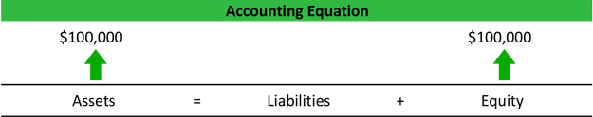
Example
Let's take a look at the formation of a company to illustrate how the accounting equation works in a business situation.
Betty is an entrepreneur who wants to start a company selling speakers for car stereo systems. After saving up money for a year, Betty decides it is time to officially start his business. She forms Speakers, Inc. and contributes $100,000 to the company. This business transaction increases company cash and increases equity by the same amount.

Slide 68
ASSETS = LIABILITIES + OWNERS EQUITY, OR A=L+OE
ASSETS
Assets are broken down into current and noncurrent (or long-term). Assets are listed from top to bottom in order of decreasing liquidity, i.e., how fast they can be converted to cash.
a. Current assets
Current assets are cash and other assets that are expected to be used during the normal operating cycle of the business, usually one year. They typically include cash and cash equivalents, short-term investments, accounts receivables, inventory and prepaid expense.
b. Non-Current assets
Noncurrent assets will not be realized in full within one year. They typically include long-term investments: property, plant and equipment; intangible assets and other assets.

Slide 69
LIABILITIES
Liabilities are listed in order of expected payment. Obligations expected to be satisfied within one year are current liabilities. They include accounts payable, trade notes payable, advances and deposits, current portion of long-term debt and accrued expenses. Noncurrent liabilities include bonds payable and other forms of long-term capital.
CAPITAL OR OWNERS’ EQUITY
The structure of the owners' equity section depends on whether the entity is an individual, a partnership or a corporation. Assuming it's a corporation, the section will include capital stock, additional paid-in capital, retained earnings, accumulated other comprehensive income and treasury stock.
Balance sheet data can be used to compute key indicators that reveal the company's financial structure and its ability to meet its obligations. These include working capital, current ratio, quick ratio, debt-equity ratio and debt-to-capital ratio.

Slide 70
TASK
ARONZO ENTERPRISES traded from July, 2016 to June, 2017 and below is the list of the balances. K
Capital at start 1 July 2016 121,900
Trade payables 19,000
Sales 280,000
Returns outwards 13,000
Discounts allowed 2,000
Discounts received 1,500
Fixtures and fittings @ cost 120,000
Depreciation fixtures & fittings 12,000
Trade receivables 24,000
Inventory 1 July 2016 50,000
Purchases 135,000
Returns inwards 5,000
Carriage outwards 4,000
Drawings 18,000
Carriage inwards 11,000

Slide 71
Rent 7,000
Rates 8,000
Insurance 10,000
Heating & lighting 12,000
Postage 500
Stationery 700
Telephone 400
Advertising 5,000
Salaries & wages 35,000
Bad debts 1,500
Cash in bank 6,000
Cash in hand 300
5 year loan from Banda 20,000
Inventory at 30 June 2017 17,000
Required:
  a. Prepare the Trial Balance as at 30th June, 2017. (10 Marks)
  b. Prepare income statement for the year end 30 June 2017. (10 Marks)
  c. Prepare the Balance Sheet as at that date. (10 Marks)
TOTAL MARKS: 30 MARKS

Slide 72
‘THERE FELICITATION AFTER LUCUBRATION’

