Slide 1
LESSON 2:
AUTONOMIC PHARMACOLOGY - OVERVIEW
DR SITANIMEZI MWEENDA

Slide 2
Organization of The Nervous System
Central Nervous System
Peripheral Nervous System
Autonomic Nervous System
Somatic Nervous System
Sympathetic
Parasympathetic

Slide 3
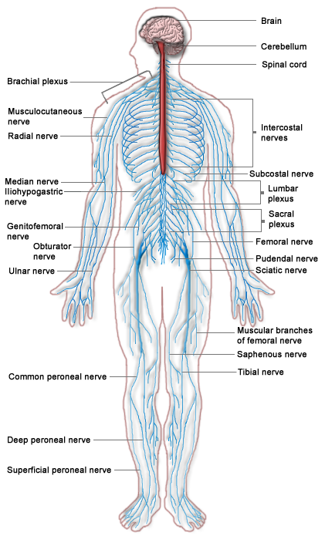
Nervous System

Slide 4
Key definitions
Neurotransmitter
A chemical that transmits signals from one neuron to another or from a neuron to an effector cell
Synapse
A junctional connection between two neurons, across which a signal can pass
Pre-synaptic neuron
Where a neurotransmitter is synthesized, stored and released upon cell activation
Post-synaptic neuron or effector cell
Where neurotransmitter is detected and its action translated into cellular activities

Slide 5
Autonomic Nervous System
The autonomic nervous system is the subdivision of the peripheral nervous system that regulates body activities that are generally not under conscious control:
Involuntary
Functions to maintain homeostasis
Central control of the autonomic nervous system comes mostly from the hypothalamus, with some input from the limbic system and the reticular activating system
Divisions of the autonomic nervous system
Parasympathetic division
Sympathetic division

Slide 6
Anatomical distribution of the autonomic nervous system
Parasympathetic neurons
Originate in the midbrain, medulla oblongata and sacral spinal cord
Sympathetic neurons
Originate from the thoracic and lumbar portions of the spinal cord
Autonomic system consists of chains of two motor neurons:
  1st: Preganglionic neuron (in brain or spinal cord)
  2nd: Postganglionic neuron (cell body in ganglion outside CNS)
Axon of 1st (preganglionic) neuron leaves CNS to synapse with the 2nd (postganglionic) neuron
Axon of 2nd (postganglionic) neuron extends to the organ it serves

Slide 7
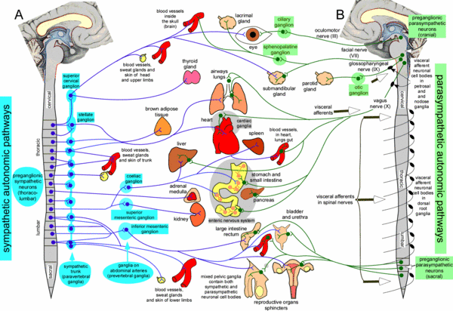
Figure drawn by the authors, incorporating material from Gray's Anatomy 31st Edition 1954, and from Cannon and Rosenblueth Physiology of the Autonomic Nervous System, 1937.

Slide 8
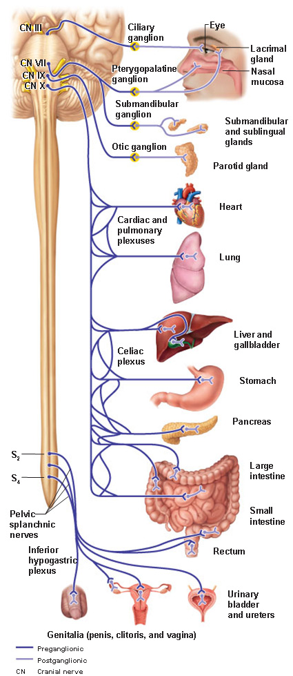

Slide 9
Neurotransmitters in the autonomic nervous system [ANS]
The principal neurotransmitters in the ANS are acetylcholine and noradrenaline
All preganglionic neurons and parasympathetic postganglionic neurons use acetylcholine as neurotransmitter
Acetylcholine is the neurotransmitter at all autonomic ganglia, neuromuscular junctions and parasympathetic tissue synapses
Most postganglionic sympathetic neurons use norepinephrine (noradrenaline) as the neurotransmitter
There are exceptions:
Sweat glands
  Innervation of the thermoregulatory sweat glands is anatomically sympathetic, but the postganglionic neurons release acetylcholine as the neurotransmitter

Slide 10
Neurotransmitters in the autonomic nervous system …. cont’d
Exceptions ….. cont’d
Kidneys
  Postganglionic neurons to the smooth muscle of the renal vasculature release dopamine
Adrenal gland
  Preganglionic neurons synapse directly on the adrenal gland, release acetylcholine, and activate nicotinic receptors in the adrenal gland medulla
  The adrenal glands release epinephrine (adrenaline) into systemic circulation

Slide 11
Neurotransmission in the parasympathetic nervous system
The principal neurotransmitter in the parasympathetic nervous system is acetylcholine
There are two types of acetylcholine receptors: nicotinic (N) and muscarinic (M)
Neurotransmission in the ganglia is achieved by preganglionic fibers releasing acetylcholine into the synaptic space, which activates nicotinic receptors on postganglionic nerve dendrites
Depolarization of postganglionic cholinergic nerves results in the release of their stored acetylcholine within the innervated tissue. The acetylcholine activates muscarinic receptors on effector cells to produce biological effects
There are 5 sub-types of muscarinic receptors: M1, M2, M3, M4 and M5
The release of acetylcholine is regulated by acetylcholine acting on presynaptic M2 receptors – activation of these receptors inhibits release of acetylcholine

Slide 12
Acetylcholine (Ach)
Ach is synthesized in nerve terminals by the cytoplasmic enzyme choline acetyltransferase which catalyses the transfer of an acetate group from acetyl coenzyme A to choline that has been transported into cholinergic neurons by a sodium dependent membrane carrier
The synthesized Ach is transported from the cytoplasm to storage vesicles
Ach is released from the vesicles by nerve action potentials through calcium-dependent exocytosis. Release can be blocked by botulinum toxin.
The effect of ACh on postsynaptic tissue is terminated by rapid action of acetylcholinesterase (AChE) that metabolizes ACh to acetate and choline. The liberated choline is taken into the presynaptic nerve terminal.
Ach is not administered for therapeutic purposes because it is hydrolysed almost instantly by butyrylcholinesterase in plasma (pseudocholinesterase, plasma cholinesterase)

Slide 13
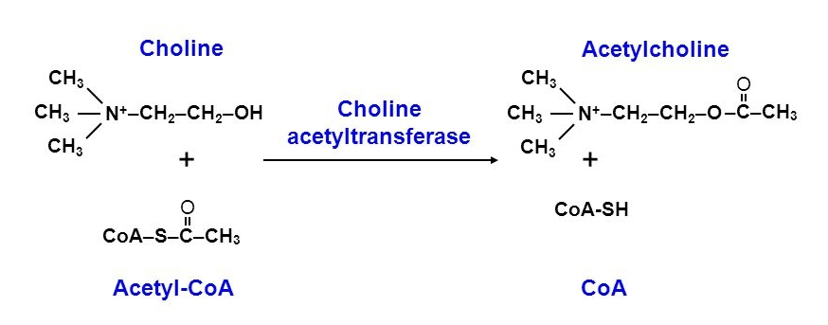

Slide 14
Functions of the parasympathetic nervous system
Eye: constriction of the pupil (meiosis) and accommodation
Lacrimation
Salivation
Slowing of the heart (bradycardia)
Decrease in blood pressure
Production of bronchial secretions
Production of digestive juices from stomach, pancreas and gallbladder
Increased gastrointestinal tract tone and peristalsis
Sphincter relaxation
Urination and defecation
Penile erection

Slide 15
Parasympathetic nervous system
Effector Organ | Receptor Subtype | Response to Cholinergic Stimulation
Eye:
Sphincter muscle, iris | M₃ | Contract to cause meiosis
Ciliary muscle | M₃ | Contract for near vision
Heart:
Sinoatrial node | M₂ | Decrease rate of depolarization
Atria | M₂ | Decrease contractility
Atrioventricular node | M₂ | Decrease rate of depolarization
Arteries, arterioles:
Endothelial cells | M₁, M₃ | Vasodilation (predominant) – mediated by nitric oxide
Smooth muscle cells | M₁, M₃ | Vasocontriction by direct action on smooth muscle

Slide 16
Parasympathetic nervous system …. cont’d
Effector Organ | Receptor Subtype | Response to Cholinergic Stimulation
Respiratory:
Tracheal, bronchial smooth muscle | M₁, M₃ | Constriction
Bronchial glands | M₂, M₃ | Increased mucous secretion
Gastrointestinal tract: | M₂, M₃ | Increased contractility, motility & secretions
Urinary Bladder:
Detrusor muscle | M₂, M₃ | Contraction
Trigone & sphincter muscle | M₂, M₃ | Relaxation
Salivary glands: | M₂, M₃ | Increased watery secretion
Erectile tissue: | M₂, M₃ | Vasodilation of cavernosa of penis and clitoris, increased blood pooling

Slide 17
Parasympathetic nervous system …. cont’d
Cholinergic Receptor subtype | Receptor distribution | Signal transduction activated
Muscarinic, M₁ | CNS neurons, smooth muscle | Phosphoinositol-coupled, excitatory, increase smooth muscle contraction
Muscarinic, M₂ | Cardiac conduction system, myocardium | K⁺-channel activators, inhibit adenylyl cyclase
 | Presynaptic nerve endings | K⁺-channel activators, inhibit adenylyl cyclase, decrease neurotransmission
Muscarinic, M₃ | Exocrine glands, smooth muscle | Phosphoinositol-coupled, increase smooth muscle contraction.
Muscarinic, M₄ | Uncertain | Inhibit adenylyl cyclase
Muscarinic, M₅ | Uncertain | Activate phosphoinositol metabolism

Slide 18
Neurotransmission in the sympathetic nervous system
Preganglionic neurons (synapse with postganglionic neurons in the ganglia) release acetylcholine as the primary neurotransmitter
Postganglionic neurons release norepinephrine as the primary neurotransmitter
Synthesis of catecholamines (dopamine, norepinephrine and epinephrine)
In presynaptic nerves, tyrosine is hydroxylated by tyrosine hydroxylase to form dihydroxyphenylalanine (dopa). Dopa is then decarboxylated by dopa decarboxylase to form dopamine. Dopamine is then transported into vesicles (this step is blocked by the drug reserpine), where it is hydroxylated to form norepinephrine. In certain areas of the brain and in the adrenal medulla, norepinephrine is methylated to epinephrine.

Slide 19
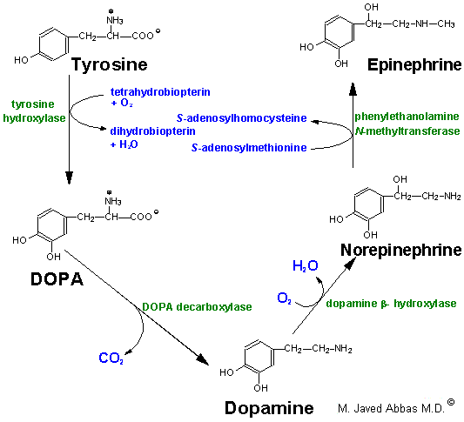

Slide 20
Norepinephrine storage and release
Norepinephrine is stored in the vesicle with ATP and neuropeptide Y (co-transmitters)
Norepinephrine is released into the synaptic cleft by exocytosis (a calcium-dependent process) when the nerve terminal is depolarized. The released norepinephrine interacts with specific adrenergic receptors (adrenoceptors) to produce tissue/organ response:
Postsynaptic - response
Presynaptic - modulation of further neurotransmitter release
Norepinephrine release can be blocked by such drugs as bretylium and guanethidine

Slide 21
Norepinephrine and epinephrine release
Norepinephrine also exists in a non-vesicular cytoplasmic pool that is released by indirectly acting sympathomimetic amines (e.g. tyramine, amphetamine, ephedrine) by a process that is not calcium-dependent.
Norepinephrine and some epinephrine are released from adrenergic nerve endings in the brain
In the periphery, epinephrine is the major catecholamine released from the adrenal medulla into the general circulation, where it functions as a hormone

Slide 22
Termination of norepinephrine action
The action of norepinephrine is terminated primarily by active transport into the cytoplasm of the pre-synaptic neurone (uptake 1) – this process can be inhibited by cocaine and tricyclic antidepressants such as amitriptyline. Norepinephrine is then transported by a second carrier system into storage vesicles (a process also blocked by reserpine)
Norepinephrine is also taken into post-synaptic tissue (uptake 2)
In the cytoplasm of pre-synaptic nerve cells, synaptic cleft and in post-synaptic tissues, norepinephrine is metabolized by monoamine oxidase (MAO) or catechol-O-methyltransferase (COMT) to inactive intermediates and finally to homovanillic acid (HVA) and methoxyhydroxy mandelic acid (VMA)

Slide 23
Regulation of adrenergic neurotransmitter release
Pre-synaptic receptors on sympathetic nerve terminals influence the release of norepinephrine:
α₂-adrenergic and muscarinic M1/M2 receptors decrease norepinephrine release
AT₁-angiotensin and nicotinic receptors increase norepinephrine release

Slide 24
Sympathetic nervous system
Effector Organ | Receptor Subtype | Response to Adrenergic stimuli
Eye:
Pupillary dilator muscle | α₁ | Contracts to cause mydriasis
Ciliary muscle | β₂ | Relaxes to allow for far vision
Heart:
Sinoatrial node | β₁, β₂ | Increased rate of depolarization (increased heart rate - positive chronotropy)
Atrioventricular node | β₁ | Increased conduction rate
Atria, ventricles | β₁ | Increased contractility (positive inotropy)
Arteries, arterioles:
Arterial smooth muscle cells in most vascular beds | α₁, α₂ | Contraction (vasoconstriction)
Arteries/arterioles in skeletal muscle and brain | β₂ | Relaxation (vasodilatation)
Respiratory tract:
Tracheal, bronchial smooth muscle | β₂ | Relaxation
Bronchial glands | α, β₂ | Decreased mucous secretion

Slide 25
Sympathetic nervous system
Effector Organ | Receptor Subtype | Response to Adrenergic stimulation
Gastrointestinal tract:
Smooth muscle wall | β₂ | Relaxation, decreased motility
Sphincters | α₁ | Contraction, decreased transit time
Urinary Bladder:
Detrusor muscle | β₂ | Relaxation, decreases voiding
Trigone & sphincter muscle | α₁ | Contraction, decreases voiding
Metabolic function:
Liver | α₁, β₂ | Glycogenolysis
Fat cells | β₃ | Increased lipolysis
Kidneys | β₁ | Renin release
Sexual organs: | α₁ | Ejaculation, orgasm
Adrenal Medulla: | N_{N} | Epinephrine release

Slide 26
Sympathetic nervous system …. cont’d
Adrenergic receptors and their effector systems
Adrenergic receptor | G-protein coupling | Signal transduction processes
β₁ | G_{s} | Activate adenylate cyclase; open calcium channels
β₂ | G_{s} | Activate adenylate cyclase; increase OR decrease intracellular calcium levels
β₃ | G_{s} | Activate adenylate cyclase; activate fatty acid lipase
α₁ | G_{q} | Activate PLC, PLD, PLA₂; increase intracellular calcium levels
α₂ | G_{i,o} | Decrease adenylate cyclase; open K⁺ channels; (reduced intracellular calcium) Activate PLC, PLA₂ (increased intracellular calcium)

Slide 27
Role of the sympathetic nervous system
Helps the body cope with external stimuli and functions during stress (triggers the flight or fight response)
Functions of the sympathetic nervous system
Increased heart rate (tachycardia)
Vasoconstriction of skin and viscera
Vasodilatation in skeletal muscle
Sweating
Bronchodilatation
Dilation of the pupil (mydriasis)
Inhibition of production of digestive juices
Inhibition of peristalsis
Relaxation of the uterus

Slide 28
Integration of autonomic function
Generally the parasympathetic system causes discrete changes in organ function and usually associated with “rest and digest”:
Increased salivary secretion
Increased GI motility
Increased urination, defecation
Increased bronchial constriction, secretions
Decreased heart rate
Pupillary constriction, decreased visual accommodation
Increased sexual arousal
Parasympathetic activity does not usually cause generalized organ system activation unless:
Acetylcholine metabolism is significantly inhibited (nerve gas, insecticides)
Exposure to muscarinic agonists (muscarine from mushrooms)

Slide 29
Integration of autonomic function …. cont’d
Sympathetic nervous system is designed to provide more wide-spread activation of organ systems during severe stress
This is assured by interconnections between sympathetic ganglia in the chain ganglia that allow almost simultaneous activation of multiple nerve bundles supplying different organs
Sympathetic activation prepares the organism to flee from or fight a potential threat:
Pupils dilate, lens flatten for far-vision
Heart rate, force increased
Vasoconstriction
Blood shunted from viscera to skeletal muscle
Increased respiration rate
Glucose release by liver
Kidney blood flow and water loss decreased
GI and bladder function decreased
Skin blood flow decreased, pilo-erection

Slide 30
How do drugs influence the autonomic nervous system?
Mimic or block the effects of the two primary neurotransmitters, acetylcholine and norepinephrine/epinephrine
Drugs that mimic neurotransmitters are referred to as “receptor agonists”: these drugs activate receptors
Drugs that block neurotransmitters are referred to as “receptor antagonists”: these drugs block the endogenous neurotransmitters from activating receptors

Slide 31
Classification of drugs affecting the autonomic nervous system
Parasympathetic nervous system
Mimic acetylcholine = cholinergic = muscarinic agonists = parasympathomimetic
Block acetylcholine = anticholinergic = anti-muscarinic = muscarinic antagonist = parasympatholytic
Sympathetic nervous system
Mimic norepinephrine/epinephrine = adrenergic = adrenergic agonist = sympathomimetic
Block norepinephrine/epinephrine = anti-adrenergic = adrenergic antagonist = sympatholytic

Slide 32
THE END

