Slide 1
Inflammation: Acute and Chronic Inflammation
Rabecca T. Kamwela
BSC. BMS, MSc. Pathology, PhD. Infectious Diseases

Slide 2
Lecture Outline
Acute Inflammation
Morphologic patterns of Acute inflammation
Chemical mediators of inflammation
Chronic Inflammation
Systemic effects of Chronic Inflammation

Slide 3
Overview of inflammation
Definition
Protective response involving host cells, blood vessels, proteins and other mediators
Intention →eliminate the initial cause of cell injury, necrotic cells and tissues and initiate tissue repair
Achieved by diluting, destroying or neutralising harmful agents
Inflammation is divided into acute and chronic forms
NOTE: The inflammatory reaction and the subsequent repair process can themselves cause considerable harm.
Notes:
Without inflammation, infections would go unchecked and wounds would never heal, inflammation is one component of a protective response that immunologists refer to as innate immunity

Slide 4
Acute inflammation
Rapid in onset and of short duration
Lasts from a few minutes to a few days
Characterized by fluid and plasma protein exudation and neutrophilic leukocyte accumulation

Slide 5
Chronic inflammation
May be more insidious and of Longer duration (days to years)
Typified by influx of lymphocytes and macrophages
Associated vascular proliferation and fibrosis (scarring).
Note: These basic forms of inflammation can coexist.

Slide 6
Features of Acute and Chronic Inflammation
Feature | Acute | Chronic
Onset | Fast: minutes or hours | Slow: Days
Cellular infiltrate | Mainly neutrophils | Monocytes/macrophages and lymphocytes
Tissue injury, fibrosis | Usually mild and self-limited | Often severe and progressive
Local and systemic signs | Prominent | Less prominent; may be subtle

Slide 7
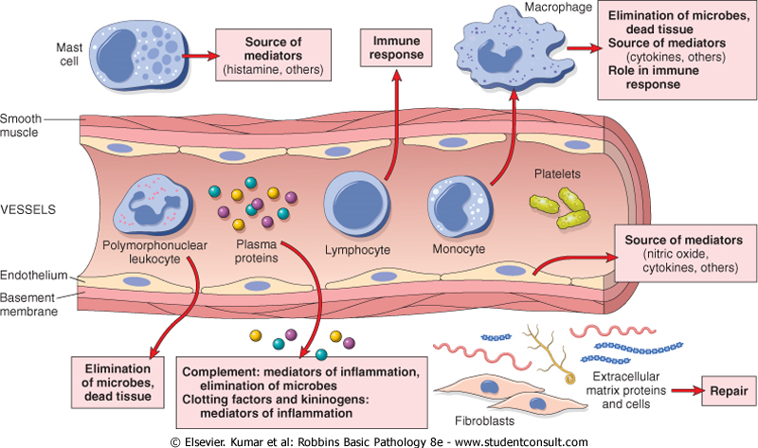
The components of acute and chronic inflammatory responses and their principal functions.

Slide 8
Acute and Chronic Inflammation
The steps of the inflammatory response can be remembered as the five Rs:
Recognition of the injurious agent
Recruitment of leukocytes
Removal of the agent
Regulation (control) of the response, and
Resolution (repair)

Slide 9
Cardinal Signs Of Acute Inflammation
Redness (rubor) due to dilation of small blood vessels within damaged tissue.
Heat (calor) due to vascular dilation and increased blood flow.
Swelling (tumor) due to accumulation of fluid in the extravascular space which, in turn, is due to increased vascular permeability.
Pain (dolor), results from the stretching & destruction of tissues due to inflammatory edema, chemical mediators etc
Loss of function (functio laesa): Severe swelling may physically immobilize the tissue.

Slide 10
Acute inflammation
Stimuli of acute inflammation include:
Infections
Trauma
Physical and Chemical agents
Tissue necrosis, including ischemia
Foreign bodies (splinters, dirt, sutures)
Immune reactions (hypersensitivity reactions)

Slide 11
Components of acute inflammation
2 major components:
Vascular Changes
  alterations in vessel caliber resulting in increased blood flow (Vasodilation) and increased vascular permeability.
Cellular Events
  Emigration of the leukocytes from the microcirculation and accumulation in the focus of injury (cellular recruitment and activation).

Slide 12
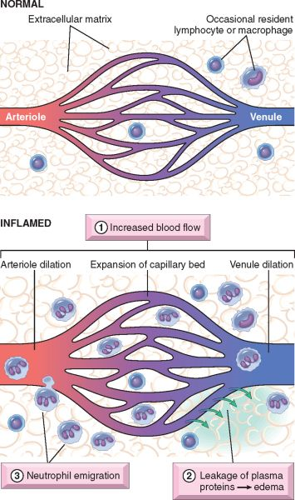
Major Local Manifestations Of Acute Inflammation, Compared To Normal

Slide 13
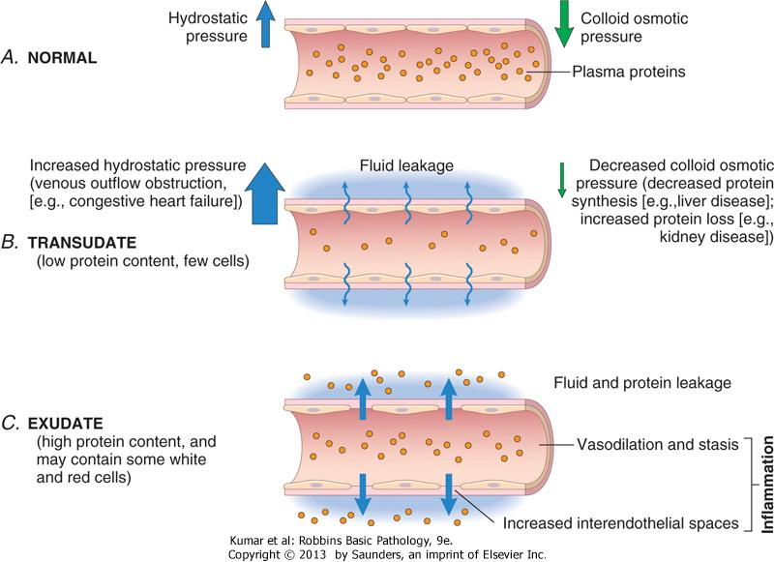
Vascular changes
Notes:
Endothelial injury results in vascular leakage by causing endothelial cell necrosis and detachment

Slide 14
Mechanisms contributing to Increased Vascular Permeability
Endothelial cell contraction leading to intercellular gaps in postcapillary venules
Endothelial injury results in vascular leakage by causing endothelial cell necrosis and detachment
Increased transcytosis of proteins by way of an intracellular vesicular pathway
Leakage from new blood vessels: vessel sprouts remain leaky until proliferating endothelial cells mature sufficiently to form intercellular junctions
Notes:
vessel sprouts remain leaky until proliferating endothelial cells mature sufficiently to form intercellular junctions

Slide 15
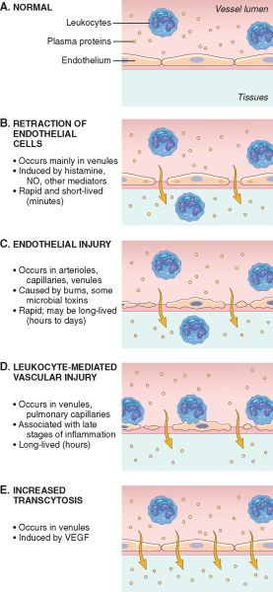
Mechanisms contributing to Increased Vascular Permeability
Pathologic basis of disease 8e

Slide 16
Responses of Lymphatic Vessels
In inflammation, lymph flow is increased and helps drain edema fluid, leukocytes, and cell debris from the extravascular space
In severe inflammatory reactions, especially to microbes, the lymphatics may transport the offending agent, contributing to its dissemination
The lymphatics may become secondarily inflamed (lymphangitis) and draining lymph nodes (lymphadenitis)

Slide 17
Responses of Lymphatic Vessels
Inflamed lymph nodes are often enlarged because of hyperplasia of the lymphoid follicles and increased numbers of lymphocytes and phagocytic cells lining the sinuses of the lymph nodes

Slide 18
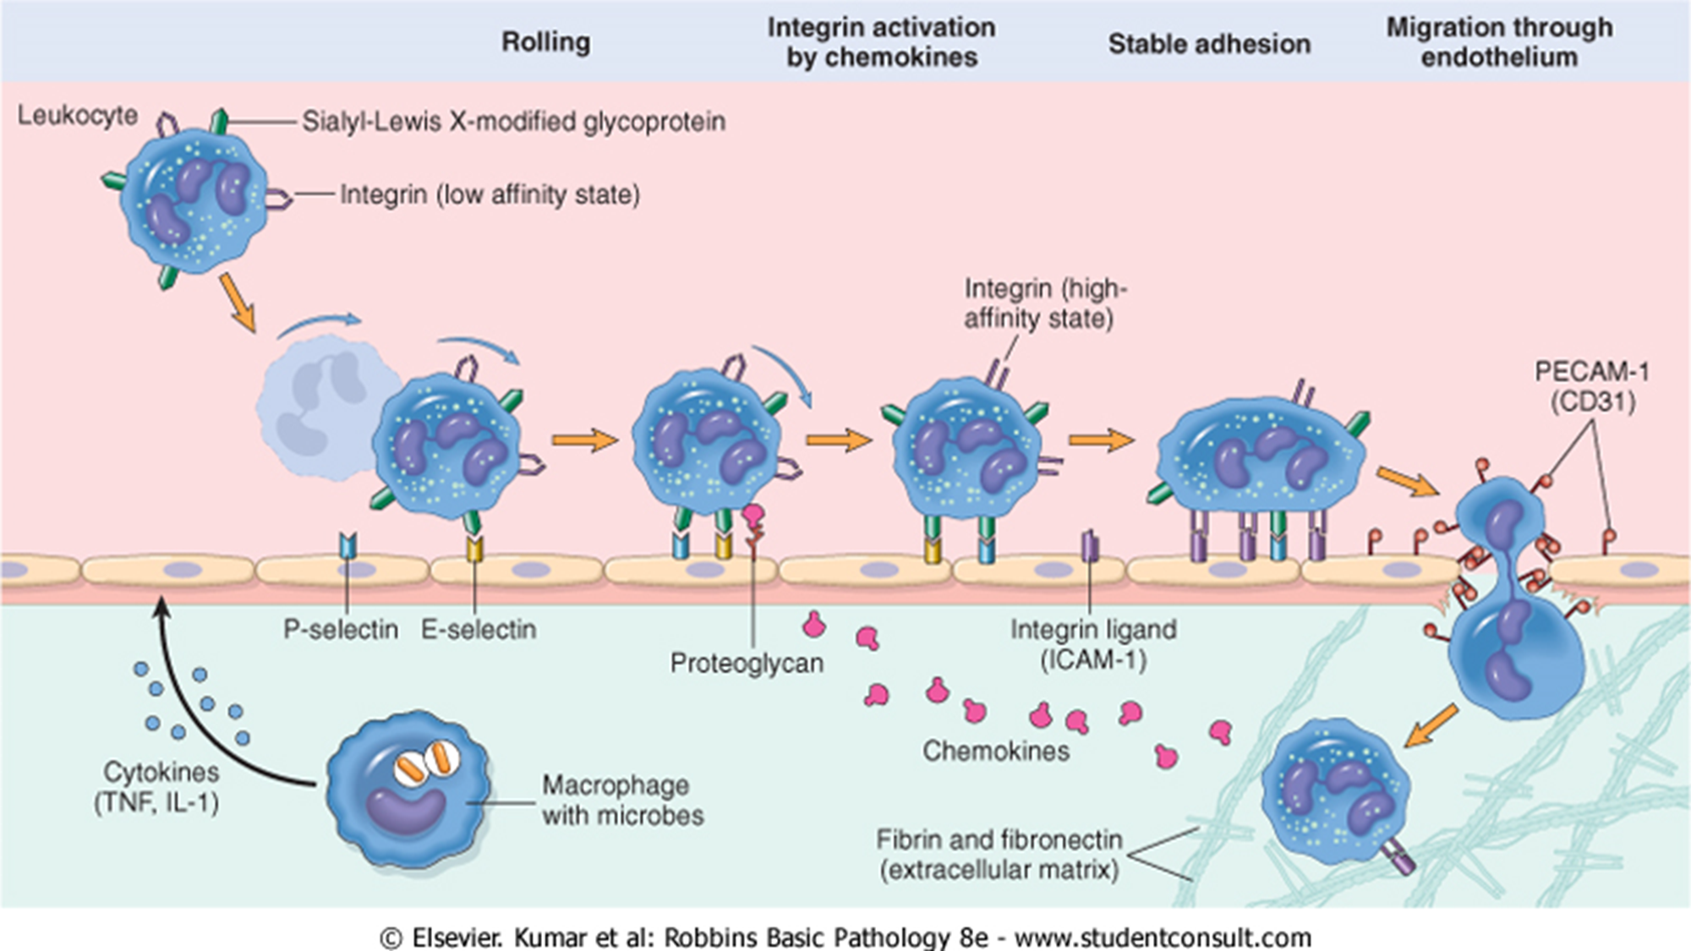
Cellular events

Slide 19
Leukocyte Activation
Once activated, leukocytes elicit the following reaction:
Phagocytosis of particles
Intracellular destruction of phagocytosed microbes and dead cells
Liberation of substances that destroy extracellular microbes and dead cells
Production of mediators that enhance the inflammatory response

Slide 20
Phagocytosis
Consists of three steps:
Recognition and attachment of the particle to the ingesting leukocyte
Engulfment with formation of a phagocytic vacuole
Killing and degradation of the ingested material

Slide 21
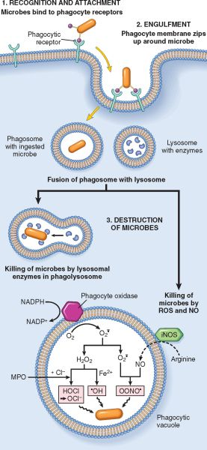
Phagocytosis
Pathologic basis of Disease 8e

Slide 22
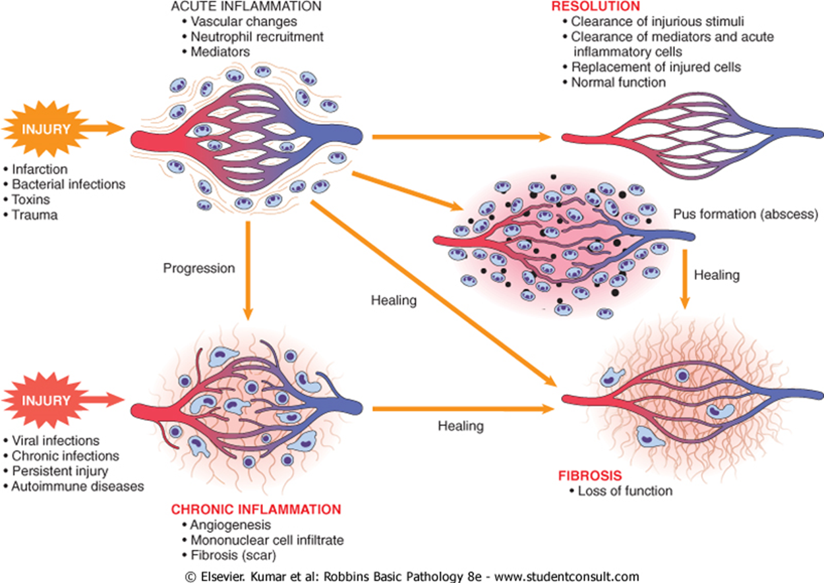
Outcomes of inflammation

Slide 23
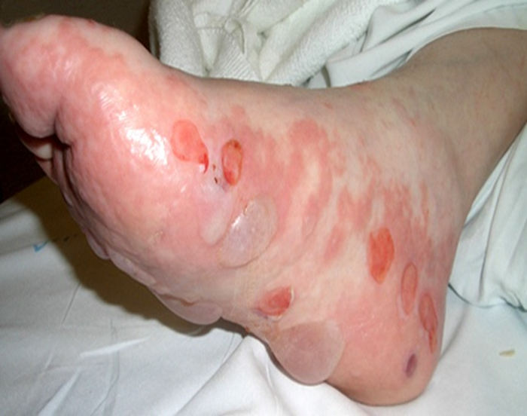
Morphologic patterns of acute inflammation
Serous inflammation
Characterised by outpouring of a watery, relatively protein- poor fluid
Derives etiher from plasma or secretions of mesothelial cells in the peritoneal, pleural and pericardial cavities
E.g skin blister resulting from a burn or viral infection

Slide 24
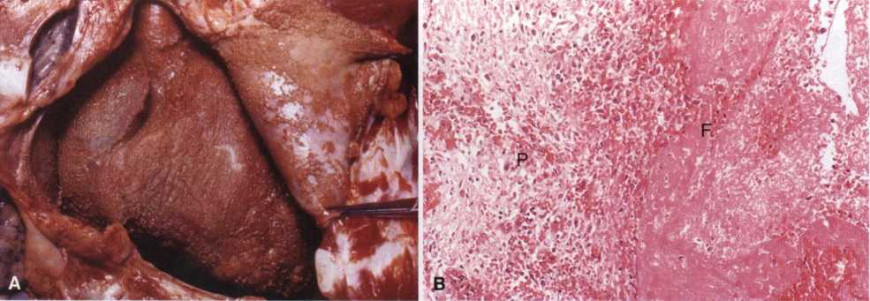
Fibrinous inflammation
Characteristic of severe burns →great vascular permeability →large molecules e.g fibrin cross the endothelial barrier
Occurs in meninges, pericadium and pleura
Healing occurs by resolution or organisation
Fibrinous pericarditis
Pathologic basis of disease 7e

Slide 25
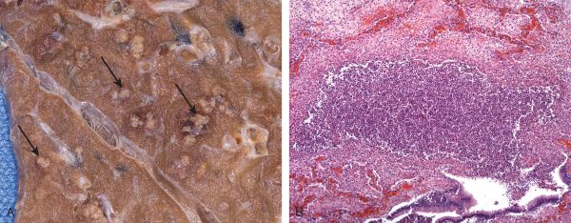
Suppurative (purulent) inflammation
Manifested by collection of large amounts of purulent exudate (pus)
More likely to be induced by pyrogenic (pus forming) organisms
Abscess →focal collections of pus
Suppurative inflammation in the lung

Slide 26
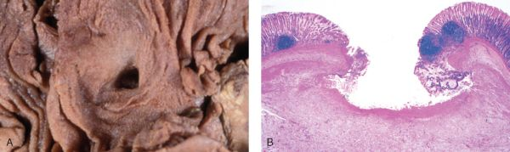
Ulcer
Local defect or excavation of an organ or tissue surface
Produced by necrosis of cells and shedding of inflamed necrotic tissue
Necrosis and resultant inflammation exist on or near a surface
Morphology of a duodenal ulcer

Slide 27
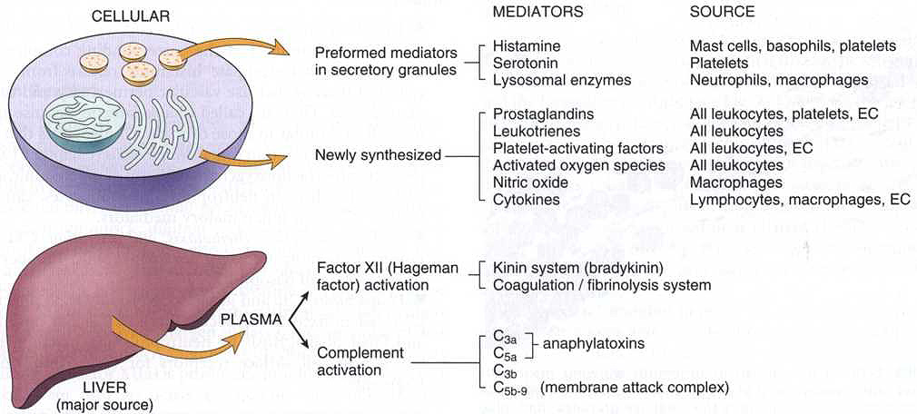
Chemical mediators of inflammation

Slide 28
Chemical Mediators of Inflammation
Mediator | Action
Histamine | Vasodilation, increased vascular permeability, endothelial activation
Serotonin | Vasoconstriction
Prostaglandins | Vasodilation, pain, fever
Leukotrienes | Increased vascular permeability, chemotaxis, leukocyte adhesion and activation

Slide 29
Mediator | Action
Platelet-activating factor | Vasodilation, increased vascular permeability, leukocyte adhesion, chemotaxis, degranulation, oxidative burst
Reactive oxygen species | Killing of microbes, tissue damage
Nitric oxide | Vascular smooth muscle relaxation; killing of microbes
Cytokines (TNF, IL-1, IL-6) | Local: endothelial activation (expression of adhesion molecules). Systemic: fever, metabolic abnormalities, hypotension (shock)
Chemokines | Chemotaxis, leukocyte activation

Slide 30
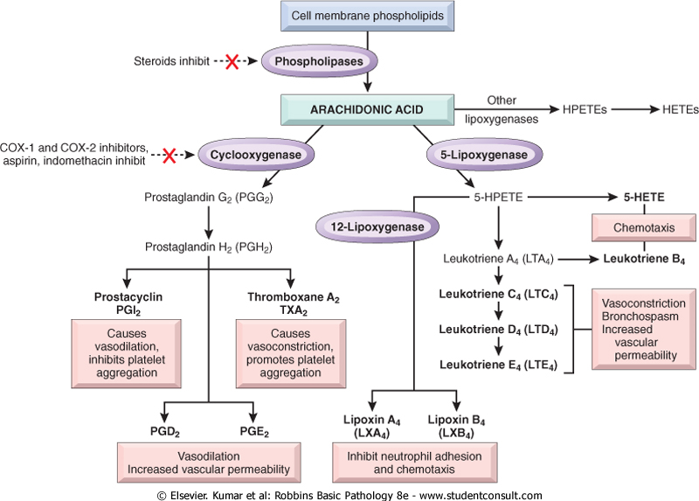
Production of arachidonic acid metabolites and their roles in inflammation

Slide 31
Mediator | Action
Plasma Protein Derived
Complement |  | Leukocyte chemotaxis and activation, direct target killing (MAC), vasodilation (mast cell stimulation)
Kinins |  | Increased vascular permeability, smooth muscle contraction, vasodilation, pain
Proteases activated during coagulation |  | Endothelial activation, leukocyte recruitment

Slide 32
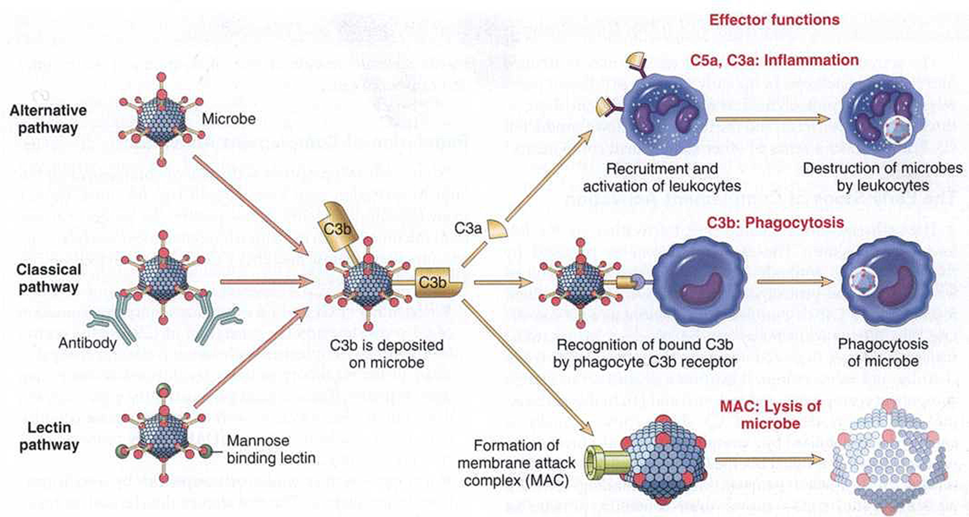
Activation and functions of complement Proteins

Slide 33
Chronic inflammation
Characterised by Infiltration with mononuclear cells, tissue destruction, and healing (repair with angiogenesis and fibrosis)
Occurs in the following settings
Persistant infections by microorganisms that are difficult to eradicate, such as mycobacteria, and certain viruses, fungi, and parasites
Immune-mediated inflammatory reaction (hypersensitivity diseases)
Prolonged exposure to potentially toxic reagents either exogenous or endogenous e.g silica

Slide 34
Chronic Inflammatory cells
Macrophages
Tissue cells derived from circulating blood monocytes after emigration from the blood stream
Scattered in most connective tissue and in organs such as liver (kupffer cells), spleen and lymph node (sinus histiocytes), CNS (microglial cells), Lungs (alveolar macrophages)
Together called mononuclear-phagocyte system

Slide 35
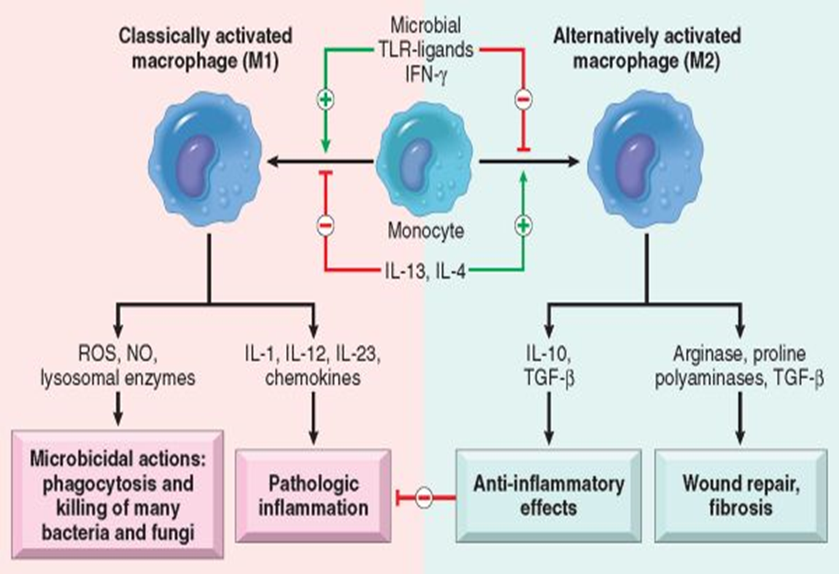
Macrophages cont…
Dominant cells of chronic inflammation
Migrate to the site of injury within 24-48 hours under the influence of chemokines and adhesion molecules
Transform into macrophages in extravascular tissue
Act as filters for microbes and as effector cells

Slide 36
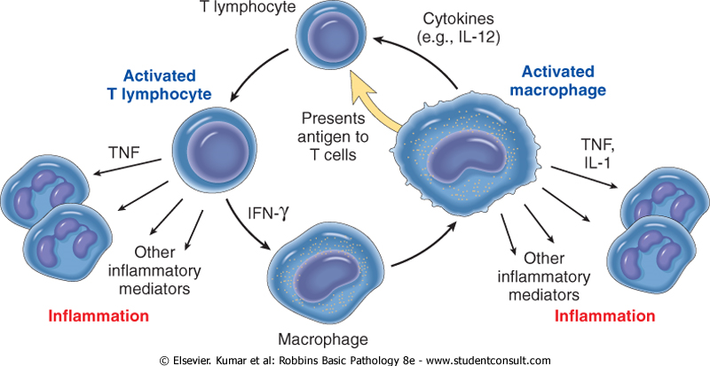
Lymphocytes
Mobilized in the setting of immune and non-immune mediated inflammation
Drive inflammation in autoimmune and other chronic inflammatory diseases
B lymphocytes →plasma cells in tissues→secrete antibodies
CD4+ T lymphocytes secrete cytokines
Macrophage-lymphocyte interaction in chronic
inflammation

Slide 37
Lymphocytes
CD4+ T lymphocytes promote inflammation and influence the nature of inflammatory reaction
T_{H}1 produce cytokine IFN-ꭚ-activates macrophages in the classical pathway
T_{H}2 secrete IL-4,IL-5 and IL13- recruit and activate eosinophils and also activation of alternative pathway macrophages
T_{H}17 secrete IL-17 and other cytokines that induce secretion o chemokines response for recruiting neutrophils and monocytes in an inflammatory response

Slide 38
Lymphocytes
Lymphocytes and macrophages interact in a bidirectional way propagating inflammation
Macrophages display antigens to T cells, produce cytokine,IL-12 that activate T cell responses
Activated T cells in turn produces cytokines which recruit and activate macrophages promoting more antigen presentation and cytokine secretion
These actions sustain chronic inflammation

Slide 39
Other cells
Eosinophils
Found in inflammatory sites around parasitic infections
Part of immune reactions mediated by IgE, associated with allergies
Eosinophil granules contain major basic protein, a highly charged cationic protein that is toxic to parasites but also causes epithelial cell necrosis.
Mast cells
Participate in acute and chronic inflammation
Armed with IgE antibodies specific for certain environmental antigens in atopic persons

Slide 40
Granulomatous inflammation
Distinctive pattern of chronic inflammation encountered in a limited number of infectious and some noninfectious conditions
A granuloma is a cellular attempt to contain an offending agent that is difficult to eradicate
Consists of a microscopic aggregation of macrophages that are transformed into epithelium-like cells, surrounded by a collar of mononuclear leukocytes, principally lymphocytes and occasionally plasma cells.
Notes:
In this attempt there is often strong activation of T lymphocytes leading to macrophage activation, which can cause injury to normal tissues

Slide 41
Granulomatous inflammation…
Epithelioid cells have a pale pink granular cytoplasm with indistinct cell boundaries, often appearing to merge into one another
Epithelioid cells fuse to form giant cells in the periphery or sometimes in the center of granulomas
May occur with persistent T-cell responses to certain microbes (mycobacterium tuberclosis, T. pallidum)
In tuberculosis, the granuloma is called a tubercle and has a central area of caseous necrosis
Notes:
Older granulomas develop an enclosing rim of fibroblasts and connective tissue

Slide 42
Systemic effects of inflammation
Collectively called acute-phase reaction or the systemic inflammatory response
Mediated by cytokine, TNF, IL-1, IL-6
IL-6 stimulates the hepatic synthesis of plasma proteins
Consists of several clinical and pathologic changes
Fever
Produced in response to substances called pyrogens that act by stimulating prostaglandin synthesis in the vascular and perivascular cells of the hypothalamus

Slide 43
Systemic effects of inflammation
Bacterial products, such as lipopolysaccharide (LPS) (called exogenous pyrogens), stimulate leukocytes to release cytokines such as IL-1 and TNF (called endogenous pyrogens)
This increases the levels of cyclooxygenases that convert AA into prostaglandins
In the hypothalamus the prostaglandins, especially PGE2, stimulate the production of neurotransmitters, which function to reset the temperature set point at a higher level
Notes:
NSAIDs, including aspirin, reduce fever by inhibiting cyclooxygenase and thus blocking prostaglandin synthesis

Slide 44
Systemic effects of inflammation
Elevated plasma levels of acute-phase proteins
mostly synthesized in the liver, and in the setting of acute inflammation, their concentrations may increase several hundred-fold
Three of the best known of these proteins are C-reactive protein (CRP), fibrinogen, and serum amyloid A (SAA) protein
Synthesis of these molecules by hepatocytes is stimulated by cytokines, especially IL-6

Slide 45
Systemic effects of inflammation
Leukocytosis
Common feature of inflammatory reactions, especially those induced by bacterial infection
The leukocyte count usually climbs to 15,000 to 20,000 cells/mL, but in some extraordinary cases it may reach 40,000 to 100,000 cells/mL.
These extreme elevations are referred to as leukemoid reactions because they are similar to those seen in leukemia

Slide 46
Systemic effects of inflammation
The leukocytosis occurs initially because of accelerated release of cells (under the influence of cytokines, including TNF and IL-1) from the bone marrow postmitotic reserve pool
Both mature and immature neutrophils may be seen in the blood
Bacterial infection- Neutrophilia
Viral infection- Lymphocytosis
Bronchial asthma, hay fever, and parasite infestations- Eosinophilia

Slide 47
Systemic effects of inflammation
Certain infections (typhoid fever, rickettsiae, and certain protozoa) are paradoxically associated with a decreased number of circulating white cells (leukopenia), likely because of cytokine-induced sequestration of lymphocytes in lymph nodes.
Increased heart rate and blood pressure, decreased sweating, chills, anorexia
In severe infections, septic shock → decreased blood pressure, disseminated intravascular coagulation, metabolic abnormalities such as hypotensive shock

Slide 48
End of Lecture

