Slide 1
Trypanosoma Cruzi
Dr J Mudenda

Slide 2
Causative agent for a vector borne disease called Chagas’s or South American trypanosomiasis.
It is a zoonotic disease

Slide 3
Epidemiology
Chagas disease is found mainly in endemic areas of 21 countries in South & central America.
An estimated 6 to 7 million people worldwide are infected with T. cruzi(WHO).
About 75 million are at risk of infection(WHO)

Slide 4
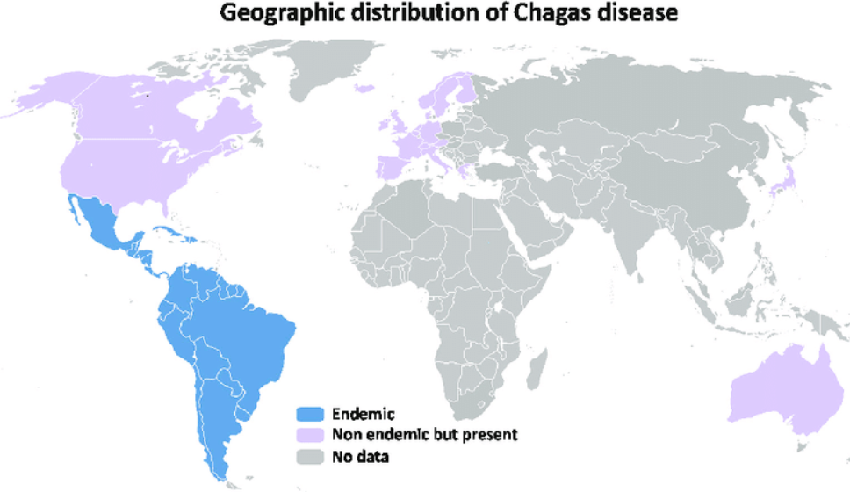
Global distribution showing the countries endemic for Chagas disease

Slide 5
The epidemiological pattern has however changed mainly due to population mobility, urbanization & emigration.
As a result, increased number of cases have been detected in Canada, USA, Europe & Western Pacific countries.

Slide 6
Morphology/Habitat
Two forms are found in humans.
Amastigote
Trypomastigote.
These parasite forms are found in different tissues-peripheral blood ,muscle tissue, nervous tissue & RES.
Amastigotes are intracellular parasites while trypomastigotes are found in the peripheral blood.

Slide 7
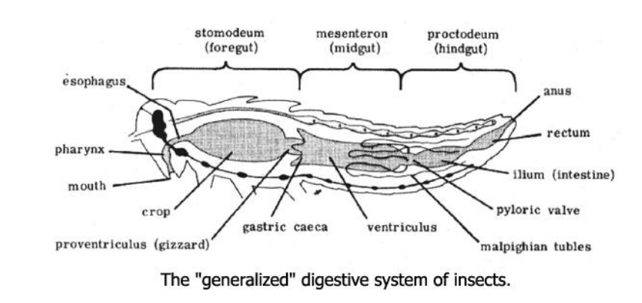
In the insect vector-reduviid bugs, amastigotes are found in midgut & metacyclic trypomastigotes are found in hindgut & feces.

Slide 8
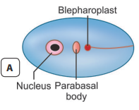
Amastigote
Amastigotes are oval(2–4 μm in diameter)with a nucleus, kinetoplast & absent flagellum.
It is the multiplication stage of the parasite.
Found in muscles, nerve cells & reticulo-endothelial system.

Slide 9
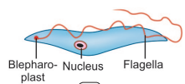
Trypomastigote
Do not ­multiply & found in the peripheral blood of man/mammalian hosts.
May appear as long slender flagellates (20 μm long) or short stumpy form (15 μm long) in blood.
They assume different shapes in stained smears- e.g. letters U,S or C.
This is the form taken up by the insect vector.

Slide 10
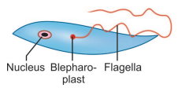
Epimastigote
Are found in the insect vector- the reduviid bug and also in culture.
Epimastigotes divide by binary fission in hindgut of the vector
It has a kinetoplast adjacent to the nucleus & an undulating membrane situated along its anterior half.

Slide 11
Life Cycle
T. cruzi passes its life cycle in 2 hosts.
Definitive host: Man
Intermediate host (vector): Reduviid bug or triatomine bug.
Reservoir host: Armadillo & domestic animals- cat, dog & pigs.
Infective form: The infective forms are metacyclic trypomastigotes found in feces of reduviid bugs.

Slide 12
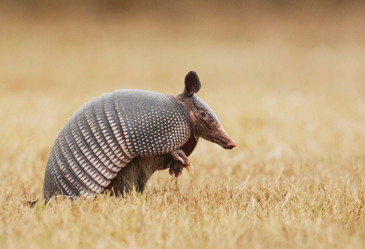


Different reservoir hosts for T.Cruzi

Slide 13
The parasite occurs in 3 different but overlapping infection cycles.
Sylvatic zoonosis in wild animals e.g. armadillos, peri-domestic cycle in domestic animals e.g. cat/dogs & a domestic cycle in humans.
Different vector species are active in these infection cycles.
The reduviid bugs-Triatoma infestans, Rhodnius prolixus & Panstrongylus megistus are important vectors in human infection.
These are adapted to living in human habitations-cracked walls & roofs.
These are night-biting bugs which typically defecate while feeding.
The feces of infected bugs contain the metacyclic trypomastigote.

Slide 14
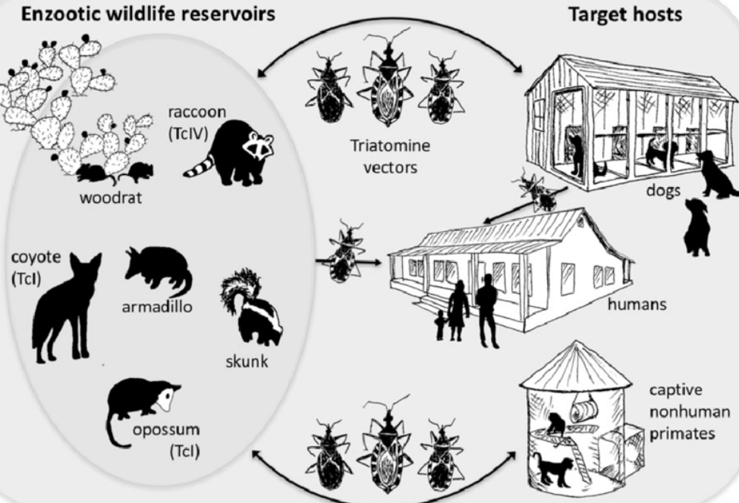
Sylvatic zoonosis, peri-domestic & a domestic cycle in humans.

Slide 15
Mode of transmission
Infection in man & other reservoir hosts occur when mucus membranes or a sore on skin is contaminated by feces of the bug with metacyclic trypomastigotes.
Other modes of transmission are:-blood transfusion
-organ transplantation
-vertical transmission
-rarely ingestion of contaminated food or drink.

Slide 16
Development in Man
The metacyclic trypomastigotes introduced by bite of bug invade the RES & spread to other tissues.
After passing through promastigote & epimastigote forms, they again become trypomastigotes which are the infective stage for reduviid bug.
No multiplication occurs in this stage except intracellularly in the amastigote form.

Slide 17
Development in Reduviid Bugs
Acquire infection by feeding on an infected host.
Most triatomine bugs are nocturnal i.e. active at night.
The ingested trypomastigotes transform into epimastigotes in the midgut then migrate to the hindgut and multiply.
These, in turn become metacyclic trypomastigotes (infective form) which are excreted in feces (stercorarian transmission).
Incubation period in the vector takes 8–10 days(extrinsic incubation period).

Slide 18
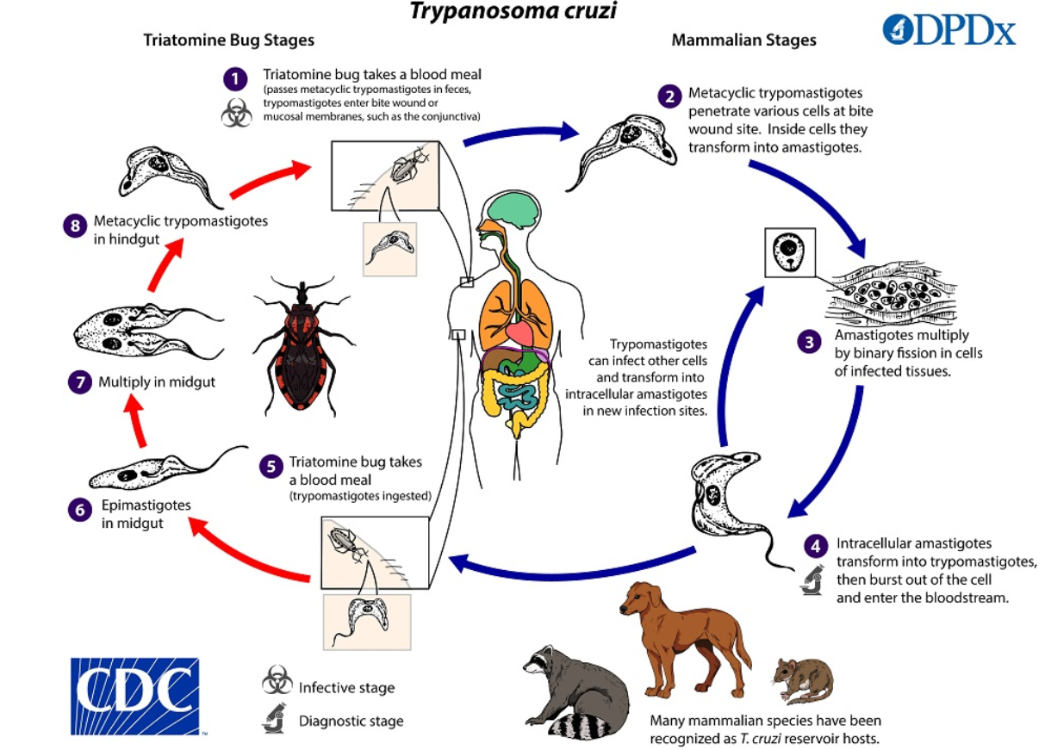
Life cycle

Slide 19
Pathogenesis & Clinical Features
The disease manifests in an acute and chronic form.
Average incubation period in man is 1–2 weeks.
Acute Chagas’ Disease
Often occur in children under 2 years of age & occurs soon after infection.
May last 1–4 months with the first sign appearing within a week post infection.
Chagoma is the typical subcutaneous lesion occurring at the site of infection.

Slide 20
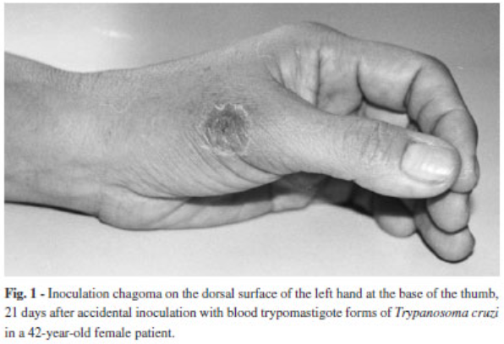
Chagoma at infection site

Slide 21
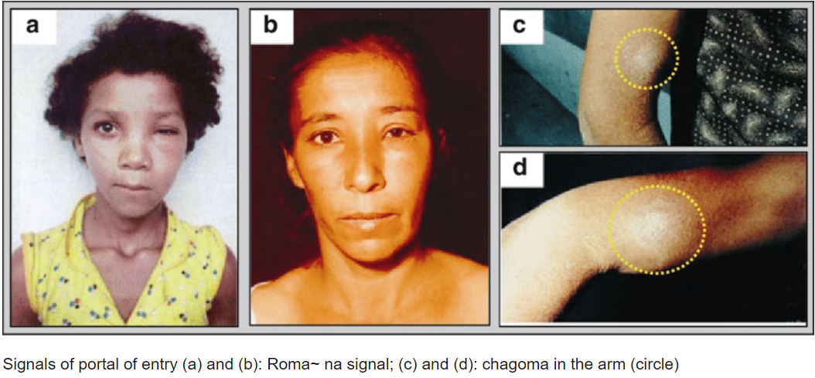
Inoculation of the parasite in conjunctiva causes unilateral, painless edema of periocular tissues in the eye called as Romana’s sign.
This is the classical finding of the acute Chagas' disease.

Slide 22
In some cases, patients may have generalized infection with fever, lymphadenopathy & hepatosplenomegaly.
The patient may die of acute myocarditis and meningoencephalitis.
Acute signs and symptoms usually resolve spontaneously within 4–8 weeks.
Thereafter patients ,enter the asymptomatic or indeterminate phase of chronic T. cruzi infection.

Slide 23
Chronic Chagas’ Disease
Usually seen years or even decades after the initial infection.
The chronic form is found in adults and older children.
In chronic phase, T. cruzi produces an inflammatory response, cell destruction, fibrosis of muscles and nerves that control muscle tone of hollow organs like heart, esophagus, colon etc.
Thus, it can lead to cardiac myopathy and mega-esophagus & megacolon (dilation of esophagus and colon).

Slide 24
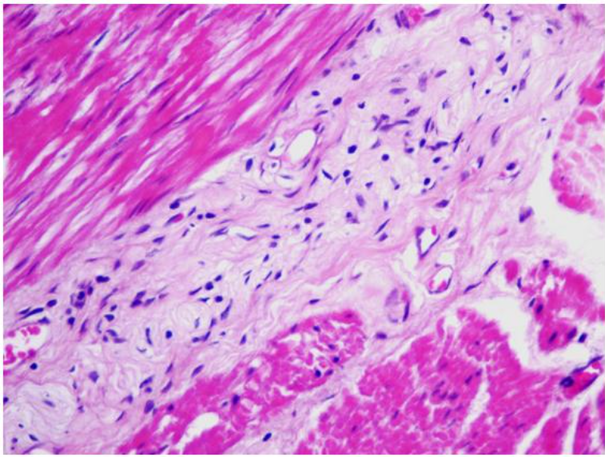
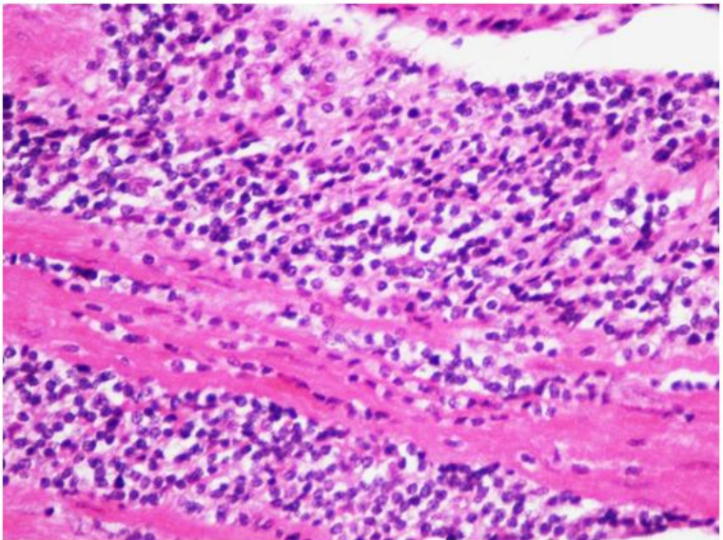
Inflammatory response in chronic phase
Agaglionosis & fibrosis in myenteric plexus in case of megaesophagus
Severe chronic myositis in a case of megaesophagus

Slide 25
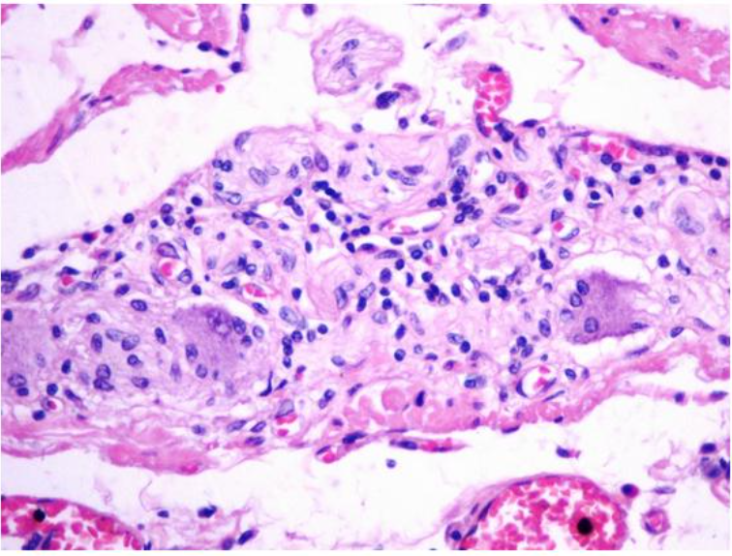
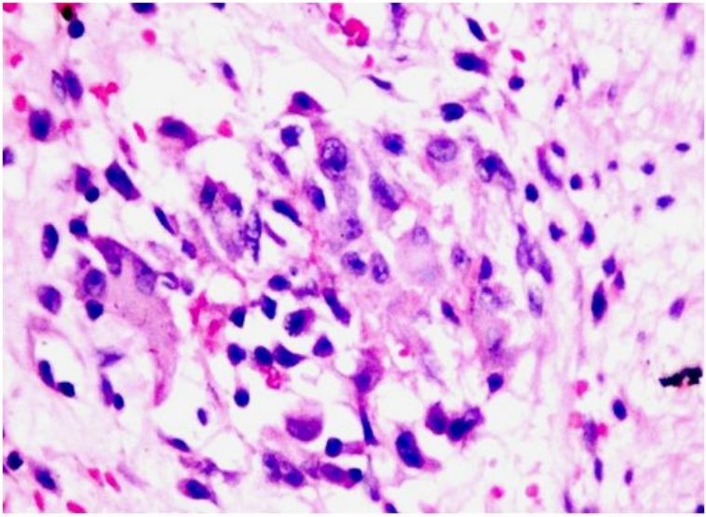
Inflammatory response in chronic phase
Mild chronic ganglionitis in esophagus without megaesophagus-arrow at ganglion cell
Myositis with granuloma in a case of megacolon-see giant cell & histiocyte

Slide 26
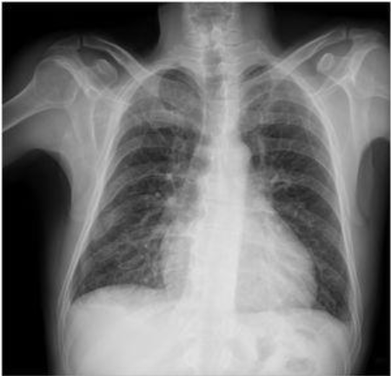
Chest X-ray showing increased cardiac area of a patient with Chagas cardiomyopathy

Slide 27
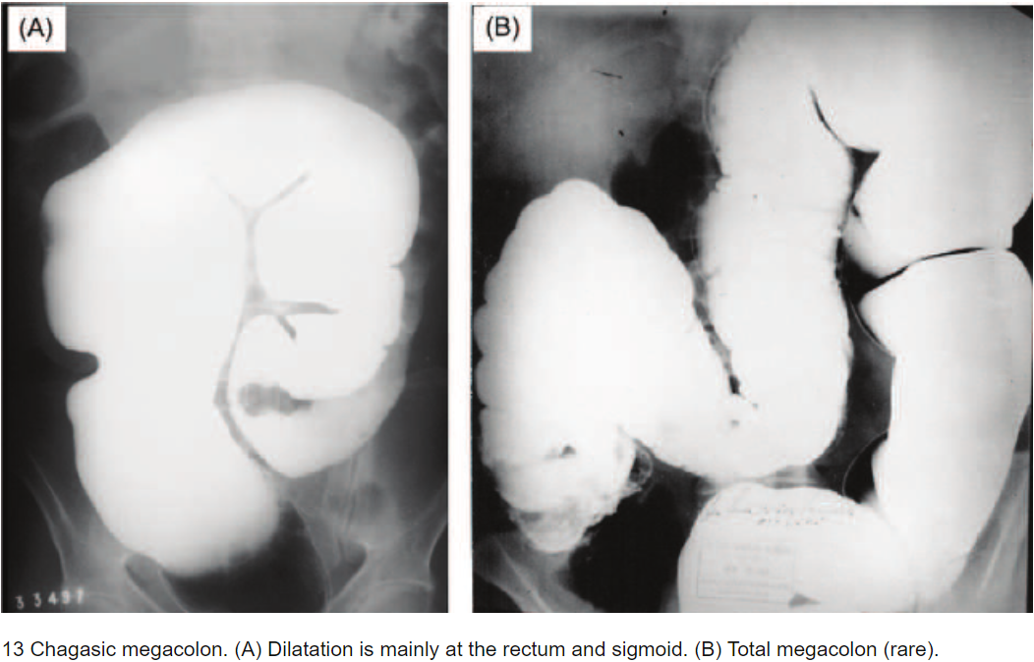

Slide 28
Congenital Infection
Congenital transmission is possible in both acute & chronic phase of the disease causing myocardial and neurological damage in the fetus.

Slide 29
Laboratory Diagnosis
Diagnosis is done by demonstration of T. cruzi in blood or tissues or by serology.
Microscopy
The diagnosis of acute Chagas’ disease requires detection of parasites.
Microscopy of fresh anticoagulated blood or the buffy coat is the simplest way to see motile organisms.
In wet mount, trypomastigotes are faintly visible but their snake-like motion against RBC’s makes their presence apparent.
Trypomastigotes can also be seen in thick and thin peripheral blood smear, stained with Giemsa stain.

Slide 30
Culture
Novy, Neal, and Nicolle (NNN) medium or its modifications are used for growing T. cruzi.
Epimastigotes and trypomastigotes are found in the culture.
Culture is more sensitive than smear microscopy

Slide 31
Animal Inoculation
Done in Guinea pig or mice where blood, CSF or lymph node aspirate are inoculated.
Trypomastigotes are looked for in the blood smears in a few days after successful inoculation.

Slide 32
Histopathology
Biopsy examination of lymph nodes and skeletal muscles and aspirate from Chagoma may reveal amastigotes of T. cruzi.
Serology
Antigens can be detected in urine and sera in patients with chronic Chagas’ disease.
ELISA has been developed for detection of antigens.
Antibody detection done by the following the following tests – IHA ,CFT ,ELISA,IIF,Direct agglutination test (DAT).
Antibody tests are recommended for field use.
Cross reaction occur in syphilis & leishmaniasis hence false positives. Major drawback for antibody based tests.

Slide 33
Intradermal Test
The antigen ‘cruzin’ is prepared from T. cruzi culture is used for the test.
A delayed hypersensitivity reaction is seen.
Molecular Diagnosis
PCR can be done but not commercially available.

Slide 34
Other Tests
Electrocardiography (ECG) and chest X­-ray are useful for diagnosis and prognosis of cardiomyopathy seen in chronic Chagas’ disease.
The combination of right bundle branch block (RBBB) and left anterior fascicular block is a typical feature of Chagas’ heart disease.
Endoscopy helps in visualization of megaesophagus in Chagas’ disease.

Slide 35
Treatment
No effective specific treatment is available for treating Chagas' disease.
Nifutrimox and benznidazole have been used with some success in both acute and chronic Chagas disease.
These drugs kill only the extracellular forms but not the intracellular forms.
Dose: Nifutrimox: 8–10 mg/kg for adults and 15 mg/kg for children.
The drug should be given orally in 4 divided doses each day for 90–120 days.
Benznidazole: 5–10 mg/day orally for 60 days.

Slide 36
Anti-failure medication is used for cases of cardiac myopathy.
Surgical intervention is indicated where required.

Slide 37
Prevention
Use of insecticide to control the vector bug.
Personal protection using insect repellant and mosquito net.
Improvement in rural housing & environment to eliminate breeding places of bugs.

Slide 38
End!!!
Thank you

