Slide 1
Introduction to medical parasitology
Dr J.Mudenda

Slide 2


Slide 3
Learning Outcomes
At the end of our discussions, you should be able to do the following:
Define the terminology & appreciate the importance of parasitology.
Classify parasites of medical importance.
For each parasite describe the following:
Geographical distribution and life cycle,
Mode of transmission and means of diagnosis
Prevention, control and treatment

Slide 4
What is parasitology?
It is the study of parasites and their pathogenic effects.
Or branch of science that deals with parasites that cause human infections and the diseases that they cause.
It involves the study of parasites, their hosts and the relationship between them.
Humans and other living organisms live in close relationship with each other.

Slide 5
Why is parasitology important
It inflicts significant morbidity and mortality to a huge population.
247 million cases of malaria recorded in 2021 (world malaria report 2021)
619,000 malaria deaths recorded during the same period.
Neglected tropical diseases (NTDs) are a group of parasitic/bacterial infectious diseases affecting more than 1.7 billion people.
Over 40% of the global NTD burden is concentrated in Africa.
Amongst children, infection leads to malnutrition, cognitive impairment, stunted growth & the inability to attend school.

Slide 6
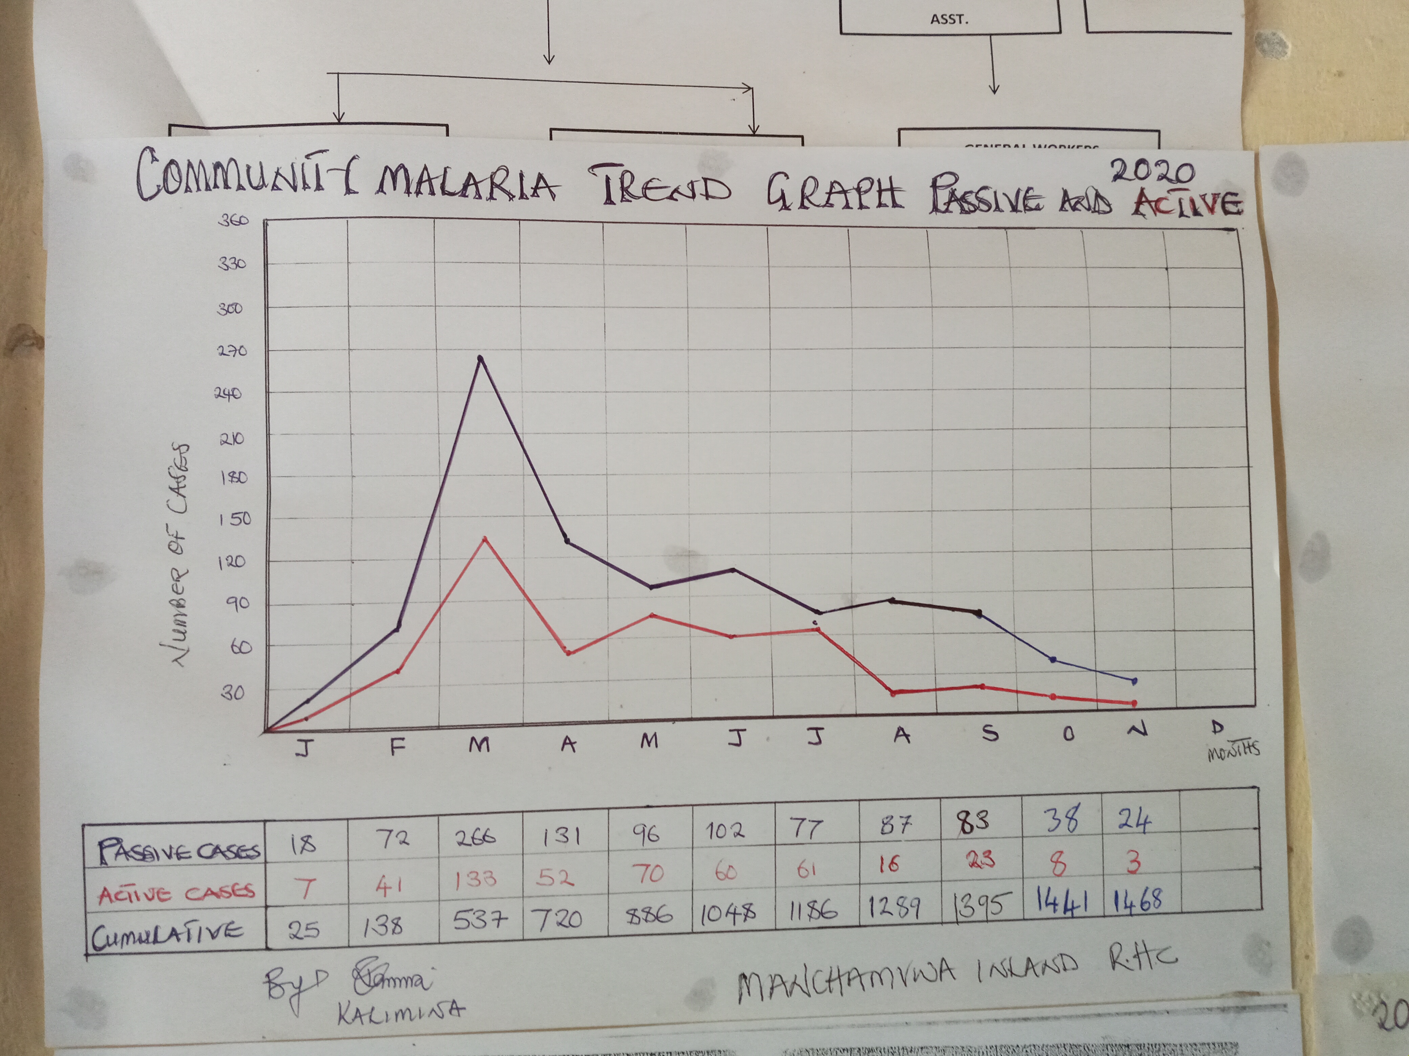
Malaria cases at a facility in Siavonga District

Slide 7
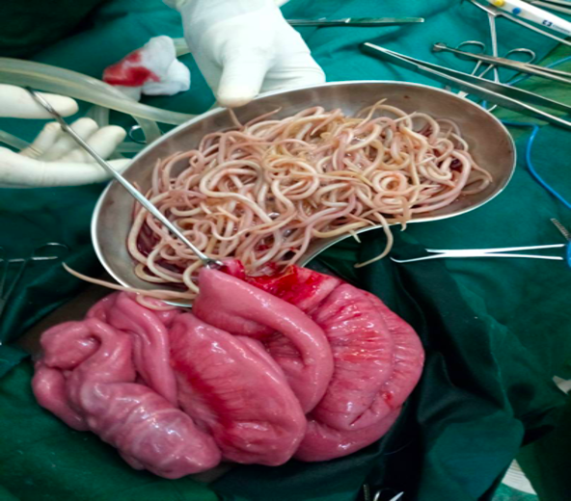
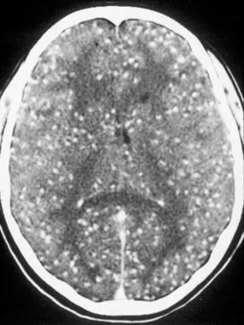
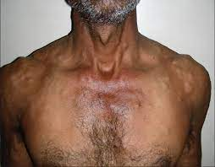
Parasite induced morbidity-IO due to Ascariasis/neurocystercosis

Slide 8
It is broadly classified into three main categories.
Protozoology(protozoa)
Helminthology(helminths)
Entomology(arthropods)

Slide 9
Medical Parasitology includes the study of 3 major groups of parasites:
Protozoa
Arthropods
Helminths
Hi I am a protozoa called One-celled organisms
I like to present my self as insects and my allies
Simply called Worms
e.g. Glossina morsitans
e.g. Giardia lamblia
e.g. Ascaris lumbricoides

Slide 10
Definition/Types of parasites
Parasite- is a living organism which depend on another organism(host) for food and shelter.
The term parasite usually applies to Protozoa(unicellular organisms) and Helminths (multicellular organisms e.g. worms) .
Parasite
Ecto-parasite
Endoparasite
Free-living parasite
Found on host surface
Found inside the host
Certain stages are non parasitic

Slide 11
Ectoparasite: found on the body surface of the host without penetrating the tissue e.g. Lice, ticks & mites.
Endoparasite: lives inside the body of the host, most disease causing protozoan and helminthic parasites are endoparasites.
Free-living parasite: refers to nonparasitic stages which live independent of the host e.g. the cystic stage of Naegleria fowleri.

Slide 12
Definition/types of host
Host -is an organism harboring the parasite and provides nutrition and shelter.
A host is usually larger than the parasite and are divided into the following:-
Definitive host: An organism in which the adult forms of the parasite lives and undergoes sexual reproduction e.g. mosquito acts as definitive host in malaria.
Man is the definitive host in majority of human parasitic infections, (e.g. filaria, roundworm, hookworm).

Slide 13
Intermediate host: is an organism in which the parasite lives during a period of development(larval stage) or where asexual multiplication takes place .
In some cases 2 diﬀerent intermediate hosts (1st & 2nd intermediate hosts) may be required to complete diﬀerent larval stages.
Reservoir host: harbors the parasite and acts as an important source of infection to other susceptible hosts e.g. dog is the reservoir host of hydatid disease.

Slide 14
Paratenic host: an intermediate host whose presence is needed to complete the parasite’s life cycle but in which no development of the parasite occurs.
Accidental host: an organism that’s under normal circumstances not infected with the parasite.

Slide 15
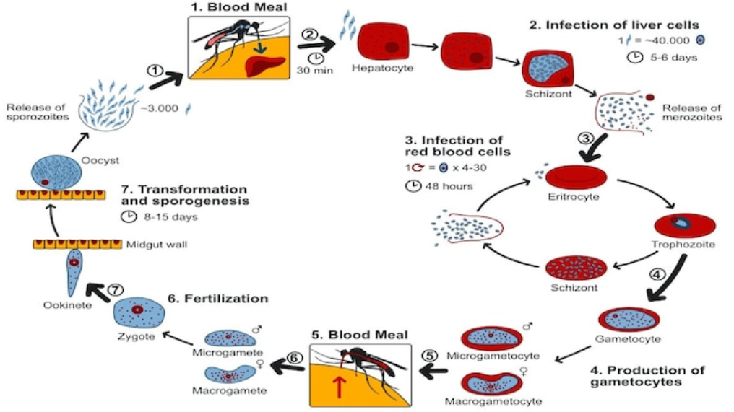
Life cycle of malaria with the mosquito as the definitive host & humans as intermediate host

Slide 16
Other terminologies
Zoonosis is a disease which is naturally transmitted between vertebrate animals and humans.
Or a parasitic disease which an animal is normally the host but also affects man.
Vector: is an organism usually an arthropod that transmits an infection from man to man or from other animals to man, e.g. female Anopheles is the vector of malarial parasite.
There are two types of vectors: mechanical and biological vectors.

Slide 17
Biological vectors(or true vectors): are vectors that not only assists in the transfer of parasites but also allows devt/or multiplication in their body.
Examples include:- Mosquito—Malaria, filariasis
Sandﬂies—Kala­-azar
Tsetse ﬂies—Sleeping sickness
Reduviid bugs—Chagas’ disease
Ticks—Babesiosis
Mechanical vectors: Only assists in the transfer of parasitic form between hosts but is not essential in the life cycle of the parasite.
Example of Mechanical vectors is a houseﬂy—amoebiasis

Slide 18
Habitat
A habitat is an organ where the parasite lives & multiplies in the body of the host e.g:-
Small intestine
Large intestine
Blood vessels
Organs; liver, lung, heart, brain
Muscles
Lymphatics
Reticulo-endothelial system
Red blood cells

Slide 19
Human-parasite relationship
Humans and other living organisms live in a close relation with each other.
This intimate interaction or living together of organisms from different species is called Symbiosis
Three common symbiotic relationships are:
Commensalism: an association in which only the parasite benefits without causing harm to its host e.g normal flora.

Slide 20
Parasitism: an association where the parasite derives benefit and the host gets nothing in return and always suffers some injury e.g worms like ascaris lumbroicoides reside in the GIT of man and feed causing an illness.
Mutualism: both organisms are metabolically dependent upon each other and one cannot live without the help of the other but none of them suffers any harm from the association e.g.certain species of flagellated protozoa living in the gut of termites.

Slide 21
Epidemiology
Environmental factors, social customs and habits of people greatly influence the distribution of parasites.
Although parasitic infections occur globally , majority occur in tropical regions where there is: -poverty
-poor sanitation and personal hygiene.
-Low education standards
-Inadequate nutrition

Slide 22
Why rich nations suffer less from parasites
High standards of education - better housing, higher standard of living.
General good health - poor health = more susceptible to disease.
Nutrition - adequate diet.
Sanitation - sewers and septic systems keeps raw sewage out of streams.
Temperate climate - parasites do better in the warmth of the tropics.
Absence of certain vectors - intermediate hosts such as the tsetse fly, certain snails, etc.

Slide 23
Life cycle of parasites
Direct life cycle: parasite only requires a single host to complete its development e.g. Entamoeba histolytica requires only a human host to complete its life cycle.
Indirect life cycle: In this case the parasite requires 2 or more host species to complete its development e.g. malarial parasite needs both human host and mosquito to complete its life cycle .

Slide 24
What are the sources of Infection
Contaminated soil and water
Soil polluted with embryonated eggs (roundworm, whipworm) may be ingested or infective larvae in soil may penetrate exposed skin (hookworm, S.stercolaris) .
Food(Gain entrance to the GIT):
Ingestion of contaminated food or vegetables containing infective stage of parasite (amoebic cysts, Toxoplasma oocysts, Echinococcus eggs) .
Ingestion of raw or under­cooked meat harboring infective larvae e.g. pork containing cysticercus cellulosae, the larval stage of Taenia solium, cysticercus bovis-T.saginata larval stage and T.spiralis).

Slide 25
Insect vectors:
Arthropods that transmits an infection from man to man or from other animals to man, e.g. anopheline for malarial parasite, Tsetse flies for Trypanosoma, sand flies for Leishmanina,Culicine mosquitoes for Wuchereria banchroft.
Animals
Include both domestic(Cow, e.g. T. saginata : Pig e.g. T. solium, Trichinella spiralis : Dog, e.g. Echinococcus granulosus ) and wild animals(Wild game animals, e.g. trypanosomiasis: Fish, e.g. fish tapeworm )
.

Slide 26
Self (autoinfection) .
Finger­ to ­mouth transmission, e.g. pinworm
Internal re-infection, e.g. Strongyloides Stercolaris.
This results from poor personal hygiene hence the emphasis for hand washing.

Slide 27
Modes of transmission
Oral transmission:
Most common mode occurring through contaminated food, water, soiled fingers, or fomites.
The infective stages being cysts, embryonated eggs, or larval forms ,many intestinal parasites enter the body in this manner.
Skin transmission:
Is another important mode of transmission.
Hookworm infection is acquired, when the larvae enter the skin of persons walking barefooted on contaminated soil.
Schistosomiasis is acquired when the cercarial larvae in water penetrate the skin.

Slide 28
Vector transmission:
Many parasites are transmitted by insect bite, e.g., malaria by Anopheles mosquito, filariasis by Culex mosquito.
Direct transmission:
Parasitic infection may be transmitted by person­ to­ person contact in some cases, e.g. kissing in the case of gingival amoebae and by sexual intercourse in trichomoniasis.
Vertical transmission:
Maternal-fetal transmission occur in malaria and toxoplasmosis .
Iatrogenic transmission:
Seen in case of blood transfusion in malaria and toxoplasmosis after organ transplantation.

Slide 29
Important pathogenic effects
Parasitic infections may be dormant or give rise to clinical disease with a few organisms such as E. histolytica living without invading the tissue (commensals).
Clinical infection produced may be acute, subacute, chronic, latent or recurrent.
Pathological changes or disease mechanisms occur in the following ways:

Slide 30
Physical obstruction: Masses of A.lumbricoides (roundworm) cause intestinal obstruction. P.falciparum malaria may produce blockage of brain capillaries in cerebral malaria
Inﬂammatory reaction: Inﬂammatory changes and consequent fibrosis e.g. lymphadenitis in filariasis and urinary bladder granuloma in Schistosoma haematobium infection cause clinical illness.
Lytic necrosis: Enzymes produced by some parasite can cause lytic necrosis e.g. E. histolytica lyses intestinal cells producing amoebic ulcers.

Slide 31
Neoplasia: Some parasites are now classified as carcinogens or lead to malignancy. The liver ﬂuke, Clonorchis cause bile duct carcinoma and S. haematobium may cause urinary bladder cancer .
Trauma: Attachment of hookworms on jejunal mucosa leads to traumatic damage of villi and bleeding at the site of attachment-cause of anemia.
Allergic manifestations: Clinical illness may be caused by host immune response to parasitic infection, e.g. eosinophilic pneumonia in Ascaris infection and anaphylactic shock in rupture of hydatid cyst

Slide 32
Laboratory diagnosis
Whilst clinical symptoms or a case history may provide clues as to which parasite may be present, laboratory diagnosis remains key in finding the definitive diagnosis.
Laboratory methods are divided into Direct and Indirect methods
Direct methods involves visualization of the parasite in a particular specimen e.g. malaria parasites in RBCs , hookworm ova in stool etc.
Indirect methods detect cytological changes, immune response or parasite products(antigens) without necessarily visualizing the parasite e.g. eosinophilia in worm infections or biochemical changes.

Slide 33
Laboratory methods include the following
Microscopy for blood film , stool, urine , sputum and biopsy examination.
Culture e.g vaginal discharge or urine for diagnosis of T.vaginalis
Serological test .eg in toxoplasmosis,schistosomiasis etc
Skin test(Immunological skin reactions) e.g in protozoa infections such as Chagas disease,toxoplasmosis and helminth infections e.g schistosomiasis(fairley’s),hydatid disease(Casoni’s).
Molecular methods

Slide 34
Xenodiagnosis
Imaging(CT imaging in neurocystercosis)
Hematology(eosinophilia in helminth infections)

Slide 35
Prevention and control
Reduction of potential sources of infection
Community education
Destruction and/or control of reservoir hosts and vector

Slide 36
Treatment of parasitic infections
Medical and surgical
Chemotherapy
Adequate nutrition

Slide 37
Websites of Interest
There are thousands of reading resources on internet providing information and images on parasites, not all of them are as trustworthy.
Two excellent sites to look for general information and visual illustrations:
CDC (Division of Parasitic Diseases)
WHO (Tropical Diseases Research Program)
Notes:
Trustworthy = جدير بالثقة

