Slide 1
Leishmania
Dr J Mudenda

Slide 2
Epidemiology
Is a protozoan parasite transmitted by the bite of an infected female sandfly.
Causes a disease called Leishmaniasis.
The disease affects some of the world’s poorest people and is associated with malnutrition, poor housing, overcrowding and a weak immune system.
An estimated 700 000 to 1 million new cases occur annually(WHO).

Slide 3
Geographically distributed across the tropics and subtropics extending through Central and South America, part of North America, central and South­east Asia, Mediterranean region & Africa.

Slide 4
General Characteristics
Members of this genus are obligate intracellular parasites.
In humans, they multiply within macrophages in which they occur exclusively in the amastigote form.
In the Insect vector(sandfly), the parasite occur in the promastigote form. They pass their life cycle in 2 hosts:
The mammalian host
And the insect vector- female sandfly

Slide 5
Three different diseases are caused by various species of genus Leishmania.
These are:
Visceral leishmaniasis: Caused by species L. donovani complex infecting internal organs of humans (liver, spleen & bone marrow).
Cutaneous leishmaniasis: Caused by species L. tropica complex, L. aethiopica, L. major and L. mexicana complex.
Mucocutaneous leishmaniasis : It is caused by L. braziliensis complex .

Slide 6
Leishmania Donovani(Old World Leishmaniasis)
Causes visceral leishmaniasis or Kala-azar.
Also causes the condition called Post Kala-azar Dermal Leishmaniasis (PKDL).
VL is a major public health problem in many parts of world with 90% cases found in India, Sudan & Brazil.
The disease can occur in endemic, epidemic or sporadic forms.

Slide 7
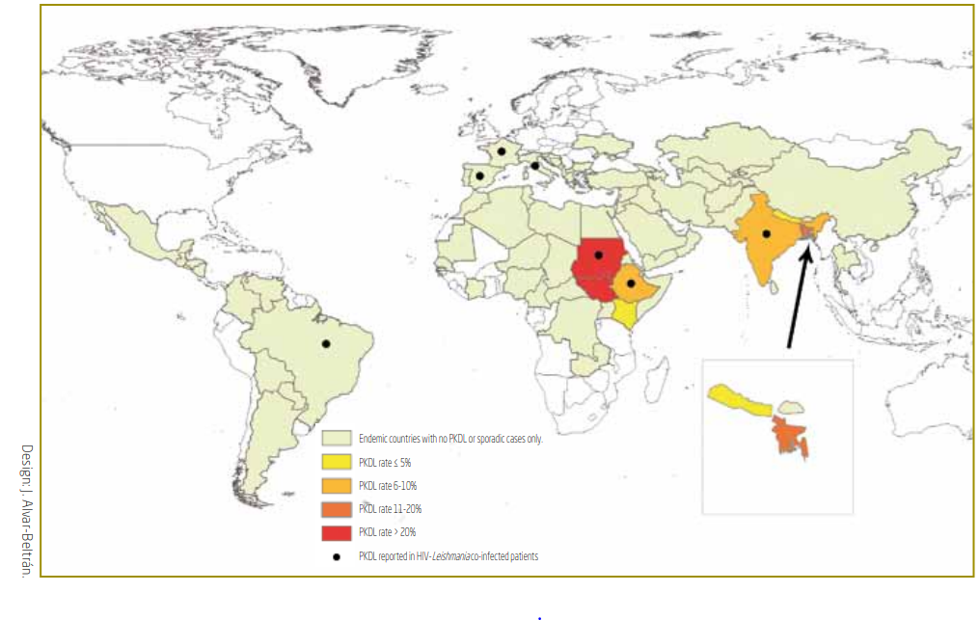
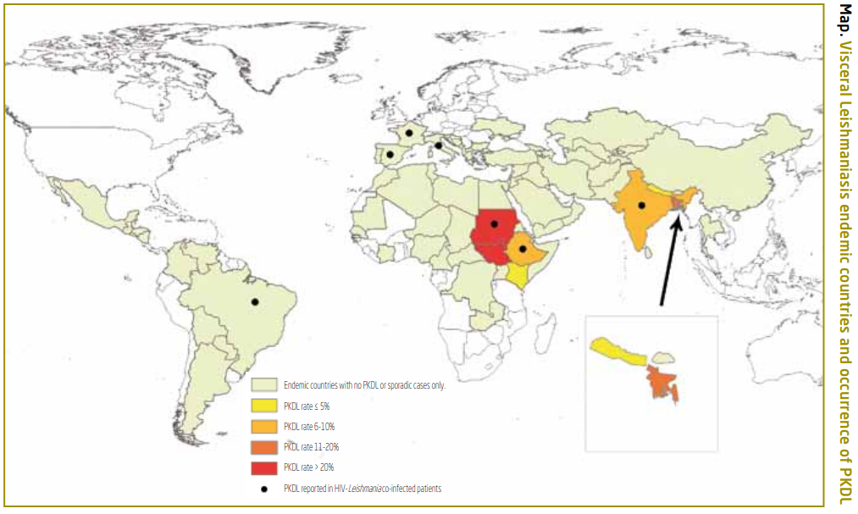
Visceral Leishmaniasis endemic countries & occurrence of PKDL

Slide 8
Habitat
The amastigote (LD body) of L. donovani is found in the reticuloendothelial system.
Found mostly within the macrophages in the spleen, liver, bone marrow and less often in other locations such as skin, intestinal mucosa and mesenteric lymph nodes

Slide 9
Morphology
The parasite exists in 2 forms.
Amastigote form: in humans and other mammals.
Promastigote form: in the sandfly and in artificial culture.
Amastigote( Also known as LD bodies)
The amastigote form (LD body) is an ovoid with absent flagela, typically intracellular being found inside macrophages, monocytes, neutrophils or endothelial cells.
Smears stained with Leishman, Giemsa, or Wright’s stain show a pale blue cytoplasm enclosed by a limiting membrane. The nucleus stains red & lying next to the red or purple ­stained kinetoplast.

Slide 10
Promastigote
It is a flagella stage present in insect vector, sandfly and in cultures.
The promastigotes are initially short, oval or pear ­shaped but subsequently become long spindle shaped cells, 15–25 µm in length and 1.5–3.5 µm in breadth.

Slide 11
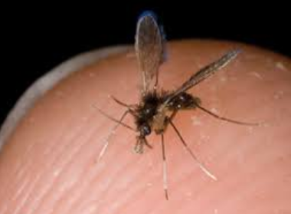
Life Cycle
L. donovani completes its life cycle in 2 hosts.
Definitive host: Man, dog and other mammals.
Vector: Female sandfly (Phlebotomus species).
Infective form: Promastigote form present in midgut of female sandfly.
phlebotomine sandfly

Slide 12
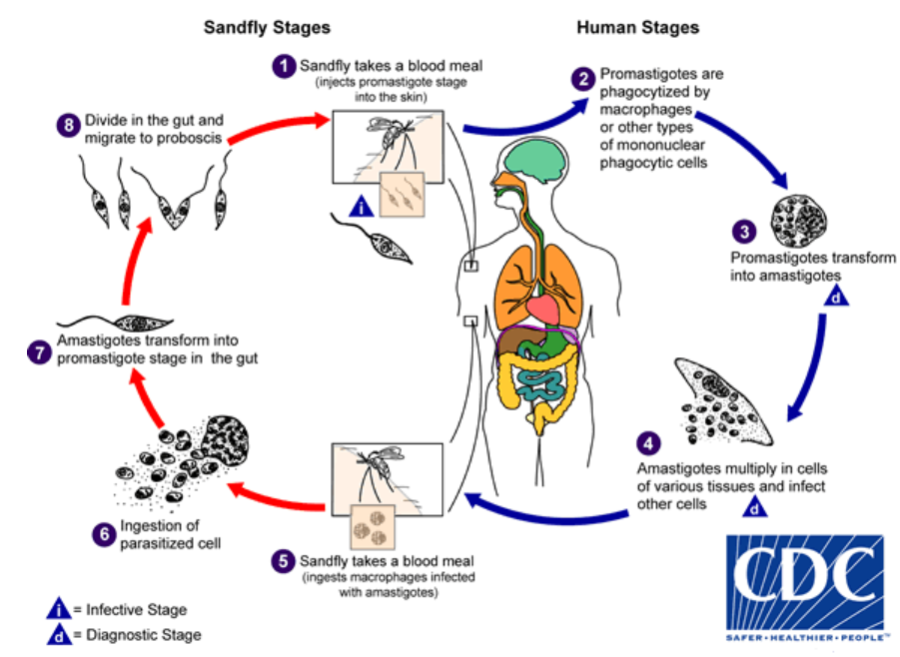

Slide 13
Mode of transmission
Humans acquire the infection when an infected female sandfly bites.
Other modes of transmission are mother to fetus (vertical),blood transfusion & accidental inoculation.
Incubation period
Usually 2–6 months but may be as short as 10 days or as long as 2 years.
The sandfly regurgitates the promastigotes in the wound caused by its proboscis.
These are engulfed by the cells of reticuloendothelial system (macrophages, monocytes, and polymorphs) and change into amastigote (LD body) within the cells .

Slide 14
The amastigote multiplies by binary fission, producing numerous daughter cells that distend the macrophage and rupture it.
The released daughter cells are in turn phagocytosed by other macrophages and histiocytes.
A small number of LD bodies are found in peripheral blood inside neutrophils or monocytes.
When a vector sandfly feeds on an infected person, the amastigotes present in peripheral blood and tissue fluids are taken up .

Slide 15
In the sandfly midgut (stomach), the amastigote elongates and develops into the promastigote form.
The promastigote multiples and migrate from the midgut to mouth parts where they accumulate and block the passage.
Such blocked sandflies regurgitate plugs of adherent parasites from the pharynx and deposit them in the punctured wound.

Slide 16
Pathogenesis
L. donovani causes visceral leishmaniasis or kala-azar.
It is a reticuloendotheliosis(proliferation of phagocytic cells) resulting from the invasion of reticuloendothelial system by L. donovani.
The parasitized macrophages disseminate the infection to all parts of the body.
In the spleen, liver, and bone marrow particularly, the amastigotes multiply enormously in the fixed macrophages to produce a ‘blockade’ of the reticuloendothelial system.
This leads to a marked proliferation and destruction of reticuloendothelial tissue in these organs.

Slide 17
The spleen and the liver gets enlarged however the spleen is the most affected organ.
In the liver , Kupffer cells and vascular endothelial cells are heavily parasitized, but hepatocytes are not affected.
Liver function is, therefore, not seriously affected, although prothrombin production is commonly decreased.
Some degree of fatty degeneration is seen and cut surface may show a ‘nutmeg’ appearance.

Slide 18
The bone marrow is heavily infiltrated with infected macrophages which may crowd the hematopoietic tissues.
Severe anemia with hemoglobin levels of 5–10 g/dL may occur in Kala-azar due to infiltration of the bone marrow & increased destruction of rbcs due to hypersplenism.
Auto-antibodies to red cells may contribute to hemolysis.
Peripheral lymph nodes and lymphoid tissues of the nasopharynx and intestine are hypertrophic.

Slide 19
Leucopenia with marked neutropenia and thrombocytopenia are frequently seen.
Antibodies against WBCs and platelets suggest an autoimmune basis for the pancytopenia observed in Kala-azar.

Slide 20
Clinical Features of Kala-Azar
Fever -continuous, intermittent or irregular.
Massive splenomegaly.
Hepatomegaly and lymphadenopathy also occur but are not so prominent.
Dry, rough and darkly pigmented skin (Kala-azar).
Thin and brittle hair.
Cachexia with marked anemia.
Epistaxis and bleeding from gums are common.
Most untreated patients die within 2 years, due to some intercurrent disease e.g. diarrhea, tuberculosis etc.

Slide 21
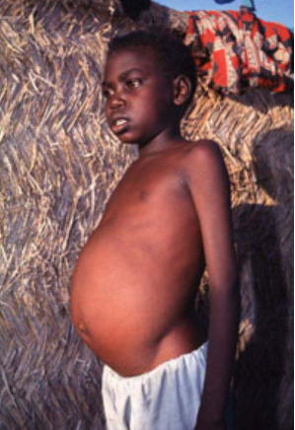
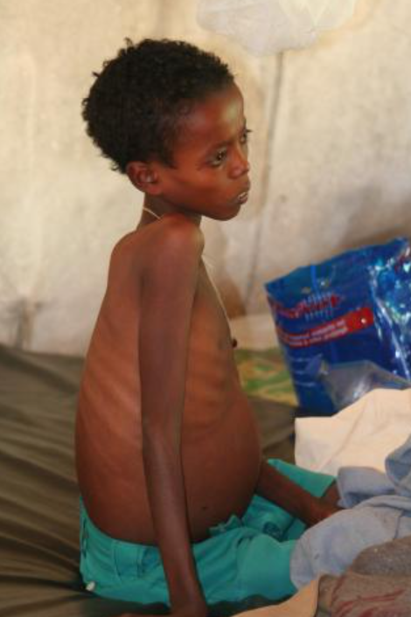
swelling of the liver & spleen seen in visceral leishmaniasis

Slide 22
Post Kala-azar Dermal Leishmaniasis
Following recovery ,about 3–10% of patients with VL in endemic areas develop PKDL within a year or 2.
PKDL is seen mainly in India and East Africa and not seen elsewhere.
PKDL is a non­ulcerative lesion of skin divided into 3 main types.
Depigmented macules resembling tuberculoid leprosy occurring on the trunk & extremities.
Erythematous patches distributed on the face in a 'butterfly pattern’.
Nodular lesion: The above lesions may develop into painless yellowish pink non-ulcerating granulomatous nodules.
The parasite can be demonstrated in the lesions.

Slide 23
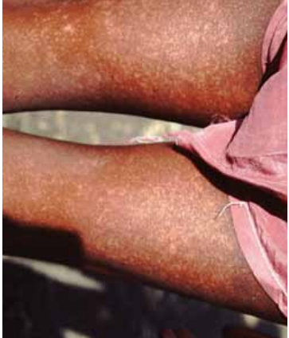
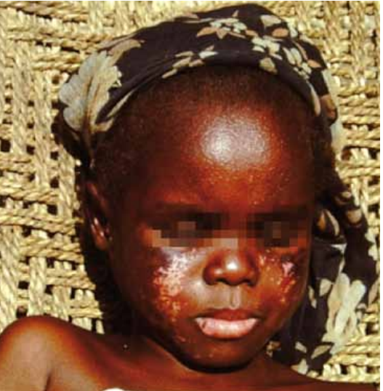
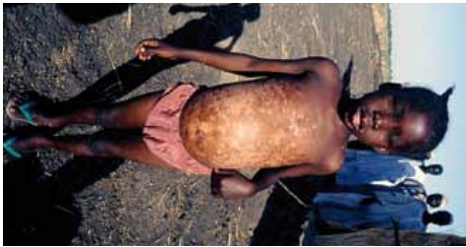
Macular lesions
Butterfly macular rash
Patient with macular lesions mainly on trunk and the legs

Slide 24
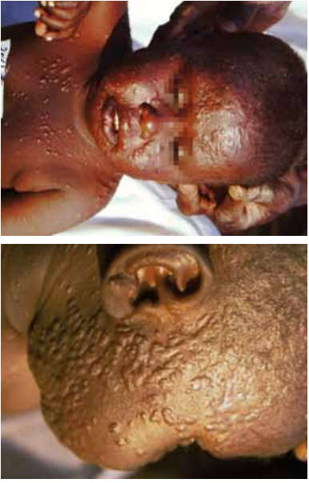
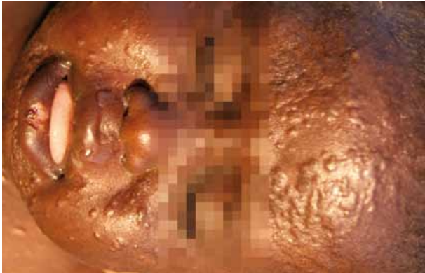
Nodular lesions

Slide 25
Immunity
Cell ­mediated immunity to leishmanial antigens is markedly suppressed allowing unrestricted intracellular multiplication of the parasite.
Similarly cellular responses to tuberculin and other antigens are also suppressed.
In contrast there is an overproduction of antibodies, both specific and non­-specific polyclonal IgG/IgM.
Circulating immune complexes are demonstrable in serum.

Slide 26
Laboratory Diagnosis
Both direct and indirect methods are used.
Direct Evidence
Microscopy
Is the gold standard for diagnosis of VL & Involve demonstration of amastigotes within macrophages in smears of tissue aspirates.
The smears are stained by Leishman, Giemsa, or Wright’s stains and examined under oil immersion objective.
Samples include peripheral blood ,bone marrow(most common diagnostic specimen ),splenic & lymph node aspirate.

Slide 27
Splenic aspirates are richer in parasites hence more valuable for diagnosis.
Only done when marrow examination is inconclusive as it can sometimes cause dangerous bleeding.
Lymph node aspiration is positive in 65% of cases of African Kala-azar, but not useful in cases of Indian Kala-azar.
Culture done on NNN medium- a drop of culture fluid is examined for promastigotes under high power objective.

Slide 28
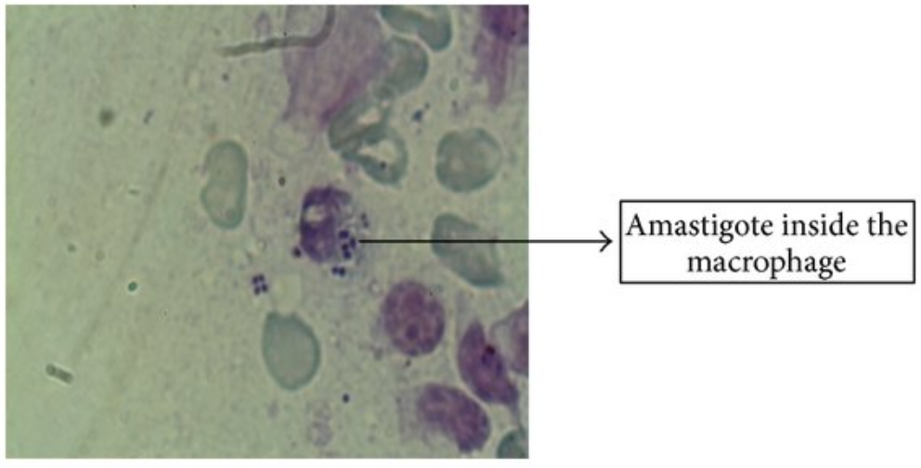

Slide 29
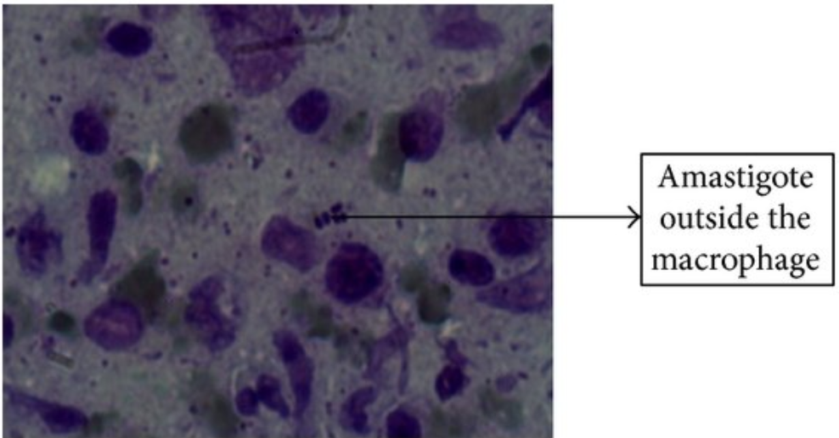

Slide 30
Indirect Evidences
Serodiagnosis
Detection of antigen: The concentration of antigen in the serum or other body fluids is very low. ELISA and PCR have been developed for detection of leishmanial antigen.
Detection of antibodies (Positive reaction also occurs in other conditions, including tuberculosis, leprosy and tropical eosinophilia)
An RDT(ICT) method for antibody with a sensitivity of 98% & specificity of 90% is available.

Slide 31
Molecular diagnosis
The use of PCR is yet to be used for routine diagnosis of visceral leishmaniasis in endemic areas.
Blood picture-Full Blood Count
Normocytic normochromic anemia and thrombocytopenia.
leucopenia accompanied by a relative increase of lymphocytes and monocytes

Slide 32
Diagnosis of PKDL
The nodular lesions are biopsied and amastigote forms are demonstrated in stained sections.
The biopsy material can be cultured or animal inoculation can be done.
Immunodiagnosis has no role in the diagnosis of PKDL.

Slide 33
Treatment
The standard treatment in most of the endemic regions consists pentavalent antimonial compound -Sodium stibogluconate & meglumine antimonate.
Amphotericin-B-deoxycholate or miltefosine are preferred in areas with antimonial resistance.
Amphotericin B is currently used when initial antimonial treatment fails.
With Liposomal amphotericin-B, higher doses can be given without toxicity thereby improving the cure.
Treatment of PKDL is same as that for visceral leishmaniasis

Slide 34
Prevention
Early detection and treatment of all cases.
Integrated insecticidal spraying to reduce sandfly population.
Destruction of animal reservoir host in cases of zoonotic Kala-azar.
Personal prophylaxis by using anti-sandfly measures like, using thick clothes, bed nets, window mesh, or insect repellants and keeping the environment clean.
No vaccine is available against Kala-azar

Slide 35
Leishmania Tropica Complex
Causes cutaneous leishmaniasis or oriental sore and consists of 3 species:
Leishmania tropica
Leishmania major
Leishmania aethiopica

Slide 36
Epidemiology/Distribution
L. tropica and L. major are found in Middle-East, central Asia( India, Afghanistan) and North Africa.
L. aethiopica occurs in Ethiopia and Kenya.
Estimated 600,000-1,000,000 cases occur world wide according to WHO.

Slide 37
Habitat
The amastigote forms are found in the reticuloendothelial cells of the skin.
Promastigote forms are found in sandfly vector.
Morphology
Morphologically similar to Leishmania donovani.

Slide 38
life cycle
L. tropica has a similar life cycle to that of L. donovani although vectors are different.
The vectors of L. tropica complex are Phlebotomus sandflies with the following species as vectors:
P. sergenti
P. pappatasi
P. causasiasus
P. intermedius

Slide 39
Mode of transmission:
Most common mode of infection is by the bite of phlebotomine sandflies.
Other modes of infection include direct inoculation of amastigotes
Following transmission the amastigotes infect mononuclear cells, neutrophils and capillary endothelial cells present in the skin .
They are also found free in the tissues.

Slide 40
Sandflies feeding near the skin lesions ingest amastigotes which develop into promastigotes in the midgut.
The promastigotes then undergo further division.
These are then transmitted to the skin as the sandfly bites, get phagocytosed by mononuclear cells and become amastigotes which multiply further.
The mononuclear cells containing amastigotes remain confined to the skin, without being transported to the internal organs like in visceral leishmaniasis.
The Incubation period varies from 2–8 months.

Slide 41
Pathology
Amastigote forms are found in histiocytes and endothelial cells.
An inflammatory granulomatous reaction with infiltration of lymphocyte and plasma cells is elicited.
Early lesions are popular are formed followed by ulcerative necrosis.
Papules and ulcers are the main pathological lesions.
These heal over months to years leaving some scars.

Slide 42
Clinical Features
Three distinct patterns of old world cutaneous leishmaniasis are recognized which vary from region-to-region.
The anthroponotic urban type with painless dry ulcerating lesions called oriental sore prevalent in the Middle East & India & caused by L tropica.
Lesions begin as a single or multiple raised papule, which grows into a nodule that ulcerates over some weeks ,seen mainly in children in endemic areas.
The ulcer is usually painless unless secondary bacterial infection occurs.
Healing of the dry ulcers occur spontaneously in about an year.
The most important vector is P. sargenti

Slide 43
The zoonotic rural type with moist ulcers which are often multiple and inflamed caused by L. major with an incubation period of less than 4 months.
Lesions due to L. major heal more rapidly than L. tropica
These are seen in the lowland zones of Asia, Middle East & Africa.
Gerbils, rats & other rodents are the reservoirs.
P. papatasi is the most important vector.

Slide 44
The non-ulcerative and often diffuse lesions(diffuse cutaneous leishmaniasis) seen in Ethiopia and Kenya.
It is a rare form of disease, where nodular lesions although restricted to skin are widely distributed.
Caused by L. aethiopica with P. longipes as the usual vector.
It is characterized by low humoral as well as cell mediated immunity.
The lesions last for years or even for entire age.
It is difficult to treat.

Slide 45
Laboratory Diagnosis
Microscopy
Demonstration of amastigote in the Giemsa stained smear from the material obtained from the indurated edge of nodule or sore is the definitive diagnosis.
Amastigotes are seen in large numbers inside macrophages.
Culture
Promastigote forms can be isolated by culture of the aspirate material in NNN medium.
Skin Test
Positive leishmanin test in children less 10 years of age from endemic areas is highly suggestive of the disease.
The skin test is negative in diffuse cutaneous leishmaniasis.

Slide 46
Treatment
Treatment of cutaneous leishmaniasis is the same as visceral leishmaniasis.
Antimony-resistant diffuse cutaneous leishmaniasis can be treated with pentamidine.
Topical treatment consists of a paste of 10% charcoal in sulphuric acid or liquid nitrogen.

Slide 47
Prophylaxis
Control of sandfly population by insecticides and sanitation measures.
Personal protection by use of protective clothing & insect repellants.
Elimination of reservoirs.

Slide 48
L. braziliensis complex/L. mexicana complex
Are distributed in Central & South America
Cause new world leishmaniasis.
Habitat
Are intracellular parasites with amastigote forms seen inside macrophages in the skin and mucous membranes of the nasal & buccal cavity.
Promastigote forms are found in the vector species Lutzomia
Morphology
The amastigote and promastigote forms of both parasites are similar to the other 2 species of Leishmania.

Slide 49
Life Cycle
Similar to that of L. donovani except:-
Amastigotes are found in the reticuloendothelial cells and lymphoid tissues of skin, but not in the internal organs.
The infection is transmitted to man from animals by bite of sandfly vector of genus Lutzomia.
Sylvatic rodents and domestic animals are the common sources and reservoir of infection.
Man to-man infection also happen by direct contact and autoinfection.

Slide 50
Clinical Features
L. mexicana complex causes cutaneous leishmaniasis which resembles the old world cutaneous leishmaniasis.
A specific lesion due to L. mexicana is the chiclero ulcer characterized by ulcerations on the pinna.
L. braziliensis complex causes both mucocutaneous & cutaneous leishmaniasis.
It causes the most severe and destructive form of cutaneous lesion involving the nose, mouth and larynx.
A nodule develops at the site of sandfly bite with symptoms consistent with oriental sore.
Subsequent mucocutaneous involvement leads to nodules inside the nose, perforation of the nasal septum, enlargement of the nose and lips (espundia).

Slide 51
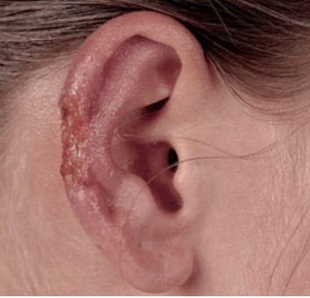
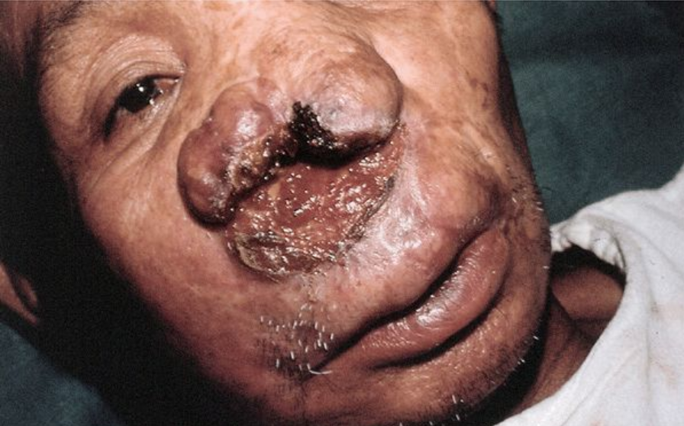
Chiclero ulcer -A deep ulcer on the pinna at the site of a sandfly bite
Espundia - A painful, mutilating ulceration with destruction of portions of the nose

Slide 52
Involvement of the larynx leads to voice changes.
Tissue destruction due to ulceration may lead to scarring that can be disfiguring.
The disease occurs predominantly in Bolivia, Brazil, and Peru
Pian Bois also known as ‘forest yaws’ characterized by appearance of single or multiple persistent painless dry ulcers caused by L. brazilensis gyanensis occur.

Slide 53
Laboratory Diagnosis
Microscopy
Demonstrates amastigotes in smears and biopsy samples taken from lesions of skin and mucous membrane.
Culture
NNN medium demonstrates promastigotes.
Serology
Antibodies can be detected in serum by IFA & ELISA.

Slide 54
Skin Test
Leishmanin test is positive in cutaneous and mucocutaneous leishmaniasis.
Treatment
Pentavalent antimonial compound is used for mild mucocutaneous leishmaniasis.
Amphotericin­ B is alternative drug currently used.
In case of respiratory complications, glucocorticoids can be used.

Slide 55
Prophylaxis
Control is difficult due to sylvatic & rural nature of the disease.
However use of insect repellants, spraying of insecticides, screening & use of protective clothing are recommended.
Vaccine development being pursued ,a polyvalent vaccine using 5 Leishmania strains is reported to be successful in reducing the incidence of the disease.

Slide 56
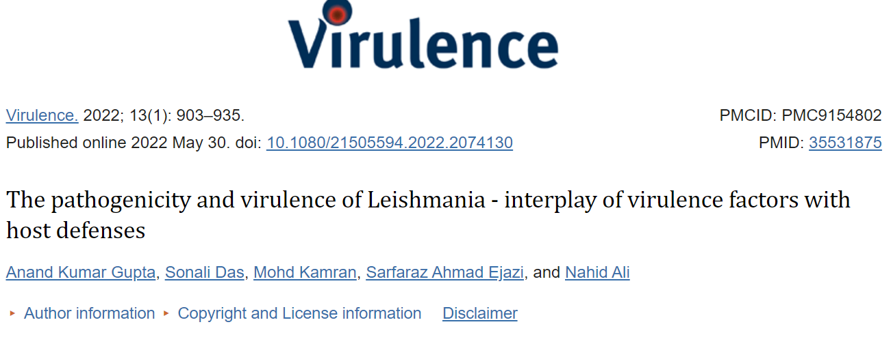

Slide 57
Reference article
Gupta AK, Das S, Kamran M, Ejazi SA, Ali N. The pathogenicity and virulence of Leishmania - interplay of virulence factors with host defenses. Virulence. 2022 Dec;13(1):903-935. doi: 10.1080/21505594.2022.2074130. PMID: 35531875; PMCID: PMC9154802.

