Slide 1
Microsporidia
Dr J Mudenda

Slide 2
Introduction
Microsporidia are a group of small unicellular obligate intracellular spore-forming parasites closely related fungi.
Are characterized by the production of resistant spores varying in size (usually 1—4 µm for medically-important species).
Previously classified as a protozoa.

Slide 3
They posses a unique invasive organelle consisting of a single polar tube that coils around the interior of the spore
Can infect a wide spectrum of invertebrate and vertebrate hosts
At least 15 of the > 1,400 species of microsporidia are associated with human disease.

Slide 4
Epidemiology
Microsporidia are ubiquitous in the environment.
Human microsporidiosis was first reported in the late 1920s.
Has emerged as an important opportunistic parasite affecting immunocompetent & immunocompromised individuals particularly AIDS patients.
Global prevalence of intestinal microsporidiosis in HIV patients ranges from 1 to 80%.
Predominantly in Africa Southeast Asia, Europe and Latin America

Slide 5
Most frequent agents of intestinal microsporidiosis in immunocompromized patients are Enterocytozoon bieneusi & Encephalitozoon species e.g intestinalis
Most infections in non-HIV-infected individuals occur in children, the elderly, travelers & organ transplant recipients.

Slide 6
Economic importance of Microsporidia
Microsporidia are well-adapted pathogens and important agricultural parasites infecting honeybees, silkworms & other insects.
The mortality rate of honeybees infected with N. ceranae is nearly 94% & infected populations usually die within 8 days.
The organism is also a parasite for fish, rodents, rabbits & primates.
Other examples are infection with Loma salmonae which infects salmon and Thelohania species which infects shrimp.

Slide 7
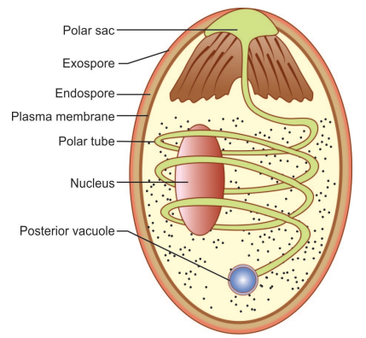
Morphology
Spores are 2–4 µm in size, oval to cylindrical in shape, with a polar tube.
Spores are the infective stage & the only stage capable of existing outside the host cell.
The polar tube is an extrusion mechanism for injecting infective spore contents into the host cell.
Spores are surround by thick double-layered cyst wall.

Slide 8
Mode of infection
Humans acquire infection through several routes including :-
Ingestion
Inhalation of spores
Direct contact with the conjunctiva
Animal contact
Person-to-person transmission
Vertical transmission has been reported in experimental animals, but no congenitally transmitted cases have been confirmed in humans.

Slide 9
life cycle
Consists of 2 distinct stages which are:-
Merogony or the proliferating stage
Sporogony or mature stage.
Spores enter the host by ingestion and/or inhalation.
Germination occurs, resulting in an extension of the polar tube & injection of sporoplasm into the host cell’s cytoplasm .

Slide 10
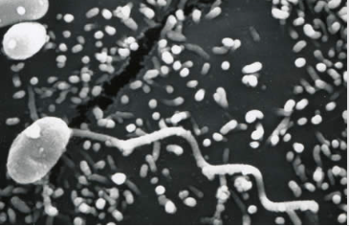
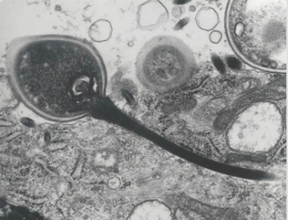
Spore with an extruded polar tube inserted into a cell injecting the infective sporoplasm(TEM/SEM)

Slide 11
The injected sporoplasm in some species is also part of the glycocalyx.
The glycocalyx intrudes on the host cells & transfers nutrition into the microsporidia.
Sporoplasm develops into meronts which is the proliferative stage.
Replication occurs through repeated binary fission forming a multinucleate cell.
This meront cell membranes thicken and form sporonts.

Slide 12
The sporonts divide and develop into sporoblast that later enters a mature stage (spore)without additional multiplication.
The mature form is equipped with the injection apparatus.
The host cells later become distended with mature spores, resulting in rupture and release of the spores.
In a single infection, Microsporidia can multiply into numerous spores hence its pathogenic capability.

Slide 13
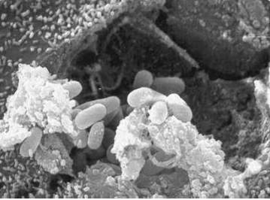
Scanning electron micrograph showing a eukaryotic cell bursting and releasing spores of Encephalitozoon hellem to the extracellular medium.

Slide 14
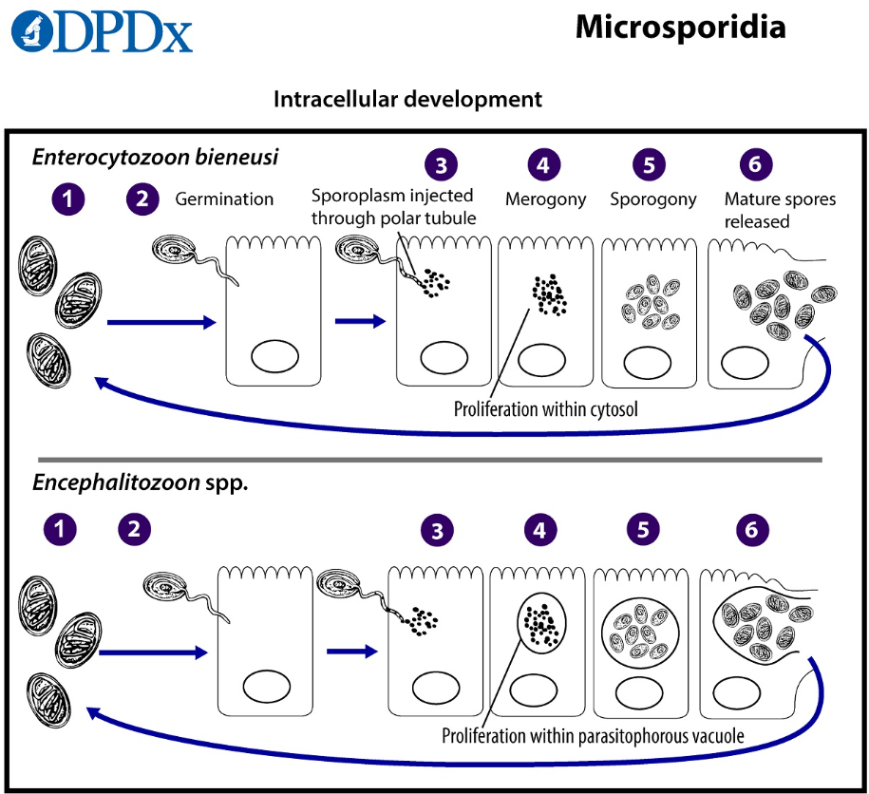
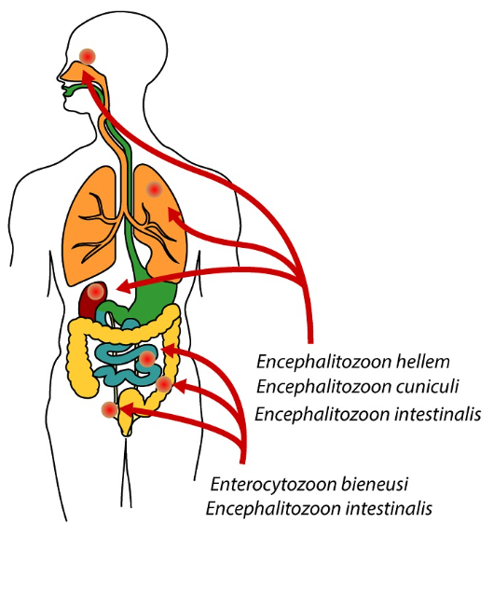

Slide 15
Clinical Features
Clinical illness caused by microsporidia varies depending on:-
The parasite species
The immune status of the host
In immunocompetent patients, microsporidia can cause an asymptomatic infection or a self-limited watery diarrhea.
There are reports of eye infections causing keratoconjunctivitis.

Slide 16
In patients with AIDS, various microsporidia species cause:-
Chronic diarrhea , malabsorption & wasting
Cholangitis, punctate keratoconjunctivitis, peritonitis, hepatitis, myositis & sinusitis.
Infections of kidneys and the gallbladder have occurred.
Vittaforma (Nosema) corneum & other species can cause ocular infections ranging from punctuate keratopathy with redness and irritation to severe, vision-threatening stromal keratitis.

Slide 17
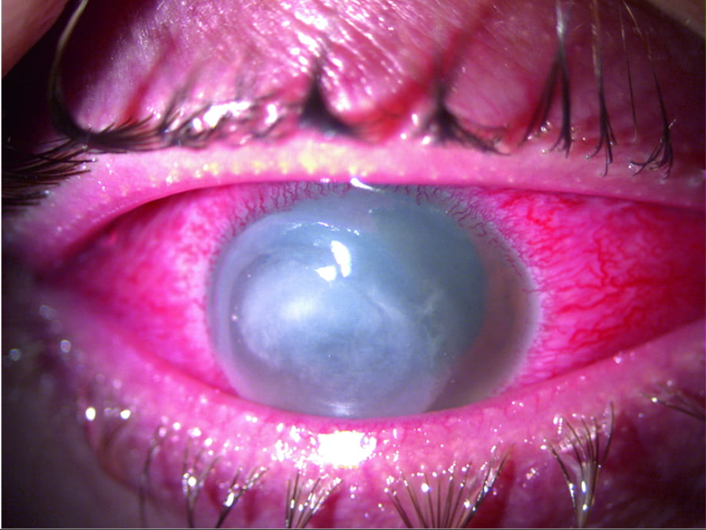
Keratitis (Interstitial)
Manifests with varying degrees of corneal opacification & neovascularization.
Neovascularization appears as the faint, pink areas in the peripheral cornea from the 11 o'clock to the 1 o'clock position.

Slide 18
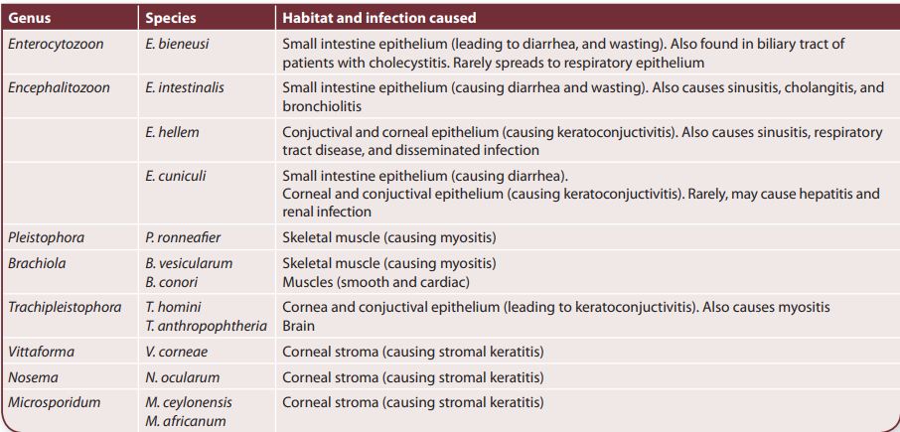
Species & disease caused

Slide 19
Laboratory Diagnosis
Light or electron microscopy with special stains
Sometimes immunofluorescence or polymerase chain reaction (PCR)–based assays
Infecting organisms can be demonstrated in the following specimens :-
Tissue biopsy
Stool, urine, cerebrospinal fluid (CSF), sputum, or corneal scrapings.
Microsporidia are best seen with special staining techniques e.g. Warthin-starry, PAS etc.
Fluorochromes are used to detect spores in tissues and smears.

Slide 20
Immunofluorescence assays (IFA) and PCR-based assays are available in specialized laboratories.
Transmission electron microscopy is currently the most sensitive test, but it is not feasible for routine diagnosis.
Molecular methods are used for speciation.

Slide 21
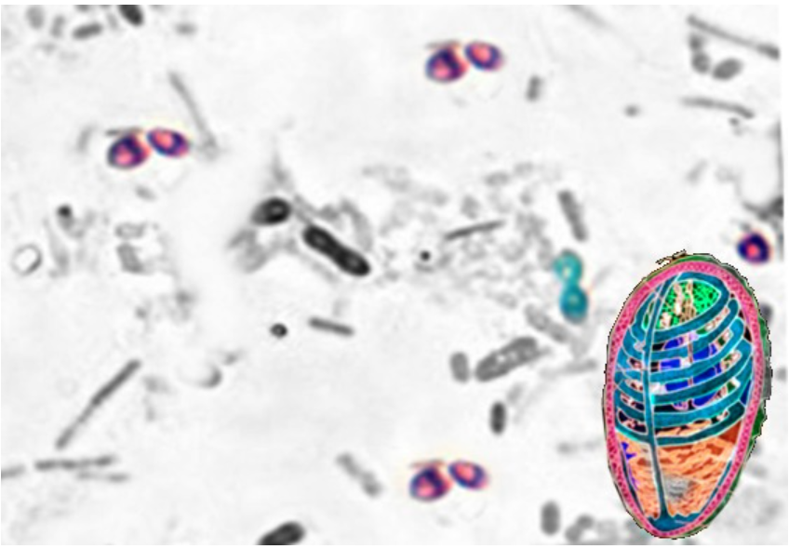
Microsporidum-light and EM

Slide 22
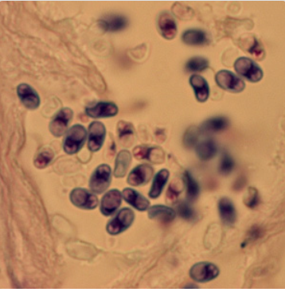
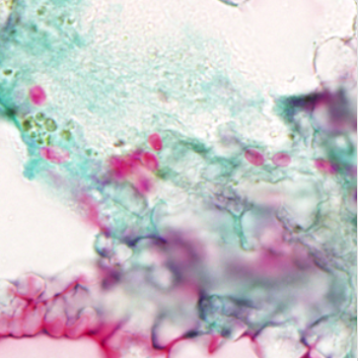
Microsporidia spores from a corneal section, stained with Giemsa.
Spores of T. acridophagus in BAL specimens, stained with Chromotrope 2R stain

Slide 23
Treatment of microsporidiosis
For patients with AIDS, initiation or optimization of antiretroviral therapy (ART) is needed.
Data suggest that treatment with ART enables a patient’s own defenses to eradicate microsporidia.
Administration of ART with immune restoration (an increase in CD4 count to >100 cells/mm³) is associated with resolution of symptoms of enteric microsporidiosis.

Slide 24
For GIT, skin, muscle, or disseminated microsporidiosis, oral albendazole or fumagillin are used depending on the infecting species
For keratoconjunctivitis, oral albendazole & topical fumagillin are used.
Duration of antimicrobial therapy and outcome depend on the level of immune reconstitution with ART.

Slide 25
Fluid support should be given if there are signs of dehydration due to diarrhea.
Patients with malnutrition and wasting should be treated with nutritional supplements.
Antimotility agents can be used if required for diarrhea control.

Slide 26
Infections in immunocompetent individuals resolves spontaneously or after one week of treatment.
NOTE
Albendazole can have serious adverse effects including liver injury (hepatitis) in 10% of patients & rarely, low white blood cell count.

Slide 27
Prevention
Improved personal hygiene and sanitation, especially in immunocompromised persons can prevent microsporidia.
Tight regulation and hygiene improvement in food chain production including breeding, processing, storing and packaging to control food contamination and pathogen spread are an crucial.

Slide 28
References
Fadhilah A, Gabbar A, Bokhari AA. Microsporidium. [Updated 2022 Aug 29]. In: StatPearls [Internet]. Treasure Island (FL): StatPearls Publishing; 2023 Jan-. Available from: https://www.ncbi.nlm.nih.gov/books/NBK537166/
Al-Brhami, K.A.R., Abdul‑Ghani, R. & Al-Qobati, S.A. Intestinal microsporidiosis among HIV/AIDS patients receiving antiretroviral therapy in Sana’a city, Yemen: first report on prevalence and predictors. BMC Infect Dis 22, 11 (2022). https://doi.org/10.1186/s12879-021-07009-3

Slide 29
https://clinicalinfo.hiv.gov/en/guidelines/hiv-clinical-guidelines-adult-and-adolescent-opportunistic-infections/microsporidiosis
https://www.cdc.gov/parasites/

