Slide 1
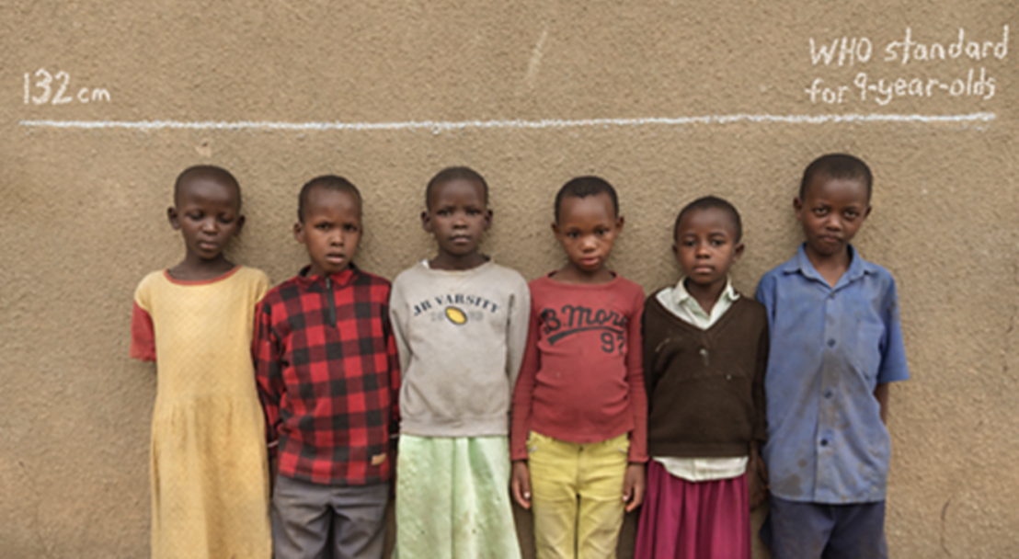
HOOKWORMS
Dr Mudenda

Slide 2
Introduction
Are parasitic nematodes that live in the small intestine of mammalian host such as humans, dog or cat.
Are characterized by the presence of well-defined buccal capsules bearing cutting plates or teeth.
Two species of hookworms, commonly infect humans:
  Ancylostoma duodenale
  Necator americanus
Named hookworm due to cervical curvature.

Slide 3
Ancylostoma duodenale(old hookworm) is a common hookworm of humans.
Necator americanus(New World hookworm) is another cause of hookworm disease in humans.
Hookworm disease is characterized by iron-deficiency anemia & hypoalbuminemia.

Slide 4
Epidemiology
Hookworm is the 2nd most common helminth infection after ascariasis.
Hookworm disease is prevalent throughout the tropics & subtropics(warm and moist climate).
Movement of infected persons has blurred the geographic differences in the distribution of the two species.
An estimated 576-740 million people in the world are infected with hookworm(CDC,2020).

Slide 5
Necator americanus
Literally means the ‘American murderer’.
Geographical distribution-South America, Southern Africa, Southern India, Northern Australia, Southern States of USA.
Habitat
Adult worms live in the small intestines, mostly the jejunum, less often the duodenum & rarely the ileum.
Are attached to mucosa, but may attach to new sites during feeding.

Slide 6
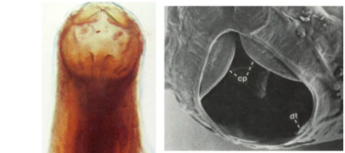
Morphology of N. americanus
Adult worms are slightly smaller than A.duodenale & pinkish or creamy grey.
Males are smaller than females being 7–9 mm by 0.3 mm.
Females being 9–11 mm by 0.4 mm.
Buccal capsule is smaller with 2 pairs of semilunar cutting plates instead of teeth like A. duodenale.

Slide 7
Posterior end of the male has a copulatory bursa which is long & wide used for attachment to the vulva during copulation.
Female worms have a vulva placed in the middle & anterior of the body.
They have excretory & oesophageal glands for exodigestion, also secretes anticoagulant.
Contraction of oesophageal muscles draws blood & anchors worms to the intestinal wall.

Slide 8
N. americanus eggs are identical with those of A. duodenale.
Life cycle is similar to that of A. duodenale
Necator has a much longer life span of about 4–20 years compared to Ancylostoma with 2–7 years

Slide 9
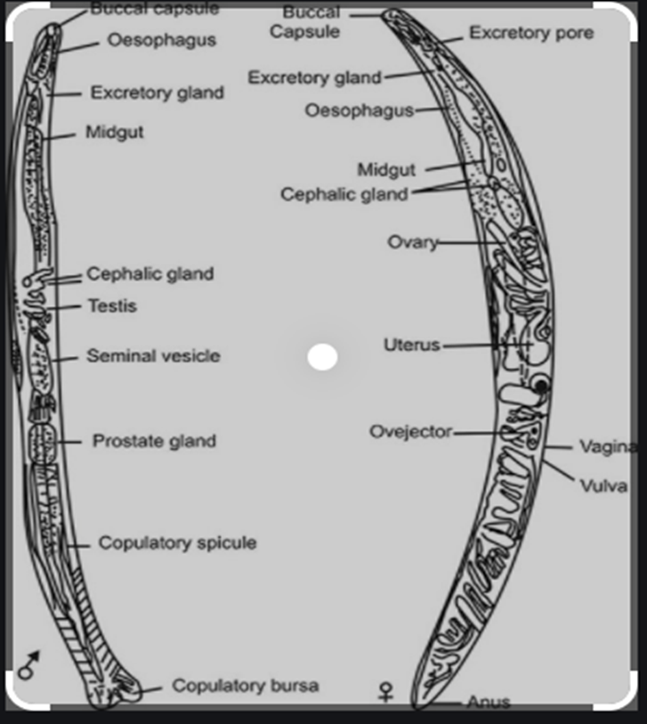
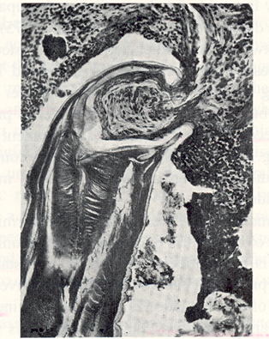

Slide 10
Ancylostoma Duodenale
Prevalent along the Mediterranean coast of Europe & Africa, northern India, China and Japan.
Habitat
similar to americanus mostly the jejunum, less often in the duodenum & rarely in the ileum.

Slide 11
Morphology
Relatively stout and cylindrical worms.
Appear pale pink or greyish white, however may appear reddish brown due to ingested blood.
The body is curved with the dorsal aspect concave & convex ventral aspect.
The buccal capsule is reinforced with a hard chitin-like substance carrying 6 teeth; 4 teeth ventrally & 2 dorsally.

Slide 12
Male worm is smaller than female worm 8-11 mm in length & 0.4 mm thick.
Posterior end of the male is expanded into a copulatory bursa.
The cloaca into which the rectum & genital canal open is situated within the copulatory bursa.
Female worm is larger, 10 to 13 mm long & 0.6 mm thick.
Female posterior end is conoid with a sub-terminal anus situated ventrally.

Slide 13
Vulva opens ventrally at junction of the middle & posterior thirds of the body.
Has a vagina leading to two closely coiled ovarian tubes which occupy posterior & middle parts of the worm.
During copulation the male attaches its copulatory bursa to the vulva.

Slide 14
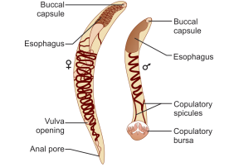
Adult worm of Ancylostoma duodenale (male & female)

Slide 15
Characteristics of hookworm eggs
Eggs are identical for both species.
Oval or elliptical in shape & colorless(Not bile stained).
Surrounded by a thin transparent hyaline shell membrane.
The egg contains an unsegmented ovum when released by the worm in the intestine.
During passage down the intestine ,the ovum develops(becomes segmented with 4 or 8 blastomeres).

Slide 16
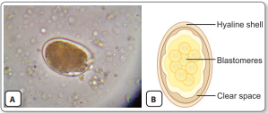
A clear space btn the segmented ovum & the egg shell exist.
A single female worm lays about 10,000–20,000 eggs in a day & with millions layed during its life time.
Egg of Ancylostoma duodenale. A. As seen under microscope; B. Schematic diagram
Both species have high fecundity with duodenale laying 10000-25000 eggs/day & Americanus producing 6-9000 eggs/day.

Slide 17
Life Cycle
Life cycle is the same for both species.
Definitive host: Humans are the only natural host.
Infective form: Is the 3rd stage filariform larva.
Adult worms inhabit the small intestine by attaching to the mucous membrane by means of mouth parts.
Eggs containing segmented ova are passed in feces of infected person & not immediately infective to humans.

Slide 18
Embryo develops inside the eggs deposited in the soil under ideal conditions .
A rhabditiform larva hatches out of the egg & grows in size by feeding on bacteria & other organic matter in the soil.
It then moults twice to become the non-feeding 3rd-stage infective Filariform larva.
Infective larva can live in the soil for 5–6 weeks.

Slide 19
Summary of stages of the life cycle
Stage 1: Passage of eggs from the infected host in faeces
Stage 2: Development in soil
Eggs under favorable conditions (damp, warm, well-oxygenated soil) hatch to rhabditiform larva i.e. L1 larva in 48 hours.
The L1 larva molts twice to develop into a filariform larva(L3) the infective stage of the parasite.
Stage 3: Entrance to new host
The L3 larva cast off their sheath and gain entrance into the body by penetrating the skin.

Slide 20
Stage4: Migration
The larva are carried by the venous circulation to the Rt heart into the pulmonary capillaries.
They break the lung capillaries, enter the alveolar spaces, ascend upward the bronchial tree to trachea, larynx & ultimately swallowed.
On entering the esophagus, the larva undergoes a 3rd molt to form 4th stage (L4 larva) equipped with a buccal capsule for adherence to the gut wall.
Stage5: Localization & laying of eggs-In the small intestine, larva undergo a 4th molt to develop into an adolescent worm.

Slide 21
Adult worms become sexually mature & start laying eggs after 6 wks post infection however devt arrest may occur & process may take longer(6 months or more).
In some cases, larvae may be swallowed & may develop directly into adults in the small intestine without a tissue phase.

Slide 22
Transmission of Hookworm
Human feces are the only source of infection, routes are:-
Cutaneous route – Penetration of the skin by infective filariform larva in the unshod state or bare hands e.g farmers/Miners.
Oral route – swallowed filariform larvae thru contaminated vegetables or fruits become infective without lung passage(Tissue phase is bypassed) .
Cases of transmammary/transplacental transmission have been reported for Ancylostoma.
Galactogenic hookworm infection not demonstrated in human hookworm except only suggested by high neonatal hookworm incidence.

Slide 23
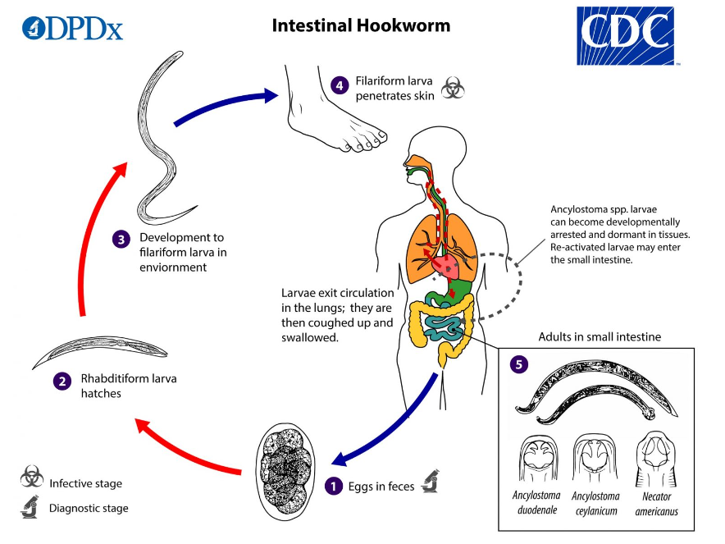

Slide 24
Pathogenesis
Pathogenicity of adult worm
Pathological changes are caused by the attachment of adult worms to the intestinal walls.
The attachment leads to mechanical disruption of the intestinal mucosa.
The parasites penetrate the blood vessels & suck the blood to get the nutrition.
These worms cause considerable loss of blood & tissue.
Ancylostoma can suck abt 0.2 ml/day of blood while Necator suck abt 0.03 ml per day.
Excessive blood loss due to heavy & prolonged worm infection leads to hypochromic microcytic anemia.

Slide 25
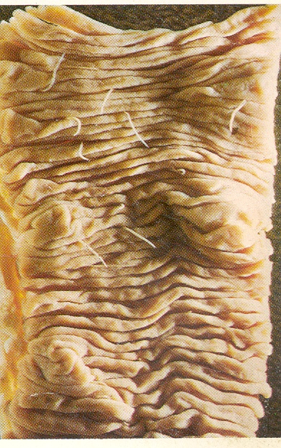

Slide 26
Pathogenicity of infective larva:
The infective filariform larva at the site of skin penetration produce a local reaction called ground itch.
This allergic manifestation is more severe in Necator infection
In previously sensitized host, it can lead to secondary bacterial infections.
Migration of large no. of larva, through the lung produces minute hemorrhage & infiltration of leucocytes resulting in the entrapment of the larva in lung tissue.
Both eosinophilia and leukocytosis occur at this stage.

Slide 27
Clinical manifestation
The clinical symptoms depend on the site where the worms are present and their burden.
1. Skin manifestation
Hookworm related cutaneous larva migrans (HrCLM) is caused by migration of larva in the epidermis.
Ground itch is the early clinical manifestation during the penetration of L3 larva on the skin believed to be due to allergic components of the larva.
Lesions are characteristically seen in & around feet particularly btwn toes.
It is associated with intense itching, edema, erythema & rash.
The associated secondary bacterial infection is more common during this stage.

Slide 28
Cutaneous larva migrans commonly caused by animal hookworms than human e.g. A.braziliense,A. caninum etc.
2. Pulmonary manifestation
It is associated with low grade fever, mild cough, dizziness & hemoptysis.
Pneumonia with pulmonary consolidation is seen in persons with severe infection.

Slide 29
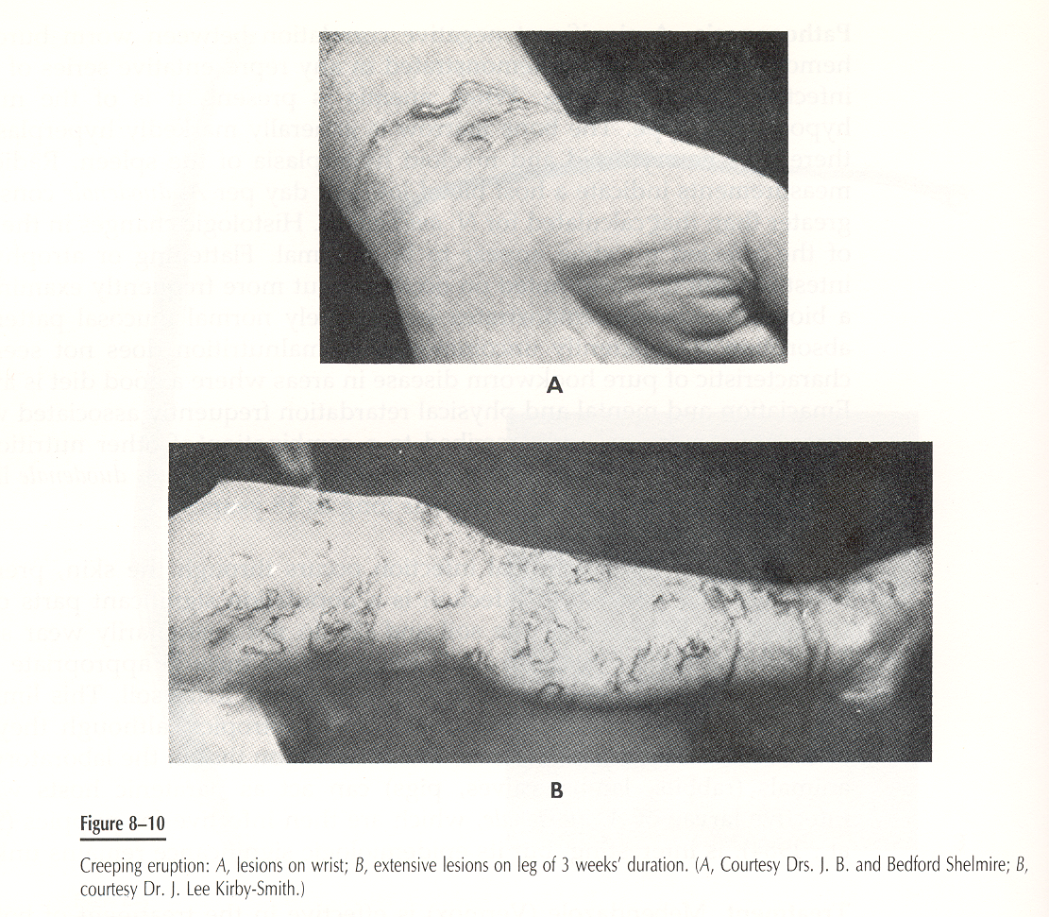
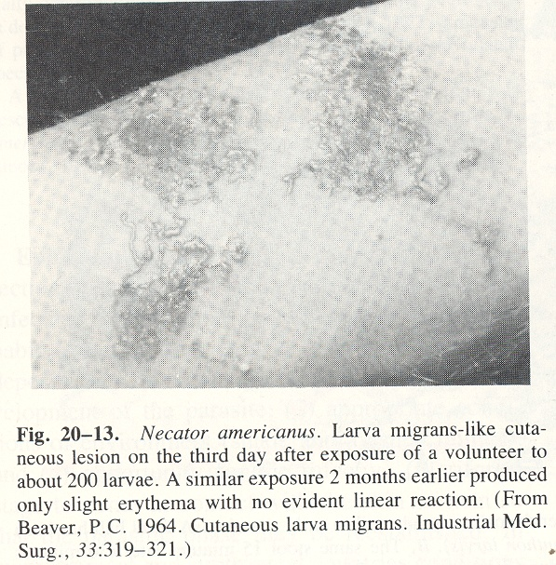

Slide 30
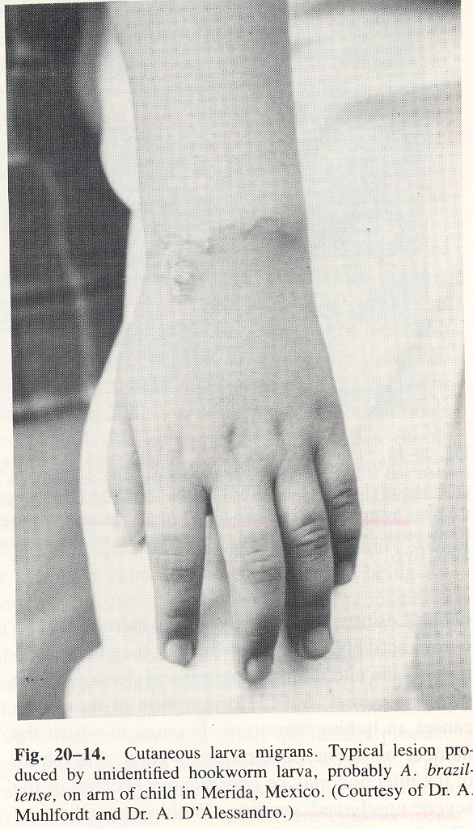

Slide 31
3. Intestinal manifestation
Acute intestinal symptoms such as abdominal pain, nausea, vomiting & hemorrhagic diarrhea are observed.
Chronic hook worm disease is characterized by blood loss & iron-deficiency anemia.
Anemia is associated with fatigue, pallor, tachycardia & dyspnea on exertion.
Hypoproteinemia may cause edema and there can be sign of malabsorption and malnutrition.

Slide 32
The severity of the disease varies with the worm burden and the amount of blood lost.
Hookworm disease is related to worm burden.
5 eggs/mg faeces – No clinical disease.
20 egg/mg faeces – associated with significant Anaemia.
50 eggs/mg faeces – Represent massive infection.
Severe hookworm anaemia commonly leads to cardiac failure.
Mental & physical development is retarded in children.

Slide 33
DIAGNOSIS OF HOOKWORM
Demonstration of eggs in feaces.
Egg counts give a measure of the intensity of infection.
Modified Kato-Katz smear technique is a useful method for quantitative estimation of eggs in stool.
Charcot-Leyden crystals in feaces – in prepatent period
Free larvae in stored feaces – to be differentiated from other larvae
Culture of eggs – Harada-Mori test & Coproculture
Full blood count reveals microcytic, hypochromic anemia and eosinophilia.

Slide 34
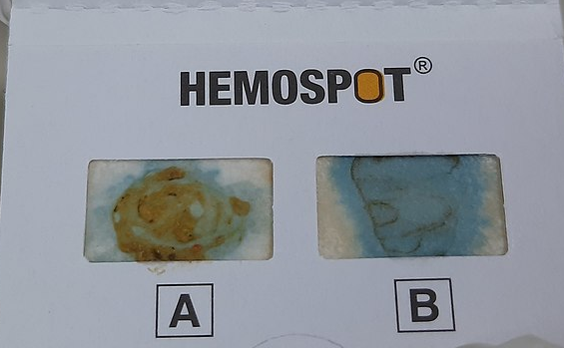
6. Occult blood test
Occult blood in the stool gives a position reaction in case of hookworm infection
Charcot-Leyden crystals are often found in the stool.
Fecal Occult Blood Test of a patients showing positive (A) and positive control (B)

Slide 35
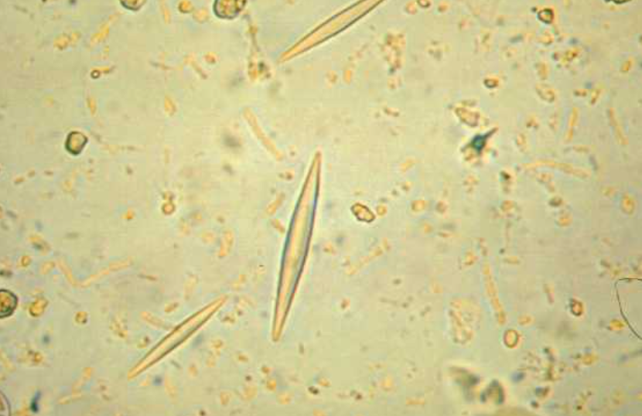
Charcot-Leyden Crystals in feces

Slide 36
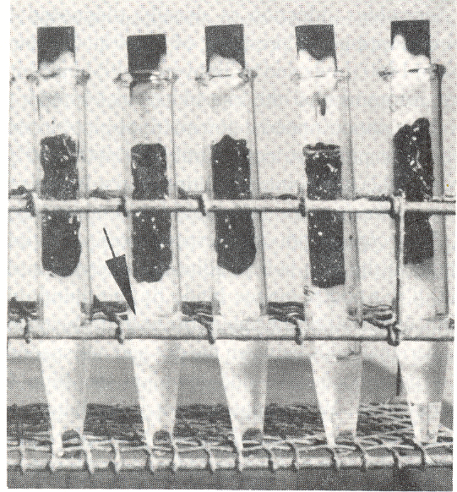
Diagnosis of Hookworm
Harada-Mori test-tube fecal culture for the diagnosis of hookworm and other intestinal nematode larvae. The cultures shown here are 3 days old, and by the upward flow and evaporation of water, the fecal film has been leached and the soluble elements have been deposited in the dark zone at the top of the filter-paper strip. The water level (shown by an arrow) is maintained by periodic replacement. After about 24 hours of leaching, the odor of feces disappears and is replaced by the aroma of damp soil. (From Beaver, P.C., Malek, E.A., and Li.ttle, M.D. 1964. J. Parasitol., 50:664-666.)

Slide 37
Treatment
Mebendazole is a drug of choice- oral, 100 mg twice daily for 3 days
Other anti parasitic drugs are- pyrantel pamoate, thiabendazole, Albendazole, levamisole
Treatment of iron deficiency anemia with replacement iron therapy.

Slide 38
Treatment for Hookworm anaemia
a. Iron therapy
b. Folic acid
c. Parenteral iron – iron dextrose when patients cannot tolerate iron by mouth or when compliance is poor.

Slide 39
Treatment for Cutaneous Larva Migrans
a. oral Thiabendazole
b. Topical Thiabendazole
c. Mebendazole
d. 10% Metriphonate in petroleum jelly - topically

Slide 40
Ancylostoma ceylanicum
Males are 8mm & females 10mm in size
Two large teeth, each with a small one on each side of the middle line.
Found in domestic cats, wild cats, dogs & man to a lesser extent in SE Asia, Phillipines, Taiwan & India
Does not cause larva migrans in man
Causes intestinal infection in man and needs to be distinguished from N. americanus & A.duodenale

Slide 41
Ancylostoma ceylanicum Cont.
6. Small bursa , as wide as it is long supported
by short lateral rays

Slide 42
Ancylostoma brazilliense
Found in wild and domestic Cats and dogs in Brazil
Phillipines, India, Thailand, Ceylon, Indonesia, New Guinea
Males – 8mm, Females – 10mm with distinct angular bend at level of vulva
Buccal capsule with pair of inconspicuous
median teeth and a pair of outer larger teeth.

Slide 43
Ancylostoma caninum
Is a dog parasite
Human parasite in the Phillipines, L₃found in skeletal muscle of man in Louisiana.
Males – 10mm, Females – 14mm
Large buccal capsule – 3prs ventral teeth
Bursa supported by slender rays
Eggs slightly larger than A.duodenale
Oesophageal ( amphidial) glands produce proteolytic enzymes

Slide 44
Other hookworms
A. turbaeformi
A. malayanum
A. ceylonicancylostoma
Uncinaria stenocephala -dogs
Bunostomum phlebotomum - cattle

Slide 45
Prevention
Sanitary disposal of human feces
Treatment of infected persons.
Use of sanitary latrines & use of foot wear.
Health education with improved nutrition supplemented with the dietary iron.

Slide 46
  Factors promoting endemicity of hookworms are as follows:-
Continuous infection in the human population
Promiscuous defecation ensuring that ova are deposited in favorable soil for extrinsic development
Appropriate conditions – sandy and humus soil
Opportunity for the infective larvae to come in contact with bare skin.

Slide 47
5. Prolonged dry and cold seasons are unsatisfactory for the extrinsic development.
Defecation habits and use of night soil in agriculture ensures inoculation of soils for human exposure.

Slide 48
7. Temperature is major factor in determining geographical distribution
Necator eggs and larvae tolerates higher temperatures than those of Ancylostoma
Necator is warm climate hookworm
Ancylostoma is cooler climate hookworm

