Slide 1
Pneumocystis Jirovecii
Dr J Mudenda

Slide 2
Introduction
First described in 1909 by Carlos Chagas as a form of Trypanosoma cruzi.
Initially classified as a protozoan until the advent of gene sequencing techniques in the late 1980s which finally settled the debate.
Pneumocystis jirovecii is now classified as a fungus of the genus pneumocystis.
Recognized as a human pathogen in the 1940s after it was observed in the lungs of malnourished infants with plasma cell pneumonitis.

Slide 3
It is an important pathogen among the immuno-compromised causing PNEUMOCYSTIS PNEUMONIA.
High incidence of the disease in patients with AIDS in the 1980s led to increased interest .
It remains an important pathogen in the developing world, esp. in areas without access to ART.
Widespread use of immunosuppressive meds for chronic diseases has led to increased incidence of Pneumocystis in the developed world.

Slide 4
Epidemiology
Primary exposure to P. jirovecii is common in young children with a seroprevalence as high as 80% noted
This is demonstrated by the increase in anti- Pneumocystis antibody during the first few years of life.
The prevalence among healthy adults ranges from 0-20% the highest so far obtained.
Prevalence of 20%-43% have been reported by studies using PCR for BAL specimens from HIV-positive patients.

Slide 5
Morphology
In mammalian lungs, Pneumocystis exists in 3 morphologically distinct forms:
Trophozoites (or trophic forms)
Sporozoites
And mature cysts
Trophozoites are the predominant form of the organism in in vivo & in vitro culture systems.

Slide 6
Life cycle
In the lungs, Pneumocystis has a biphasic life cycle featuring:-
An asexual phase, which consists of the binary fission of trophozoites.
A sexual phase during which trophozoites fuse, leading to the formation of cysts.
Haploid trophozoites conjugate into diploid early sporozoites, which undergo meiotic division followed by mitotic replication.
This results in the formation of late sporozoites containing eight nuclei (or spores).

Slide 7
The maturation of late sporozoites leads to formation of thick-walled cysts.
Cysts are the agents of disease transmission via inhalation (airborne).
β-(1,3)-D-glucan synthetase generates a cyst wall rich with β-(1,3)-D-glucan.
β-1,3-glucan is absent in trophozoites.
This is the target of binding, activation and phagocytosis by macrophages.

Slide 8
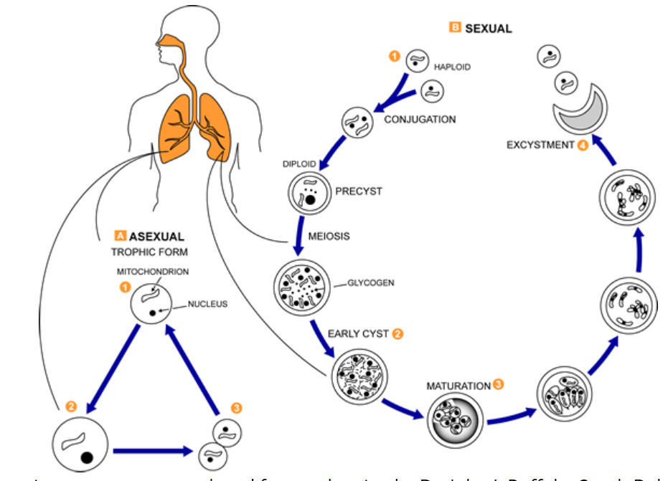

Slide 9
Host Risk Factors
Congenital or acquired immune deficits.
T-lymphocyte deficiencies as well as defects in macrophage function are implicated in the pathogenesis of PJP.
In non-HIV patients, the most common risk factor for PJP is steroid therapy.
Hematological malignancies-patients with acute lymphoblastic leukemia (ALL) and patients who have undergone allogeneic stem cell transplantation are among the highest risk groups for PJP.

Slide 10
Pathogenesis
Pneumocystis jirovecii has a preference for infecting the lung in at-risk individuals.
It attaches to Type I alveolar epithelium allowing the fungus to transition from its small trophic form to the larger cystic form.
Adherence of Pneumocystis to alveoli is not the singular cause of diffuse alveolar damage.
But rather it is the host's inflammatory response that causes significant lung injury & impaired gas exchange leading to hypoxia & possibly respiratory failure.

Slide 11
Pneumocystis is primarily an alveolar pathogen, but in the setting of severely immunocompromised individuals, the rare disseminated form may be seen.
Examples of extra-pulmonary manifestations that may be seen in patients include hepatosplenomegaly, ocular, ear or skin lesions.

Slide 12
Clinical Presentation
Patients will present with the following:-
Fever,
Dyspnea with hypoxemia beyond the radiographic appearance
Nonproductive cough (sputum is usually not present unless the patient has a bacterial infection)
Prominent constitutional symptoms(weight loss & night sweats)
NOTE-PJP should be considered in the differential diagnosis of any immunocompromised individual with the above

Slide 13
Diagnosis
The diagnosis of PJP requires a high index of suspicion in immunocompromised patients with compatible clinical syndromes, laboratory & radiographic findings.

Slide 14
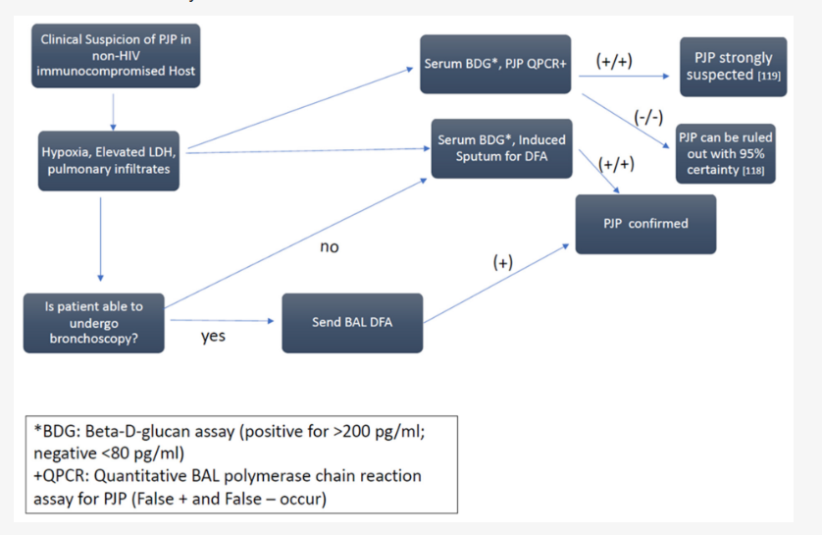
Approach to the diagnosis of Pneumocystis pneumonia

Slide 15
Radiography
No radiographic pattern is pathognomonic for PJP & radiographic mimics exist.
X ray show diffuse patchy consolidative and ground-glass opacities.
May present with atypical features-cavitary or nodular features which are amplified in co-infections such as CMV or adenovirus.

Slide 16
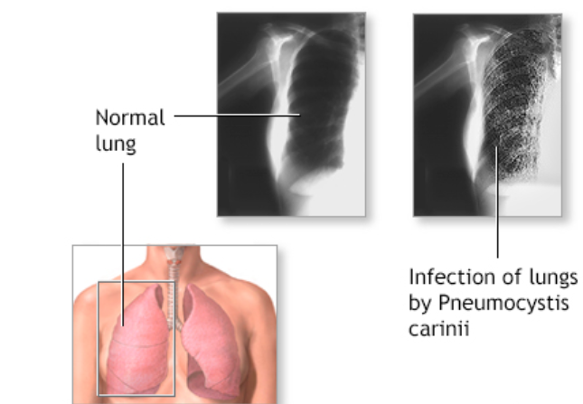

Slide 17
Laboratory Diagnosis
Microscopy
Relies on direct visualization of parasites in induced sputum , BAL specimens & transbronchial or open lung biopsy specimens.
Both conventional stains & immunofluorescent staining via monoclonal antibodies to Pneumocystis are employed.
Common stains include PAS ,GMS & toluidine-blue which stain the cyst cell wall.

Slide 18
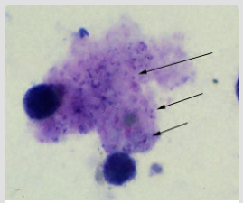
Trophozoites of P. jirovecii in a bronchoalveolar lavage (BAL) specimen from an AIDS patient, stained with Giemsa.

Slide 19
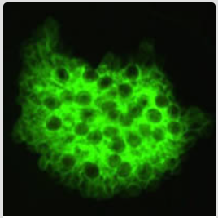
Direct immunofluorescence antibody stain using monoclonal antibodies that target Pneumocystis jirovecii.
This image is from a bronchoalveolar lavage (BAL) specimen from a patient with a malignancy.

Slide 20
Histopathology
The classic histologic appearance is thickened alveoli walls & foamy eosinophilic exudates within the alveoli.
Rarely, Pneumocystis can trigger a granulomatous inflammatory response and the formation of necrotizing (or less commonly non-necrotizing) granulomas.

Slide 21
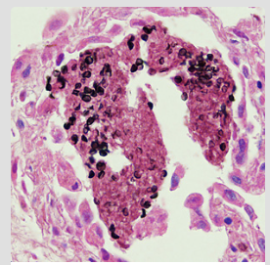
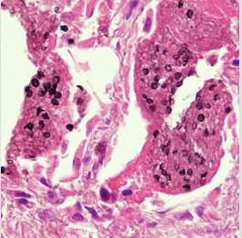
Cysts of P. jirovecii in lung tissue stained with methenamine silver & H&E.
The walls of the cysts are stained black.
Intracystic bodies are not visible with this stain.

Slide 22
Non-specific tests
Are useful as adjuncts & include the enzyme lactate dehydrogenase (LDH) and serum (1,3)-β-D-glucan assay (BDG).
Serum LDH is usually elevated (>300 IU/mL) in patients with PJP reflecting diffuse pneumonia.
BDG is a non-specific fungal marker with high sensitivity but low specificity for PJP used as a surrogate (rather than a stand-alone) test for a suspected diagnosis of PJP.

Slide 23
Serodiagnosis
Antibody detection is not useful for diagnosis of pneumocystis pneumonia.
P. jirovecii antigen can be demonstrated by ELISA.

Slide 24
Treatment
In patients at risk for Pneumocystis pneumonia, early antimicrobial therapy is initiated based on clinical signs & symptoms, radiology & available lab data.
Microbiological evidence of organisms in BAL or induced sputum specimens should not delay treatment
Trimethoprim-sulfamethoxazole or pentamidine are the drugs of choice.
Trimethoprim 5 mg/kg and sulfamethoxazole 25 mg/ kg, 6–8 hourly oral or IV are given for 14 days in the non-HIV patients and for 21 days in HIV patients.
Pentamidine 4 mg/kg/day, given parenterally once daily for 14 days, is effective in non-HIV patients.

Slide 25
Unresolved issues
Several aspects of the pathogenesis of PJP remain poorly understood.
These include the unknown natural reservoir of the fungus and the potential role of immunocompetent hosts as reservoirs or intermediate hosts of infection.

Slide 26
References
Joseph H. Skalski, Theodore J. Kottom, Andrew H. Limper, Pathobiology of Pneumocystis pneumonia: life cycle, cell wall and cell signal transduction, FEMS Yeast Research, Volume 15, Issue 6, September 2015, fov046, https://doi.org/10.1093/femsyr/fov046
Apostolopoulou, A.; Fishman, J.A. The Pathogenesis and Diagnosis of Pneumocystis jiroveci Pneumonia. J. Fungi 2022, 8, 1167. https://doi.org/10.3390/jof8111167
https://www.cdc.gov/parasites/

