Slide 1
Hemoflagellates
Dr J Mudenda

Slide 2
Introduction
Hemoflagellates are parasites that move using a flagella and reside in blood and tissue .
Clinically significant members belong to the genera Leishmania and Trypanosoma.
There are four morphologic forms associated with these hemoflagellates: amastigote, promastigote, epimastigote and trypomastigote
Names are related to the position of the flagella in relation to the position of the nucleus and its point of emergence from the cells.
All the organisms in the two genera involve some combination of these morphologic forms.

Slide 3
The major difference between the two genera is the primary diagnostic form found in each.
For Leishmania it is the amastigote and for Trypanosoma it is the trypomastigote.
The exception is Trypanosoma cruzi in which amastigotes may also be found.
Transmission of all hemoflagellates is via the bite of an arthropod vector.

Slide 4
General Characteristics
They live in the blood and tissues of man/vertebrate hosts and in the gut of the insect vectors.
They have a single nucleus, a kinetoplast, and a single flagellum.
Nucleus is round or oval and is situated in the central part of the body.
Kinetoplast consists of a deeply staining parabasal body and adjacent dot­like blepharoplast.
The portion of flagellum which is inside the body of the parasite and extends from the blepharoplast to surface of the body is an axoneme.
A free flagellum at the anterior end traverses on the surface of the parasite as a narrow undulating membrane.

Slide 5
All members of the family have similar life cycles.
They all require an insect vector as an intermediate host.
Multiplication in both the vertebrate and invertebrate host is by binary fission.
There is NO sexual cycle is known.

Slide 6
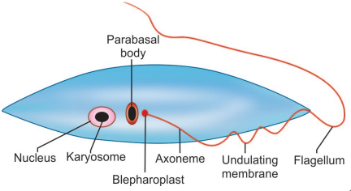
Basic morphology of hemoflagellates
Parabasal body and blepharoplast together constitute the kinetoplast

Slide 7

Morphological stages from amastigote to trypomastigote
N=Nucleus ; P=Parabasal body ; B=Blepharoplast ; A=Axoneme ; U=Undulating membrane ; F= Flagellum

Slide 8
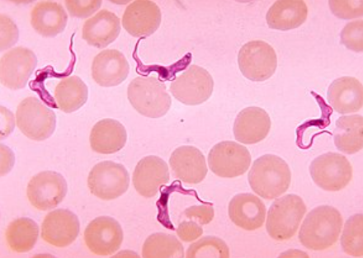
Trypanosomes

Slide 9
General Characters
Members of this genus exist at sometime in their life cycle as trypomastigote stage.
However some trypanosomes such as T. cruzi assume amastigote forms in vertebrate hosts.
They pass their life cycle in 2 hosts— vertebrate hosts (definitive hosts) and insect vectors (intermediate hosts).
In the vector the parasite undergoes devt and multiplication afterwhich it becomes infective.
Two modes of development in the vector occur and are accordingly classified into 2 groups—Salivaria and Stercoraria.

Slide 10
In salivaria, the trypanosomes migrate to mouth parts of the vectors, so that infection is transmitted by their bite.
Examples are T. gambiense and T. rhodesiense causing African trypanosomiasis, which are transmitted by the bite of tsetse fl ies.
In stercoraria, the trypanosomes migrate to the hindgut and are passed in feces e.g. T. cruzi causing Chagas’ disease acquired by rubbing the feces of the vector bug into the wound caused by its bit.

Slide 11
Human trypanosomiasis epidemiology
Is restricted to two geographical regions- Africa and South America.
This is due to the vector being confined to these places alone.
African trypanosomiasis (sleeping sickness)
South American trypanosomiasis (Chagas’ disease)

Slide 12
Human African Trypanosomiasis(HAT)
Trypanosoma brucei complex

Slide 13
Epidemiology of HAT
Control efforts have reduced the number of reported annual cases.
Less than 10,000 cases reported in 2009 after 50 years of control efforts.
Fewer than 2000 cases were reported to WHO in 2017–2018.
In 2020, fewer than 700 combined cases were reported to WHO with 85% caused by T. b. gambiense and around 15% caused by T. b. rhodesiense.

Slide 14
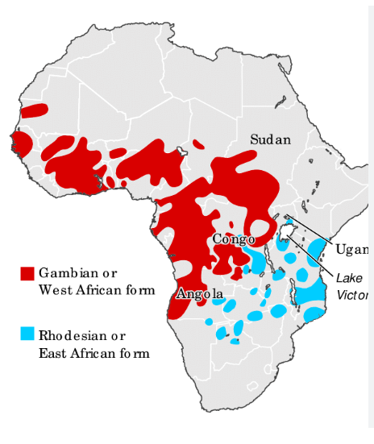

Slide 15
Trypanosoma brucei gambiense
Also referred to as West African sleeping sickness or Gambian trypanosomiasis.
Found in 24 countries in tropical areas of west & central Africa in shaded areas along stream banks where the tsetse fly vector breeds.
Accounts for 97% of reported cases of sleeping sickness.
The course of the illness is chronic & less aggressive than Trypanosoma Brucei Rhodesiense.
It is transmitted by two species of tsetse flies -Glossina palpalis and Glossina tachinoides.

Slide 16
Habitat/Morphology
Trypanosomes live in man and other vertebrate host.
Are a parasite of connective tissue where they multiply rapidly.
They then invade regional lymph nodes, blood and finally may involve central nervous system.
In humans/vertebrate host, T. brucei gambiense exists as trypomastigote form with high pleomorphism i.e. can be slender, broad short stumpy and an intermediate form.
In insects, it occurs as epimastigote and metacyclic trypomastigote forms.

Slide 17
Life Cycle
T. brucei gambiense is digenetic i.e. passes its life cycle in 2 hosts .
Definitive(Vertebrate)host include man, game animals, and other domestic animals.
Intermediate(Invertebrate) host is an arthropod vector the Tsetse fly of glossina species
Both male and female Glossina species (G. palpalis) transmit the disease to humans & dwell on the banks of shaded streams, wooded savanna and agricultural areas.
The infective form to humans is the metacyclic trypomastigote.

Slide 18
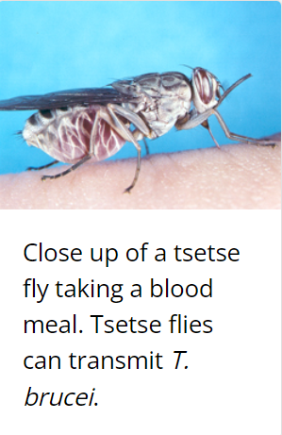
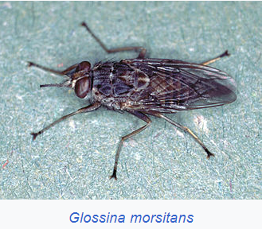

Slide 19
Mode of transmission are:
Through the bite of tsetse fly .
Congenital transmission (recorded).
Man is the only reservoir host,(pigs and others domestic animals known to act as chronic asymptomatic carriers of the parasite).
Metacyclic trypomastigotes are inoculated into man when an infected tsetse fly takes a blood meal.
These transform into slender blood trypomastigotes that multiply asexually before entering the peripheral blood and lymphatic circulation.

Slide 20
The slender forms become non dividing short stumpy forms and enter the blood stream , CNS invasion occur in chronic infection.
Trypomastigotes (short plumpy form) are then ingested by tsetse fly (male or female) during blood meal.
In the midgut of the fly, short stumpy trypomastigotes develop into long, slender forms and multiply.
In salivary glands they develop into epimastigotes,multiply and eventually transform into the infective metacyclic trypomastigotes.
Thereafter, the fly remains infective throughout its life of about 6 months.

Slide 21
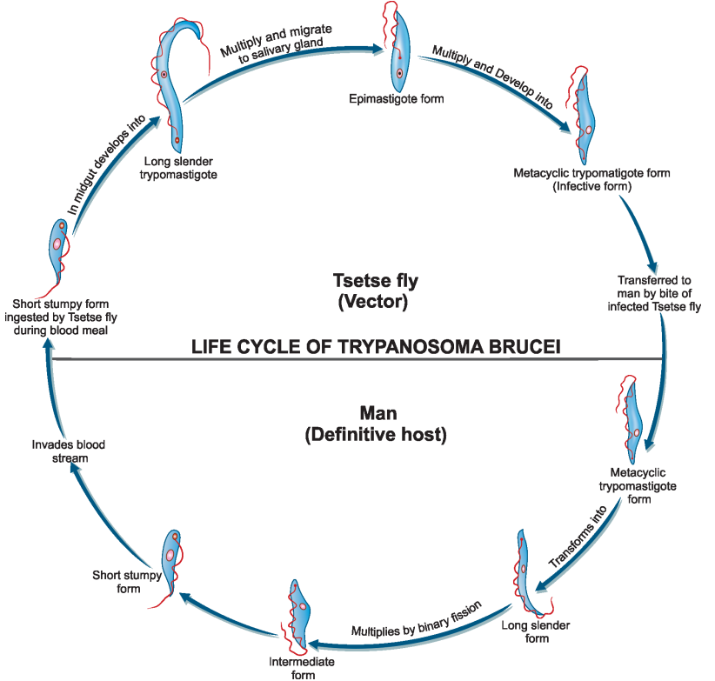
Life cycle of Trypanosoma brucei

Slide 22
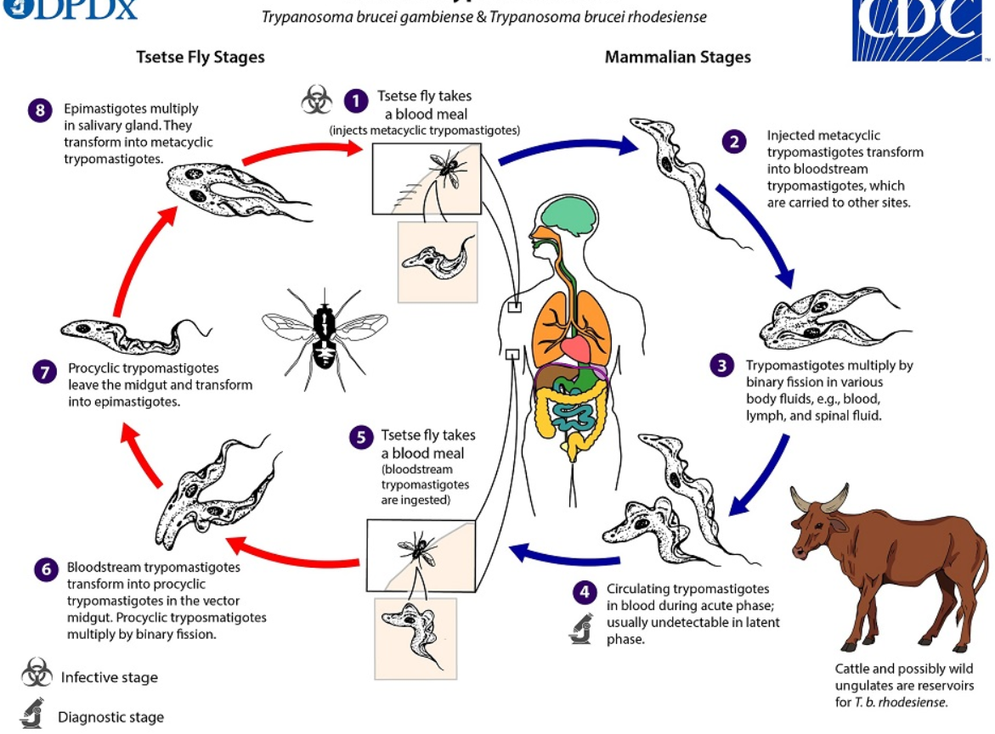

Slide 23
Immune evasion mechanisms-Antigenic Variation
As a way of evading the immune system, Trypanosomes undergo periodic antigenic change of surface glycoproteins called variant surface glycoprotein (VSG).
As many as 1,000 or more VSG genes are known to help evade immune response.
Other mechanisms are resistance to trypanolytic serum proteins(Trypanosome Lytic Factors 1 & 2), immunosuppression, shedding of enormous VSG in circulation leading to formation of immune complexes with antibodies.

Slide 24
Pathogenesis & clinical features
T. brucei gambiense causes African trypanosomiasis, a chronic illness that can persist for many years.
Infection follows a period of parasitemia after which the parasite gets localized predominantly in the lymph nodes.
A painless chancre appears at the site of tsetse fly bite followed by intermittent fever, chills, rash, anemia, weight loss, and headache.
Systemic trypanosomiasis without CNS involvement is referred to as stage I disease.
In this stage, there is hepatosplenomegaly and lymphadenopathy, particularly in the posterior cervical region (Winterbottom’s sign).

Slide 25
Myocarditis may develop in stage I disease although commonly seen in T. brucei rhodesiense infections.
Hematological features seen in stage I include anemia, moderate leukocytosis, and thrombocytopenia.
Stage II disease involves CNS invasion occurring several months marking the start of ‘sleeping sickness’.
Headache, mental dullness, apathy and day time sleepiness begin at this stage.
The patient falls into profound coma followed by death from asthenia

Slide 26
Histopathology show chronic meningoencephalitis with heavy infiltration by lymphocytes, plasma cells, and morula cells(atypical plasma cells)
Brain vessels show perivascular cuffing followed by infiltration of the brain and spinal cord, neuronal degeneration and microglial proliferation.
Abnormalities in CSF include raised intracranial pressure, pleocytosis, and raised total protein concentrations.

Slide 27
Trypanosoma Brucei Rhodesiense (East African Trypanosomiasis)
Trypanosoma brucei rhodesiense is found in 13 countries in eastern and southern Africa.
Also referred to as East African sleeping sickness
Represents under 3% of reported cases and causes an acute infection.
First signs and symptoms are observed a few weeks or months after infection.
The disease develops rapidly and invades the central nervous system.

Slide 28
Epidemiology of trypanosomes in Zambia
Historical hot spots of rhodesiense HAT epidemics are the Luangwa & the Kafue River Valleys since 1960.
According to WHO ,Zambia currently reports <100 new HAT cases annually.
These are mainly from the old foci in the tsetse fly-infested Luangwa River Valley comprising Chama, Mpika, Chipata, Mambwe & Rufunsa districts.
The disease is also re-emerging in Rufunsa.
Other areas are the Kafue ecosystem comprising Kafue National Park (KNP) and its surrounding Game Management Areas (GMA).

Slide 29
Why few cases?
Underdiagnosis mainly due to lack of HAT surveillance and control programmes.
Misdiagnosis with other febrile conditions, such as malaria, tuberculosis & HIV/AIDS.

Slide 30
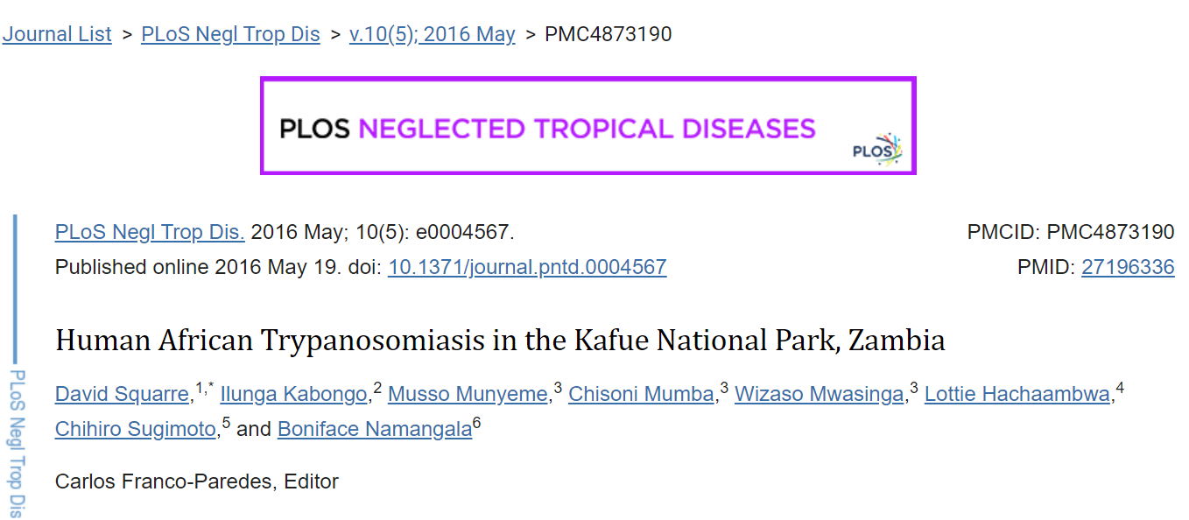

Slide 31
Its vectors are G. morsitans , G. palpalis and G. Swynnertoni found in the open savannah countries.
Although transmission by the vector is usually from man ­to­ man, the disease is actually a zoonosis.
The reservoir host are wild game animals like bush buck, antelope and domestic animals like cattle.
Its morphology, habitat, and life cycle is similar to T. brucei gambiense .

Slide 32
Pathogenesis and Clinical Feature
T. brucei rhodesiense causes an acute illness with an incubation period of 4 weeks.
Pathological features are similar in both diseases although edema, myocarditis and weakness are more prominent in East African sickness.
Somnolence and lymphadenitis is less prominent than in T.b.gambiense
Febrile paroxysms are more frequent and severe with heavy parasitemia.
CNS involvement happens early and death can occur without its involvement.

Slide 33
Differences Between West Africa & East African Trypanosomiasis
Characteristics | West African | East African
Organism | T. brucei gambiense | T. brucei rhodesiense
Distribution | West and Central Africa | East and Central Africa
Vector | Tsetse fly(Glossina palpalis group) | Tsetse fly (Glossina morsitans group)
Reservoir | Mainly humans | Wild & domestic animals
Virulence | Less | More
Disease course | Chronic(late CNS invasion, months to years) | Acute(early CNS invasion)
Mortality | Low | High
Lymphadenopathy | Prominent & early | Less common
Parasitemia | Low | High

Slide 34
Laboratory Diagnosis
Both species of African trypanosomiasis are diagnosed in a similar way.
Specific Findings
Microscopy
Definitive diagnosis is established by demonstration of trypanosomes in peripheral blood, bone marrow, lymph node, CSF & chancre fluid by microscopy.
Serodiagnosis
Antigen detection- Antigens from serum and CSF can be detected by ELISA.
Antibody detection- Various serological methods are used to detect the high serum IgM levels and later, CSF IgM antibodies in patients with African trypanosomiasis e.g. IHA,CFT,ELISA etc.

Slide 35
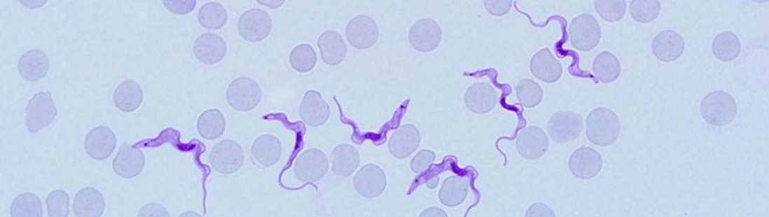
Trypanosoma brucei rhodesiense in a Giemsa-stained blood smear

Slide 36
Non­-specific Findings
Anemia and monocytosis.
↑ ESR due to rise in gamma globulin levels.
Reversal of albumin: globulin ratio.
Increased CSF pressure, raised cell count and proteins.

Slide 37
Treatment
In the initial stages(stage I),i.e. without CNS involvement, pentamidine is the drug of choice for gambiense HAT & suramin is the drug of choice for rhodesiense HAT.
Pentamidine dose is 3–4 mg/kg body weight, im daily for 7–10 days. Suramin dose is 20 mg/kg body weight in a course of 5 injections iv at an interval of 5–7 days.
Suramin does not cross the blood brain barrier & is nephrotoxic
In patients with CNS involvement, melarsoprol (Mel­B) is the drug of choice-can cross the blood brain barrier. Dose: 2–3 mg/kg/per day (max. 40 mg) for 3–4 days.

Slide 38
Fexinidazole is an oral treatment for gambiense HAT for stage I & II. Its indicated as the first line for 1st & non-severe 2nd stage. Currently a clinical trial for its use in rhodesiense HAT is ongoing.

Slide 39
Prevention
Control is based on early diagnosis & treatment of cases to reduce the reservoir of infection.
Control of tsetse fly population (most important preventive measure) by wide spraying of insecticides, traps & baits impregnated with insecticides.

Slide 40
https://www.who.int/data/gho/data/themes/topics/human-african-trypanosomiasis

