Slide 1
AMOEBA
Dr J Mudenda

Slide 2
Introduction
Amoebae are membrane bound protozoan parasites with no fixed shape classified as either free-living or intestinal amoebae.
The cytoplasm has an outer ectoplasm & inner endoplasm-used for movement/phagocytosis.
Reproduction occurs by fission and budding.
In unfavorable conditions a cyst is formed and is the infective form-e.g. Entamoeba histolytica.
The free-living amoebae occasionally act as human pathogens causing meningo-encephalitis and other infections, e.g. Naegleria/Acanthamoeba.
The parasitic amoebae inhabit the alimentary canal.

Slide 3
Classification of Amoebae
Intestinal amoebae
Free-living amoebae
Entamoeba histolytica
Entamoeba dispar
Entamoeba coli
Entamoeba gingivalis
Most are non pathogenic except Entamoeba histolytica
Naegleria fowleri
Acanthamoeba spp
Balamuthia mandrillaris
All free-living amoebae are opportunistic pathogens

Slide 4
Entamoeba Histolytica
First demonstrated in dysentery feces of a patient in Russia St. Petersburg in1875.
E. histolytica has 22 strains of which only 9 are invasive, the rest are noninvasive commensals.
Pathogenic & nonpathogenic strains are morphologically identical but represent 2 different species—the pathogenic strains being E. histolytica & the nonpathogenic strains classified as E. dispar.
Trophozoites of E. dispar contain bacteria, but no RBCs.

Slide 5
Epidemiology
Prevalent worldwide wherever sanitation is poor although much more common in the tropics.
Reported to affect about 10% of world population and 50% of people in developing countries may be infected with the parasite.
Majority of infected humans (80–99%) are asymptomatic.
Most deaths occur in the tropical belt of Asia, Africa & Latin America.
It’s the 3rd leading parasitic cause of death after malaria & schistosomiasis.

Slide 6
Immunity
Infection with invasive strains leads to both humoral & cellular Immune responses.
Serological response is not seen in infection with non-invasive strains.
Antibodies can be demonstrated within a week of invasive infection.
Some degree of protection occur after an infection as shown by the low cases of recurrence of invasive colitis and liver abscess in endemic areas.
Course & severity of amoebiasis does not seem to be affected by HIV infection.

Slide 7
Morphology
E. histolytica occurs in 3 forms.
Trophozoite
Precyst
Cyst
-Trophozoite- is the actively motile, growing stage of the parasite & the only FORM present in tissues.
-Contain phagocytosed RBCs a feature diagnostic of E. histolytica(not present in commensals).
-Trophozoites are killed by drying, heat, & chemical sterilization.

Slide 8
Precystic Stage
Trophozoites undergo encystment in the intestinal lumen(not in tissues or faeces outside the body)
During this process, the trophozoite extrudes its food vacuoles & becomes round leading to a precystic stage.
It then secretes a highly retractile cyst wall around it and becomes cyst.

Slide 9
Cystic Stage
Starts as an early cyst with a single nucleus.
As the cyst matures, the nucleus undergoes 2 successive mitotic divisions to form 4 nuclei.
The mature cyst is thus quadrinucleate.
Is highly resistant to gastric juice & unfavorable environmental conditions.

Slide 10
Life Cycle
E. histolytica passes its life cycle in a single host-man
Transmitted via fecal oral route-infn acquired by ingestion of food & water contaminated with cysts.
Infective form is a mature quadrinucleate cyst passed in feces of convalescents/carriers.
Cysts remain viable under moist conditions for about 10 days.
Ingested cysts pass through the stomach undamaged until reaching terminal ileum or caecum where excystation occur due to the alkaline environment.

Slide 11
Excystation leads to release of a quadrinucleate amoeba called the metacyst.
The metacyst nuclei immediately undergo division to form 8 nuclei each of which gets surrounded by its own cytoplasm to form 8 small amoebulae or metacystic trophozoites.
The metacystic trophozoites colonise the submucosal tissue of caecum & colon in the glandular crypts and grow by binary fission.
Some metacystic trophozoites develop into precystic forms & cysts which are passed in feces to repeat the cycle.

Slide 12
In most of the cases, E. histolytica remains as a commensal in the large intestine without causing any ill effects.
Such persons become carriers or asymptomatic cyst passers and are responsible for maintenance and spread of infection in the community.
It may however be activated leading to clinical disease.
Such latency and reactivation are the characteristics of amoebiasis.

Slide 13
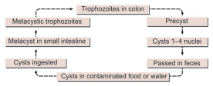
Schematic summary of Life cycle

Slide 14
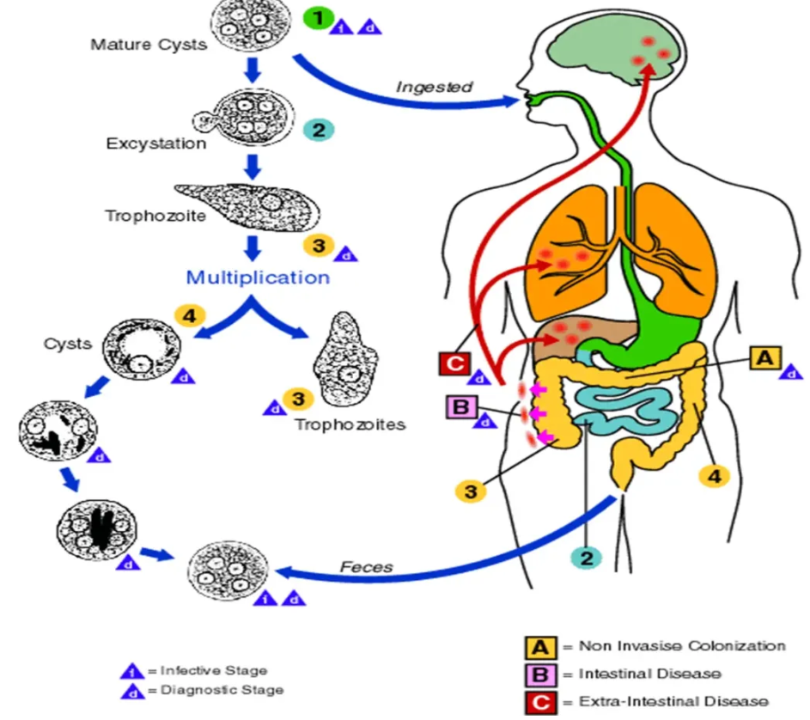

Slide 15
Pathogenesis & Clinical Features
E. histolytica causes two forms of the disease ,intestinal & extra-intestinal amoebiasis.
Incubation period is highly variable with an average ranges of 4 days to 4 months.
Amoebiasis can present in different forms & degree of severity, depending on the organ affected & the extent of damage caused.

Slide 16
Intestinal Amoebiasis
Is characterized by multiple flask shaped ulcers confined to the colon-caecum, sigmoid & ­rectum.
Intervening mucous membrane btn ulcers remain healthy although ulcers may coalesce to form large necrotic lesions covered with brownish slough.
This happens only in about 10% of cases of infection with the remaining 90% being asymptomatic.
Ulcers are caused by penetration of the mucosa by trophozoites facilitated by their motility & the tissue lytic enzyme histolysin which damages the mucosal epithelium.
Other parasite virulence factors include Amoebic lectin, cystine proteinase which inactivates complement factor C3 and ionophore.

Slide 17
Host factors affecting the course of infection are stress, malnutrition, alcoholism, corticosteroid therapy, bacterial flora & immunodeficiency.
Glycoproteins in colonic mucus blocks attachment of trophozoites to epithelial cells hence changes in the nature & quality of colonic mucus may influence virulence.
Tumor-like masses of granulation tissue called amoeboma form on the intestinal wall from a chronic ulcer.

Slide 18
The amoeba penetrates to submucosal layer & multiplies rapidly, causing lytic necrosis thus forming an abscess which then breaks down to form an ulcer.
Occasionally, the ulcers may involve the muscular & serosa layer of the colon causing perforation & peritonitis.
Superficial lesions generally heal without scarring, deep ulcers form scars which may lead to strictures, partial obstruction & thickening of the gut wall.

Slide 19
Clinical Features of Intestinal Amoebiasis
Clinical course is characterized by prolonged latency, relapses or short breaks btn episodes.
Typical manifestation of intestinal amoebiasis is amoebic dysentery although quite often, only diarrhea or vague abdominal symptoms may occur.
Compared to bacillary dysentery, amoebic dysentery is usually gradual in onset with abdominal tenderness which is less & localized.

Slide 20
The patient is usually afebrile & nontoxic however in fulminant colitis where there is confluent ulceration & necrosis of colon the patient is febrile and toxic.
Chronic involvement of the caecum causes a condition simulating appendicitis.
Charcot-Leyden crystals are often present & E.histolytica trophozoites can be seen containing ingested erythrocytes.

Slide 21
Extra intestinal Amoebiasis
Hepatic Amoebiasis
Involvement of the liver is the most common extra intestinal complication of amoebiasis.
Usually there is no hx of amoebic dysentery in 50% of cases & about 2–10% of the infected suffer from hepatic complications.
Amoebic hepatitis from probable repeated invasion by amoebae from an active colonic infection/toxic substances occur.

Slide 22
Liver damage is due to the inflammatory response to trophozoites (lysosomal enzymes and cytokines).
Liver abscesses usually in the upper right lobe may occur in 5–10% of persons with intestinal amoebiasis.
It consists of central necrotic tissue & normal periphery liver tissue with invading amoeba.
They may be multiple or solitary with jaundice only occurring in multiple lesions or when pressing on the biliary tract.

Slide 23
Pulmonary Amoebiasis
Most often follows extension of hepatic abscess through the diaphragm .
Rarely primary amoebiasis of the lung may occur by direct hematogenous spread from the colon bypassing the liver.
The lower part of the right lung is usually affected.
Hepato-bronchial fistula usually results with expectoration of chocolate brown sputum.
The patient presents with severe pleuritic chest pain, dyspnea & non-productive cough.

Slide 24
Metastatic Amoebiasis
Involvement of distant organs occur by hematogenous spread & via lymphatics.
Hence abscesses in the kidney, brain, spleen & adrenals have been noticed.
Spread to brain leads to severe destruction of brain tissue and is fatal.
Other areas affected are the skin (Cutaneous Amoebiasis) & Genitourinary Amoebiasis( where the prepuce& glans are affected).
Penile amoebiasis is acquired through anal intercourse
The destructive ulcerative lesions resemble carcinoma.

Slide 25
Laboratory Diagnosis
Microscopy
Definitive diagnosis depends on microscopic demonstration of actively motile trophozoites in freshly-passed stool.
Presence of ingested RBCs identifies E. histolytica.
Iodine-stained preparation is needed to demonstrate cysts or dead trophozoites.
Macroscopic features include brownish black foul-smelling stool intermingled with blood & mucus.

Slide 26
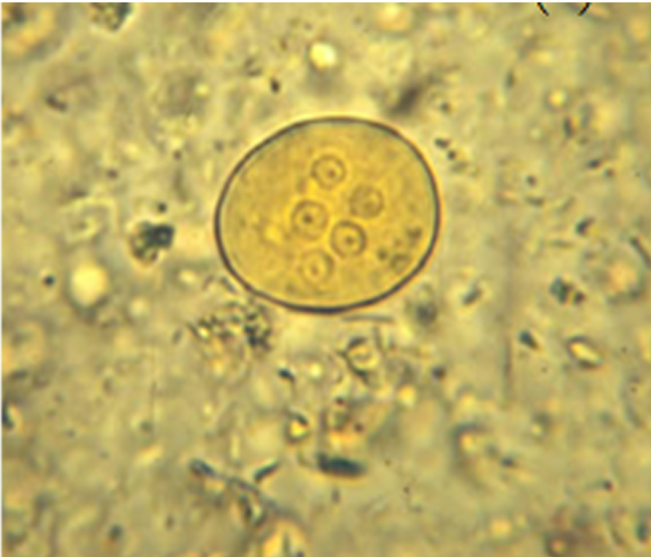
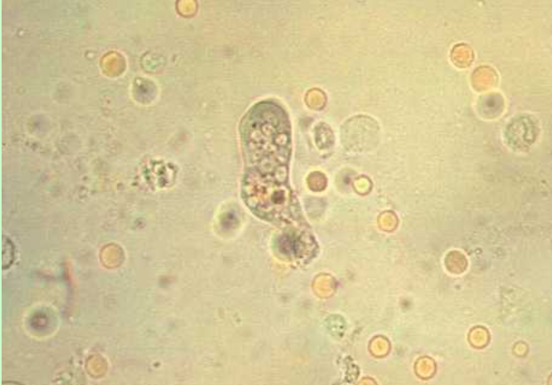
A trophozoite of Entamoeba histolytica showing ingested red blood cells
A cyst of Entamoeba histolytica

Slide 27
Stool Culture
Stool culture is a sensitive method in diagnosing chronic & asymptomatic intestinal amoebiasis.
Sero-diagnosis
Serological tests become positive only in invasive amoebiasis.
Tests done include IHA,Latex agglutination test & ELISA.
lHA & LA are highly sensitive but often give false-positive results as they remain positive for several years even after successful treatment.

Slide 28
Diagnosis of Extra-intestinal Amoebiasis
Can be done by microscopic examination of the liver biopsy & also pus aspirate from the abscess may demonstrate trophozoite.
Radiological examination is useful e.g the diagnosis of amoebic liver abscess is based on the detection (generally by USG or CT) of space occupying lesions in the liver & a positive serologic test for antibodies against E. histolytica antigens.

Slide 29
Treatment
Three classes of drugs are used in the treatment of amoebiasis.
Luminal amoebicides: These include Iodoquinol, paromomycin, & tetracycline which act in the intestinal lumen but not in tissues.
  Note: Metronidazole & tinidazole act on both sites but non of them reach high levels in the gut lumen hence patients with amoebic colitis or amoebic liver abscess should also receive a luminal agent.

Slide 30
Tissue amoebicides: Are effective in systemic infections but less effective in the intestine. Examples include emetine, chloroquine, etc.
Luminal & tissue amoebicides: Metronidazole and related compounds like tinidazole and ornidazole act on both sites and are the drug of choice for treating amoebic colitis and amoebic liver abscess.

Slide 31
Prevention
Preventive measures are like those of other fecal-oral infections. These are :
Improved sanitation to prevent water/food contamination from human excreta.
Health education & improved personal habits helps in control.
Detection & treatment of carriers and their exclusion from food handling occupations will help in limiting the spread of infection.

Slide 32
PATHOGENIC FREE-LIVING AMOEBAE
Numerous free-living amoebae are found in water & soil.
However only a few are potentially pathogenic and can cause human Infections.
These are termed as amphizoic organisms -can multiply both in the body of a host (endozoic) and in free-living (exozoic) conditions.

Slide 33
The pathogenic ones are Naegleria Fowleri & Acanthamoeba causing:
Primary amoebic meningoencephalitis (PAM) – caused by amoebofl agellate Naegleria (the brain eating amoeba).
Granulomatous amoebic encephalitis (GAE) and chronic amoebic keratitis (CAK) – caused by Acanthamoeba
Balamuthia have also been reported to cause GAE.
PAM & CAK occur in healthy individuals while GAE has been associated with immunodeficient patients.

Slide 34
Naegleria Fowleri
Fowleri is the only specie of the genus Naegleria which infects man.
It causes the disease called primary amoebic meningoencephalitis (PAM), a brain infection that leads to destruction of brain tissue.
It has world wide distribution.
Commonly found in warm freshwater (e.g. lakes, rivers, and springs) & soil.
N. fowleri is a heat-loving (thermophilic) amoeba that thrives in warm water at low oxygen tension.
Only 32 infections were reported in the US in the last 10 years from 2002 to 2011 with no case reported in Zambia.

Slide 35
Morphology
The parasite occurs in 3 forms:
Cyst
Amoeboid trophozoite form
Flagellate trophozoite form
Trophozoite Stage
The trophozoites occur in 2 forms, the amoeboid and flagellate.

Slide 36
Amoeboid trophozoite form
The amoeboid form has rounded pseudopodia, a spherical nucleus & pulsating vacuoles(used for engulfing RBCs /WBCs).
It is the feeding, growing & replicating form of the parasite, seen on the surface of vegetation, mud and water.
It is also the invasive stage & the infective form of the parasite.

Slide 37
Flagellate form
The biflagellate form occurs within a minute when trophozoites are transferred to distilled water.
The flagellate can revert to the amoeboid form, hence N. fowleri is classified as amoeboflagellate.

Slide 38
Cyst Stage
It’s the resting or the dormant form & can resist unfavorable conditions such as drying and chlorine up to 50 ppm(2ppm kills the cyst).
Trophozoites encyst due to unfavorable conditions such as food deprivation, desiccation, cold temperature etc.
Cysts and flagellate forms of N. fowleri have never been found in tissues of cerebrospinal fluid (CSF).

Slide 39
Life Cycle
Infection occurs during swimming or diving in warm river freshwater/ponds.
Infn can also occur in poorly maintained swimming pools or during nasal irrigation using contaminated tap water.
The amoeboid form is the infective stage to man & multiplies by binary fission.
Under unfavorable conditions, it forms a cyst which undergoes excystation when conditions are favorable .

Slide 40
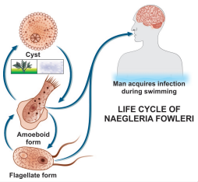
Flagellate form of trophozoite
helps in the spread of N. fowleri
to new water bodies.
Completion of the life cycle occur
in the external environment.

Slide 41
Pathogenicity and Clinical Features
Patients are mostly previously healthy young adults or children.
Infection occur following swimming or diving in ponds containing amoebae.
The amoebae invade the nasal mucosa, pass through the olfactory nerve branches in the cribriform plate into the meninges & brain.
This initiates an acute purulent meningitis and encephalitis called primary amoebic meningo encephalitis (PAM) .
The incubation period varies from 2 days to 2 weeks during which the patient experiences anosmia.

Slide 42
The disease advances rapidly causing fever, headache, vomiting, stiff neck, ataxia, seizure and coma.
Cranial nerve palsies, especially of the third, fourth, and sixth nerves have also been documented.
The disease almost always ends fatally within a week (average 5 days).

Slide 43
Laboratory Diagnosis
Microscopy
The diagnosis of PAM is by microscopy based on the presence of motile Naegleria trophozoites in wet mounts of freshly-obtained CSF.
The CSF picture resembles that of bacterial meningitis with a cloudy to purulent appearance, prominent neutrophilic leukocytosis, elevated protein & low glucose.
Cysts are not found in CSF or brain.
At autopsy, trophozoites can be demonstrated in brain histologically by immunofluroscent staining.

Slide 44
Culture
N. fowleri can be grown in several kinds of liquid axenic media or non-nutrient agar plates coated with Escherichia coli. Both trophozoites and cysts occur in culture.
Molecular Diagnosis
Newer tests based on polymerase chain reaction (PCR) technology are being developed.

Slide 45
Treatment
Amphotericin-B is the drug of choice administered via IV or intrathecally (injected into the spinal canal or subarachnoid space).
Treatment combining miconazole & sulfadiazine has shown limited success when administered early.
More than 95% cases of PAM are fatal despite of treatment.

Slide 46
Acanthamoeba Species
A. culbertsoni (formerly, Hartmanella culbertsoni) is the species most often responsible for human infection.
Infection by other species like A. polyphagia, A. castalleni, and A. astromyx have also been reported.
This is an opportunistic protozoan pathogen found worldwide in the environment in water and soil.
Approximately 400 cases have been reported worldwide

Slide 47
Morphology
Acanthamoeba exists as active trophozoite form & a highly resistant double-walled cystic form.
The trophozoite is large in size & characterized by spine-like pseudopodia (acanthopodia).
It differs from Naegleria in not having a flagellate stage & in forming cysts in tissues.
Cysts are present in all types of environment all over the world.

Slide 48
Life Cycle
Both trophozoites & cysts are infective.
Infections occur by inhalation of a cyst or trophozoite.
Infection can also occur by ingestion of cysts or through contact with traumatized skin or eyes.
After inhalation of aerosol or dust containing trophozoites and cysts, the trophozoites reach the lungs from which they invade the CNS hematogenously producing granulomatous amoebic encephalitis (GAE).

Slide 49
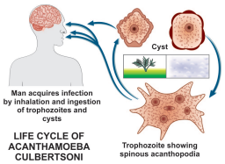
Life cycle of Acanthamoeba culbertsoni

Slide 50
Pathogenesis & Clinical Features
Infection usually occurs in patients with immunodeficiency, diabetes, malignancies, malnutrition, systemic lupus erythematosus.
The parasite spreads hematogenously into central nervous system.
Subsequent invasion of the connective tissue & induction of pro-inflammatory responses lead to neuronal damage that can be fatal within days.
A postmortem biopsy show severe edema & hemorrhagic necrosis.

Slide 51
Clinical Disease
Presents mainly as 2 chronic conditions—keratitis & encephalitis.
Acanthamoeba keratitis
Follows infection of the eye that typically occurs in healthy persons & is due to entry of the amoebic cyst through abrasions on the cornea.
Majority of such cases have been associated with the use of contact lenses.
The picture resembles that of severe herpetic keratitis with a slow relapsing course but the eye is severely painful in amoebic infection

Slide 52
Unilateral photophobia, excessive tearing, redness and foreign body sensation are the early signs & symptoms (disease is bilateral in some contact lens users).
Keratitis and uveitis can result in permanent visual impairment or blindness.
Granulomatous amoebic encephalitis(GAE):
It is a serious infection of the brain and spinal cord that typically occurs in persons with a compromised immune system.

Slide 53
GAE is believed to follow inhalation of the dried cysts.
The incubation period is long with slow evolution of the illness.
Clinical picture is that of intracranial space-occupying lesions with seizures, paresis & mental deterioration.
Disseminated infection
In immuno-comprised states AIDS, widespread infection affecting the skin, lungs, sinuses, and other organs independently or in combination can occur.

Slide 54
Laboratory Diagnosis
Diagnosis of amoebic keratitis is by demonstration of the cyst in corneal scrapings on wet mount, histology and culture. Growth can be obtained from corneal scrapings inoculated on nutrient agar, overlaid with live or dead Escherichia coli and incubated at 30°C.
Diagnosis of GAE is made by demonstration of trophozoites and cysts in brain biopsy, culture & immofluroscence microscopy using monoclonal antibodies.
CSF shows lymphocytic pleocytosis, slightly elevated protein levels, and normal or slightly decreased glucose levels.
CT scan of brain provides is inconclusive.

Slide 55
Treatment
In acanthamoeba keratitis, current therapy involves topical administration of biguanide or chlorhexadine with or without diamidine agent.
In severe cases, where vision is threatened, penetrating keratoplasty can be done.
No effective treatment is available for GAE. Multidrug combinations including pentamidine, sulfadiazine, rifampicin, and fluconazole are being used with limited success.

Slide 56
Balamuthia Mandrillaris
B. mandrillaris, a leptomixid free-living amoeba, is a newly identified specie reported to cause GAE.
Morphology
It exists as a cyst & an amoeboid trophozoite stage(flagellate stage is absent).
It is relatively large, irregular in shape & actively motile by broad pseudopodia.
Cyst of B. mandrillaris are usually spherical surrounded by a three-layered cyst wall comprising an outer irregular ectocyst, a middle mesocyst & an inner endocyst round wall.
Under light microscopy, it appears to have two walls—an outer irregular wall & an inner smooth wall.

Slide 57
Infection is transmitted through respiratory tract, skin lesions or the eyes.
The life cycle is similar to that of Acanthamoeba spp.
Clinical Disease
It causes granulomatous amoebic encephalitis in both healthy & immunocompromised hosts particularly in children & elderly.

Slide 58
Laboratory Diagnosis
Laboratory diagnosis is done by identifying trophozoites of B. mandrillaris in the CSF .
Also identifying trophozoites & cysts in brain tissue.
PCR also gives reliable diagnosis.

