Slide 1
Toxoplasma gondii
Dr J Mudenda

Slide 2
Lecture outline
INTRODUCTION
EPIDEMIOLOGY
LIFE CYCLE
PATHOGENICITY AND VIRULENCE FACTORS
CLINICAL PRESENTATION AND TREATMENT
CONCLUSION AND RECOMMENDATION
REFERENCES

Slide 3
Introduction
T. gondii was first discovered in 1908 in Tunis within the tissue of a North African rodent,Ctenodactylus gondii .
In the same year it was also described in Brazil in rabbits by Nicolle and Manceaux.
It was rediscovered in 1935 in the brain of guinea pigs
In 1939 it was found as the cause of encephalitis in 31 day old infant.

Slide 4
In 1969 infective cysts were detected in the stools of cats.
A member of the Apicomplexa related to plasmodium,isospora and others.
It is a single celled intracellular protozoan that causes Toxoplasmosis a parasitic disease.
Found in several animals including cattle,pigs,sheep,also birds and humans but the essential reservoir host is the common house cat and other felines.

Slide 5
Is distributed worldwide and occurs in areas where cats are many and where low hygiene holds sway.
Infection is high where meat is eaten raw or partially cooked.
Infection is common but diseases are rare.
In domesticated animals, Toxoplasmosis is the leading cause of abortion in sheep and goats.

Slide 6
Epidemiology
It is one of the most common parasites in humans & approximately 25 -30% of the world’s human population is infected by Toxoplasma(Montoya and Liesenfeld).
Serological studies estimate that up to a third of the global population has been exposed to and maybe chronically infected with T gondii, although infection rates differ significantly from country to country(pappas et al.,2009).
It is capable of infecting virtually all warm blooded animals(Linday and Dubey,2013)

Slide 7
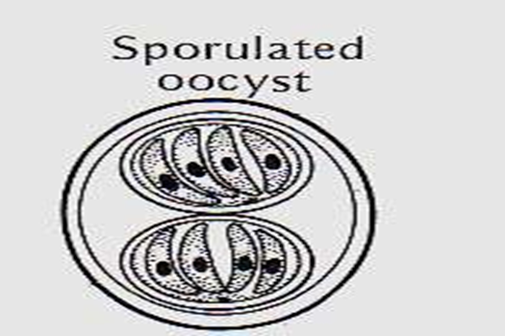
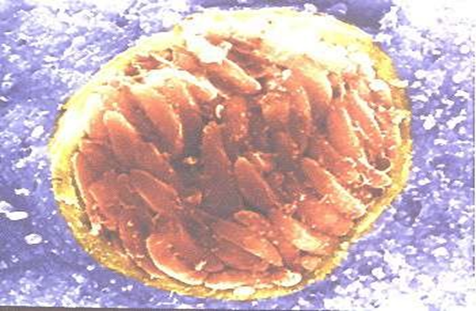
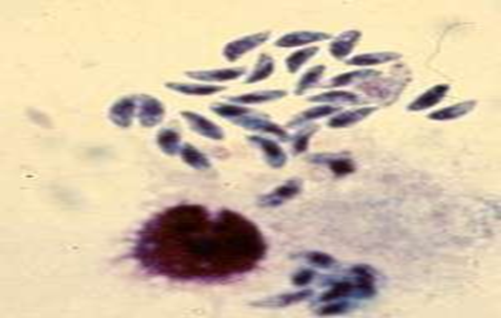
Morphology
Toxoplasma gondii exists in three forms
All the three parasite stages are infectious.
Oocysts
Tachyzoites(trophozoite)
Tissue cysts (bradyzoite)

Slide 8
Trophozoite and tissue cyst represent stages in asexual multiplication (schizogony).
The oocyst is formed by sexual reproduction (gametogony or sporogony).
All 3 forms occur in domestic cats and other felines, which are the definitive hosts supporting both schizogony & gametogony.
Only the asexual forms, trophozoites and tissue cysts are found in humans, other animals and birds which are the intermediate hosts.

Slide 9
Trophozoites (Tachyzoites)
Are crescent shaped with one rounded and one pointed end.
4-6um in length and 2-3 micron in width
Rapidly growing stage observed in the early stage of infection. & found in the body fluids.
Its an asexual form & multiplies by endodyogeny.
It can infect phagocytic and non-phagocytic, cells.
When stained with giemsa,cytoplasm appears blue and nucleus is red and located at the rounded end.

Slide 10
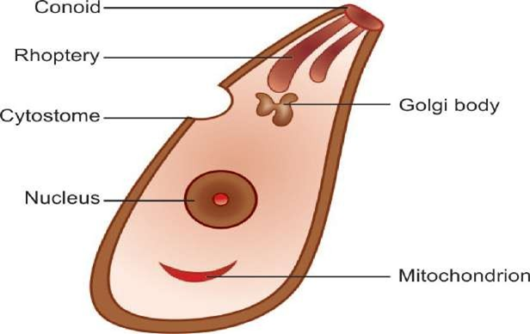
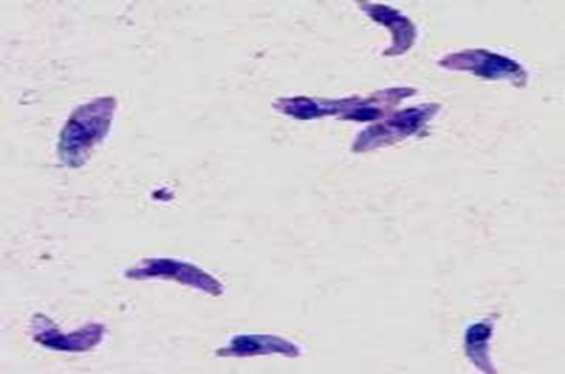
Tachyzoite
Giemsa stained trophozoites

Slide 11
Bradyzoites-Tissue cyst
They are a slow-growing stage or resting form found inside the tissue cysts.
They mark the chronic phase of infection & can be found in the brain(most common site),skeletal muscle & other organs.
Are resistant to low pH and digestive enzymes during stomach passage.
Cysts remain viable in tissue for several years.
It is relatively resistant and when the raw or undercooked meat containing the cysts is eaten, infection occurs.
Cysts are susceptible to drying,temp > 60°C, freezing and thawing.

Slide 12
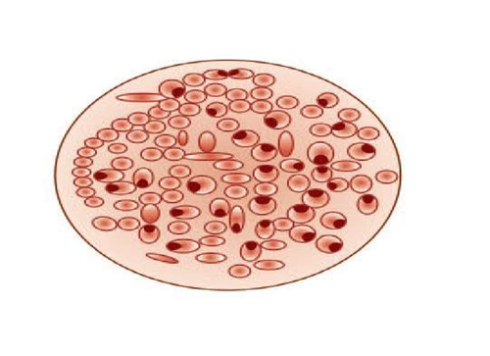

Protective cyst wall is finally dissolved and bradyzoites infect tissue and transform into tachyzoites.
Bradyzoites are released in the intestine and initiate infection by invading intestinal epithelial cells.
Dissemination to various tissues & organs occur through blood & lymphatic dissemination.
In immune competent hosts, cysts remain silent while may get reactivated in immunodeficient subjects leading to clinical disease

Slide 13
Oocysts in the feces of cat
Oocysts only develop in definitive hosts –cats and other felines but not in humans.
They develop in the intestines of the cat following ingestion of tissue cysts containing bradyzoites.
Gametocytes develop from merozoites in the small intestine .
Fusion of gametes during the sexual cycle produces the oocyst which is excreted in the feces.
Oocysts appear in the cat’s feces 3-5 days after infection by cysts.
The oocyst is noninfectious before sporulation ,requires oxygen and sporulate in 1- 5 days.

Slide 14
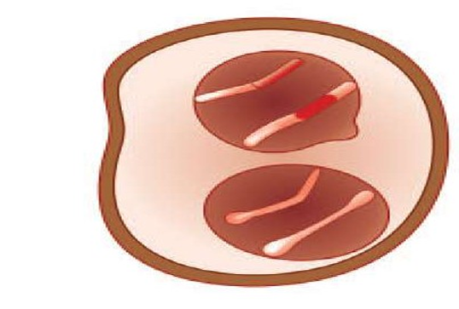
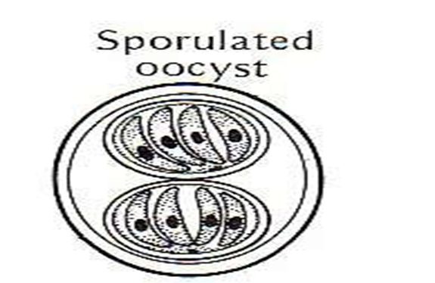
Sporulation occur in the soil to form 2 sporocysts each containing 4 sporozoites.
The sporulated oocyst is infective.
Oocyst is very resistant to environmental conditions and can remain infective in soil for months to about a year.
When the infective oocyst is ingested, it releases sporozoites in the intestine which initiates infection.
Unsporulated oocyst
Sporulated oocyst with 2 sporocysts containing 4 sporozoites each

Slide 15
Transmission
According to Tenter et al.(2000) infection in humans and other warm blooded animals can occur :-
By consuming raw or undercooked meat containing T gondii tissue cysts.
By ingesting water , soil , vegetables or anything contaminated with oocysts shed in the feces of an infected animal.
From blood transfusion or organ transplant.
Transplacental transmission from mother to fetus , particularly when T gondii is contracted during pregnancy.
Reactivation of infection(immunocompromised e.g AIDS or immunosuppressed e.g corticosteroid drugs)

Slide 16
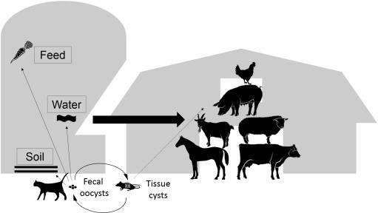
Transmission

Slide 17
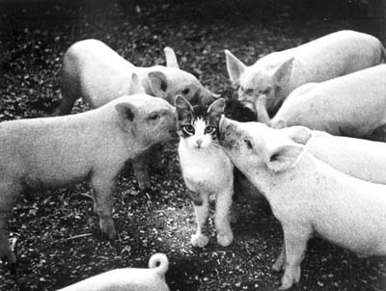
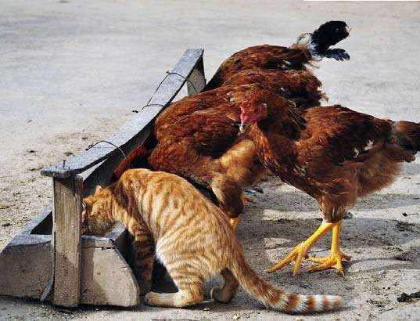
Toxoplasma gondii
Non-felid hosts (important sources of human infections)
Swine
Systemic toxoplasmosis, ingest oocyst from cat feces or tissue cyst from prey.
  Fever, respiratory signs
  Highly prevalent in free-range pigs
  Important source of infection for humans
Poultry
Systemic toxoplasmosis, ingest oocyst from cat feces
  Prevalent in free-range and back-yard chickens
  Important source of infection for humans

Slide 18
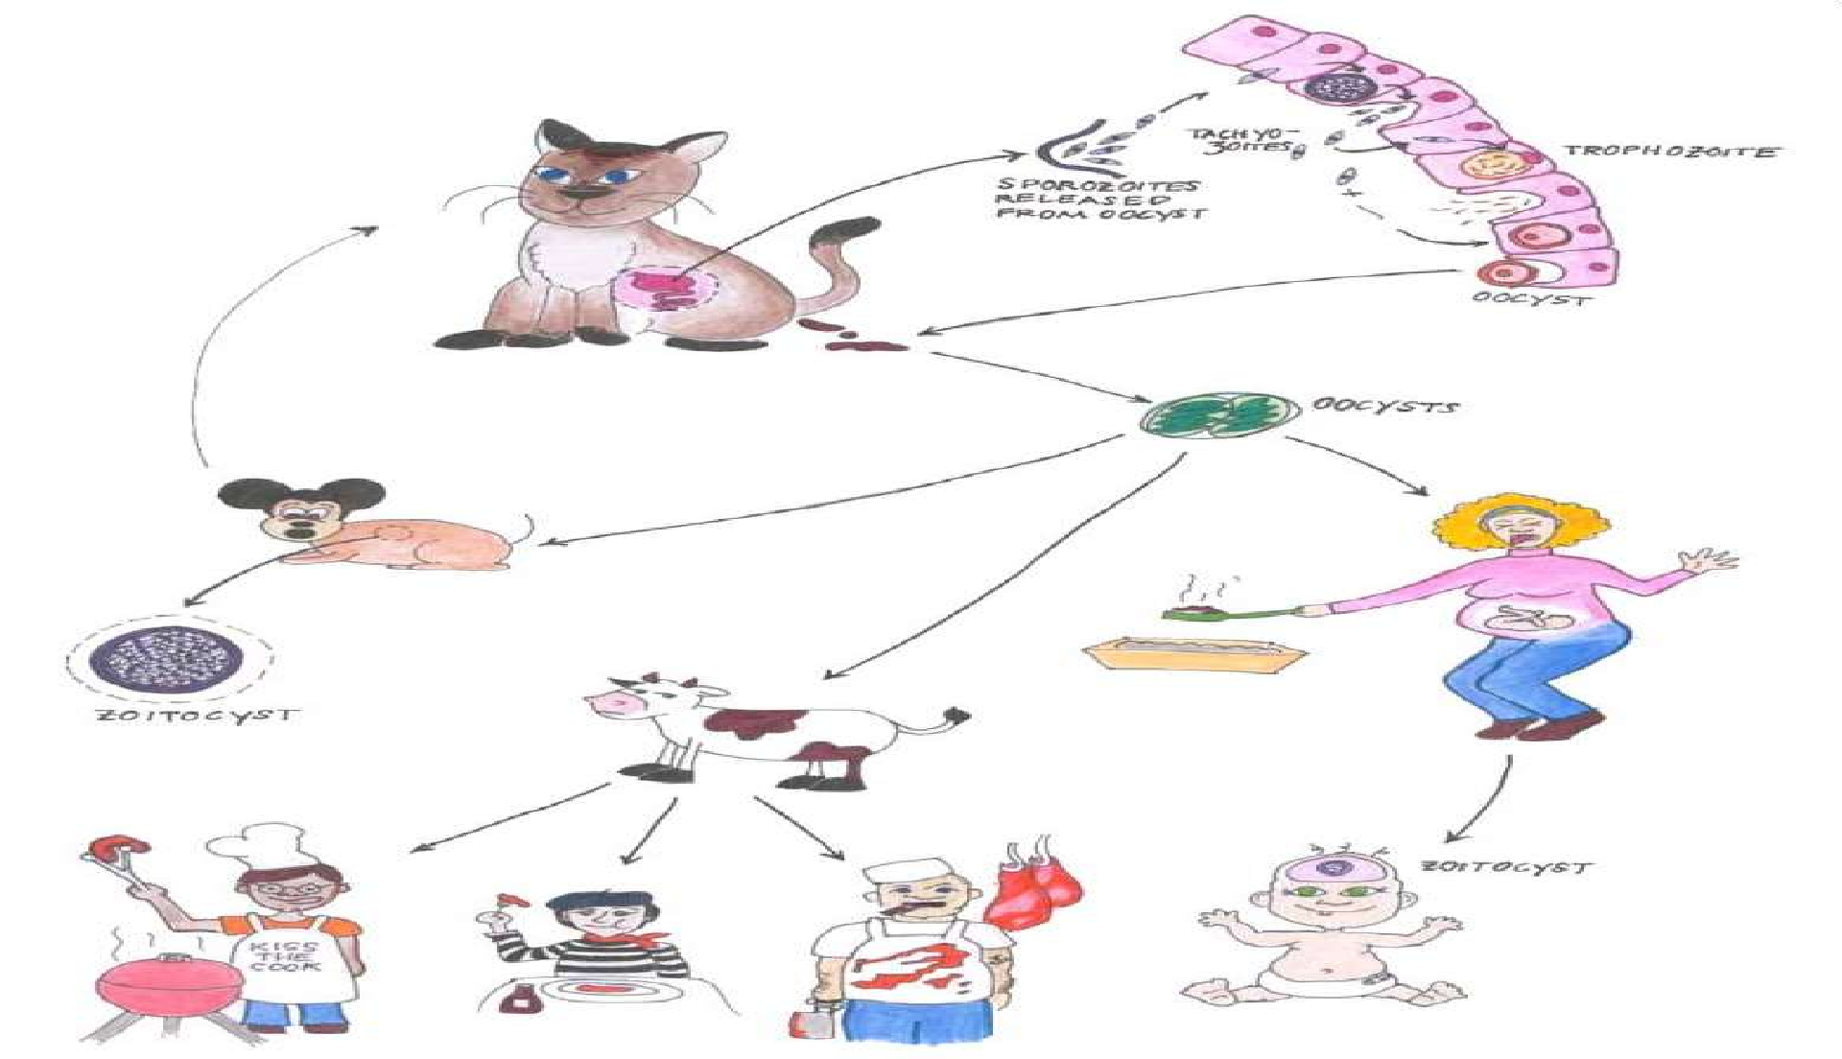
Many Humans at risk with Toxoplasmosis

Slide 19
Life cycle
T. gondii completes its life cycle in 2 hosts.
Definitive host: Cats and other felines, in which both sexual and asexual cycle takes place.
Intermediate hosts: Man and other mammals, in which only the asexual cycle takes place.
T. gondii has 2 types of life cycles:
Enteric cycle
Exo-enteric cycle

Slide 20
Enteric cycle
Occurs in definitive hosts where both sexual (gametogony) and asexual (schizogony) reproduction occur within the mucosal epithelial cells of the small intestine.
Cat acquires infection by ingestion of tissue cysts in the meat of rats and other animals or by ingestion of oocysts passed in its feces.
The bradyzoites are released in the small intestine and they undergo asexual multiplication (schizogony) forming merozoites.
Some merozoites enter extraintestinal tissues forming tissue cysts in other organs of the body.

Slide 21
Other merozoites transform into male & female gametocytes and sexual cycle (gametogony) begins, with the formation of microgamete and macrogamete.
A macrogamete is fertilized by motile microgamete forming an oocyst, which passes through maturation stages (sporulation) in the soil after being excreted from host through feces.
A mature oocyst containing 8 sporozoites is the infective form which may be ingested by rats or other mammals to repeat the cycle

Slide 22
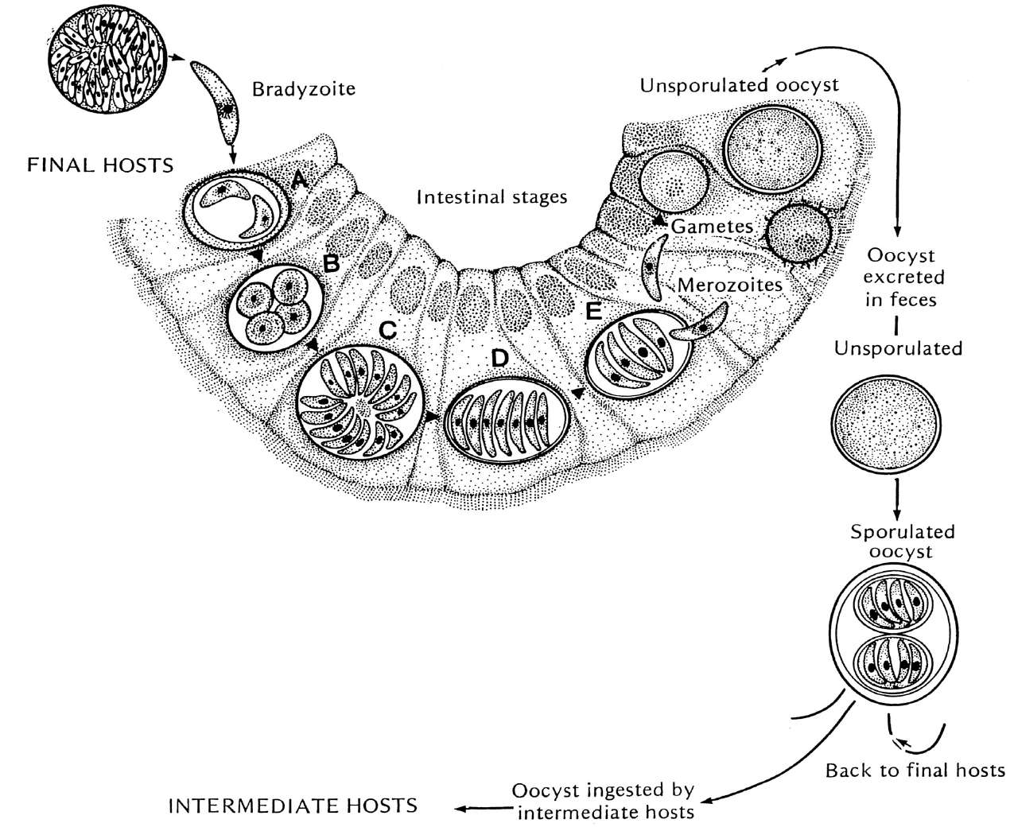



_{Zygote} Encapsulation of zygote
Toxoplasma gondii
Tissue cyst
within a rigid wall: oocyst
Oocyst
Gametocytes
Multiplication
Bradyzoites infect cells and become tachyozoites.
Merozoites
Cat’s intestinal enterocytes

Slide 23
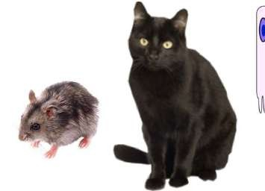
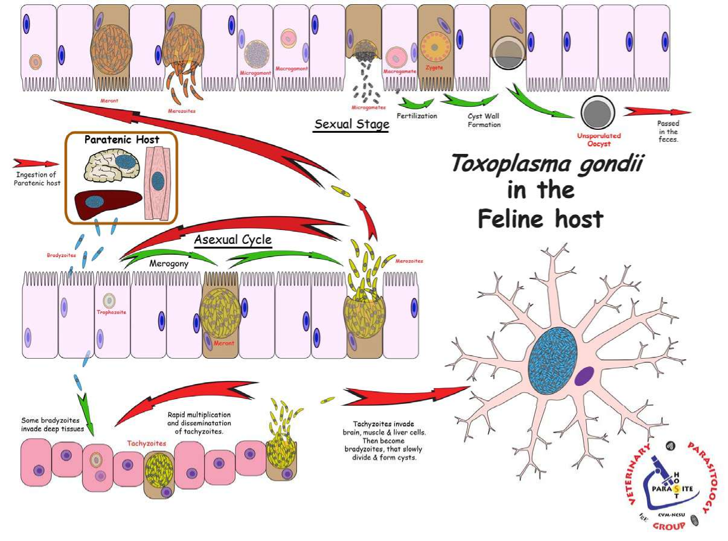

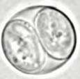
start here
(Sporogony)

Slide 24
Exo-enteric cycle
Exo-enteric cycle occurs in humans, rats, sheep, cattle, pigs, birds & other intermediate hosts.
Sporozoites from the oocysts and bradyzoites from the tissue cysts enter into the intestinal mucosa and multiply asexually and tachyzoites are formed (endodyogeny).
Tachyzoites continue to multiply and spread locally by lymphatic system and blood.
Some tachyzoites spread to distant extraintestinal organs like brain, eye, liver, skeletal muscles etc. to form tissue cysts(human infn is dead end).
The slowly multiplying forms inside the tissue cysts are known as bradyzoites, which remain viable for years.
The dormant bradyzoites inside the cyst may be re-activated in immune suppression causing renewed infection in the host

Slide 25
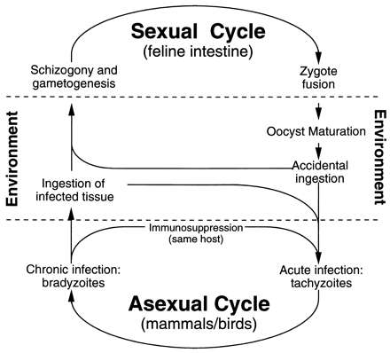

Slide 26

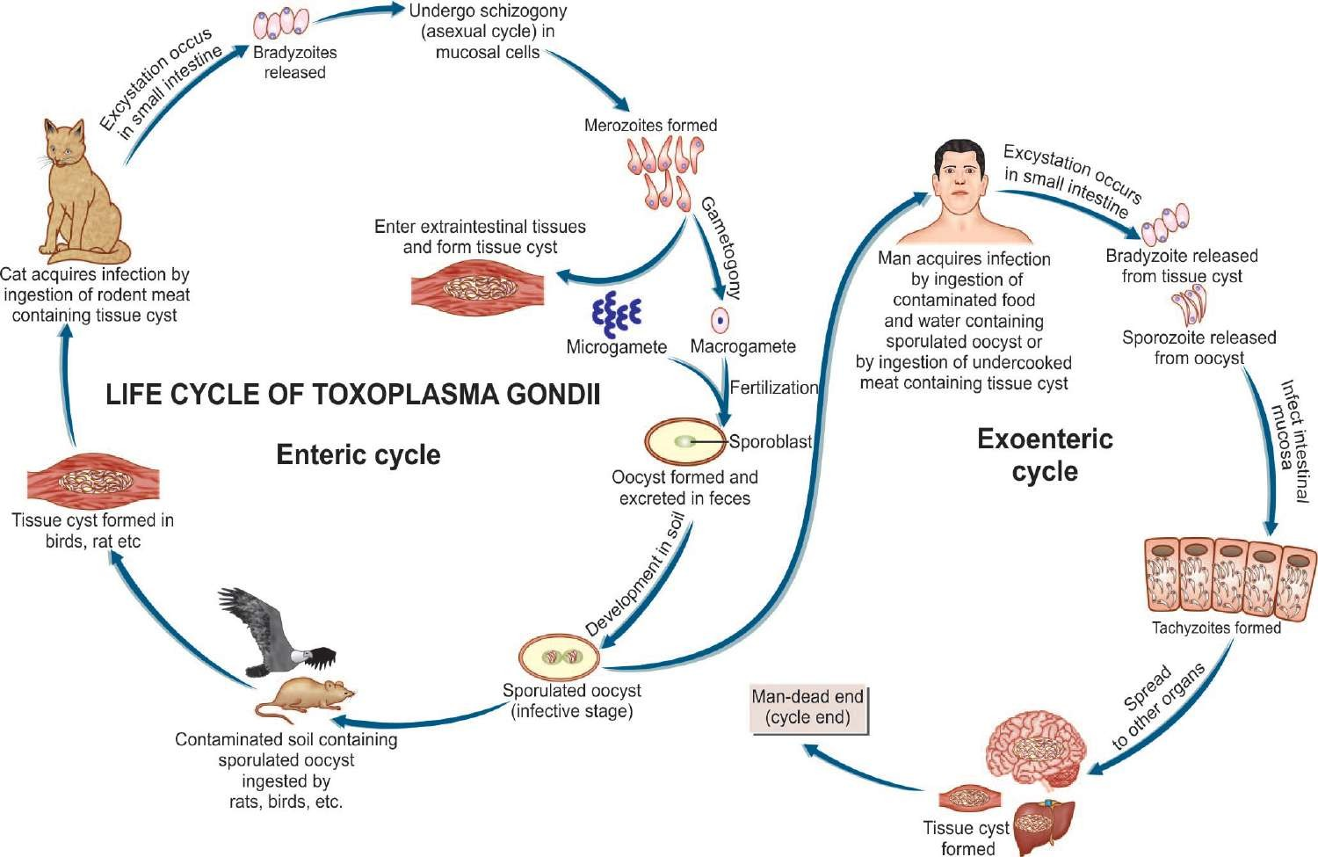
Life cycle of T. gondii

Slide 27
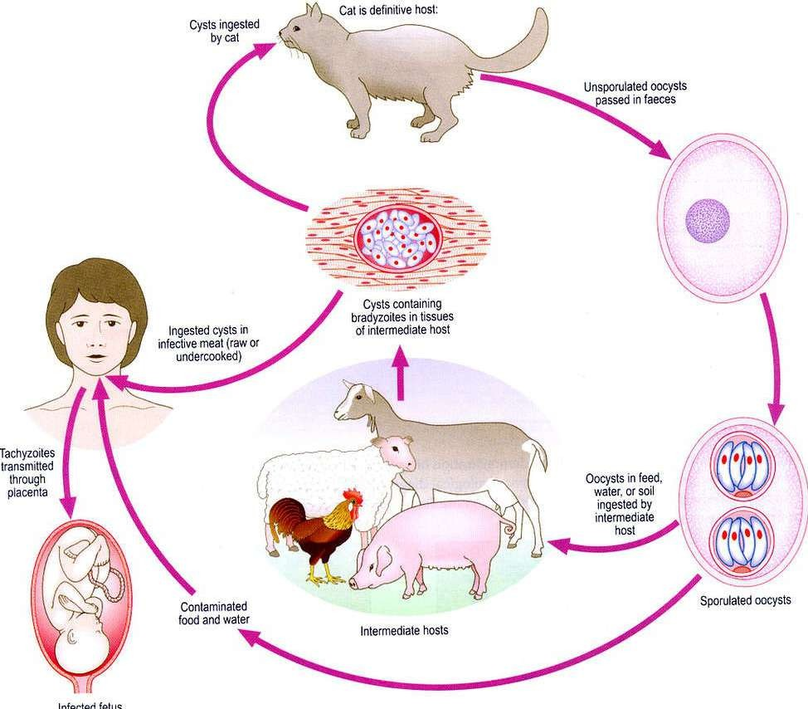

Slide 28
Pathogenicity and virulence factors
It has ability to invade a wide variety of host cells which is an active process relying on parasite motility and sequential secretion of proteins from secretory organelles micronemes, rhoptries and the dense granules.
Attachment of the parasite to the host cell membrane involves secretion of micronemes protein (MIC2)
Cell invasion involves a process called gliding motility promoted by actin-myosin interaction and dynamic rearrangement of the parasite cytoskeleton.
Formation of tight relationship occur between apical end and host cell membrane called moving joint.
Internalization of the parasite into the parasitophorus vacuole(PV).

Slide 29
The moving joint around the invading parasite requires the distribution of the apical membrane antigen(AMA1) and Rhoptry(ROP) neck protein.
Parasitophorus vacuole membrane (PVM) is formed which requires the secretion of the protein from ROPs(ROP18,ROP16).
Dense granular protein also contribute to the formation of PVM during the 1st hour of invasion.
Replication is by endodyogeny and the tachyzoites divide during the 6-9h cycle.
They exit the cell usually after 64-128 parasites have accumulated in the PV.
The parasite avoid destruction by preventing fusion of the phagosome with the lysosome.

Slide 30
Clinical Features
The course of Toxoplasma infection depends on the immune status of the infected person.
Most human infections are asymptomatic however active progression of infection is more likely in immunocompromised individuals.
Toxoplasmosis has acquired great importance as one of the major fatal complications in AIDS.
Clinical toxoplasmosis may be congenital or acquired

Slide 31
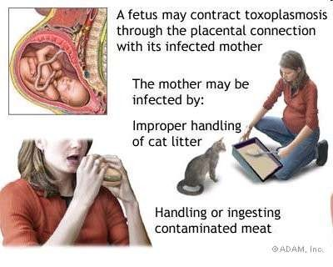
Congenital toxoplasmosis
occurs when the mother gets 1° Toxo infection during pregnancy whether clinical or asymptomatic.
Mothers with latent infn acquired earlier do not ordinarily infect their babies although tissue cyst reactivation during pregnancy occur & liberate trophozoites, which may infect the fetus in utero.
Fetal infn risk rises with progress of gestation(high in the third trimester than 1st trimester).
The severity of fetal damage is highest, when infection is transmitted in early pregnancy.
Some newborns show clinical symptoms of Toxo weeks, months & even years after birth

Slide 32
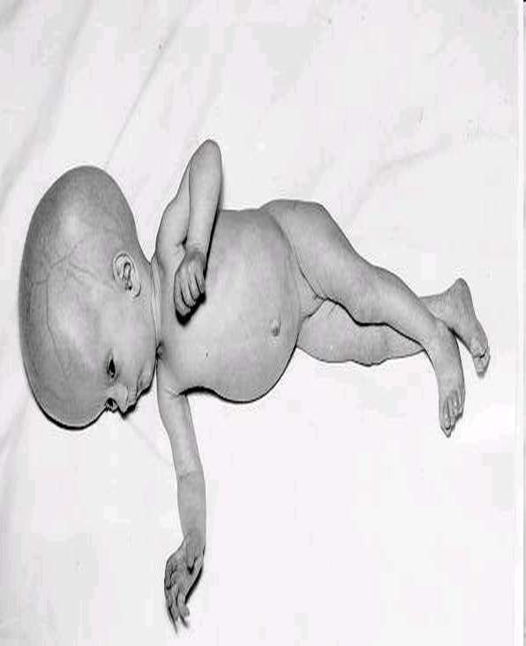
Congenital Infection
The manifestations include:-
Chorioretinitis, blindness & cerebral calcifications
Convulsions, deafness, & mental retardation.
Poor motor coordination.
Hydrocephalus & microcephaly

Slide 33
Early & Late Anomalies in Toxoplasmosis
Manifestations of acute toxoplasmosis include fever, jaundice, rashes, microphthalmia, cataract, glaucoma, lymphadenopathy, myocarditis & hepatosplenomegaly.
These may manifest at birth in some children.
Clinical manifestation in infected fetus may be delayed until long after birth.
Neurological problems of learning difficulties may be caused by long delayed effects of late prenatal infection.

Slide 34
Acquired Toxoplasmosis
Infection acquired postnatally is mostly asymptomatic.
The most common manifestation of acute acquired toxoplasmosis is lymphadenopathy( cervical nodes mostly affected).
The illness may resemble mild flu and is self-limited although lymphadenopathy may persist.
Fever, headache, myalgia & splenomegaly are often present.
In some cases, there may be a typhus-like exanthema with pneumonitis, myocarditis & meningoencephalitis, which may be fatal.

Slide 35
Systemic Toxoplasmosis
In immune-competent individuals, infection will present with the following:-
1st exposure
  Most often asymptomatic
  “flu-like” illness that may last for weeks
  Fever, myalgia, sore throat, lymphadenopathy
Future exposures
  Individuals are immune-protected hence no pathology
Can remain latently infected with cysts

Slide 36
In immunocompromised patients, Toxoplasmosis may be serious & fatal.
May be due to reactivation of latent infection or new acquisition of infections.
In most cases the brain is most common affected organs.
Other involved organs include eyes, lungs (Toxoplasma pneumonia), pancreas, GIT,heart & liver.
The disease may present with meningoencephalitis, altered mental status, seizures, cerebellar signs & behavioral( neuropsychiatric) changes.

Slide 37
Laboratory Diagnosis
Serodiagnosis is the main stay for diagnosis of toxoplasmosis.
Detection of IgM & IgG antibodies using latex agglutination assays and ELISA commonly used.
Detection of antigen by ELISA indicates recent Toxoplasma infection.
Microscopy
Tachyzoites & tissue cysts can be detected in various specimens eg blood, CSF, sputum, amniotic fluid etc.
Biopsies from lymph node, spleen & brain are also used.

Slide 38
Imaging
MRI & CT scan are used to diagnose toxoplasmosis with CNS.
USG of the fetus in utero at 20–24 wks of pregnancy is useful for diagnosis of congenital toxoplasmosis.

Slide 39
Treatment
Congenital Toxoplasmosis
Pyrimethamine & sulfadiazine with folic acid is used.
Corticosteroids may be added to reduce chorioretinitis.
Immune competent persons
Do not require treatment unless they have persistent severe symptoms.
Patients with ocular toxoplasmosis are treated for 1 month with pyrimethamine plus either sulfadiazine or clindamycin.

Slide 40
Immunocompromised Patients
T gondii seropositive AIDS patients with low CD4+ (<100/ul )should receive 1°prophylaxis against toxoplasma encephalitis.
Trimethoprim­ sulfamethoxazole(septrin) is the drug of choice.
In sulfonamide sensitive pts , dapsone­-pyrimethamine is the recommended alternative.
Prophylaxis against encephalitis can be stopped once ART is responding and CD4+ count is >200/µL for 3 months.

Slide 41
Prevention
Avoiding contact with cat and its feces in individuals at risk e.g. pregnant & immunocompromised persons.
Proper cooking of meals especially meat products.
Proper washing of hands and washing of vegetables and fruits before eating.
T. gondii screening in blood & its products in blood banks.
NOTE: Toxoplasmosis control is difficult due to a wide range of animal reservoirs.
No effective vaccine is available currently.

