Slide 1
ANTERIOR NECK REGION

Slide 2
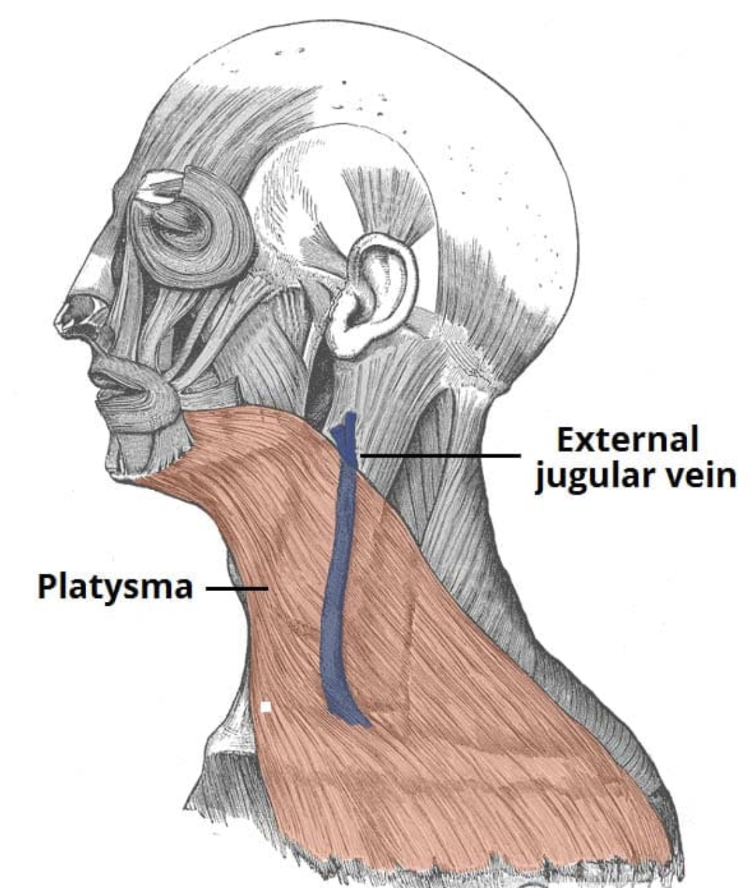

Slide 3
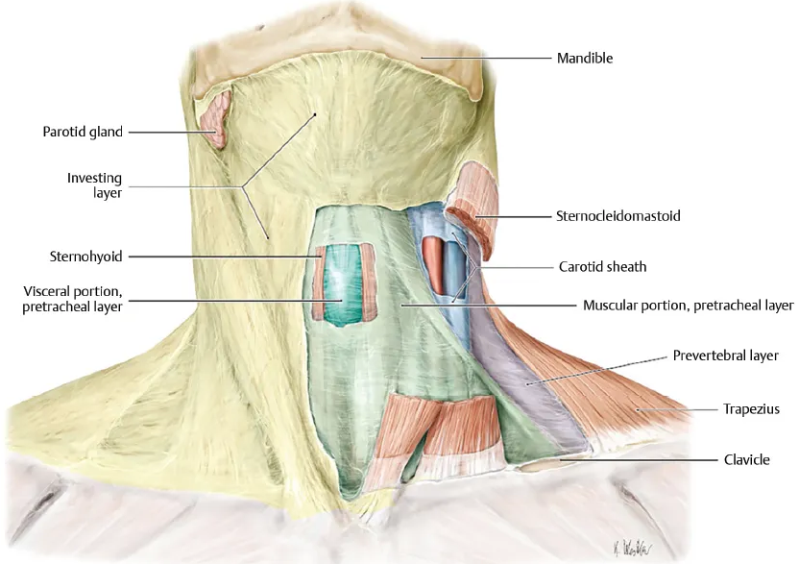

Slide 4
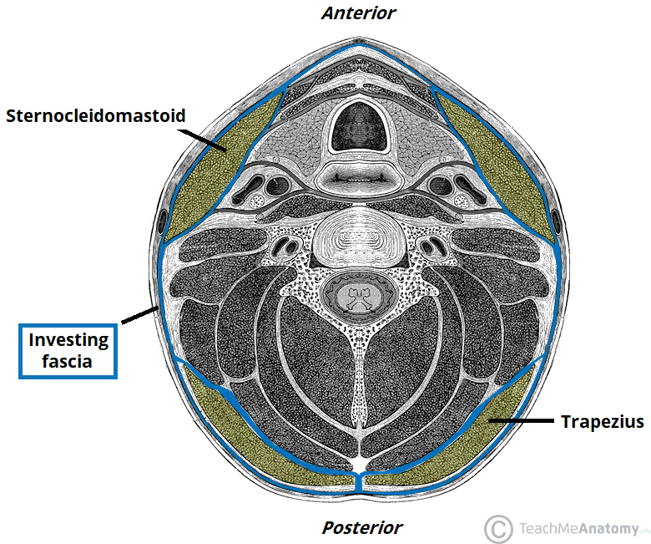

Slide 5
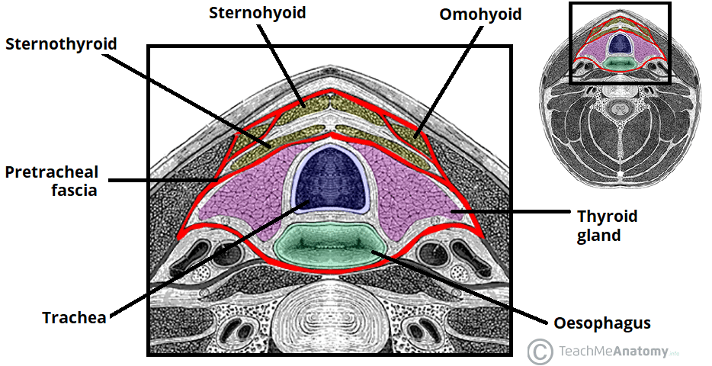

Slide 6
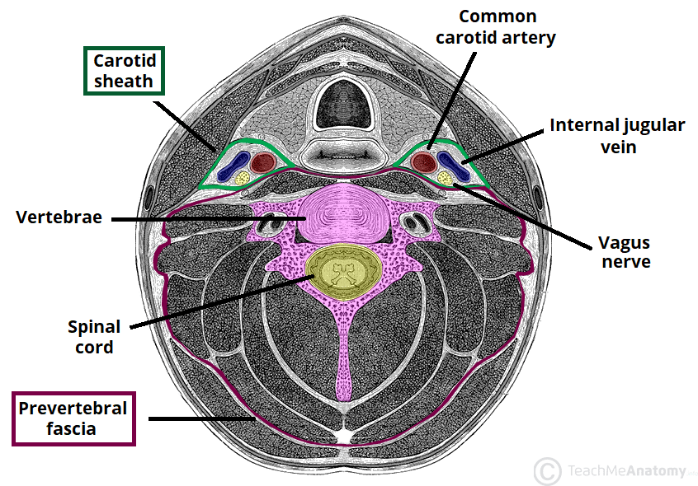

Slide 7
Introduction
The anatomy of the head and neck is complicated secondary to the important neurovascular structures that have a variable course and depth as they traverse through the tissue.
These structures may suffer a potential injury during surgical dissection. The neck divides into subdivisions and compartments.
Neck is a cylindrical - shape that joins the head to the trunk (Thorax).
The weight, connections and movements of the head are supported by the neck.

Slide 8
Contd..
The neck extends from Lower border of mandible - to upper surface of manubrium Anteriorly and Posteriorly from superior nuchal line (occipital bone) to inter-veterbral disc between C VII to T1.
Within the cylinder, the neck is organized into 4 compartments contained within unique layers of cervical fascia.

Slide 9
4 compartments of the neck
1. Visceral compartment – Is anterior-Parts of digestive, respiratory, endocrine glands
2. Vertebral: Posterior and contains cervical vertebrae, spinal cord, cervical nerves, and its muscles
3. Two Neurovascular compartments – either side consisting of major vessels and nerve.
Like a collar, the investing layer of covers the neck. In its course around the neck, it divides to enclose sternocleidomastoid and trapezius muscles.
The 2 fascial layers (pre-tracheal and prevertebral fasciae) split the neck into anterior and posterior compartments

Slide 10
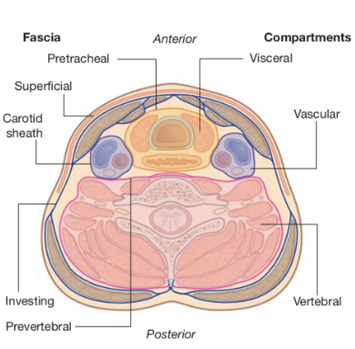
COMPATMENTS OF THE NECK REGION

Slide 11
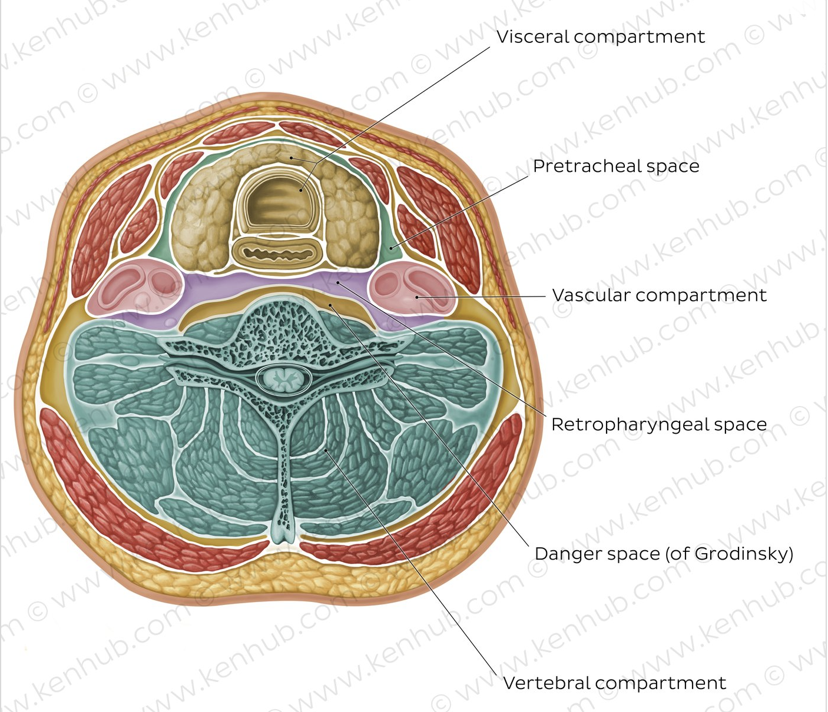

Slide 12
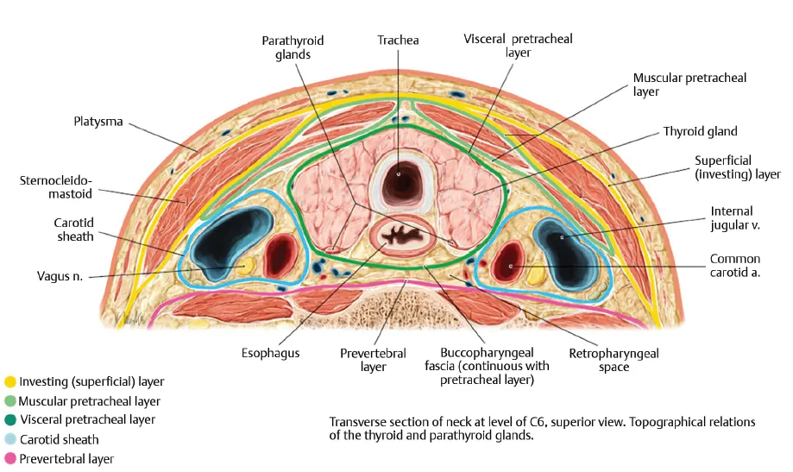

Slide 13
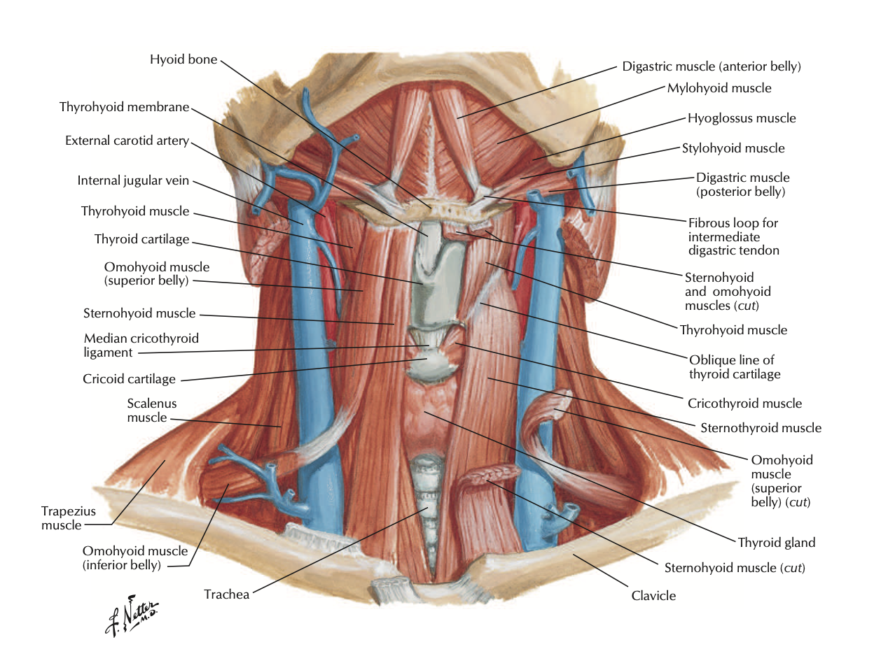

Slide 14
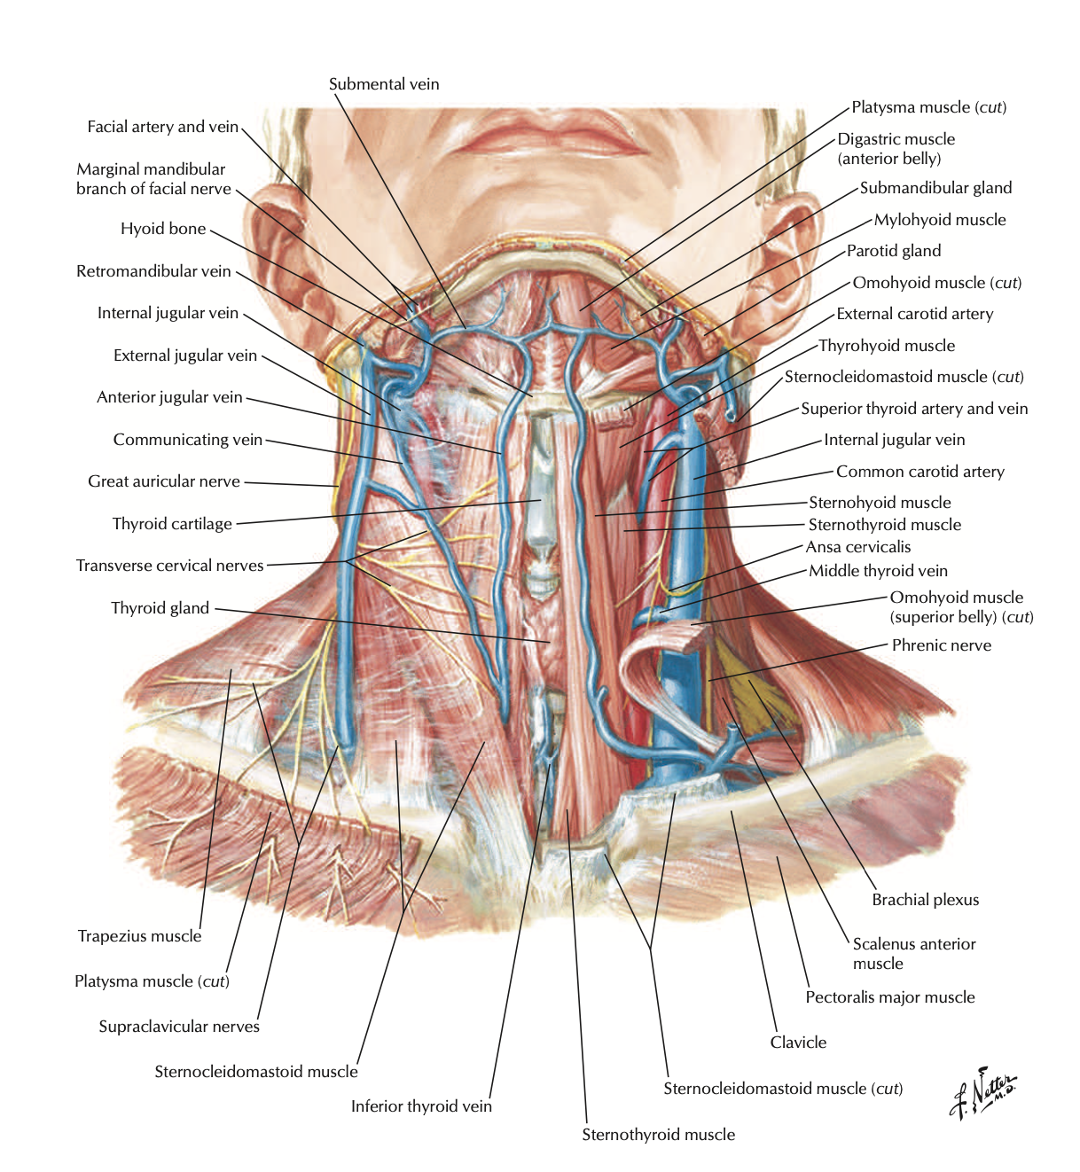

Slide 15
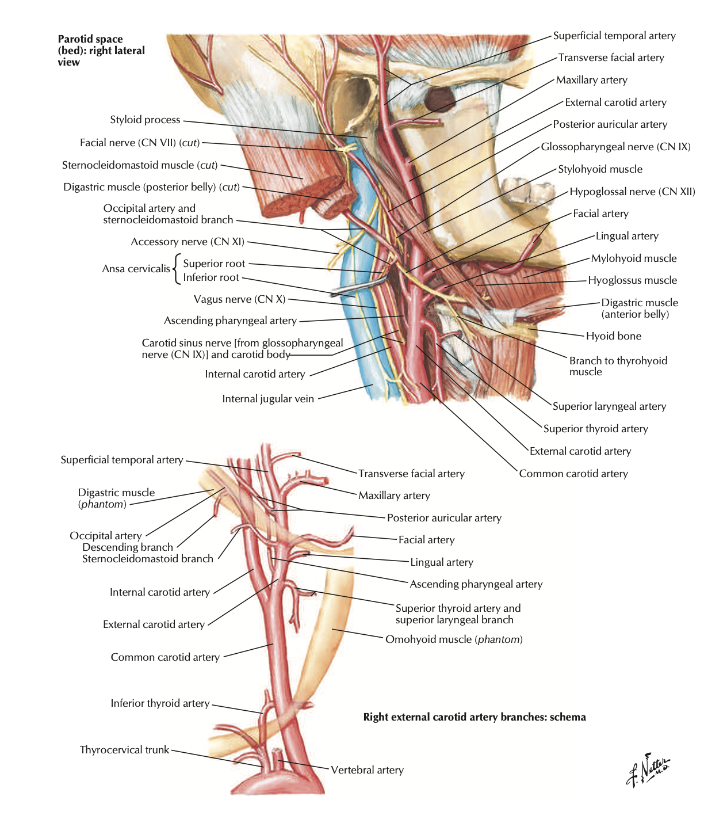

Slide 16
The anterior compartment
The anterior region of the neck includes strap muscles, digestive (pharynx and esophagus) and respiratory tracts (larynx and trachea).
The thyroid gland clasps the front and sides of the larynx and trachea and overlaps the carotid tree on each side.
These structures are bounded anteriorly by pre-tracheal fascia, which stretches on either side to unite together with the investing layer of deep cervical fascia.
On each side of the midline tubes are several ascending and descending neurovascular structures composed of common carotid, internal carotid and external carotid arteries, internal jugular vein and nerves. These structures are contained in the carotid sheath

Slide 17
Contd..
In the midline are the following structures;
Hyoid bone – C3 cervical vertebrae situated in a depression below the mentum and can be easily felt if the neck is extended.
The hyoid bone can be grasped between the thumb and index finger and can move from side to side
Thyroid cartilage C3-C4 - cervical vertebrae. The most notable characteristic in the anterior region of the neck, especially the anterior angle created by the fusion of its 2 laminae which create the laryngeal prominence. It’s noticeable in men and named Adams apple. In females it’s not noticeable generally.

Slide 18
Contd..
Cricoid cartilage - C6 cervical vertebrae. It can be easily felt below the thyroid cartilage.
Tracheal rings: Located below the cricoid cartilage.
Isthmus of the thyroid gland: It is located on the very front of the 2nd 3rd and 4th tracheal rings.
Suprasternal (jugular) notch: T2-T3 thoracic veIt’s depression just above sternum between the medial enlarged ends of the clavicle and can be easily felt.

Slide 19
Contd..
Thyroid lobe: It can be felt on each side just below the level of cricoid cartlage
Common carotid artery: It can be observed and felt on each side in the level of junction between the larynx and trachea along the anterior border of SCM muscle.
The common carotid artery can be compressed against the notable anterior tubercle of transverse process of the 6th cervical vertebra named carotid tubercle (Chassaignac’s tubercle).

Slide 20
Suprahyoid muscles 4
The suprahyoid muscles are a group of four muscles located superior to the hyoid bone of the neck and include stylohyoid, digastric, mylohyoid and geniohyoid muscles
Action-They all act to elevate the hyoid bone – an action involved in swallowing.
The arterial supply to these muscles is via branches of the facial artery, occipital artery, and lingual artery.

Slide 21
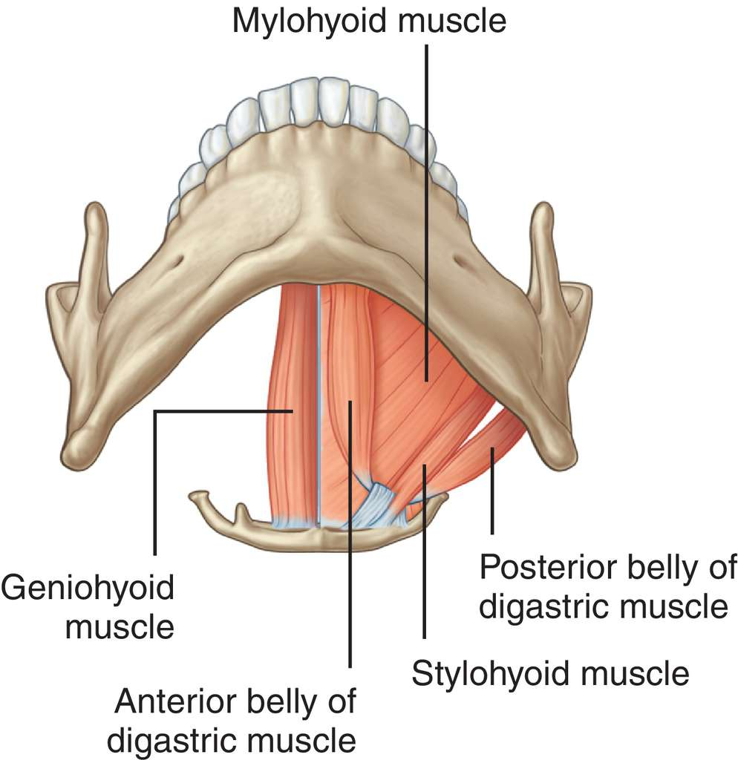
Suprahyoid muscles

Slide 22
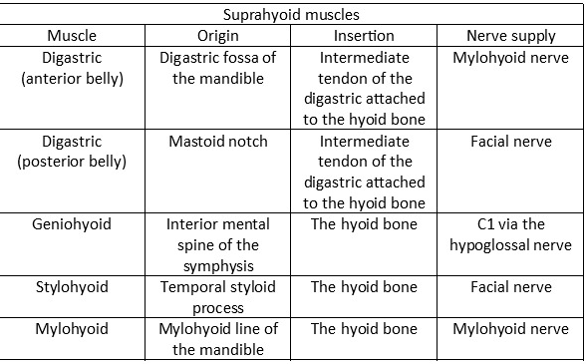

Slide 23
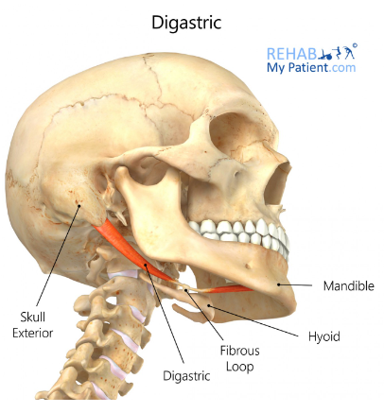

Slide 24
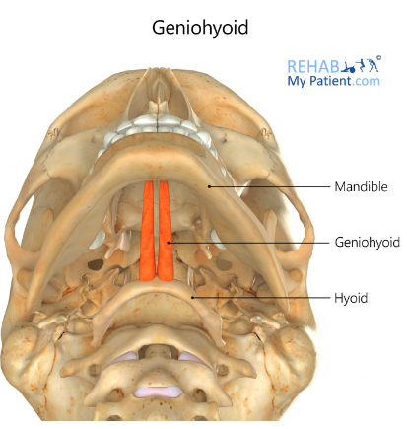

Slide 25
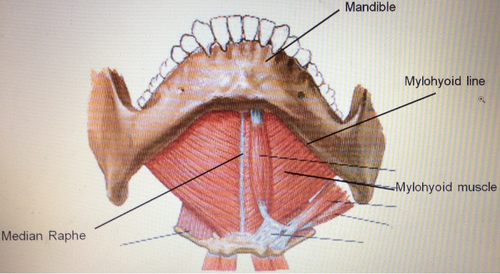

Slide 26
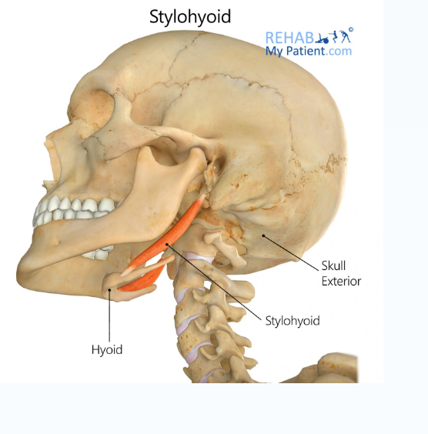

Slide 27
Infrahyoid muscles
The infrahyoid muscles are a group of four muscles that are located inferiorly to the hyoid bone in the neck. These include; Sternothyroid, Thyrohyoid, omohyoid, and sternothyroid (TOSS). They can be divided into two groups:
Superficial plane – Omohyoid and sternohyoid muscles.
Deep plane – Sternothyroid and thyrohyoid muscles.
Together, the infrahyoid muscles play an active role in swallowing through the movement of the larynx.
The thyrohyoid elevates the larynx whereas the sternothyroid depress the larynx.

Slide 28
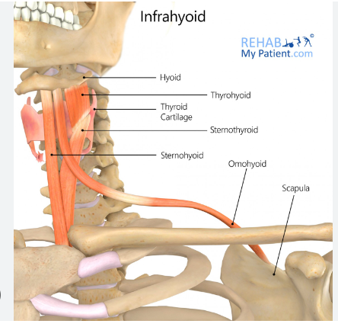

Slide 29
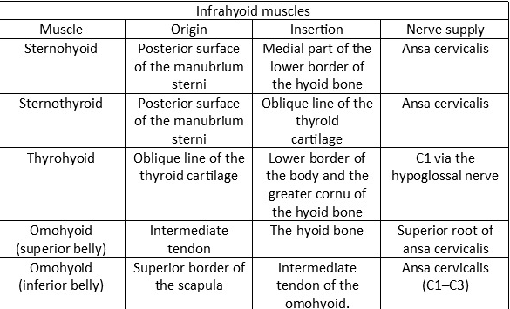

Slide 30
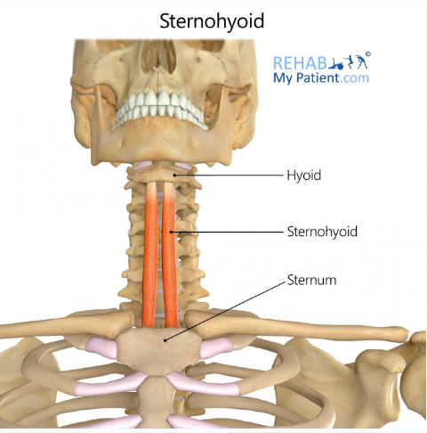

Slide 31
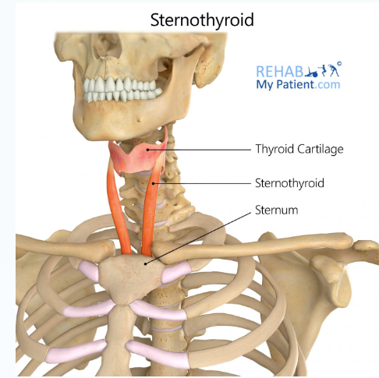

Slide 32
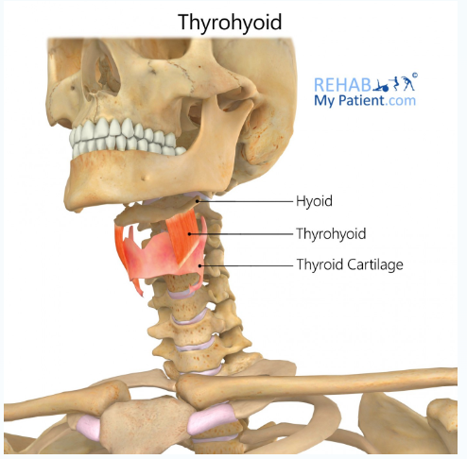

Slide 33
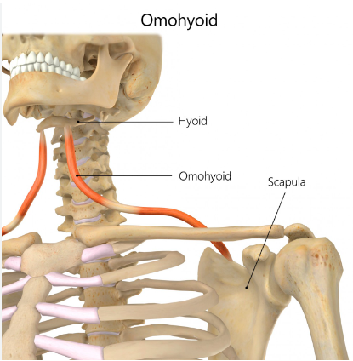

Slide 34
Contd..
The arterial supply to the infrahyoid muscles is via the superior and inferior thyroid arteries, with venous drainage via the corresponding veins.
The infrahyoid muscles receive innervation from the deep ansa cervicalis (C1 to C3), a branch of the cervical plexus.
The thyrohyoid muscle also receives nerve supply by the superior ansa cervicalis going alongside the hypoglossal nerve

Slide 35
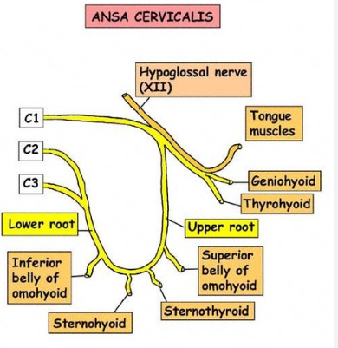

Slide 36
Anterior Triangle
The anterior triangles refer to bilateral anatomic subdivisions of the neck comprising the anterior surface of the neck, deep to the superficial cervical fascia and platysma muscle.
Laterally - Anterior border of sternocleidomastoid muscle.
Superior border - Inferior border of the mandible.
Medially - Midline of the neck.
Roof - Investing fascia
Floor - Visceral fascia
Contents - The contents of the anterior triangle include muscles, nerves, arteries, veins and lymph nodes. The triangle is subdivided into 4

Slide 37
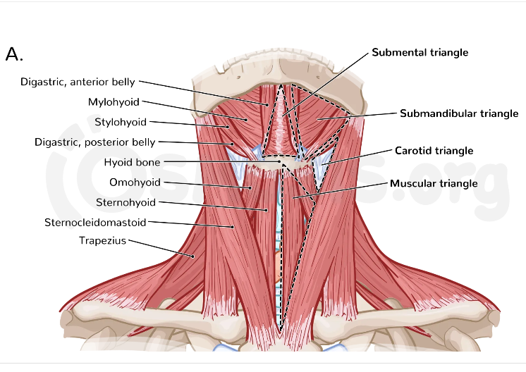

Slide 38
Subdivisions
The anterior triangle is subdivided by the hyoid bone, suprahyoid and infrahyoid muscles into four triangles.
1. Carotid Triangle
The carotid triangle of the neck has the following boundaries:
Superior – Posterior belly of the digastric muscle.
Lateral – Medial border of the sternocleidomastoid muscle.
Inferior – Superior belly of the omohyoid muscle.
The main contents of the carotid triangle are the Common Carotid Artery (which bifurcates within the carotid triangle into the external and internal carotid arteries), the Internal Jugular Vein and Vagus nerves.

Slide 39
Carotid sinus and carotid body
The carotid triangle also contains the carotid sinus, a dilated portion of the internal carotid arteries. It contains specific sensory cells, called baroreceptors. The baroreceptors detect stretch as a measure of blood pressure. The glossopharyngeal nerve provides information to the brain, and this is used to regulate Blood Pressure.
The carotid body is a chemoreceptor located in the adventitia of the bifurcation of the common carotid artery.
Chemoreceptor function: Carotid body monitors the blood's pH, pCO2, and pO2 and thereby modulates cardiovascular and respiratory function primarily through sympathetic tone.

Slide 40
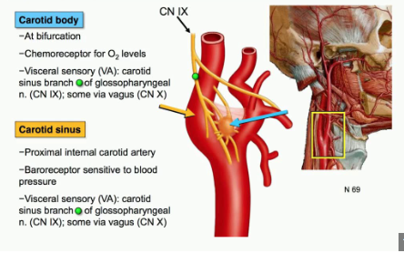

Slide 41
Clinical relevance of the Carotid Triangle
In the carotid triangle, many of the vessels and nerves are relatively superficial, and so can be accessed by surgery.
Neckties should not be tied tightly - it might compress the Internal carotid arteries suppling the brain
Anaethetic artery- Common carotid, superficial temporal, facial utilized

Slide 42
2. Submental Triangle (suprahyoid triangle)
The submental triangle in the neck is situated underneath the mentum. It is unpaired. It is bounded:
Inferiorly – Hyoid bone.
Medially – Midline of the neck.
Laterally – Anterior belly of the digastric.
Roof - skin, superficial cervical fascia, the platysma and deep cervical fascia.
Floor - is formed by the two mylohyoid muscles, which meet in a median fibrous raphe.
Contents - Mylohyoid nerve, submental lymph nodes, Submental branches of the facial artery and Submental branches of the facial vein

Slide 44
3. Submandibular Triangle
The submandibular triangle is located underneath the body of the mandible. The boundaries of the submandibular triangle are:
Superiorly – Body of the mandible.
Anteriorly – Anterior belly of the digastric muscle.
Posteriorly – Posterior belly of the digastric muscle.
Roof - formed the skin, superficial cervical fascia, the platysma and deep cervical fascia.
Floor – Mylohyoid muscle
Contents - Submandibular salivary gland, and lymph nodes. The facial artery and vein also pass through this area.

Slide 46
4. Muscular Triangle
The muscular triangle is situated more inferiorly and it has four boundaries. The boundaries of the muscular triangle are:
Superiorly – Hyoid bone.
Medially – Imaginary midline of the neck.
Supero-laterally – Superior belly of the omohyoid muscle.
Infero-laterally – Inferior portion of the sternocleidomastoid muscle.

Slide 47
Contents
The muscular triangle contains some muscles. The strap (infrahyoid) muscles, hence its name:
Omohyoid – superior belly
Sternohyoid
Sternothyroid
Thyrohyoid
Organs - Thyroid parathyroid glands.
- Cervical parts of trachea and Oesophagus

Slide 48
Elements of Gastro Intestinal and Respiratory systems in the anterior triangle
Oesophagus – Is the muscular food passage lying between the trachea vertebrae column, has a short course. Begins at CVI and it’s a downward continuation of the pharynx above and courses through the thoracic inlet downward to the abdomen. Cervical part of the oesophagus is related to;
Anteriorly- Trachea
Posteriorly- Longus coli muscles of the vertebrae column
Laterally – Lobes of the Thyroid gland.
Blood supply – Inferior thyroid arteries, Drainage, corresponding veins – drain in the brachiocephalic trunk.
Lymphatic drainage – Deep cervical lymph nodes

Slide 49
Trachea (rough air vessel)
Is a non collapsible tube forming part of the lower airway. It is kept patent by the C- shaped cartilaginous rings, cartilage being deficient posteriorly. Diameter – 1.5 to 2cm
Begins at lower boarder of the cricoid cartilage as continuation from the larynx and courses downwards to the thorax. It has the following relations;
Anteriorly
Fascia – Skin, superficial fascia, Pretracheal, investing facsia
Muscles – Sternal hyoid and stenothyroid
Isthmus - of the thyroid gland 2nd and 3rd tracheal rings
Vessels - Inferior thyroid veins

Slide 50
Contd..
Posteriorly –Oesophagus, longus coli and recurrent laryngeal nerves
On either side – Lobes of thyroid gland and Common thyroid artery
Blood supply – Inferior thyroid arteries, drainage by corresponding veins into left brachiocephalic vein
Lymphatic drainage – Pretrachea and paratracheal nodes.
Nerve supply – Recurrent laryngeal nerve

Slide 51
Clinical relevance
1. Compression from pathological thyroid, thymus, lymph nodes and from aortic arch causing dyspnea, irritative cough and husky voive
2. Tracheostomy – emergencies 2-3 tracheal rings

Slide 52
Thyroid gland
The thyroid gland is located in the anterior neck and spans the C5-T1 vertebrae. It consists of two lobes (left and right), which are connected by a central isthmus anteriorly – this produces a butterfly-shape appearance.
The lobes of the thyroid gland are wrapped around the cricoid cartilage and superior rings of the trachea. The gland is located within the visceral compartment of the neck (along with the trachea, oesophagus and pharynx). This compartment is bound by the pretracheal fascia.

Slide 53
Anatomical Relations
The thyroid gland is closely associated with numerous other structures in the anterior neck:
Anteriorly – Infrahyoid muscles, namely the sternothyroid, superior belly of the omohyoid and sternohyoid
Laterally – Carotid sheath, containing the common carotid artey, internal jugular vein and vagus nerve
Medially – Organs – larynx, pharynx, trachea and oesophagus
  – Nerves – External laryngeal and recurrent laryngeal

Slide 54
Contd..
The thyroid gland secretes hormones directly into the circulation and is highly vascularised.
Arterial Supply
The arterial supply to the thyroid gland is via two main arteries:
Superior thyroid artery – arises as the first branch of the external carotid artery. It lies in close proximity to the external branch of the superior laryngeal nerve
Inferior thyroid artery – arises from the thyrocervical trunk (a branch of the subclavian artery). It lies in close proximity to the recurrent laryngeal nerve

Slide 55
Contd..
In a small proportion of people (around 10%) there is an additional artery present – the thyroid ima artery. It arises from the brachiocephalic trunk and supplies the anterior surface and isthmus of the thyroid gland.
Venous Drainage
Venous drainage is carried by the superior, middle, and inferior thyroid veins, which form a venous plexus around the thyroid gland.
The superior and middle veins drain into the Internal Jugular Vein and the inferior empties into the brachiocephalic vein.

Slide 56
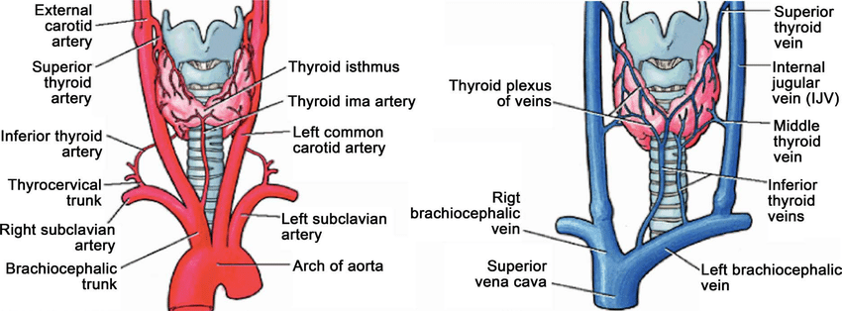

Slide 57
Parathyroid glands
The parathyroid glands are usually located on the posterior aspect of the thyroid gland. They are flattened and oval in shape – situated external to the thyroid gland itself but within the pretracheal fascia.
Most individuals have four parathyroid glands.
Superior parathyroid glands (x2) – derived from the fourth pharyngeal pouch. They are located at the middle of the posterior border of each thyroid lobe, approximately 1cm superior to the entry of the inferior thyroid artery into the thyroid gland.

Slide 58
Contd..
Inferior parathyroid glands (x2) – derived from the third pharyngeal pouch. Although inconsistent in location between individuals, the inferior parathyroid glands are usually found near the inferior poles of the thyroid gland.
The vascular supply is similar to that of the thyroid gland.
Arterial supply is chiefly via the inferior thyroid artery (as this artery supplies the posterior aspect of the thyroid gland – where the parathyroids are located). Collateral arterial supply is from the superior thyroid artery and thyroid ima artery.
Venous drainage is into the superior, middle, and inferior thyroid veins.

Slide 59
Lymph drainage
The lymphatic drainage from the parathyroid glands is to the paratracheal and deep cervical nodes.
Nerves supply
The parathyroid glands have an extensive supply of sympathetic nerves derived from thyroid branches of the cervical ganglia.

Slide 60
Contd..
Clinical application
Tumours of the thyroid gland may compress other important structures
Palpate any swelling of the thyroid gland from behind
Subtotal thyroidectomy done

Slide 61
References
Chaurasia B. D (2016) Human Anatomy Head and Neck, 7th Ed, CBS Publishers, New Delhi
Drake L, Vogl A. W and Mitchell (2020), Gray’s Anatomy for students
4th Ed, Elsevier, Canada

