Slide 1
BACK OF THE NECK MUSCLES
DR MULOFWA ISAAC

Slide 2
COVERAGE
Introduction
Back of the neck muscles
Suboccipital region
Clinical correlates

Slide 3
INTRODUCTION

Slide 4
What is the neck?

Slide 5
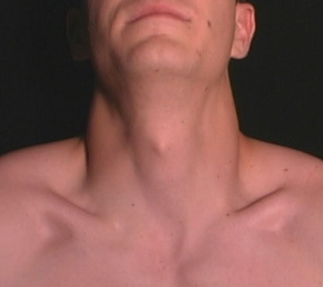
Also known as the cervical region is situated between the head and the torso.
Upper limit: external occipital protuberance and superior nuchal (posteriorly), hyoid bone (anteriorly)
Lower limit: supra-pleural membrane/ Sibson`s fascia

Slide 6
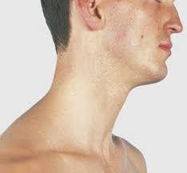
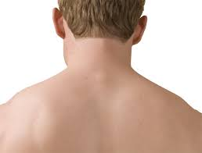
COMPARTMENTS OF THE NECK
ANTERIOR/
VISCERAL
LATERAL
POSTERIOR/
MUSCULAR

Slide 7
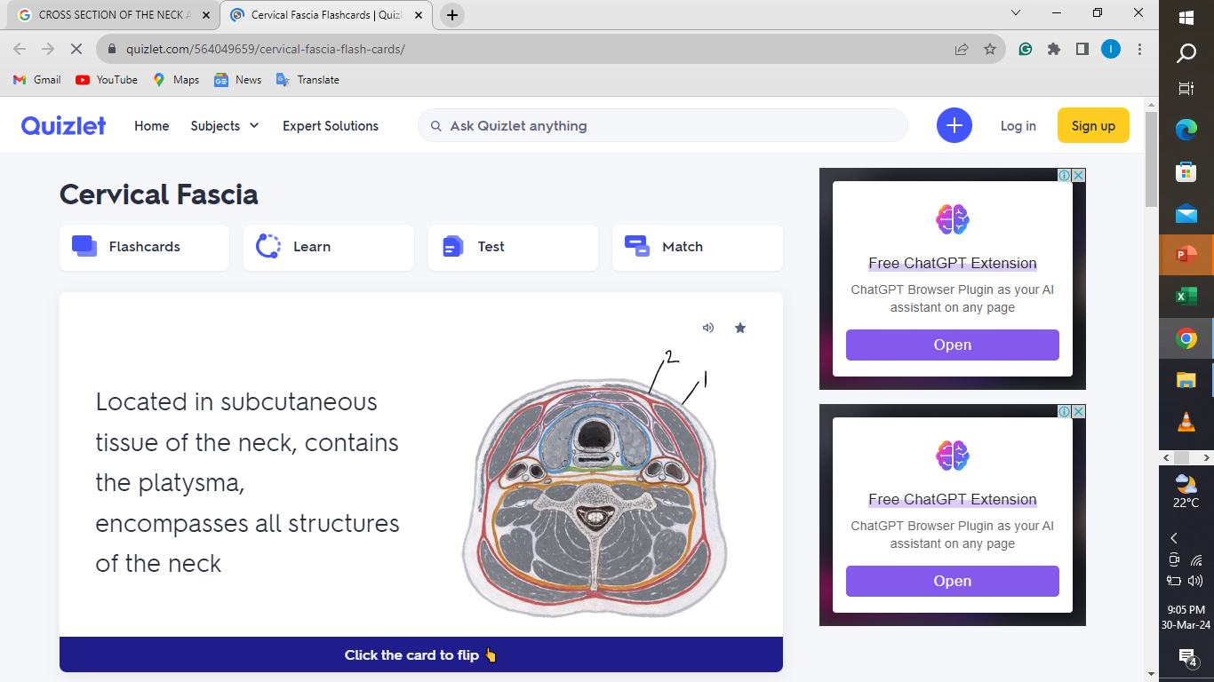
CROSS SECTION OF THE NECK AT C7
ANTERIOR
SKIN
SUPERFICIAL FASCIA
INVESTING LAYER
POSTERIOR

Slide 8
THE BACK OF THE NECK MUSCLES

Slide 9
Posterior compartment is also called the muscular compartment because its mostly contains muscles
It spans from the anterior margin of the trapezius to another.
From superficial to deep: Skin, superficial fascia, investing layer of deep fascia, muscular layer and cervical vertebra
The muscles of the back of the neck are divided into 2: extrinsic and intrinsic muscles.

Slide 10
Posterior neck muscles are grouped into 4 layers:
1st layer: Trapezius.
2nd layer: Splenius capitis/cervicis.
3rd layer: Semispinalis capitis/cervicis, iliocostalis cervicis, longissimus capitis/cervicis, spinalis cervicis.
4th layer: Suboccipital muscles.

Slide 11
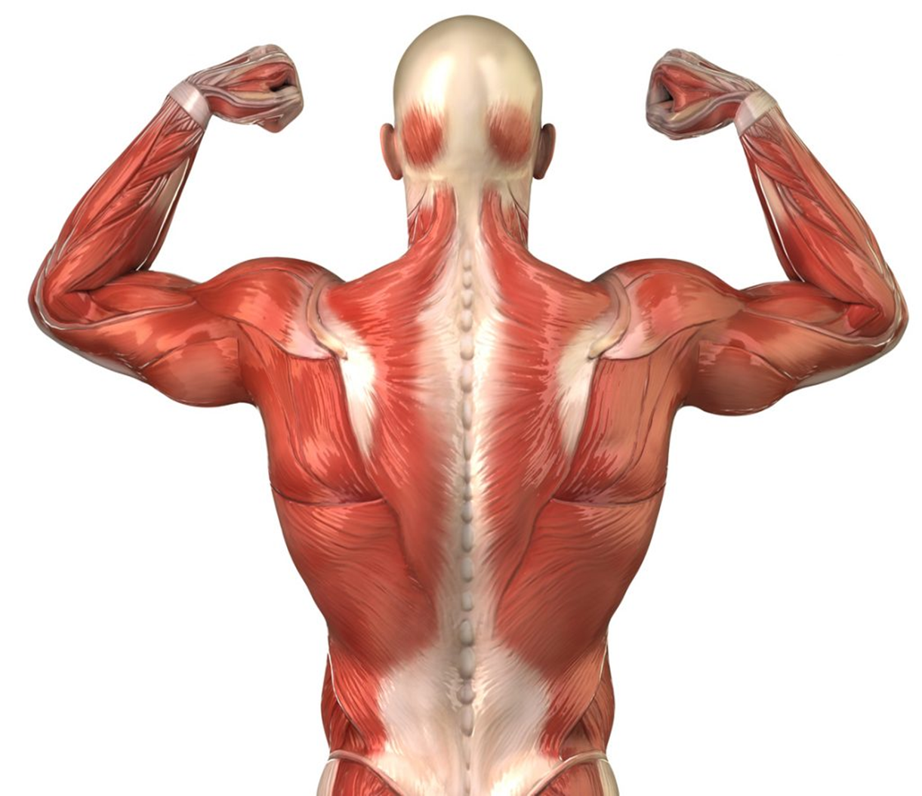
1st layer

Slide 12
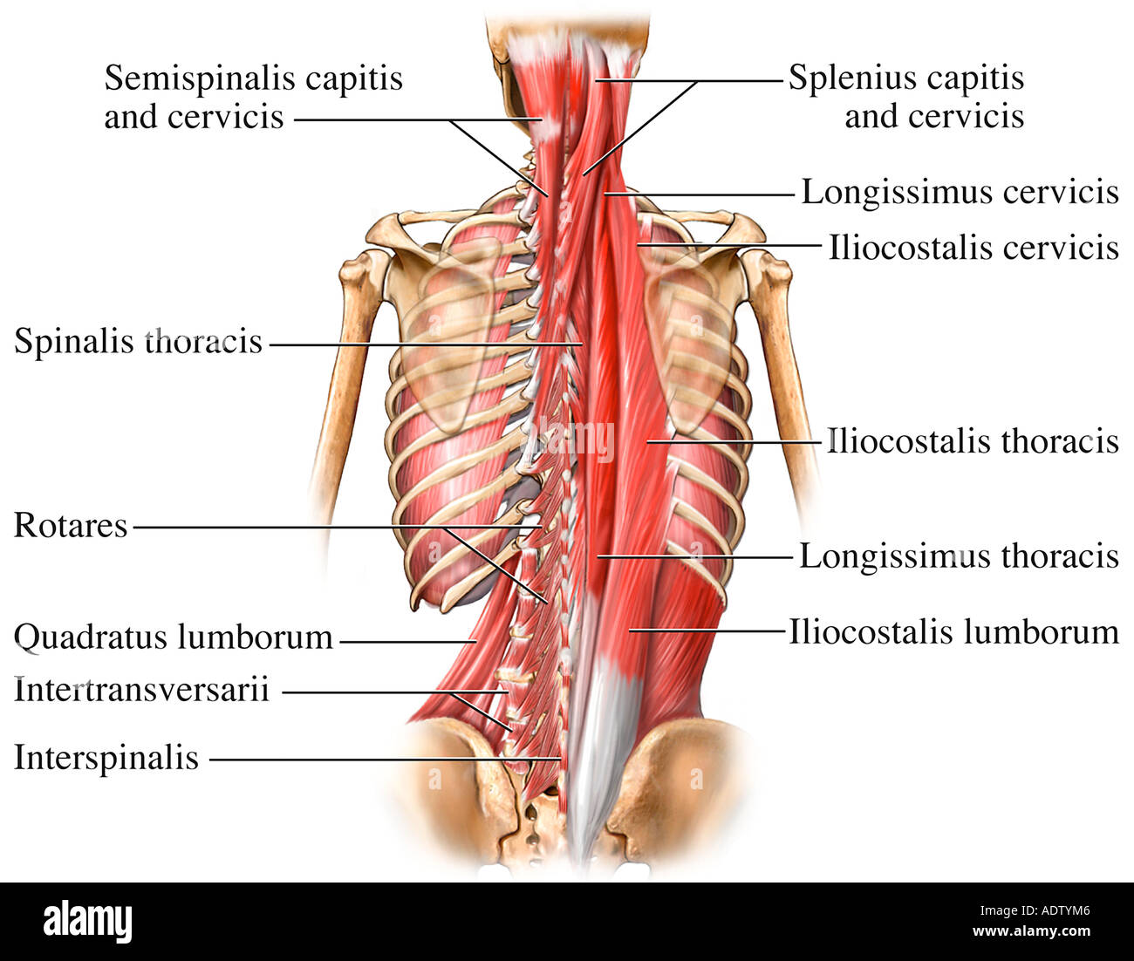
2nd & 3rd layers

Slide 13
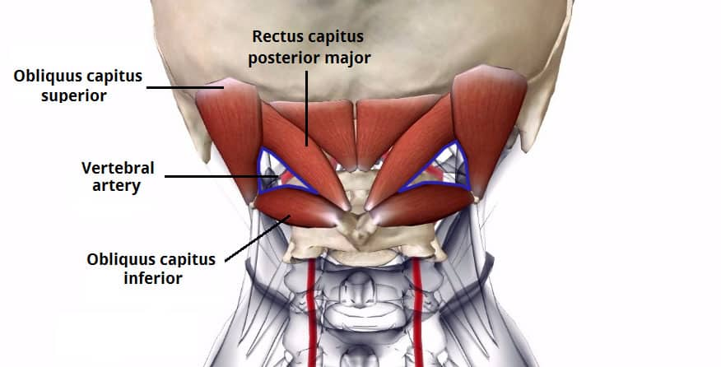
4th Layer

Slide 14
SUBOCCIPITAL REGION

Slide 15
Region between the occiput and the spine of the axis.
In this region, there are 4 muscular layers: (1)Trapezius, (2)splenius capitis, (3)semispinalis capitis & longissimus capitis and (4) suboccipital muscles.

Slide 16
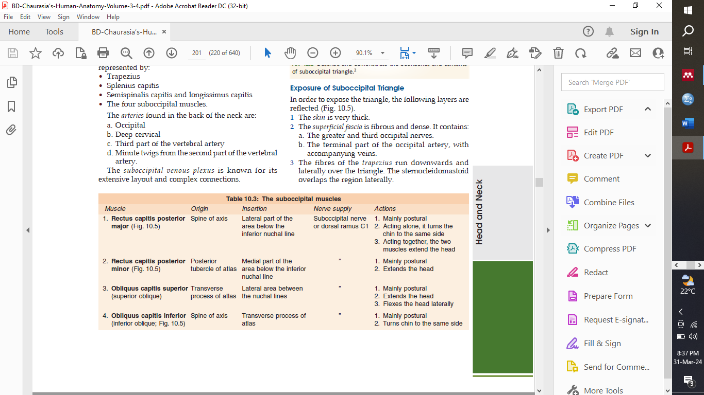

Slide 17

The suboccipital muscles are arranged in such a way that they form a triangle called suboccipital triangle.
There are 3 main contents of this triangle: 3rd part of vertebral artery, Dorsal ramus of nerve C1—suboccipital nerve, Suboccipital plexus of veins.

Slide 18
Superomedially
Rectus capitis posterior major muscle supplemented by
the rectus capitis posterior minor (Fig. 10.5).
Superolaterally
Superior oblique capitis muscle.
Inferiorly
Inferior oblique capitis muscle.
Roof
Medially
Dense fibrous tissue covered by the semispinalis capitis.
Laterally
Longissimus capitis and occasionally the splenius capitis.
Floor
1 Posterior arch of atlas.
2 Posterior atlanto-occipital membrane.

Slide 19
Vertebral artery
It is the first and largest branch of the first part of the subclavian artery, destined chiefly to supply the brain.
Out of its four parts, only the third part appears in the suboccipital triangle.
This part appears at the foramen transversarium of the atlas, grooves the atlas, and leaves the triangle by passing deep to the lateral edge of the posterior atlanto-occipital membrane.

Slide 20
The artery is separated from the posterior arch of the atlas by the first cervical nerve and its dorsal and ventral rami.

Slide 21
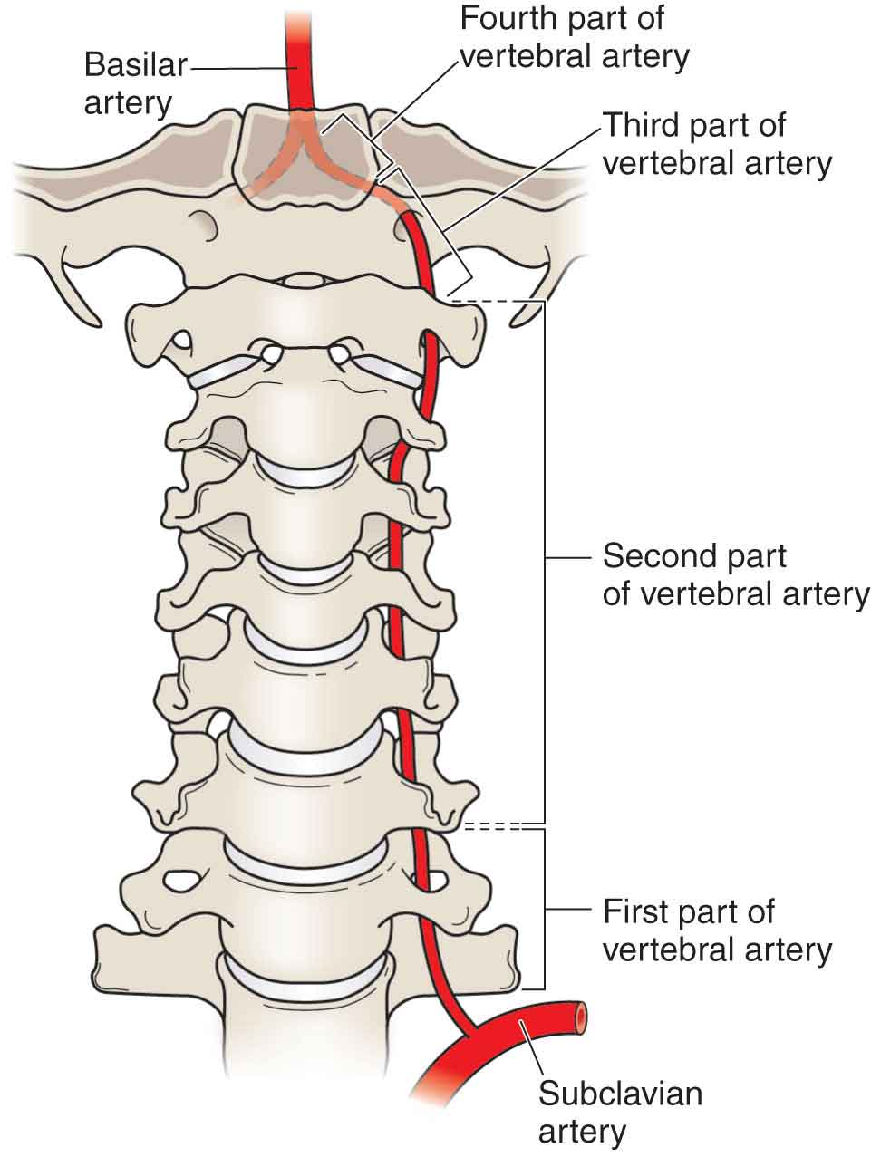

Slide 22
Dorsal Ramus of First Cervical Nerve
It emerges between the posterior arch of the atlas and the vertebral artery, and soon breaks up into branches which supply the four suboccipital muscles and the semispinalis capitis.
The nerve to the inferior oblique gives off a communicating branch to the greater occipital nerve capitis

Slide 23
Suboccipital Plexus of Veins
It lies in and around the suboccipital triangle, and drains the:
1. Muscular veins
2. Occipital veins
3. Internal vertebral venous plexus
4. Condylar emissary vein.
It itself drains into the deep cervical and vertebral plexus of veins.

Slide 24
CLINICAL CORRELATES

Slide 25
MENINGITIS
Neck rigidity, seen in cases with meningitis, is due to spasm of the extensor muscles of the neck.
CISTERN PUNCTURE
Cisternal puncture is done when lumbar puncture fails.

Slide 26
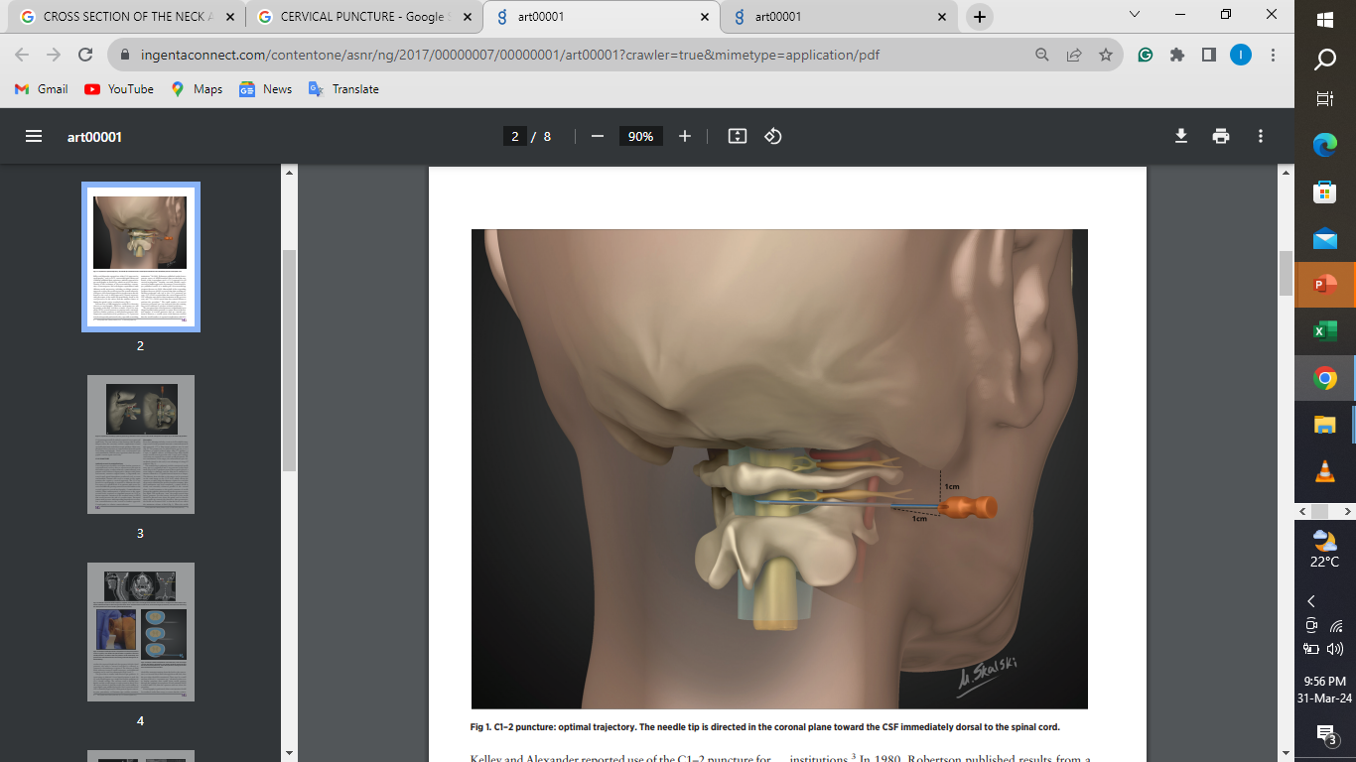

Slide 27
THE END

Slide 28
SAMPLE REVISION QUESTIONS
Describe the borders of the neck?
Define the suboccipital region?
Describe the 4 muscular layers seen the suboccipital region of the neck?
Describe the borders and contents of the suboccipital triangle?
Describe the borders of the posterior triangle of the neck? A stab above the middle third of the clavicle will cause which life threatening condition?

