Slide 1
Face, Scalp and Trigeminal Nerve
Presenter : Doreen KAWELENGA

Slide 2
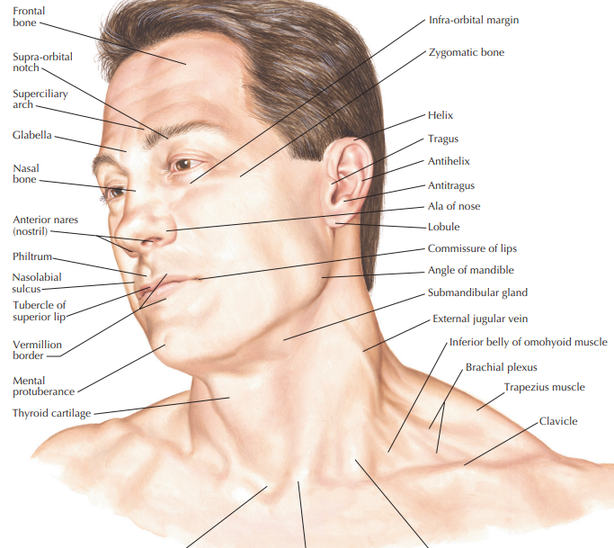

Slide 3
The face refers to the anterior portion of the head.
Its margins include;
Superiorly: the superciliary arches
Inferiorly: the lower edges of the mandible
Laterally: the ears

Slide 4
Embryology
Major facial development occurs between the 4th and 8th weeks of embryonic development
The process includes contributions from the cranial ectoderm which helps form the face and oral cavity and the mesenchyme which contributes to the first branchial arch and its derivatives.

Slide 5
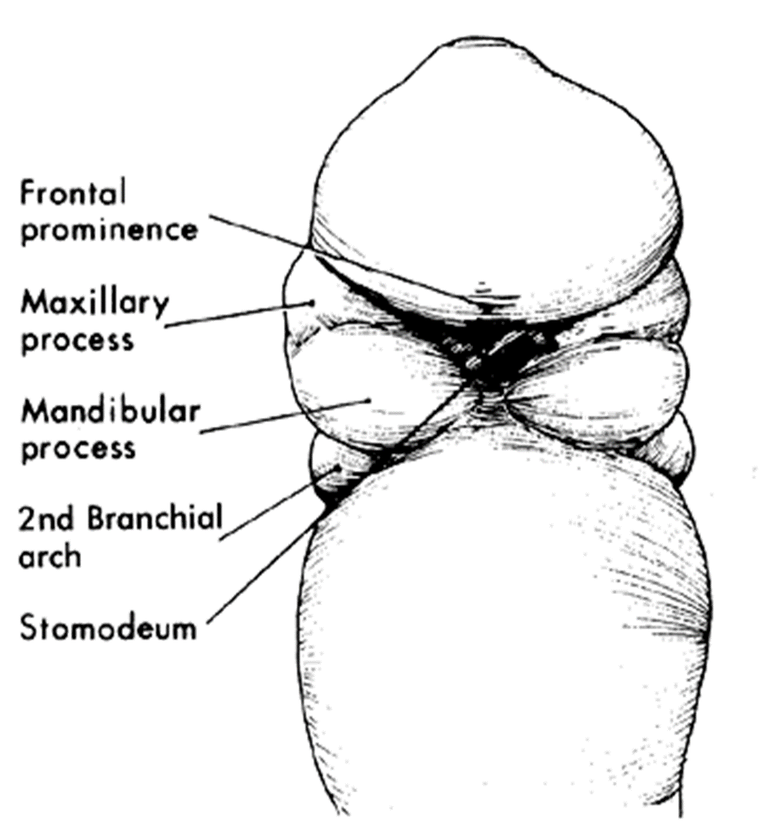
Shortly after the anterior pore closes in the fourth week, the forebrain begins to enlarge and pushes the overlying ectoderm forward and laterally creating the frontonasal process

Slide 6
Five processes contribute to face formation. These are;
Unpaired—frontonasal
Paired—maxillary and
Paired mandibular processes.
• Components of each process: – Core of mesenchyme – Covering surface ectoderm.

Slide 7
Derivatives from each process
• Frontonasal process
Forehead
Nasal septum
Philtrum of upper lip
Premaxilla bearing four incisor teeth. –
Maxillary process
Whole upper lip except philtrum –
Most of palate except the part formed by premaxilla.
Mandibular process - Whole lower lip.

Slide 8
First Pharyngeal Arch Derivatives
• Skeletal—malleus, incus, maxilla, mandible, zygomatic bone, sphenomandibular ligament.
• Muscular—muscles of mastication, tensor tympani, tensor veli palatini, mylohyoid, anterior belly of digastric.
• Nerve—mandibular nerve.
• Artery—part of maxillary artery

Slide 9
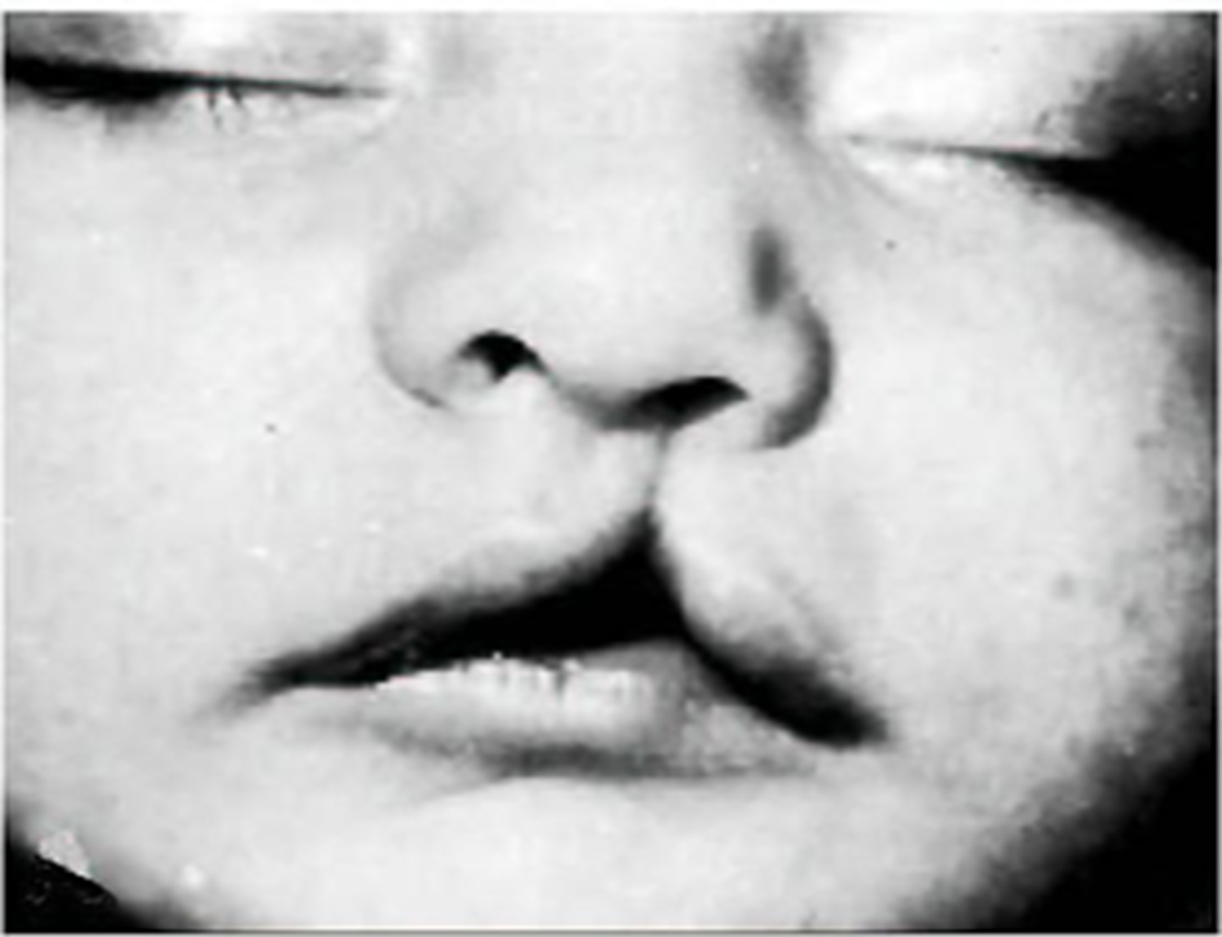
Clinical Relevance
• Unilateral cleft lip (upper lip)—failure of fusion of globular process with maxillary process.
• Bilateral cleft lip—failure of fusion of maxillary process and globular swellings bilaterally.
• Mandibular and lower lip cleft nonfusion of mandibular process.

Slide 10
Muscles of Facial Expression
These muscles develop from the 2nd pharyngeal arch embryonically
They are in superficial fascia with origin from bone and insertions into skin
They are the only muscles that insert into skin

Slide 11
Facial muscles can be grouped into
Orbital group
Nasal group
Oral group
Other muscles

Slide 12
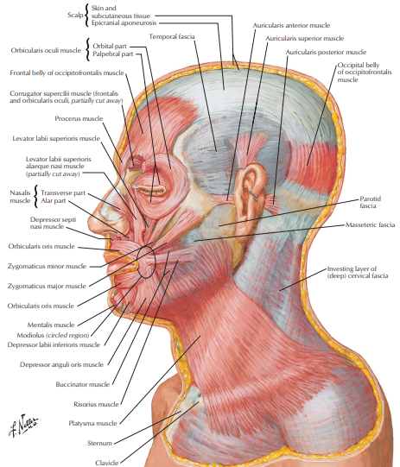

Slide 13
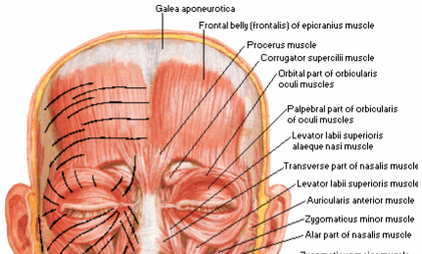
Orbital Group
Consists 2 muscles
Orbicularis oculi which is further divided into; palpebral and orbital parts.
Corrugator supercilii

Slide 14
Clinical relevance
If the facial nerve becomes damaged , the orbital muscles cease to function. As they are the only muscles that can close the eye lids, clinical consequences include;
Exposure keratitis, cornea dries out.
Ectropion, drooping of lower eye lid. Lacrimal fluid pools in the lower eyelid and can not be spread across the surface of the eye. Causes laceration of the corneal surface.
TEST raising eyebrows and closing eyelids

Slide 15
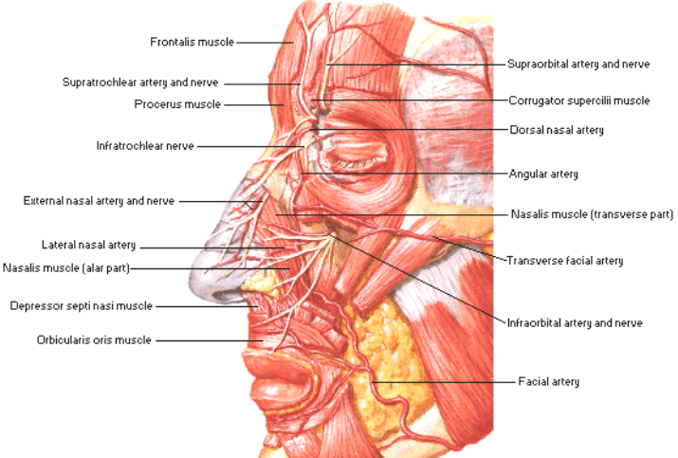
NASAL GROUP
Consists 3 muscles
Nasalis which has 2 parts; transverse and alar parts
Procerus
Depressor septi
Netter`s Atlas

Slide 16
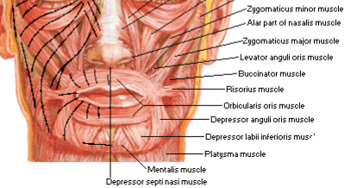
Oral Group -11 muscles
Depressor anguli oris
Depressor labii inferioris
Mentalis, Risorius
Zygomaticus major
Zygomaticus minor
Levator labii superioris
Levator labii superioris alaeque nasi
Obicularis oris

Slide 17
Other Muscles
Anterior auricular
Superior auricular
Posterior auricular
Occipitofrontalis

Slide 18
Clinical relevance
Paralysis can lead to difficulty in eating , with food collecting between the teeth and cheeks.
Tissue around the mouth sags , and is drawn across to the opposite side while smiling.

Slide 19
Innervation
Innervation to the muscles of facial expression is by the Facial nerve (CN VII)
It originates from the margin of the pons and medulla
Enters the internal acoustic meatus
Exits the skull via the stylomastoid foramen
Pierces the parotid gland and divides into five (5) branches

Slide 20
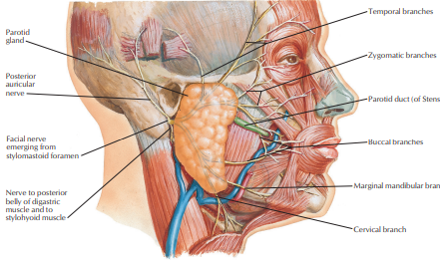
Branches of
Facial nerve
Temporal
Zygomatic
Buccal
Marginal mandibular
cervical
Netter`s Atlas

Slide 21
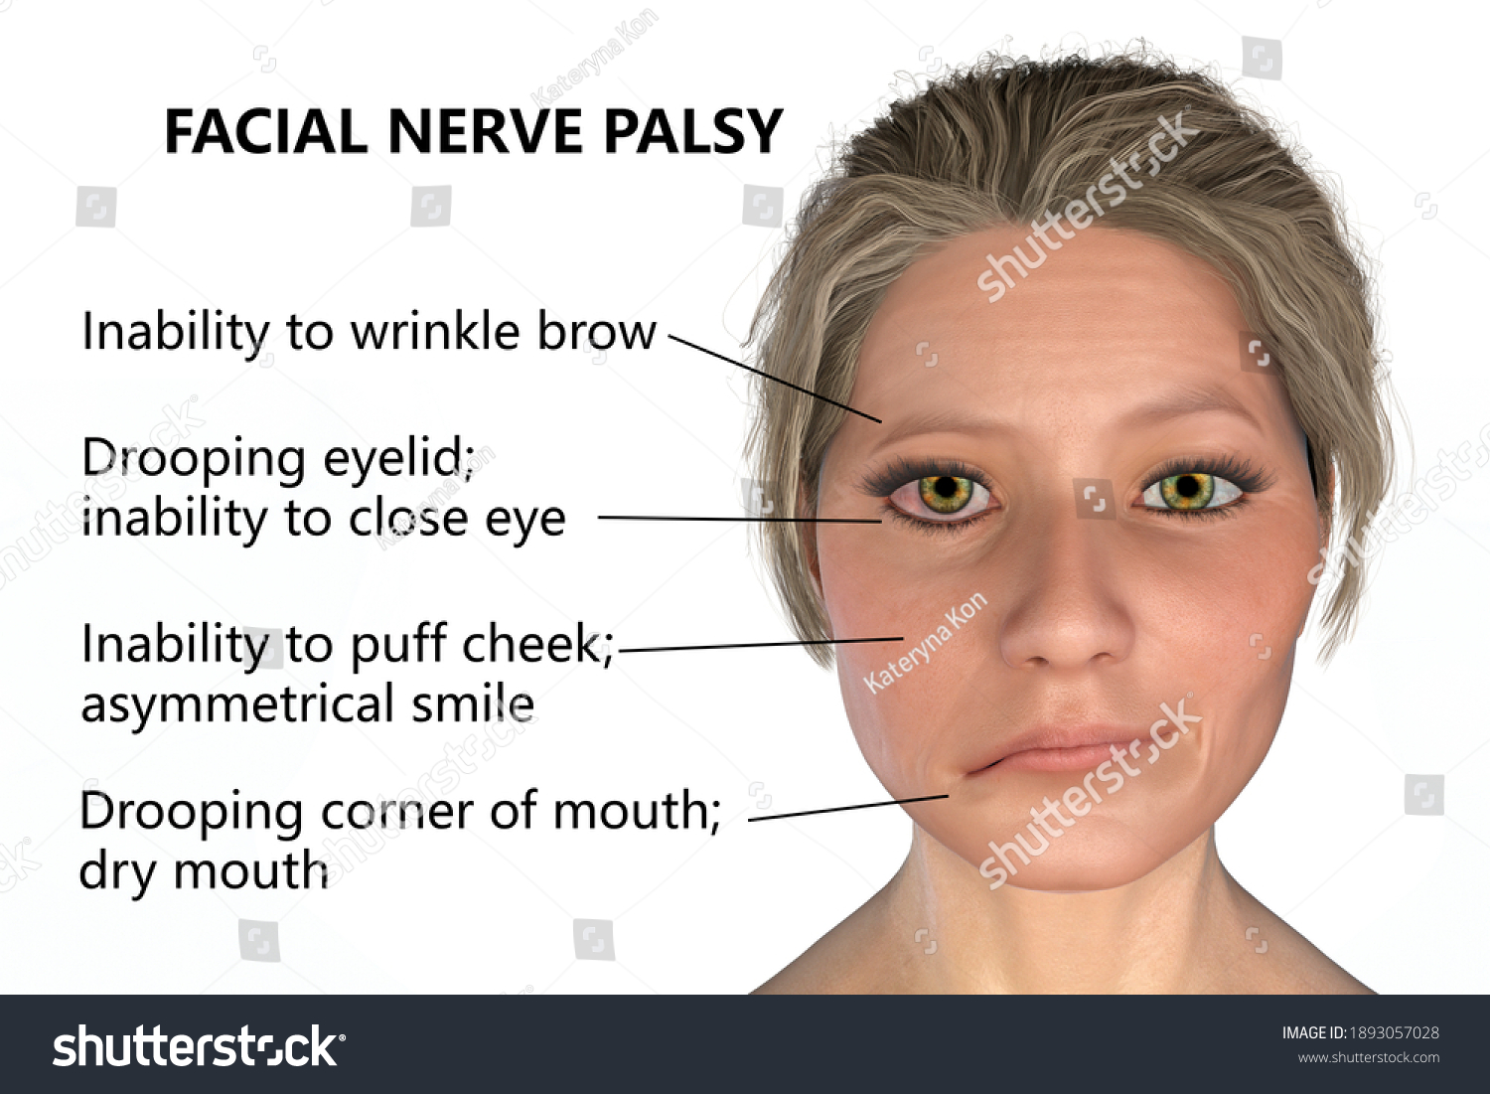
Clinical relevance
Facial palsy

Slide 22
Blood Supply
Most arteries of the face are branches of the external carotid artery
The facial artery provides the major arterial supply to the face
It arises from the external carotid artery to the inferior border of the masseter all the way to the canthus of the eye
It sends branches to upper and lower lips (superior and inferior labial arteries)

Slide 23
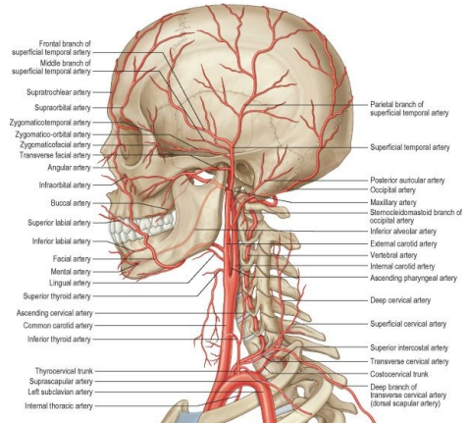

Slide 24
Lateral nasal artery which supplies the nose
Terminates as the angular artery supplying the medial canthus
The superficial temporal artery is a smaller terminal branch of the external carotid artery that emerges between the temporal mandibular joint and the ear and ends in the scalp by dividing into the frontal and parietal branches

Slide 25
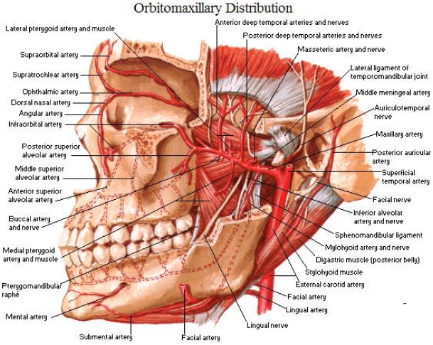
The maxillary branch is also a small branch of the external carotid artery
The transverse facial artery which arises from the superficial temporal artery within the parotid gland and divides into numerous branches which supply; the parotid gland and duct and masseter and skin other the face

Slide 26
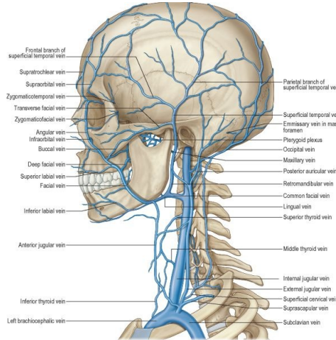
Venous Drainage

Slide 27
The facial vein provides major drainage to the face
It begins at the medial canthus of the eye as the angular vein by union of the supratrochlea and supraorbital veins
This runs inferoposteriorly through the face posterior to the facial artery
Inferior to the margin of the mandible, it is joined by the anterior branch of the retromandinular vein
The facial vein drains into the internal jugular vein

Slide 28
The superior temporal vein drains the forehead and scalp
Near the auricule, it enters the parotid glad
Joins the maxillary vein to form the retromandibular vein which descends within the parotid gland superficial to the external carotid artery and deep to the facial nerve

Slide 29
It divides into the anterior branch that joins the facial vein and posterior branch that joins the posterior auricular branch
The posterior auricular and posterior retromadibular veins join to form the external jugular vein which drains into the subclavian vein

Slide 30
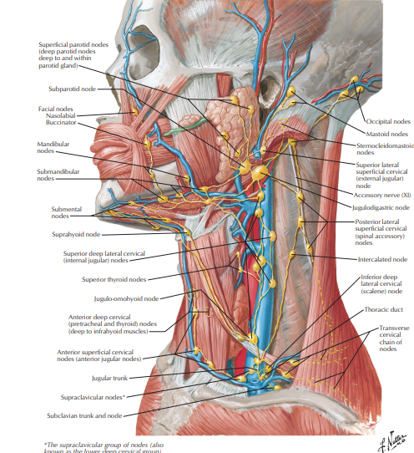
Lymphatic Drainage
Lateral part of the face including the eyelids drain inferiorly into the parotic lymph nodes
Lymph from the deep parotid nodes drain into the deep cervical nodes
Lymphatic vessels from the upper lip and lateral parts of the lower lip drain into the sub-mandibula lymph nodes
Lymphatic vessels in the chin and central part of the lower lip drain into the sub-mental lymph nodes

Slide 31
Scalp
This is a part of the head that extends from the supercilliary arches anteriorly to the external occipital protruberance and superior nuchal line posteriorly.
Laterally, it continues inferiorly to the zygomatic arch

Slide 32
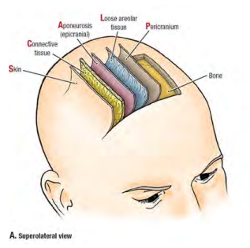

SCALP
It is a multilayered structure
S-skin
C – dense connective tissue
A – aponeurotic layer
L – loose connective tissue
P - pericranium

Slide 33
The first three layers are tightly adherent to one another forming a single unit known as the scalp proper
Skin- outermost layer Contains sweat glands, sebaceous glands, hair follicles, abundant arterial supply and venous drainage.
Common site for sebaceous cysts.

Slide 34
Deep connective tissue – connects the skin to the epicranial aponeurosis.
Highly vascularized, contains nerves, arteries and veins supplying the scalp
When scalp is cut, dense connective tissue holds the cut vessels open and leads to profuse bleeding

Slide 35
Aponeurotic layer - firmly attached to skin by dense connective tissue
It’s a strong tendineous sheet
Attachment for the frontalis belly anteriorly and Occipitalis belly posteriorly
Forms the aponeurotic tendon that connects the 2 muscles

Slide 36
Loose connective tissue - separates the aponeurotic layer from the pericranium
Facilitates movement of the scalp proper over the skull
It is considered a danger area of the scalp as it contains emissary veins. These are valveless veins which connect the extra cranial veins of the scalp to the intracranial dural venous sinuses.
The emissary veins are a potential pathway for spread of infection from scalp to the intracranial space.

Slide 37
Pericranium - deepest layer of the scalp
Comprises a deep layer of connective tissue
Periosteum of the skull attaches firmly to the cranial bones
Can however be detached with ease except in the areas of the cranial sutures

Slide 38
Innervation
It is supplied by branches of the trigeminal nerve anterior to the ear and vertex of the head
Zygomaticotemporal
Auriculotemporal
Supratemporal
supraorbital

Slide 39
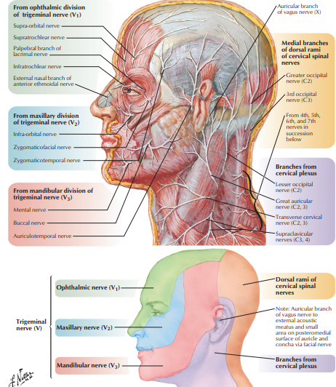

Slide 40
Posterior to the ear and vertex, the scalp is supplied by the cervical nerves and bracnhes from C2 and C3
Greater auricular
Greater occipital
Lesser occipital
Third occipital

Slide 41
Blood Supply
Branches of the external carotid arteries and opthalmic artery which is a branch of the internal carotid artery.
Opthalmic artery; supratrochlear and supraorbital a.
External carotid artery;
Posterior auricular artery
Occipital artery
Superficial temporal artery

Slide 42
Trigeminal Nerve (CN V)
Originates anteriorly from the upper lateral pons as two roots (motor and sensory)
It passes medially near the tentorium cerebelli over the apex of the petrous temporal bone into the middle cranial fossa
Its ganglion is in a slight depression (meckel’s cave) on the temporal bone in the middle cranial fossa.
It innervates muscle of mastication and mediates general sensation from the face, eye, and nasal and oral cavities

Slide 43
The sensory root passes beneath the tentorium to the trigeminal ganglion.
The motor root does not enter the ganglion, instead, it passes inferiorly to exit the skull through the foramen ovale with the Mandibular division of the ganglion
The Ophthalmic division pierces the wall of the trigeminal cave and runs forward in the lateral wall of the cavernous sinus
Exits the skull through the superior orbital fissure

Slide 44
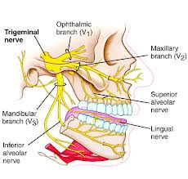

Slide 45
Trigeminal nerve divides into 3 branches;
1. Ophthalmic division- passes anteriorly through the lateral wall of the cavernous sinus
Innervates the area above the upper eyelid and dorsum of the nose.
Supplies the face as the supraorbital, supratrochlear, infratrochlear , external nasal and lacrimal nerves.

Slide 46
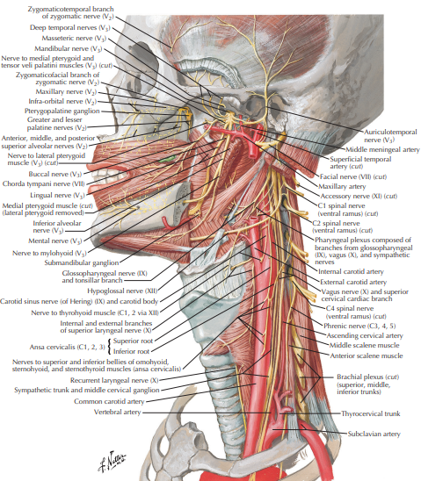

Slide 47
2. Maxillary division-passes through the lower part of the lateral wall of the cavernous sinus
• Innervates the face below the level of the eyes and above the upper lip.
• Supplies the face as the zygomaticofacial, zygomaticotemporal, and infraorbital nerves.

Slide 48
Mandibular division- passes through the foramen ovale in the infratemporal fossa
• Innervates the face below the level of the lower lip.
• Supplies the face as the auriculotemporal, buccal, and mental nerves.

Slide 49
The trigeminal nerve also supplies motor fibers to the:
Temporalis, Masseter, Medial and lateral Pterygoids
Mylohyoid, Anterior belly of Digastric, Tensor tympani and Tensor palatini

Slide 50
Clinical Relevance
Trigeminal neuralgia is a type of trigeminal neuropathy brought on by nerve damage. The condition causes sudden, intense facial pain on one side of your face. The pain can feel like an electrical shock

