Slide 1
FACIAL NERVE
(CNVII)
DR. MULOFWA ISAAC

Slide 2
COVERAGE
Introduction
Origin of facial nerve
Course & Termination of facial nerve
Clinical correlates

Slide 3
INTRODUCTION

Slide 4
Cranial nerves are a component of the peripheral nervous system which is derived from the neural crest cells.
There are 12 pairs of cranial nerves, visible on the under surface of the brain.
These nerves are act as the lower motor neurons of the corticobulbar/corticonuclear tract.
These nerves have their nuclei in the brain, then they leave the cranium by passing through the cranial foramina to the structures they supply.

Slide 5
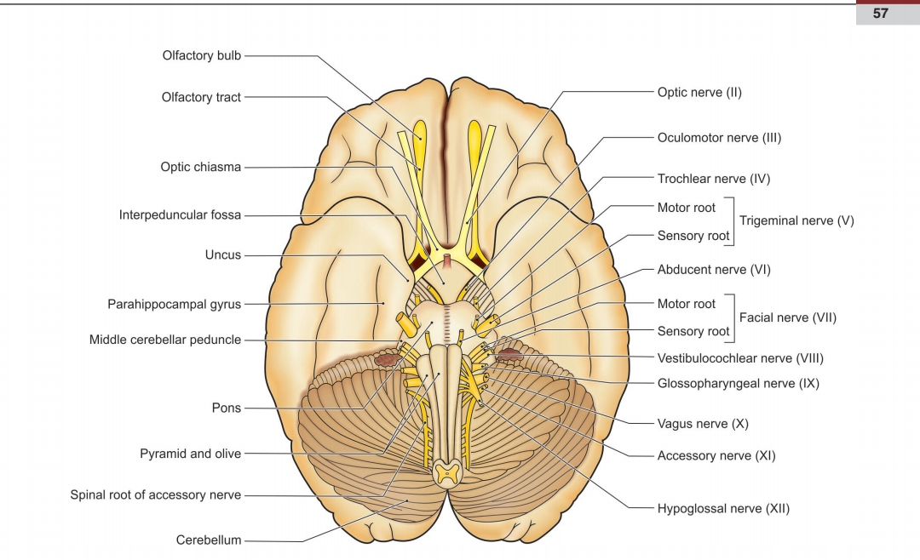

Slide 6
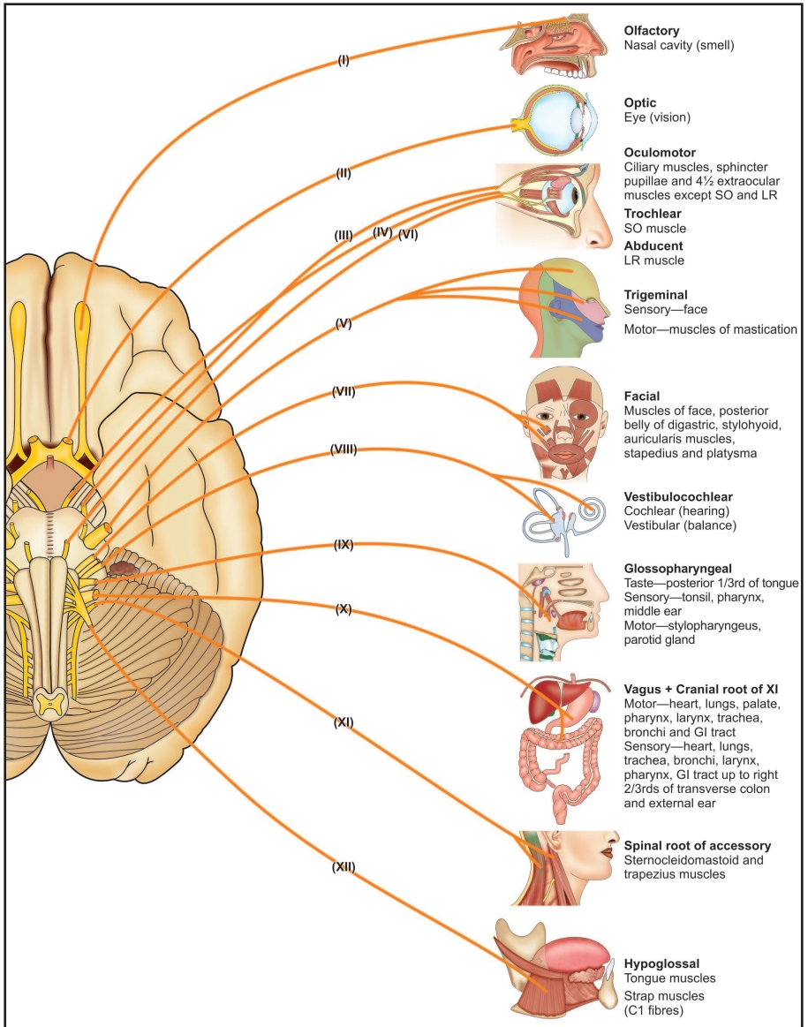

Slide 7
ORIGIN OF FACIAL NERVE

Slide 8
Facial nerve is the 7th cranial nerve derived from the 2nd pharyngeal arch.
This is the main nerve which innervates muscles of facial expression.
The nerve has multiple functional components: Special visceral affarent (SVA) - taste sensation, Special visceral efferent (SVE) - muscles of facial expression, General visceral affarent (GVA) - salivary glands, lacrimal gland, glands of the nose, palatine, etc., General visceral efferent (GVE) - parasympathetic to the above glands,

Slide 9
Facial nerve arises from 4 nuclei situated in the lower pons. These include:
1. Motor nucleus (motor)
2. Superior salivatory nucleus (parasympathetic)
3. Lacrimatory nucleus (parasympathetic)
4. Nucleus of tractus solitarius (gustatory)

Slide 10
Motor nucleus lies deep in the reticular formation of the lower pons.
The part of the nucleus that supplies muscles of the upper part of the face receives corticonuclear fibers from the motor cortex of both the right and left sides.
In contrast, the part of the nucleus that supplies muscles of the lower part of the face receives corticonuclear fibers only from the opposite cerebral hemisphere

Slide 11
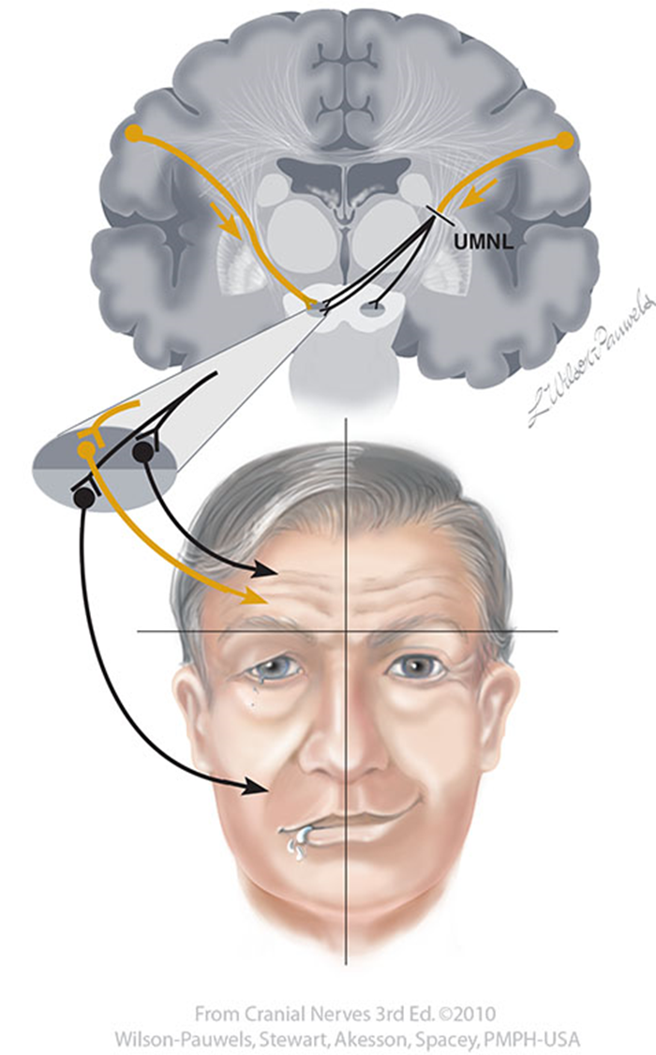

Slide 12
COURSE & TERMINATION

Slide 13
The course of the facial nerve is complex and is anatomically divided into 2 parts:
Intracranial course: course through the cranium. From the nuclei to the point just before it exits via the stylomastoid foramen.
Extracranial course: course of the nerve outside the cranium. From stylomastoid foramen to the face and neck.

Slide 14
INTRACRANIAL COURSE
Nerve arises from the nuclei in the lower pons as 2 roots: large motor root and a small sensory root (nerve intermedius) which are situated medial to CNVIII.
The roots along with CNVIII run laterally to reach the internal acoustic meatus in the petrous part of the temporal bone.
In addition, the labyrinthine artery accompanies these nerves in the internal acoustic meatus.

Slide 15
At the bottom of the meatus, the 2 roots leave and enter a `Z` shaped canal called facial canal. 3 events occur within this canal:
2 roots fuse and form the facial nerve
Facial nerve forms the geniculate ganglion
The nerve gives 3 intracranial branches: greater petrosal nerve, nerve to stapedius and chorda tympani

Slide 16
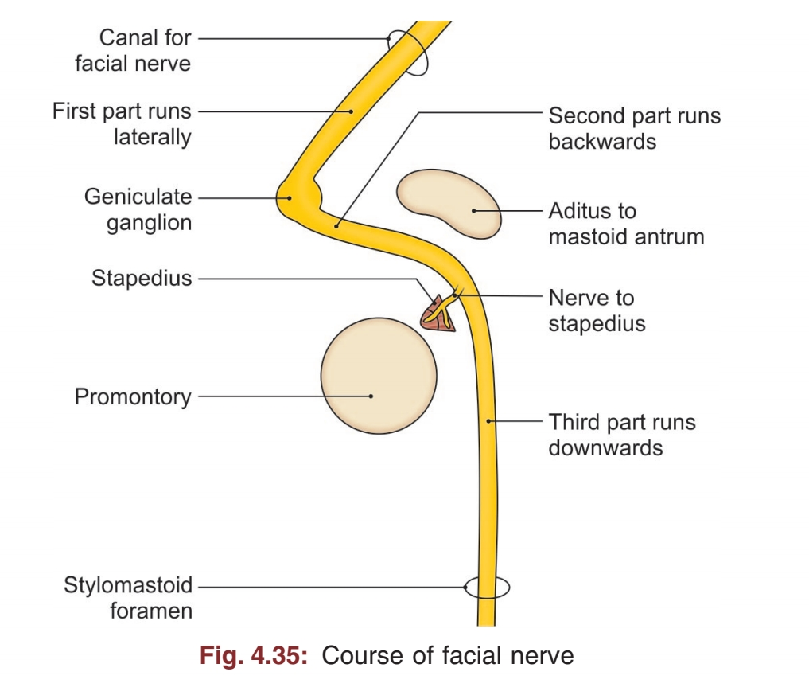

Slide 17
Greater petrosal nerve: joined by deep petrosal nerve forming the nerve to pterygoid canal and eventually the form the sphenopalatine ganglion. Sends parasympathetics to the lacrimal and mucous.
Nerve to stapedius: arises opposite the pyramid of the middle ear and supplies the stapedius muscle of the ear.
Chorda tympani: arises about 6mm above the stylomastoid foramen. Supplies taste sensation to the anterior 2/3 thirds of the tongue.

Slide 18
After these 3 events, the intracranial course ends.

Slide 19
EXTRACRANIAL COURSE
Begins after the facial nerve leaves the facial canal via the stylomastoid foramen.
It crosses the lateral side of the base of the styloid process. After exiting the it gives branches: Posterior auricular nerve, nerve to stylohyoid and nerve to digastric.

Slide 20
The main trunk (purely motor) continues anteriorly and inferiorly into the parotid gland.
It continues forward through the gland crossing the retromandibular vein and external carotid artery.
Behind the neck of the mandible, it divides into 5 terminal branches: temporal, zygomatic, buccal, marginal mandibular & cervical branch.

Slide 21
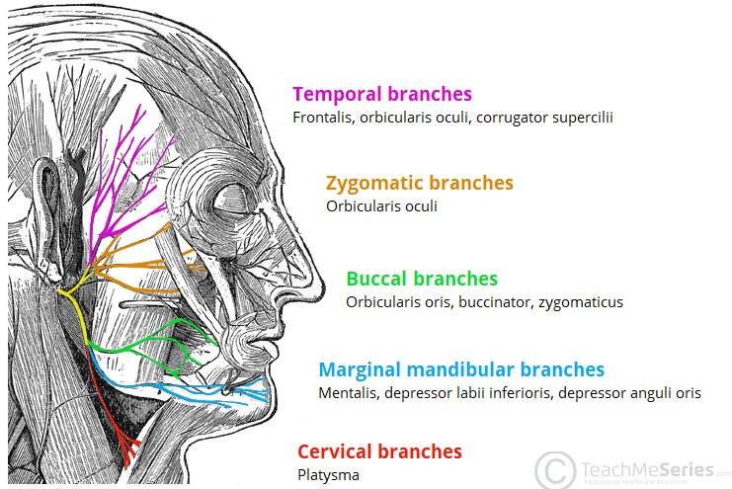

Slide 22
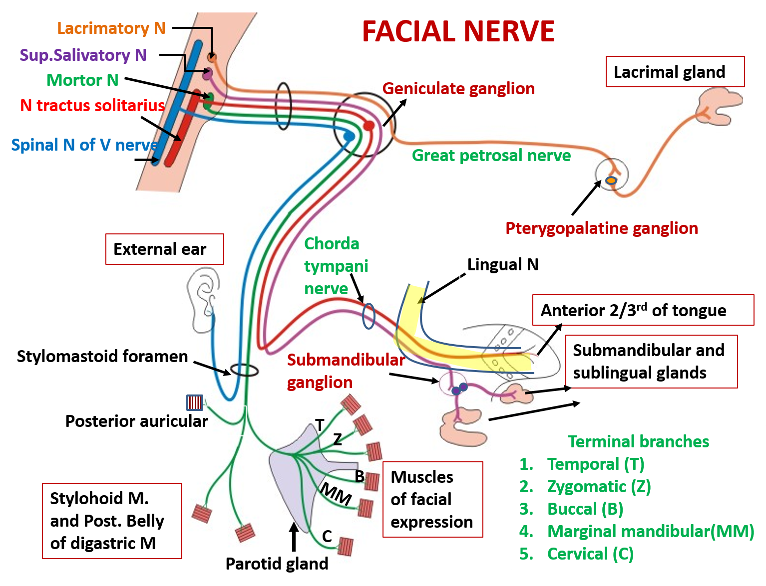

Slide 23
CLINICAL CORRELATES

Slide 24
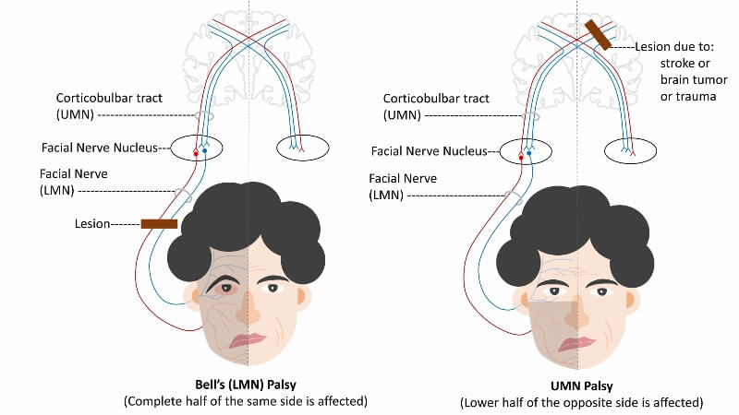

Slide 25
THE END

