Slide 1
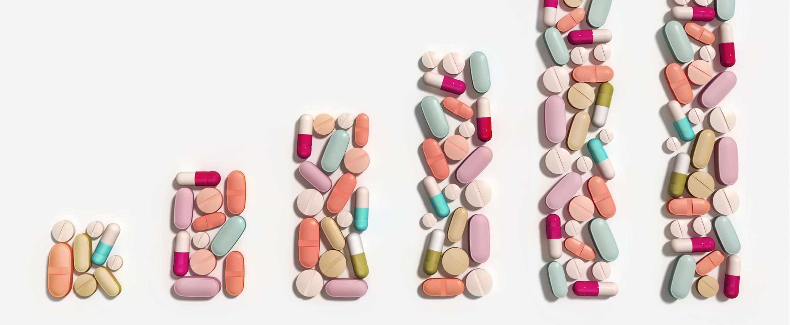
Thyroid hormones and antithyroid drugs
Dr T.N. Chidumayo

Slide 2

Outline the main steps in the biosynthesis of thyroid hormones.
Describe the mechanism and physiological of action of thyroid hormones.
Describe the mechanisms of actions, clinical indications, adverse effects and contraindications of the drugs used in the treatment of hyperthyroidism.
Outline the drug treatment of hypothyroidism.
LEARNING OBJECTIVES

Slide 3
Introduction
Thyroxine (T₄) and tri-iodothyronine (T₃) are hormones secreted by the thyroid gland
T₃ and T₄ are synthesized and stored in the thyroid follicles
Thyroid hormone secretion is regulated by thyroid stimulating hormone (TSH) secreted by the anterior pituitary and thyrotropin releasing hormone (TRH) from the hypothalamus

Slide 4
Physiology of Thyroid Hormones
In the peripheral tissues, most of the secreted T₄ is converted to T₃ (active hormone)
T₃ is 3-5 times more potent than T₄ and acts faster
Both T₃ and T₄ are extensively bound to plasma proteins
The free hormone is metabolised in the liver and excreted in bile
The half-life of T₄ is 6-7 days and that of T₃ is 1-2 days

Slide 5
THE THYROID: Thyroid Hormone Receptor Agonists
Natural thyroid hormones are formed by the iodination of tyrosine residues on the glycoprotein thyroglobulin. A tyrosine residue may be iodinated at one (monoiodotyrosine, MIT) or two (diiodotyrosine, DIT) positions.
Two iodinated tyrosines are then coupled to synthesize triiodothyronine (T3; formed from MIT and DIT) or thyroxine (T4; formed from two DIT molecules).
T4 synthesis exceeds T3 synthesis fivefold. Eighty percent of circulating T3 is derived from deiodination of T4.
Biosynthesis is stimulated by TSH, which acts by a membrane-associated G-protein coupled receptor that increases follicular cell cAMP.
Iodine is a potent inhibitor of thyroid hormone release.

Slide 6
Thyroid hormone preparations
Thyroid hormone preparations include:
Levothyroxine sodium, a synthetic sodium salt of T4 that maintains normal T4 and T3 levels.
Liothyronine sodium, a synthetic sodium salt of T3.
Liotrix, a 4:1 mixture of the above T4 and T3 preparations.
Thyroid USP, is prepared from dried and defatted animal thyroid glands and contains a mixture of T4, T3, MIT, and DIT.
The potency of animal-based thyroid hormone preparations can vary. Thyroid USP is not recommended for initial therapy.
Thyroid USP is not recommended for initial therapy.

Slide 7
Mechanism of action
Thyroid hormones interact with specific nuclear receptor proteins located in the nucleus of target cells.
They alter the synthesis rate of specific mRNAs, leading to increased production of specific proteins, including Na 1 /K 1 -ATPase.
Increased ATP hydrolysis and oxygen consumption contribute to the effects of thyroid hormones on basal metabolic rate and thermogenesis. T3 is the most important ligand for the thyroid receptor; T4 binds very weakly.
Thyroid hormones affect all tissues.

Slide 8
Pharmacologic properties
More than 99% of circulating T4 is bound to plasma proteins; only 5%–10% of T3 is protein bound. Most T3 and T4 are bound to TBG.
T4 also binds to prealbumin, and both T4 and T3 bind weakly to albumin.
T3 has a t 1/2 of approximately 1 day; T4 has a t 1/2 of approximately 5–7 days.
Levothyroxine sodium and liothyronine sodium can be administered orally or IV. Oral absorption rates range from 30% to 65%.
Levothyroxine sodium is preferred to liothyronine because it has better oral absorption, longer t 1/2, and produces a favorable T4:T3 ratio.

Slide 9
Metabolism
T3 and T4 are inactivated by deiodination.
Conjugation of T3 and T4 with glucuronic acid or sulfate occurs in the liver, and the metabolites are secreted in the bile.
Some enterohepatic circulation of the metabolites occurs; 20%–40% of T4 is eliminated in the feces.

Slide 10
Actions
Thyroid hormones are essential for normal physical and mental development of the fetus.
Linear growth of the long bones, growth of the brain, and normal myelination depend on thyroid hormone.
Hypothyroidism in infants leads to cretinism (myxedema with physical and mental retardation).

Slide 11
Thyroid Hormone increase:
Basal metabolic rate and blood sugar levels.
Synthesis of fatty acids and decrease plasma cholesterol and triglyceride levels.
Heart rate and peripheral resistance.
Inhibit TRH and TSH release from the hypothalamus and pituitary, respectively.
Thyroid hormones exert maintenance effects on the CNS, reproductive tract, GI tract, and musculature.

Slide 12
Therapeutic uses
Primary, secondary, or tertiary hypothyroidism caused by:
Hashimoto disease, Myxedema, Simple goiter (thyroid gland enlargement without hyperthyroidism)
Following surgical ablation of the thyroid gland
TSH-dependent carcinomas of the thyroid may be treated with thyroid hormones if other therapies are not feasible.

Slide 13
Adverse effects
Thyroid hormones produce:
Iatrogenic hyperthyroidism, nervousness, anxiety, and headache.
arrhythmias, angina, or infarction in patients with underlying cardiovascular disease.
Thyroid hormones should be used cautiously in the elderly.

Slide 14

Antithyroid Drugs

Slide 15
Antithyroid Drugs: Thioamides
Thioamides include propylthiouracil (PTU) and methimazole.
Methimazole is approximately 10 times more potent than PTU.
Thioamides interfere with the organification and coupling of iodide by inhibiting the peroxidase enzyme.
PTU inhibits the conversion of T4 to T3.
PTU can be used during pregnancy, while methimazole is teratogenic.

Slide 16
Thioamides contd.
Thioamides remain active after oral administration; 50%–80% is absorbed.
1/2 life of 1–2 hours; they are concentrated in the thyroid gland and inhibit thyroid hormone biosynthesis for 6–24 hours.
They do not affect T3/T4 already within the thyroid; attaining euthyroid status may take 2–4 months.
Thioamides are eliminated in the urine as glucuronides.

Slide 17
Thioamides:Uses and Adverse Effects
Treat hyperthyroidism from Graves disease and toxic goiter.
Control hyperthyroidism prior to thyroid surgery.
SE: rashes, headache, or nausea; they may also induce leukopenia or agranulocytosis.

Slide 18
Anion inhibitors of thyroid function
Anion inhibitors of thyroid function include thiocyanate, perchlorate, and fluoborate.
They are monovalent anions with a hydrated radius similar in size to that of iodide.
Anion inhibitors competitively inhibit the transport of iodide by the thyroid gland.
Use is limited by severe toxicities (including fatal aplastic anemia) to occasional diagnostic use for thyroid function.

Slide 19
Iodide
In high intracellular concentrations, iodide inhibits several steps in thyroid hormone biosynthesis, including iodide transport and organification (Wolff-Chaikoff effect).
Iodide inhibits the release of thyroid hormone.
Iodide is usually combined with a thioamide; it is rarely used as sole therapy.

Slide 20
Iodide: Uses and side effects
1. Iodide is used before thyroid surgery, causing firming of thyroid tissues and decreased thyroid vascularity, and in the treatment of spirotrichosis.
Iodide may cause angioedema, rash, a metallic taste on administration, and hypersensitivity reactions.
2. In treatment of spirotrichosis.

Slide 21
Radioactive iodine 131 I
Emits beta particles and x-rays.
Radioactive t 1/2 of 8 days.
131 I is transported and concentrated in the thyroid. High-energy radioiodine emissions are toxic to follicular cells.
Used to treat hyperthyroidism via nonsurgical ablation of the thyroid gland or reduction of hyperactive thyroid gland without damage to the surrounding tissue.
In low doses it is used to diagnosis of hyperthyroidism, hypothyroidism, and goiter;
May be used to assess thyroid responsiveness.
Radioactive t1/2 of 8 days.
High-energy radioiodine emissions are toxic to follicular cells.
May be used to assess thyroid responsiveness.

