Slide 1
Drugs used to treat Ischaemic Heart Disease
M.Kampamba (DipPharm, Bpharm, MclinPharm) PhD candidate
Clinical Pharmacy Specialist (Specialty: Pharmacotherapist
Lecturer University of Zambia
School of Health Sciences
Pharmacy Department
School of Medicine
Physiology Department

Slide 2
Learning objectives
By the end of this lecture, you should be able to:
Define angina pectoris
List types of angina
Explain the pathophysiology of ischemic heart disease (IHD)
Classify types of drugs used in IHD
Describe pharmacological and side effects of antianginal drugs

Slide 3
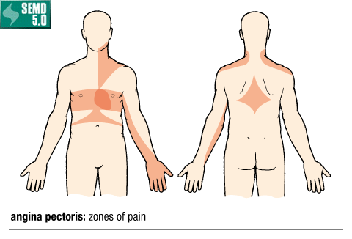
ANGINA PECTORIS
Chest pain that occurs when the coronary blood flow is inadequate to supply O2 required by the heart
Angina pectoris is the principle symptom of ischemic heart disease (IHD).

Slide 4
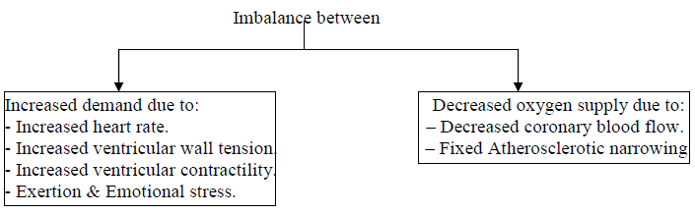
Pathophysiology of Angina
Angina results from transient episodes of ischemia due to an imbalance between myocardial oxygen supply and oxygen demand.

Slide 5
Types of Angina
Typical Stable Angina (Exertional Angina, Artherosclerotic Angina):
Caused by fixed Artherosclerotic narrowing of an epicardial coronary artery.
Occurs on exertion and relieved by rest.
Therapeutic rationale: Decrease cardiac load (preload and afterload) and increase myocardial blood flow.

Slide 6
Types of Angina
Variant Angina (Vasospastic Angina, Prinzmetal's angina):
Focal and diffuse reversible coronary spasm leading to episodes of decreased coronary flow resulting in decreased oxygen supply (not relieved by rest).
Therapeutic rationale: Decrease vasospasm of coronary vessels.

Slide 7
Types of Angina
Unstable Angina (pre-infarction angina, crescendo angina, angina at rest) :
Mixed pattern of angina.
Commonly associated with increased risk of myocardial infarction.
Coronary blood flow is reduced due to:
Episodes of increased epicardial coronary artery spasm.
Formation of non-occlusive thrombi resulting from rapture of atherosclerotic plaque.
Therapeutic rationale: Inhibit platelet aggregation and thrombus formation, decrease cardiac load, and vasodilate coronary arteries

Slide 8
QUESTION TIME
A 63 years old male professor suffering from chest pain upon exertion. A diagnosis of IHD was made. What type of angina was he suffering from?
a. Variant angina
b. unstable angina
c. Stable angina
d. non-of the above

Slide 9
Classes of Anti-Anginal Drugs
Organic Nitrates
Calcium channel blockers.
β-adrenergic receptor antagonists (β-blockers).
Potassium channel activators

Slide 10
Organic Nitrates
NITRATE PREPARATIONS
sublingual glyceryl trinitrate (gtn)
buccal glyceryl trinitrate
transdermal glyceryl trinitrate
oral isosorbide dinitrate
oral isosorbide mononitrate
intravenous gtn- for acute myocardial infarction/left ventricular failure -10 -200 µg /min intravenous infusion, titrating to clinical response and blood pressure.

Slide 11
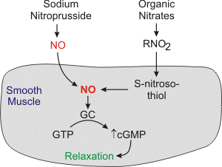
Mechanism of action
Enzymatically converted to a reactive free radical - Nitric oxide (NO)
Nitric oxide activates smooth muscle soluble guanylyl cyclase (GC) to form cGMP.
Increased intracellular cGMP inhibits calcium entry into the cell, decreasing intracellular calcium concentrations and causing smooth muscle relaxation cGMP is broken down to GTP by Phosphodiesterase-V enzyme. Drugs (sildenafil) that inhibit Phosphodiesterase-V enzyme will potentiate the action of nitrates and this may lead into severe hypotension.

Slide 12
Antianginal effects
Dilate epicardia coronary arteries resulting in increased blood flow to myocardial tissues
They reduce preload and afterload → decrease myocardial workload resulting in decreased myocardial oxygen demand;
Reduce platelet aggregation by stimulation of platelet guanylate cyclase;
Sublingual or IV administration; avoids 1st pass effect.

Slide 13
DURATION OF ACTION OF SOME NITRTATE PREPARATIONS
 | PEAK ACTION | DURATION OF ACTION
Sublingual GTN(Tablet 300-500µg or metered dose aerosol 400µg/spray) | 4-8 minutes | 10-30 minutes
Buccal GTN (1-5 mg tablet 6 hourly) | 4-10 minutes | 30-300 minutes
Transdermal. GTN (5-10 daily) | 1-3 hours | Up to 24 hours
Oral isosorbidedinitrate.(10-20 mg 8 hourly) | 45-120 hours | 2-6 hours
Oral isosorbide mononitrate ( 20-60 mg once or twice a day) | 45-120 hours | 6-10 hours

Slide 14
Adverse effects & Contraindications of Organic Nitrates
Orthostatic hypotension
Tachycardia
Severe throbbing headache
Dizziness
Flushing
Syncope (fainting)
Contraindicated in raised intracranial pressure

Slide 15
2. Which of the following nitrate can be administered through sublingual, buccal and transdermal?
a. Isorsobide mononitrate
b. Isorsobide dinitrate
c. Glyceryl trinitrate
d. All of the above
3. A 59 black man with a history of angina is given a prescription for an oral nitrate formulation (isosorbide dinitrate) 20 mg bid. A second agent that this patient should be warned "NOT" to take while on this oral nitrate formulation is:
aspirin (low dose)
grapefruit juice
metoprolol
Sildenafil
St. John's wort

Slide 16
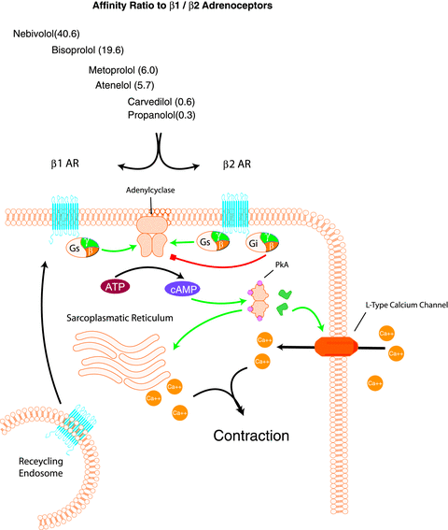
Beta-adrenergic Receptor Blockers
(β-blockers)
E. Mol. Pharm. 2nd ed.

Slide 17
All beta-blockers cause a competitive inhibition of the β receptor and counter the effects of catecholamines
Block beta adrenergic receptors and inhibit the adenylate cyclase from converting ATP to cAMP the second messenger,
Reduced levels of cAMP inactivates protein kinase A (PKA) resulting in dephosphorylation of the membrane calcium channel and hence decreases calcium entry into the cytosol. This cause smooth muscle relaxation and therefore blood vessel dilation
In addition, PKA enhances calcium release from the sarcoplasmic reticulum. The increase in calcium loading leads to an positive inotropic effect. Therefore Beta adrenergic drug blocks this action as well

Slide 18
BETA BLOCKERS
MODE OF ACTION: Lowers myocardial oxygen demand by
          reducing heart rate
          reducing blood pressure
          reducing myocardial contractility
          : Increase blood flow to the coronary tissues by:
          A. Increasing diastolic period resulting in increased ventricular filling.
          This increases blood flow to the myocardia tissues
          Side effects
          Bronchospasms ( can precipitate asthma)
          Worsens peripheral vascular disease
          Bradycardia
          Hypotension
          Worsens symptoms of heart failure
          Impotency
          7. Worsens of angina symptoms if withdrawn suddenly

Slide 19
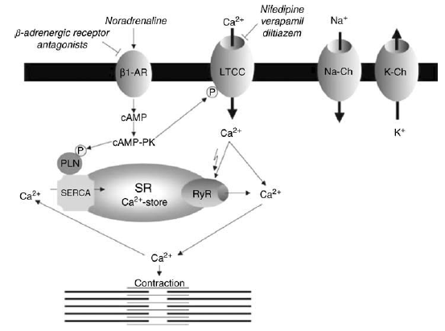
Calcium Channel Blockers (CCBs)
E. Mol. Pharm. 2nd ed.

Slide 20
CALCIUM CHANNEL BLOCKERS
MODE OF ACTION
DECREASES MYOCARDIAL OXYGEN DEMAND BY REDUCING BLOOD PRESSURE AND MYOCARDIAL CONTRACTILITY
Increase oxygen supply by dilating epicardia coronary arteries.
TYPES
DIHYDROPYRIDINE CALCIUM ANTAGONISTS
NIFEDIPINE SR
Amlodipne
NICARDIPINE OFTEN CAUSE REFLEX TACHYCARDIA-BEST USED IN COMBINATION WITH BETA BLOCKER-not used or caution when using
B. NON- DIHYDROPYRIDINE CALCIUM ANTAGONISTS
VERAPAMIL
DILTIAZEM
SUITABLE FOR PATIENTS WHO ARE NOT RECEIVING BETA BLOCKERS AS THEY DECREASE THE HEART RATE ( DANGEROUS ADDITIVE EFFECT)

Slide 21
CALCIUM CHANNEL ANTAGONISTS MAY REDUCE MYOCARDIAL
CONTRACTILITY TO A DEGREE THAT CAN AGGRAVATEOR PRECIPITATE
HEART FAILURE
UNWANTED EFFECTS
PERIPHERAL OEDEMA
FLUSHING
HEADACHE
DIZZINESS
Hypotension
Constipation

Slide 22
Calcium Channel Blockers (CCBs)
Drug Name | Clinical Uses | Dosage | Adverse Effects
Amlodipine | Stable & Vasospastic Angina; Hypertension | 5-10mg PO OD | headache, nervousness, dizziness, constipation, peripheral oedema, etc
Nifedipine | Vasospastic & Stable Angina, Hypertension (SR preps only) | 20 -60mg/day PO (SR preps) | Dizziness, light-headedness, headache, nervousness, constipation, AV block, flushing, rash, etc
Diltiazem, Verapamil | Angina, HTN, Arrhythmia, Atrial fibrillation or flutter | 30–360 mg/day PO 80-120mg t.d.s PO | nausea, diarrhea, edema, angina, bradycardia, AV block, flushing, rash, headache

Slide 23
Potassium Channel Activators
E. Mol. Pharm. 2nd ed.

Slide 24
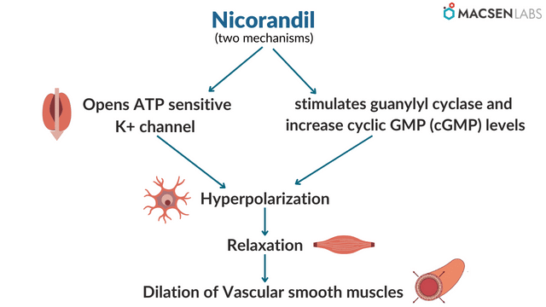
POTASSIUM CHANNEL ACTIVATORS (NICORANDIL)
Activates guanylate cyclase or facilitates the release of NO, leading to increased cGMP levels with a reduction in intracellular calcium and vascular smooth muscle cell relaxation
Potassium channel dependent -ATP in vascular smooth muscle are opened, this produces hyperpolarization with subsequent close of the voltage-sensitive calcium channels and decrease in calcium influx and intracellular calcium, resulting in myosin light chain dephosphorylation and vascular smooth muscle relaxation

Slide 25
Ivabradine
Mechanism of action
Ivabradine is a new drug that blocks sodium-potassium channels in pacemaker potential thereby decreases automaticity.
Hence it can be used instead of beta blockers in agina pectoris
Side effects
Blurred vision.
chest pain or discomfort.
fast or irregular heartbeat.
lightheadedness, dizziness, or fainting.
pounding in the ears.
slow or irregular heartbeat.
unusual tiredness.

Slide 26
Caution in:
hypovolaemic patients
Patients with pulmonary oedema
Side effects:
Headache
Flushing
Dizziness
Weakness
May cause a dose dependent increase in heart rate
Myalgia
Angioedema

Slide 27
Ranolazine
Ranolazine is an anti-anginal drug used for the treatment of chronic angina
It can be used alone or in conjunction with nitrates, beta-blockers, angiotensin receptor blockers, anti-platelet drugs, calcium channel blockers, lipid-lowering drugs, and ACE inhibitors
Ranolazine inhibits sodium and potassium ion channel currents.
It has been shown to exert weak activity on L-type calcium channels making it a weak direct vasodilator and exerts minimal direct effects on atrioventricular nodal conduction

Slide 28
Side Effects
Bloating or swelling of the face, arms, hands, lower legs, or feet.
chest tightness.
difficult or labored breathing.
fast, irregular, pounding, or racing heartbeat or pulse.
lightheadedness.
rapid weight gain.
tingling of the hands or feet.
unusual weight gain or loss

Slide 29
Management of Angina Pectoris
Avoid Risk Factors: - Smoking, Diet, Treatment of hypertension, Diabetes, Hyperlipidemia and Thyrotoxicosis.
Reduce risk of Myocardial Infarction:
Anti-platelets e.g. Aspirin.
Hypolipidemic agents e.g. Clofibrate.

Slide 30
Management of Angina Pectoris
Typical Stable Angina (Exertional Angina):
Acute attack: - Nitroglycerine, GTN sublingual tablets.
Prophylaxis: - Long acting Nitrates, Beta-blockers, CCBs.
If inadquate response to a single drug, add a drug from a different class to increase beneficial effects and decrease undesirable effects.
Vasospastic Angina:
Nitrates and CCBs are effective in relieving and preventing ischemic attacks.
Beta-blockers are contraindicated because they produce coronary spasm.
Unstable Angina:
Anti-platelet drugs (e.g. Aspirin 75mg) to decrease incidence of thrombosis.
Heparin IV.
Beta-blockers, CCBs and Nitrates.
Surgical: Revascularization and Angioplasty.

Slide 31
Acute Myocardial Infarction

Slide 32
Drug Therapy of Acute Myocardial Infarction
95% Oxygen: - Inhalation of O2 increases arterial PO2 → increases diffusion of O2 into the ischemic myocardium.
Pain Relief: - Morphine 2-4mg IV given initial dose that can be repeated PRN. (Morphine produces potent analgesia and reduces myocardial O2 demand through marked vasodilatation).
Sedation: Diazepam 5mg given 4 times/day.
Measures to limit the size of infarction:
Beta-blockers, Nitrates or CCB’s can be used by the I.V route; these agents reduce myocardial oxygen demand.
Reperfusion by fibrinolytic therapy (e.g. Streptokinase).
Anticoagulants: (in patients with obesity, History of MI, etc)

Slide 33
END OF LECTURE
Thank you for having me

