Slide 1
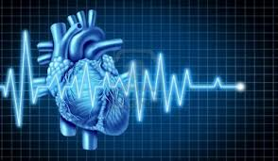
Anti-arrythmic Drugs
M.Kampamba (DipPharm, Bpharm, MclinPharm) PhD candidate
Clinical Pharmacy Specialist (Specialty: Pharmacotherapist
Lecturer University of Zambia
School of Health Sciences
School of Medicine

Slide 2
Learning objectives
By the end of this lecture, students should be able to:
Define and describe different types of arrhythmia
Classify anti-arrhythmic drugs based on Vaughan Williams classification
Describe the pharmacological and side effects of antiarrythmia drugs

Slide 3
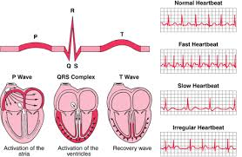
Arrhythmia is a disturbance of normal heart rhythm either resulting in a faster rhythm (tachycardia, >100bpm) or faster arrhythmia (tachyarrhythmia, >150 - 250bpm, flutter, >250 – 350bpm, fibrillation, >350bpm) or slowed rhythm (bradyarrhythmia, <60bpm)
Criteria:
HR outside normal range (60 – 100 bpm);
Rhythm not originating from SA node;
Abnormal conduction pathway;
Abnormal conduction velocity.

Slide 4
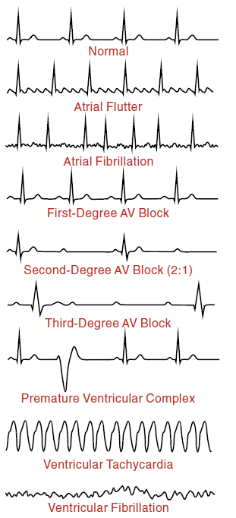
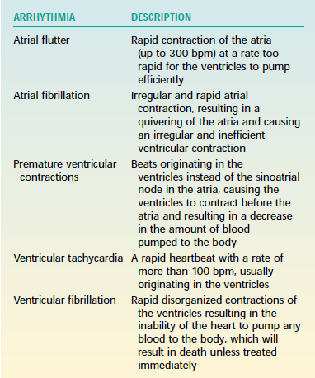
Types of Arrhythmia

Slide 5
Pathophysiology
Cardiac Arrhythmias
Disturbance in impulse generation
e.g. Increased/decreased automaticity; ectopic focus
Disturbance in impulse conduction
e.g. AV block
Re-entry arrhythmia
e.g. Decreased retrograde conduction, WPW syndrome, etc

Slide 6
Antiarrhythmic Drugs
All antiarrhythmic drugs act by altering ion fluxes within excitable tissues in the myocardium;
3 ions of primary importance: Na⁺, Ca²⁺, and K⁺
Antiarrhythmic drugs classified by their ability to directly or indirectly block flux of one or more of these ions across the membranes of excitable cardiac muscle cells;

Slide 7
Vaughan Williams Classification of Antiarrhythmic Drugs
Class | Mode of Action | Drug Names | Side effects
I | Na⁺ Channels Blockers
I A | Prolong action potential | Quinidine, Procainamide, Pisopyramide, Ajmaline I.V. | Check for the individual by using the BNF
I B | Shorten repolarization (AP duration) | Lidocaine, Mexiletine, Tocainide, Phenytoin | Check for the individual by using the BNF
I C | Less effect on repolarization | Flecainide, Propafenone, Encainide, | Check for the individual by using the BNF
II | Beta-Adrenergic Blockers | Propanolol, Metopropol, Esmolol, Acebutolol, etc | bronchospasm, hypoglycemia, increased PR, depressions, impotence, etc
III | K+ Channels Blockers (Prolong repolarization) | Amiodarone, Sotalol | Amiodarone:visual defects, c de pointes arrhythmia alteration of thyroid function and lung fibrosis
IV | Calcium Channel (L-type) Blockers | Verapamil, Diltiazem | Check under antihypertensives
Miscellaneous | Miscellaneous Actions | Adenosine, Magnesium, Alinidine Digoxin

Slide 8
Miscellaneous Antiarrhythmic Drugs
Cardiac glycosides (e.g. Digoxin, Digitalis): activate vagus nerves → slowing of sinus rate and prolongation of AV conduction time; Used in treatment of atrial fibrillation (in combination with β-blockers & verapamil);
Adenosine: K⁺-channel opener: activates atrial A1-adenosine receptor → I_{K.Ado} channel opening → hyperpolarization, slowing of spontaneous depolarization, reduces sinus rate and AV conduction;
Has extremely short t_{1/2} (~0.6–1.5 sec); Given by rapid IV bolus

Slide 9
Atropine (and its derivative ipratropium bromide)
Muscarinic M2 receptors mainly present in supraventricular tissue and AV node; activation by ACh → opening of hyperpolarizing I_{K.ACh} and inhibits pacemaker (I_{f} current) probably via βγ-subunit of G_{i} protein → hyperpolarization and slower spontaneous depolarization;
Therefore, muscarinic M2 receptor antagonists like atropine inhibit adenylyl cyclase via G_{i} proteins → reduce intracellular cAMP → increased HR and accelerated AV conduction;
Used for bradyarrhythmia treatment

Slide 10
Magnesium
Precise antiarryhthmic mechanism not well understood;
Mechanism postulated to involve important influence on Na⁺/K⁺ ATPase transport across myocardial cell membrane and therefore on cardiac action potential.
Used for therapy of torsades de pointes (Mg²⁺ has suppressive effect on development of spontaneous after depolarizations that cause this arrhythmia)
Also useful in treating arrhythmias associated with digitalis toxicity

Slide 11
Management of Cardiac Arrhythmias
Arrhythmia Type | 1st Choice Drug | Alternative Choice
Atrial fibrillation/flutter | Verapamil, Diltiazem, and/or β-blocker | Digoxin, Class IA, IC drugs, Low dose amiodarone
Supraventricular tachycardia | Adenosine, Verapamil, or Diltiazem | Class II drugs, Digoxin, Class IA, IC, II, or IV drugs
Sustained Ventricular Tachycardia | Cardioversion (safest & effective option), Lidocaine | Procainamide, Bretylium or Amiodarone, Sotalol, Class IA, IB, II, III
Ventricular Fibrillation | Defibrillation is treatment of choice; Lidocaine to prevent recurrence | Amiodarone, procainamide or bretylium to prevent recurrence
Torsades de pointes | Magnesium sulfate | Potassium (if hypokalemic), Isoprenaline
Bradyarrhythmia | Atropine, Ipratropium | Cardiac pacing

Slide 12
Question Time
Which one of the following is class 1c antiarrhythmic?
a. fleceinide
b. quinidine
c. phenytoin
d. propafenone
Alteration of thyroid function can be caused by:
a. Sotalol
b. Phenytoin
c. Amiodarone
d. Verapamil

Slide 13
END OF LECTURE
Thank you for having me

