Slide 1
Histamine and Antihistamine
PGY 4210
M.Kampamba (DipPharm, Bpharm, MclinPharm) PhD candidate
Clinical Pharmacy Specialist (Specialty: General Pharmacotherapy)
University of Zambia
Lecturer:
School of Medicine
School of Health Sciences

Slide 2
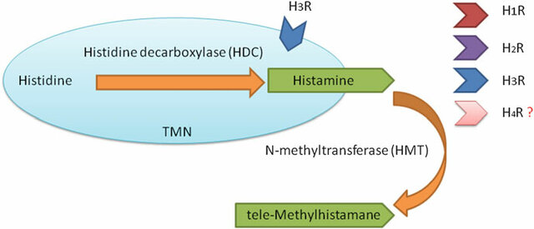
Histamine
It is a base amine formed from histidine by decarboxylase enzyme.
It is present in high concentration in the lung, skin and GIT.
·It is stored in mast cells and basophiles with Heparin and acidic proteins

Slide 3
Histamine Release
Histamine is released from mast cells during immunological reactions.
Antigen-IgE interaction activates phospholipase-C enzyme which causes the
Generation of di-acylglycerol (DAG) and inositol triphoshate (IP3) which increase the intracellular Ca++ which triggers histamine release.
· Drugs which increase the intracellular concentration of cAMP (e.g. beta-agonists) inhibit histamine release by activating protein kinase-A which acts as anintracellular breaking mechanism

Slide 4
Histamine liberators:
Some basic drugs (alkaloids) e.g. Morphine, Tubocurarine, Hydrazine and Atropine cause histamine release by replacing it in its granules
Histamine release resulting in several undesirable effects, such as:
Hypotension
Urticaria
Pruritus
tachycardia

Slide 5
Question Time
Which one of the following drugs are mast cell stabilizer and inhibit histamine release?
a. Morphine
b. Salbutamol
c. Hydralazine
d. Terbuteline

Slide 6
Antihistamines
H1 receptors in;
Smooth muscle; cause spasm in intestine, uterus and bronchi.
Blood vessels; cause vasodilatation leading to drop of blood pressure, increased capillary permeability with oedema.
–Sensory nerve endings; cause itching.
Receptors are blocked by anti-histamines (H1 antagonists).

Slide 7
H2 receptors in;
Stomach; increases gastric HCl secretion.
Blood vessels; cause vasodilatation and drop of blood pressure, increased capillary
permeability with oedema.
Heart; cause positive inotropic and chronotropic actions.
H2 receptors are blocked by H2 blockers e.g. Cimetidine and Ranitidine.
H3 receptors are present in presynaptic neurons. They regulate histamine release.

Slide 8
H4 receptors
The most prominent expression of H4 receptor is found in bone marrow, peripheral blood, spleen, and thymus
Expression has also been reported in the lung, small intestine, and colon.
H₄ receptors modulate eosinophil migration and selective recruitment of mast cells leading to amplification of histamine-mediated immune responses and eventually to chronic inflammation.
H₄ receptor involvement in dendritic cell activation and T cell differentiation documents its immunomodulatory function

Slide 9
The Classical or First Generation Antihistamines:
Antihistamines (H1 histamine receptor antagonists)
Members (Preparations):
- Diphenyhydramine
- Chlorpheniramine
- Promethazine
Cinnarizine
Alimemazine
cyclizine

Slide 10
Actions
Block the actions of Histamine on H1 receptors.
CNS; block H1 receptors causing sedation and hypnosis.
Anticholinergic (atropine-like) effects.

Slide 11
Therapeutic Uses:
Allergic reactions e.g. allergic rhinitis and urticaria.
Motion sickness for their anticholinergic and sedative effects.
Parkinsonism for their anticholinergic effects
Antiemetic ( promethazin)
Antitussive ( diphenyhydramine)

Slide 12
Side Effects:
Sedation
drowsiness.
- Anticholinergic effects e.g. dry mouth, urine retention and constipation.

Slide 13
Second Generation Antihistamines:
Preparations:
Terfenidine
Astemizole
Loratadine
Cetirizine
They have anti-allergic effects similar to the first generation antihistamines but without sedation or anticholinergic effects.
Terfenadine and Astemizole in particular may induce rare but serious cardiac arrhythmia and sudden death.

Slide 14
Third Generation Antihistamines:
They are metabolites of the second generation with similar or superior effects to the parent compounds without cardiac toxicity
Parent compounds without cardiac toxicity e.g. Fexofenadine (Telfast); 120mg/day orally.

Slide 15
2. Use of this class of over-the-counter drugs has been associated with an increased incidence of automobile accidents, increased work injuries & a significant decline in cognitive function in the elderly. A commonly used member of this drug class is:
Diphenhydramine
Fexofenadine
Loratadine
Nizatidine
3. A 24 year-old patient presents on a bright sunny Spring morning with a constellation of signs & symptoms that include a stuffy runny nose, sneezing, red, itchy & watery eyes, and a cough related to postnasal drip. A diagnosis of allergic rhinitis is made. In addition to a decongestant or corticosteroid spray, what other medication could you recommend that would counteract the effects related to histamine release, but have the least impact on mental status?
brompheniramine
chlorpehniramine
diphenhydramine
fexofexadine
ranitidine

Slide 16
End of lecture
Thank you for having me

