Slide 1
INTRODUCTION TO PHARMACOKINETICS & PHARMACODYNAMICS
Dr Sindwa Kanyimba
Lecturer, Pharmacology

Slide 2
INTRODUCTION
Pharmacokinetics refers to the movement of the drug into the body, through the body, and out of the body; and takes into account the processes of drug input (absorption), drug distribution and elimination of the drug from the body (metabolism and excretion)
Pharmacodynamics describes the effects of drugs and the mechanisms by which drugs exert their effects

Slide 3
LEARNING OBJECTIVES
Explain the terms Pharmacokinetics and Pharmacodynamics
Explain the importance of pharmacokinetics and pharmacodynamics in the determination of drug dosage regimens
Outline the four pharmacokinetic processes of Absorption, Distribution, Metabolism and Excretion
Differentiate between drug actions and drug effects
Outline the mechanisms by which drugs produce their effects

Slide 4
LEARNING OBJECTIVES …. CONT’D
Describe the relationship between pharmacokinetics and pharmacodynamics
Describe the time course of drug action
Describe the relationship between drug dose and clinical response
Define the terms Therapeutic Range and Therapeutic Index
Calculate the Therapeutic Index

Slide 5
PHARMACOKINETICS
  Pharmacokinetics is the study of the processes involved in the disposition of drugs, namely absorption, distribution, metabolism and excretion (ADME), including:
  The rate and extent to which drugs are absorbed into the body and distributed to the body tissues
  The rate and pathways by which drugs are eliminated from the body by metabolism and excretion
  The relationship between time and plasma drug concentration

Slide 6
PHARMACOKINETICS …. CONT’D
Understanding the pharmacokinetic processes is important because:
  They form the basis on which the optimal dose regimen is chosen
  They explain the majority of the inter-individual variation in the response to drug therapy

Slide 7
PHARMACOKINETICS: ADME
  Absorption
The process by which drugs enter the body
  Given by any route other than intravenously, drug molecules must cross tissue membranes (e.g. skin epithelium, subcutaneous tissue, gut endothelium, capillary wall) to enter the blood
  Distribution
The process by which drugs move around the body
  After entering the blood, drug molecules must cross capillary walls to enter the tissues, reach cell membranes and enter cells

Slide 8
PHARMACOKINETICS: ADME …. CONT’D
  Metabolism
  The process by which drugs are chemically altered to make them sufficiently water-soluble for excretion in urine or faeces (via the biliary tract)
  Metabolism occurs in a variety of body organs and tissues, but chiefly in the liver, gut wall, kidney and skin

Slide 9
PHARMACOKINETICS: ADME …. CONT’D
  Excretion
  The process by which drugs leave the body
  Drugs that are sufficiently water-soluble will be excreted unchanged in the urine
  Lipid-soluble drugs must be modified to water-soluble metabolites before excretion via the kidney or into the intestine via the bile

Slide 10
PHARMACOKINETICS: APPLICATION
For a drug to produce a beneficial effect without intolerable unwanted effects, it needs to be present in the right place, at the right concentration and for the right duration
Changes in drug tissue and plasma concentration over time is determined by the pharmacokinetic profile of the drug
Knowledge of drug pharmacokinetics is therefore required for rational dosing; dose regimens are determined from drug pharmacokinetic parameters

Slide 11
PHARMACODYNAMICS
  Pharmacodynamics is the study of the biochemical and physiological effects of drugs and their mechanisms of action
  Involves the study of the actions and effects of drugs
  Involves the study of the interactions between drugs and cellular macromolecular components which result in biological effects

Slide 12
DRUG ACTION VERSUS DRUG EFFECT
  Drug action
  Mechanisms by which the drug produces a response in living organisms
  Drug effect
  The observable consequence of a drug action
  Example: The action of penicillin is to interfere with cell wall synthesis in bacteria and the effect is the death of the bacteria

Slide 13
MECHANISM OF ACTION VERSUS MODE OF ACTION
Mechanism of action: Refers to the specific biochemical interaction through which a drug produces its pharmacological effect (= Drug Action)
Mode of action: Describes a functional or anatomical change, resulting from the exposure of a living organism to a drug (= Drug Effect)
Mechanism of action describe changes at molecular level while mode of action describes changes at cellular level

Slide 14
MECHANISMS OF ACTION
Most drugs act by interacting with macromolecular targets (mostly proteins) which include receptors, enzymes, carriers, membrane bound transport proteins and pumps, and ion channels
Drugs action may lead to stimulation or depression of normal physiological functions. Stimulation increases the rate of activity while depression reduces the rate of activity.
Drugs may act by increasing or decreasing enzymes, hormones or other chemical mediators of biological activities

Slide 15
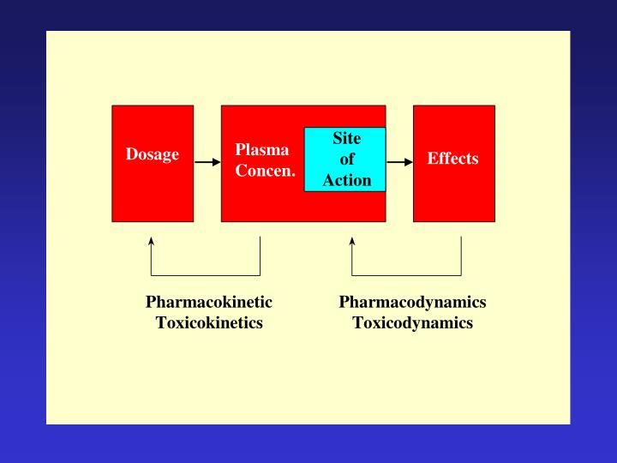
RELATIONSHIP BETWEEN PHARMACOKINETICS AND PHARMACODYNAMICS

Slide 16
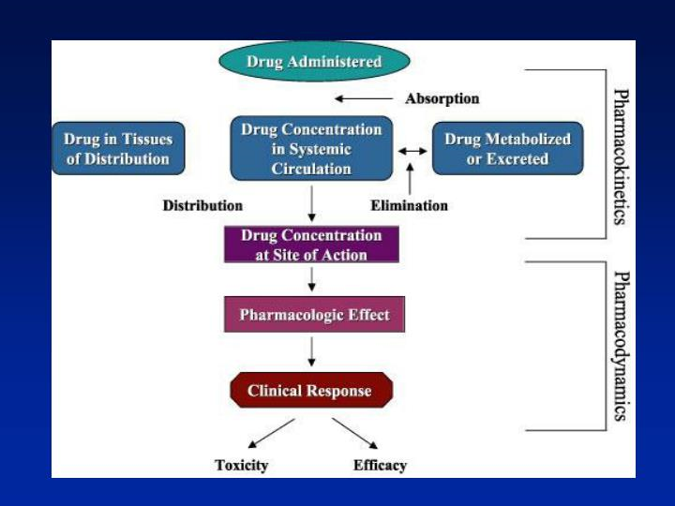
RELATIONSHIP BETWEEN PHARMACOKINETICS AND PHARMACODYNAMICS …. CONT’D

Slide 17
RELATIONSHIP BETWEEN PHARMACOKINETICS AND PHARMACODYNAMICS …. CONT’D
            The pharmacokinetic properties of a drug determine the concentration of drug achieved in plasma and tissues, including the site of action of the drug
            Drug effects are proportional to the concentration of drug at the action site
            An equilibrium is established between plasma drug concentration and concentration at the active site, therefore there is a correlation between drug effects and plasma drug concentration

Slide 18
RELATIONSHIP BETWEEN PHARMACOKINETICS AND PHARMACODYNAMICS
Pharmacokinetics determines the change in plasma drug concentration with time, and therefore how rapidly and for how long the drug will appear at the target organ
Pharmacodynamics determines the magnitude of drug effect in relation to plasma drug concentration

Slide 19
RELATIONSHIP BETWEEN PHARMACOKINETICS AND PHARMACODYNAMICS …. CONT’D
The relationship between dose and effect can be separated into two components:
  Pharmacokinetic (dose-concentration)
  Pharmacodynamic (concentration-effect)
Plasma drug concentration forms the link between drug dosing and drug effect
Dose → CONC → Effect
Plasma drug concentration provides the link between pharmacokinetics and pharmacodynamics and is therefore the focus when determining a dose regimen

Slide 20
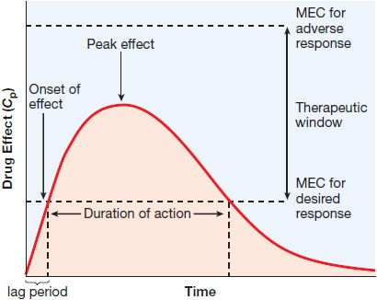
TIME COURSE OF DRUG ACTION

Slide 21
TIME COURSE OF DRUG ACTION …. CONT’D
Onset of drug action
The time it takes after the drug is administered to reach a concentration that produces a response
Duration of action
The time during which the drug is present in a concentration large enough to produce a response
Peak effect
The time it takes for the drug to reach its highest effective action

Slide 22
TIME COURSE OF DRUG ACTION …. CONT’D
Onset of drug action
The time it takes after the drug is administered to reach a concentration that produces a response
Duration of action
The time during which the drug is present in a concentration large enough to produce a response
Peak effect
The time it takes for the drug to reach its highest effective action

Slide 23
RELATIONSHIP BETWEEN DRUG DOSE & CLINICAL RESPONSE
Minimum effective dose (MED): The lowest dose level of a drug that provides a clinically significant response
There is a threshold for each drug to produce a response
Doses of drugs below that threshold will produce no observable effect
Maximum tolerated dose (MTD): The highest dose of a drug that will produce the desired effect without unacceptable toxicity

Slide 24
RELATION BETWEEN DRUG DOSE & CLINICAL RESPONSE …. CONT’D
Therapeutic
Toxic
% Responding
ED₉₉
TD₁
TD₅₀
ED₅₀
Dose
Notes:
In this dose-effect plot, the therapeutic and toxic effects are plotted.
This study illustrates an important principle when a drug is administered to an organism - there is no single dose-effect curve relationship that can adequately characterize the full spectrum of activity of a drug. All drugs produce at least 2 effects and therefore have at least 2 quantal dose-response curves - one for the therapeutic effect and one or more for the toxic effect.
The safety of a drug depends on the degree of separation between the doses producing a therapeutic effect and the doses which produce side effects, both of which can be characterized by quantal dose-effect curves.
BUTTON

Slide 25
RELATIONSHIP BETWEEN DRUG DOSE & CLINICAL RESPONSE …. CONT’D
Median effective dose (ED₅₀): The dose of a drug that produces a specified effect in 50% of the population that takes that dose
Median toxic dose (TD₅₀): The dose of a drug that produces a particular toxic effect in 50% of the population that takes that dose
Median lethal dose (LD₅₀): The dose of a drug required to kill 50% of a given test population

Slide 26
THERAPEUTIC RANGE (WINDOW) AND THERAPEUTIC INDEX
Therapeutic range (therapeutic window)
The concentration of drug between minimum effective concentration and maximum safe concentration is known as therapeutic range
Range of the dose levels from the MED to the MTD
Therapeutic index
MTD/MED
TD₅₀/ED₅₀

Slide 27
THERAPEUTIC RANGE (WINDOW) AND THERAPEUTIC INDEX …. CONT’D
The relative safety of a drug can be expressed by its therapeutic index
A drug with a wide therapeutic index has a high safety margin and is relatively safe; the lethal dose is much larger than the therapeutic dose
A drug with a narrow therapeutic index is more dangerous for the patient because small increases over normal doses may induce toxic reactions

Slide 28
END
Thanks for listening

