Slide 1
Pharmacodynamics
PGY 4210
M.Kampamba (DipPharm, Bpharm, MclinPharm) PhD candidate
Clinical Pharmacy Specialist (Specialty: General Pharmacotherapy)
University of Zambia
Lecturer:
School of Medicine
School of Health Sciences

Slide 2
Learning Objectives
At the end of this session, YOU should be able to:
Define pharmacodynamics
Classify types of mechanism of action
Understand drug-receptor dynamics;
Describe the action of ligands on different receptor types
Apply fundamental concepts of pharmacodynamics to therapeutics

Slide 3
6. Classify and describe types of adverse drug reactions
7. Classify and describe types of drug interaction

Slide 4
Definition
Pharmacodynamics :is the study of biochemical and physiological effect of drugs and their mechanism of action in the body.

Slide 5
Mechanism of action (MOA)
MOA refers to the specific biochemical interaction through which a drug produces its pharmacological effect
There are two types of mechanism of drug action.
a. Non- receptor mediated mechanism of action : it does not involve drug interaction with a particular receptor
b. Receptor mediated mechanism of action: It involves interaction of the drug with a particular receptor at a specific site in the body

Slide 6
Non- receptor mediated mechanism of action
DRUG ACTING ON ENZYMES
Drug can inhibit or enhance an enzyme e.g
Aspirin inhibits cyclo-oxyginase enzyme
DRUG ACTING ON PLASMIC MEMBRANE
Polyene antifungal increase permeability of fungal membrane e.g. Amphotericin B.
DRUGS ACTING ON SUBCELLULAR STRUCTURES
.Colchicine disrupts, the microtubules inhibiting mitosis (used in gout)

Slide 7
DRUGS ACTING ON GENETIC APPARATUS
Chloramphenicol, macrolides, aminoglycosides inhibit bacterial protein synthesis.
Drugs like antimetabolite (trimethoprim, pramaquine.) alkylating agent (cyclophosphamide) that inhibit DNA synthesis or disrupt DNA function respectively.

Slide 8
DRUGS ACTING BY CHEMICAL MEANS
Antiacid act in peptic ulcer disease by neutralize acid in the stomach.
Protomine antagonizes heparin by chemical means.
DRUGS ACTING PHYSICAL MEANS
Lubricant like liquid paraffin used in constipation
Adsorbent, absorb toxics and microorganisms in the GIT e.g. Charcoal

Slide 9
Question time ( true or false)
Which one of the following drug act by disrupts, the microtubules inhibiting mitosis ?
a. Chloramphenicol
b. Colchicine
c. Aspirin
d. Amphotericin B
e. Albendazole

Slide 10
RECEPTOR MEDIATED MECHANISM
Receptors are specific cellular structures which are protein in nature and may be extracellular or intracellular.
Receptor interact with chemical transmitters or drugs (agonist) to trigger a change in the body which result in the final observed effect.
They are blocked by other drugs (antagonist or blockers).
Receptors are characterized by specificity, selectivity and sensitivity.

Slide 11
Two state receptor model
A receptor may exist in two interchangeable states, active (Ra) & inactive (Ri) which are in equilibrium.
Binding of drug shift this equilibrium in either direction.

Slide 12
Ligand- any molecule which attaches selectively to particular receptors.
Affinity -The strength of the reversible interaction between a drug and its receptor, as measured by the dissociation constant, is defined as the affinity of one for the other.
Intrinsic activity – capacity to induce a functional change in the receptor.
Specificity - A drug that interacts with a single type of receptor that is expressed on only a limited number of differentiated cells will exhibit high specificity.

Slide 13
DRUG- RECEPTOR INTERACTION
Drug can interact with the receptors in various ways.
Drugs that bind to physiological receptors and mimic the regulatory effects of the endogenous signaling compounds are termed agonists
Agonist Interact with the receptor (affinity) and activate the receptor (efficacy) to produce a physiological change
It has affinity and efficacy . E.g. adrenaline.

Slide 14
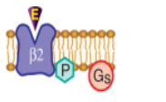
If the drug binds to the same recognition site as the endogenous agonist (the primary or orthosteric site on the receptor) the drug is said to be a primary agonist.
e,.g salbutamol stimulate Beta-two
adrenergic receptors

Slide 15
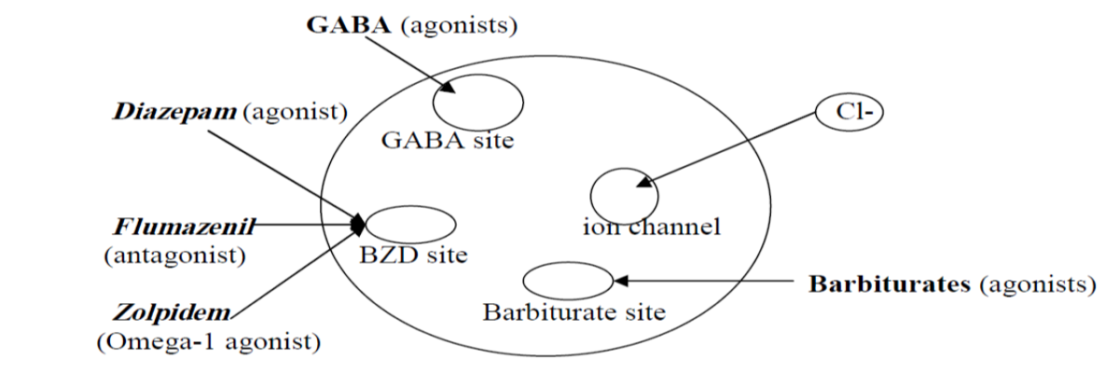
Allosteric agonists bind to a different region on the receptor referred to as an allosteric site. E.g benzodiazepine and Barbiturates binding on GABA-receptors
Allosteric sites of GABA receptors

Slide 16
Antagonist
This interact with the receptor (affinity) but no activation e.g. atropine.
Partial Agonist (agonist-antagonist)
Interact with the receptor but with less efficacy than full agonist.
In the presence of the agonist, it acts as the antagonist. e.g. Succinycholine (muscle relaxant).

Slide 17
TYPES OF ANTAGONISTS
Chemical Antagonists
The antagonist interact with the agonist away from the receptor e.g. protamine sulphate which antagonize heparin in the plasma.
Physiological Antagonism
This is where the antagonist inhibit the action of the agonist by acting on different receptor e.g. B₂ bronchodilators effect of adrenaline antagonizes the bronchial constriction effect of histamine (H1) receptors.
Competitive Antagonism
The antagonist competitive with the agonist on the same recognition site of the receptor causing the agonist to appear as if it was less potent e.g. Beta blocker and Beta agonist

Slide 18
Question time (True or false)
2. A drug that bind to a different region on the receptor is called?
Primary agonist
Partial agnost
Antogonst
Allosteric agonists

Slide 19
PHYSIOLOGICAL RECEPTORS
GPCR
Ion channels
Transmembrane enzymes
Transmembrane, non-enzymes
Nuclear receptors
Intracellular enzymes

Slide 20
Cellular Pathways Activated by Physiological Receptors
Signal Transduction Pathways
Physiological receptors have at least two major functions, ligand binding and message propagation (i.e., signaling).
Two functional domains within the receptor:
-ligand-binding domain and
-effector domain.
The regulatory actions of a receptor may be exerted directly on its cellular target(s), on effector protein(s), or may be conveyed by intermediary cellular signaling molecules called transducers.

Slide 21
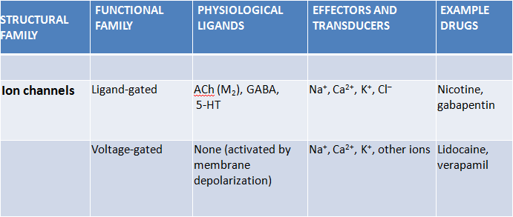
Notes:
The voltage-gated ion channels allow permeation of only one type of ion while the ligand-gated channels are less selective and allow permeation of two or more types of ions through the channel pore.

Slide 22
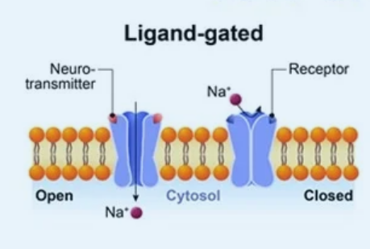
Receptors with intrinsic ion channel
Ligand gated ion channels.
No intervention of G-protein or second messenger.
Response is fastest (in milliseconds).
e.g. GABAA, 5HT3,

Slide 23
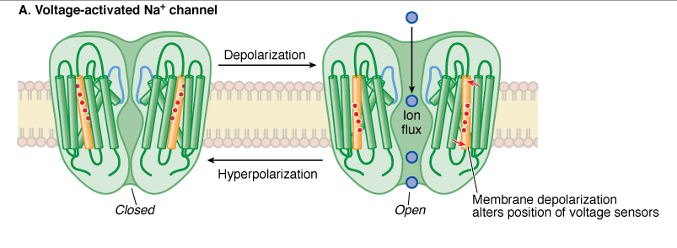
Voltage-activated Na⁺ channel with the pore in the open and closed state.
Notes:
The voltage-gated ion channels allow permeation of only one type of ion while the ligand-gated channels are less selective and allow permeation of two or more types of ions through the channel pore.

Slide 24
Physiological Receptor
STRUCTURAL FAMILY | FUNCTIONAL FAMILY | PHYSIOLOGICAL LIGANDS | EFFECTORS AND TRANSDUCERS | EXAMPLE DRUGS
GPCR | β Adrenergic receptors | NE, Epi, DA | G_{s} ; AC | Dobutamine
 | Muscarinic cholinergic receptors | ACh | G_{i} and G_{q}; AC, ion channels, PLC | Atropine
 | Eicosanoid receptors | Prostaglandins, leukotrienes, thromboxanes | G_{s}, G_{i} and G_{q} proteins | Misoprostol, montelukast

Slide 25
G Proteins
GPCRs a family of heterotrimeric GTP-binding regulatory proteins termed G proteins.
G proteins are signal transducers that convey the information that agonist is bound to the receptor from the receptor to one or more effector proteins.
The G protein heterotrimer is composed of a guanine nucleotide-binding α subunit, which confers specific recognition to both receptors and effectors, and an associated dimer of β and ϒ subunits.
G–protein-regulated effectors include enzymes such as
-adenylyl cyclase,
-phospholipase C,
-cyclic GMP phosphodiesterase (PDE6),
-membrane ion channels selective for Ca²⁺ and K⁺.

Slide 26
The subunits fall into four families (G_{s}, G_{i}, G_{q}, and G_{12/13}).
The G_{s} α-subunit uniformly activates adenylyl cyclase;
the G_{i} α-subunit can inhibit certain isoforms of adenylyl cyclase;
the G_{q} α-subunit activates all forms of phospholipase C;
and the G_{12/13} α-subunits couple to guanine nucleotide exchange factors (GEFs), such as p115RhoGEF for the small GTP-binding proteins Rho and Rac.

Slide 27
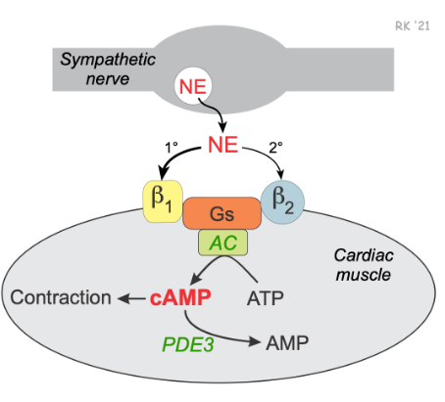


Slide 28
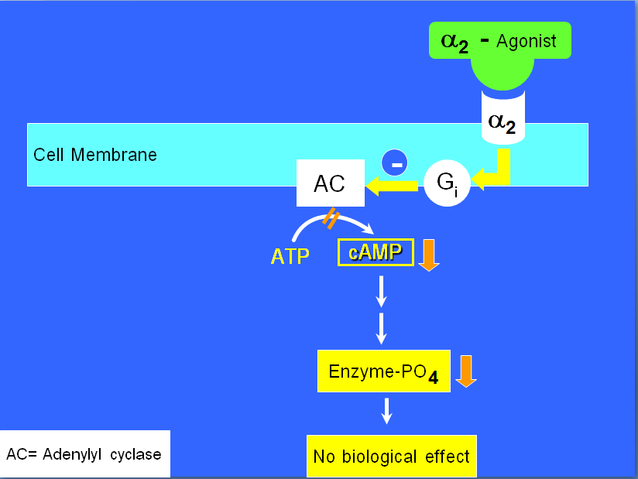

Slide 29
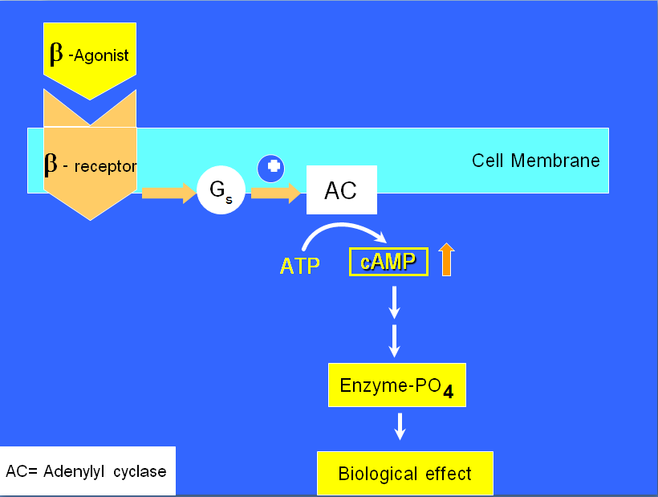

Slide 30
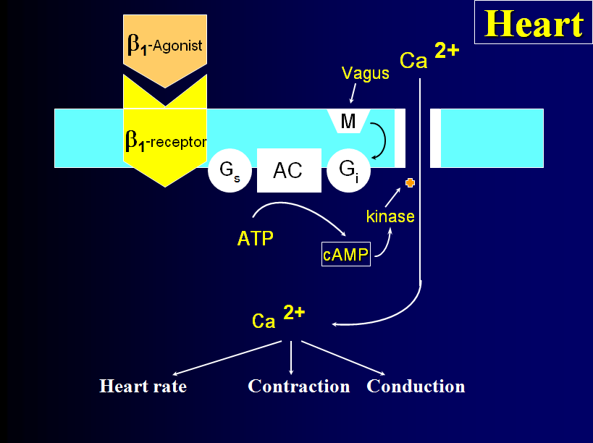

Slide 31
Adenylyl cyclase-cAMP pathway
↑ cAMP (2nd messenger)
PKA phosphorylation
Various functions
-↑ heart contraction
-Smooth mus relaxation
-Glycogenolysis
-lipolysis

Slide 32
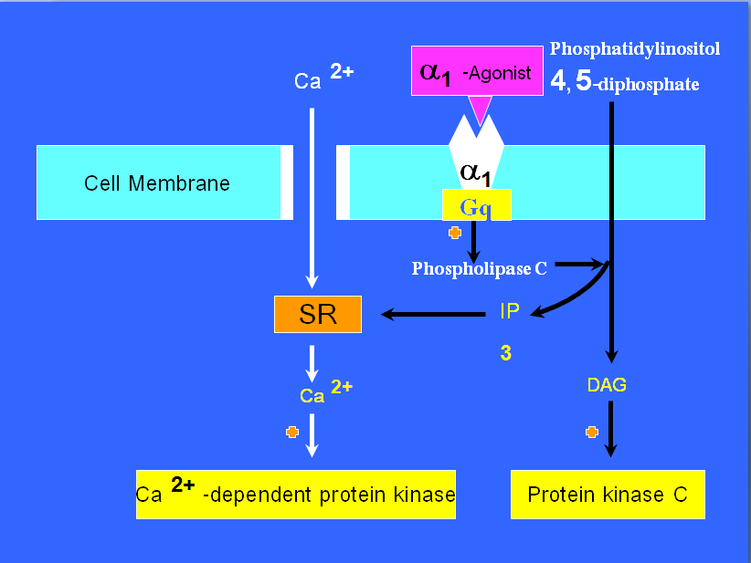
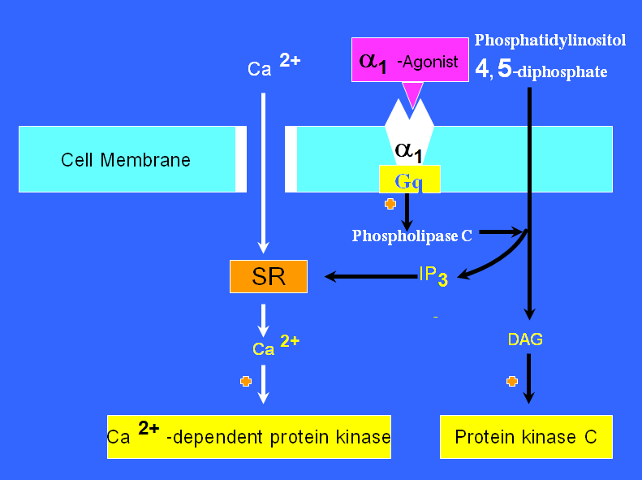

Slide 33
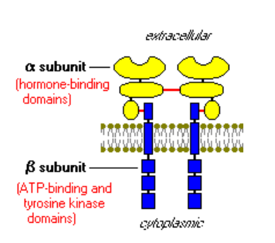
Enzyme linked receptors
With intrinsic enzymatic activity.
Notes:
Insulin binds to a specific receptor consisting of two alpha and two beta subunits. The alpha subunits are extracellular and carry the insulin-binding site. The beta subunits span the cell membrane, its intracellular end has tyrosine kinase. Binding of insulin to the alpha-subunits results in autophosphorylation of the tyrosine kinase. This causes activation of intracellular protein kinase affecting different metabolic enzymes e.g.
phosphorylase, lipase, e.t.c.

Slide 34
Receptors regulating gene expression
Several biologic ligands are sufficiently lipid-soluble to cross the plasma membrane and act on intracellular receptors.
e.g.
steroids (corticosteroids, mineralocorticoids, sex steroids, vitamin D), and thyroid hormone, whose receptors stimulate the transcription of genes by binding to specific DNA sequences near the gene whose expression is to be regulated.
Target DNA sequences called response elements.

Slide 35
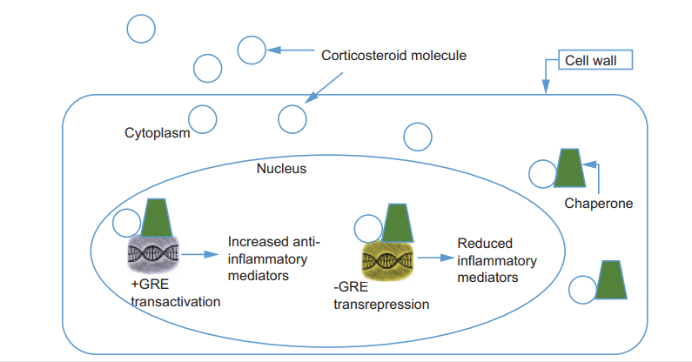
Mechanism of action of corticosteroids
Notes:
Steroid molecule diffuses across cell membranes and binds to glucocorticoid receptors, which causes a conformational change in the receptor.
The receptor-glucocorticoid complex is able to move into the cell nucleus, where it dimerizes and binds to glucocorticoid response elements .
Glucocorticoid response elements are associated with genes that either suppress or stimulate transcription, which results in ribonucleic acid and protein synthesis; these effects are called transrepression or trans-activation. Inhibit the transcription factors that control the synthesis of proinflamatory mediators

Slide 36
Question Time
Which one of the following drug binds to enzyme linked receptor?
Garbapentine
Prednisolone
Nicotine
Salbutamol

Slide 37
Efficacy: This is the capacity of the drug to produce maximum effect
Potency: It is the dose of a drug in relation to its effects. The smaller the dose required to produce therapeutic effects the higher the potency. Potency is expressed as ED50
ED50 is the dose required to produce the maximum desired therapeutic effects.

Slide 38
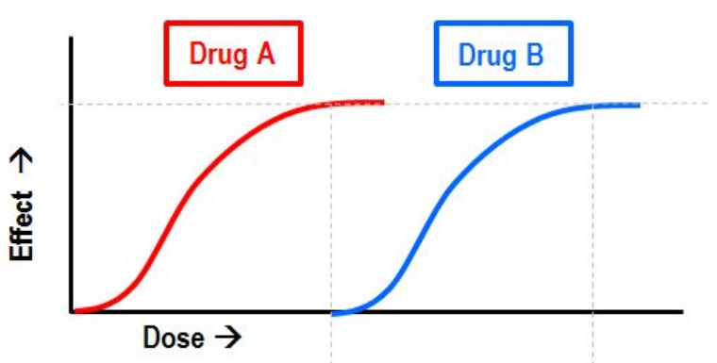

Slide 39
THERAPEUTIC INDEX (TI)
TI is margin of safety that exists between the dose required to produce the toxic effect to that required to produce therapeutic effect
Narrow therapeutic indexes indicate that any small change in the dose of drug will induce toxic effect
Drugs with narrow therapeutic index include digoxin, theophyllin and barbiturates

Slide 40
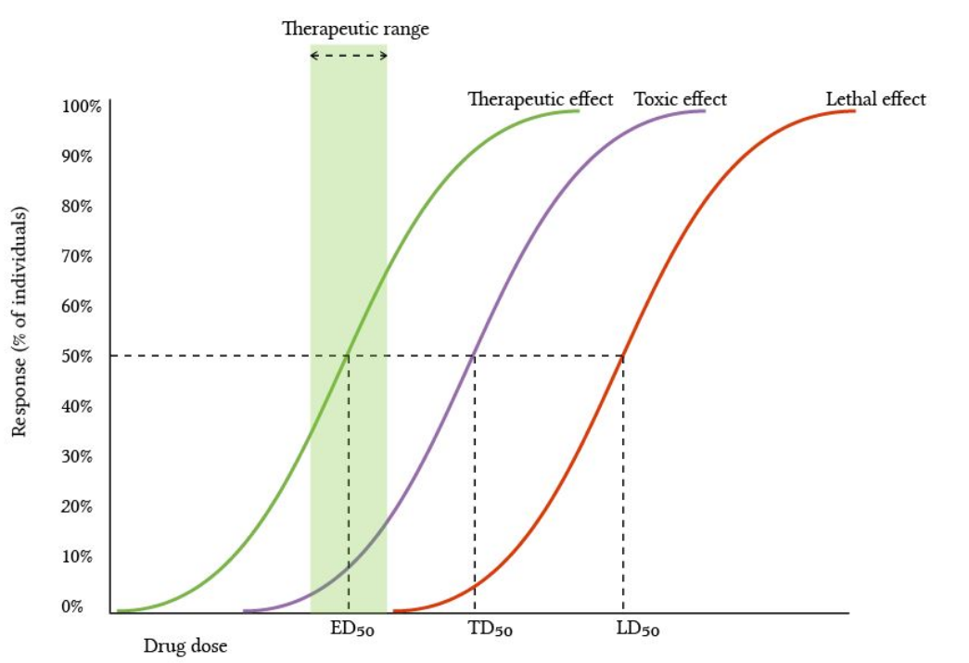

Slide 41
ADVERSE DRUG REACTION(ADR)
ADR A response to a drug that is noxious and unintended and occurs at doses normally used in man for the prophylaxis, diagnosis or therapy of disease, or for modification of physiological function

Slide 42
Extended Rawlins-Thompson classification of ADRs
Type of reaction | Features | Examples
Type A: Augmented pharmacological effect | Common Predictable effect | Bradycardia associated with abeta-adrenergic receptor antagonist
Type B: Bizarre effects not related to pharmacological effect | Uncommon Unpredictable | Anaphylaxis associated with a penicillin antibiotic
Type C: Dose-related and time-related | Uncommon Related to the cumulative dose | Hypothalamic pituitary-adrenal axis suppression by corticosteroids
Type D: Time-related | Uncommon Usually dose-related | Carcinogenesis
Type E: Withdrawal | Uncommon Occurs soon after withdrawal of the drug | Opiate withdrawal syndrome

Slide 43
FACTORS AFFECTING DRUG RESPONSIVENESS.
DOSE
Sex
Age
Pathological state
Weight of the patient

Slide 44
DRUG INTERACTION
These are the pharmacological responses which can not be explained by the action of one drug but are due to multiple drugs acting concurrently
Drug interaction may be desired or undesired, beneficial or harmful
Drug interaction may result in antagonism or synergism
SYNERGISM: Cordinated action of two or more drugs is greater than the sum of each drug acting separately.

Slide 45
Types of drug interaction
Pharmacokinetics interaction occurring at sites of absorption, distribution, metabolism and excretion.
Pharmacodynamic interaction occurring at the site of action.

Slide 46
At the site of entry (before absorption)
Tetracycline chalets metals. Its absorption is reduced by Ca2+ and A13+ containing antacid.
Iron seriously reduce absorption of tetracycline
At the site of transit or storage
A competition at plasma protein binding sites.
Asprinn, phenylbutazone, indomethecin and clofibrate, all can displace and hence the action of warfarin leading to haemorrhagic attacks

Slide 47
At the site of biotransformation
Enzyme induction – enzyme induction increases the metabolism of other drugs given simultaneously with them, phenobarbitone, Phenytoin, carbamazepine and refampicin.
Enzyme inhibition : Drugs that depress metabolizing enzymes may potentiate other drugs e.g. chloramphenicol, cimetidine. Allopurinol, and ritonavir .
At site of excretion
Probenecid block the transport (from blood to urine) by organic acid secretion) e.g. penicillin and cephalosporin leading to prolongation of their duration of action.
Thiazides inhibit the excretion of lithium

Slide 48
pharmacodynamic drug interaction
At the site of action or nearby
They may be synergism or antagonistic
Synergism examples include:
Alcohol potentates CNS depressants
Digitals bradycardia is increased by Propranolol and calcium channel blockers.
Antagonistic examples include:
B-agonist and B- blockers
Morphine and naloxone
Methotrexate and folinic acid

Slide 49
Question Time
Q4. Which one of the following drug’s absorption is affected by food rich in calcium or antacids?
a. quinolones
b. tetracycline's
C. Indomethacine
D. ritonavir

Slide 50
End of lecture
Thank you for having me

