Slide 1
CNS
1

Slide 2
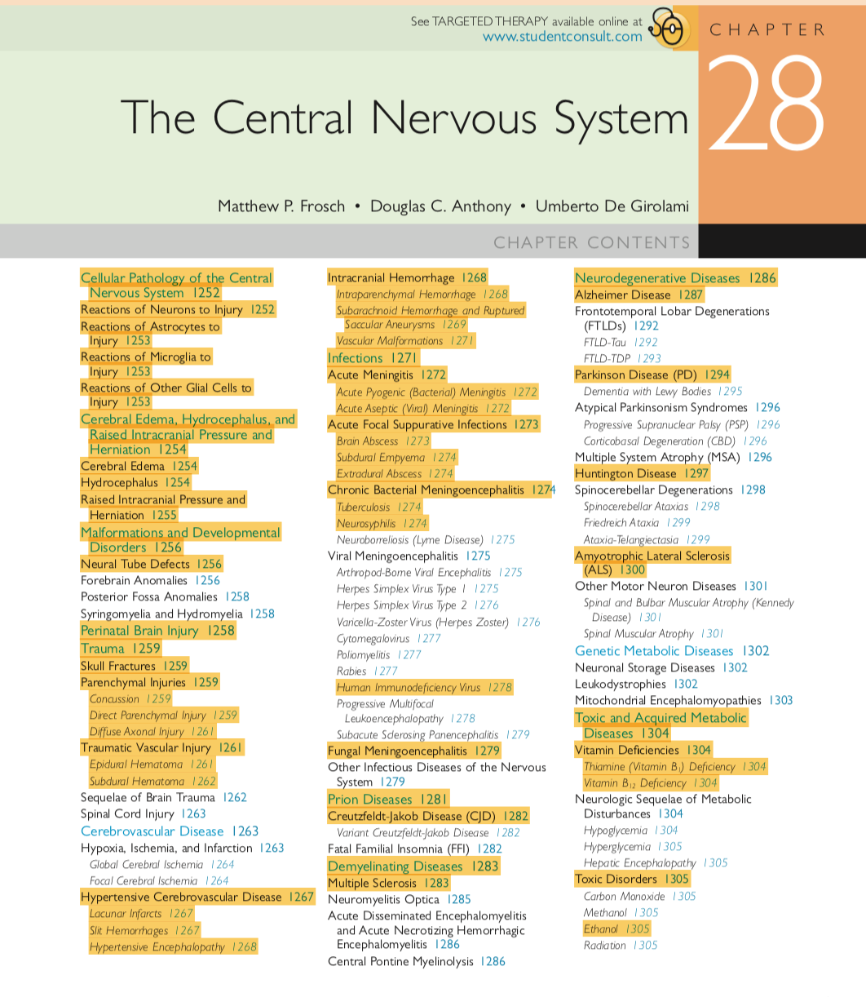
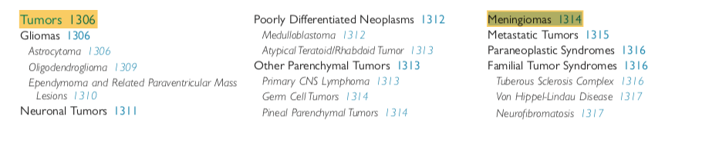

Slide 3
GROSS ANATOMY OF THE BRAIN AND SPINAL CORD
HISTOLOGY OF THE CNS
CELLULAR REACTIONS TO INJURY
CEREBRAL EDEMA
RAISED INTRACRANIAL PRESSURE AND HERNIATION
HYDROCEPHALUS
MALFORMATIONS
PERINATAL BIRTH INJURY

Slide 4
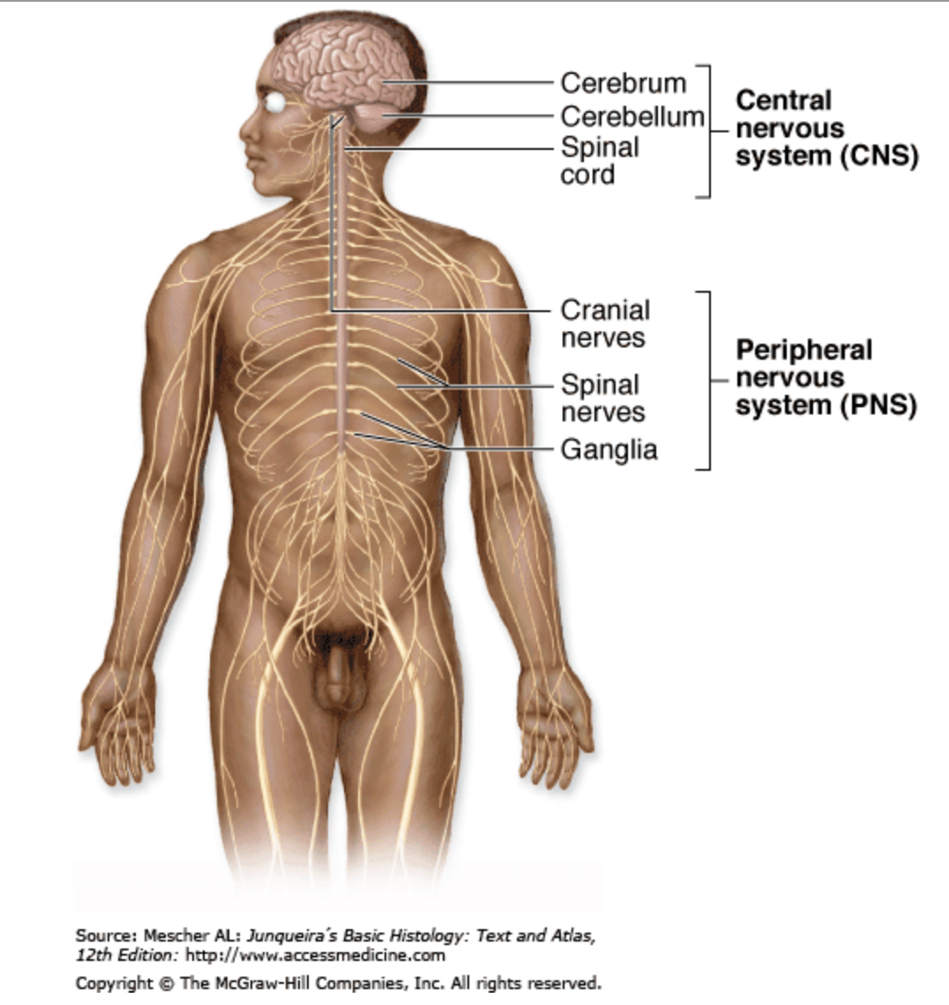

Slide 5
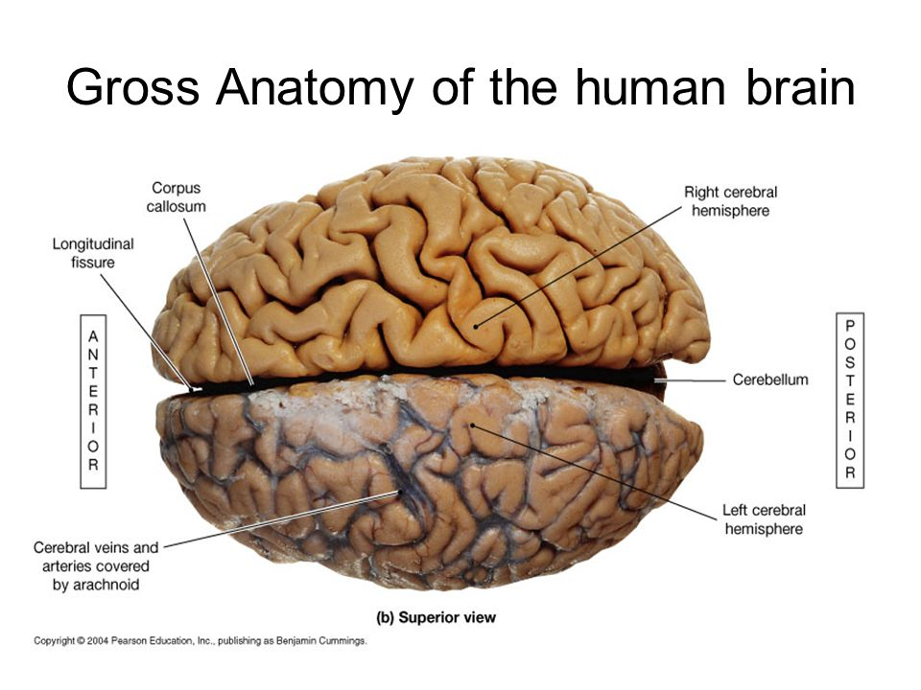

Slide 6
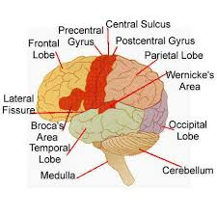
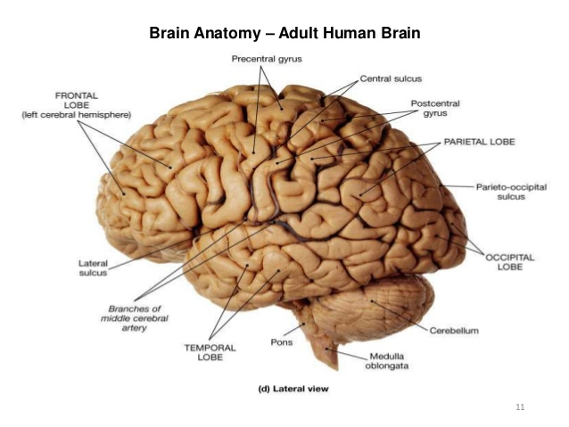
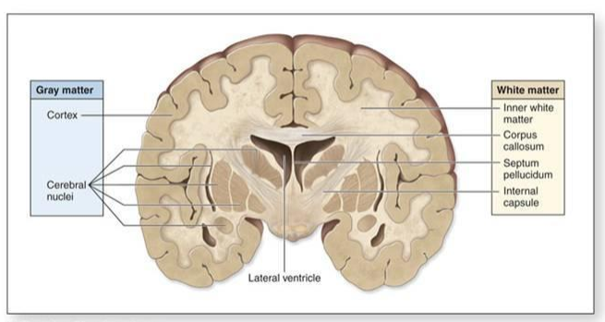

Slide 7
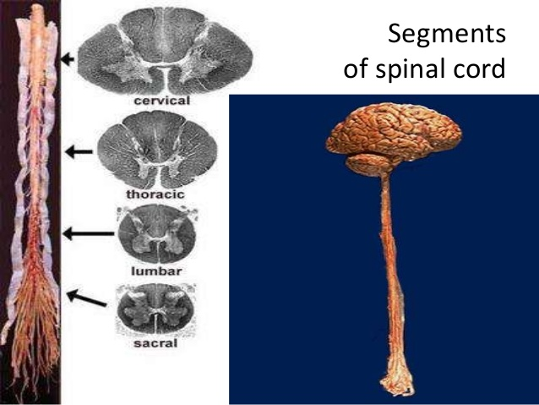
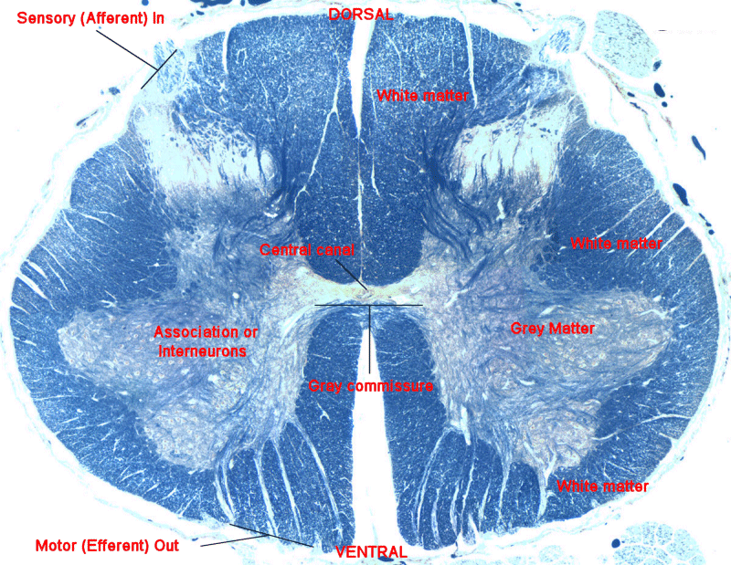

Slide 8
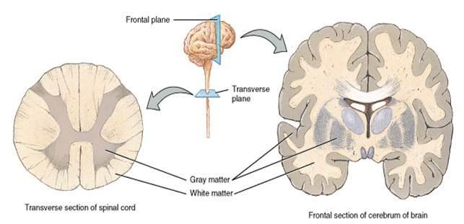

Slide 9
GROSS ANATOMY OF THE BRAIN AND SPINAL CORD
HISTOLOGY OF THE CNS
CELLULAR REACTIONS TO INJURY
CEREBRAL EDEMA
RAISED INTRACRANIAL PRESSURE AND HERNIATION
HYDROCEPHALUS
MALFORMATIONS
PERINATAL BIRTH INJURY

Slide 10
HISTOLOGY
    Neurones
    Glia
        astrocytes
        ependymal cells
        oligodendrocytes
        microglia

Slide 11
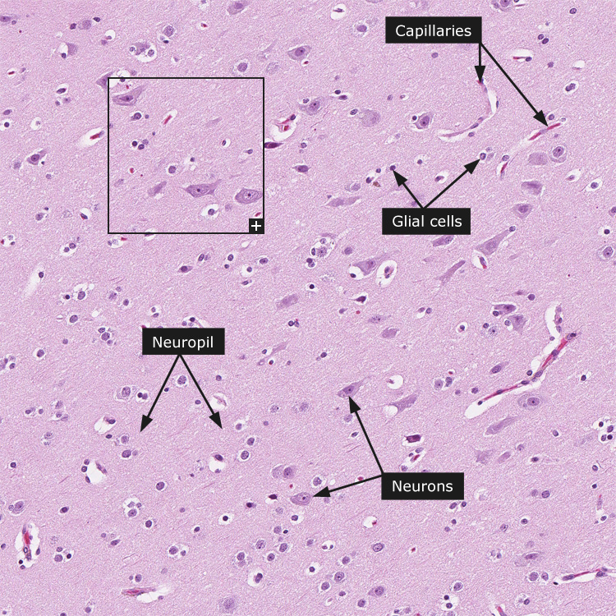
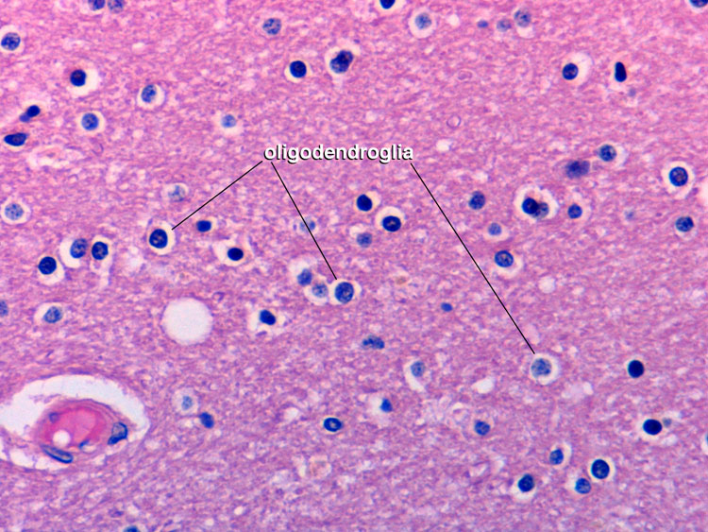
Brain (cerebral hemisphere)

Slide 12
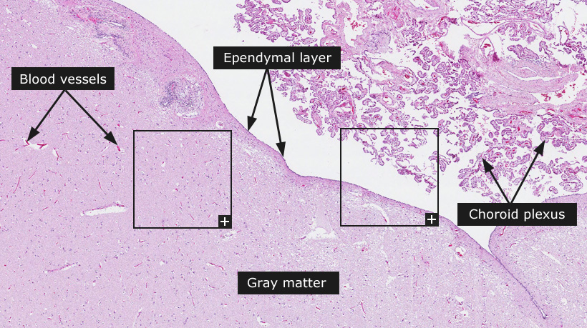
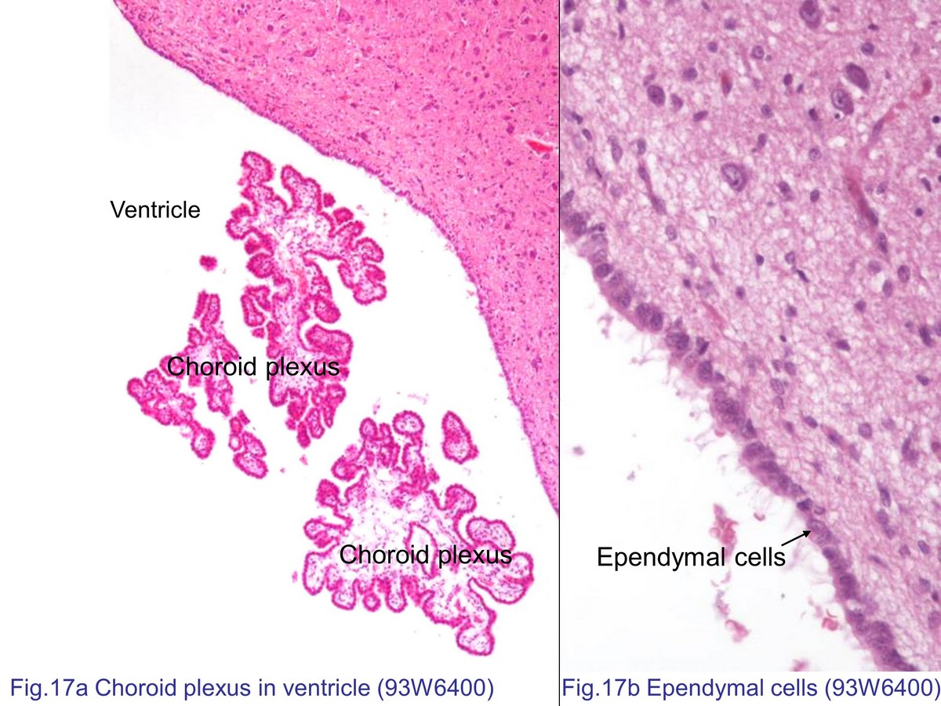
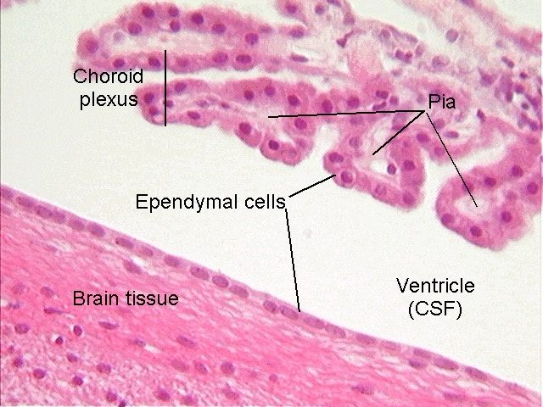

Slide 13
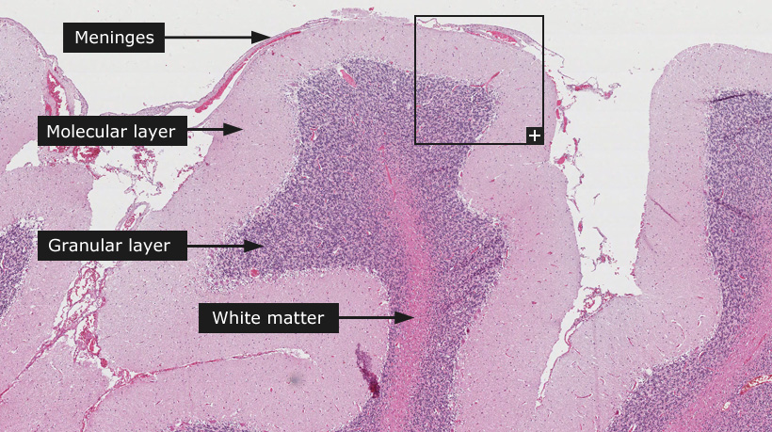
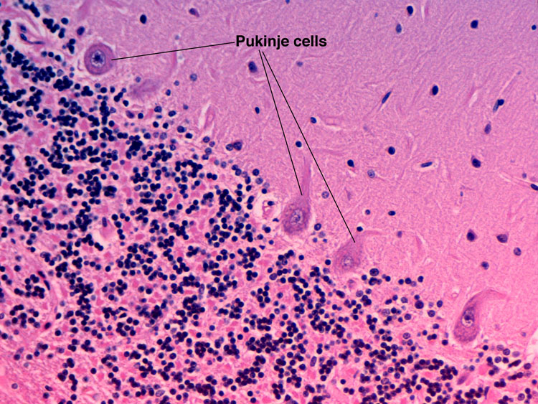
Cerebellum

Slide 14
GROSS ANATOMY OF THE BRAIN AND SPINAL CORD
HISTOLOGY OF THE CNS
CELLULAR REACTIONS TO INJURY
CEREBRAL EDEMA
RAISED INTRACRANIAL PRESSURE AND HERNIATION
HYDROCEPHALUS
MALFORMATIONS
PERINATAL BIRTH INJURY

Slide 15
Cellular reactions to injury
A) NEURONES
    injury may be acute or a slow process
    acute injury
        as a result of;
            glucose or oxygen deficiency
            trauma
    Slow process
        as a result of accumulation of abnormal proteins

Slide 16
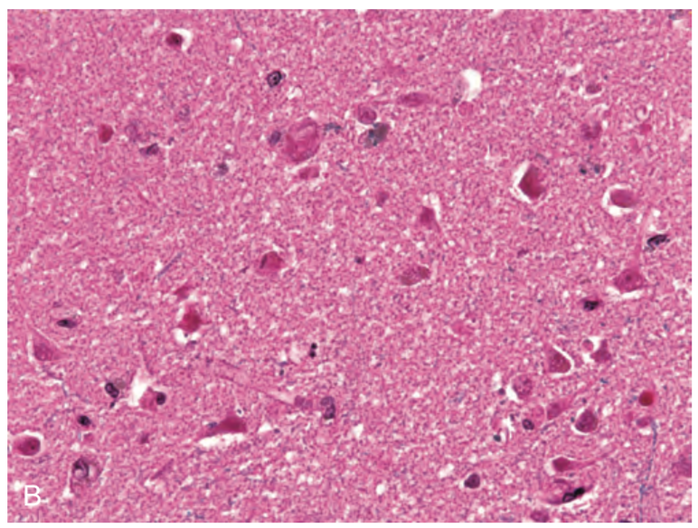
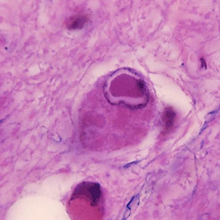
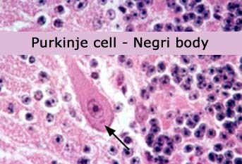
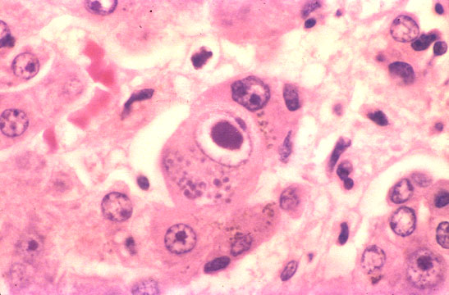
RED NEURONS (Acute axonal injury)
Acute ischemic injury causes diffuse eosinophilia of neurons, which are beginning to shrink
Subacute and chronic neuronal injury (degeneration)
Cell loss and reactive gliosis
eg ALS, Alzheimer disease
Axonal reaction
Change observed in cell body during regeneration of an axon
Neuronal inclusions
Aging
    lipofuscin, proteins, carbohydrates rates
Viral infection
    Herpes infection=> Cowdry body (intranuclear)
    Rabies=> Negri body (cytoplasmic)
    CMV=> nuclear and cytoplasmic

Slide 17
B) ASTROCYTES
    gliosis => hyperplasia and hypertrophy
    conversion to gemistocytic astrocytes
    hypoxia, hypoglycaemia, toxic injury=> cell swelling
    long standing hyperammonemia due to CLD, Wilson disease etc => Alzheimer type II astrocytes

Slide 18
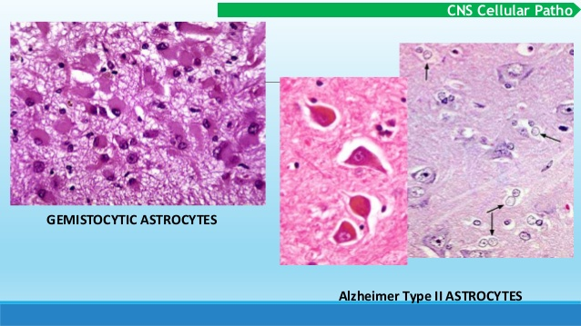

Slide 19
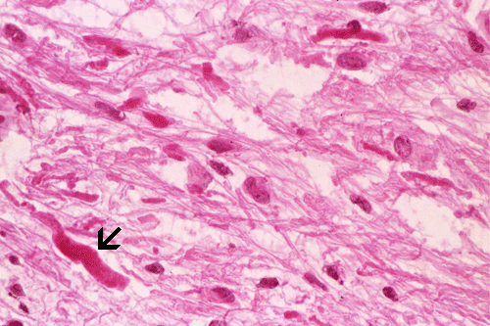
Other types of cell injury result in formation of cytoplasmic inclusion bodies;
    Rosenthal fibers
        can be found in pilocytic astrocytoma as well

Slide 20
C) MICROGLIA
    resident macrophages of CNS
    Injury;
        proliferation
        develop elongated nuclei (Rod cells-neurosyphilis)
        microglial nodules- aggregates around small foci of necrosis
        neuronoppagia-congregate around cell bodies of dying neurons

Slide 21
D) OTHER GLIAL CELLS
    i) Oligodendrocytes
        injury or apoptosis
              demyelinating disorders and leukodystrophies
        glial cytoplasmic inclusions (alpha synuclein)
              multiple system atrophy

Slide 22
  ii) Ependymal cells
      no specific pattern of reaction

Slide 23
GROSS ANATOMY OF THE BRAIN AND SPINAL CORD
HISTOLOGY OF THE CNS
CELLULAR REACTIONS TO INJURY
CEREBRAL EDEMA
RAISED INTRACRANIAL PRESSURE AND HERNIATION
HYDROCEPHALUS
MALFORMATIONS
PERINATAL BIRTH INJURY

Slide 24
CEREBRAL EDEMA
    result of;
        increased fluid leakage from blood vessels
        injury to various cells of the CNS
    2 major pathways;
        vasogenic edema=> increased extracellular fluid
            BBB disruption
            increased vascular permeability
        cytotoxic edema=> increased intracellular fluid
            neuronal, glial or endothelial cell injury

Slide 25
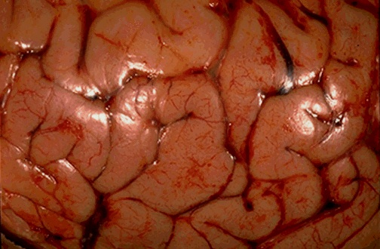
may result in herniation

Slide 26
RAISED INTRACRANIAL PRESSURE AND HERNIATION
    HERNIATION
        displacement of brain tissue past rigid dural folds (falx and tentorium) or through openings in the skull due to increased intracranial pressure

Slide 27
Subfalcine (cingulate) herniation
Transtentorial (uncinate, mesial temporal) herniation
Tonsillar herniation

Slide 28
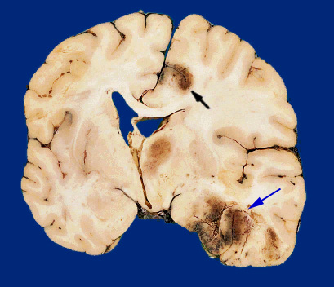
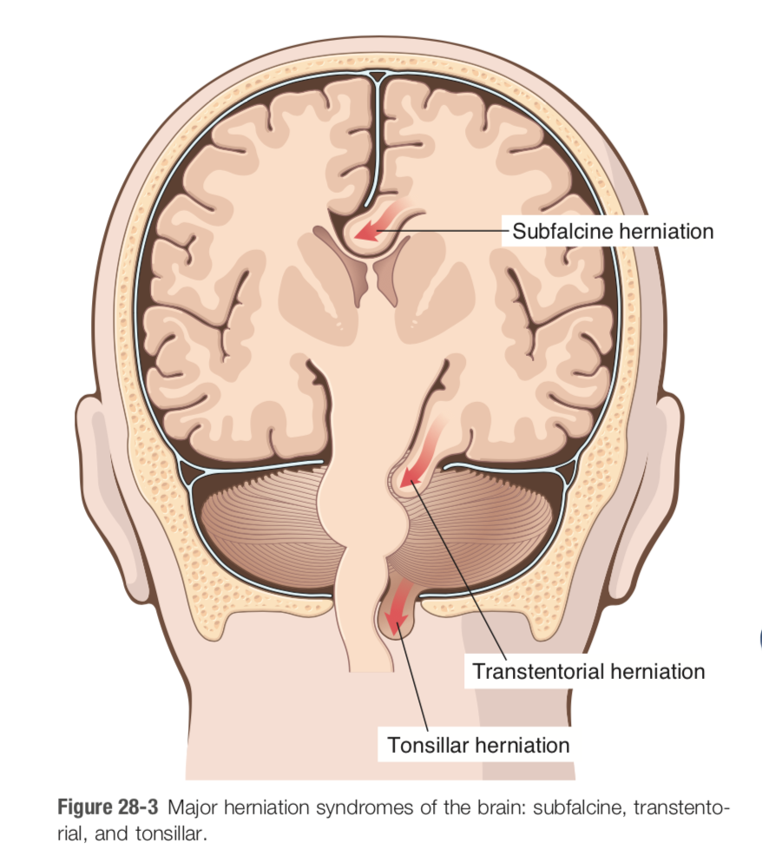
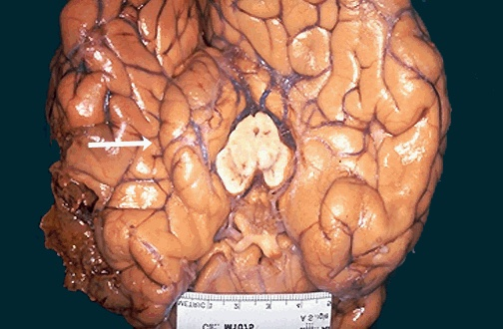
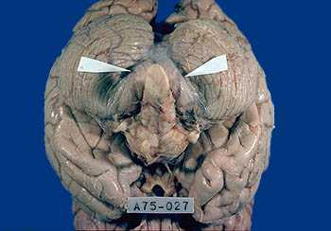

Slide 29
GROSS ANATOMY OF THE BRAIN AND SPINAL CORD
HISTOLOGY OF THE CNS
CELLULAR REACTIONS TO INJURY
CEREBRAL EDEMA
RAISED INTRACRANIAL PRESSURE AND HERNIATION
HYDROCEPHALUS
MALFORMATIONS
PERINATAL BIRTH INJURY

Slide 30
HYDROCEPHALUS
      accumulation of excessive CSF within the ventricular system
      Normal CSF production/circulation/resorption?

Slide 31
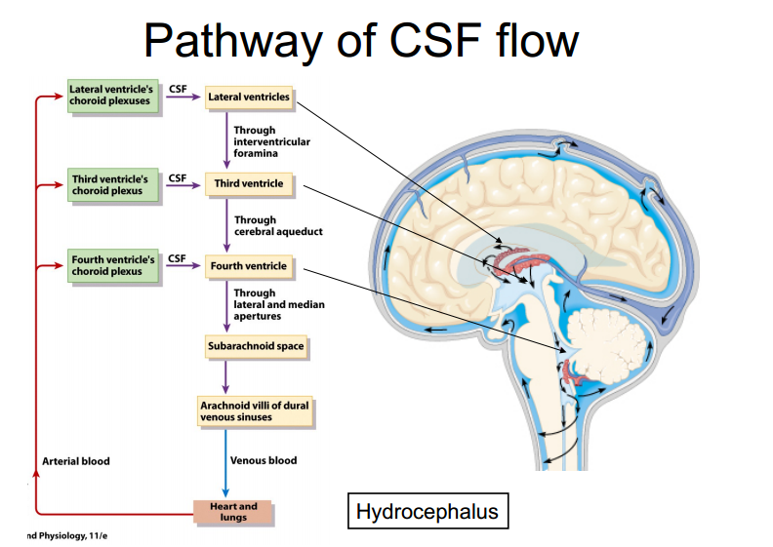

Slide 32
      causes;
          impaired flow and resorption of CSF
      infancy vs in adults
      communicating vs non communicating

Slide 33
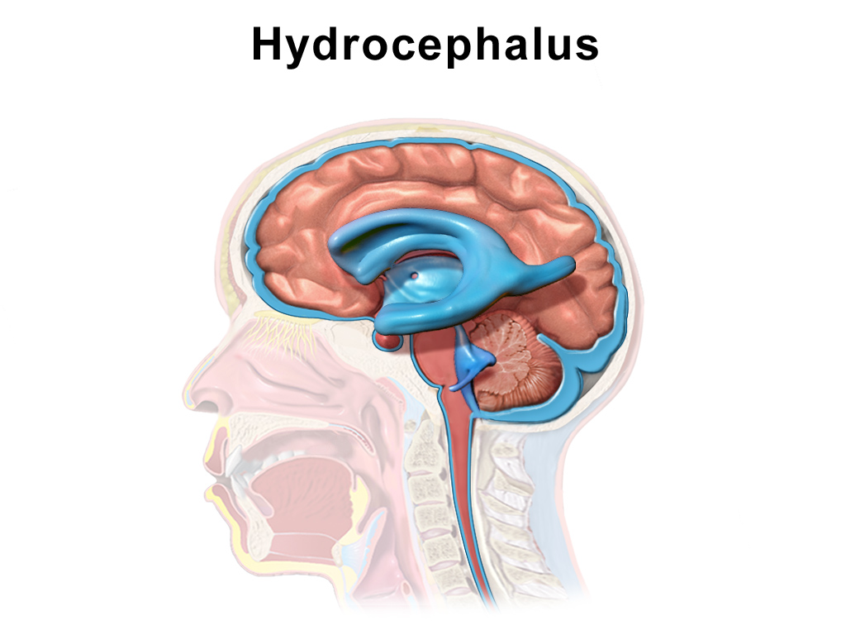
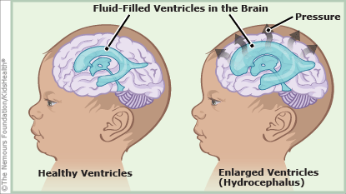

Slide 34
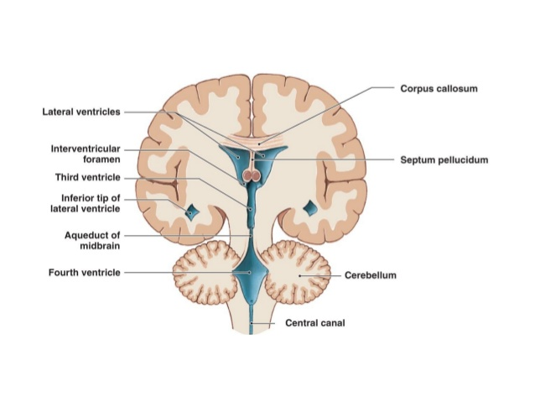
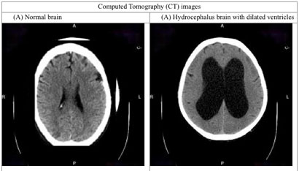

Slide 35
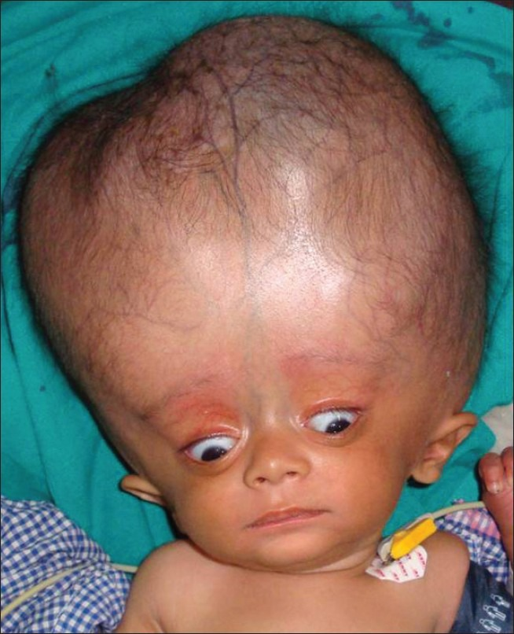

Slide 36
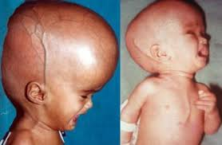

Slide 37
GROSS ANATOMY OF THE BRAIN AND SPINAL CORD
HISTOLOGY OF THE CNS
CELLULAR REACTIONS TO INJURY
CEREBRAL EDEMA
RAISED INTRACRANIAL PRESSURE AND HERNIATION
HYDROCEPHALUS
MALFORMATIONS
PERINATAL BIRTH INJURY

Slide 38
MALFORMATIONS AND DEVELOPMENTAL DISORDERS
pathogenesis and etiologic of most CNS malformations=> unknown
result of genetic and environmental influences
teratogenic compounds
      toxic compounds
      infections

Slide 39
    CNS MALFORMATIONS
Neural tube defects
    anencephaly, encephalocele, spina bifida
Forebrain anomalies
    polymicrogyria, holoprosencephaly, agenesis of corpus callosum
Posterior fossa anomalies
    Arnold -Chiari malformation, Dandy-Walker malformation
Syringomyelia and Hydromyelia

Slide 40
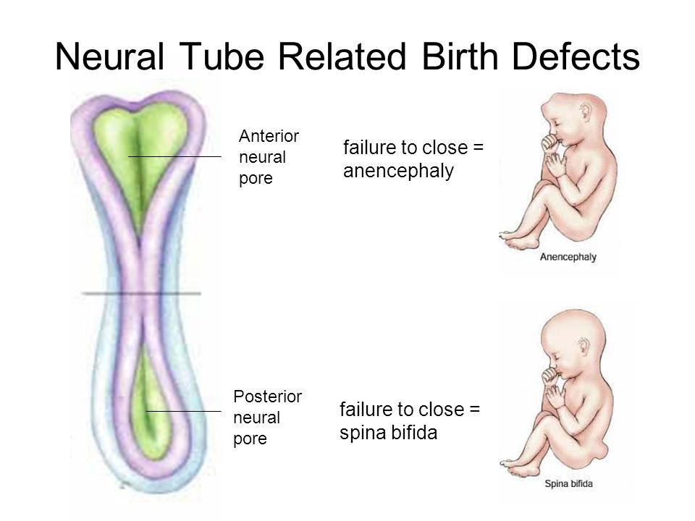
A. NEURAL TUBE DEFECTS
      failure to close or reopening off a region of the neural tube (closes normally by day 28 of embryonic development)
      account for most of the CNS malformations
      usually involves the spinal cord
      risk factor- folate deficiency in early pregnancy

Slide 41
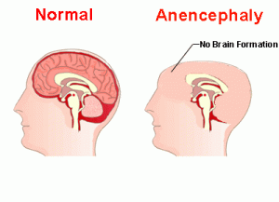
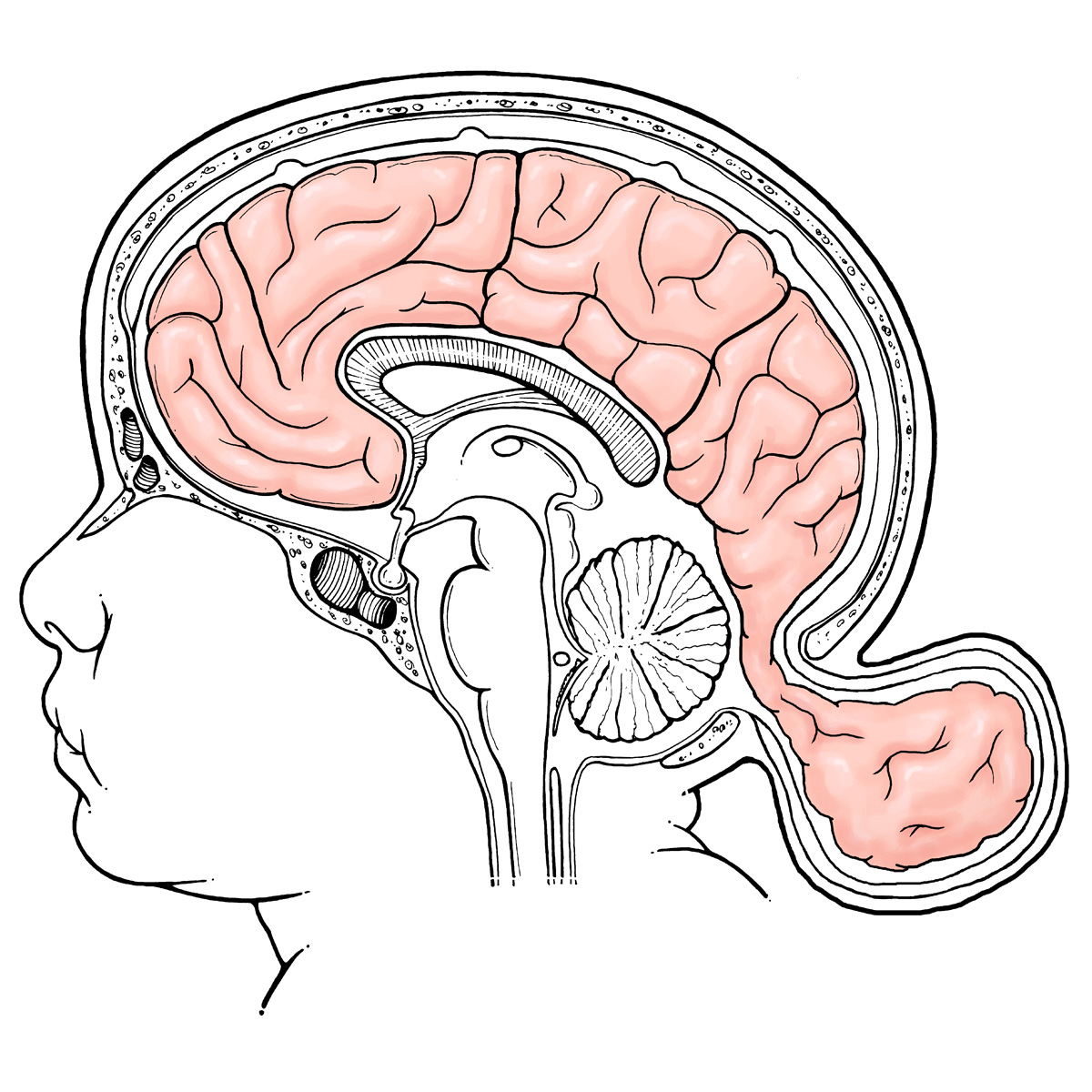
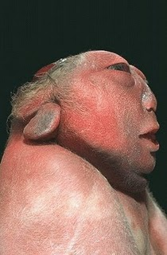
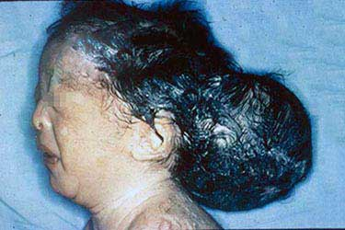
Anencephaly
Encephalocele

Slide 42
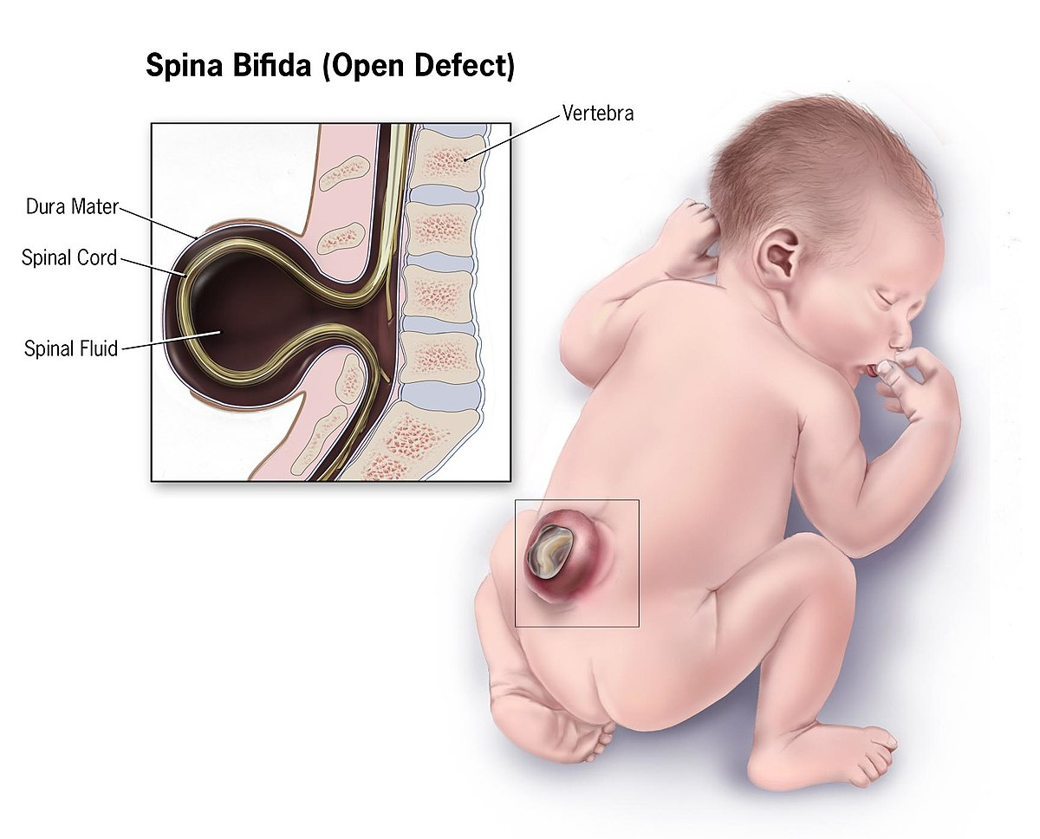
Other vertebral column defects
    myelomeningocele
    meningocele

Slide 43
B. FOREBRAIN ANOMALIES
    result from abnormalities in generation and migration of neurones
    changes can be;
        seen from the surface of the brain (either too few or too many gyri)
        in the organisation of the brain into lobes
        in the structure of the cerebral cortex
        in the distribution of neurons within the brain

Slide 44
Megalencephaly or Microencephaly (fetal alcohol syndrome, HIV-1)
Lissencephaly- reduced number of gyri
Polymicrogyria- small, unusually numerous, irregularly formed cerebral convolutions
Neuronal heterotopias- ass with epilepsy
      collections of neurones in inappropriate locations
Holoprosencephaly- incomplete separation of cerebral hemispheres across the midline
Agenesis of the corpus callosum- absence of white matter bundles carrying cortical projections from one hemisphere to the other

Slide 45
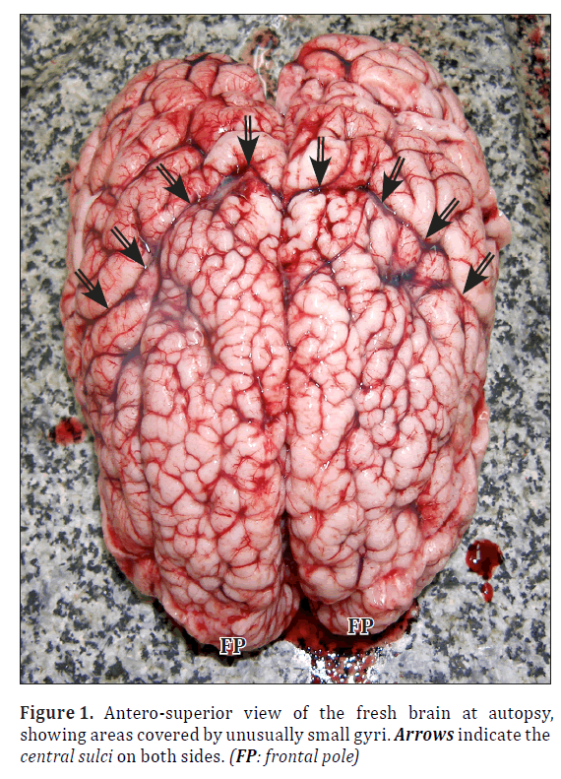
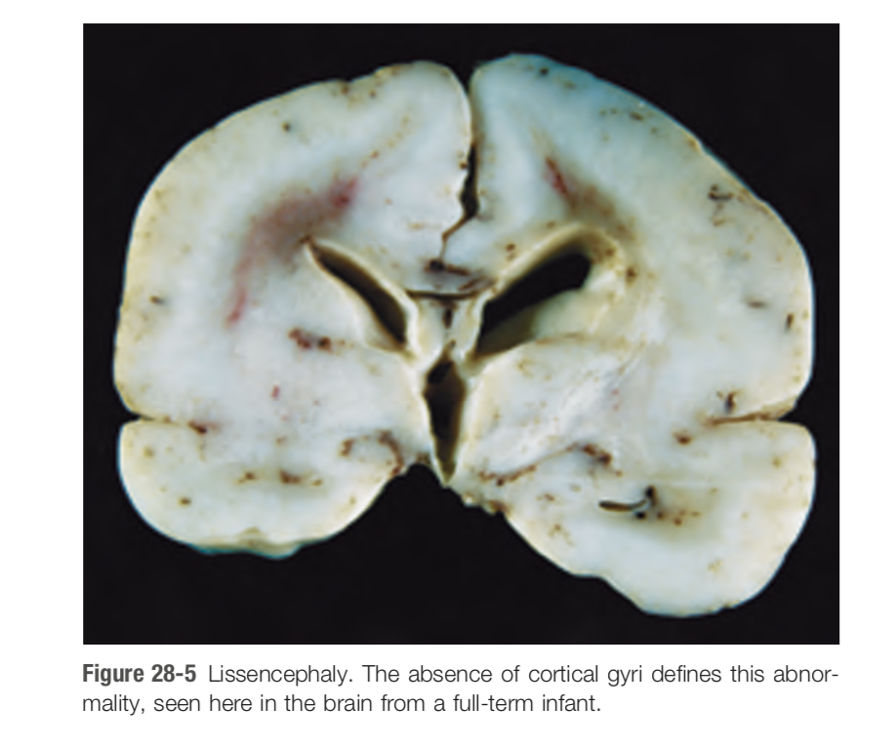

Slide 46
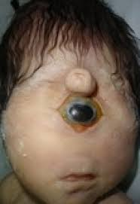
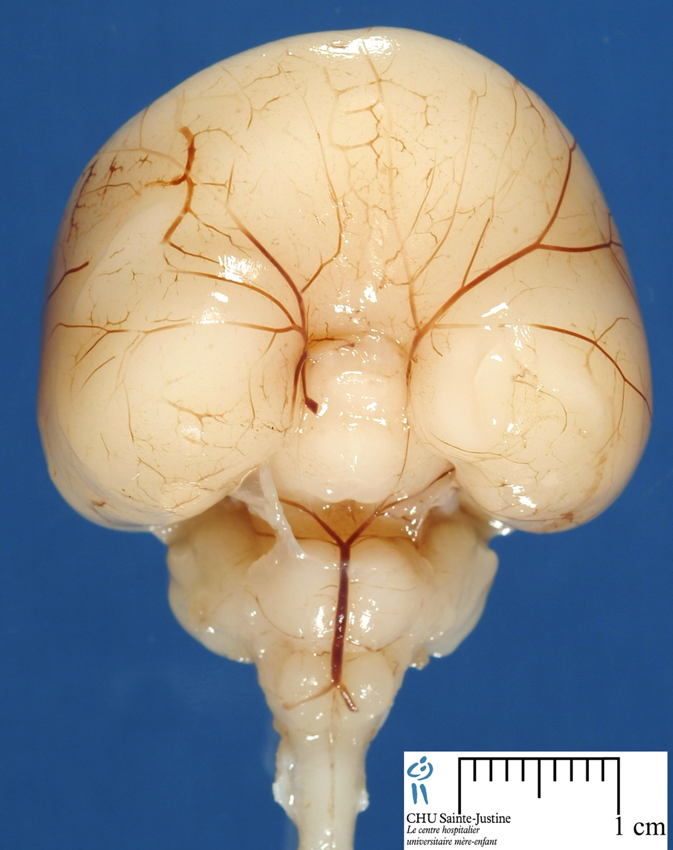
HOLOPROSENCEPHALY
    incomplete separation of cerebral hemispheres across the midline
    midline facial abnormalities
    ass with trisomy 13

Slide 47
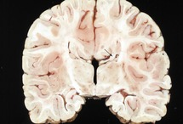
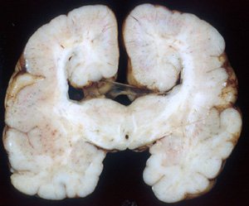
Agenesis of the corpus callosum

Slide 48
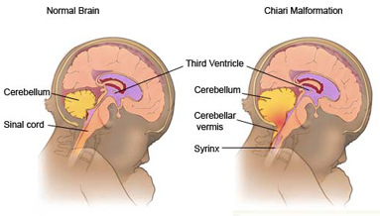
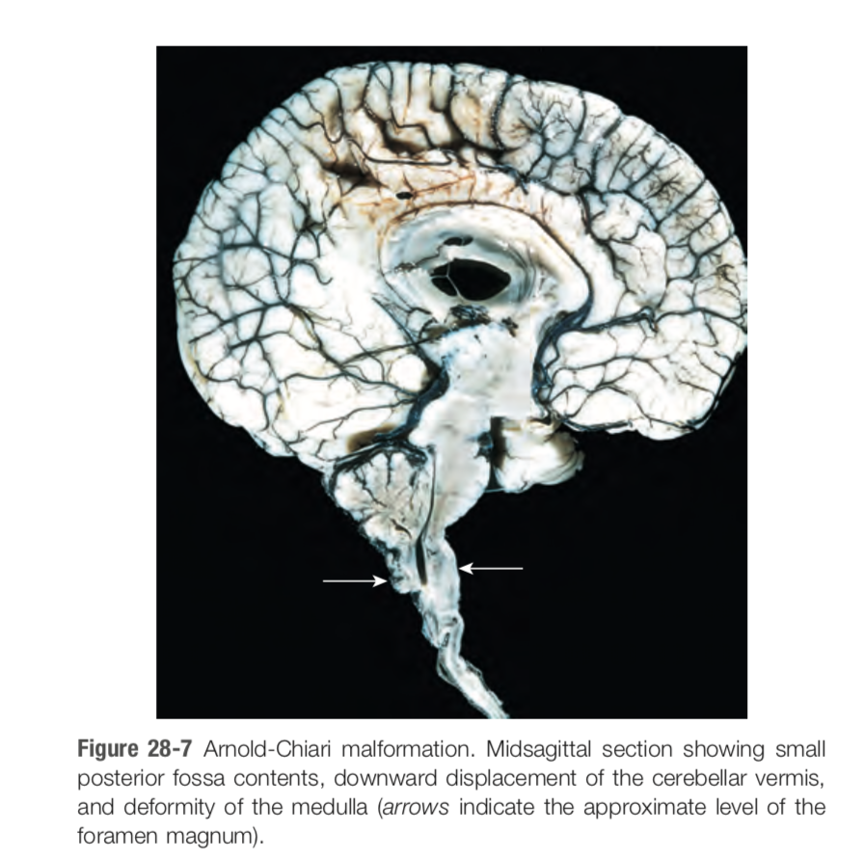
C. POSTERIOR FOSSA ANOMALIES
Arnold-Chiari malformation
  small posterior fossa
  misshapen midline cerebellum with downward extension of vermis through the form magnum
  hydrocephalus
  lumber myelomeningocele

Slide 49
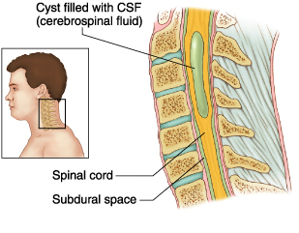

SYRINGOMYELIA/SYRINX
    fluid filled cleft like cavity in the inner portion of the cord
HYDROMYELIA
    expansion of the ependyma lined central canal of the cord

Slide 50
GROSS ANATOMY OF THE BRAIN AND SPINAL CORD
HISTOLOGY OF THE CNS
CELLULAR REACTIONS TO INJURY
CEREBRAL EDEMA
RAISED INTRACRANIAL PRESSURE AND HERNIATION
HYDROCEPHALUS
MALFORMATIONS
PERINATAL BIRTH INJURY

Slide 51
PERINATAL BIRTH INJURY
May result in childhood onset neurologic disability
CEREBRAL PALSY
    non progressive neurologic motor deficit characterised by combinations of;
        spasticity
        dystonia- random, slow, uncontrolled movements in limbs/trunk
        ataxia/athetosis
        paresis
    signs and symptoms may not be apparent at birth
    Generally 3 forms
        spastic CP-upper motor neurones
        athetoid/dyskinetic CP-basal ganglia (involuntary movement e.g dystonia or chorea-random dance like movements)
        ataxic CP-cerebellum (shaky, uncoordinated movement)

Slide 52


Slide 53
end

