Slide 1
CNS
3

Slide 2
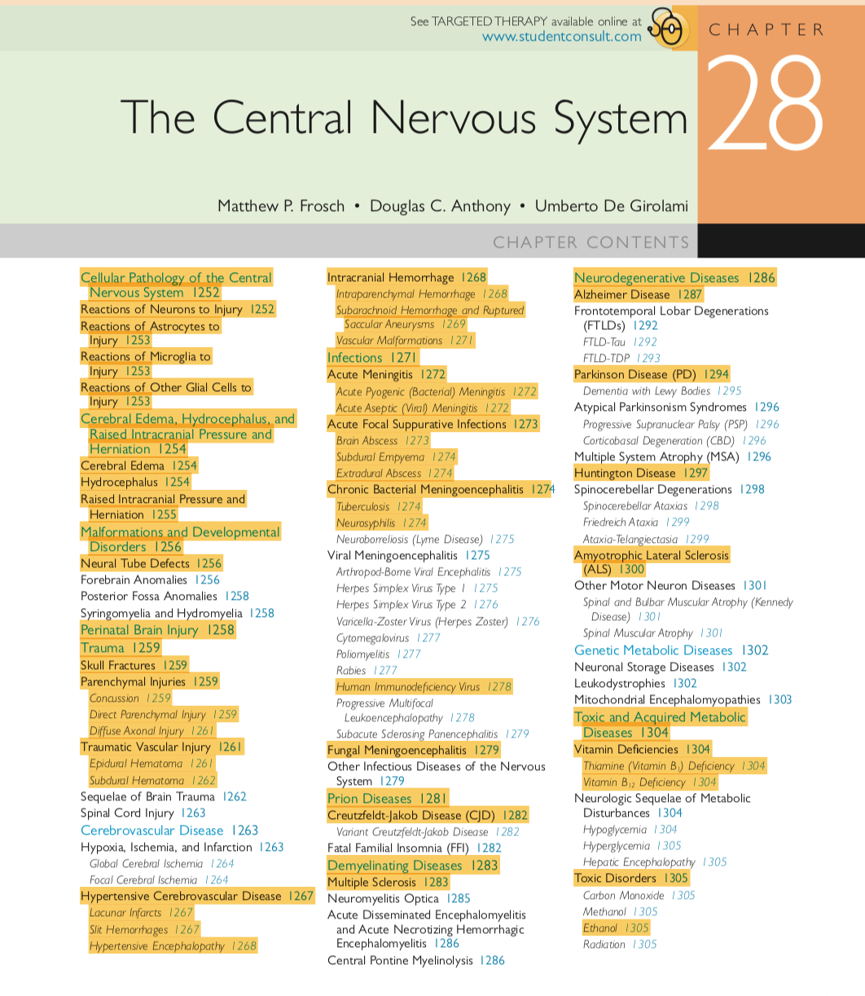
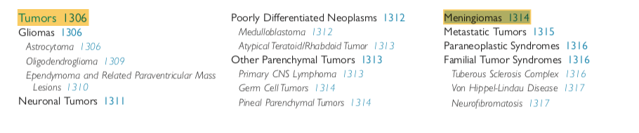

Slide 3
CNS INFECTIONS
PRION DISEASES

Slide 4
CNS INFECTIONS

Slide 5
Four routes by which microbes enter the nerveous system;
    hematogenous- most common
    direct implantation
    local extension
    along the peripheral nervous system eg rabies and herpes poster virus

Slide 6
ACUTE MENINGITIS
ACUTE FOCAL SUPPURATIVE INFECTIONS
CHRONIC BACTERIAL MENINGOENCEPHALITIS
VIRAL MENINGOENCEPHALITIS
FUNGAL MENINGOENCEPHALITIS
OTHER

Slide 7
MENINGITIS
    inflammatory process of the leptomeninges and CSF within subarachnoid space
    usually bacterial infection
    polymorphonuclear cells in CSF, increased protein, reduced glucose
    infectious meningitis
              acute pyogenic usually bacterial
              aseptic usually viral
              chronic (tb, spirochetal, cryptococcal)

Slide 8
ENCEPHALITIS
    parenchymal infection of the brain
    usually viral
    usual involvement of meninges (inflammation)
    lymphocytes and macrophages in perivascular (Virchow- Robbins) space
MENINGOENCEPHALITIS
    inflammation of the meninges and brain parenchyma

Slide 9
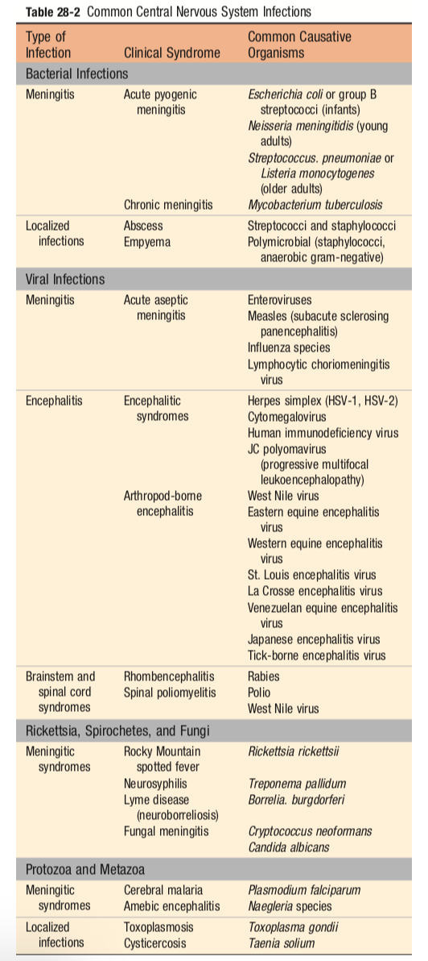

Slide 10
ACUTE MENINGITIS
      acute pyogenic (bacterial) meningitis
      acute aseptic (viral) meningitis

Slide 11
ACUTE PYOGENIC (BACTERIAL) MENINGITIS
clinical features
      headache
      photophobia
      irritability
      altered consciousness
      neck stiffness
CSF
    increased pressure
    cloudy
    increased neutrophils
    increased protein
    reduced glucose

Slide 12
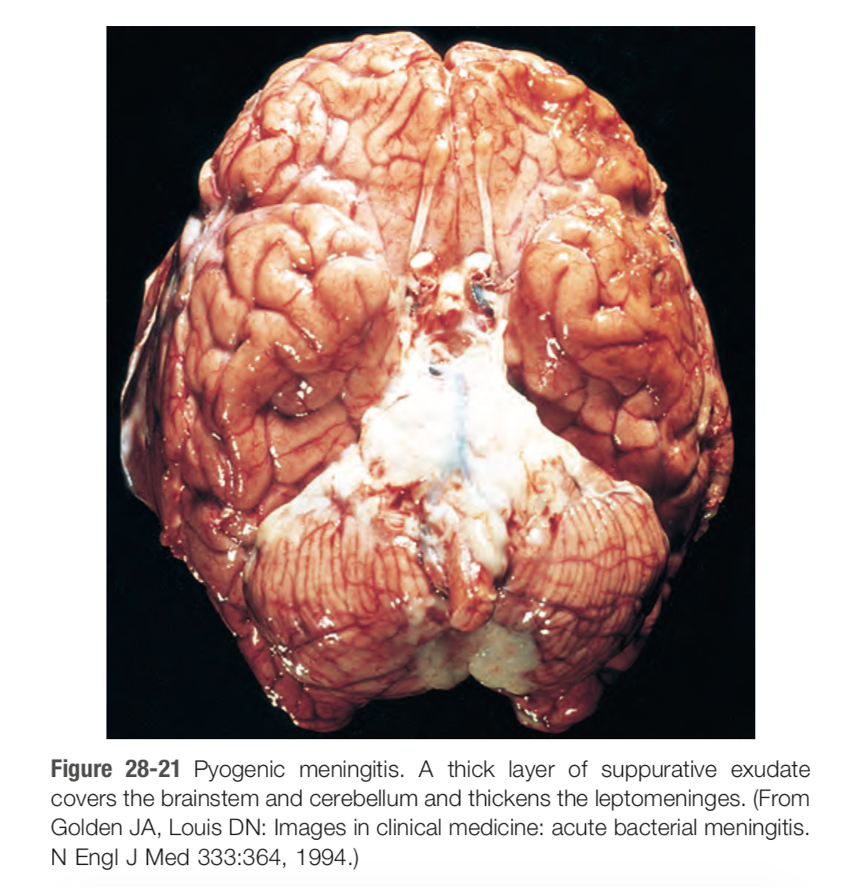

Slide 13
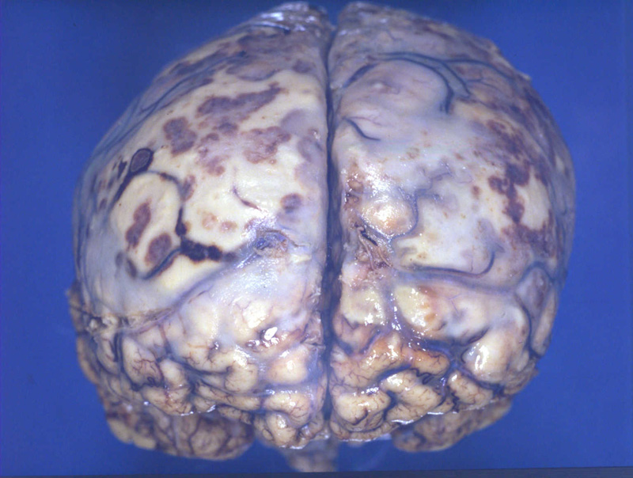

Slide 14
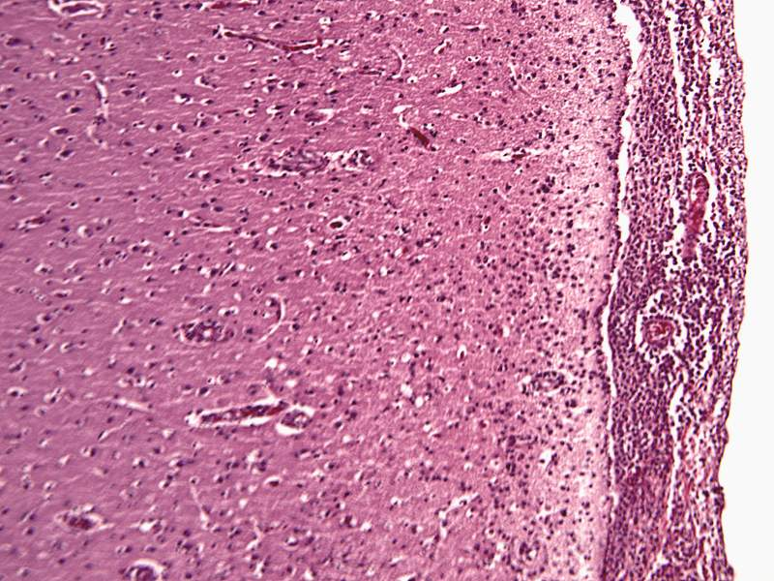

Slide 15
ACUTE ASEPTIC (VIRAL) MENINGITIS
absence of organisms by bacterial culture
manifestations of meningitis
viral aetiology usually enteroviruses
CSF
    lymphocytic pleocytosis
    moderate protein elevation
    normal glucose

Slide 16
ACUTE FOCAL SUPPURATIVE INFECTIONS
Brain abscess
Subdural empyema
Extradural abscess

Slide 17
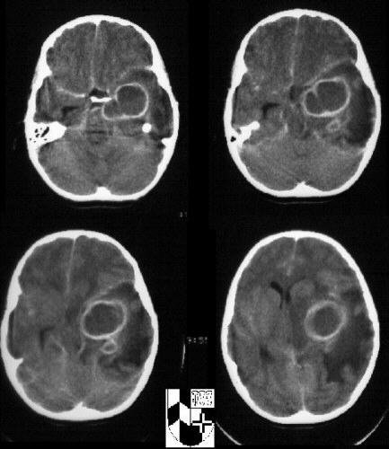

Slide 18
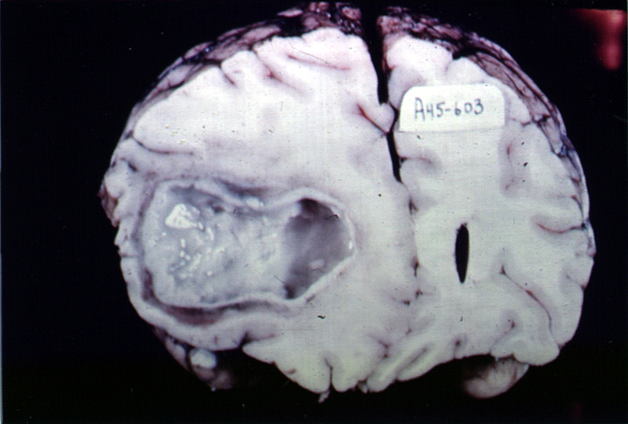
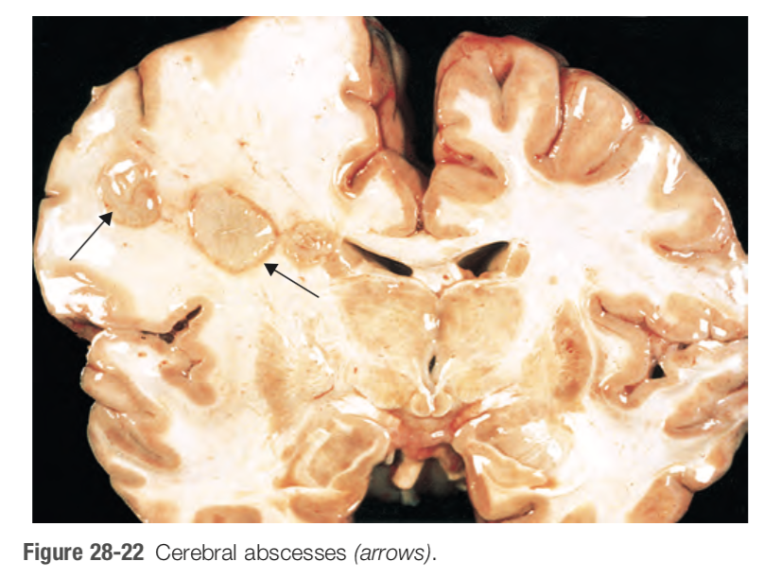

Slide 19
CHRONIC BACTERIAL MENINGOENCEPHALITIS
Tuberculosis
Neurosyphilis
    meningovascular
    paretic
    tabes dorsalis
Lyme disease (neuroborreliosis)

Slide 20
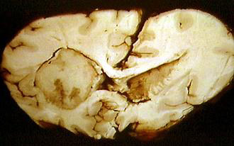
Tuberculoma

Slide 21
VIRAL MENINGOENCEPHALITIS
Arthropod borne viral encephalitis
Herpes simplex virus type 1 (HSV 1)
HSV 2
Varicella- Zoster virus (Herpes Zoster)
Cytomegalovirus
Poliomyelitis
Rabies
HIV
Progressive multifocal leukoencephalopathy
Subacute sclerosing panencephalitis

Slide 22
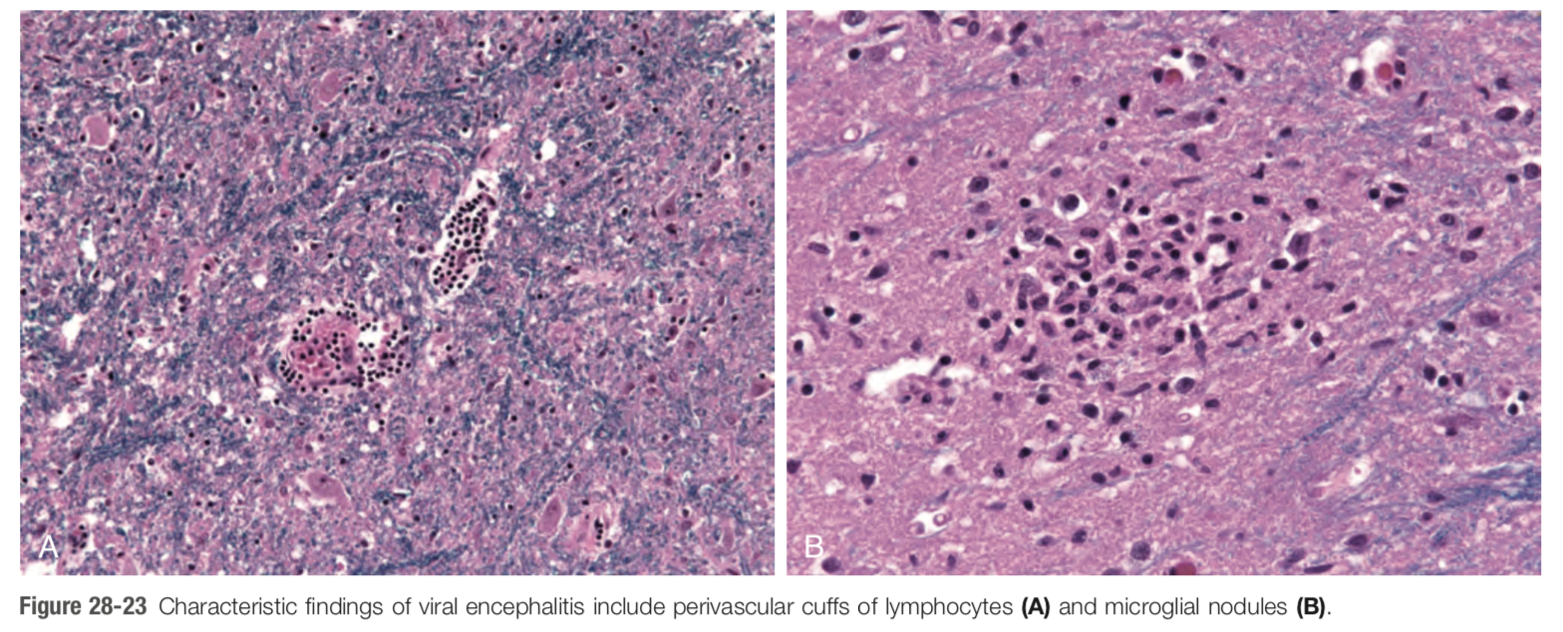
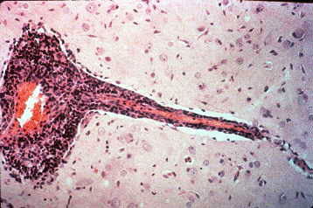

Slide 23
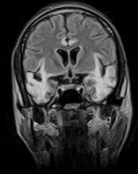
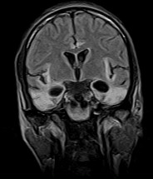
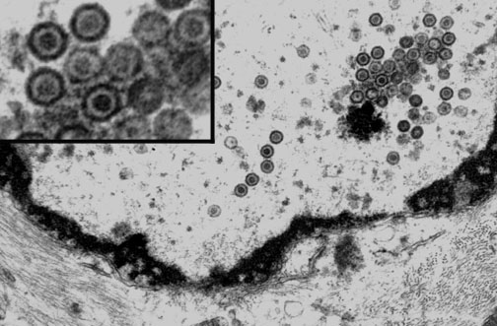
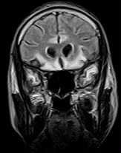
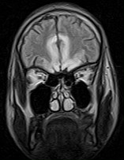
Bitemporal encephalitis is HSV until proven otherwise

Slide 24
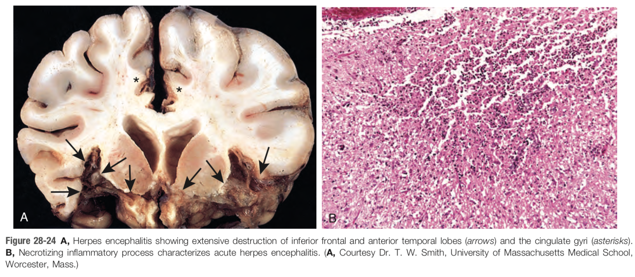

Slide 25
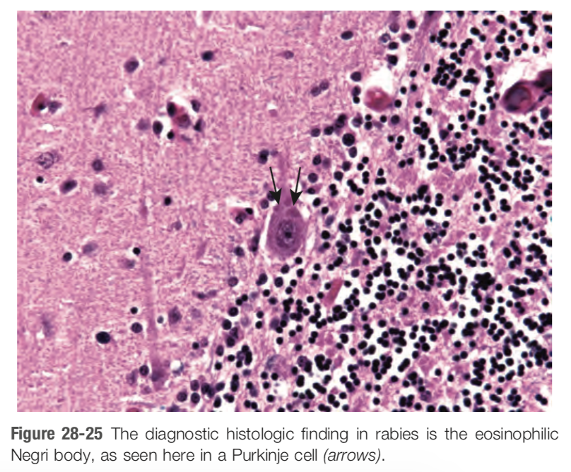

Slide 26
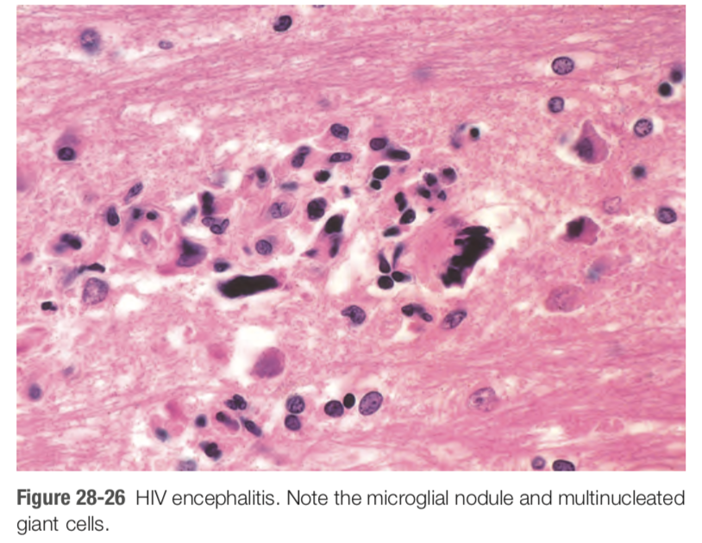

Slide 27
FUNGAL MENINGOENCEPHALITIS
primarily in immunocompromised individuals
usually hematogenous spread to the CNS
Usual suspects;
      candida
      mucor species
      aspergillus
      cryptococcus

Slide 28
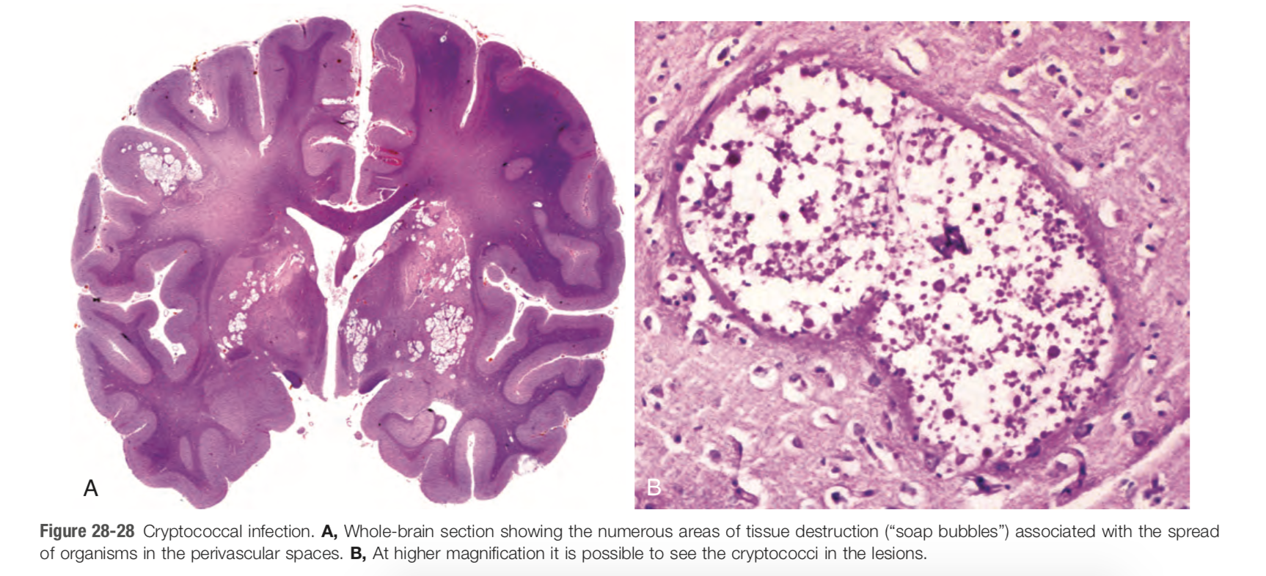
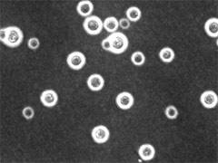
STAIN?

Slide 29
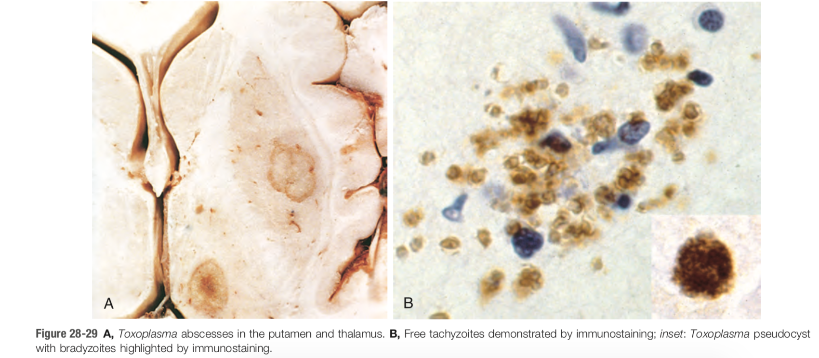
OTHER INFECTIONS OF THE NERVOUS SYSTEM
    toxoplasmosis
    cerebral amebiasis
    cerebral malaria

Slide 30
PRION DISEASES

Slide 31
Abnormal forms of a cellular protein that causes rapidly progressive neurodegenerative disorders
may be;
      sporadic
      familial or
      transmissible

Slide 32
group of diseases include;
    Creutzfeldt-Jakob disease
    Gerstmann-Straussler-Scheinker syndrome
    fatal familial insomnia
    kuru
      in humans

Slide 33
all associated with abnormal forms of a specific protein termed prion protein (PrP)
All characterised by spongiform change
      resulting from vacuoles in neurones and glia
clinically
      rapidly progressive dementia
      fatal
      no treatment

Slide 34
Pathogenesis;
    normal PrP 30kD cytoplasmic protein present in neurons
    disease result when PrP undergoes confirmatory change

Slide 35
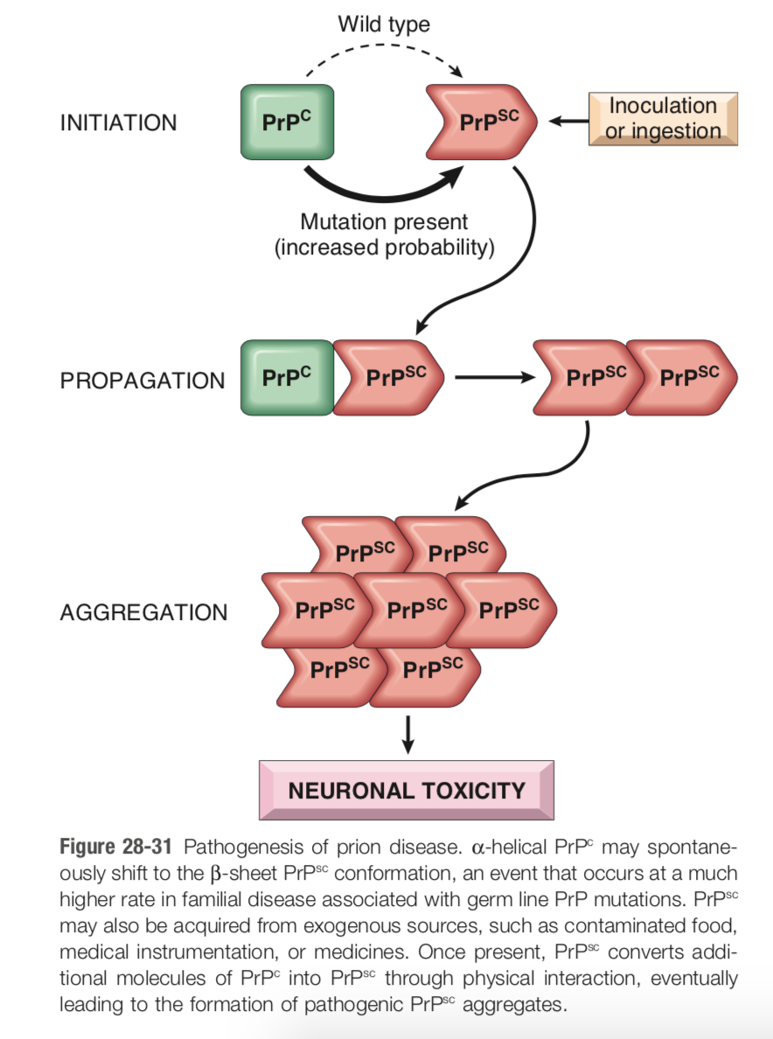

Slide 36
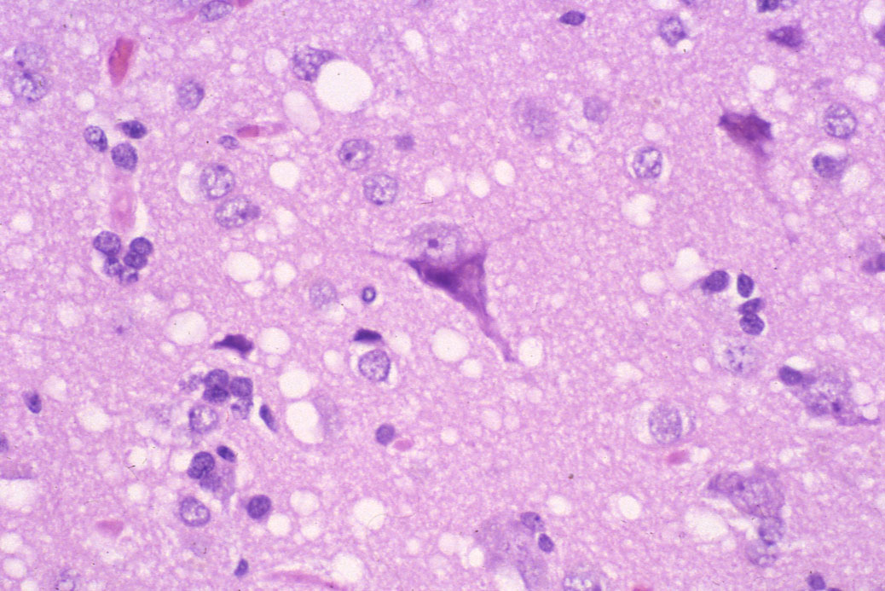

Slide 37
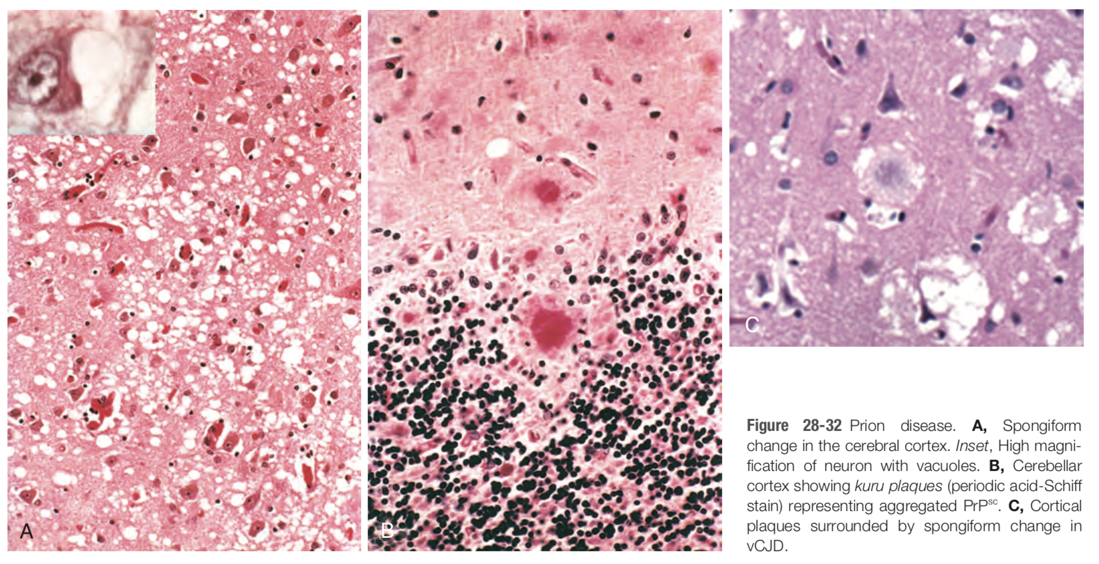

Slide 38
end

