Slide 1
BLOOD VESSELS 1
Arteries
Veins
Lymphatics

Slide 2
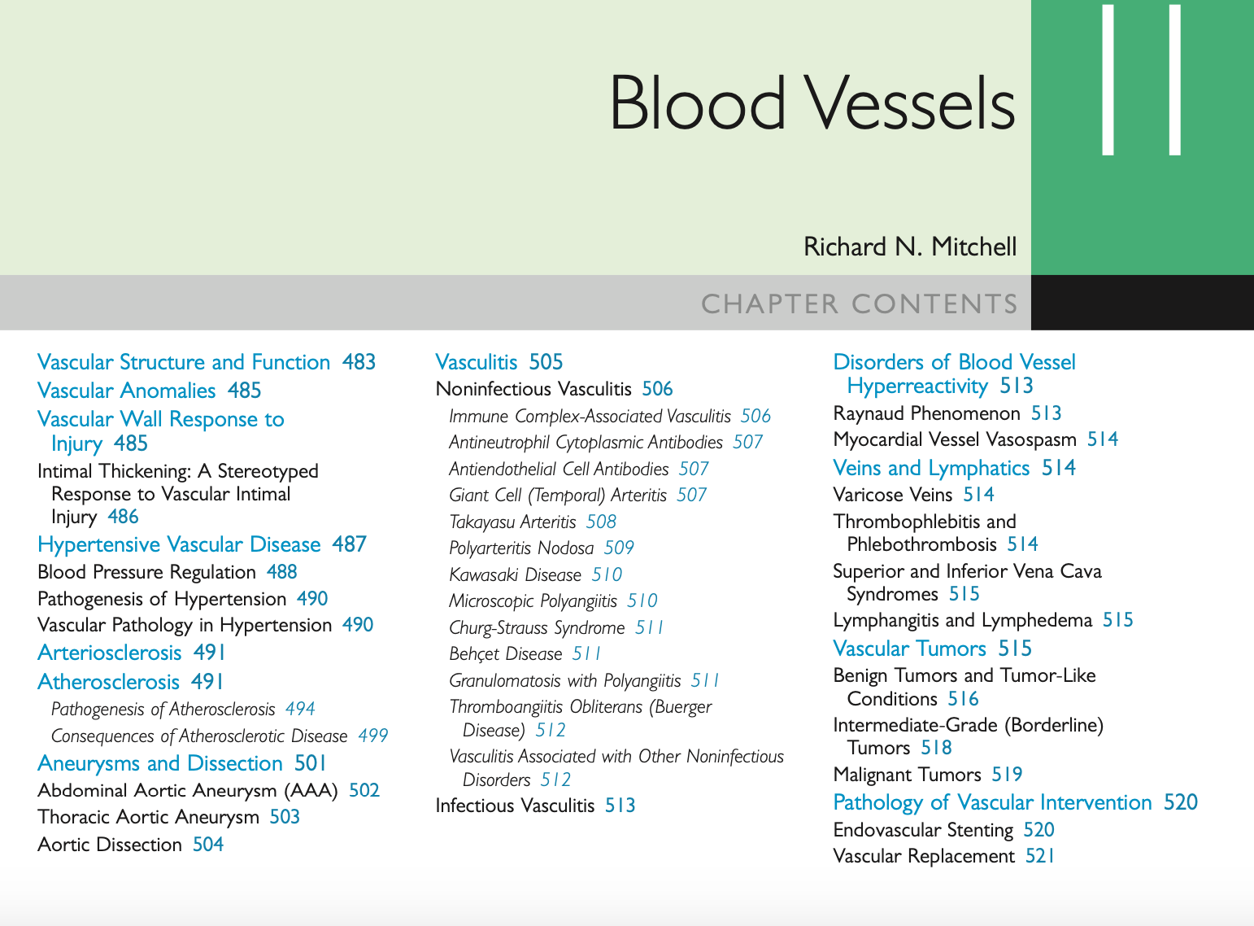

Slide 3
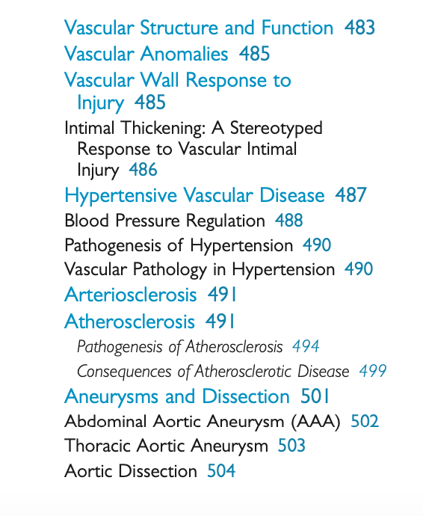
PART 1

Slide 4
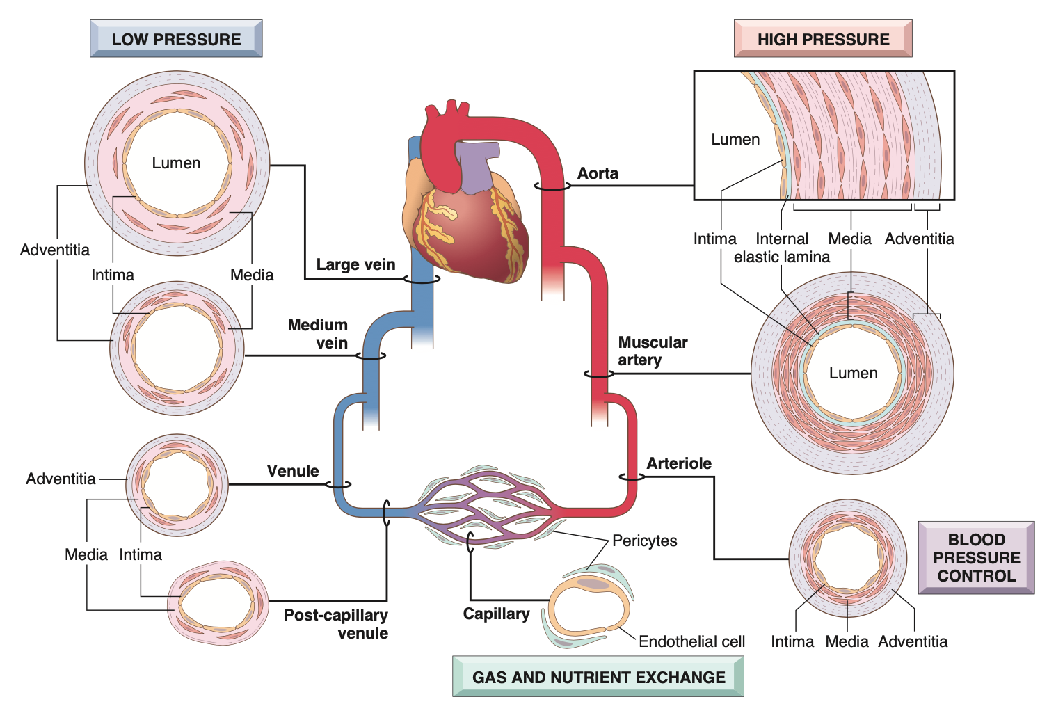

Slide 5
TYPES OF ARTERIES
Based on their size and structure they are divided into:
  Large or elastic arteries : aorta and large branches
  Muscular or medium sized arteries: other branches of aorta- coronary & renal
  Small arteries: small arteries < 2mm diameter & arterioles 20-100um

Slide 6
Capillaries
    diameter of RBC
    endothelial cell layer, no media
    +/- pericytes

Slide 7
Postcapillary venule;
    inflammation
        site of vascular leakage
        leukocyte exudation
Veins;
    larger diameter
    thinner walls
    contains 2/3 of total blood volume
    prone to dilatation, compression, infiltration by tumour and inflammatory processes

Slide 8
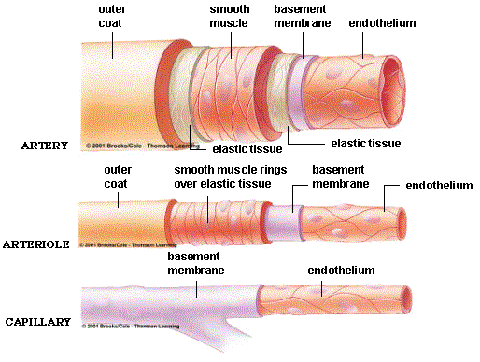

Slide 9
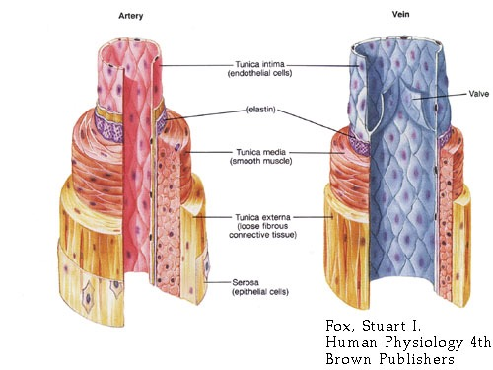

Slide 10
Lymphatics;
    Thin walled
    Lined by endothelium
    Drainage system for interstitial tissue fluid
    May disseminate bacterial and tumor cells to distant sites

Slide 11
VASCULAR ANOMALIES;
    Developmental or berry aneurysms
    Arteriovenous fistulas
    Fibromuscular dysplasia

Slide 12
Berry aneurism

Slide 13
Clinical presentation?

Slide 14
Arteriovenous fistulas or aneurysms
abnormal communications between arteries and veins
  Usually arised as:
  Developmental defect
  Rupture of an arterial aneurysm into adjacent vein
  Penetrating injury that pierce arteries and veins
  inflammatory necrosis of adjacent vessels
Clinical significance depends on short-circuit blood from A to V side

Slide 17
Clinical use of A-V fistulas;
    surgically created
    provide vascular access for chronic dialysis
    WHY WOULD SOME ONE NEED DIALYSIS?

Slide 19
FIBROMUSCULAR DYSPLASIA
Irregular thickening of the walls of medium to large muscular arteries
OCCURS IN;
  Renal
  Carotid
  Splanchnic and
  Vertebral vessels
Cause is unkown. Common in young women
1st degree relatives have increased incidence
Complications include
Luminal stenosis of renal arteries causing renovascular hypertension
Vascular outpouching resulting in aneurysms

Slide 20
VASCULAR WALL CELLS AND THEIR RESPONSE TO INJURY
The main cellular components of the walls of vessels are:
1) endothelial cells
2) smooth muscle cells
3) pericytes (the cells normally arranged along capillaries and venules)

Slide 21
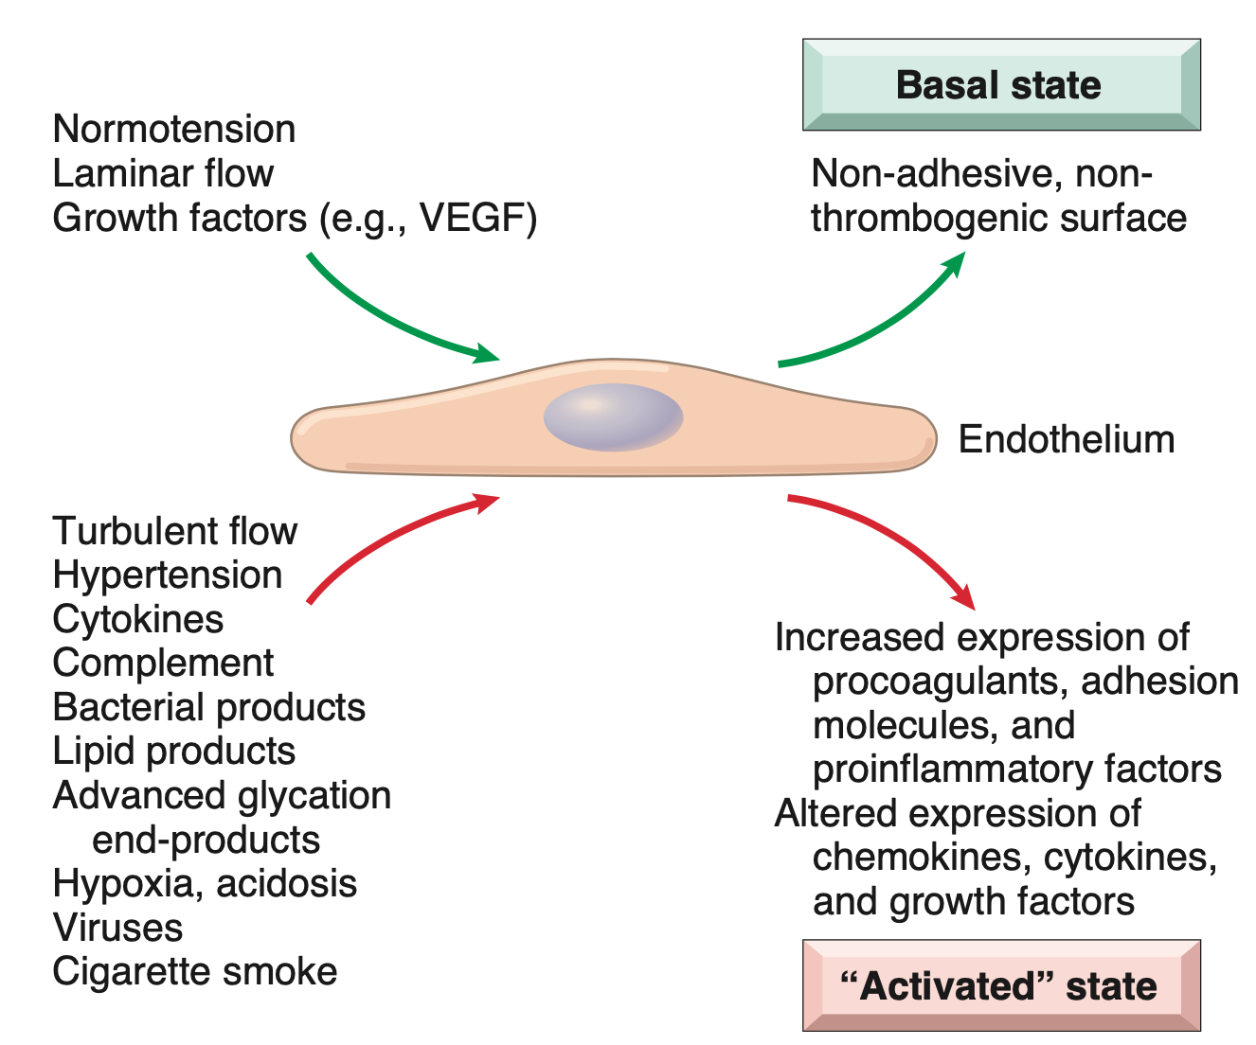

Slide 22
Endothelial injury is critical :
    to the formation of thrombi
    to the initiation of atherosclerosis and
    the vascular effects of hypertension and other disorders !!

Slide 23
ENDOTHELIAL CELL RESPONSE TO STIMULI
Response can either be:
      Endothelial activation
      Endothelial dysfunction

Slide 24
ENDOTHELIAL ACTIVATION
Definition:
Response to pathophysiologic stimuli
Adjusts constitutive functions
Express newly acquired inducible properties
Inducers of endothelial activation include:
Cytokines and bacterial products: causing inflam and septic shock
Hemodynamic stress and lipid products: critical to atherosclerosis
Viruses, complement components and hypoxia

Slide 25
ENDOTHELIAL ACTIVATION
Activated endothelial cells in turn:
  Express adhesion molecules
  Produce cytokines and chemokines
  GFs and vasoactive molecules: results in vasoconstriction or vasodilation
  Major histocompatibility Complexes
  Pro-coagulants and anti–coagulants
  NO : acts on SM as a relaxing factor
  Endothelin: acts on SM as contracting factor

Slide 26
ENDOTHELIAL DYSFUNCTION
Definition:
An altered phenotype that alters vasoreactivity
Or induces a surface that is thrombogenic
Or abnormally adhesive to inflammatory cells
It is partly responsible for:
Initiation of thrombus formation
Atherosclerosis
Vascular lesions of hypertension

Slide 27
SMOOTH MUSCLE
Smooth muscle cells are able to:
    a) mediate vasoconstriction
    b) mediate vasodilatation
    c) synthesize collagen, elastin, and proteoglycans
    d) elaborate the growth factors and cytokines
    e) proliferate
    f) migrate into the intima

Slide 28
Intimal thickening: A stereotyped response to vascular injury
    vascular injury
      stimulates smooth muscle cell recruitment and proliferation
      matrix synthesis

Slide 29
Healing of injured vessels include formation of a NEOINTIMA:
  Endothelial cells migrate to denudation areas from
      Adjacent uninjured areas
      Circulation precursors
  Smooth muscle cells migrate into the intima from
      Medial smooth muscles
      Precursor cells
Smooth muscle cells proliferate and synthesize ECM like fibroblasts in wound healing
The resulting neointima is completely covered by endothelial cells

Slide 30
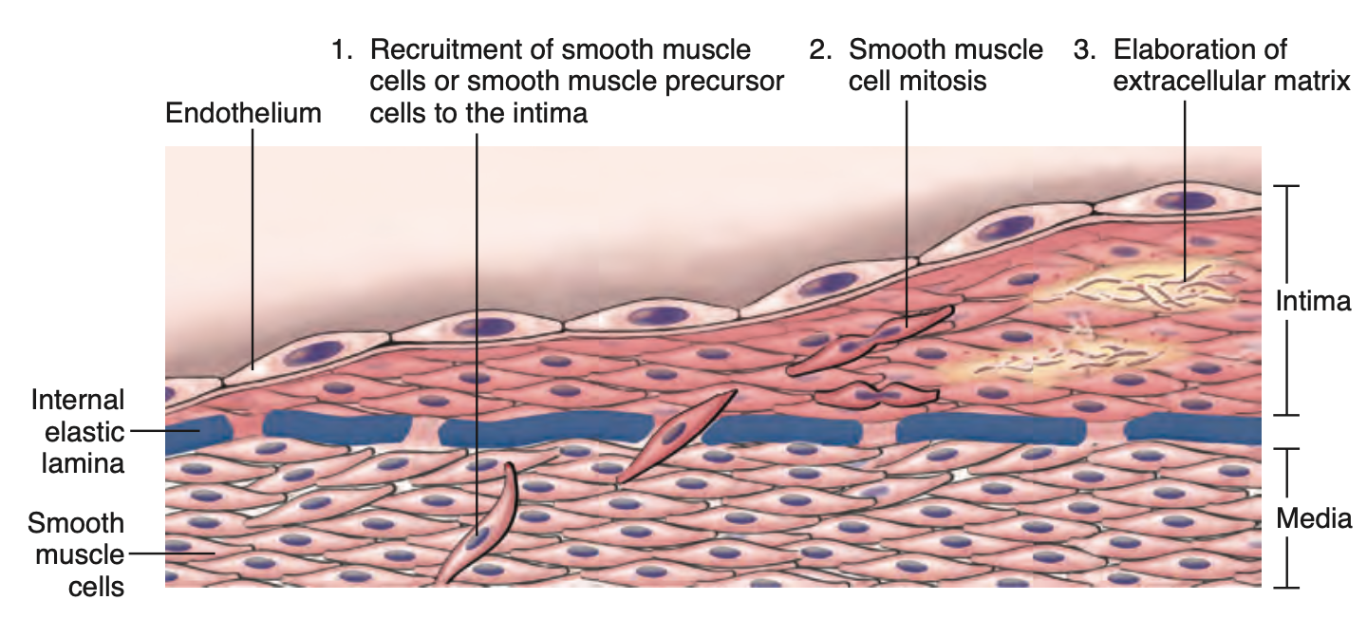

Slide 31
this neointimal response occurs with any form of vascular damage or dysfunction, irrespective of cause
          intimal thickening is the stereotypical response of the vessel wall to any insult

Slide 32
Hypertensive vascular disease
BP has to be maintained in a narrow range
Hypotension-inadequate organ perfusion
    tissue dysfunction
    death
Hypertension
    can result in end organ damage
    major risk factor for atherosclerosis

Slide 33
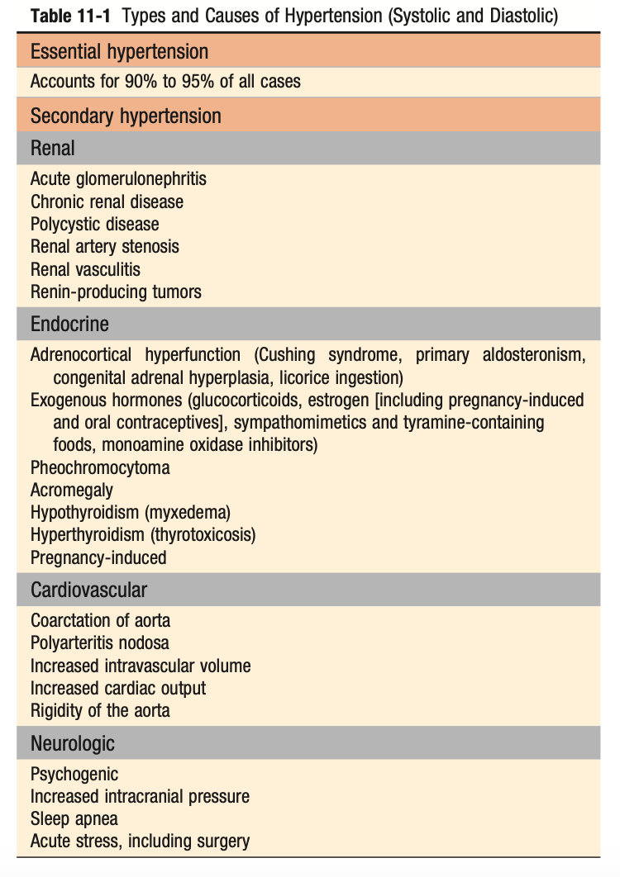

Slide 34
Normal BP?
Malignant Hypertension?

Slide 35
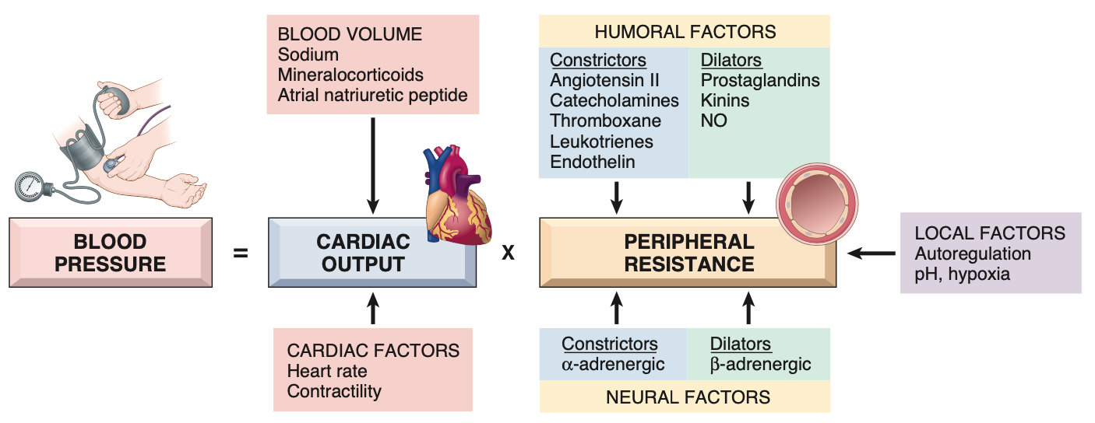
BLOOD PRESSURE REGULATION
CO = HR X SV

Slide 36
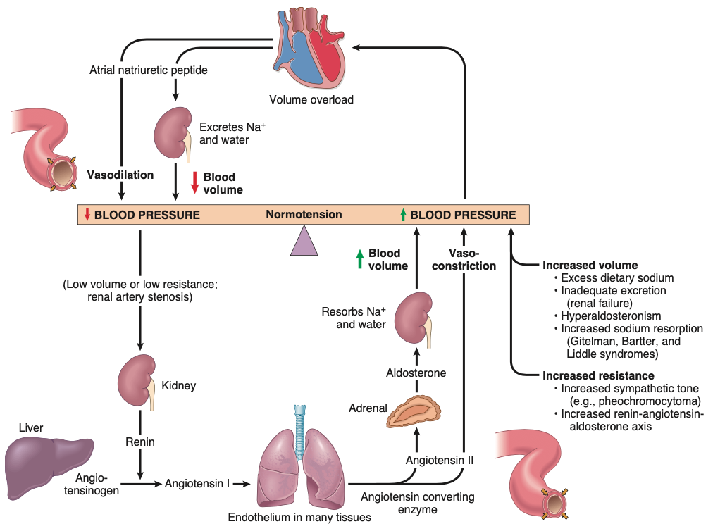

Slide 37
PATHOGENESIS OF HYPERTENSION
  Primary-largely unknown (environmental, genetic)
  Secondary
      renovascular hypertension
      single gene disorders eg Liddle syndrome => gain of fxn mutation in Na channel , with increased distal Na reabsorption

Slide 38
VASCULAR PATHOLOGY IN HYPERTENSION
    Large vessels
        accelerates atherogenesis
        degenerative changes in walls
            results in
              aortic dissection
              cerebrovascular hemorrhage

Slide 39
  Small blood vessel disease
      hyaline arteriolosclerosis
      hyperplastic arteriolosclerosis

Slide 40
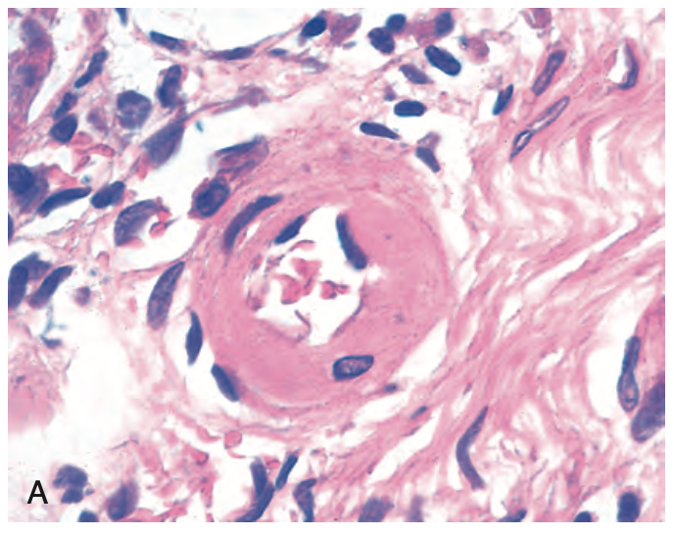
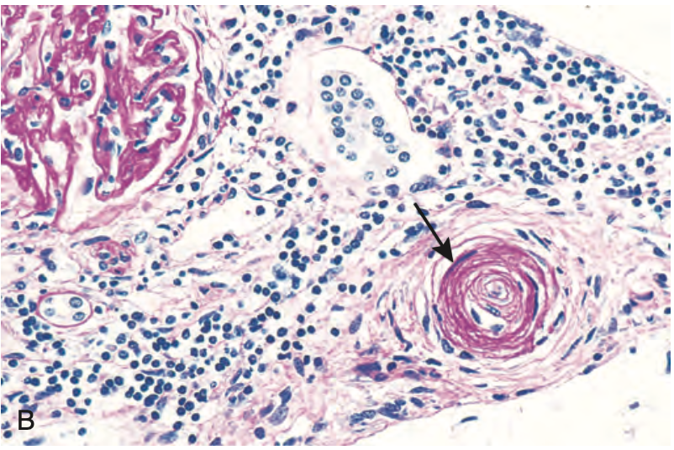
?
“benign hypertension”
diabetic microangiopathy
?
“malignant hypertension”

Slide 41
ARTERIOSCLEROSIS
Definition:
Means hardening of arteries
The term refers to arterial wall thickening and loss of elasticity
There are 3 general patterns:
    Arteriolosclerosis-small arteries and arterioles (hyaline and hyperplastic)
    Monckeberg medial sclerosis-calcification of muscular arterial walls
    Atherosclerosis

Slide 42
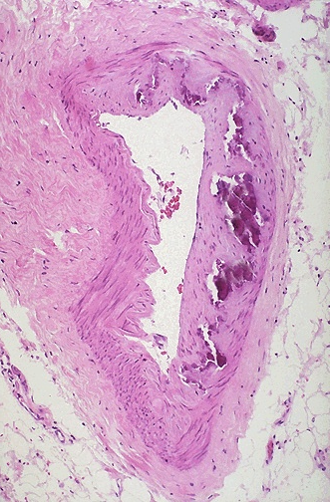
Notes:
Atherosclerosis and arteriosclerosis are often used so interchangeably, it is hardly worth differentiating them anymore, other than to know they are different!

Slide 43
ATHEROSCLEROSIS
Characterized by an intimal lesions called an atheromas (atheromatous plaques or atherosclerotic plaques)
An atheroma consists of a raised lesion of:
  Soft, yellow, core of lipid : cholesterol and esters
  Covered by white fibrous cap
Complications:
  Mechanical obstruction to flow
  Rapture causing vessel thrombosis
  Weakening media causing aneurysm formation
Coronary artery disease is an important manifestation of this disease

Slide 44
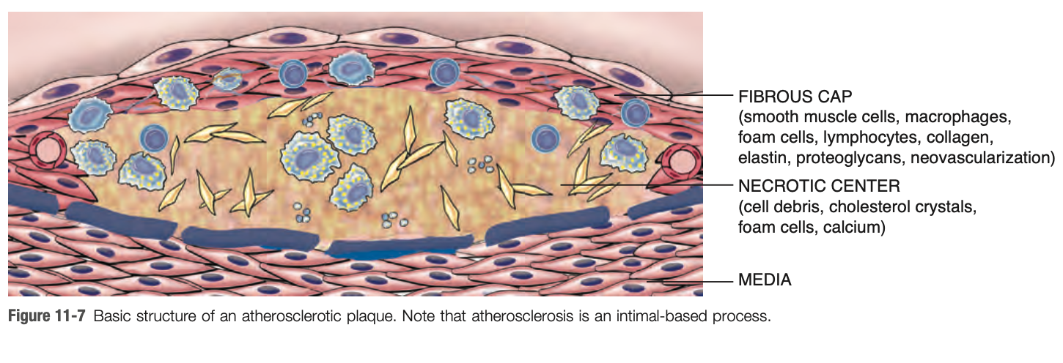

Slide 45
A) Epidemiology
Atherosclerosis is virtually ubiquitous among developed countries
It is much less prevalent in Central and South America, Africa, and Asia.
Evidences exist that it depends on the life style and dietary customs.

Slide 46
EPIDEMIOLOGY
Risk Factors
A) Constitutional risk factors- less controllable
Age:
Advanced age increases risk
Sex:
Male gender is a risk factor
Premenopausal women are relatively protected, effect of estrogens
Genetics
Familial Hypercholesterolemia accounts for small percentage
Polymorphisms related to HTN or DM

Slide 47
EPIDEMIOLOGY
B) Modifiable risk factors
  Hyperlipidemia- hypercholesterolemia
  Hypertension
  Smoking
  Diabetes mellitus
Other risk factors
  Inflammation
  Elevated plasma homocysteine,
  Metabolic syndrome
  High levels of Lipoprotein A
  Factors affecting hemostasis and thrombosis.
  Lack of exercise
  Competitive stressful life style: type A personality
  Obesity

Slide 48
PATHOGENESIS
    “Response to injury” hypothesis
      chronic inflammatory and healing response of the arterial wall to endothelial injury
      lesion progression=> interaction of;
          modified lipoproteins
          monocyte derive macrophages
          T lymphocytes
          with endothelial cells and smooth muscle cells

Slide 49
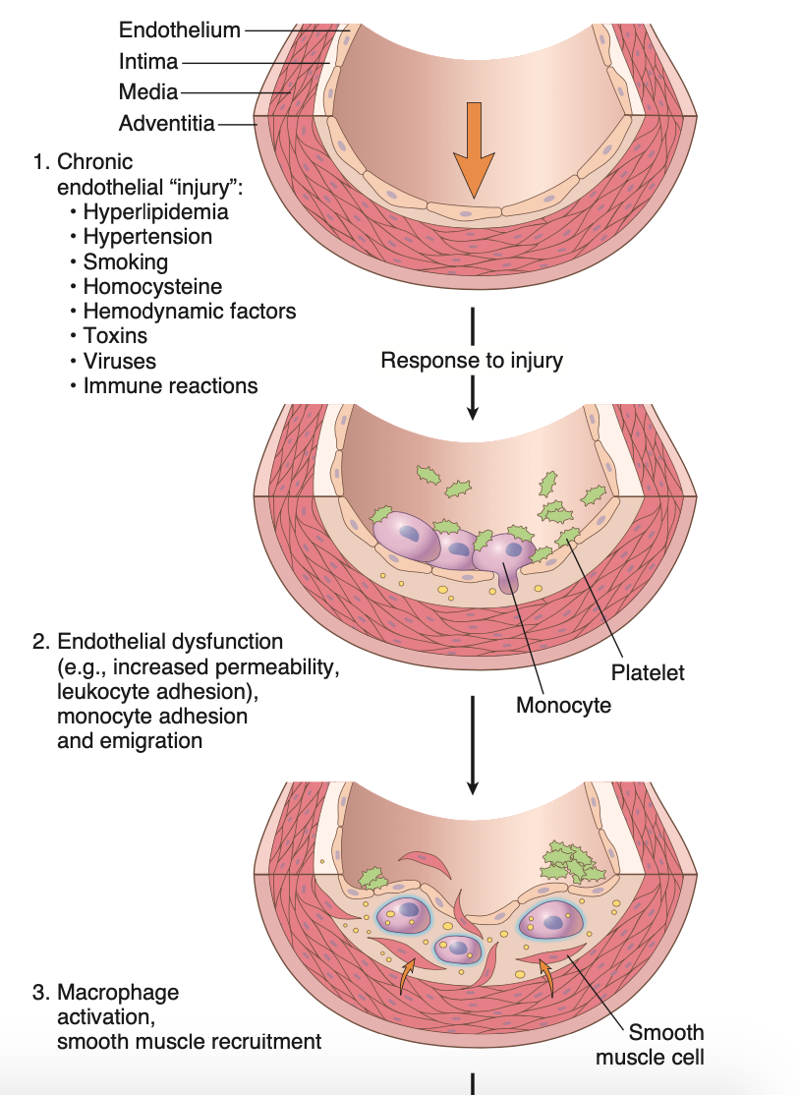

Slide 50
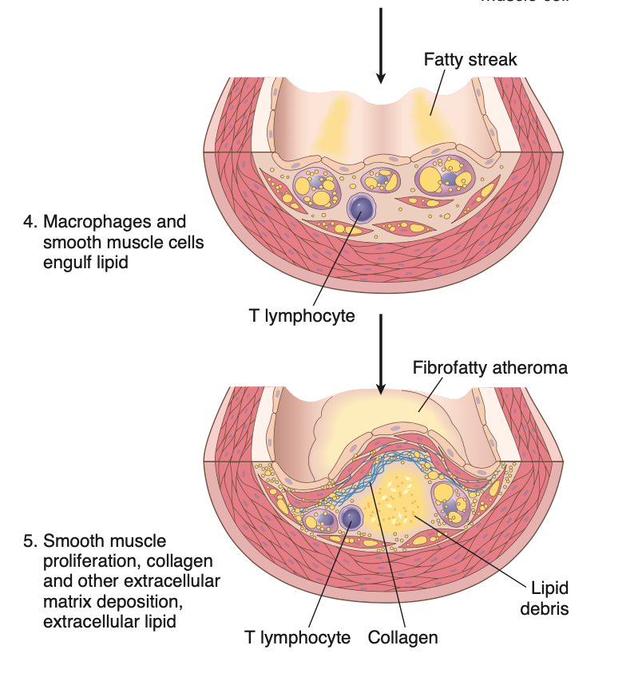

Slide 51
PATHOGENESIS OF ATHEROSCLEROSIS
According to the model, atherosclerosis progresses in the following sequence:
Endothelial injury and dysfunction:
Causes increased permeability, leukocyte adhesion and thrombosis
Accumulation of lipoproteins in vessel walls :
LDL and its oxidized forms
Monocyte adhesion to the endothelium:
Followed by migration into the intima + formation into macrophages & foam cells
Platelet adhesion:
Factor release:
From activated PLTs, macrophages, vascular wall cells
These induce smooth muscle recruitment from media and circulating precursors
Smooth muscle activation and ECM production:
Lipid accumulation:
Both extracellular and within macrophages and SM cells

Slide 52
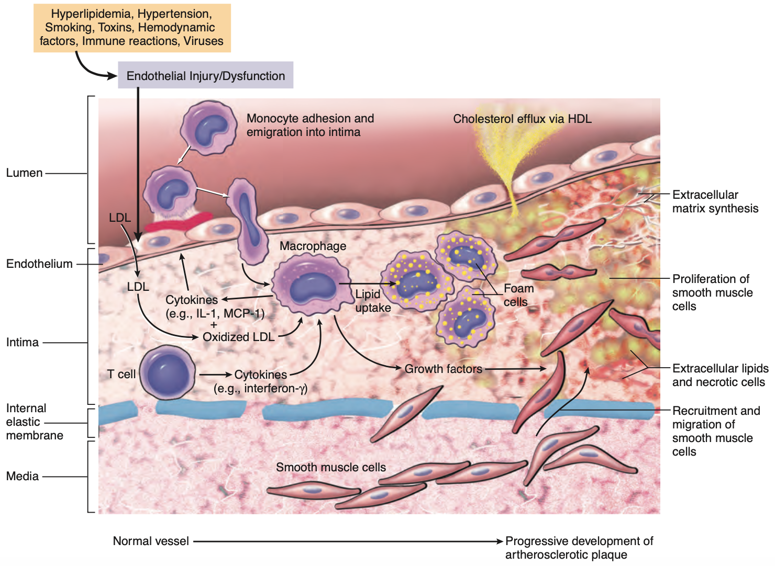

Slide 53
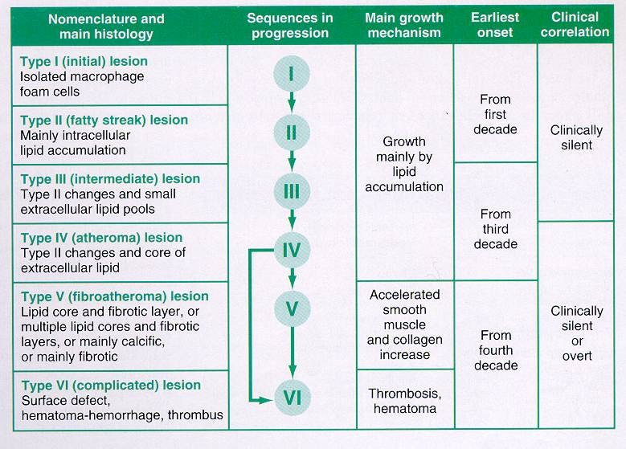

Slide 54
MORPHOLOGY OF ATHEROSCLEROSIS
Morphology consists of:
    Fatty streaks
    Atherosclerotic plaque

Slide 55
MORPHOLOGY OF ATHEROSCLEROSIS
.
Fatty streaks:
Earliest lesions in atherosclerosis
They are composed of lipid filled foamy macrophages
Begin as multiple minute flat yellow spots
They eventually coalesce into elongated streaks 1cm or more in length
They do not cause any flow disturbance
Can be seen in infants less than 1 year old
Seen in all children older than 10 years
Relationship to atherosclerotic plaque is not clear
Coronary fatty streaks form during adolescence
They are found on same anatomic location as atherosclerotic plaques

Slide 56
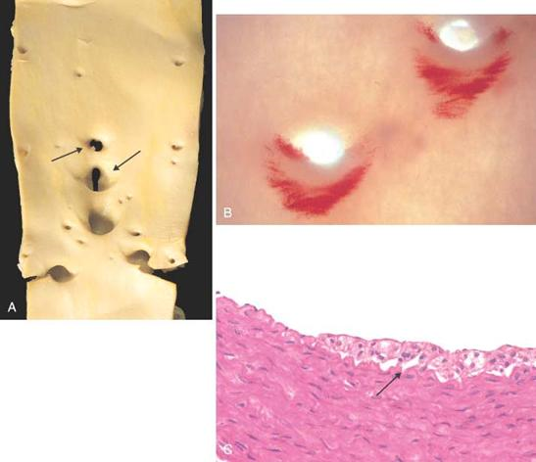
FATTY
STREAKS
Notes:
The streaks are more noticeable at the ostia of the aorta because that is where PRESSURE is the greatest. This simple observation makes it easier to understand the relationship between hypertension and atherosclerosis

Slide 57
MORPHOLOGY OF ATHEROSCLEROSIS
Atherosclerotic plaque:
The key processes are:
Intimal thickening
Lipid accumulation
Grossly:
They impinge on lumen of arteries
Appear white to yellow
Superimposed thrombus over ulcerated plaque is red brown
Plaques are 0.3 to 1.5 diameter. They may coalesce to form larger masses
Only involve a portion of any given artery and rarely circumferential (eccentric)

Slide 58
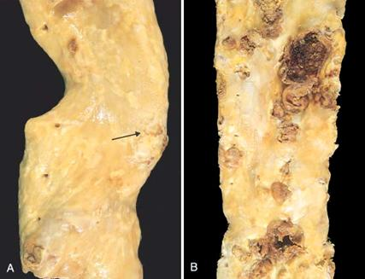
MILD ADVANCED

Slide 59
MORPHOLOGY OF ATHEROSCLEROSIS
Atherosclerotic plaque:
The most commonly affected in descending order are
  Abdominal aorta
  Coronary artery
  Popliteal artery
  Internal carotid
  Circle of Willis
Vessels that are usually spared include:
  Vessels of the upper extremities
  Mesenteric vessels
  Renal vessels
  Except at the ostia of renal and mesenteric vessels

Slide 60
MORPHOLOGY OF ATHEROSCLEROSIS
Atherosclerotic plaque:
Have 3 principle components
  Cells: SM cell, macrophages, and T cells
  ECM: collagen, elastic fibres and proteoglycans
  Lipids: intracellular and extracellular
These components occur in varying proportions

Slide 61
MORPHOLOGY OF ATHEROSCLEROSIS
Atherosclerotic plaque:
Typically, there is a:
Fibrous cap:
Composed of smooth muscle cells and relatively dense collagen
2.The shoulder:
To the side and beneath the cap
More cellular composed of macrophage, T cell and smooth muscles
Necrotic core:
Deep to the fibrous core
Composed of lipids, debris of dead cells, fibrin, foamy cells, thrombus & plasma
Clefts left behind after washing crystalline cholesterol
Neovascularization
Periphery to the lesion
Proliferating small blood vessels

Slide 62
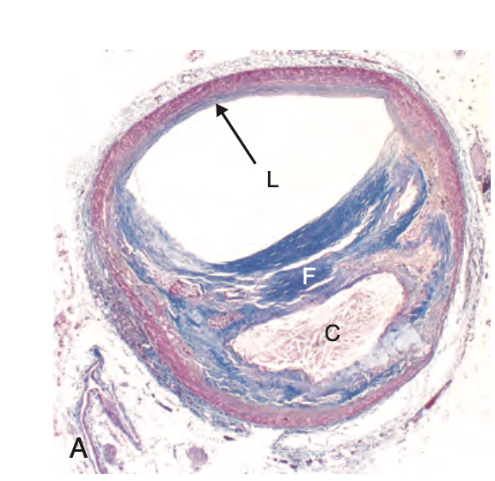

Slide 63
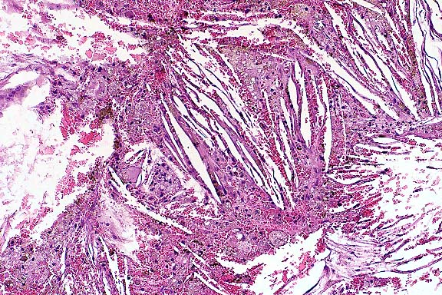
CHOLESTEROL CLEFTS
Notes:
Needle shaped washed out spaces in arteries, are cholesterol clefts, and can be nothing else, and like all other fat, yellow grossly, white microscopically.

Slide 64
CONSEQUENCES OF ATHEROSCLEROSIS
1. Stenosis
2. Rupture, ulceration or erosion, and Hemorrhage into a plaque
      (acute plaque changes)
3. Thrombosis
4. Vasoconstriction
5. Atheroembolism
6. Aneurysm formation

Slide 65
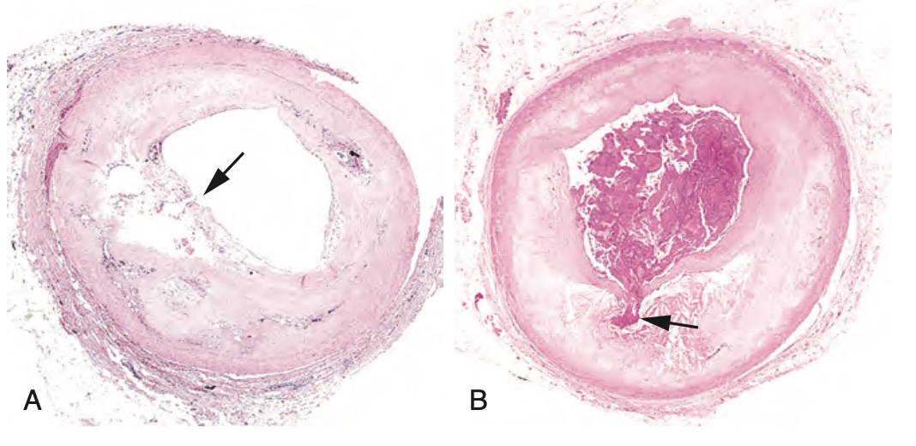

Slide 66
Heart?
Brain?
Aorta?
Peripheral vessels? eg legs

Slide 67
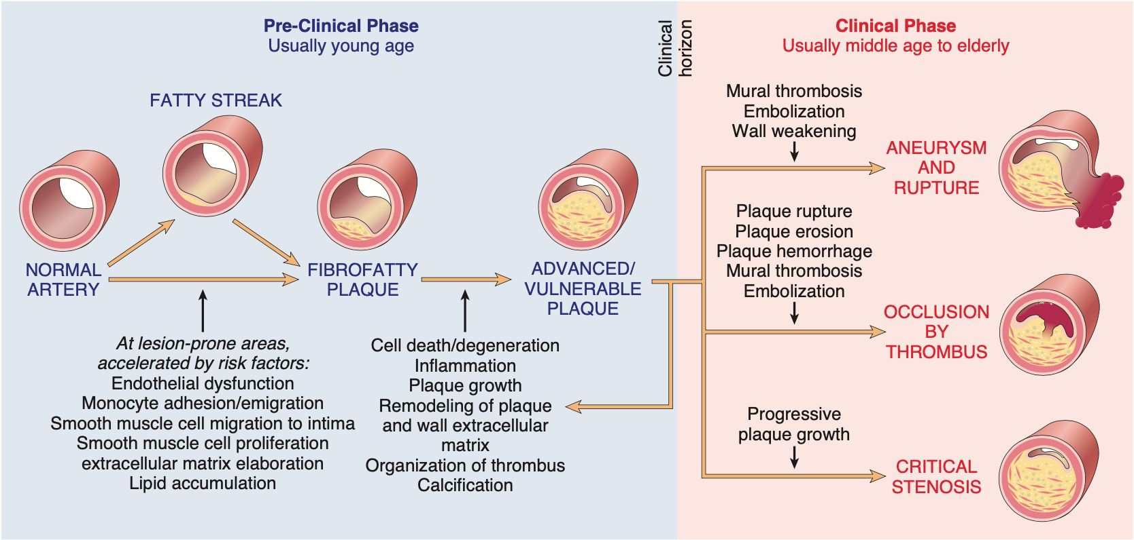

Slide 68
CONSEQUENCES OF ATHEROSCLEROTIC DISEASE
ACUTE PLAQUE CHANGES
Events that trigger abrupt changes in plaque configuration:?
Composition of plaques:
A. Stable plaque:
Fibrous caps are thick and densely collagenous
Minimum inflammation
Negligible underlying atheromatous core
Vulnerable plaque
Fibrous cap is thin
Increased inflammation
Large lipid atheromatous core

Slide 69
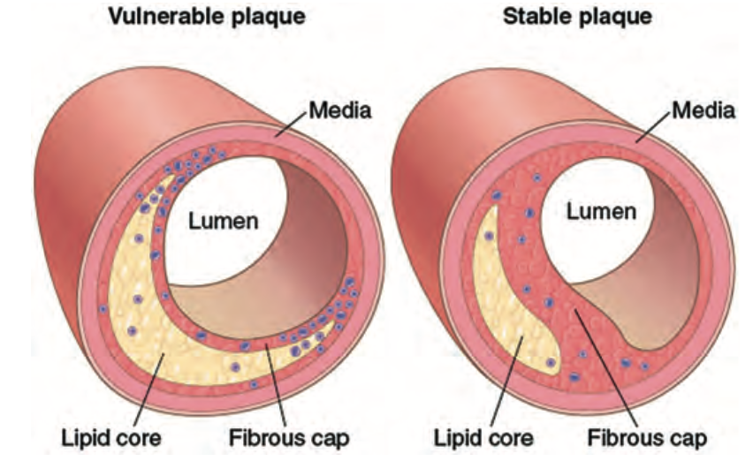

Slide 70
ANEURYSM AND DISSECTION
Definition:
It is a localized abnormal dilation of blood vessels or the heart
It can either be:
Congenital
Acquired
An aneurysm can be:
True aneurysm
Pseudo - aneurysm

Slide 71
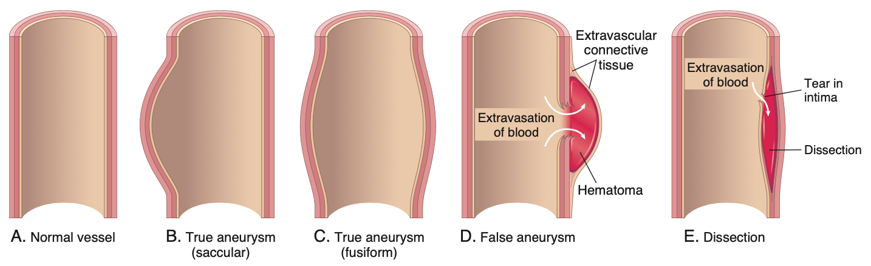

Slide 72
ANEURYSM AND DISSECTION
True aneurysm:
Involves intact attenuated arterial wall
Or intact thinned ventricular wall
E.G: atherosclerotic, syphilitic, congenital and ventricular aneurysms
Pseudo – aneurysm:
Is a defect in the vascular wall
Leads to an extravascular hematoma
The hematoma freely communicates with intravascular space
Referred to as a pulsating hematoma
E.G: Ventricular rapture after MI, and leak of a vascular graft

Slide 73
ANEURYSM AND DISSECTION
Arterial Dissection:
Definition:
Arise when blood enters the arterial wall itself
A hematoma dissects between the arterial layers
Dissections are often but not always aneurysmal
Aneurysms and dissections can rapture

Slide 74
ANEURYSM AND DISSECTION
Classification of aneurysm:
Generally classified by shape and size
Saccular aneurysms:
Spherical out pouching
Involving only a portion of the vessel
5 to 20cm in diameter
Often contain a thrombus
Fusiform aneurysms:
Diffuse circumferential dilation
Involve a long vascular segment
Diameter up to 20cm
Can involve aortic arch, abdominal aorta, and iliac artery

Slide 75
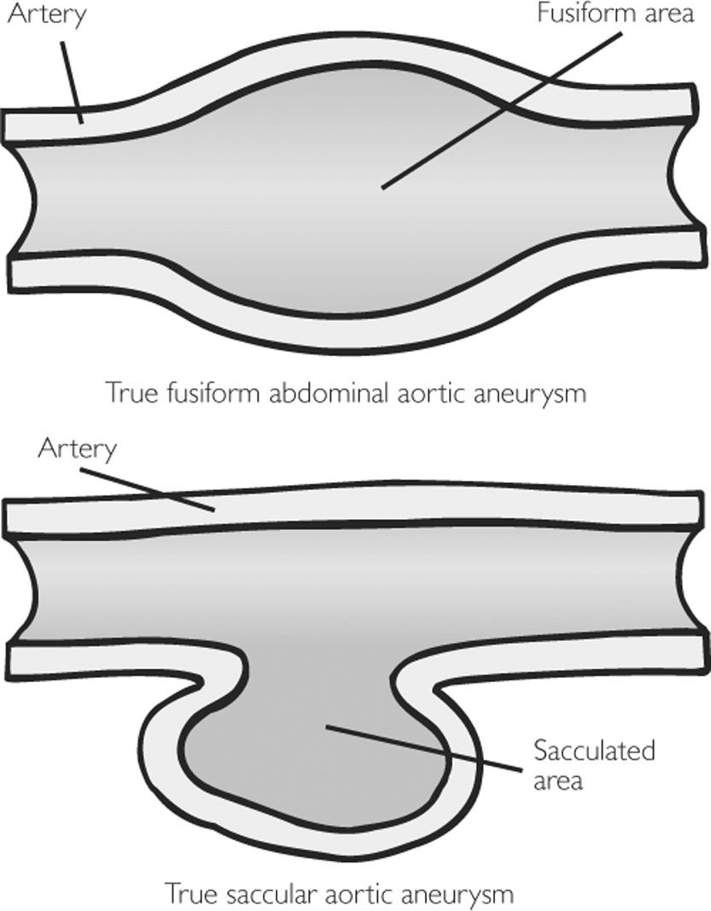

Slide 76
ANEURYSM AND DISSECTION
Pathogenesis of aneurysm:
Aneurysms occur when structure and function of vessel CT is compromised
Weakening of vessel wall is important in common sporadic form of aneurysm
Examples of causes of defects include:
The intrinsic quality of the vascular wall connective tissue is poor-Marfan syndrome
The balance of collagen degradation and synthesis is altered
The vascular wall is weakened by loss of SM cells
The inappropriate synthesis of non collagenous or non elastic ECM

Slide 77
ANEURYSM AND DISSECTION
PATHOGENESIS
1. The intrinsic quality of the vascular wall connective tissue is poor
Marfans syndrome
There is defective fibrillin synthesis
This leads to aberrant TGF-B activity
And thus weakening of elastic tissue causing aorta to dilate
Loeys - Dietz syndrome
Mutation in TGF-B receptors
Leads to abnormalities in elastin, collagen I and III
Vessels can rapture fairly easily
Ehlers – Danlos syndrome
Defective type III collagen
There is altered cross link associated Vit C deficiency
Its an example of nutrition basis for aneurysm formation

Slide 78
ANEURYSM AND DISSECTION
PATHOGENESIS
2. The balance of collagen degradation and synthesis is altered
This can be altered by:
Inflammatory infiltrates and
Destructive proteolytic enzymes they produced
MMP production is increased in:
Atherosclerotic plaque or
Vasculitis
Decreased tissue inhibitor of metalloproteinase (TIMP)
Contribute to overall ECM degradation
Genetic predisposition to aneurysm in setting of inflammation
Polymorphism of MMP or TIMP genes
The nature of the local inflammatory response

Slide 79
ANEURYSM AND DISSECTION
PATHOGENESIS
The vascular wall is weakened by loss of SM cells and
The inappropriate synthesis of non collagenous or non elastic ECM
Both result from ischemia of the inner media
It occur when
There is intimal thickening as in atherosclerosis
Narrowing of the vaso vasorum as in systemic hypertension
Ischemia leads to degenerative changes in the aorta which include:
Smooth muscle cell loss or
Change in synthetic phenotype
Change in synthetic phenotype leads to cystic medial degeneration which includes:
Scarring and loss of elastic fibres
Inadequate ECM synthesis
Production of increased amounts of GAGs

Slide 80
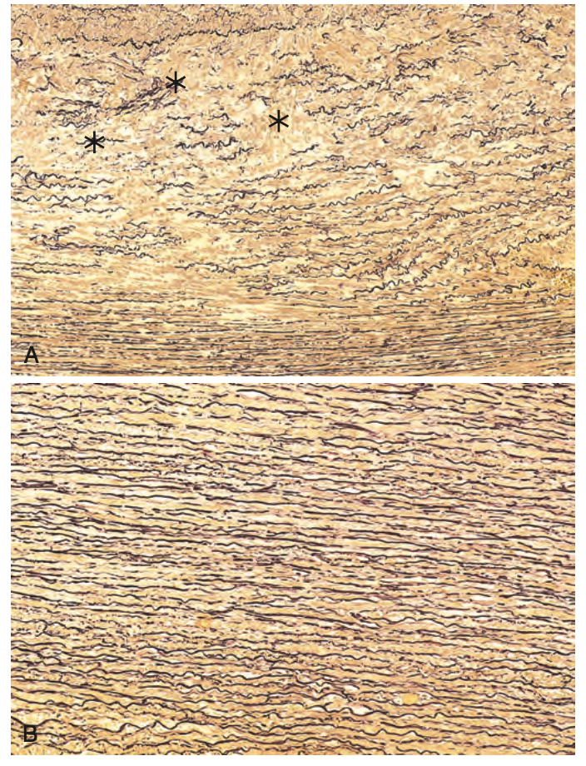
Cystic media degeneration-Marfan syndrome

Slide 81
The two most important disorders that predispose to aneurysms are:
Atherosclerosis
Hypertension
Atherosclerosis is a greater factor in abdominal aorta aneurysms
Hypertension is a greater factor in ascending aorta aneurysms
Other factors that weaken vessel walls include
Trauma
Vasculitis
Congenital defects – berry aneurysms
Infections – mycotic aneurysms

Slide 82
ANEURYSM AND DISSECTION
Mycotic aneurysms can originate from:
Septic embolus from infective endocarditis
An adjacent suppurative process
Circulating organisms directly infecting arterial walls
End stage syphilis obliterative endarteritis affects small vessels
Includes vaso vasorum of thoracic aorta
    This leads to:
    Ischemic injury of the aortic media and
    Aneurysmal dilatation
    This sometimes involves the aortic valve annulus

Slide 83
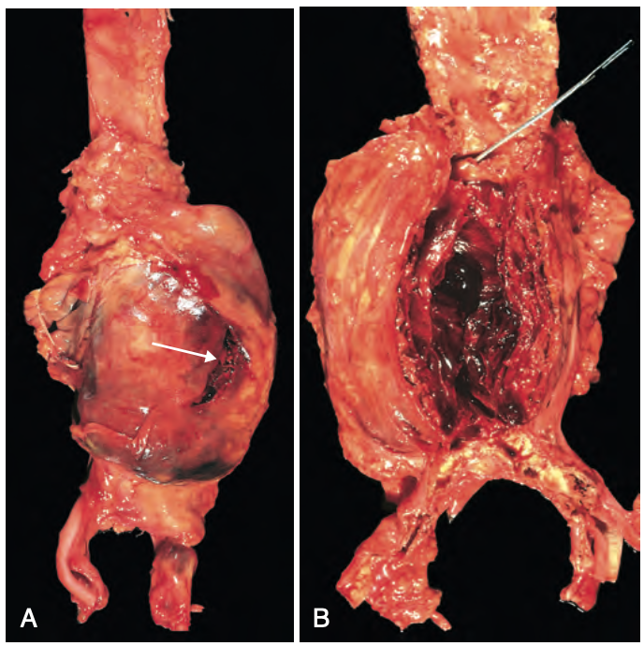
Most abdominal aortic aneurysms (AAA) occur between the renal arteries and the bifurcation of the aorta
commonly ass with atherosclerosis

Slide 84
ABDOMINAL AORTIC ANEURYSMS
Clinical consequences of AAA:
    Rupture
    Obstruction of branch vessels
    Embolism from atheroma and mural thrombus
    Impingement of adjacent structures
    Abdominal mass

Slide 85
ABDOMINAL AORTIC ANEURYSMS
Risk of rupture:
0% per year for AAAs , 4cm diameter
1% per year for AAAs, 4 to 5cm diameter
11% per year for AAAs, 5 to 6cm diameter
25% per year for AAAs, >6cm diameter
Most aneurysms expand at a rate of 0.2 to 0.3 cm per year
20% expand more rapidly

Slide 86
THORAIC AORTIC ANEURYSMS
Most commonly associated with hypertension
May also result from Marfans and Loeys – Dietz syndrome
Patients with syphilitic aneurysm die of heart failure
    This is due to aortic valve incompetence

Slide 87
THORAIC AORTIC ANEURYSMS
Give rise to sign and symptoms referred to as:
Encroachment of the mediastinal structures gives rise to;
  Respiratory difficulty due to encroachment of lungs and airways
  Difficulty in swallowing due to compression of esophagus
  Persistent cough due to irritation of recurrent laryngeal nerves
  Pain caused by erosion of bone
  Cardiac disease ( aortic valve dilation, valvular insufficiency and MI )
  Rapture

Slide 88
AORTIC DISSECTION
Occurs when blood sprays apart the laminar planes of media
It forms a blood filled channel within the aortic wall
It is catastrophic if it ruptures through adventitia
In contrast to aneurysms, dissections
May be associated with dilation
May not be associated with dilation

Slide 89
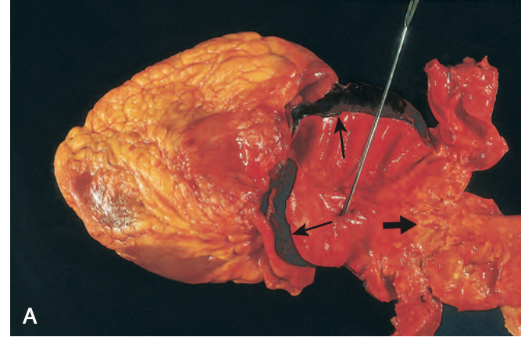
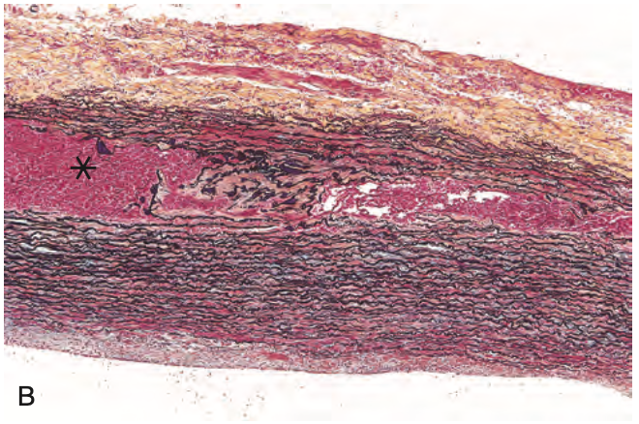

Slide 90
AORTIC DISSECTION
Principally occurs in two groups
Men aged between 40 to 60 years
90% of cases of dissection
Antecedent hypertension
Younger patients
With systemic or localized abnormalities of CT
E.G. Marfans syndrome

Slide 91
AORTIC DISSECTION
Clinical features:
Risk of complication depends strongly on the region affected
Type A Dissections:
Proximal lesions with two subtypes
Referred to as DeBakey I or II
Type I: involves both ascending and descending aorta
Type II: involves just ascending aorta
Type B Dissections:
Distal lesions not involving the ascending aorta
Usually distal to subclavian
Also referred to as DeBakey III

Slide 92
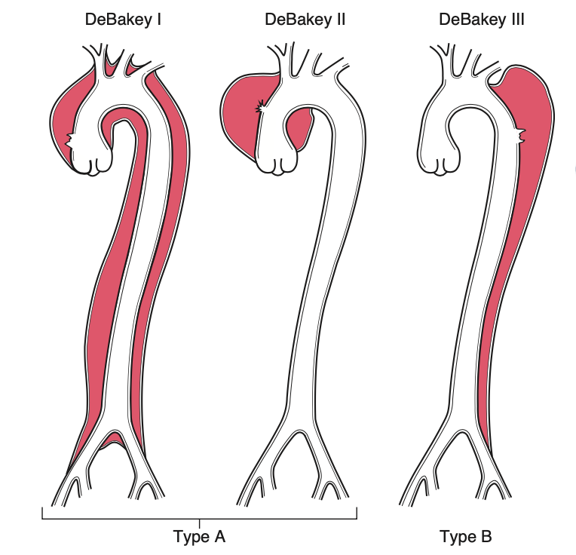

Slide 93
End

