Slide 1
Gastrointestinal system
Dr. Mumba
Robbins based

Slide 2
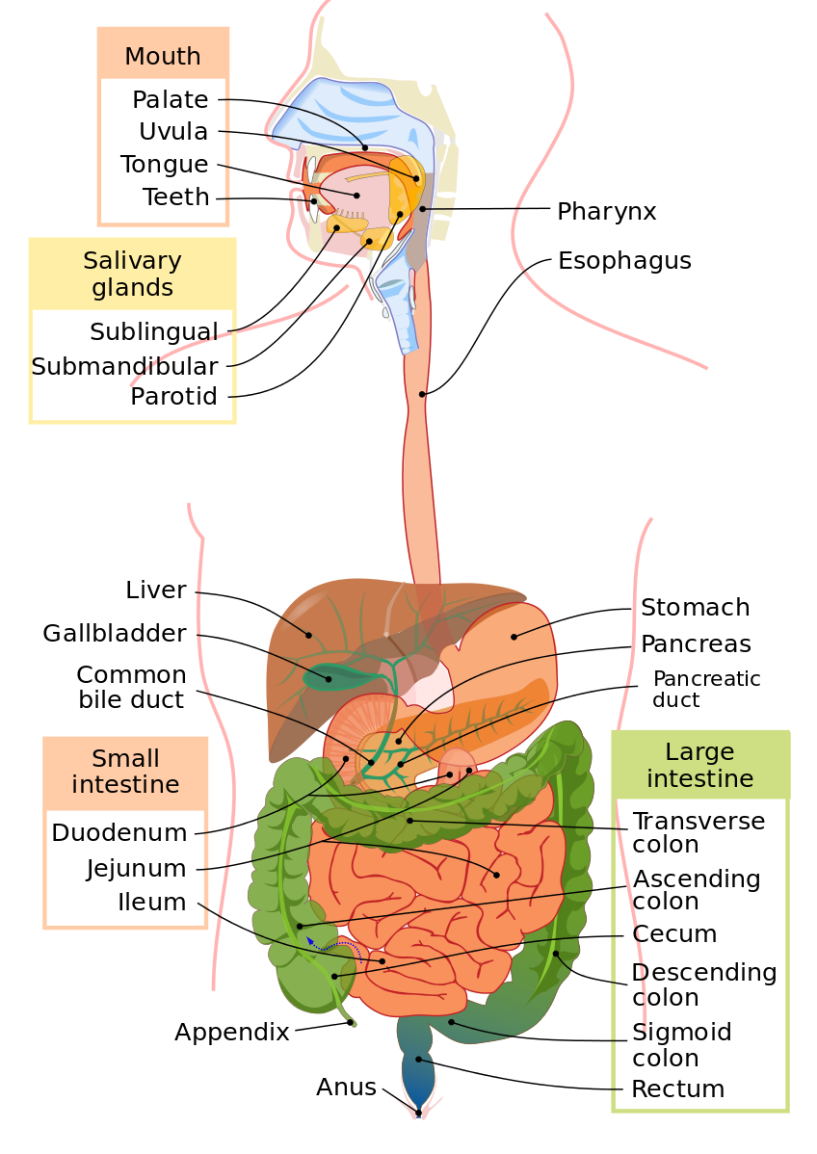
General layout of the GIT

Slide 3
General Anatomical/Congenital abnormalities of the GIT
Agenesis-rare
Atresia-commoner (NO LUMEN)
Fistulae-aspiration, suffocation, pneumonia and severe fluid and electrolyte imbalance
Stenosis
    congenital
    acquired-inflammation (radiation, GERD etc.)

Slide 4
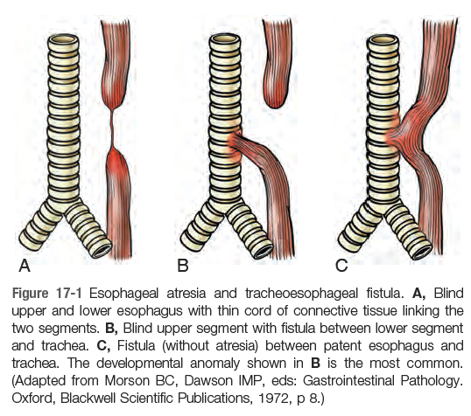

Slide 5
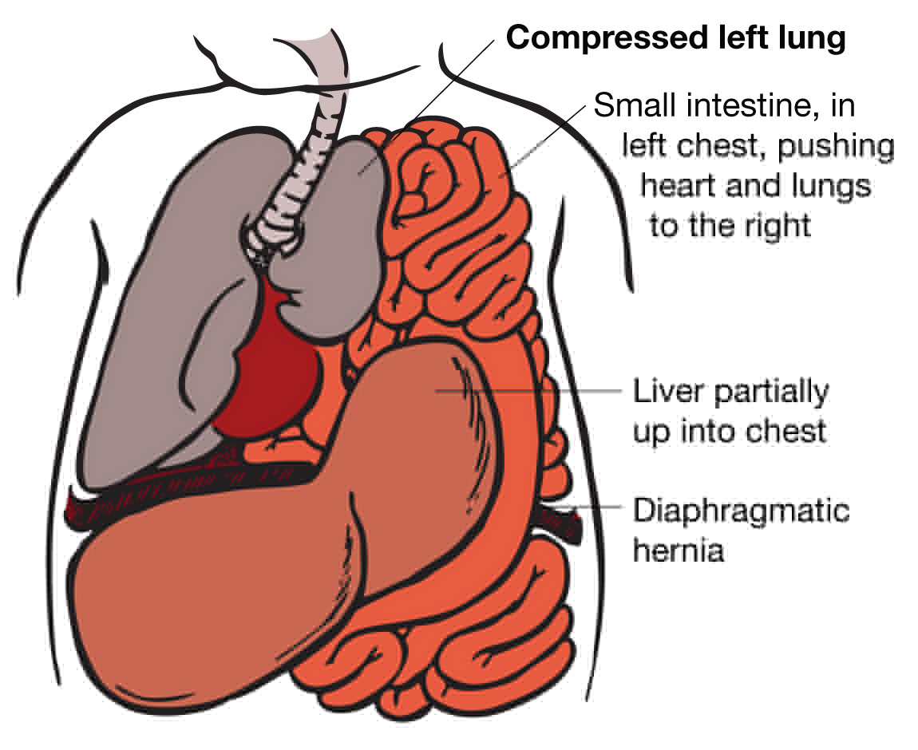
Diaphragmatic hernia

Slide 6
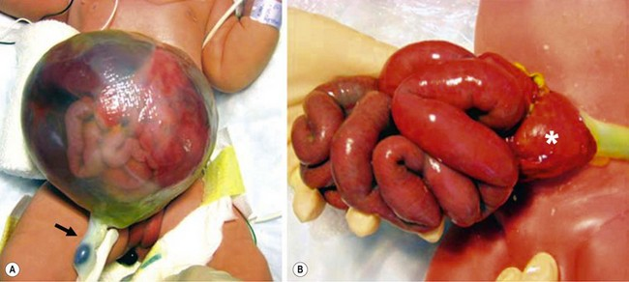
Omphalocele and Gastroschisis

Slide 7
Ectopia
  ectopic tissue-developmental rests
  ectopic gastric mucosa in the upper 1/3 of the oesophagus
  also-pancreatic and

Slide 8
Merkel diverticulum
    occurs in the ileum
    blind out-pouching of the alimentary tract that communicates with the lumen and includes all 3 layers of the bowel wall (true diverticulum)
    failed involution of the vitelline duct (yolk sac to developing gut lumen)
    “rule of 2’s”

Slide 9
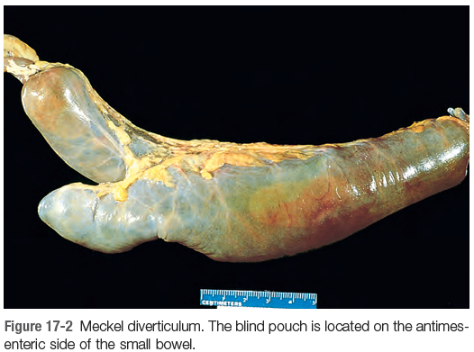
Merkel diverticulum

Slide 10
Pyloric stenosis
    congenital hypertrophic pyloric stenosis
      3-5:1=m:f
      1/300-900 live births
      c/f?
    Acquired pyloric stenosis
      adults
      antral gastritis
      peptic ulcer near pylorus
      ca distal stomach
      pancreatic ca

Slide 11
Hirschsprung disease
  Congenital aganglionic megacolon
  1/5000 live births
  10% in down syndrome children
  males>females
  Pathogenesis
      premature arrest of neural crest cell migration from cecum to rectum
      premature death of ganglion cells
      distal intestinal segment without both Meissner and Auerbach myenteric plexus=Aganglionosis

Slide 12
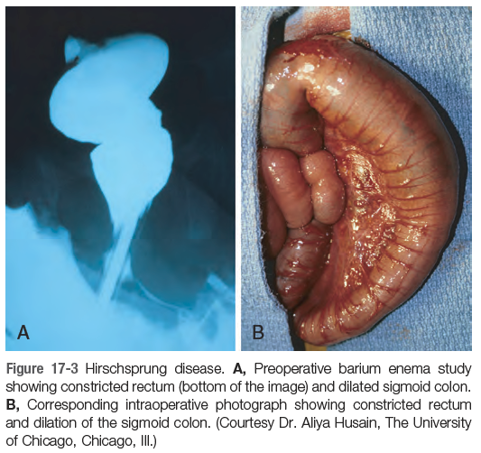

Slide 13
Clinical features
  immediate postpartum period=> failure to pass meconium
  obstruction/constipation (with visible ineffective peristalsis)
  complications
    enterocolitis
    fluid and electrolyte imbalance
    perforation
    peritonitis

Slide 14
Treatment
    Surgical resection of affected part and anastomosis
Acquired magacolon (other causes of megacolon)
    Chagas disease
    Obstruction by neoplasm/inflammatory stricture
    toxic magacolon complicating ulcerative colitis
    visceral myopathy
    functional psychosomatic disorders

Slide 15
Esophagus
Stomach
Small and large intestine (colon)
Peritoneal cavity

Slide 16
ESOPHAGUS

Slide 17
ESOPHAGUS
Esophagus
  Anatomical/congenital disorders
  motor disorders (achalasia)
  inflammation (esophagitis)
  tumours (benign and malignant)

Slide 18
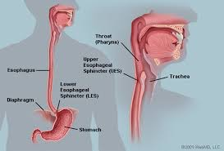

Slide 19
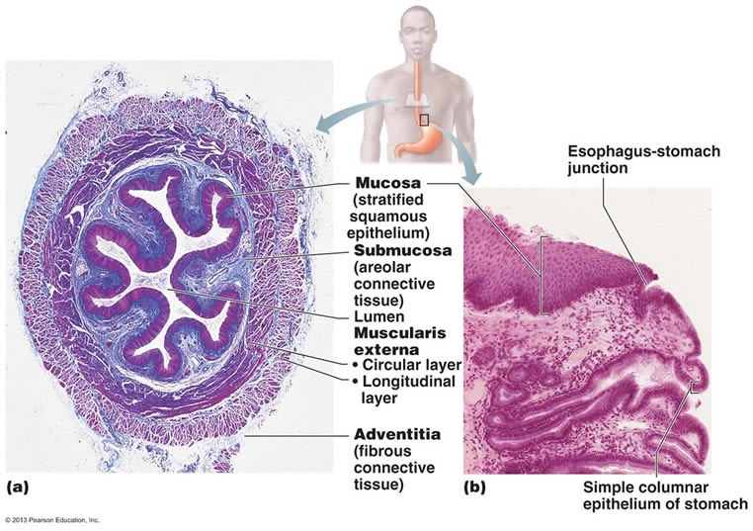

Slide 20

Working definitions
DYSPHAGIA
DIFFICULTY IN SWALLOWING
ODYNOPHAGIA
PAIN DURING SWALLOWING
HEARTBURN
RETROSTERNAL BURNING PAIN
HEMATEMESIS
VOMITING BLOOD

Slide 21
Anatomic disorders

Slide 22
Esophageal obstruction
structural or functional
    A) functional (esophageal dysmotility)
      1. nutcracker esophagus
      2. diffuse esophageal spasm
      3. hypertensive lower esophageal sphincter
      may result in development of small diverticulae;

Slide 23
    Epiphrenic diverticulum-immediately above the lower esophageal sphincter
    Zenker diverticulum-located immediately above the upper esophageal sphincter

Slide 24
    B) Structural (mechanical obstruction)
      strictures or cancer
      C/F?
      Benign esophageal stenosis-fibrous thickening of submucosa
      Esophageal mucosal webs
      Esophageal rings (Schatzki rings)
        A rings-above GE junction
        B rings-at squamo-columnar junction

Slide 25
Acalasia
  Increased tone of LES
  Impaired smooth muscle relaxation
  characterized by triad of;
    1. incomplete LES relaxation
    2. increased LES tone
    3. Aperistalsis of the esophagus

Slide 26
Primary or secondary achalasia
  Primary
    distal esophageal inhibitory neuronal degeneration (ganglion cell degeneration)
  Secondary
    may arise in Chagas disease
    Trypanosoma cruz infection->destruction of myenteric plexus

Slide 27
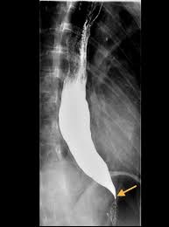
Barium swallow

Slide 28
Treatment;
  laparoscopic myotomy
  pneumatic ballon dilatation
  botox injection

Slide 29
Esophageal causes of hematemesis
Esophageal Causes of Hematemesis;
Lacerations (Mallory-Weiss syndrome)
Esophageal perforation (cancer or Boerhaave syndrome) Varices (cirrhosis)
Esophageal-aortic fistula (usually with cancer)
Chemical and pill esophagitis
Infectious esophagitis (Candida, herpes)
Benign strictures
Vasculitis (autoimmune, cytomegalovirus)
Reflux esophagitis (erosive)
Eosinophilic esophagitis
Esophageal ulcers (many etiologies)
Barrett esophagus
Adenocarcinoma
Squamous cell carcinoma
Hiatal hernia

Slide 30
Esophageal varices
Diseases that prevent flow of blood from intestines through the liver to the heart
The diseases cause portal hypertension and can lead to formation of esophageal varices

Slide 31
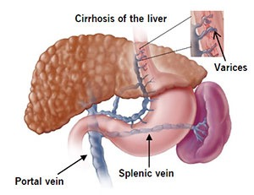

Slide 32
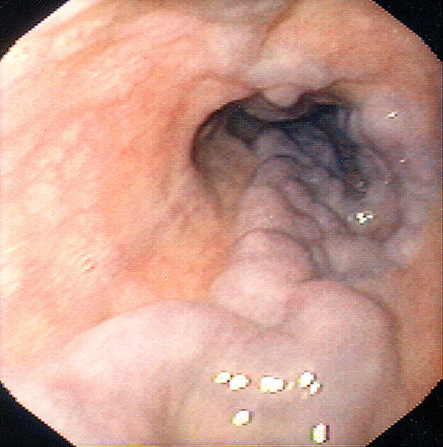
Another important cause of varices include schistosomiasis

Slide 33
Clinical features
  present in 50% of patients with cirrhosis
  varicella bleeding
      hematemesis
      melena (black stool)
      30% die as a direst consequence of variceal bleed

Slide 34
Treatment
    beta blockers-help to prevent bleeding*
    endoscopic sclerotherapy (inject thrombotic agents)
    ballon tamponade*
    variceal ligation*

Slide 35
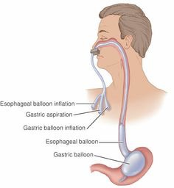
Sengestaken-Blakemore tube (esophagogastric tamponade tube)

Slide 36
Mallory-Weiss tears
longitudinal mucosal tears near the GE junction
ass with severe retching or vomiting secondary to acute alcohol intoxication
vs Boerhaave syndrome

Slide 37
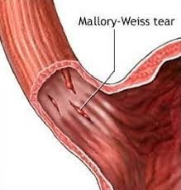

Slide 38
Esophagitis
Chemical
Infectious
Reflux
Eosinophilic

Slide 39
A) Chemical esophagitis
    alcohol
    corrosive acids/alkalis
    excessive hot fluids
    heavy smoking
    etc

Slide 40
B) Infectious esophagitis
    herpes simplex virus
    cytomegalovirus
    fungal infection
        candidiasis
        mucormycosis
        aspergillosis

Slide 41
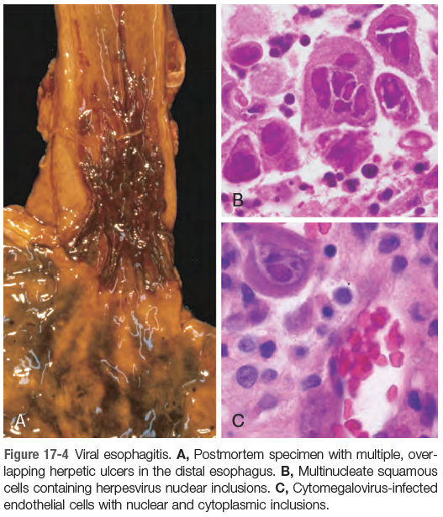

Slide 42
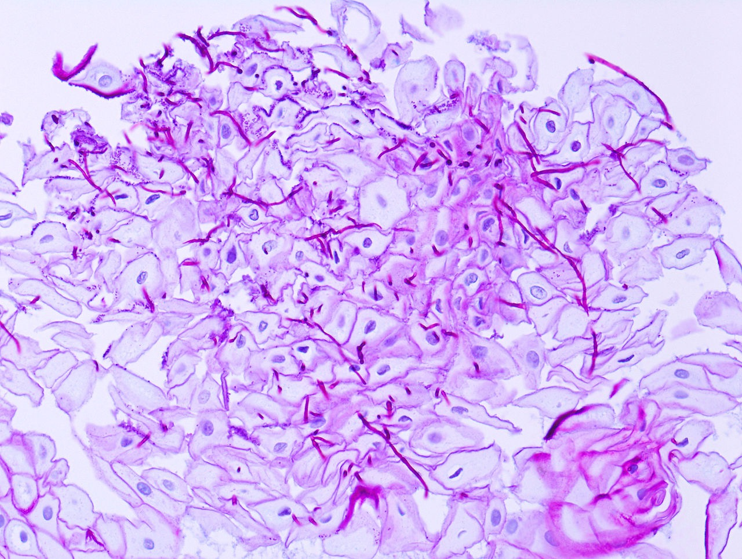
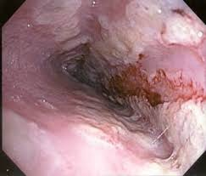
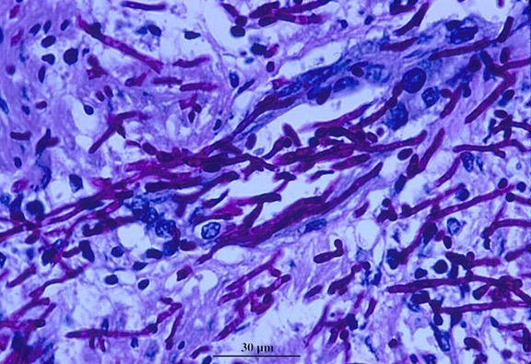

Slide 43
C) Reflux esophagitis
  oesophagus is sensitive to acid
  submucosal glands-secrete mucin and bicarbonate
  lower esophageal sphincter tone-prevents reflux of stomach acidic contents
  failure=>GERD (gastoesophageal reflux disease)

Slide 44
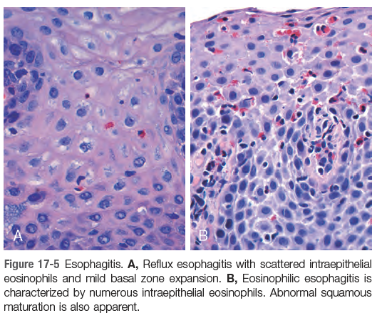
Histology
  basal zone hyperplasia
  lamina propria papillae elongation
  eosinophils
  +/- neutrophils

Slide 45
clinical features;
    usu > 40years
    heartburn
    dysphagia
    regurgitation of sour tasting gastric contents

Slide 46
Treatment
    proton pump inhibitors
Complications
    ulceration
    hematemesis
    melena
    stricture development
    Barrett esophagus

Slide 47
D) Eosinophilic esophagitis
    symptoms
        food impaction
        dysphagia
        feeding intolerance in children
    majority are atopic
    histology
        abundant intraepithelial eosinophils
    Treatment
        prevent exposure to food allergens (cows milk, soy products)
        corticosteroids

Slide 48
Barrett esophagus
complication of chronic GERD (10% of symptomatic patients)
characterized by replacement of squamous epithelium by metaplastic columnar epithelium and goblet cells
increased risk for adenocarcinoma

Slide 49
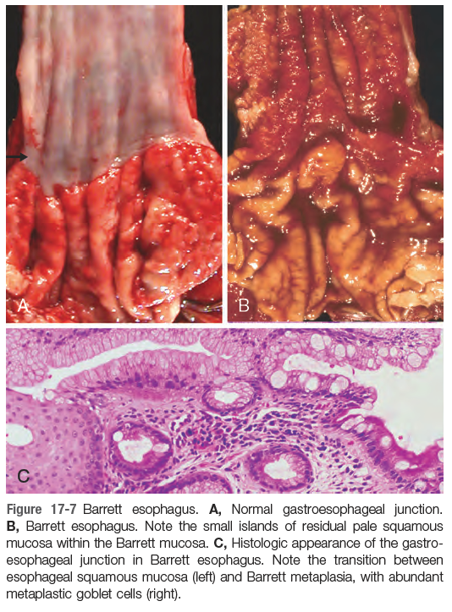

Slide 50
Dysplasia in Barrets esophagus
    low grade
    high grade

Slide 51
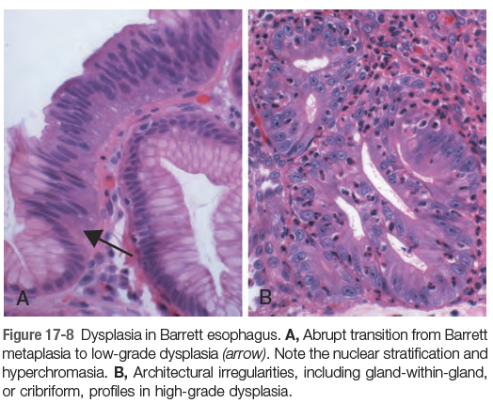

Slide 52
Esophageal tumours
Benign or malignant
Epithelial or mesenchymal in origin
    epithelial?
    mesenchymal?

Slide 53
Esophageal carcinoma
Squamous cell carcinoma
Adenocarcinoma

Slide 54
Squamous cell carcinoma
4:1 male to female (USA)
Risk factors
  alcohol
  tobacco
  poverty
  caustic esophageal injury
  acalasia
  Plummer-Vinson syndrome
  diets deficient in fruits and vegs
  freq intake of very hot drinks

Slide 55
most occur in the middle 1/3 of the esophagus
Clinical features?

Slide 56
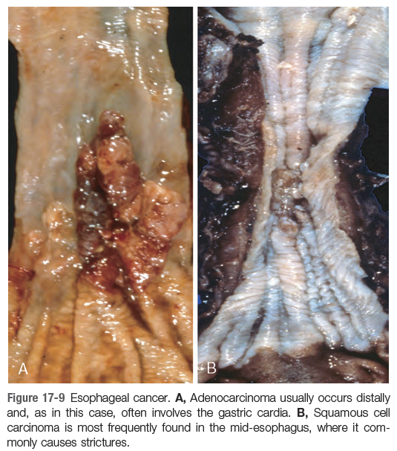

Slide 57
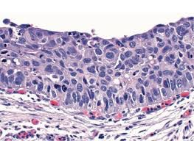
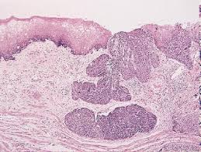

Slide 58
Adenocarcinoma
most arise from Barrett esophagus
other risk factors
    tobacco use
    radiation exposure
7:1 male to female ratio
usu-distal 1/3 of esophagus

Slide 59
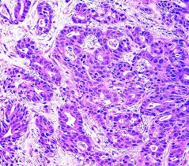

Slide 60
END

Slide 61
Sample test/exam questions
Write short notes on;
  Hirschsprung disease
  Merkel diverticulum
  pyloric stenosis
  Achalasia
  Mallory-Weiss tears
  Gastroesophageal varices
Write short notes on congenital malformations of the gastrointestinal tract.
Write short notes on the esophageal causes of hematemesis.
Writes an essay on gastroesophageal varices to include causes, pathophysiology, clinical features, treatment and complications.
Write a long essay on esophagitis.
Write an essay on Barrett esophagus to include its complications.
Write short notes on esophageal cancers.

