Slide 1
MYELOID LEUKAEMIAS

Slide 2
Introduction
The leukaemias are a group of disorders characterised by the accumulation of malignant white cells in the bone marrow and blood
The abnormal cells cause symptoms because of:
Bone marrow failure e.g anaemia neutropenia, thrombocytopenia
Infiltration of organs e.g liver, spleen, lymph nodes, meninges, brain, skin or testes

Slide 3
Classification of leukaemia
The main classification is into four types: acute or chronic leukaemias, which are further subdivided into lymphoid or myeloid leukaemias.
Acute leukaemias are usually aggressive diseases in which malignant transformation occurs in a haemopoietic stem cell or early progenitor.
Acquired genetic damage results in an increased rate of proliferation, reduced apoptosis and a block in cellular differentiation.
Together these events cause accumulation in the bone marrow of early haemopoietic cells known as blast cells.
The dominant clinical feature of acute leukaemia is usually bone marrow failure caused by accumulation of blast cells, although organ infiltration also can occur.
If untreated, acute leukaemias are usually rapidly fatal, although with modern treatments most younger patients are ultimately cured of their disease.

Slide 4
Diagnosis of acute leukaemia
Defined as presence of >20% blast cells in blood or bone marrow at clinical presentation
Can be diagnosed with <20% blasts if specific leukaemia associated cytogenetic or molecular genetic abnormalities are present
Lineage of blasts is defined by microscopy (morphology), immunophenotype (flow cytometry), cytogenetic and molecular analysis
This defines whether blasts are of myeloid or lymphoid lineage and localises the stage of cellular differentiation
Typical “myeloid immunophenotype” is CD13⁺, CD33⁺, CD117⁺ and TdT⁻
Cytogenetic and molecular analysis is essential and usually performed on marrow or peripheral blood with very high blast count

Slide 5
ACUTE MYELOID LEUKAEMIA (AML)

Slide 6
Pathogenesis - 1
The AML genome contains an average of about 10 mutations within protein-coding genes in each case, among the smallest number of any adult cancer.
Many AML ‘driver mutations’ promoting clonal expansion have been identified, with the most common being within FLT3, NPM1 and DNMT3A.
Some other mutations, e.g. of ASXL1 or mutations in splicing-associated genes, are frequent in myelodysplastic syndromes (MDS) and when found in AML suggest that it is secondary to MDS, which may not have been recognized clinically.
The mutations usually occur on only one of the two alleles for the gene and, depending on the gene, may be ‘loss of function’, ‘gain of function’ or ‘neomorphic’ (i.e. conferring a novel function).

Slide 7
Pathogenesis - 2
Some AML cases are characterized by a gene-fusion event, which usually arises from translocations, with the most common being PML-RARA, CBFB-MYH11 and RUNX1-RUNX1T1, which are found in around 15%, 12% and 8% of cases, respectively.
Mutations of genes DNMT3A, TET2, ASXL1 and less commonly IDH1, IDH2, TP53 or spliceosome genes may be found in the blood cells of healthy subjects, especially after age 60 years (age-related clonal haemopoiesis or clonal haemopoiesis of indeterminate potential).
Patients with these mutations can develop AML, which may present many years later.
The likelihood of AML development is higher in those with IDH1, IDH2, TP53 or spliceosome gene mutations, more than one mutation, high mutation allele burden, or an elevated red cell distribution width.

Slide 8
Incidence
AML is the most common form of acute leukaemia in adults and becomes increasingly common with age, with a median onset of 65 years.
It forms only a minor fraction (10–15%) of the leukaemias in childhood.
Cytogenetic and molecular abnormalities and response to initial treatment have a major influence on prognosis.

Slide 10
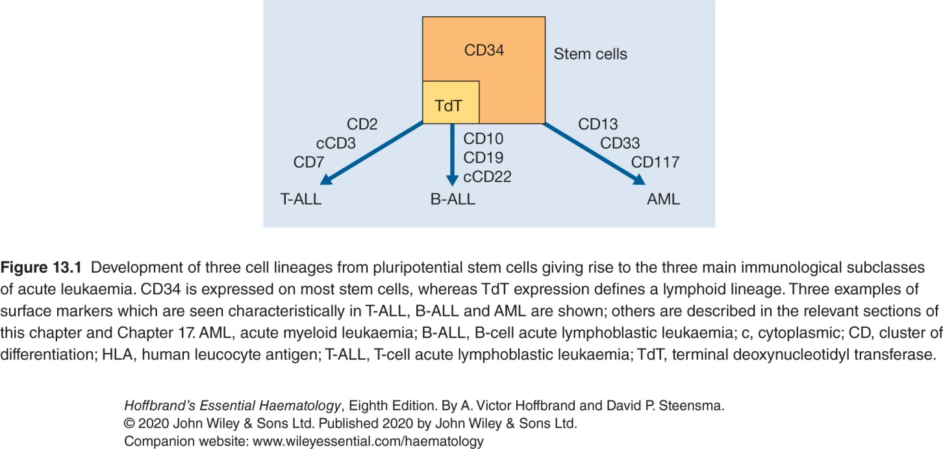

Slide 12
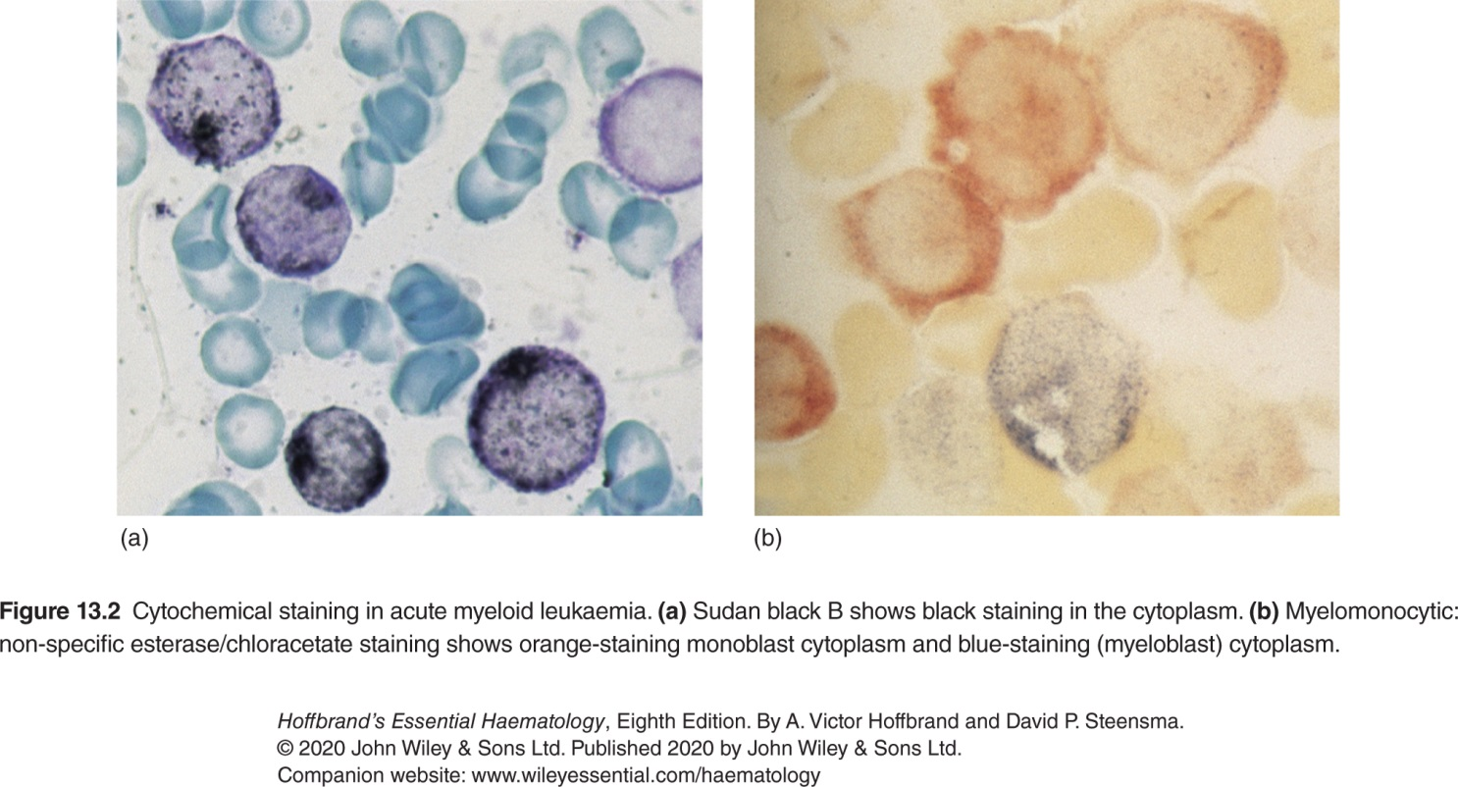

Slide 13
Classification of AML
AML with recurrent genetic abnormalities encompasses subtypes with specific chromosomal translocations or gene mutations
Detection of these abnormalities defines the tumour as AML
These disorders have a good prognosis
2. AML with myelodysplastic related changes
Associated with microscopic features of dysplasia in atleast 50% of cells in atleast 2 lineages
Clinical outcome is impaired in relation to the first group

Slide 14
Classification of AML cont…
3. Therapy-related myeloid neoplasms (t-AML)
Arise in patients previously treated with drugs such as etoposide or alkylating agents
They commonly exhibit mutations in the TP53 or KMT2A(MLL) gene and the clinical response is usually poor.
4. AML, not otherwise specified
Defined by absence of cytogenetic abnormalities

Slide 15
Classification of AML cont…
Myeloid sarcoma
Rare but refers to a disease that resembles a solid tumour but composed of myeloid blast cells. This is often called ‘extramedullary leukaemia’, ‘granulocytic sarcoma’ or ‘chloroma’
Myeloid proliferations related to Down’s Syndrome
Children with Down’s have greatly increased risk of acute leukaemia
Two myeloid variants are recognised:
Transient abnormal myelopoiesis – self limiting leucocytosis
AML
7. In addition, acute leukaemias of ambiguous lineage (mixed phenotype acute leukaemias) are rare cases that express two markers for both myeloid and lymphoid differentiation

Slide 16
Clinical features
Dominated by pattern of bone marrow failure caused by accumulation of malignant cells
Infections are frequent
Anaemia and thrombocytopenia may be profound
Thrombocytopenia and DIC are characteristic of promyelocytic variant of AML (APL)
Tumour cells can infiltrate a variety of tissues
Gum hypertrophy and infiltration, skin involvement (leukaemia cutis) and central nervous system (CNS) disease are characteristic of the myelomonocytic and monocytic subtypes.

Slide 17
Investigations
Normochromic normocytic anaemia with thrombocytopenia
Total WBC usually increased
Blasts on peripheral smear
Bone marrow is hypercellular and contains many leukaemic blasts
Blasts characterised by morphology, cytochemistry, immunological and cytogenetic analysis
Critical for determination of prognosis and developing a treatment plan
Tests for DIC positive in APL
Biochemical tests as baseline prior to treatment may show increased uric acid or LDH
Differential diagnosis includes Acute lymphoid leukaemia (ALL) or marrow infiltration by other malignancies (e.g carcinoma)

Slide 19
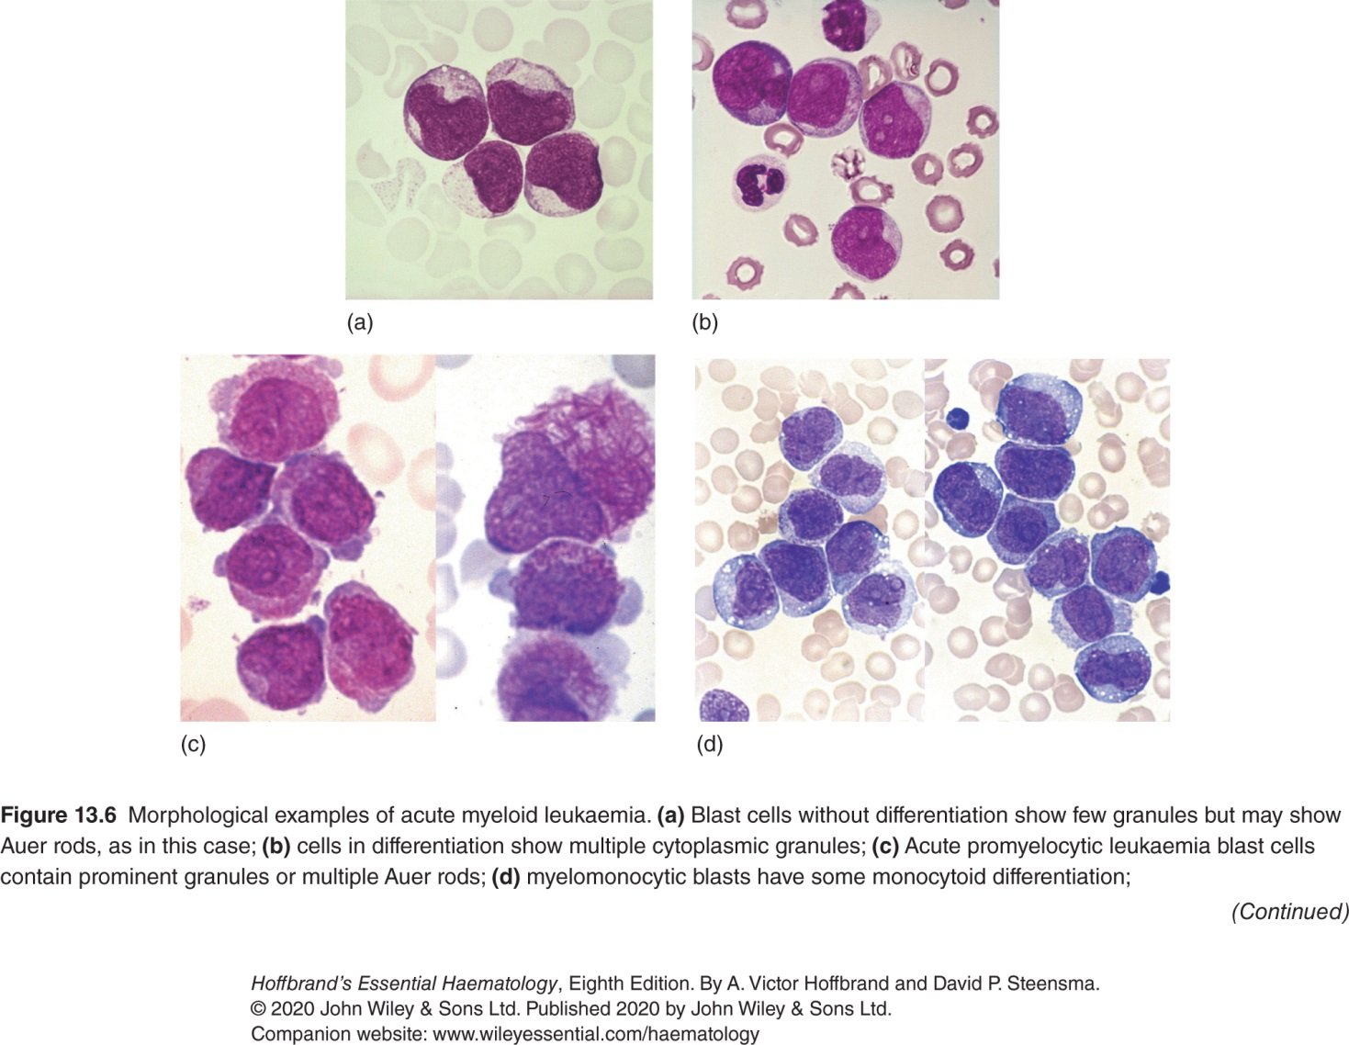

Slide 20
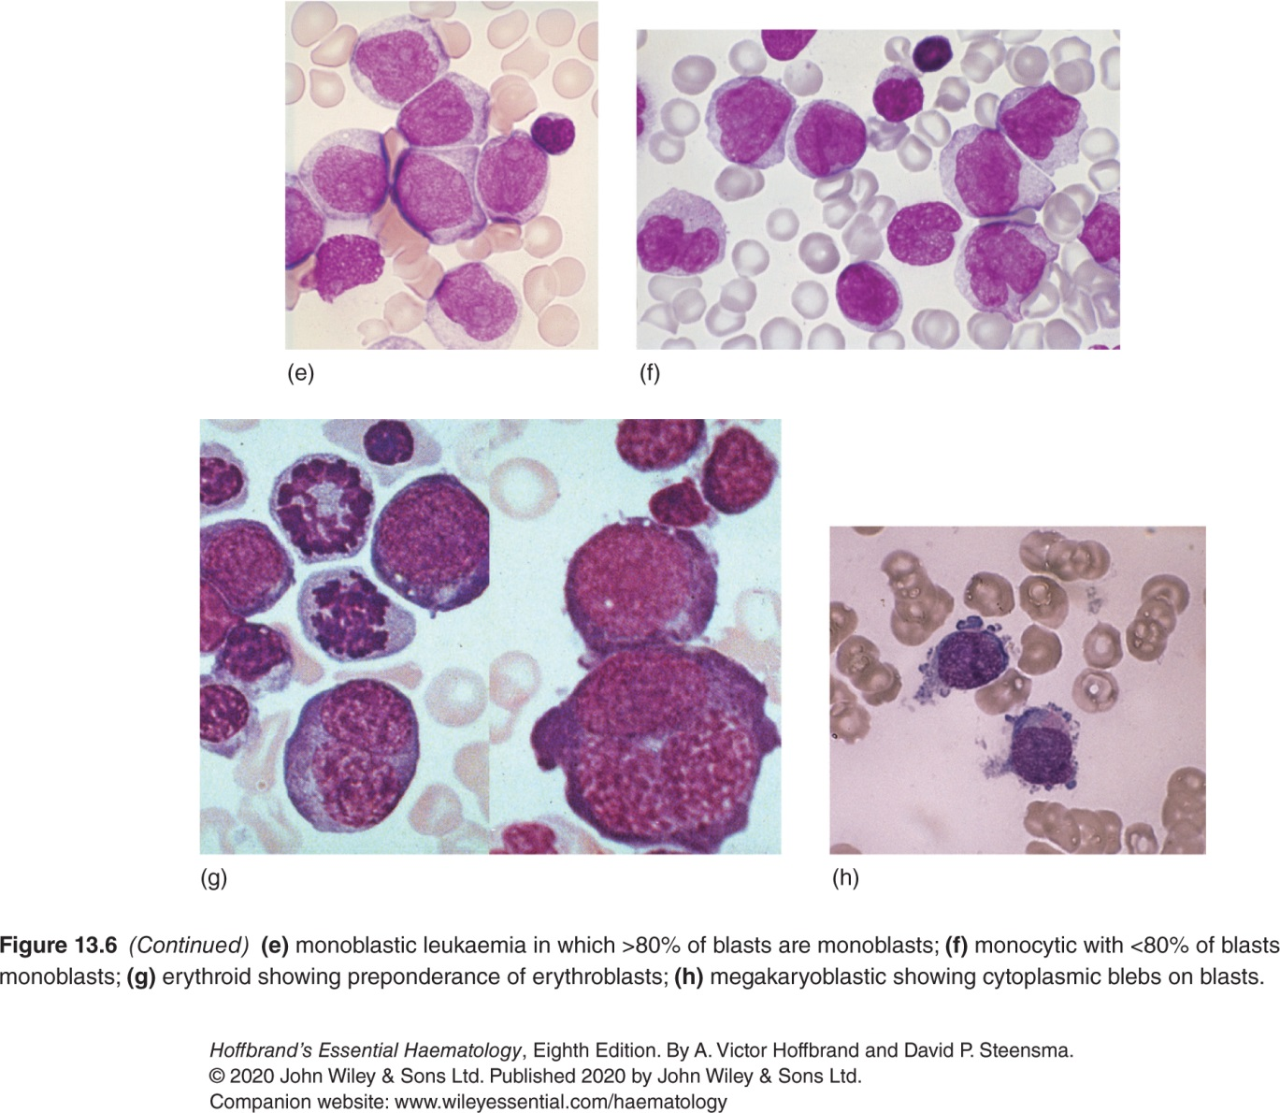

Slide 21
Treatment
General supportive therapy
Aim of treatment
Central venous cannula insertion
Blood product support
Prevention of tumour lysis syndrome
Maintenance of platelet count >10x10⁹/L and Hb >8g/dL
Fever treated promptly
Induce complete remission (<5% blasts in bone marrow, normal blood counts and clinical status)
Consolidate with intensive therapy, hopefully eliminating the disease
Allogeneic stem cell transplantation is considered in poor prognosis cases or patients who relapse

Slide 22
Specific therapy for AML
Determined by age, performance status and cytogenetic lesion (present or not)
Younger patients, treatment primarily with use of intensive chemotherapy, usually given in four blocks each of approximately 1 week
Commonly used drugs are cytosine arabinoside and daunorubicin

Slide 24
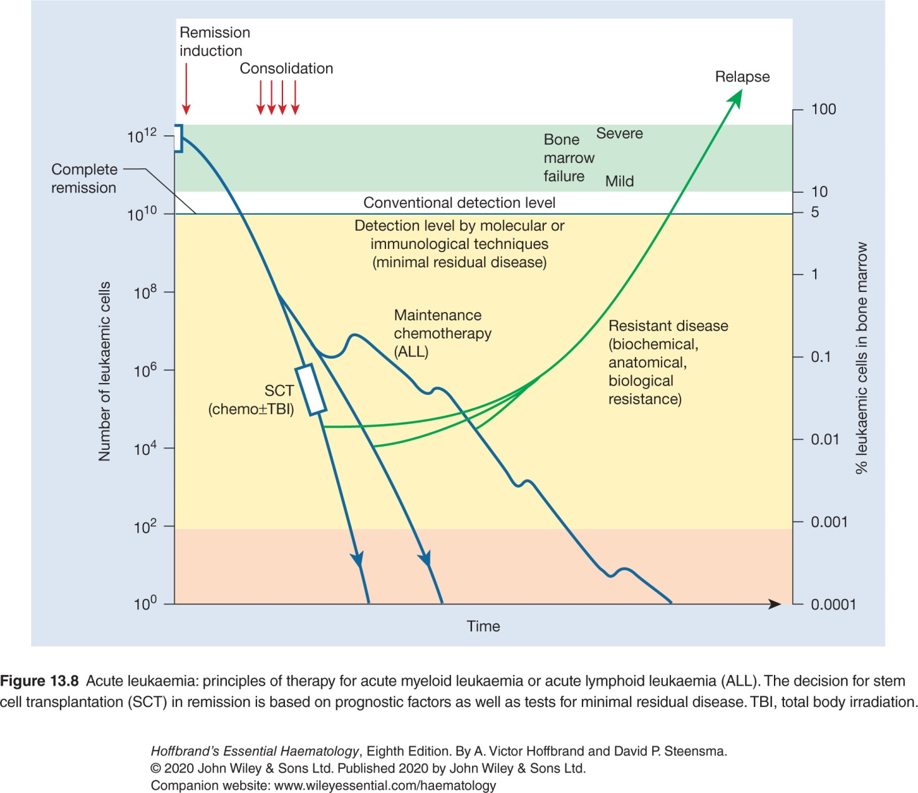

Slide 25
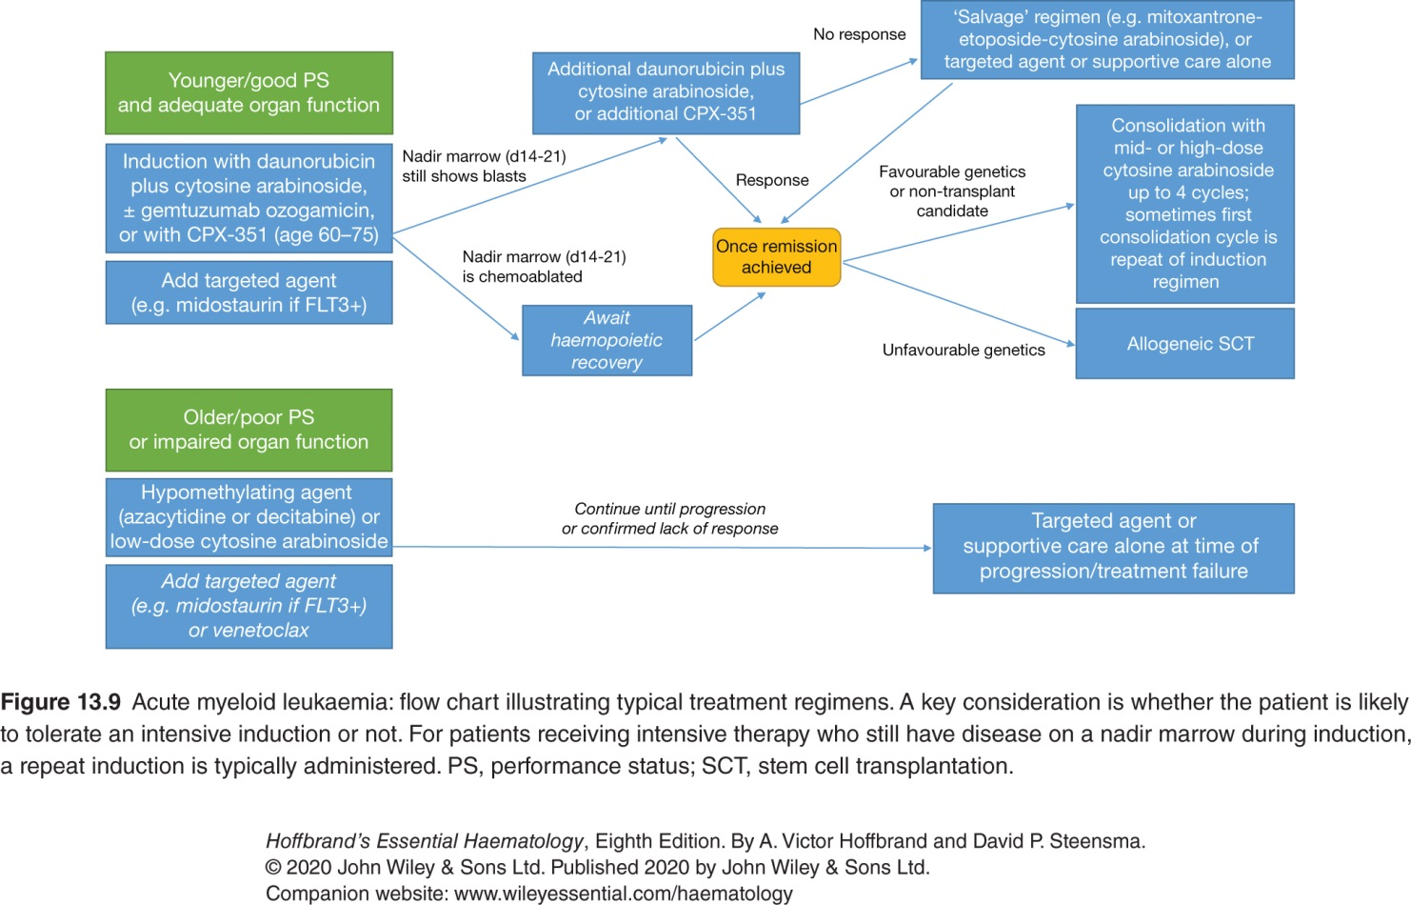

Slide 26
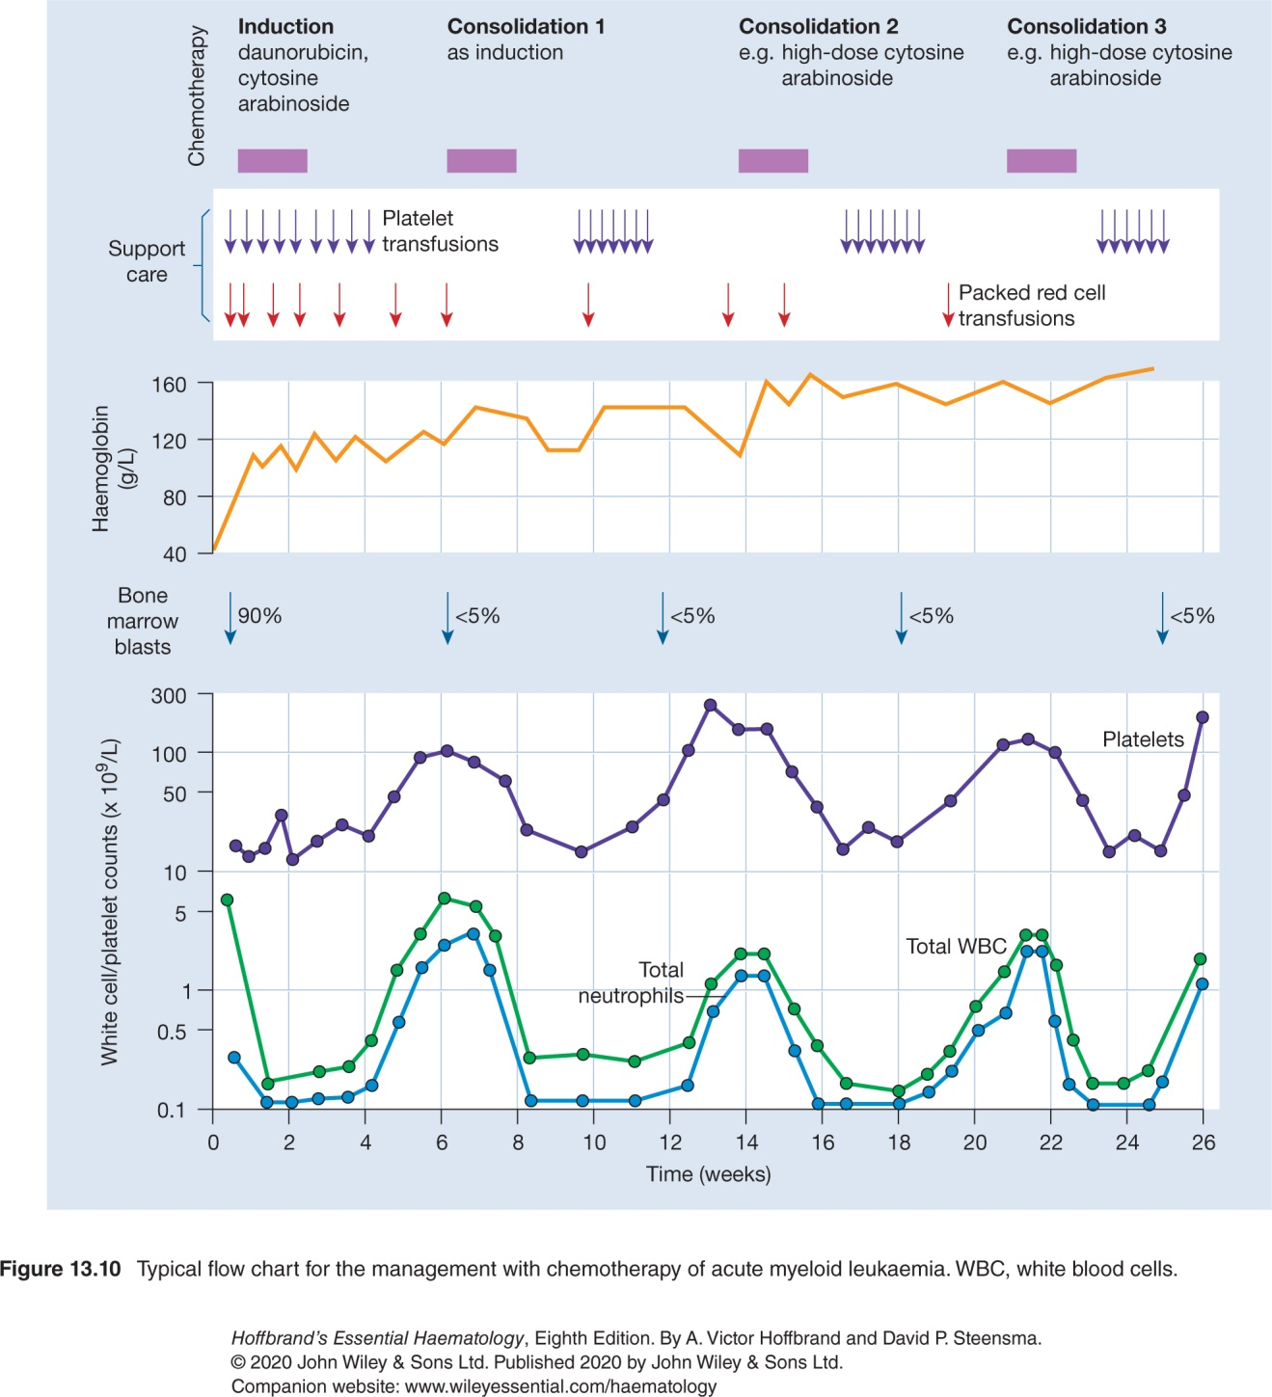

Slide 27
Prognosis and treatment stratification
The outcome for an individual patient with AML will depend on a number of factors, including age and white cell count at presentation.
However, the genetic abnormalities in the tumour are the most important determinant.
The initial goal is to achieve a complete remission.
Complete remission is defined as less than 5% marrow blasts without Auer rods, neutrophil count greater than 1.0 × 10⁹/L, platelets greater than 100 × 10⁹/L, independence of red cell transfusions and no extramedullary disease.

Slide 29
Monitoring of minimal residual disease
Monitoring of minimal (measurable) residual disease (MRD) during and after chemotherapy, for example detection of a positive FLT3 mutation test in otherwise complete remission, is being investigated as a means to guide appropriate treatment.
It may be performed by molecular tests or flow cytometry of the abnormal ‘leukaemia-associated immunophenotype’ seen in over 90% of cases.
If the only mutation detected after induction on a molecular genetic MRD assay is DNMT3A, TET2 or ASXL1 at low variant allele frequency, akin to clonal haemopoiesis of indeterminate potential (CHIP), the relapse risk is lower than for detection of other mutations.

Slide 30
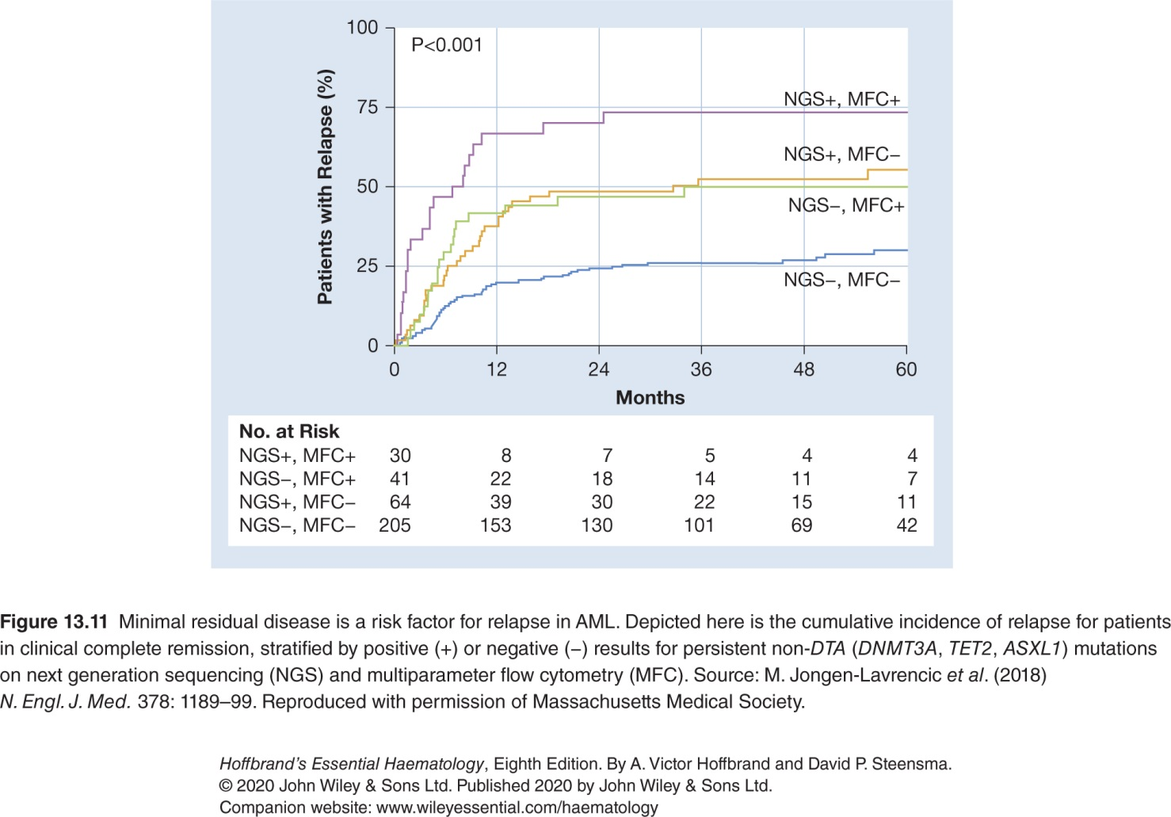

Slide 31
Stem cell transplantation
Allogeneic SCT reduces the rate of AML relapse and is offered in selected intermediate- and high-risk cases in first remission.
It carries risk of morbidity and mortality, so is not used for patients in the favourable risk group unless they have disease relapse.
Reduced-intensity conditioning regimens have raised the age at which patients may be considered for SCT.
Autologous transplantation confers no benefit above that of post-remission chemotherapy.

Slide 32
Treatment of replapse
Most patients suffer relapse and the outlook will then depend on age, the duration of the first remission and the cytogenetic risk group.
In addition to further chemotherapy to try to obtain a second remission, allogeneic SCT with either standard or reduced-intensity conditioning is usually performed in those patients who can tolerate the procedure and who have a suitable donor.
Arsenic trioxide, if it has not been used initial treatment or it has been several years since its prior use, is useful in management of relapse in the promyelocytic variant.
For patients with mutations of IDH2, enasidenib is approved and leads to complete remission in up to 20% of cases, while for those with mutations of IDH1, ivosidenib is approved and has a similar remission rate.
Gladesgib, an inhibitor of the Hedgehog pathway, is approved, as are gemtuzumab, ozogamicin and ventoclax.

Slide 33
Patients over 70 years old
The median age for presentation of AML is approximately 65 years and treatment outcomes in the elderly are poor because of primary disease resistance and poor tolerability of intensive treatment protocols.
Death from haemorrhage, infection or failure of the heart, kidneys or other organs is more frequent than in younger patients.
In elderly patients with serious disease of other organs, the decision may be made to use supportive care with or without gentle single-drug chemotherapy, e.g. with low-dose cytarabine, azacytidine or hydroxycarbamide.
Ventoclax alone or in combination with one of these drugs appears beneficial in early trials.
In those who are otherwise well, combination chemotherapy similar to that used in younger patients may produce long-term remissions, and reduced-intensity SCT is increasingly being offered.

Slide 34
Outcome
The prognosis for patients with AML has been improving steadily, particularly for those <60 years of age, and approximately one-third of this group can expect to achieve long-term cure.
For the elderly the situation is poor, and less than 10% of those over 70 years of age achieve long-term remission.

Slide 35
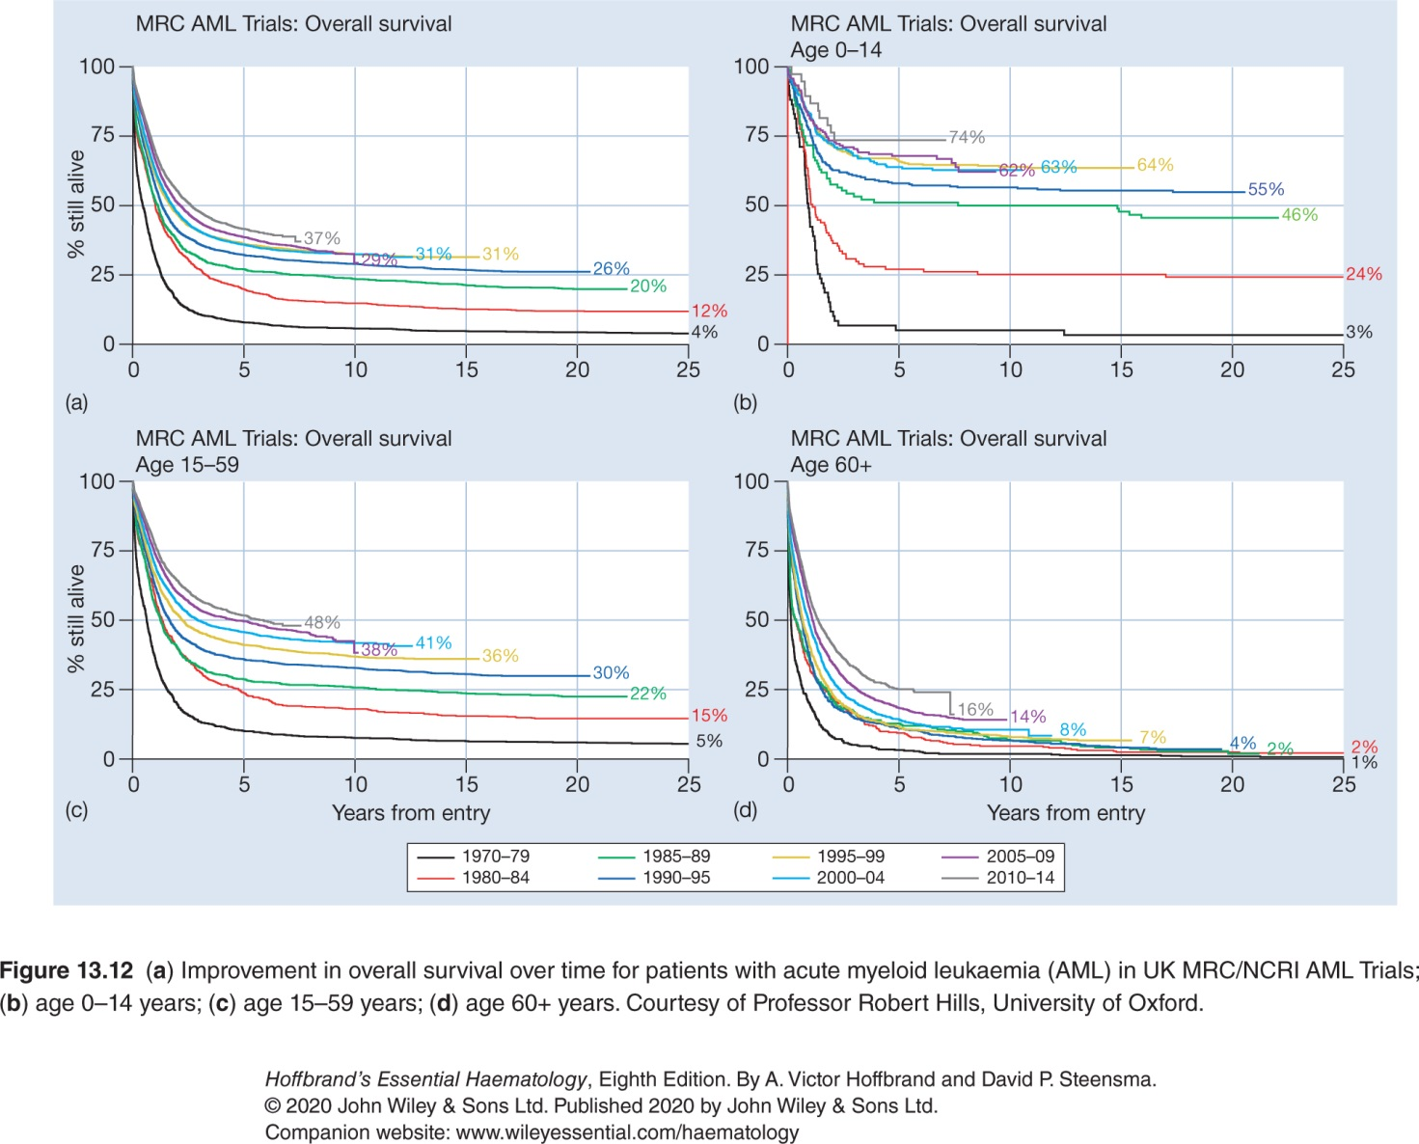

Slide 36
CHRONIC MYELOID LEUKAEMIA

Slide 37
Introduction
The chronic leukaemias are distinguished from acute leukaemias by their slower progression
With currently available treatments, most patients with chronic leukaemias will live many years.
Chronic leukaemias can be broadly subdivided into myeloid and lymphoid groups.
The World Health Organization (WHO) 2016 classification of the myeloproliferative neoplasms includes chronic myeloid leukaemia BCR-ABL1 positive (CML), discussed here, the non-leukaemic myeloproliferative neoplasms and rare chronic neutrophilic and eosinophilic leukaemias, and the myelodysplastic/myeloproliferative neoplasms

Slide 39
Pathogenesis
Chronic myeloid leukaemia, BCR-ABL1 rearrangement positive (CML) is a clonal disorder of a pluripotent stem cell.
The disease accounts for around 15% of leukaemias and may occur at any age.
The diagnosis of CML is rarely difficult and is assisted by the characteristic presence of the Philadelphia (Ph) chromosome.
This results from the t(9;22) (q34;q11) translocation between chromosomes 9 and 22, as a result of which part of the oncogene ABL1 is moved to the BCR gene on chromosome 22 and part of chromosome 22 moves to chromosome 9.
The abnormal chromosome 22 is the Ph chromosome; the variant chromosome 9 does not have a specific name.
In the Ph translocation 5′ exons of BCR are fused to the 3′ exons of ABL1.

Slide 40
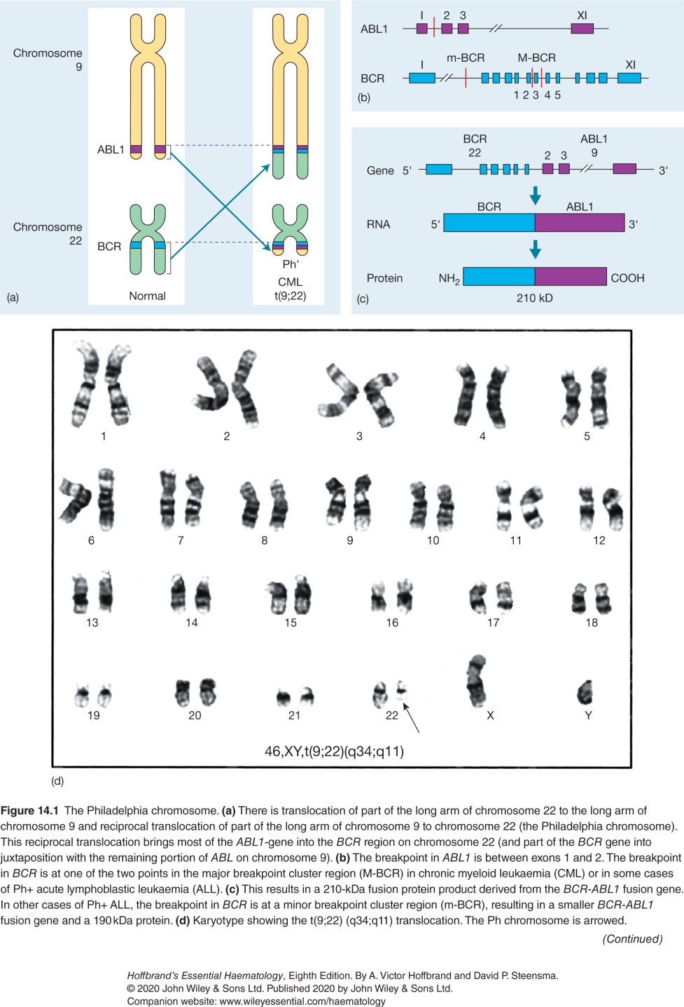

Slide 41
Clinical features
CML occurs in either sex (male : female ratio of 1.4 : 1), most frequently between the ages of 40 and 60 years. However, it may occur in children and neonates, as well as in the very old. In up to 50% of cases the diagnosis is made incidentally from a routine blood count. In those cases where the disease presents clinically, the following features may be seen:
Symptoms related to hypermetabolism (e.g. weight loss, lassitude, anorexia or night sweats).
Splenomegaly is nearly always present and may be massive. In some patients, splenic enlargement is associated with considerable abdominal discomfort, pain or indigestion.
Features of anaemia may include pallor, dyspnoea and tachycardia.
Bruising, epistaxis, menorrhagia or haemorrhage from other sites because of abnormal platelet function.
Gout or renal impairment caused by hyperuricaemia from excessive purine breakdown may be a problem.
Rare symptoms include visual disturbances and priapism.

Slide 42
Laboratory findings
Leucocytosis usually >50x10⁹/L and sometimes >500x10⁹/L
Increased circulating basophils
Normochromic normocytic anaemia is usual
Platelet count may be increased (most frequently), normal or decreased
Bone marrow is hypercellular with granulopoietic predominance
Presence of BCR-ABL1 gene fusion by RT-PCR analysis and in 98% of cases, Philadelphia (Ph) chromosome on cytogenetic analysis
In addition to BCR-ABL1, some patients have mutations in neoplasia-associated genes, e.g. ASXL1, IKZF1 and RUNX1, or other fusions or rearrangements at diagnosis. These patients are more likely to transform to acute leukaemia than those with only BCR-ABL1.
Serum uric acid usually raised

Slide 43
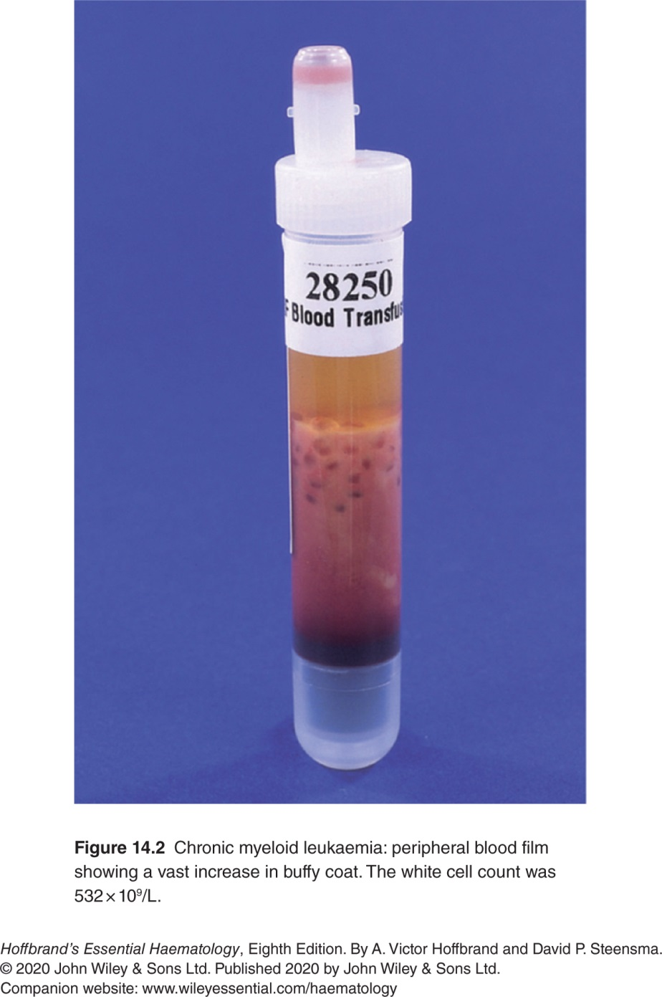

Slide 44
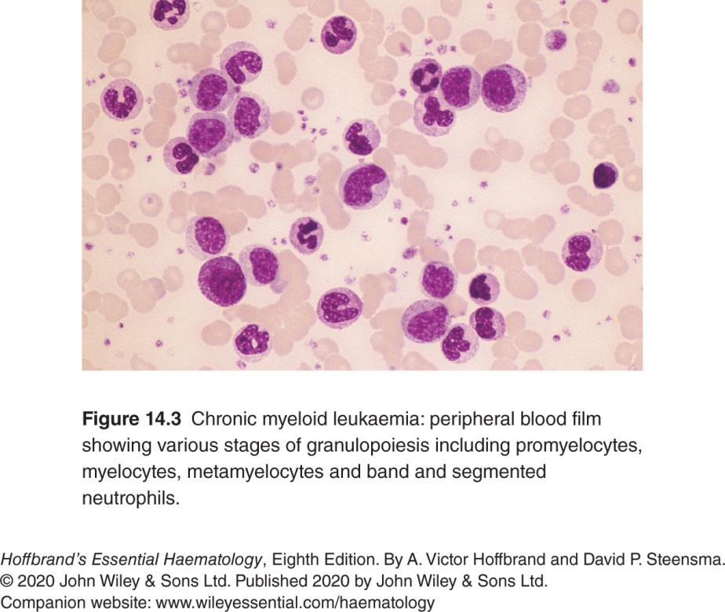

Slide 45
Prognostic scores (stages)
Attempts have been made to stage CML at presentation in order to predict prognosis.
In the past, the most frequently used were the Sokal, Hasford and EUTOS scores, which took into account factors such as age, blast cell percentage, spleen size and platelet count.
However, the rate of response to a tyrosine kinase inhibitor (TKI) is now a more useful measure of prognosis.

Slide 46
Treatment

Slide 47
Treatment of chronic phase
Tyrosine kinase inhibitors
TKIs are the mainstay of the treatment of CML and several different drugs are now available
First-line therapy for patients with chronic phase CML is usually imatinib, nilotinib or dasatinib.
Most experience exists with imatinib, which is also the cheapest.
Overall around 60% of patients given imatinib achieve an excellent response and remain on the drug long-term, whereas 40% proceed to a second-line agent due to intolerance or inadequate response.
Nilotinib and dasatinib are also used as second-line therapy after imatinib.
Bosutinib is also an effective therapy, while ponatinib is effective against CML that carries the T315I mutation within ABL1
Asciminib has a distinct pattern of binding to ABL kinase and may be useful either in combination with another TKI or in the event of resistance mediated by a mutation of the ABL kinase.

Slide 49
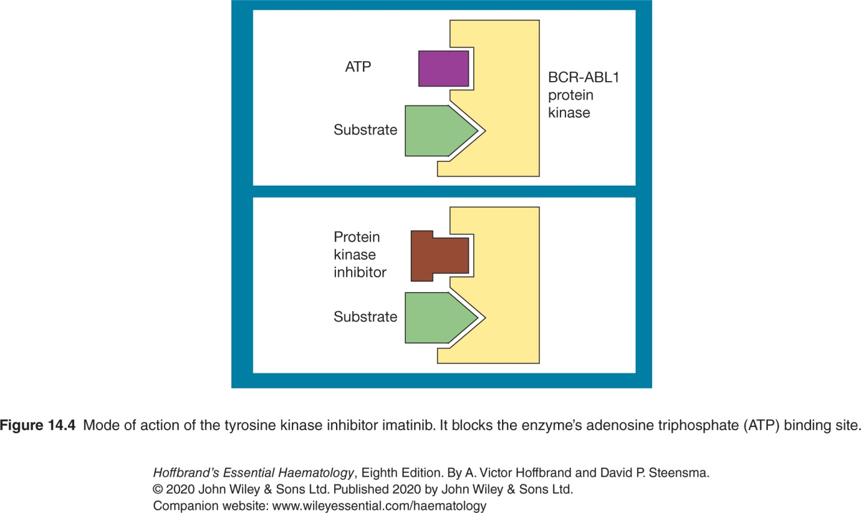

Slide 50
Monitoring of response to imatinib
Highly effective at reducing number of tumour cells in bone marrow
Monitor by karyotypic analysis of the bone marrow together with PCR analysis for BCR-ABL1
Assessment starts with regular bone marrow analysis (3-6 months)
A complete cytogenetic response (CCyR) is defined as absence of Ph +ve cells
Once CCyR is achieved, monitoring continues with PCR quantification of BCR-ABL1 transcripts at regular intervals

Slide 51
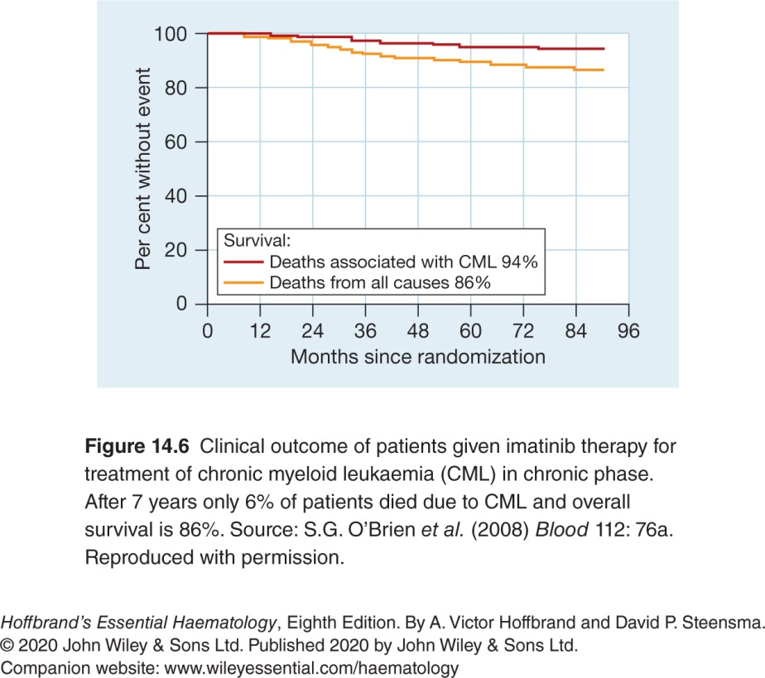

Slide 52
Response to TKI therapy and stopping therapy
TKI therapy is highly effective and after 5 years of treatment the progression-free survival is 85–90%, with overall survival over 90%.
For patients becoming BCR-ABL1 transcript negative, about 60% will remain negative on stopping TKI therapy or remain in remission with a stable low level of the transcripts, and these patients are likely to be cured.
For those who do become BCR-ABL1 positive again after stopping with a rising level of transcripts, treatment with the TKI will usually result in restoration of disease control.

Slide 53
Stem cell transplantation
Allogeneic SCT is a potentially curative treatment for CML, but because of the risks associated with the procedure, it is usually reserved for TKI failures or patients presenting in accelerated or acute phases.
The results are, however, better when it is performed in chronic rather than these later phases.
The 5-year survival is approximately 50–70%.
Relapse of CML after the transplant is a significant problem

Slide 54
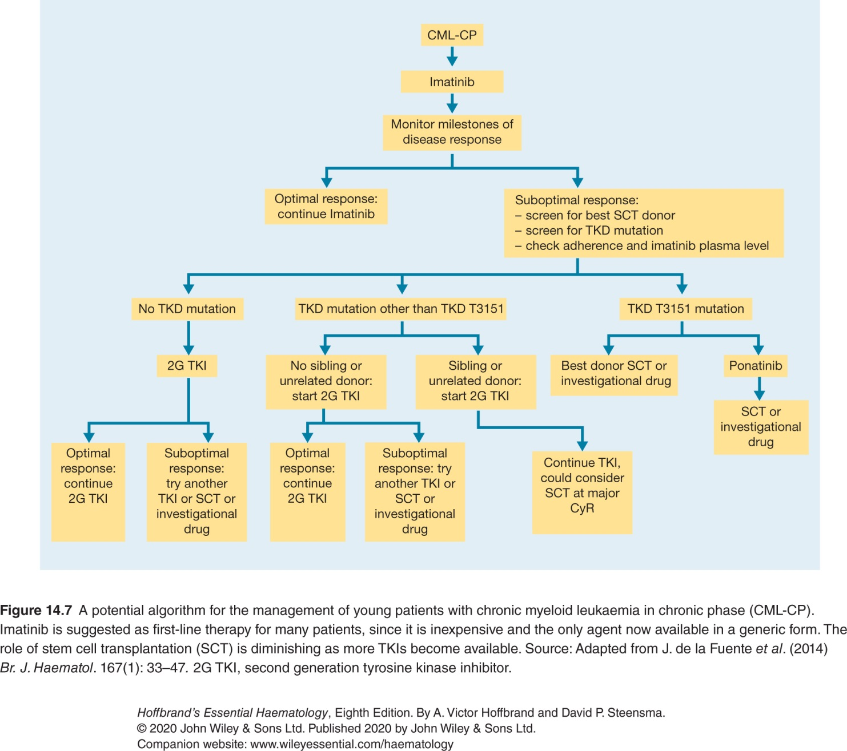

Slide 55
Accelerated phase disease and blast transformation - 2
Acute transformation (greater than 20% blasts in blood or marrow, either lymphoblasts or myeloblasts) may occur rapidly over days or weeks.
More commonly there is an accelerated phase with anaemia, thrombocytopenia (platelets less than 100 × 10⁹/L), increase in blood basophils to greater than 20% or marrow blast cells 10–19% with blast cells in the blood.
The spleen may be enlarged despite control of the blood count and the marrow may be fibrotic.
New clonal chromosomal or molecular abnormalities may appear.
The patient may be in this phase for several months, during which the disease is less easy to control than in the chronic phase.

Slide 56
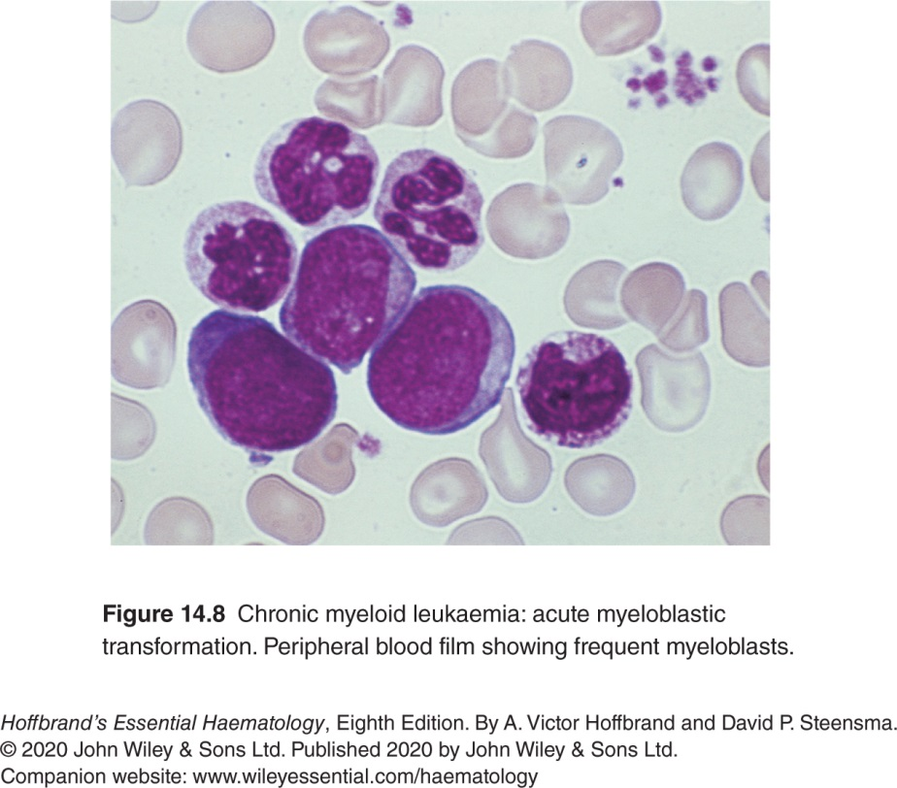

Slide 57
Accelerated phase disease and blast transformation - 2
In approximately one-fifth of cases of acute transformation this is lymphoblastic and patients may be treated in a similar way to ALL, with a number of patients returning to the chronic phase for months or even a year or two.
In the majority, transformation is into acute myeloid leukaemia or mixed types.
These are more difficult to treat and survival is rare beyond 1 year without SCT.
TKIs are valuable in the management of blastic transformation, but resistance to treatment usually occurs within a few weeks.
Allogeneic SCT is a valuable option where possible.

Slide 58
End of presentation

