Slide 1

Haematology
Hemolytic Anaemia 2
Marah Mubita
University of Zambia,
School of Medicine,
Pathology and Microbiology Dept.

Slide 2
Acquired haemolytic anaemias

Slide 3
1. Immune haemolytic anaemias
RBCs are destroyed by immune process either mediated by Abs or complement
Anaemia severity depends on level of hemolysis and BM compensation
Usually classified as
  Autoimmune haemolytic anaemias
  Alloimmune haemolytic anaemias
  Drug induced haemolytic anaemia
Usually presents with low Hb, Reticulocytosis, unconjugated bilirubin and increased serum antibodies

Slide 4
A. Autoimmune hemolytic anaemia
Autoimmune haemolytic anaemias (AIHAs) are caused by Abs against self red cells.
They are characterized by a positive DAT also known as the direct coomb's test
It affects 3 / 100,000 people each year
Twice as common in women than in men
Most of the time its idiopathic
They are divided into ‘warm’ (37°C) and ‘cold’ (4°C) types
We may also have the mixed AIHA

Slide 5
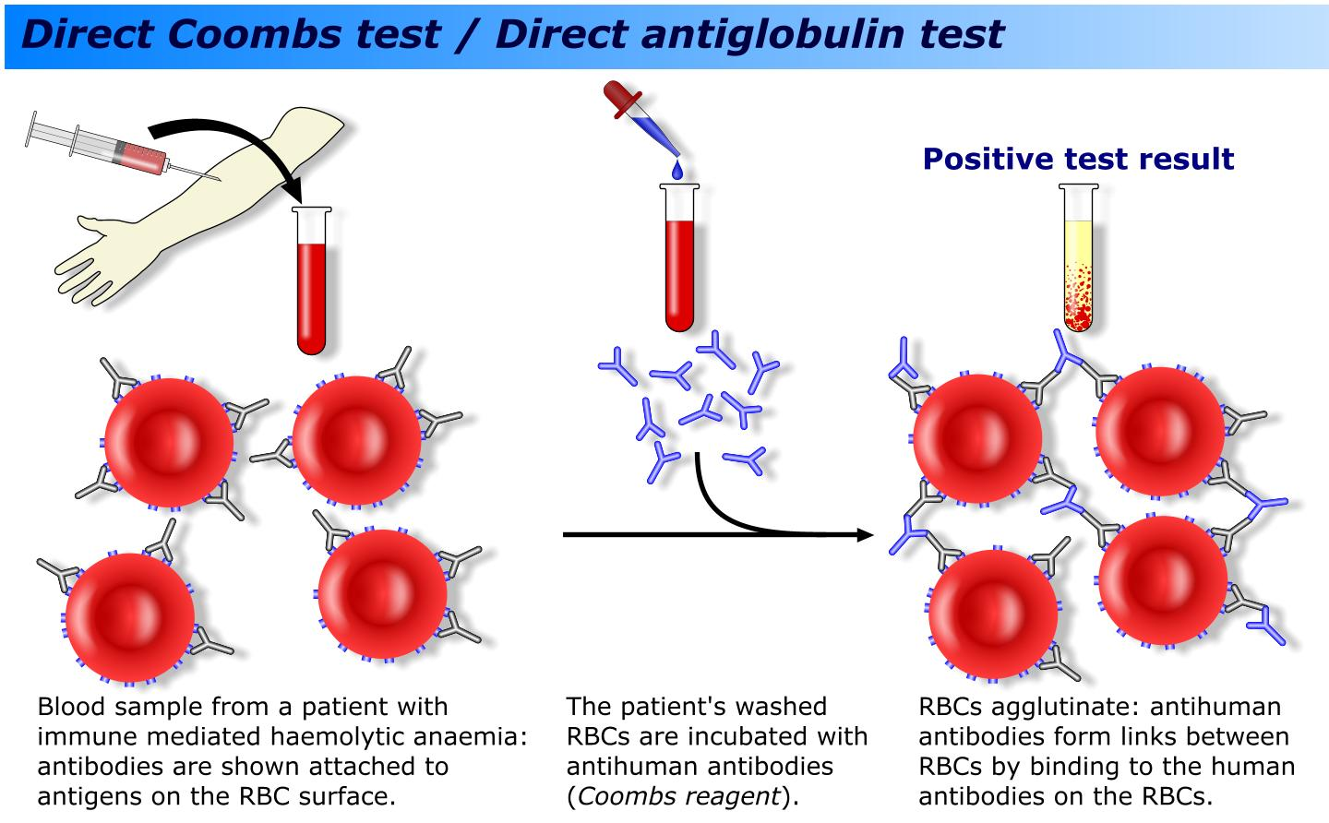

Slide 6
Warm Autoimmune hemolytic anaemias
70% of all AIHA are warm type
80% of warm AIHA prefer oldest RBCs
20% have no preference for age of RBCs
Associated with IgG, IgA, IgM autoantibodies usually working at 37 °C
  DAT – IgG + C 67%, IgG only 20%, C only 13%
The red cells are coated with IgG alone or with complement
The coated cells are therefore taken up by RE macrophages and destroyed predominantly in the spleen

Slide 7
Severe anaemia of acute onset (intravascular)
Spleen often enlarged
Disease usually remits and relapses
Usually idiopathic
When associated with idiopathic thrombocytopenic purpura, its called Evans syndrome
Also seen in systemic lupus erythematosus
Shows marked spherocytosis

Slide 8
Clinical features
Onset varies from acute to chronic
Classic symptoms of anaemia
  Pallor, fatigue, dyspnea, dizziness, palpitations, lethargy, confusion, syncope
Dark coloured urine
Jaundice
Splenomegaly
Thrombosis - DVT, PE

Slide 9
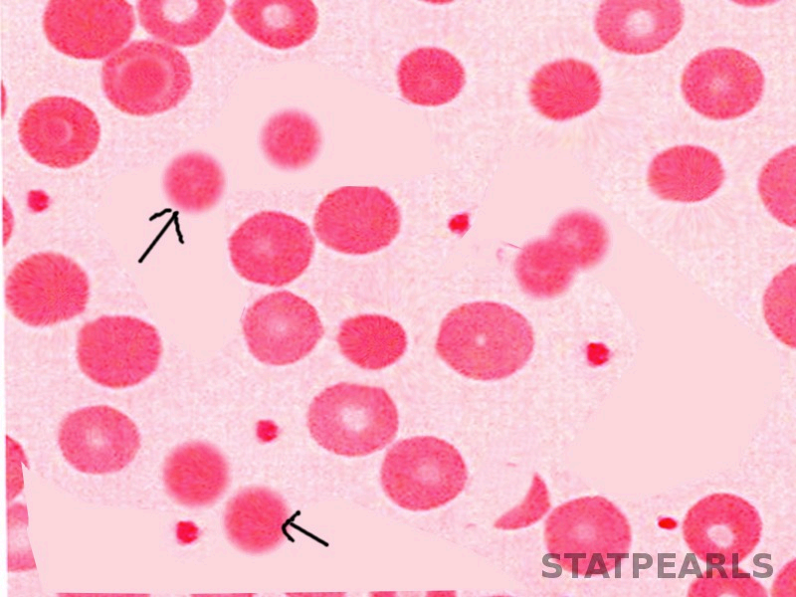

Slide 10
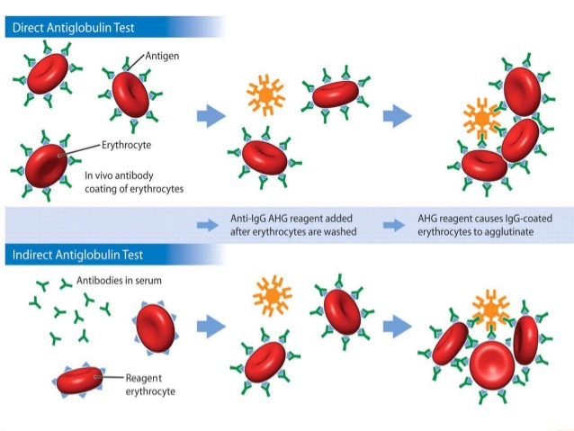

Slide 11
Cold Autoimmune hemolytic anaemias
Aka cold agglutinin disease
Has no sex or age predilection
The Abs attaches RBCs mainly in the peripheral circulation where the blood temperature is cooler
Ab is usually IgM and binds to red cells best at 3-4°C but can react up to 30°C
Both intra and extravascular haemolysis can occur
In nearly all these cold AIHA syndromes the antibody is directed against the ‘i’ antigen on the red cell surface

Slide 12
May be idiopathic
Can be seen in mycoplasma pneumoniae or infectious mononucleosis
Lymphoproliferative disorders like leukemia or lymphoma may also produce cold agglutinins
Usually DAT positive because of the use of polyspecific antibodies
DAT negative AIHA are very fatal
  Usually IgA/IgM but may respond to steroids
Anaemia usually lower than actual count with false MCV due to agglutination

Slide 13
Clinical features
Haemolytic anaemia usually chronic and aggravated by the cold
Associated with both intravascular and haemolysis.
Mild jaundice and splenomegaly may be present.
Patient may develop acrocyanosis (purplish skin discoloration) at the tip of the nose, ears, fingers and toes Aka known as Raynaud’s phenomenon
Less marked spherocytosis

Slide 14
Paroxysmal Cold Haemoglobinuria (PCH)
May be quite common in young children
Acute onset of severe hemolysis with haemoglobinemia and Haemoglobinuria
Erythrophagocytosis by neutrophils is common and is distinctive
Donath-Landsteiner test is diagnostic (Anti-P antibody)
Patients have a stormy course but good ultimate prognosis
RBCs may be seen Rosetting around neutrophils

Slide 15
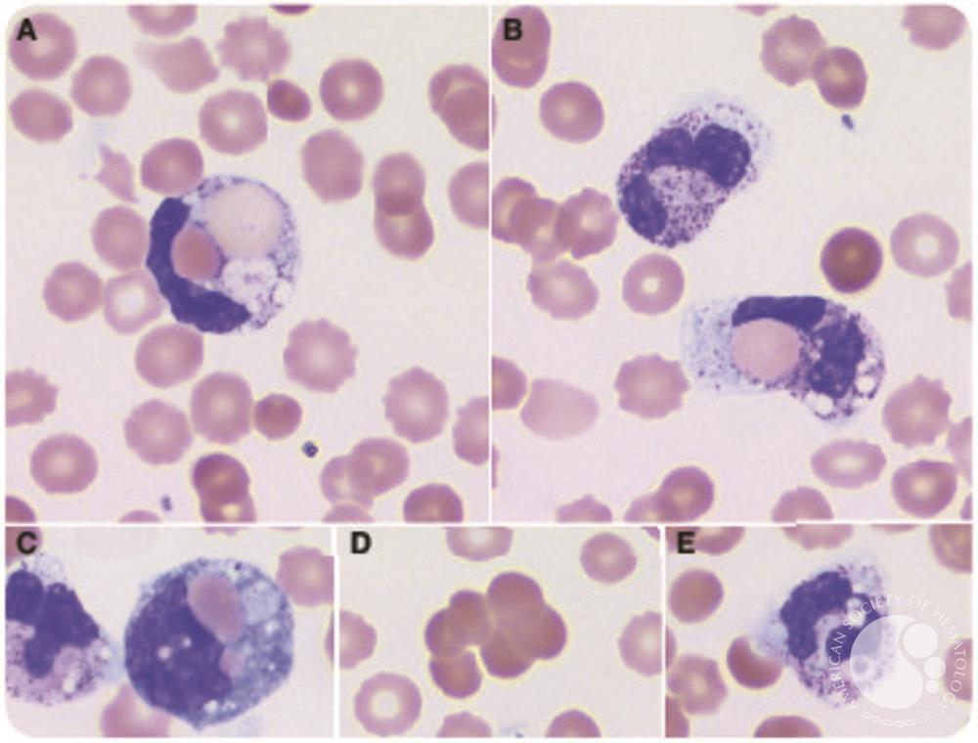

Slide 16
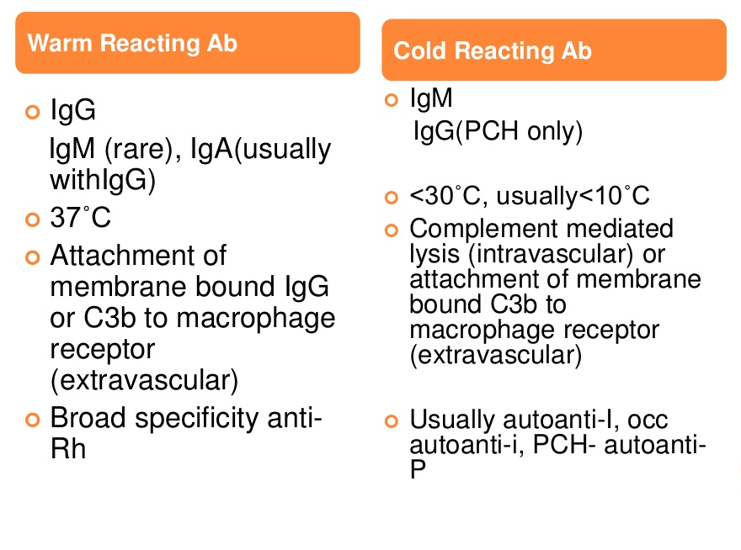
Characteristics of agglutinins

Slide 17
B. Alloimmune haemolytic anaemias
In these anaemias, antibody produced by one individual reacts with red cells of another.
Two important situations are
  Transfusion of ABO – incompatible blood and
  Rh disease of the newborn
Allogeneic transplantation for renal, hepatic, cardiac and bone marrow has led to the recognition of hemolytic anaemia from Abs produced by donor lymphocytes present in the allograft
Is a type 2 hypersensitivity reaction

Slide 18
C. Drug induced hemolytic Anaemia
Drugs can cause immune haemolytic anaemias via three mechanisms
1) Antibody directed against a drug – red cell membrane complex (e.g. penicillin, ampicillin). This only occurs with massive doses of the antibiotic.
2) Deposition of complement via a drug – protein - antibody complex onto the red cell surface (e.g. quinidine, rifampicin); or
3) A true autoimmune haemolytic anaemia in which the role of the drug is unclear (e.g. methyldopa).

Slide 19
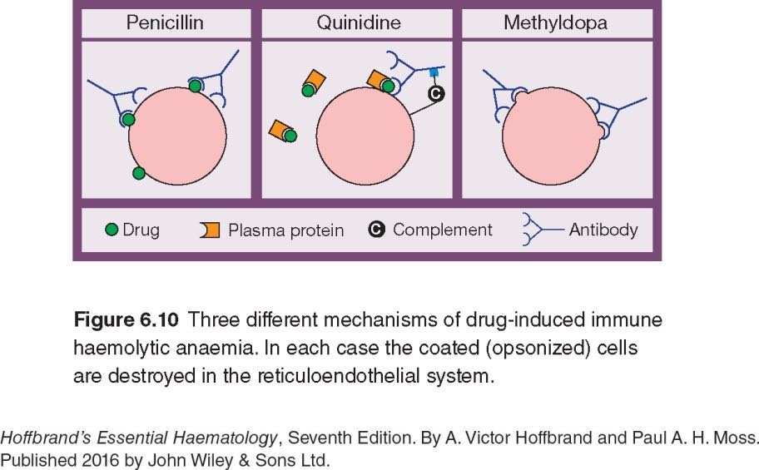

Slide 20
Hemolytic Anaemias Resulting from Mechanical Trauma to Red Cells
Aka Microangiopathic haemolytic anaemia (MAHA)
These occur when red cells are exposed to an abnormal surface (shear damage) such as seen in non-endothelialized artificial heart valve or arterial graft
or flow through small vessels containing fibrin strands ( in DIC,HUS,TTP)
Or flow through damaged small vessels
Haemolysis is both extra- and intravascular; the blood film shows deeply staining fragmented red cells
Notes:
thrombotic thrombocytopenic purpura
haemolytic uraemic syndrome,
widespread adenocarcinoma
malignant hypertension
preeclampsia
meningococcal septicaemia

Slide 21
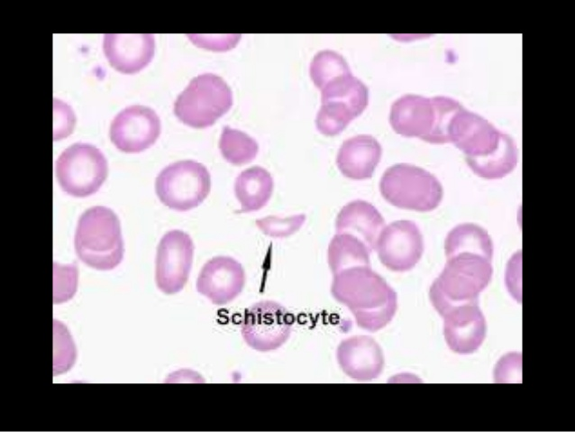

Slide 22
March Haemoglobinuria
This is caused by damage to red cells between the small bones of the feet
Usually occurs during prolonged marching or running.
Common Amongst soldiers, policemen and security guards
The blood film does not show fragments.

Slide 23
Infections
Infections can cause haemolysis in a variety of ways.
1. Precipitate an acute haemolytic crisis in G6PD deficiency Or
2. Cause microangiopathic haemolytic anaemia (e.g. with meningococcal or pneumococcal septicaemia).
Malaria causes haemolysis by extravascular destruction of parasitized red cells as well as by direct intravascular lysis (Black water fever)
Clostridium perfringens septicaemia can cause intravascular haemolysis with marked microspherocytosis

Slide 24
Chemicals and Physical agents
Certain drugs (e.g. dapsone and sulfasalazine) in high doses cause oxidative intravascular haemolysis (Heinz bodies)
In Wilson’s disease an acute haemolytic anaemia can occur
Chemical poisoning (e.g. with lead, chlorate or arsine) can cause severe haemolysis.
Severe burns damage red cells causing acanthocytosis or spherocytosis.

Slide 25
