Slide 1
Inflammation and Repair
Dr. Zuze

Slide 2
Definition
Inflammation:
A response of vascularized tissues that delivers Immune cells and molecules to sites of infection and cell damage in order to eliminate the offending agents.
Notes:
goal →eliminating the offending agent and repair
Purpose → mearnt to be a protective response

Slide 3
Causes:
Infections: bacteria, viruses, fungi, parasites.
Physical agents
Chemical agents
Foreign materials
Tissue necrosis: Ischemic necrosis.
Immunologic: hypersensitivity , autoimmune reactions.

Slide 4
Steps → 5Rs
RECOGNITION
RECRUITMENT OF LEUCOCYTES
REMOVAL
REGULATION
REPAIR

Slide 5
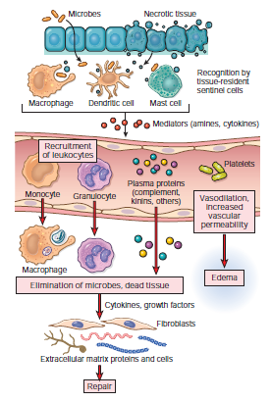

Slide 6
Recognition:
Microbes:
Plasma membrane receptors for extracellular microbes, eg. Toll-like receptors (TLRs), lectin
Receptors on endosomes for ingested microbes and
Cytosolic receptors for intracellular microbes
Cell damage: Cytosolic receptors :NOD-like receptors (NLRs)
Activates inflammasome→ cytokine interleukin-1 and thus induces inflammation

Slide 7
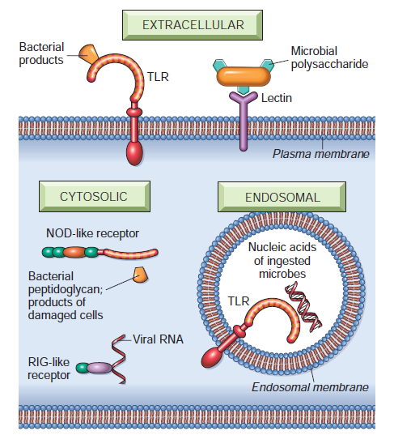
Cellular Receptors :
Notes:
C-type lectin receptors (CLRs) recognize polysaccharides and components on microbes
RIG-like receptors (RLRs) for viral nucleic acids. RIG, retinoic acid-inducible gene.

Slide 8
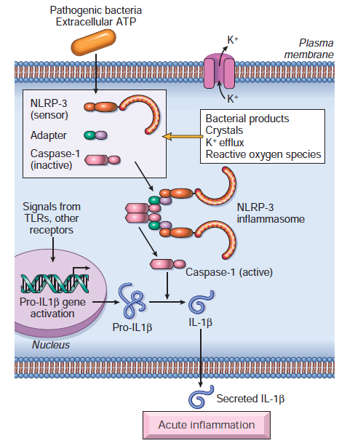
Inflammasome
Notes:
The inflammasome is a protein complex responsible for activation of inflammatory response
induces the secretion of biologically active interleukin 1.
The inflammasome consists of a sensor protein (an example is the leucine-rich protein NLRP3), an
adapter, and the enzyme caspase-1, which is converted from an inactive to an active form.
IL 1 leads to propagation of inflammation

Slide 9
Signs: hallmarks of acute inflammation.
1. RUBOR: Redness
2. TUMOR: Swelling
3. Color: Heat
4. DOLOR: Pain
5. FUNCTIO LAESA: Loss of function

Slide 10
Fundamental properties of the inflammatory response
Components of the Inflammatory Response
Major components include blood vessels and leukocytes.
Blood vessels dilate (stasis) and increase in permeability.
Allows selected circulating proteins and cells to enter sites of infection or tissue damage

Slide 11
Harmful Consequences of Inflammation
Same mechanism involved in elimination of offending agents and can cause harmful effects
Especially chronic inflammation
Exaggerated inflammatory reaction→ Hypersensitivity
Misdirected inflammatory reaction →Autoimmune diseases

Slide 12
Local and systemic inflammation
Can be localized; confined to the site of infection or damage
local inflammation can have systemic effects like fever ,caused by mediators of inflammation
Can be systemic as in disseminated bacterial infections → leading to sepsis

Slide 13
Mediators of inflammation
Required for propagation of an inflammatory response

Slide 14
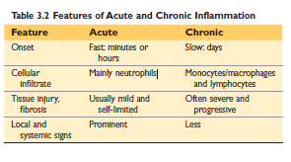
ACUTE AND CHRONIC INFLAMMATION
Notes:
Chronic inflammation - agents that are difficult to eradicate, (e.g.,tubercle bacilli) ,self antigens and environmental antigens.
chronic inflammation may coexist with unresolved acute inflammation, as may occur in peptic ulcers.

Slide 15
Acute Inflammation
Usually the initial response to infection and tissue damage
Develops within minutes/hours/few days
Often a self-limited response to offending agents that are easy to eliminate
Predominant cells involved are Neutrophils

Slide 16
If elimination of offending agents fails, inflammation takes on a chronic course.
Chronic phase is longer with more tissue damage.
Calls for recruitment of lymphocytes and macrophages, angiogenesis and CT deposition

Slide 17
Acute inflammation
Pathogenesis: 3 major components:
1.Vasodilation:
a. Increased blood flow, which is the cause of heat and redness (erythema)
b. Leads to stasis of blood→ accumulation of leucocyte along endothelium
2. Increased vascular permeability:
a. Contraction and retraction of endothelial cells and
b. Endothelial injury
Exudation
3. Emigration of leukocytes to the focus of injury,
Notes:
Exudate ;high protein concentration, contains cellular debris, due to increased vascular permeability
Transudate; low protein content (most of which is albumin), little or no cellular material, and low specific gravity. It is essentially an ultrafiltrate of blood plasma that
is produced as a result of osmotic or hydrostatic imbalance

Slide 18
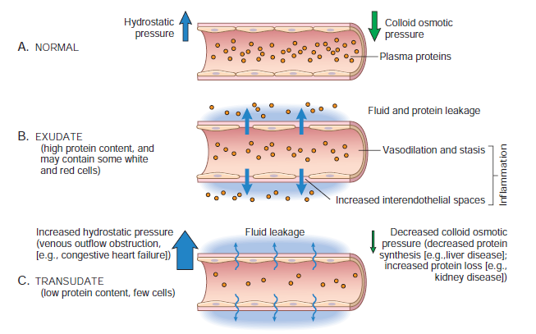

Slide 19
Leukocyte migration
Margination: because of dilatation and stasis of blood flow white cells assume a peripheral position along the endothelial surface.
Rolling and adhesion to endothelium
Migration across the endothelium and vessel wall.
4. Migration towards site of infection or tissue
Notes:
Vascular endothelium in its normal state does not bind circulating cells or allow their passage. In inflammation the endothelium is activated and can bind leukocytes as a prelude to their exit from blood vessels.

Slide 20
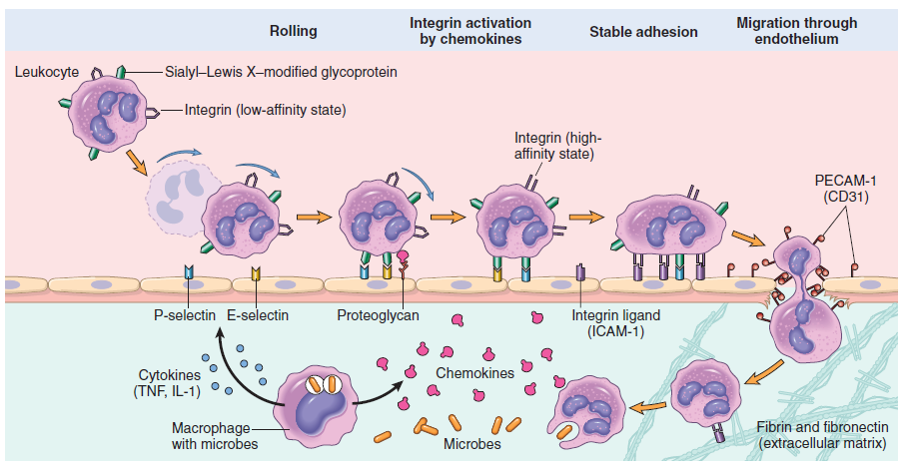
leukocyte migration
Notes:
Bind ,detach bind detach - ROLLING

Slide 21
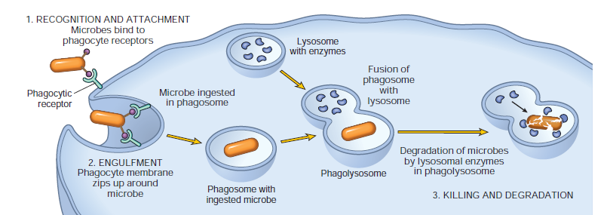
Phagocytosis and Elimination of microbes
Steps:

Slide 22
Phagocytosis and Elimination of microbes
Steps:
RECOGNITION AND ATTACHMENT
Microbes bind to phagocyte receptors.
ENGULFMENT:
Phagocyte membrane zips up around microbe to form a phagosome
Fusion of phagosome with lysosome to form Phagolysosome
KILLING AND DEGRADATION.
Degradation of microbes by lysosomal enzymes in phagolysosome

Slide 23
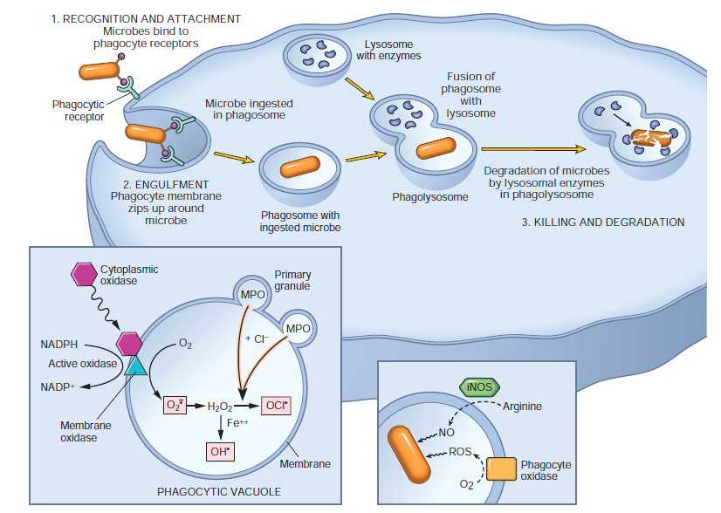
Phagocytosis and Elimination of microbes
Steps:

Slide 24
Role of complement system in inflammation
The complement system is a group of plasma proteins that function in both innate and adaptive
The system consists of more than 20 proteins, some of which are numbered C1 through C9
Complement proteins are present in inactive forms in the plasma
Activation starts by cleavage of C3 via three pathways

Slide 25
Three (3) pathways of activation:
The Classical pathway→ binding of C1 to antibody (IgM or IgG) that has combined with antigen.
The alternative pathway which can be triggered by microbial surface molecules (e.g., endotoxin, or lipopolysaccharide [LPS])
The lectin pathway, in which plasma mannose-binding lectin binds to carbohydrates on microbes and directly activates C1.
C3 CONVERTASE
Notes:
All three pathways of complement activation lead to the formation of an active enzyme called C3 convertase, which splits C3 into two functionally distinct fragments,
C3a and C3b.

Slide 26
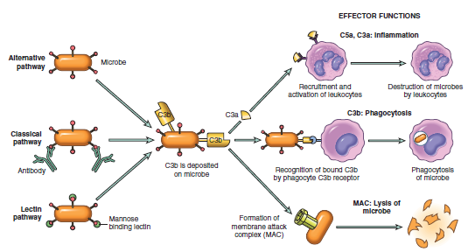
Notes:
Membrane attack complex (C5-9) lyse bacterial membranes
C3b and C3bi are opsonins
C3a and C5a: propagation of inflammation, increase vascular permeability

Slide 27
Mediators of Inflammation
These are substances that initiate, propagate and regulate an inflammatory response.
Include:
- Vasoactive amines; histamine and serotonin
- Lipid mediators; Prostaglandins, lipoxins and leukotrienes ; also called eicosanoids or arachidonic acid metabolites.
Cytokines, chemokines
Products of the complement system

Slide 28
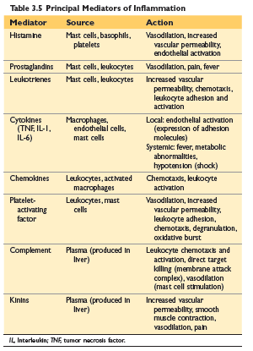
Mediators of Inflammation

Slide 29
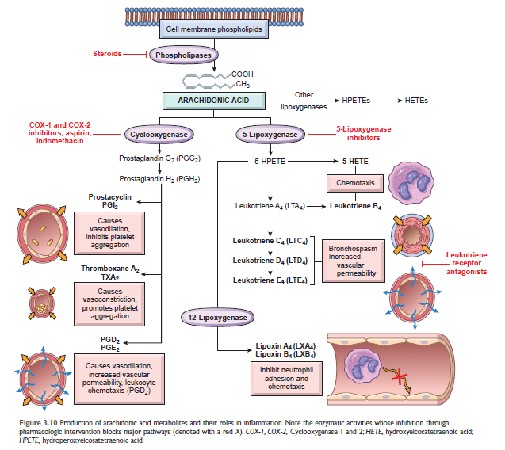
Arachidonic Acid Metabolites
Notes:
EICOSANOIDS
Principal eicosanoids are prostaglandins, thromboxanes, leukotrienes

Slide 30
Termination of the Acute Inflammatory Response
Inflammation declines after the offending agents are removed
simply because the mediators of inflammation are produced for only as long as the stimulus persists
Switch to production of anti-inflammatory cytokine transforming growth factor-β (TGF-β) and IL-10
anti inflammatory arachidonic acid metabolite : lipoxins (LXA4 and LXB4)
Notes:
12-LIPOXIGENASE PATHWAY –ANTIINFLAMMATORY LIPOXINS

Slide 31
Outcomes of Acute Inflammation
Complete resolution
Healing by connective tissue replacement (scarring, or fibrosis).
Progression of the response to chronic inflammation

Slide 32
Morphologic Patterns of Acute Inflammation
Serous Inflammation:
Accumulation of Serous fluid or exudation of cell poor fluid into spaces created by cell injury or into body cavities lined by the peritoneum, pleura, or pericardium. E.g skin blistering, effusions in body cavities.
Fibrinous Inflammation
A fibrinous exudate develops when the vascular leaks are large or there is a local procoagulant stimulus

Slide 33
Purulent (Suppurative) Inflammation and Abscess
characterized by the production of pus and edema fluid.
The most frequent cause of purulent (also called suppurative) inflammation is infection with bacteria as staphylococci; these pathogens are referred to as pyogenic (pus-producing) bacteria.
A common example of an acute suppurative inflammation is acute appendicitis.

Slide 34
CHRONIC INFLAMMATION
An inflammatory response of prolonged duration (weeks to months) in which tissue injury and repair coexist
Causes of Chronic Inflammation
1.Persistent infection: by microorganisms that are difficult to eradicate, such as mycobacteria
2. Autoimmune diseases E.g. SLE, rheumatoid arthritis
3.Prolonged exposure to potentially toxic agents E.g. Silicosis, cholesterol in blood vessels which causes atherosclerosis
4. progression from acute inflammation

Slide 35
Chronic inflammation is characterized by:
Infiltration with mononuclear cells, which include macrophages, lymphocytes, and plasma cells
Tissue destruction
Repair by fibrosis and angiogenesis

Slide 36
Cells of chronic inflammation
Macrophage
Derived from circulating monocytes
Progenitor cells from embryonic yolk sac of fetal liver
Tissue resident macrophages : Kupffer cells (liver),sinus histiocytes (spleen & LN), alveolar macrophages (lung), microglia (CNS)

Slide 37
Functions;
Phagocytosis
Secreting cytokines and growth factors,: that propagates inflammation and initiate repair of tissues
Antigen presentation to T lymphocytes and respond to signals from T cells, thus setting up a feedback loop

Slide 38
Role of Lymphocytes
Produce cytokines that amplify and propagate chronic inflammation.
generation of long-lived memory cells-persistent inflammatory response

Slide 39
There are three subsets of CD4+ T cells that secrete different types of cytokines and elicit different types of inflammation.
Th1 cells produce the cytokine IFN-γ, which activates macrophages
Th2 cells secrete IL-4, IL-5, and IL-13, which recruit and activate eosinophils and are macrophage activation.
Th17 cells secrete IL-17 and other cytokines, which induce the secretion of chemokines responsible for recruiting neutrophils (and monocytes) into the reaction

Slide 40
OTHER CELLS
Plasma cells
Eosinophils: Parasitic infection
Mast cells

Slide 41
Granulomatous Inflammation
A form of chronic inflammation characterized by collections of activated macrophages , often with T lymphocytes, and sometimes associated with central necrosis.
Its goal is to wall off difficult to kill or persistent injurious agents leading to granuloma formation
Caseating granulomas → central area of necrosis

Slide 42
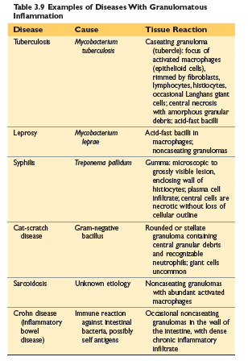

Slide 43
END

Slide 44
TISSUE REPAIR
Refers to the restoration of tissue architecture and function after an injury.
Occurs by two processes: Regeneration, which restores the normal state of tissues, and Scarring, the deposition of connective tissue (fibrous)
scar formation occurs in tissues incapable of regeneration, or in severely damaged tissues

Slide 45
Tissues of the body are divided into three based on their proliferative potential.
Labile or continuously dividing tissues-consist of cells that are continuously dividing e.g. skin epithelium, mucosal lining of GIT , haematopoetic stem cells etc.
Stable or quiescent tissues-have only minimal proliferative activity but are capable of dividing in response to injury or loss of tissue mass e.g. hepatocytes , fibroblasts etc.
Permanent tissues-consist of non dividing cells so when injured heal by fibrous tissue e.g. nerve and cardiac muscle cells.
Notes:
Stable cells in G0

Slide 46
Steps in Scar Formation
hemostatic plug formation
Inflammation.
Cell proliferation: Epithelial cells, Endothelial cells and pericytes proliferate to form new blood vessels, a process known as angiogenesis.
Fibroblasts proliferate and migrate into the site of injury and lay down collagen fibers that form the scar.
Formation of granulation tissue.
Deposition of connective tissue.

Slide 47
Angiogenesis
Angiogenesis is the process of new blood vessel formation from existing vessels
Angiogenesis consists of the following steps:
1. Vasodilation of pre-existing vessels
2. Separation of pericytes from the abluminal surface and breakdown of the basement membrane to allow formation of a vessel sprout.
3. Migration of endothelial cells toward the area of tissue injury.
4. Proliferation of endothelial cells just behind the leading front (“tip”) of migrating cells.
5. Remodeling into capillary tubes.
6. Maturation of vessels: Recruitment of smooth muscle cells and pericytes for capillaries
7. Suppression of endothelial proliferation and deposition of the basement membrane.

Slide 48
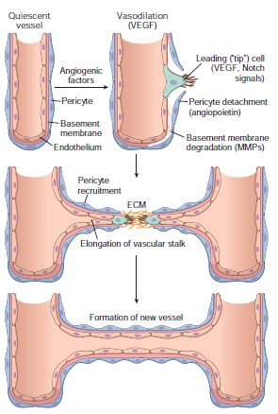
Angiogenesis
Notes:
Mechanism of angiogenesis. In tissue repair, angiogenesis occurs mainly by growth factor–driven outgrowth of residual endothelium,
sprouting of new vessels, and recruitment of pericytes to form new vessels.

Slide 49
Factors That Influence Tissue Repair.
Infection ; prolongs inflammation, increasing local tissue injury.
Diabetes
Nutritional status
Glucocorticoids (steroids)
Mechanical factors
Poor perfusion; due to PVD, diabetes ,obstructed venous drainage (e.g., in varicose veins)
Foreign bodies
Extent of tissue injury

Slide 50
Healing of Skin Wounds
Based on the nature and size of the wound, the healing of skin wounds is said to occur by first or second intention.
Healing by First Intention
When the injury involves only the epithelial layer, the principal mechanism of repair is epithelial regeneration, also called primary union or healing by first intention. E.g.; clean, uninfected surgical incision approximated by surgical suture
Healing by Second Intention
Occurs In wounds with large tissue deficits, results in a greater mass of scar tissue.

Slide 51
END

