Slide 1
Repair by Connective Tissue Deposition
Fred Maate

Slide 2
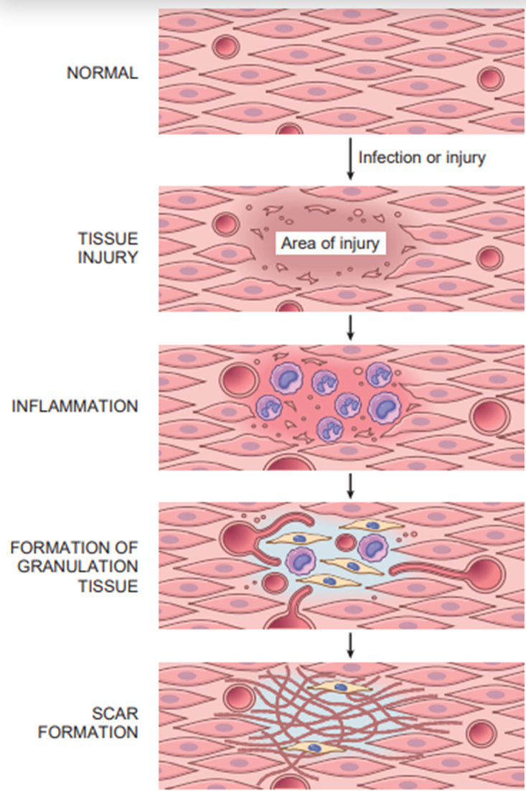
Repair by Connective Tissue Deposition
Steps in Scar Formation
Angiogenesis
Deposition of Connective Tissue
Remodeling of Connective Tissue

Slide 3
Angiogenesis
Formation of granulation tissue
Remodelling of connective tissue

Slide 4
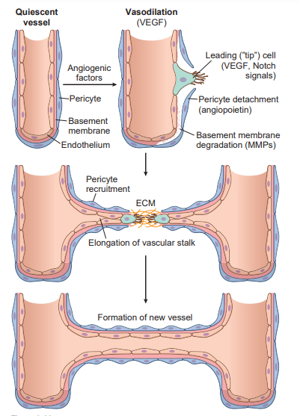
Angiogenesis
VEGF

Slide 5
Deposition of Connective Tissue
migration and proliferation of fibroblasts into the site of injury and
deposition of ECM proteins produced by these cells.

Slide 6
Deposition of Connective Tissue
Transforming growth factor-β (TGF-β) is the most important cytokine for the synthesis and deposition of connective tissue proteins.
Other cytokines- PDGF, FGF-2

Slide 7
Remodeling of Connective Tissue
The outcome of the repair process is influenced by a balance between synthesis and degradation of ECM proteins.
matrix metalloproteinases (MMPs) degrade collagens and other ECM components
Tissue inhibitors of metalloproteinases (TIMPs) inhibit MMPs

