Slide 1

Plasma Proteins in Clinical Medicine
Mr. Z. Ngwira
University of Zambia,
School of Medicine,
Dept. of Pathology and Microbiology

Slide 2
Lecture objectives
To know the measurement and application of plasma proteins
To know the functions and clinical uses of specific plasma proteins
To know proteins in other body fluids

Slide 3
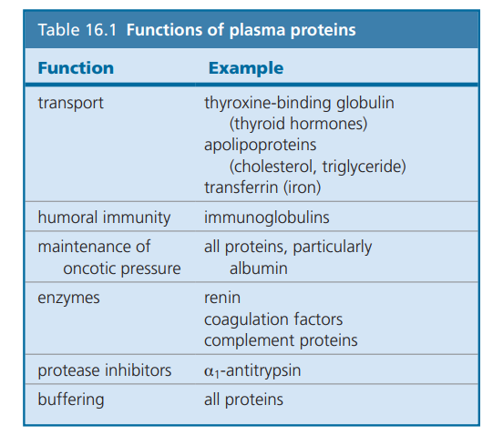

Slide 4
Measurements of proteins
A) Quantitative measurement of a specific protein:
by chemical or immunological methods
Immunochemical Methods - Specific proteins may be identified by immunochemical assays in which the reaction of the protein (antigen) and its antibody is measured.

Slide 5
Measurement of Plasma Proteins
B) Semiquantitative measurement by electrophoresis:
Proteins are separated on the basis of their electrical charge.
Procedure:
1- Serum or plasma is applied to a support medium (cellulose acetate or a gel)
2- Electrical current applied.
3- The gel is stained with a dye that visualizes proteins.

Slide 6
Measurement of PP
Electrophoreses separates the proteins into five broad fractions:
Albumin, a1-globulin, a2-globulin, b-globulin & g-globulin
Each of the globulin fractions consists of a mixture of several proteins

Slide 7
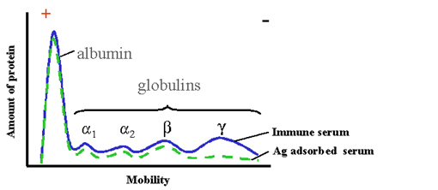
Separation
1. Electrophoresis
A/G=1.5~2.5

Slide 8
Types of Plasma Proteins
Prealbumin
Albumin
α₁-Globulins:
  α₁-Antitrypsin, α-fetoprotein
α₂-Globulins:
  Ceruloplasmin, haptoglobin
β-Globulins:
  CRP, transferrin, β2-microglobulin
γ- Globulins
Fibrinogen

Slide 9
Metabolism of Plasma Proteins
The concentration of plasma proteins (PP) is determined by 3 main factors:
Rate of synthesis
Distribution
Rate of catabolism
A) Synthesis:
Most plasma proteins are synthesized in the liver, although some of them are produced in other sites e.g. Immunoglobulins by lymphocytes.

Slide 10
Metabolism of Plasma Proteins
B) Distribution:
In health, the total concentration of proteins in plasma is around 70 g/L in normal adult males
Water passes more freely through capillary walls than proteins and therefore the concentration of proteins in the vascular space is affected by fluid distribution.
Application of a tourniquet for extended periods leads to fluid loss from the occluded veins; increasing apparently plasma protein concentrations.
C) Catabolism:
PP are degraded throughout the body.
Most proteins are degraded after being taken up by cells within the body.

Slide 11
Albumin
Most abundant plasma protein (~40 g/L) in normal adult
Synthesized in the liver.
Half-life in plasma: 20 days
Decreases rapidly in injury, infection and surgery
Tissue cells can take up albumin by pinocytosis where it is hydrolyzed to amino acids

Slide 12
Functions of Albumin
1. Transport: It can bind and transport many diverse molecules, which include:
a. Metal ions: such as calcium and copper.
b. Free fatty acid: albumin binds to free fatty acid released by adipose tissue and facilitates their transfer to other tissue.
c. Bilirubin to the liver for conjugation: this protects from the toxic side effects of unconjugated bilirubin.
d. Bile acid: albumin carries the bile acids that are recycled from the intestine to the liver in the hepatic portal vein.
e. Hormones: such as thyroid hormones and the steroid hormones

Slide 13
2. Maintainance of osmotic pressure
Colloid osmotic pressure, is a form of osmotic pressure exerted by proteins in blood plasma that usually tends to pull water into the circulatory system.
Because large plasma proteins cannot easily cross through the capillary walls.
In conditions where plasma proteins are reduced, e.g. from being lost in the urine (proteinuria) or from malnutrition, there will be a reduction in osmotic pressure, leading to enhanced fluid retention in tissue spaces (edema).

Slide 14
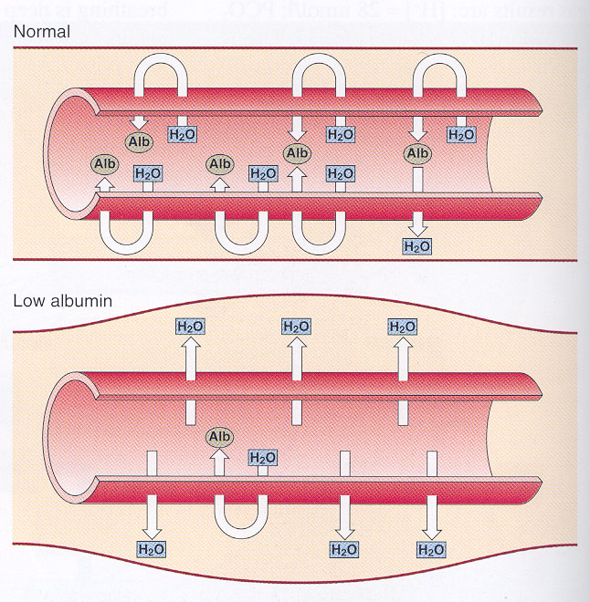
Colloid osmotic pressure
Low albumin, causing oedema.

Slide 15
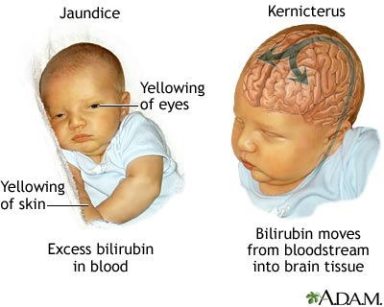
Functions of Albumin
3. Albumin binds different drugs and strongly affects the pharmacokinetics of these drugs.
  For example, sulfonamides can cause the release of unconjugated bilirubin from albumin by competitive binding. If given to infants, sulfonamides may lead to kernicterus.

Slide 16
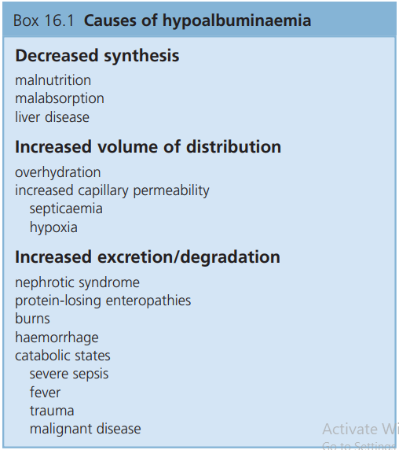
Hypoalbuminemia
Causes
Decreased albumin synthesis (liver cirrhosis, malnutrition) leading to edema
Increased catabolism in infections
Excessive excretion by the kidneys (nephrotic syndrome)
Excessive loss in bowel
Severe burns (plasma loss in the absence of skin barrier)

Slide 17
Hypoalbuminemia
Effects
Edema due to low oncotic pressure
  Albumin level drops in liver disease causing low oncotic pressure
  Fluid moves into the interstitial spaces causing edema
Reduced transport of drugs and other substances in plasma
Reduced protein-bound calcium
  Total plasma calcium level drops
  Ionized calcium level may remain normal

Slide 18
Inherited abnormalities of albumin
The bisalbuminaemias, in which two forms of albumin are present; there are usually no clinical consequences
Analbuminaemia, in which there is less than 1g/L of the albumin; clinical consequences are slight, and oedema, although present, is surprisingly mild.

Slide 19
Hyperalbuminemia
No clinical conditions are known that cause the liver to produce large amounts of albumin
The only cause of hyperalbuminemia is dehydration

Slide 20
Clinical uses of albumin measurement
Assessment of long term nutritional status (t½ 20 days)
Calculation of corrected calcium
Liver function test
Assessment of risk of kernicterus
Assessment of hydration status

Slide 21
Globulin
Protein electrophoresis is used to categorize globulins into the following four categories:
  Alpha 1 globulins (α₁-Antitrypsin, α-fetoprotein)
  Alpha 2 globulins (Ceruloplasmin, haptoglobin)
  Beta globulins (CRP, transferrin, β2-microglobulin)
Gamma globulins (Immunoglobulins)

Slide 22
Synthesis of Globulins
α and β globulins are synthesized in the liver.
Y globulins are synthesized in plasma cells and B-cells of lymphoid tissues (Reticulo- endothelial system)
Synthesis of Y globulins is increased in chronic infections, chronic liver diseases, auto immune diseases, leukemias, lymphomas and various other malignancies.

Slide 23
α1-Antitrypsin
Synthesized by the liver and macrophages
An acute-phase protein that inhibits proteases
It can combine with trypsin, elastase and other proteases and inhibits them
Mutations in the SERPINA1 gene can lead to a deficiency of α1-antitrypsin protein or an abnormal form of the protein that cannot control neutrophil elastase

Slide 24
α1-Antitrypsin
Neutrophil elastase is released from leukocytes to fight infection, but if not deactivated can digest elastin needed for bronchi expansion in the lungs leading to emphysema if not controlled by α₁-antitrypsin
The abnormal form of α₁-antitrypsin can also accumulate in the liver and can cause cirrhosis.
Alpha1-antitrypsin is an acute phase reactant, Increased levels of alpha1-antitrypsin are seen in inflammatory reactions, pregnancy, and contraceptive use.

Slide 25
Clinical consequences of α₁-antitrypsin deficiency
Emphysema- Normally antitrypsin protects the lung tissue from proteases(active elastase) released from macrophages
α₁-AT Forms a complex with protease and inactivates it.
In its deficiency, the active elastase destroys the lung tissue by proteolysis.
Smoking and Emphysema- A methionine (residue 358) of α₁-antitrypsin is involved in its binding to proteases.

Slide 26
α₁-antitrypsin deficiency
Smoking can cause oxidation of Met358 to methionine sulfoxide and inactivate α1–AT.
Affected molecules of α1-antitrypsin no longer neutralize proteases.
This is particularly devastating in patients (eg, PiZZ phenotype) who already have low levels of α1-antitrypsin.
The further diminution in α 1-antitrypsin brought about by smoking results in increased proteolytic destruction of lung tissue, accelerating the development of emphysema.

Slide 27
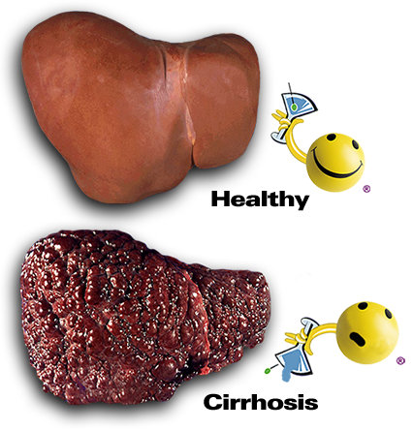
α₁ –antitrypsin deficiency liver disease
mutant α₁ –antitrypsin accumulates and aggregates to form polymers, by unknown mechanism and cause liver damage followed by accumulation of collagen resulting in fibrosis (cirrhosis).

Slide 28
Variants of α1-antitrypsin
Normal form is : Pi MM - M is the normal allele (Pi stands for Proteinase inhibitor)
Abnormal forms : Pi SS ~60% normal activity
Pi ZZ~15% normal activity: a point mutation causes a single amino acid substitution preventing glycosylation and thus secretion.
Compound heterozygotes are also common, e.g. Pi SZ (38% normal activity)

Slide 29
α-fetoprotein (AFP)
Synthesized in the developing embryo and fetus by the parenchymal cells of the liver
AFP levels decrease gradually during intra-uterine life and reach adult levels at birth
Function is unknown but it may protect fetus from immunologic attack by the mother
No known physiological function in adults

Slide 30
AFP
Elevated maternal AFP levels are associated with:
Neural tube defect, anencephaly (absence of the major portion of the brain),
Decreased maternal AFP levels are associated with: Increased risk of Down’s syndrome
AFP is a tumor marker for: Hepatoma and testicular cancer

Slide 31
Caeruloplasmin
Binds 8 Cu atoms per molecule
95% of plasma Cu is associated with caeruloplasmin.
Oxidizes Fe2+ to Fe3+ and thus facilitates iron binding to transferrin, facilitating Hb synthesis.

Slide 32
Caeruloplasmin deficiency
Wilson's disease : inherited disease with failure of normal liver excretion of Cu into the bile, resulting in hepatic Cu overload with cirrhosis and deposition of Cu in brain (encephalopathy) and pupil (Kayser Fleischer ring).
Increased Cu stores decrease caeruloplasmin synthesis.
Diagnosis : low plasma caeruloplasmin and increased hepatic copper as well as increased urinary excretion of copper

Slide 33
Haptoglobin
glycoprotein, synthesized by the liver
Function
It can bind with the free hemoglobin (extra-corpuscular Hb) in a tight noncovalent complex Hp-Hb during hemolysis.
Hp-Hb(155 kDa) cannot pass through glomeruli of kidney while free Hb(65kDa) can and Hp prevent the loss of free Hb into urine.
free Hb passes through glomeruli, enters tubules and precipitates therein = kidney damage

Slide 34
Haptoglobin
Low levels of plasma concentration of Hp can diagnose haemolytic anaemia.
Hp levels fall when Hb is constantly being released from red blood cells (as in haemolytic anaemia)
Haptoglobin is considered an acute-phase protein that is elevated in many inflammatory diseases, such as ulcerative colitis, acute rheumatic disease, heart attack, and severe infection.

Slide 35
C-Reactive Protein
An acute-phase protein synthesized by the liver
Involved in the promotion of immune system through the activation of complement cascade.
activates complement, and binds to LDL in the atherosclerotic plaque
A marker for ischemic heart disease
High plasma levels are found in many inflammatory conditions such as rheumatoid arthritis
Elevated levels of CRP stimulate the production of tissue factor that initiates coagulation

Slide 36
β2-microglobulin
light chain component of the histocompatibility complex (HLA)
Present on the surface of lymphocytes and most nucleated cells
Filtered by the renal glomeruli due to its small size but most (>99%) is reabsorbed)
Elevated serum levels are found in Impaired kidney function
Overproduction in disease e,g rheumatoid arthritis
In patients with human immunodeficiency virus (HIV), a high B2M level in the absence of renal failure indicates a large lymphocyte turnover rate, which suggests the virus is killing lymphocytes

Slide 37
Transferrin
a glycoprotein, synthesized by the liver.
A major iron-transport protein in plasma
A negative acute phase protein
Functions
Transferrin transports iron from catabolism of heme and from food (gut) to its storage sites, where it is incorporated into apoferritin, another protein, to form ferritin.
Transferrin also carries iron to cells, such as bone marrow, that synthesize hemoglobin and other iron-containing compounds
2 moles of Fe3+ per 1 molecule of transferrin

Slide 38
Clinical Significance
Plasma level of transferrin drops in:
Malnutrition, liver disease, kidney disease inflammation, malignancy
Low transferrin can impair haemoglobin production and lead to anaemia (iron deficiency anaemia).
Iron deficiency anaemia results in increased hepatic synthesis of transferrin causing relative excess levels of transferrin in plasma

Slide 39
Fibrinogen
Synthesized in the liver.
Its function is to form a fibrin clot (when activated by thrombin)
Fibrinogen is removed in the clotting process and is not seen in serum.
It is one of the acute phase proteins.
Its level rises with pregnancy and the use of oral contraceptives.
Decreased values generally reflects extensive coagulation during which the fibrinogen is consumed.

Slide 40
Acute Phase Proteins, APP
The levels of certain plasma proteins change during inflammation, infection, injury, cancer etc. These proteins are “Acute Phase Proteins, APP ”
Include C-reactive protein (CRP), fibrinogen, haptoglobin ,α1-antitrypsin, albumin and transferrin.
APP are believed to play a role in the body’s response to inflammation, changes in their plasma concentrations are generally regarded as being sensitive, although non-specific indicators of inflammation.

Slide 41
Positive Acute Phase Proteins
are increased within 24 hours of injury in response to humoral mediators (Cytokines – IL-1, IL-6, tumor necrosis factors , the interferons and platelet activating factors) which are produced by tissue macrophages, monocytes & endothelial cells in inflammation ,etc..
These proteins are called acute phase reactants
They are synthesized due to body’s response to injury
Examples: alpha 1-Antitypsin, haptoglobin, ceruloplasmin, fibrinogen, c-reactive protein

Slide 42
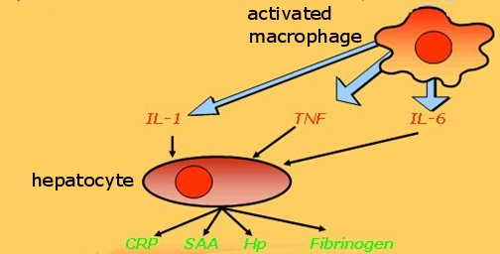
Acute phase reactant response

Slide 43
PAPP
Functions:
1. Binding to polysaccharides in bacterial walls
2. Activating complement
3. Stimulating phagocytosis
4. Protease inhibitors probably inactivate enzymes released from lysosomes & minimize damage that may occur.

Slide 44
Negative Acute Phase Proteins
These proteins decrease in inflammation e.g Albumin, prealbumin, transferrin
Mediated by inflammatory response via cytokines and hormones
Synthesis of these proteins decrease to save amino acids for positive acute phase protein

Slide 45
Gamma Globulins
They are glycoproteins produced by plasma cells in response to an immunogen with antibody activity
They occupy the gamma region on electrophoresis
Immunoglobulins (Ig) play a key role in the defense mechanisms of the body
There are five types of immunoglobulins IgG, IgA, IgM, IgD, and IgE

Slide 46
Antibody
Antibody is a protein/ immunoglobulin capable of specific combination with the antigen.
They are produced in response to the invasion of foreign molecules in the body
Bound to the surface of B-Lymphocytes or Circulating in the blood as free immunoglobulins
Bind target antigens by highly specific interaction (lock-and-key principle)
Made specifically to bind a unique antigenic epitope (also called an antigenic determinant)
Possesses an antigen binding site

Slide 47
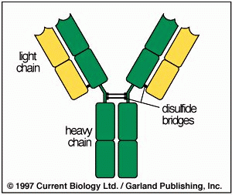
Basic Immunoglobulin Structure

Slide 48
The Prototype Immunoglobulin Molecule
Heavy Chains (five types: α, γ, μ, δ, ε)
Light Chains (two types: λ and κ )
Fab fragment
Fc fragment
Constant and variable regions
Disulfide linkages
Fab
VH
VL
CH1
CL
CH2
Fc
CH3

Slide 49
Antibody
The heavy chain determines the subclass of each antibody.
The subclasses of antibodies differ in the number of disulfide bonds and the length of the hinge region
The most commonly used antibody in immunochemical procedures is of the IgG class because they are the major immunoglobulin (Ig) released in serum.

Slide 50
Antibody
antigen specific Fab or F(ab) arms, which are critical for actual antigen binding
The constant Fc “tail” that binds immune cell Fc receptors and also serves as a useful “handle” for manipulating the antibody during most immunochemical procedures.
The number of Fab regions on the antibody, corresponds with its subclass, and determines the valency of the antibody
constant regions define structure and immune function

Slide 51
Mammalian Antibody Classes
Antibodies are classed according to the type of immunoglobulin heavy chain
Each antibody class can have either κ (kappa) or λ (lambda) immunoglobulin light chains
In mammals we recognise five classes and chains
  IgM μ (mu)
  IgD δ (delta)
  IgG γ (gamma)
  IgA α (alpha)
  IgE ε (epsilon)

Slide 52
Major functions of immunoglobulins
Immunoglobulin | Major Functions
IgG (monomer) | Main antibody in the secondary response. Opsonizes bacteria, Fixes complement, neutralizes bacterial toxins and viruses and crosses the placenta.
IgA (Dimer) | Secretory IgA prevents attachment of bacteria and viruses to mucous membranes. Does not fix complement. Provides immunity to infant digestive tract
IgM (pentamer) | Produced in the primary response to an antigen. Fixes complement. Does not cross the placenta. Antigen receptor on the surface of B cells.
IgD (monomer) | Present on surface of B-lynphocytes,involved in antigen recognition.
IgE (monomer) | Mediates immediate hypersensitivity Defends against worm infections. Does not fix complement.
Notes:
MAJOR FUNCTIONS OF THE IMMUNOGLOBULINS

Slide 53
Hypogammaglobulinemia
Losses from body- same as albumin- through urine, GIT or skin
Decreased synthesis by plasma cells
Primary genetic deficiency
Secondary – drug induced (Corticosteroid therapy), uremia, hematological disorders and AIDS(Acquired Immuno deficiency syndrome)

Slide 54
Hypergammaglobulinemia
May result from stimulation of
B cells (Polyclonal hypergammaglobulinemia)
Monoclonal proliferation (Paraproteinemia)
Polyclonal hypergammaglobulinemia:
Stimulation of many clones of B cells produce a wide range of antibodies
gamma-globulin band appears large in electophoresis
Clinical conditions: acute and chronic infections, autoimmune diseases, chronic liver diseases

Slide 55
Monoclonal Hypergammaglobulinemia
Proliferation of a single B-cell clone produces a single type of Ig (paraprotein)
Appears as a separate dense band (paraprotein ) in electrophoresis
Paraproteins are characteristic of malignant B-cell proliferation
Clinical condition: multiple myeloma, Leukemia, Hodgkin’s disease

Slide 56
Proteins from other body fluids
Other body fluids being studied for their protein content apart from plasma include peritoneal, pleural, seminal, and vaginal fluids, tears, saliva and amniotic fluid.

Slide 57
Urinary Protein
Proteins found in the urine are from the blood; however, urinary proteins can originate from the kidney and urinary tract and from extraneous sources such as the vagina and prostate.
Plasma proteins appear in the urine because they have passed through the renal glomerulus and have not been reabsorbed by the renal tubules
Urinary proteins serve as important marker for the assessment of kidney injury.

Slide 58
Protein in other body fluids
Amniotic fluid is analysed for AFP and other analytes in antenatal screening for fetal defects
Saliva is tested for secretory IgA for evaluation of possible immunological deficiency
Faeces are assayed for AAT in the diagnosis of gastrointestinal protein loss
Pathological accumulation of fluid in the peritoneal and pleural cavities vary in protein contents
1. Ultrafiltrate with low protein concentration of less than 3g/dl (Transudates)
2. Serous fluid with high protein concentration of more than 3g/dl (Exudates)
Transudates reflect change in permeability of filtering membranes while exudates result from infection or malignancy

Slide 59
Abnormal proteins
Bence – Jone’s proteins
Present in the urine of a patient suffering from multiple myeloma (50% of patients)
Molecular weight 45,000
Bence Jones proteins have the remarkable characteristic of precipitating on heating urine from 45⁰ – 60⁰ C and redissolve when the heating is continued above 80⁰ C

Slide 60
The End

