Slide 1
The Somatosensory system
Dr Theresa Chikopela Sikazwe

Slide 2
Sensory receptors – let us begin
Sensory receptors are specialized epithelial cell or neuronal proteins
They physically interact with a force, energy or chemical
They then transduce the energy of the stimuli into a change in membrane potential.
Often surrounded by non-neural cells to form a sense organ
They transmit impulses through fibres – each terminating on a specific point in the CNS
With the information coming from the sensory receptors, the brain creates an internal representation of the external environment
It then alters organs function to maintain homeostasis.

Slide 3
Classification
Receptors can be classified based on;
Distribution; somatic or visceral as well as special
Location of stimuli;
  Exteroceptors (external stimuli – pressure, touch, pain, temp, special senses), proprioceptors (within connective tissue, muscle, joints, tendons, inner ear), interoceptors, visceroceptors (internal)
Morphology;
  free nerve endings (pain, temperature, light touch), encapsulated nerve endings (pressure, vibration, deep touch) and specialized cells – special senses
The type of stimulus for which they respond to; also known as modality - light, sound, temperature etc
Adaptation to stimulus
  When applied stimulus acts for a prolonged duration, some receptors may stop responding in the course of time.
  Reduction of action potential transmission in nerve fiber
  Some receptors take time to reach this point (slowly adapting), others reach faster (fast adapting)

Slide 4
Modality
Thermoreceptors: respond to temperature changes
Photoreceptors: react to light, including the receptors in the retinas of the eyes.
Nociceptors: respond to damaging stimuli, resulting in pain, which include extreme cold or heat, excessive pressure, and inflammatory chemicals
Chemoreceptors: respond to chemicals in a solution, such as molecules that are tasted or smelled, or any changes in chemistries of blood or interstitial fluid
Mechanoreceptors: react to mechanical forces, including BP, other types of pressure, touch, stretching, and vibrations

Slide 5
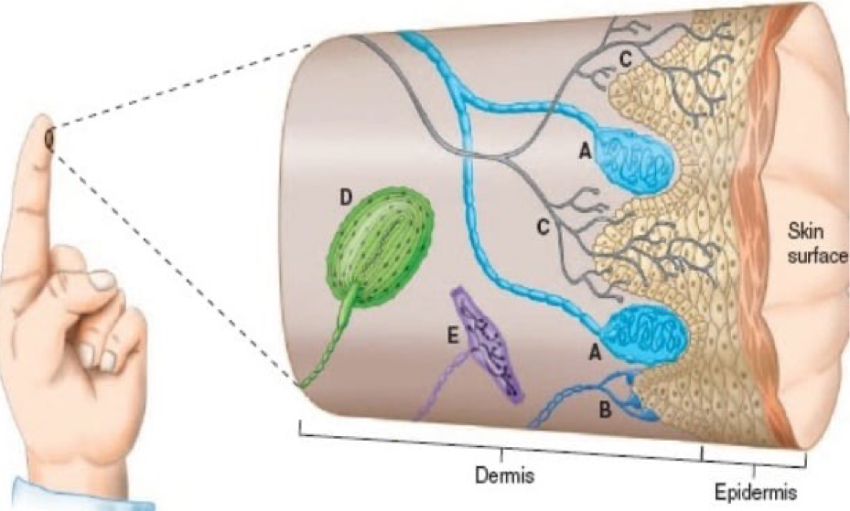
Mechanoreceptors
There are four classes of mechanoreceptors
  Tactile receptors
  Proprioceptors
  Baroreceptors
  Organ of Corti and vestibular system hair cells.
Tactile receptors detect innocuous stimuli in skin
Meissner’s corpus
Merkel’s disks
Free nerve endings
Pacinian corpuscles
Ruffini corpuscles

Slide 6
Meissner corpuscles:
  Dendrites encapsulated in connective tissue
  Respond to changes in texture and slow vibrations.
  Beneath epidermis - papillae
Merkel cells:
  Expanded dendritic endings
  Respond to sustained pressure and touch.
  Upper layers of skin near base of epidermis
  Found mostly in fingers and palms
  Small with well defined boarder
  Sensitive to edges
  Typing, texting etc

Slide 7
Ruffini corpuscles
  Enlarged dendritic endings with elongated capsules
  Respond to sustained pressure and skin stretch, joint deformation
  Deeper in dermis – hairy skin
Pacinian corpuscles
  unmyelinated dendritic endings
  Encapsulated by concentric lamellae of connective tissue- onion.
  respond to deep pressure and fast vibration
  Viscera like pancreas, breasts, genitals
  Usually in deep dermis of globose skin

Slide 8
General properties of receptors
Excitability:
  They can initiate action potentials
  They also produce graded potentials (local or subthreshold potentials) – difference between generator and receptor potentials
Adequate stimulus:
  Require enough strength of stimulus to excite the receptor to initiate action potentials.
Receptor protein specificity:
  Sensory receptors are optimally selective for a single type of stimulus.
  Some are polymodal – respond to more than one type of stimulation

Slide 9
Sensation and perception
Sensation - process of receiving information and encoding it to transmit to various areas of the nervous system
  To create an accurate neural representation of sensory stimuli, the brain must distinguish FOUR stimulus properties
  Modality - Type/kind of energy
  Location - site on the body or space where the stimulus originated
  Intensity - frequency of APs generated
  Duration - the time from start to end of a response in the receptor
Perception - process of receiving and interpreting the sensations
  Based on the present state of the internal and external environment, and the memory of similar situations.

Slide 10
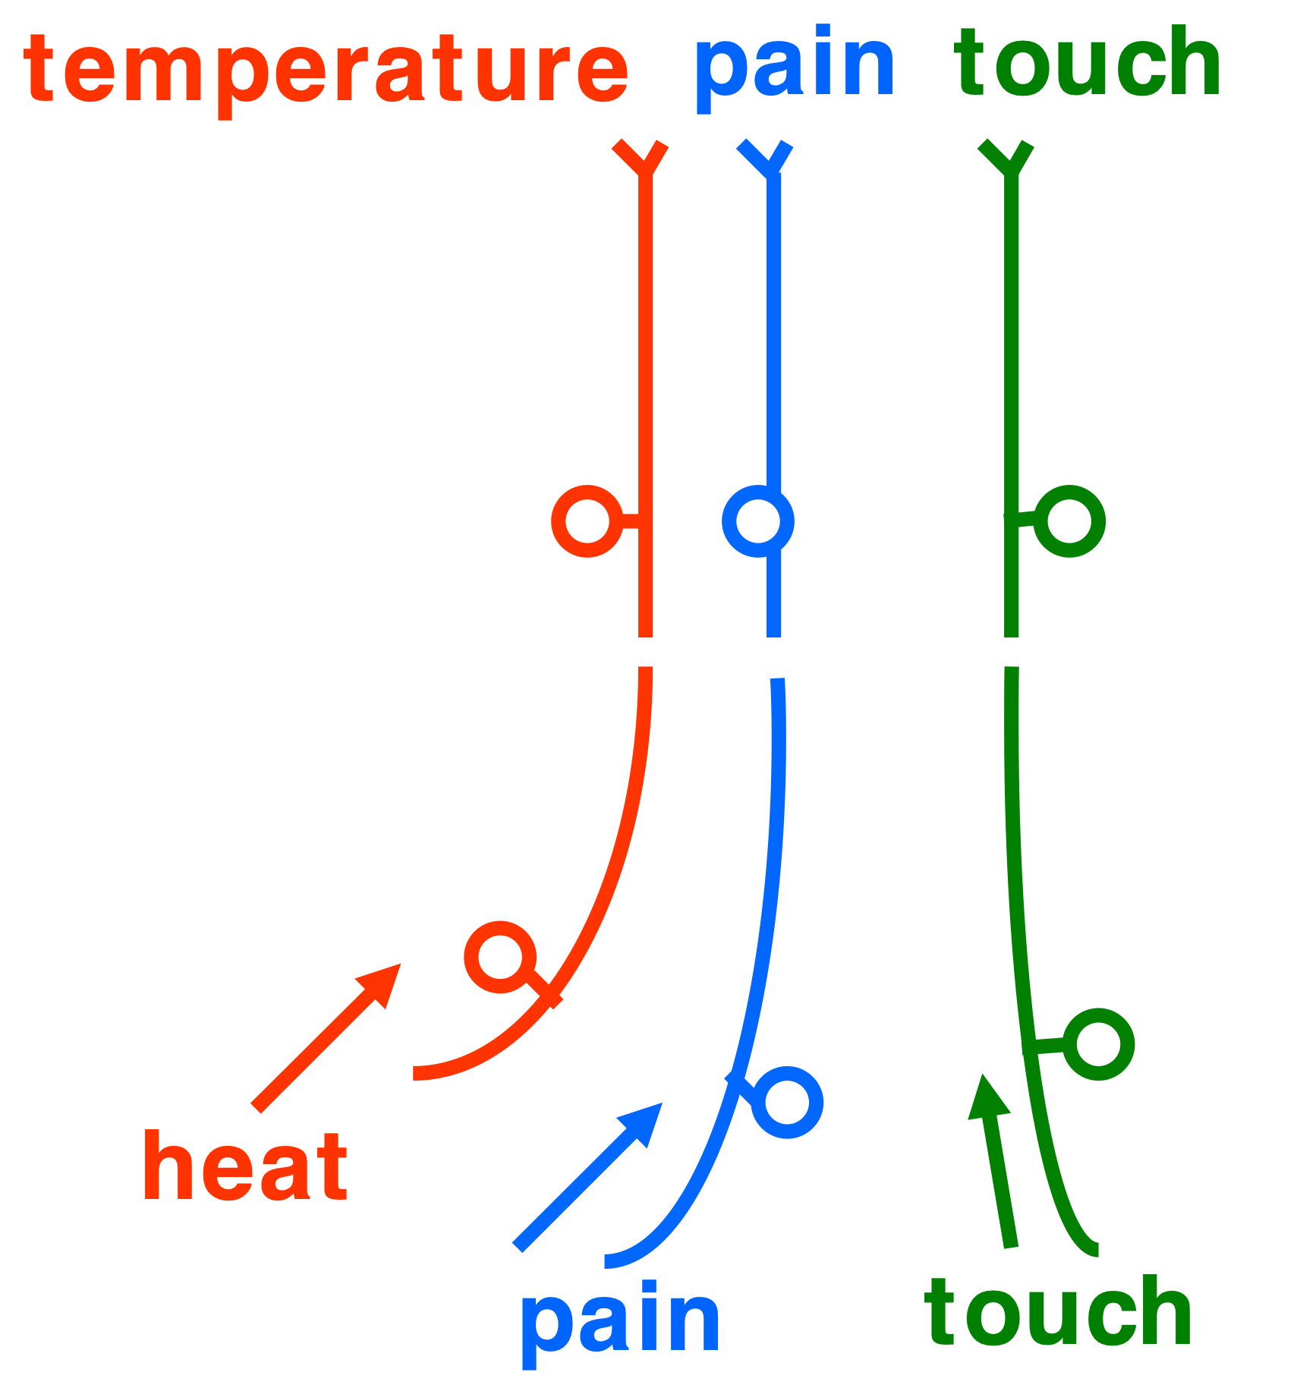
1. STIMULATION MODALITY
Each receptor type is most sensitive to a particular type of stimulus (modality).
The brain thus associates a signal coming from a specific group of receptors with a specific modality.
There is a direct association between a receptor and a sensation
These sensations follow a discrete path to the brain
2. STIMULUS LOCATION
The site of a sensory neuron is vital to determine the location of its neural message
  The bodily area where a stimulus can affect a sensory receptor is called receptive field.
Areas that contain a higher number of small receptor fields can achieve better spatial resolution
  E.g. fovea of the retina, fingertips and lips.

Slide 11
3. STIMULUS INTENSITY
Coded by number of receptors activated (population coding) – the more the receptors, the more intense
Takes into consideration the frequency of action potentials (frequency coding) – the more the stimulation, the more intense
4. STIMULUS DURATION
if a stimulus is prolonged, firing of the neuron gets slower over time (Sensory adaptation)

Slide 12
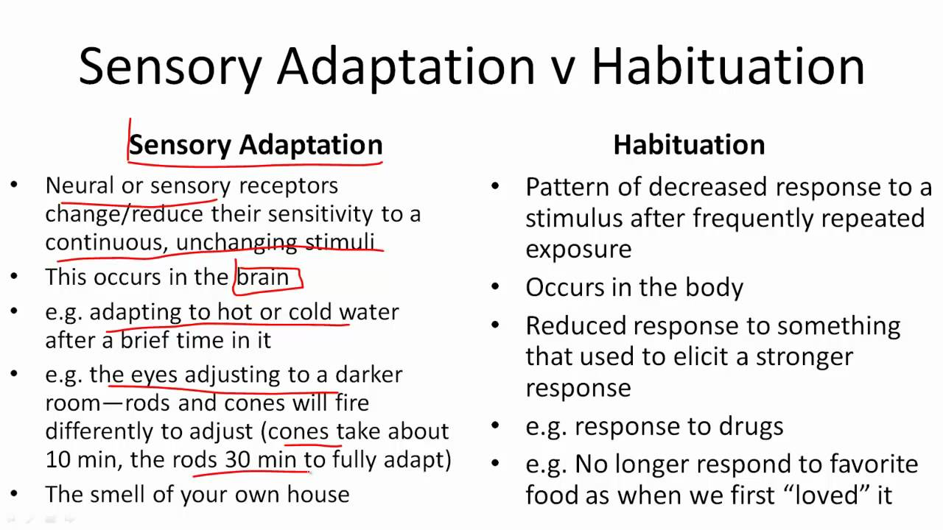

Slide 13


Slide 14
The anatomists -
From the receptors, there are specific pathways that are followed to reach the CNS
  While some end in the spinal cord as reflexes, some are consciously perceived by moving up to the higher brain centres in specific pathways
The spinal cord have dorsal, lateral and anterior tracts
The dorsal column is for express sensation with high myelination compared to the other two
  The dorsal column has highly accurate information through it and more localised
  The dorsal column carries sensation from most mechanoreceptors
  Examples; DC - fine touch, Vibration, two point discrimination, proprioception
Examples; A - crude touch, L- pain and temperature
  Sexual orgasms

Slide 15
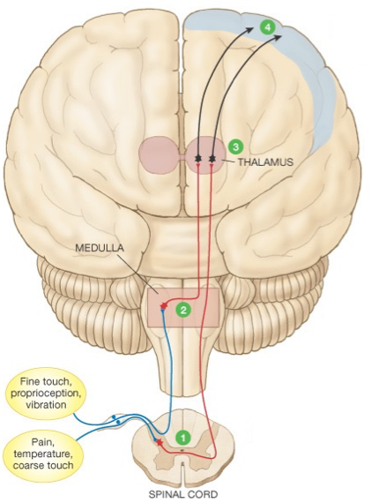
Sensory projection pathway: brain identifies site of stimulation
Cerebral Cortex - Perception
3rd Order Neuron
2nd Order Neuron
1st Order Neuron
Transduction
Receptor
Stimulus
Notes:
First-order neurons conduct impulses from somatic receptors into the brain stem or spinal cord.
Second-order neurons: interneurons that conduct impulses from the brain stem and spinal cord to the thalamus.
Third-order neurons conduct impulses from the thalamus to the area of the cerebral cortex

Slide 16
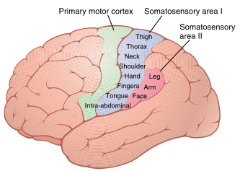
When signal reaches the brain
The brain has a pretty good representation of your body
Topography –
  Primary sensory cortical areas contain neurons that construct a location-specific organization.
Somatotopic representation-
  Displays in the primary sensory cortex
  Distorted anatomical version of the body called a sensory homunculus.
  It is based on sensitivity

Slide 17
The somatosensory cortex

Slide 18
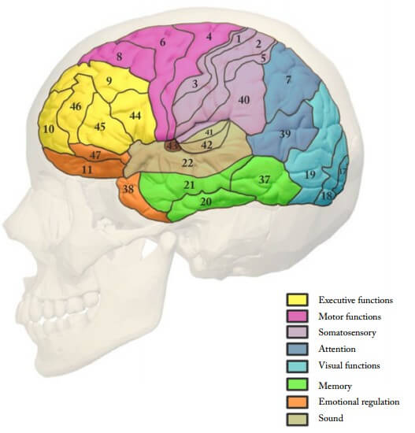
Broadmann’s areas
The primary somatosensory cortex is located in a ridge of cortex called the postcentral gyrus
  It is found in the parietal lobe.
  just posterior to the central sulcus
  Brodmann's areas 3a, 3b, 1, and 2.
The secondary somatosensory cortex (SII; area 40) is in the lower parietal lobe.
  This receives connections from the primary sensory cortex and also less specific thalamic nuclei.
  It then sends projections to limbic structures such as the amygdala and hippocampus
Notes:
Neurons in areas 3b and 1 respond primarily to cutaneous stimuli
Neurons in 3a respond mainly to stimulation of proprioceptors
Area 2 neurons process both tactile and proprioceptive stimuli

Slide 19
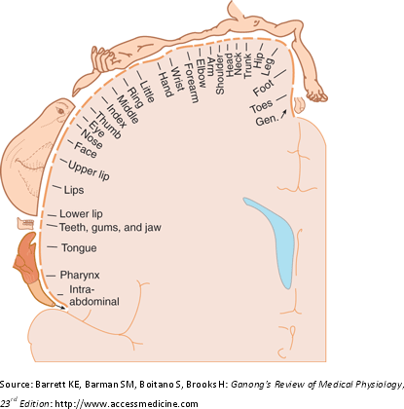
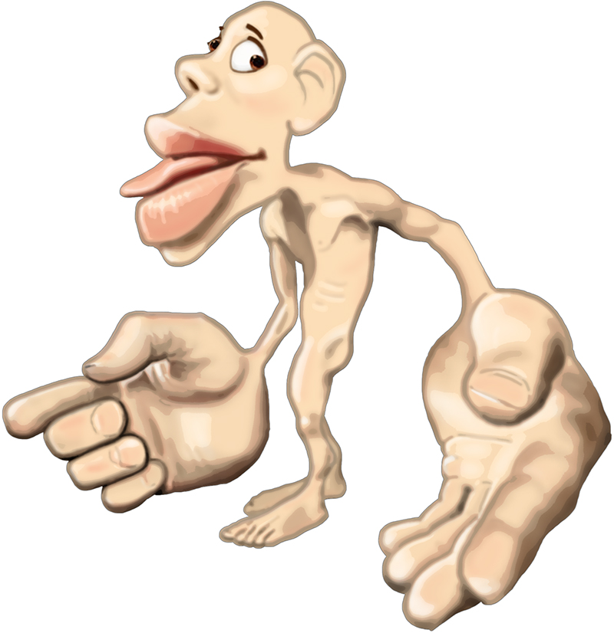

Slide 20
If you were to design a sensory system:
  What would be your key question?
  What is the system designed to detect?
  What would be the components of the system?

Slide 21
Force/energy/Chemical
Stimuli
Motor, Hormonal Memory
Transduction
CNS
Receptor
Detector
Output Mechanism
Interpreter/Integrator
Output/ Response
Modulator

