Slide 1
Psychopharmacology

Slide 2
“The desire to take medicines is perhaps the greatest feature that distinguishes man from animals’’
(Sir William Osler)

Slide 3
Introduction
The modern treatment era in psychiatry began with the introduction of effective psychotropic medications in the 1950’s.
In as much as the introduction of effective medication revolutionized mental health treatment & psychiatry, there were widespread concerns that psychiatrist were no longer interested in patients & their very own problems, but concerned only with the manipulation of NTs.
Indeed, many psychiatrists have chosen to delegate psychotherapy to non-physicians such as psychologists & social workers, preferring to focus on medication management

Slide 4
The splitting of treatment is being critically reassessed as it has become clear that the patients do best with a combination of medication & psychotherapy and that having a single mental health care provider is preferable as well as cost-effective

Slide 5
Significant points in the history of psychotropic drugs
1949 | Lithium discovered in Australia
1951 | Chlorpromazine the first AP drug discovered in France
1952 | MAOI’s are discovered when a TB drug found to improve mood
1958 | TCA article is published in the American Journal of Psychiatry
1960 | Harris published the first article on the effectiveness of BZD’s in the Journal of the American Medical Association
1980s | A new class of antidepressants,SSRI’s is developed & fluoxetine is marketed
1990s | Clozapine the first truly new AP agent in 40yrs is released in the USA the others follow later on
2000s | Drugs to treat patients with Alzheimer disease are widely available

Slide 6
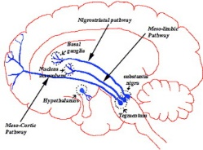
Dopaminergic system

Slide 7
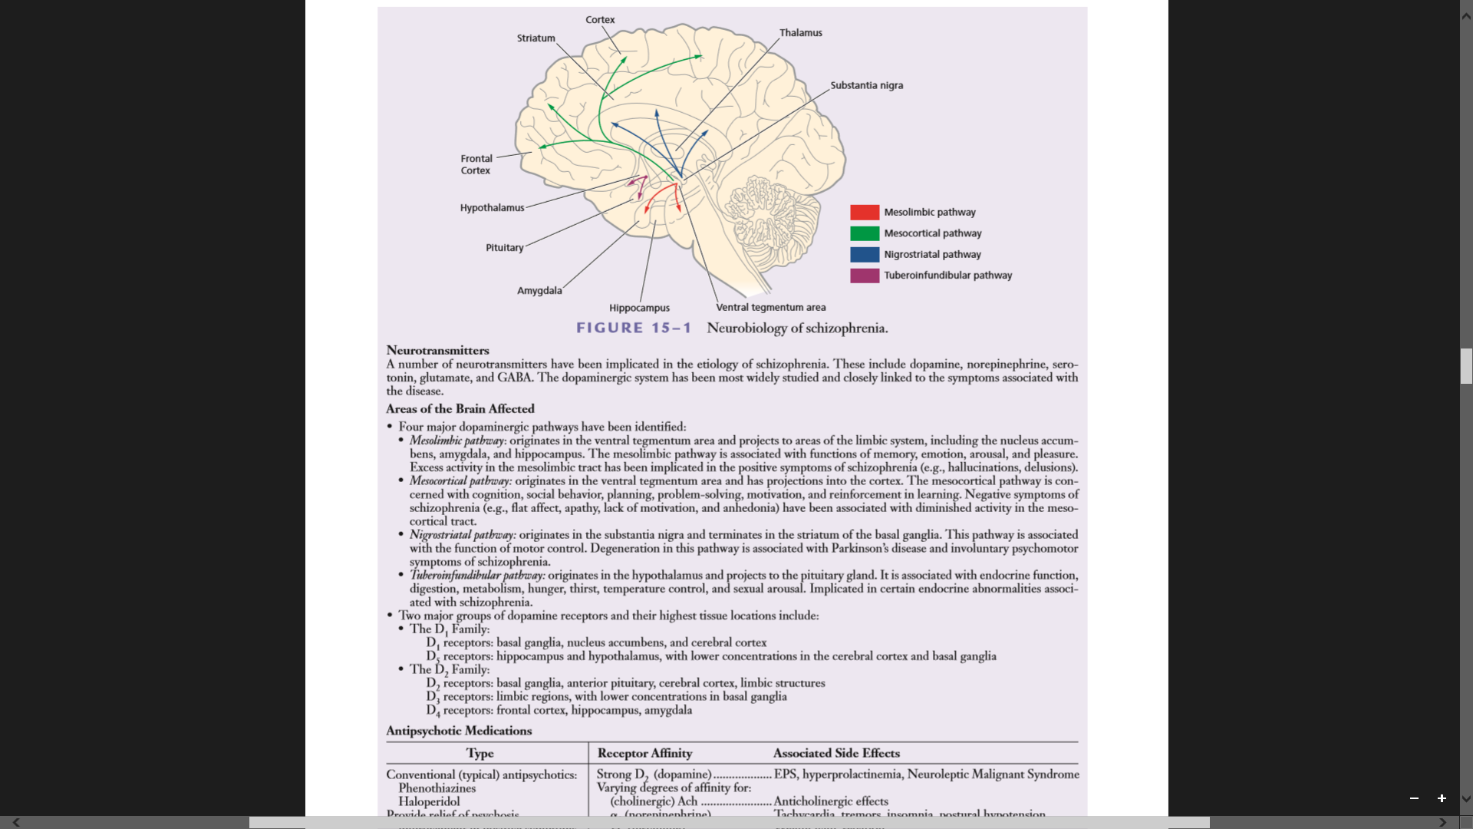

Slide 8
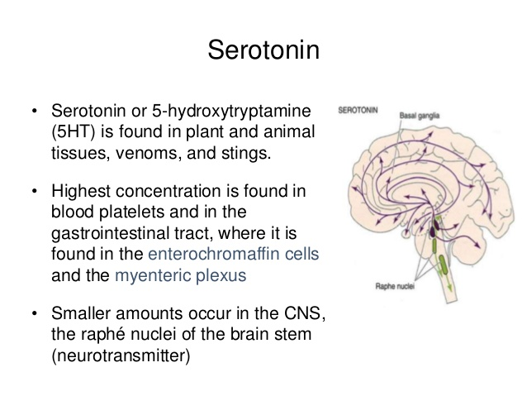
Serotonergic system

Slide 9
Role of serotonin in Neuropsychiatric diseases
Has multiple physiologic roles which include:
  Pain perception
  Regulation of sleep,appetite,temperature & Blood pressure, vomiting cognitive function & mood (feeling of well-being)
It has also been found to be involved in conditions such as:
  Depression-deficiency in the amount of cortical & limbic 5HT,NEP,DA
  Anxiety –increase in 5HT
  Aging-decrease in 5HT
  ADHD-decrease in 5HT
  Migraine-decreased 5HT amounts

Slide 10
If I take the wings of the morning and dwell in the uttermost parts of the sea, Even there your hand shall lead me and your right hand shall hold me.
(Psalms 139:9-10)

Slide 11
ANTIPSYCHOTICS
Historically been referred to as:
  Major tranquilizers (emotional quieting & sedation)
  Ataractics (produce calmness or serenity)
  Neuroleptics (Greek term for clasping)
Research shows 80% of patients relapse after 5 years
Classified as:
  Traditional, Typical or FGAs
  Atypical, conventional or SGAs
  Atypical or Third generation (TGAs)

Slide 12
Antipsychotics
USES
  Drugs used primarily to treat schizophrenia & other psychotic disorders
  Also prescribed to patients with psychotic mood disorders
  In patients whose psychoses are medically induced or due to drug of abuse
  Often used to control:
    aggressive behaviour in intellectually disabled patients
    Autism spectrum disorder patients
    Patients with borderline personality disorder
    Patients with delirium & other neurocognitive disorders
    Also prescribed in patients with Tourette’s disorder to diminish the frequency & severity of vocal & motor tics

Slide 13
Examples
First Generation | Second Generation & Third Generation
Chlorpromazine-phenothiazine (low potency) | Alipiprazole Brexipiprazole TGAs Cariprazine
Thioridazine | Clozapine Asenapine
Fluphenazine decaonate (Depot)(modacate) | Lurasidone
Perphenazine | Olanzapine
Trifluperazine (stelazine) | Quetiapine
Thiothixene- Thioxathenes | Risperidone Iloperidone
Haloperidol-Butyrophenone (Haldo):high potency | Ziprazidone Paliperidone

Slide 14
Mechanism of Action of FGAs
Predominat D₂ receptor Blockers; clinical effectiveness occurs 60-70% blockade.
RECEPTOR | EFFECTS
D₂ | Mesolimbic tract: Antipsychotic effect Nigrostraiatal tract:EPSEs Tuberoinfundibular tract: Prolactin level elevation Mesocortical tract: Secondary negative symptoms-caused by AP (worsens)
5-HT_{2A} | Improves negative symptoms, decreased EPSEs
M₁ | Anticholinergic effects: dry mouth & Blurred vision (ensure not hallucinations/Illusions), Decreased sweating,constipation,slowed bladder activity
H₁ | Sedation, weight gain (increased appetite),orthostasis
Alpha -1 | Orthostasis,dizziness,sedation
Alpha-2 | Sexual dysfunction
GABA | Lowers seizure threshold (avoid in known epilepsy & withdrawal),produce anxiety

Slide 15
Side Effects of FGAs
AP produce numerous side effects because of peripheral nervous system (PNS) & CNS actions
PNS anticholinergic effects are a result of blocking 4 cranial nerves that have a parasympathetic components
  The exception is decreased sweating which is a sympathetic system function

Slide 16
CN III | Oculomotor nerve blockade results in mydriasis (dilated pupils) & impaired accommodation,. Blurred vision might result
CN VII | Facial nerve blockade results in dry mouth, decreased tearing, dry nasal passages
CN IX | Glossopharyngeal nerve blockade: dry mouth & nasal passages
CN X | Vagus nerve blockade: tachycardia,constipation & urinary hesitation

Slide 17
Antiadrenergic effect
Orthostatic Hypotension is the major effect
  Due to alpha- 1 receptor blockade
  Occurs mostly in older adults
  Reflex tachycardia
Nursing staff ensure routine BP checks!!!

Slide 18
Cardiac arrhythmias
These drugs have the potential to for lengthening the QTc interval
  A measure of ventricular depolarization & repolarization
Can be associated with fatal arrhythmias
A normal QTc interval is 330 to 440msec
  Drug induced: men ≥ 450msec;women ≥ 470msec
Nursing staff to ensure ECG monitoring is done more so in patients at risk!!

Slide 19
Relative intensity of common adverse effects of AP at usual therapeutic doses.
Drug | Daily dose range (mg) | sedation | Postural Hypotension | Anti- cholinergic | EPS | Weight gain
Chlorpromazine | 50-1000 | +++ | +++ | ++ | ++ | ++
Fluphenazine | 12.5-75 I.M | ++ | + | + | +++ | +
Haloperidol Haloperidol decao | 0.5-20 50-300 IM/m | + + | + + | + + | +++ +++ | + +
Zuclopenthixol Decaonate | 200-400 IM 2-4 wks. | +++ | + | ++ | +++ | +
Patients on long acting preparations require a test dose especially in drug naïve.

Slide 20
Extrapyramidal Side Effects
EPSEs-nonadeherence- relapse- rehospitalisation
EPSEs | SIGNS/SYMPTOMS | TIME TO DEVELOP | TREATMENT
Dystonia-Freezing (types) Torticollis(contracted positioning of neck) Oculogyric Laryngeal-Pharyngeal | Muscular spasms in any part of the body such oculogyric crisis, torticollis.in extreme cases, the back may arch or jaw may dislocate. Painful & frightening Person may need assistance breathing | Acute dystonia can occur within hours of starting antipsychotics(mins for IM/IV use). TD occurs months to years of AP txt. Approximately 10%.more common in young males. Rare in elderly. Occurs in neuroleptic naïve and with high potency AP like Haloperidol | Anticholinergic drugs given PO.IM,IV depending on severity of symptoms. Response to IV seen in 5mins. Response to IM seen in 20 mins/ Benztropine 1-2mg

Slide 21
Parkinsonism Sometimes mistaken for –ve symptoms of schizophrenia or depression. | Tremor and/or rigidity Bradykinesia Decreased facial expression Flat monotone voice Slow body movements Inability to initiate movement (akinesia) Bradyphrania(slowed thinking) Salivation | Days to weeks after AP drugs are started or dose is increased 20% more common in elderly females & those with pre-existing neurological damage e.g. head injury & stroke | Several options are available depending on the clinical presentation. Reduce dose Change to atypical drug Or prescribe an anti cholinergic medication Benztropine 0.5-4mg po or benzhexol 2-5mg TID

Slide 22
EPSE | SIGNS/SYMPTOMS | TIME TO DEVELOP | TREATMENT
Akathisia Can be mistaken for; psychotic agitation Restless leg syndrome Has been linked to suicide & aggression towards others Sometimes mistaken for anxiety | A subjectively unpleasant state on inner restlessness where there is a strong desire or compulsion to move Foot tapping when seated Constantly crossing/uncrossing legs Rocking foot to foot Constantly pacing up & down | Acute Akathesia occurs within hours to weeks of AP txt or increasing dose. | Reduce antipsychotic dose Change to an atypical AP Low dose BZ ( 2-5mg po TID) Propranolol (20-40 mg po TID/QID) Benztropine 0.5-4mg po

Slide 23
EPS | SIGN/SYMPTOM | TIME TO DEVELOP | TREATMENT
Tardive dyskinesia Tardive means late appearing | A wide range of movements can occur such as lip smacking or chewing, tongue protrusion, choreiform movements(pill rolling or piano playing) Pelvic thrusting Severe orofacial movements can lead to difficulty speaking, eating or breathing. Movements are worse under stress. | 5% individual/year of AP exposure More common in elderly women, those with affective illness & those who have had acute EPSEs early on in txt. Months to years to develop. Approximately 50% cases are reversible | Stop anticholinergics if prescribed Reduce dose of AP Change to atypical drug Clozapine is the most likely to be associated with symptom resolution Other drugs :valproate and clonazepam maybe prescribed.

Slide 24
Endocrine side effects consequence of Chronic Prolactin elevation
WOMEN | MEN
Amenorrhea | Impotence
Loss of libido | Loss of libido
Galactorrhea | Gynecomastia
Long term risk for osteoporosis | Lowered sperm count
Changes in menstrual cycle | Ferminization

Slide 25
Neuroleptic Malignant syndrome
Rare but potentially fatal adverse effects which can develop any time during treatment.
The full syndrome is said to occur in 0.5 to 1% of those of traditional AP medication.
Consists of:
      Hight temp-42 degrees
      Muscle rigidity
      Altered consciousness
      Neutrophilia
      Raised creatine kinase
      Autonomic instability
      Occasionally haemorrhagic tendency
      Milder variants of the full syndrome are thought to occur with both newer and traditional AP.

Slide 26
Treatment of NMS
Depends on severity of the symptoms
  In all cases discontinue AP medication.
  Monitor basic functions and ensure adequate hydration using IV fluids
  In milder cases conservative management maybe sufficient, however sometimes oral bromocriptine is indicated.
    Bromocriptine 2.5mg po BID initially, gradually increasing to 5mg TID & dantrolene 50 mg IV, every 12hours upto 7 doses.
  In patients suspected with or documented NMS ,the continuing need for AP medication should be reviewed by a psychiatrist.30% of these patients will develop the syndrome on again on rechallenge.

Slide 27
Pisa syndrome
Older individuals are particularly susceptible to this side effects of leaning on one side
Maybe treated with higher doses of dopamine agonists

Slide 28
Sexual side effects
D₂ & alpha-2 blockade as well as elevated sexual side effects are responsible
Sexual activity can be divided into 4 stages
  Desire – caused by dopamine blockade
  Arousal-significant issue in females
  Orgasm-causes most problems in men
  Relaxation
Sildenafil citrate (Viagra can be of help)

Slide 29
Gastrointestinal side effects
Due to blockade of H₁ receptor
Insulin resistance is an outcome-causes weight gain
Carbohydrate craving is a common feature

Slide 30
Nursing implications
Therapeutic Vs Toxic levels
  Overdose is fatal,CNS depression,agitation,convulsions,hyperthermia,arrhthymias
Use during pregnancy
  Pose few risks during pregnancy
  Avoid in first trimester-risk of EPSEs to foetus
Use in Older Adults
  Reduced doses should be emphasized due to decreased hepatic metabolism,EPSEs & anticholinegic effects are heightened in old age
Teaching patients
Side effects
Drug –Drug interactions

Slide 31
SGAs Antipsychotics
The pharmacological profile of SGAs differ in that, they are weak D₂ receptor antagonists but are potent serotonin type 2A (5HT_{2A}) receptor antagonists & have significant anticholinergic & antihistaminic activity as well.
Do not cause EPS in therapeutic doses

Slide 32
Relative intensity of common adverse effects of AP at usual therapeutic doses.
Drug | Daily dose range (mg) | sedation | Postural hypotension | Anti-cholinergic | EPS | Weight gain
Clozapine | 100-600 | +++ | +++ | +++ | +* | +++
Olanzapine | 5-20 | ++ | ++ | + | +* | ++
Quetiapine | 300-700 | + | ++ | + | +* | ++
Risperidone | 0.5-6 | + | ++(initially) | 0 | +* | +
0=negligent/absent,+= mild,++=moderate,+++= marked. *= rarely a problem at usual dose.

Slide 33
Drug | Dosing info | Action if no response after.3wks | comments
Olanzapine | 2.5-10mg po nocte | Gradually increase doses over the next two wks. to 10-20mg | Monitor for EPS and reduce dose if necessary
Risperidone | 1mg po nocte increasing to 1mg BID or as 2mg single dose nocte | Gradually increase doses over the next 2 wks. 2-4mg | Monitor for EPS and reduce dose if necessary
Quetiapine | 25mg po BID on day 1,increasing as tolerated to 50mg BID on day 2,100mg BID on day 3 and 150mg BID on day 4.usual effective daily dose is 300 to 450 mg in divided doses | Gradually increase doses over the next 2 wks.300-600mg | Monitor for EPS and reduce dose if necessary
diazepam | 5 to 10mg | Upto 40mg | Short-term Treatment of anxiety, insomnia & agitation.

Slide 34
Laboratory investigations
There are no definitive tests for bipolar disorder, schizophrenia, or major depression
However, tests can be used to identify potential medical problems appearing as psychiatric disturbances, as well as to look for substances such as lysergic acid diethylamide (LSD) or cocaine in a patient's system.
Laboratory tests are also useful in long-term monitoring of medications such as lithium and valproic acid.
Screening tests:
Complete blood count (CBC) to assess for anaemia and thrombocytopenia
Renal function tests
Liver function tests
Thyroid function tests
Laboratory studies including determinations of chloride, sodium, potassium, bicarbonate, serum urea nitrogen, creatinine, and blood sugar levels
Urine toxicology or serum toxicology tests when drug use is suspected
ECG Should be carried out at base line(clozapine & olanzapine) cause electrocardiographic changes-elongation of QT interval.

Slide 35
END

