Slide 1
Drugs used in the management of anxiety disorders & Insomnia
PGY 4110/3320

Slide 2
What is sleep?

Slide 3
A condition of body and mind that typically recurs for several hours every night, in which the eyes are closed, the postural muscles relaxed, the activity of the brain altered, and consciousness of the surroundings practically suspended:

Slide 4
SLEEP ARCHITECTURE
Physiology of Sleep
Non-rapid eye movement (NREM) sleep- Approximately 75% of total sleep.
1. Stage N l:
  Transition state between wakefulness that is characterized by:
  A low voltage, fast frequency electroencephalogram (EEG)
  High muscle tone
  Eye movements of various types
  Unequivocal sleep (i.e., low voltage, mixed frequency EEG, decreasing muscle tone, and slow rolling eye movements) that is subjectively experienced by most individuals as drowsiness. Initiation of sleep occurs over 15-30 minutes.

Slide 5
2. Stage N2:
Characterized by:
Sleep spindles and K-complexes (function uncertain).
A lighter alpha-wave sleep that makes up approximately half of total sleep time (TST).
3. Stages N3: (i.e., delta sleep or slow-wave sleep)
characterized by:
  High voltage, slow (i.e., delta) waves.
  Often considered the most restorative sleep during which there appears to be protein synthesis, wound healing, and restoration of immune function.

Slide 6
B. Rapid eye movement (REM) sleep
  Takes place approximately every 90 minutes, and occurs 4 to 5 times per night
Approximately 25% of total sleep (function uncertain)
Characterized by:
  A low voltage, mixed frequency EEG similar to Stage N l, but with some unique waveforms (e.g., saw tooth waves).
  The lowest muscle tone of the night (i.e., substantial inhibition of muscle tone).
  Bursts of bilaterally conjugate eye movements occur.
Associated with dreaming- 80-90% of awakenings during REM result in classic dream reports.

Slide 7
C. Physiologic Events
1. Autonomic activity
a. NREM - Heart and respiratory rates are generally slow and regular
b. REM -Heart rate, respiratory rate, and blood pressure are irregular, with rapid fluctuations
2. Nocturnal erections - Occur during REM sleep in males
3. Temperature - Poikilothermic (i.e., cold-blooded) in REM sleep and lowest in the early morning.

Slide 8
4. Neuroendocrine activity
  Cortisol concentrations are the lowest at sleep onset
  Growth hormone is released during delta sleep
  Melatonin secretion increases during sleep and is suppressed by bright light

Slide 9
INSOMNIA
A. Primary complaint of unsatisfying sleep quantity or quality, with presence of one or more of the following symptoms:
1. Difficulty with sleep initiation
2. Difficulty with sleep maintenance
3. Early-morning awakening
B. The sleep complaint is associated with social, occupational, academic, educational, behavioral, or functional distress or impairment
C. Sleep complaint takes place at least 3 nights per week and has been present for at least 3 month

Slide 10
D. Sleep difficulties happen even with ample opportunity to sleep

Slide 11
Etiology/Risk Factors
Gender - 55-60% of patients are female and the ratio may be as high as 2: 1
Age
  Insomnia is more common in the elderly who most often complain of awakening in the middle of the night and the early morning.
  Young adults are more likely to have difficulty initiating sleep.
C. Situational stress (e.g., work, finances, major life events, interpersonal conflicts).
D. Environmental (e.g. noise, light, extremes of temperature, high altitude)

Slide 12
E. Poor sleep hygiene
F. Psychiatric and general medical conditions - an estimated 40-50% of persons with chronic insomnia have a comorbid psychiatric illness, most commonly depression or anxiety.
Approximately 80% of patients with major depression have insomnia.
G. Substances, herbals, and medications
  Alcohol may have an initial sedative effect but it increases the number of awakenings, lessens overall TST and quality of sleep, and can result in next day somnolence

Slide 13
  During the first portion of the night, alcohol increases non-REM sleep and decreases REM sleep.
  Alcohol is rapidly metabolized and is generally out of the system by the middle of the night.
  During the second half of the night patients experience more awakenings, withdrawal symptoms, and REM rebound causing nightmares, sweating, or vivid dreams.
  Alcohol may cause snoring and apneas in patients without a history of OSA (Obstructive sleep apnea )
  Changes in sleep architecture can persist despite abstinence in those with a history of alcoholism

Slide 14
H. Unemployment and lower socioeconomic status

Slide 15
Genetics
Genetics have not been determined for insomnia, but mutations have been identified in several sleep disorders
Fatal Familial Insomnia- an extremely rare autosomal dominant genetic disorder.
  Missense mutation of GAC (Asp) to AAC (Asn) on codon 178 of the prion protein (PRNP) gene on chromosome 20 pter-p 12 where position 129 amino acid is methionine.
  A mutation at codon 200 has also been identified
  Met 129 homozygosity polymorphism is usually associated with severe insomnia and a clinical course of less than 1 year
  Met/Val129 heterozygosity polymorphism is associated with a '' pseudo hypersomnia" with night hallucinations and a course greater than 2 years.

Slide 16
B. Advanced Sleep-Phase Syndrome is associated with a single gene mutation on the period 2 gene located on 2q37.3

Slide 17
Pathophysiology
Anatomical Structures
Suprachiasmatic nucleus (SCN) - ''the master biological clock“
Located in the hypothalamus and controls circadian rhythms
Circadian Process - light/dark cycle affects the SCN
  During light, melatonin release is suppressed
  Darkness results in production and secretion of melatonin from the pineal gland, with attenuation of the SCN' s alerting signal
B. Pineal gland - secretes melatonin that is released when it is dark outside prompting drowsiness and regulates the sleep wake cycle

Slide 18
Pathophysiology cont.
Neurotransmitters
Sleep promoting neurotransmitters
1. Gamma-aminobutyric acid (GABA)- Main inhibitory neurotransmitter
2. Adenosine - May inhibit wake promoting neurons
3. Melatonin- Regulates circadian rhythm.

Slide 19
B. Wake promoting neurotransmitters
Norepinephrine (NE)- The cessation of NE activity is associated with the loss of muscle tone experienced during sleep.
Acetylcholine (Ach)/cholinergic neurons are located in the basal forebrain and promote arousal and REM sleep
Histamine promotes/maintains wakefulness. Cessation of histamine activity is associated with the loss of consciousness during sleep.
Serotonin (5-HT)- high levels promote wakefulness; 5HT_{2A} stimulation causes insomnia.

Slide 20
5. Dopamine (DA)- Promotes alertness
6. Orexin (OX) or hypocretin- Promotes wakefulness, suppresses REM and NREM sleep.
C. Histamine, 5-HT, and NE levels are thought to be reduced/inactive during REM sleep.

Slide 21
Treatment Guidelines
Non-pharmacological management is considered effective and is the standard of care.
  The initial approach should include a behavioral intervention (e.g., stimulus control therapy, relaxation therapy).
B. If pharmacological treatment is indicated, the general approach is initial therapy with:
A short-intermediate acting benzodiazepine (BZD) receptor agonist
Non-BZD receptor agonist (NBRA)
Ramelteon

Slide 22
Medications should ideally be discontinued after 4-5 weeks.
  If continued long-term, however, consistent follow-up, adverse effect monitoring, and evaluation for comorbid conditions is required.
The American Academy of Sleep Medicine (AASM) guidelines recommend:
  For sleep onset and sleep maintenance insomnia- Eszopiclone ,temazepam, or zolpidem
For sleep maintenance insomnia only- Doxepin or suvorexant.
For sleep onset insomnia only-Ramelteon, Triazolam, or Zaleplon

Slide 23
Behavioral Therapies
Stimulus Control Therapy
1. Avoid associating the bed or bedroom with poor sleep or the inability to sleep
2. Lie down to sleep only when sleepy
3. Use bed only for sleep (and sexual activity)
4. If unable to fall asleep get up, leave bed, and go to another room. Do something relaxing, return to bed, and repeat as necessary.
5. Set alarm to the same time every day
6. Avoid napping during the day

Slide 24
B. Sleep Restriction Therapy.
1. Limit time in bed to the amount consistent with optimal sleep efficiency. Generally, the total time in bed should not be less than 5-6 hours
2. Gradually increase time spent in bed by I5-minute increments
3. Avoid in patients with epilepsy, bipolar disorder, or sleepwalking disorder, as sleep restriction can worsen these conditions
4.Educate patients this may increase daytime sleepiness and caution should be exercised during activities requiring mental alertness (including driving)

Slide 25
C. Relaxation Training
1. Decreases high physiologic, cognitive, or emotional arousal
2. Patients progressively relax their muscles from head to feet
3. May also include breathing exercises or meditation
4. Most effective for patients with high muscular tension and cognitive arousal

Slide 26
First-Line(Non Pharmacologic) | Cognitive Behavioral therapy
Second-Line (Initial Pharmacologic approach) | Short-acting BZD or NBRA is effective for insomnia
Other considerations | ln persons > 55 years of age, prolonged-release melatonin• may help sleep onset and quality. Olanzapine and quetiapine may improve sleep but are associated with adverse effects. Antihistamines have a limited role

Slide 27
Pharmacological Treatments
Benzodiazepines [BZD]
A. Indications
1. Short-term therapy for insomnia characterized by difficulties with:
a. Falling asleep: estazolam, flurazepam, quazepam, temazepam
b. Sleep onset: triazolam
c. Frequent nocturnal awakenings: estazolam, flurazepam, quazepam
d. Early morning wakening: estazolam, flurazepam, quazepam

Slide 28
B. Mechanism of Action
1. BZDs bind to the gamma sub-unit of the GABA_{A} receptor
2. Binding causes an allosteric (structural) modification of the receptor resulting in an increase in GABA_{A} receptor activity
3. BZDs do not substitute for GABA, which binds at the alpha sub-unit, but increase the frequency of channel opening events which leads to an increase in chloride ion conductance and inhibition of the action potential

Slide 29
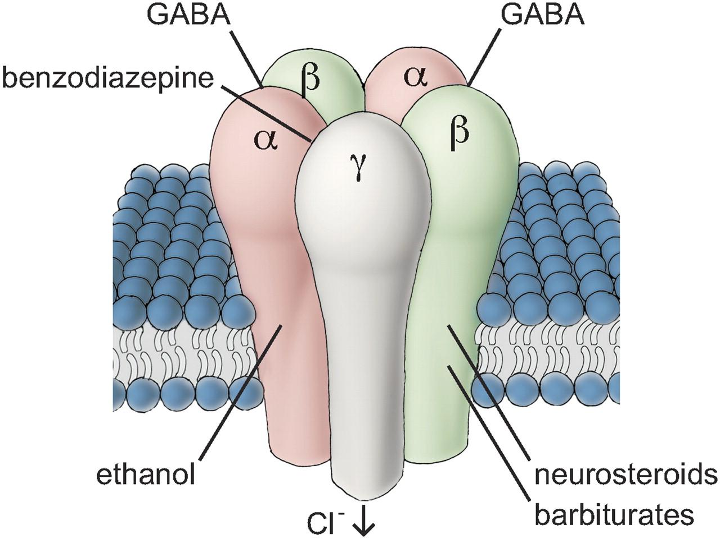

Slide 30
Non-Benzodiazepine Receptor Agonists [NBRAs]
Indications.
Short-term treatment of insomnia- Eszopiclone, Zaleplon
  Eszopiclone specifically reduces time to sleep onset and improves sleep maintenance
  Zaleplon reduces time to sleep onset only
2. Short-term treatment of insomnia characterized by difficulties with
a. Sleep onset - zolpidem, zolpidem CR
b. Sleep maintenance- zolpidem CR
3. Middle of the night awakening followed by difficulty falling back to sleep - zolpidem sublingual

Slide 31
B. Mechanism of Action
1. Eszopiclone - exact mechanism is unknown, but it is thought to interact with GABA-receptor complexes located near or allosterically coupled with BZD receptors.
2. Zaleplon - selectively binds to the omega-1 (BZD₁) receptor on the α subunit on GABA_{A} / chloride ion channel receptor complex and potentiates t-butyl- bicyclophosphorothionate binding.

Slide 32
Zolpidem - selectively binds to omega-1 (BZD₁)with a high affinity ratio of α₁ / α₅ subunits that may account for the lack of muscle relaxant, anxiolytic, and anticonvulsant effects and preservation of stage N3 sleep

Slide 33
Ramelteon
A. Indication - Insomnia characterized by difficulty with sleep onset.
B. Mechanism of Action
Melatonin type 1 (M₁) and melatonin type 2 (M₂) receptor agonist with a greater affinity and selectivity for these receptors than melatonin.
  Activity at M₁ is thought to attenuate the alerting signal from the SCN (regulating sleep onset).
  At M₂ to synchronize sleep-wake phases

Slide 34
Doxepin
Indication- sleep maintenance (less effective for promoting sleep onset).
B. Mechanism of Action - low doses exert effect through "selective" histamine type 1 antagonist activity

Slide 35
Suvorexant
Indication - Insomnia characterized by difficulties with sleep onset and/or maintenance.
B. Mechanism of Action - OX receptor antagonist highly selective at orexin type I (OX1) and orexin type 2 (OX2) receptors.

Slide 36
Natural Products
Melatonin- has the most promising evidence of the supplements used to manage insomnia
  Consider in circadian rhythm disorders (e.g., jet lag), delayed sleep phase syndrome, and patients with low endogenous melatonin levels
  May decrease sleep latency in children with sleep onset insomnia and delayed sleep phase syndrome .
  Adverse events are minimal, and it is considered safe for short-term use

Slide 37
B. Valerian- appears to act on central GABA systems
  Adverse effects- GI upset, headache, contact allergies, restless sleep, bitter taste, heart palpitations, depression, impaired alertness, and mydriasis
  C. German chamomile - sedative effects may be related to the BDZ-like compound on the flower head

Slide 38
-END-

