Slide 1
Over view of the CNS
Introduction to Neuropharmacology
MED IV & III

Slide 2
Introduction
The nervous system, comprised of two major components:
  Peripheral nervous system (PNS)
  Central nervous system (CNS),
    has three main functions: sensory input, integration of data, and motor output
The PNS is subdivided into sensory (afferent) and motor (efferent) divisions.
Afferent sensory neurons conduct signals from the PNS to the CNS. Efferent motor neurons conduct signals from the CNS to the PNS

Slide 3
The efferent motor division of the PNS is subdivided into somatic and autonomic systems
  The somatic nervous system controls voluntary movements.
  The autonomic nervous system (ANS) controls involuntary responses
The sympathetic division of the ANS mobilizes body systems and is responsible for “fight or flight” responses.
The parasympathetic division of the ANS conserves energy and is responsible for responses related to “calm and relaxation.”

Slide 4
The CNS has three functional levels:
  Neocortical, limbic, and vegetative.
  The vegetative or lowest level consists of the brain stem and the reticular activation system that connect the brain to the spinal cord.
  The mid-level is the limbic system or the emotional centre of the brain responsible for the biochemical events that constitute the stress response.
The highest and most sophisticated level of the brain is the Neocortex

Slide 5
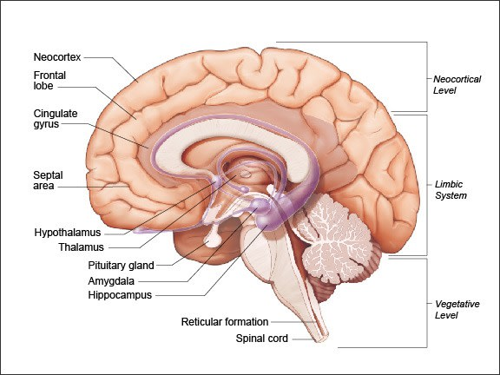

Slide 6
The Neocortex consists of grey matter surrounding the white matter of the cerebrum.
The cerebral hemispheres, which contain the cerebral cortex and basal ganglia, are connected by a bundle of nerve fibers called the corpus callosum.
The cerebral cortex is responsible for high-level functions, such as sensory perception, generation of motor commands, spatial reasoning, conscious thought, and in humans, language.

Slide 7
Basal Ganglia
Consist of three deep nuclei of gray matter and include the caudate and putamen nuclei - known as the striatum, and the Globus pallidus.
They help initiate and control cortical functions.
  These actions include intended movement, behaviour, and certain aspects of cognition.
Regions of the basal ganglia responsible for movement ensure that intended actions are carried out and irrelevant movements are inhibited.

Slide 8
Limbic system
The cerebral cortex contains parts of, and interacts with, elements of the limbic system.
Significant structures of the limbic system include:
cingulate gyrus, amygdala, hippocampus, thalamus, and hypothalamus.
The cingulate gyrus coordinates:
  Smells and sights with pleasant memories of previous emotions
  Participates in the emotional reaction to pain and the regulation of aggressive behaviour.

Slide 9
Hippocampus
Involved in:
  Learning memory, i.e., the conversion of temporary memories into permanent memories;
  Helps to analyse and remember special relationships essential for accurate movements
  Facilitates the use of memory to modify behaviour.
The amygdala connects with the hippocampus, the septal area, and the thalamus and mediates such feelings as friendship, affection, and expression of mood.

Slide 10
Thalamus & Hypothalamus
Various nuclei of the thalamus link sensory pathways from the periphery to the cortex and structures of the limbic system and is associated with changes in emotional activity.
The hypothalamus controls:
  Mood (e.g., expression of emotions such as pleasure, rage, aversion, and displeasure)
  Motivated behaviors such as sexuality and hunger
  Regulates thirst and body temperature
  Via the pituitary gland, controls hormonal processes

Slide 11
Cerebellum
Receives information related to spatial positioning; and sends signals to the motor areas of the cortex via the thalamus and down the spinal cord to regulate proprioception.
The cerebellum coordinates skeletal muscle activity in space and time; maintains balance
Controls eye movement
Influences motor learning (e.g., eye-hand coordination) and cognitive functions (e.g., timing of repetitive events and language).

Slide 12
Brainstem
The brainstem (medulla, pons and midbrain) connects the spinal cord to the thalamus and the cortex.
The medulla and pons contain control centres that direct the autonomic nuclei that regulate heart rate, respiration, digestive functions, and reflex reactions (e.g., coughing and vomiting).
In the midbrain, neurons in the periaqueductal gray send descending projections to the spinal cord and modulate pain perception.

Slide 13
Spinal cord
The spinal cord is organized into White and Gray matter.
White matter consists of fiber tracts that connect the periphery and spinal cord to more rostral areas of the CNS.
Gray matter consists of dorsal and ventral horns.
The dorsal horn relays sensory information from the periphery to the CNS.
The ventral horn relays signals from central motor areas to skeletal muscle. Interneurons connect sensory and motor neurons and mediate reflexes.

Slide 14
Distant areas of the nervous system connect to one another and relay signals between the PNS and the CNS via long-tract neurons.
Local circuit neurons maintain connectivity within a localized area of the CNS and modulate signal transmission.
Single-source divergent neurons originate in various nuclei of the brainstem, hypothalamus, and basal forebrain and innervate broad areas of the CNS

Slide 15
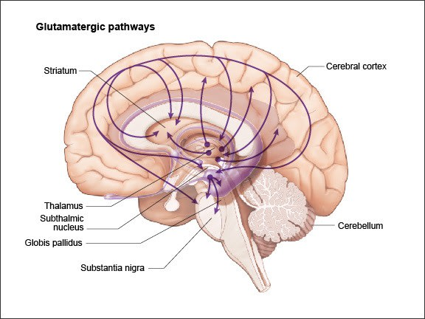
Glutamatergic neurons are found throughout the brain - most densely concentrated in the cerebral cortex, the hippocampus, the amygdala, the basal ganglia, the brain stem, and the spinal cord.

Slide 16
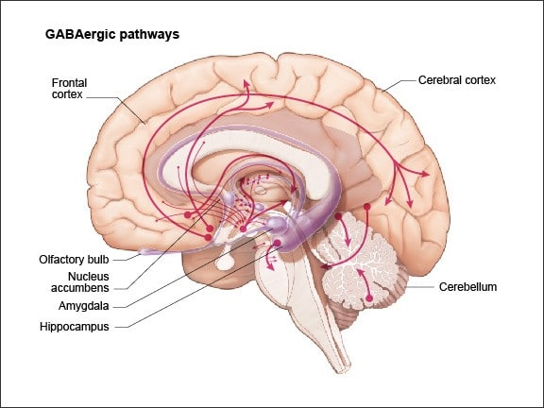
GABAergic neurons are found throughout the brain - most highly concentrated in the Substantia nigra and globus pallidus of the basal ganglia, the cerebellum, the hypothalamus, interneurons throughout the brain, the periaqueductal gray, and the spinal cord.

Slide 17
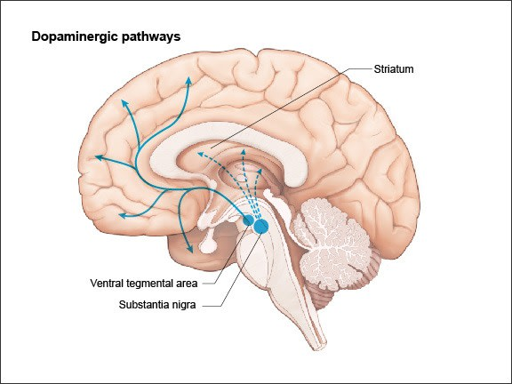
Dopaminergic neurons arise in the Substantia nigra and the ventral tegmental area and project to the striatum and the cerebral cortex, and to the amygdala and the hippocampus of the limbic system.

Slide 18
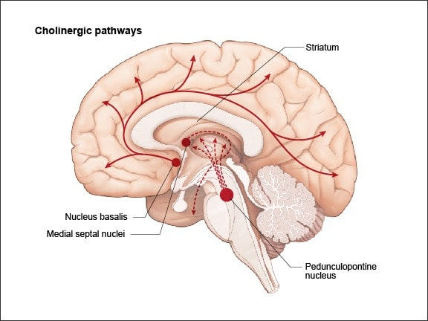
Cholinergic neurons arise in the pedunculopontine nucleus, the nucleus basalis, and the medial septal nuclei and project widely throughout the brain (hippocampus), and the spinal cord.

Slide 19
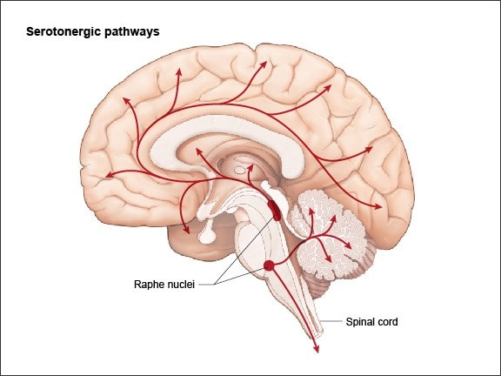
Serotonergic neurons arise in the raphe nuclei and project to the limbic system, the basal ganglia; and via the basal forebrain, to the cerebral hemispheres as well as the cerebellum and the spinal cord.

Slide 20
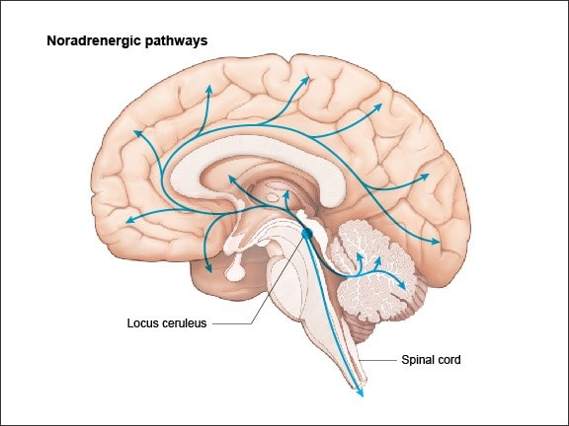
Noradrenergic neurons arise in the locus coeruleus and the lateral tegmental area and project widely throughout the cerebral cortex, the hypothalamus, the brain stem, cerebellum, and the spinal cord

Slide 21
Neurons communicate with one another and with other cells through the release of neurotransmitters.
Neurotransmitters are synthesized by cytoplasmic enzymes and are stored in neuronal vesicles.
When a nerve is stimulated its resting potential changes and the action potential generated causes an influx of Ca2+ ions into the presynaptic nerve terminal and the content of neurotransmitter-filled vesicles exocytose into the synaptic cleft.

Slide 22
The released neurotransmitter diffuses across the synaptic cleft and on the postsynaptic axonal membrane binds either to:
  A neurotransmitter-gated inotropic receptor and/or to a metabotropic receptor (e.g., a G protein-coupled receptor).
Inotropic receptor activation modulates ion channel function directly,
While metabotropic receptor activation leads mainly to cAMP-dependent modulation of other ion channels.

Slide 23
A neurotransmitter may be excitatory or inhibitory and in some cases both (as a function of receptor subtypes).
Excitatory neurotransmitters induce a net inward current by opening cation-specific ion channels, e.g., Na+ and Ca2+ ion channels; or by closing K+ ion “leak channels.”
  The net influx of Na+ and Ca2+ ions and the reduced outward flow of K+ ions across the neuronal membrane results in axonal membrane depolarization.

Slide 24
Inhibitory neurotransmitters induce a net outward current by opening K+ ion channels or Cl‑ ion channels and induce K+ efflux or Cl‑ influx, respectively.
The loss of intracellular cations (i.e., K+ ions) and the gain of intracellular anions (i.e., Cl‑ ions) moves the membrane potential away from its threshold value, reduces the ability of inward current to depolarize the membrane, and results in neuronal membrane hyperpolarization.

Slide 25
Termination of inotropic neurotransmission at postsynaptic neurons is accomplished by two mechanisms:
  Degradation of the neurotransmitter by enzymes in the synaptic cleft
  Neurotransmitter uptake into the presynaptic terminal by specific transporters allowing the neurotransmitter to be recycled into synaptic vesicles for storage.
Termination of signalling by a G protein-coupled neurotransmitter also involves intracellular enzymes.

Slide 26
Neurotransmitters in the CNS include:
Acetylcholine , amino acids, monoamines, and a number of neuroactive peptides and purines.
Major amino acids neurotransmitters include: glutamate, gamma-aminobutyric acid (GABA), and others such as glycine and aspartate.
Major monoamine neurotransmitters include: the catecholamines dopamine and norepinephrine; and the indoleamine- serotonin

Slide 27
MAJOR NT IN CNS
NEUROTRANSMITTER SYSTEM | RECEPTOR TYPES | FUNCTIONAL CLASS | MAJOR ACTIONS
GLUTAMATE | Ionotropic Kinate NMDA,AMPA Metabotropic mGlu₁ & mGlu₅ | Excitatory Inhibitory | Memory, Learning
GABA | Ionotropic GABA_{A} Metabotropic GABA_{B} | Inhibitory | Sleep, muscle tone, source of well being
DOPAMINE | Metabotropic D₁ & D₅ D₂,D₃&D₄ | Excitatory Inhibitory | Movement,attention,learning,emotional regulation,memory,motivation(reward system),executive functions

Slide 28
NOREPHINEPHRINE | Metabotropic α1, β1, β2, and β3 α2 | Excitatory Inhibitory | Vigilance, alertness, responsiveness to unexpected stimuli, source of well-being, sleep-wakefulness, learning, memory, attention, consciousness, regulates temperature and pituitary function, reduced digestion, increased heartbeat
SEROTONIN | Ionotropic 5-HT3 Metabotropic 5-HT1 5-HT2 and 5-HT4-7 | EXCITATORY INHIBITORY EXCITATORY | Mood, arousal, modulates eating (appetite), pain perception, behaviour, regulates body temperature, sexual behaviour
ACETYLCHOLINE | Ionotropic Nicotinic Metabotropic Muscarinic M1 and M5 Muscarinic M4 | EXCITATORY EXCITATORY INHIBITORY | Alertness, sleep-wakefulness, skeletal muscle contraction, memory formation, learning and general intellectual functioning, sensory responses

Slide 29
Neurotransmitter | Postsynaptic effect | Derived from | Site of synthesis | Postsynaptic receptor | Fate
1.Acetyl choline (Ach) | Excitatory | Acetyl co-A + Choline | Cholinergic nerve endings Cholinergic pathways of brainstem | Nicotinic Muscarinic | Broken by acetyl cholinesterase
2. Catecholamines i. Epinephrine (adrenaline) | Excitatory in some but inhibitory in other | Tyrosine produced in liver from phenylalanine | Adrenal medulla and some CNS cells | Excites both alpha α & beta β receptors | Catabolized to inactive product through COMT & MAO in liver Reuptake into adrenergic nerve endings Diffusion away from nerve endings to body fluid
ii.Norepinephrine | Excitatory | Tyrosine, found in pons. Reticular formation, locus coerules, thalamus, mid-brain | Begins inside axoplasm of adrenergic nerve ending is completed inside the secretary vesicles | α₁ α₂ β₁ β₂
iii. Dopamine | Excitatory | Tyrosine | CNS, concentrated in basal ganglia and dopamine pathways e.g. nigrostriatal, mesocorticolimbic and tubero-hypophyseal pathway | D₁ to D₅ receptor | Same as above

Slide 30
Neurotransmitter | Postsynaptic effect | Derived from | Site of synthesis | Postsynaptic receptor | Fate
3. serotonin (5HT) | Excitatory | Tryptophan | CNS, Gut (chromaffin cells) Platelets & retina | 5-HT₁ to 5-HT ₇ 5-HT ₂ A receptor mediate platelet aggregation & smooth muscle contraction | Inactivated by MAO to form 5-hydroxyindoleacetic acid(5-HIAA) in pineal body it is converted to melatonin
4. Histamine | Excitatory | Histidine | Hypothalamus | Three types H_{1,} H_{2 ,}H₃ receptors found in peripheral tissues & the brain | Enzyme diamine oxidase (histaminase) cause breakdown
5. Glutamate | Excitatory 75% of excitatory transmission in the brain | By reductive amination of Kreb’s cycle intermediate α –ketoglutarate. | Brain & spinal cord e.g. hippocampus | Ionotropic and metabotropic receptors. Three types of ionotropic receptors e.g. NMDA, AMPA and kainate receptors. | It is cleared from the brain ECF by Na ⁺ dependent uptake system in neurons and neuroglia.

Slide 31
Neurotransmitter | Postsynaptic effect | Derived from | Site of synthesis | Postsynaptic receptor
6. Aspartate | Excitatory | Acidic amines | Spinal cord | Spinal cord
7. Gama amino butyric acid(GABA) | Major inhibitory mediator | Decarboxylation of glutamate by glutamate decarboxylase (GAD) by GABAergic neuron. | CNS | GABA – A increases the Cl ⁻ conductance, GABA – B is metabotropic works with G – protein GABA transaminase catalyzes. GABA – C found exclusively in the retina.
8. Glycine | Inhibitory | Is simple amino acid having amino group and a carboxyl group attached to a carbon atom | Spinal cord | Glycine receptor makes postsynaptic membrane more permeable to Cl⁻ ion.

Slide 32
-END-

