Slide 1
Brainstem
H.Z. Mwale

Slide 2
Introduction
The brain stem is located between the cerebrum and the spinal cord
Consists of the midbrain, pons and medulla oblongata
It occupies the posterior cranial fossa of the skull
Gives rise to cranial nerves III to XII
Microscopically, it consists of deep gray matter surrounded by white matter fibre tracts

Slide 3
Functions:
The brainstem has three broad functions:
It serves as a conduit for the ascending tracts and descending tracts connecting the spinal cord to the different parts of the higher centers in the forebrain
It contains important reflex centers associated with the control of respiratory and cardiovascular functions and consciousness
It contains the important nuclei of cranial nerves III through XII

Slide 4
Midbrain
The midbrain measures about 2 cm in length and connects the pons and cerebellum with the forebrain.
Its long axis inclines anteriorly as it ascends through the opening in the tentorium cerebelli.
The midbrain is traversed by a narrow channel, the cerebral aqueduct, which is filled with cerebrospinal fluid.

Slide 5
The midbrain comprises two lateral halves, called the cerebral peduncles;
Each of these is divided into an anterior part, the crus cerebri, and a posterior part, the tegmentum, by a pigmented band of gray matter, the substantia nigra
In the tegmentum is the red nucleus which contains numerous blood vessels and receives info from the cerebrum and cerebellum and issues subconscious motor commands concerned with muscle tone and posture
Lateral to the red nucleus is the melanin-containing substantia nigra which secretes dopamine to inhibit the excitatory neurons of the basal nuclei

Slide 6
Midbrain
On the posterior surface are four colliculi (corpora quadrigemina).
These are rounded eminences that are divided into superior and inferior pairs by a vertical and a transverse groove
The superior colliculi are centers for visual reflexes and the inferior colliculi are lower auditory centers.
In the midline below the inferior colliculi, the trochlear nerves emerge.
These are small-diameter nerves that wind around the lateral aspect of the midbrain to enter the lateral wall of the cavernous sinus.

Slide 7
Midbrain
On the lateral aspect of the midbrain, the superior and inferior brachia ascend in an anterolateral direction
The superior brachium passes from the superior colliculus to the lateral geniculate body and the optic tract.
The inferior brachium connects the inferior colliculus to the medial geniculate body
On the anterior aspect of the midbrain, there is a deep depression in the midline, the interpeduncular fossa, which is bounded on either side by the crus cerebri.
Many small blood vessels perforate the floor of the interpeduncular fossa, and this region is termed the posterior perforated substance.
The oculomotor nerve emerges from a groove on the medial side of the crus cerebri and passes forward in the lateral wall of the cavernous sinus

Slide 9
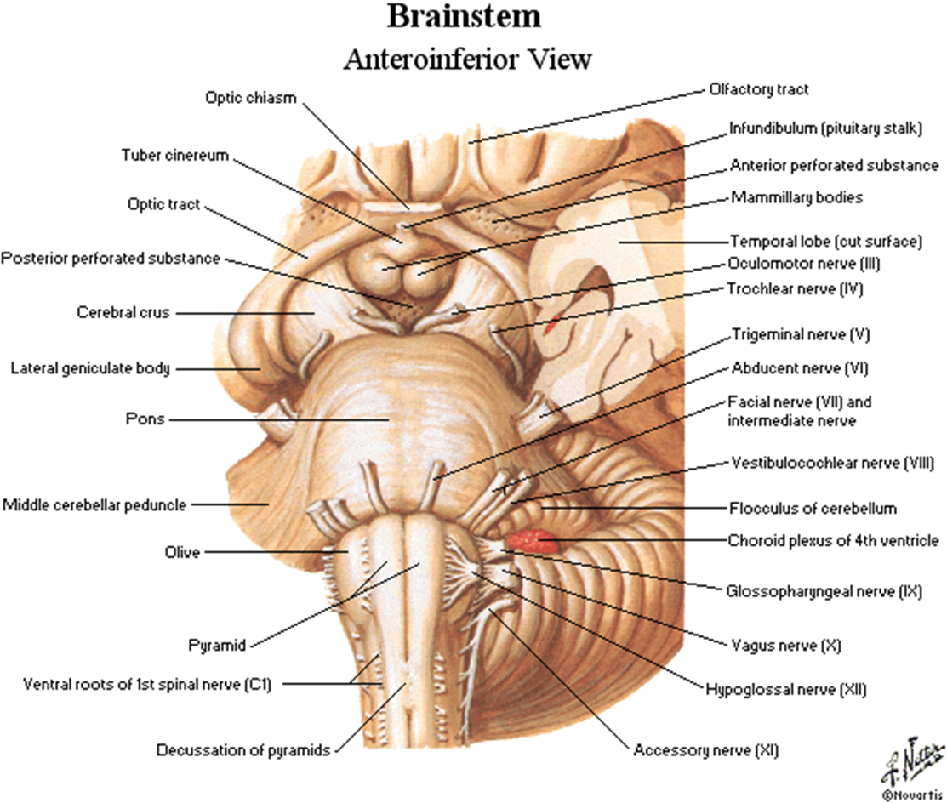


Slide 10
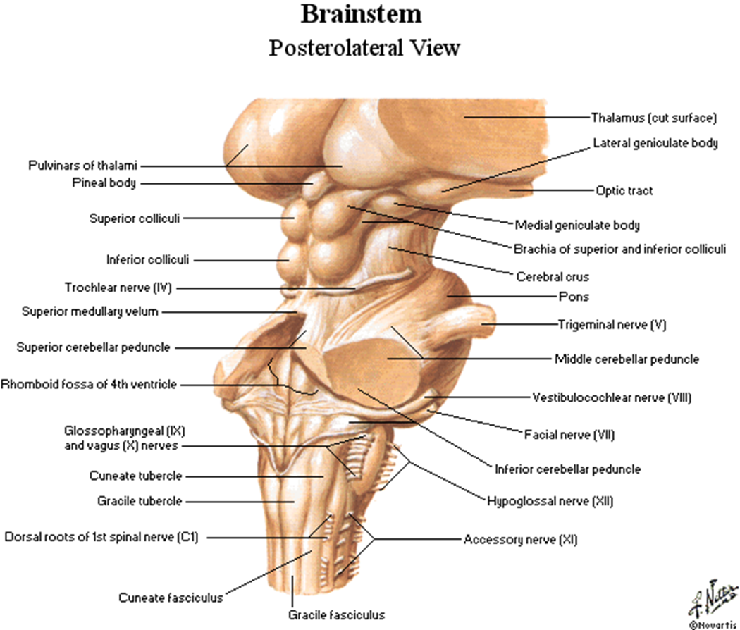

Slide 11
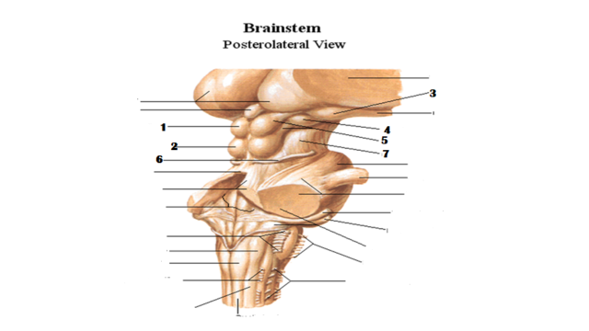

Slide 12
Internal structure of the midbrain
The midbrain comprises two lateral halves, called the cerebral peduncles; each of these is divided into an anterior part, the crus cerebri, and a posterior part, the tegmentum, by a pigmented band of grey matter, the substantia nigra
The narrow cavity of the midbrain is the cerebral aqueduct, which connects the third and fourth ventricles.

Slide 13
Internal structure of the midbrain
The tectum is the part of the midbrain posterior to the cerebral aqueduct; it has four small surface swellings known as corpora quadrigemina
The cerebral aqueduct is lined by ependyma and is surrounded by the central grey matter.
On transverse sections of the midbrain, the interpeduncular fossa can be seen to separate the crura cerebri, whereas the tegmentum is continuous across the median plane

Slide 14
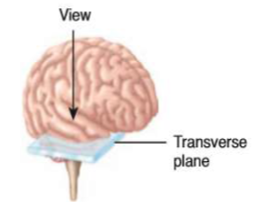
Posterior

Slide 16
Cerebral peduncle includes : Basis pedunculi, Substantia nigra and tegmentum which includes red nuclei.
■ Basis pedunculi – consists of large mass of vertically running descending fibres from cerebral cortex.
■ Substantia nigra – mass of pigmented gray matter, Part of basal ganglia.
■ Tegmentum
Consists of red nucleus which is involved in regulation of posture, control muscular movements, muscle tone, movements of eyeball, etc.
Nuclei of III and IV cranial nerves.
Reticular formation - small clusters of neuronal cell bodies (gray matter) interspersed among small bundles of myelinated axons (white matter).

Slide 17
Transverse section of the midbrain at the level of the inferior colliculi
The inferior colliculus, consisting of a large nucleus of grey matter, lies beneath the corresponding surface elevation and forms part of the auditory pathway.
It receives many of the terminal fibres of the lateral lemniscus.
The pathway then continues through the inferior brachium to the medial geniculate body.

Slide 18
Transverse section of the midbrain at the level of the inferior colliculi
The trochlear nucleus is situated in the central grey matter close to the median plane just posterior to the medial longitudinal fasciculus.
The emerging fibres of the trochlear nucleus pass laterally and posteriorly around the central grey matter and leave the midbrain just below the inferior colliculi.
The fibres of the trochlear nerve now decussate completely in the superior medullary velum.
The mesencephalic nuclei of the trigeminal nerve are lateral to the cerebral aqueduct.
The decussation of the superior cerebellar peduncles occupies the central part of the tegmentum anterior to the cerebral aqueduct.
The reticular formation is smaller than that of the pons and is situated lateral to the decussation

Slide 19
Transverse section of the midbrain at the level of the inferior colliculi
The medial lemniscus ascends posterior to the substantia nigra the spinal and trigeminal lemnisci are situated lateral to the medial lemniscus.
The lateral lemniscus is located posterior to the trigeminal lemniscus.
The substantia nigra is a large motor nucleus situated between the tegmentum, and the crus cerebri and is found throughout the midbrain.
The nucleus is composed of medium-size multipolar neurons that possess inclusion granules of melanin pigment within their cytoplasm.
The substantia nigra is concerned with muscle tone and is connected to the cerebral cortex, spinal cord, hypothalamus, and basal nuclei

Slide 20
Transverse section of the midbrain at the level of the inferior colliculi
The crus cerebri contains important descending tracts and is separated from the tegmentum by the substantia nigra.
The corticospinal and corticonuclear fibres occupy the middle two-thirds of the crus.
The frontopontine fibres occupy the medial part of the crus, and the temporopontine fibres occupy the lateral part of the crus.
These descending tracts connect the cerebral cortex to the anterior grey column cells of the spinal cord, the cranial nerve nuclei, the pons, and the cerebellum.

Slide 21
Transverse section of the midbrain at the level of the superior colliculi
The superior colliculus, a large nucleus of grey matter that lies beneath the corresponding surface elevation, forms part of the visual reflexes.
It is connected to the lateral geniculate body by the superior brachium.
It receives afferent fibres from the optic nerve, the visual cortex, and the spinotectal tract.
The efferent fibres form the tectospinal and tectobulbar tracts, which are probably responsible for the reflex movements of the eyes, head, and neck in response to visual stimuli.
The afferent pathway for the light reflex ends in the pretectal nucleus.

Slide 22
Transverse section of the midbrain at the level of the superior colliculi
This is a small group of neurons situated close to the lateral part of the superior colliculus.
After relaying in the pretectal nucleus, the fibres pass to the parasympathetic nucleus of the oculomotor nerve (Edinger-Westphal nucleus).
The emerging fibres then pass to the oculomotor nerve.
The oculomotor nucleus is situated in the central grey matter close to the median plane, just posterior to the medial longitudinal fasciculus.
The fibres of the oculomotor nucleus pass anteriorly through the red nucleus to emerge on the medial side of the crus cerebri in the interpeduncular fossa.
The nucleus of the oculomotor nerve is divisible into a number of cell groups.

Slide 23
Transverse section of the midbrain at the level of the superior colliculi
The medial, spinal, and trigeminal lemnisci form a curved band posterior to the substantia nigra, but the lateral lemniscus does not extend superiorly to this level.
The red nucleus is a rounded mass of grey matter situated between the cerebral aqueduct and the substantia nigra.
Its reddish hue, seen in fresh specimens, is due to its vascularity and the presence of an iron-containing pigment in the cytoplasm of many of its neurons.

Slide 24
Transverse section of the midbrain at the level of the superior colliculi
Afferent fibres reach the red nucleus from (1) the cerebral cortex through the corticospinal fibres, (2) the cerebellum through the superior cerebellar peduncle, and (3) the lentiform nucleus, subthalamic and hypothalamic nuclei, substantia nigra, and spinal cord.
Efferent fibres leave the red nucleus and pass to (1) the spinal cord through the rubrospinal tract (as this tract descends, it decussates), (2) the reticular formation through the rubroreticular tract, (3) the thalamus, and (4) the substantia nigra.

Slide 25
Transverse section of the midbrain at the level of the superior colliculi
The reticular formation is situated in the tegmentum lateral and posterior to the red nucleus
The crus cerebri contains the identical important descending tracts—the corticospinal, corticonuclea, and corticopontine fibres—that are present at the level of the inferior colliculus.

Slide 27
The pons

Slide 28
The pons
Is anterior to the cerebellum and connects the medulla oblongata to the midbrain.
It is about 2.5 cm long and owes its name to the appearance presented on the anterior surface, which is that of a bridge connecting the right and left cerebellar hemispheres.
The anterior surface is convex from side to side and shows many transverse fibres that converge on each side to form the middle cerebellar peduncle.
There is a shallow groove in the midline, the basilar groove, which lodges the basilar artery.
On the anterolateral surface of the pons, the trigeminal nerve emerges on each side.
Each nerve consists of a smaller, medial part, known as the motor root, and a larger, lateral part, known as the sensory root.
In the groove between the pons and the medulla oblongata, there emerge, from medial to lateral, the abducent, facial, and vestibulocochlear nerve

Slide 29
Pons
The posterior surface of the pons is hidden from view by the cerebellum.
It forms the upper half of the floor of the fourth ventricle and is triangular in shape.
The posterior surface is limited laterally by the superior cerebellar peduncles and is divided into symmetrical halves by a median sulcus.
Lateral to this sulcus is an elongated elevation, the medial eminence, which is bounded laterally by a sulcus, the sulcus limitans.

Slide 30
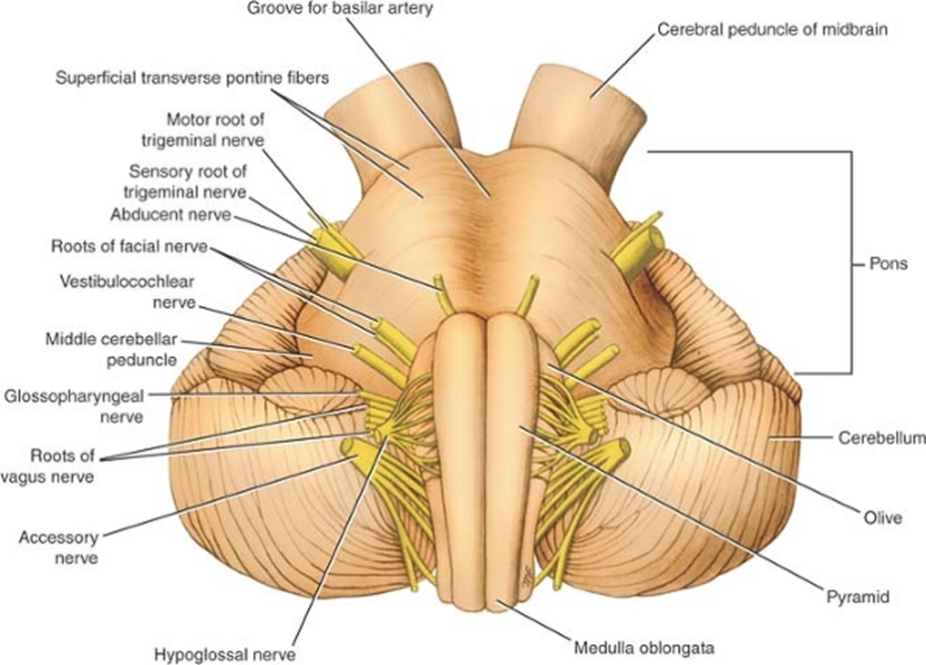

Slide 31
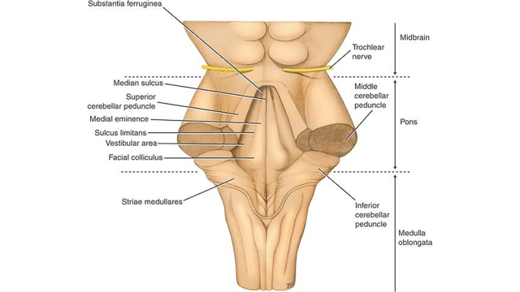

Slide 32
Pons
The inferior end of the medial eminence is slightly expanded to form the facial colliculus, which is produced by the root of the facial nerve winding around the nucleus of the abducent nerve.
The floor of the superior part of the sulcus limitans is bluish-grey in colour and is called the substantia ferruginea; it owes its colour to a group of deeply pigmented nerve cells.
Lateral to the sulcus limitans is the area vestibuli produced by the underlying vestibular nuclei

Slide 33
Internal structure of the pons
The structure of the pons may be studied at two levels:-
transverse section through the caudal part, passing through the facial colliculus
transverse section through the cranial part, passing through the trigeminal nuclei.

Slide 34
Transverse Section Through the Caudal Part
The medial lemniscus rotates as it passes from the medulla into the pons.
It is situated in the most anterior part of the tegmentum, with its long axis running transversely.
The medial lemniscus is accompanied by the spinal and lateral lemnisci.
The facial nucleus lies posterior to the lateral part of the medial lemniscus.
The fibres of the facial nerve wind around the nucleus of the abducent nerve, producing the facial colliculus.

Slide 35
Transverse section through the caudal part
The medial longitudinal fasciculus is situated beneath the floor of the fourth ventricle on either side of the midline.
The medial longitudinal fasciculus is the main pathway that connects the vestibular and cochlear nuclei with the nuclei controlling the extraocular muscles (oculomotor, trochlear, and abducent nuclei)
The medial vestibular nucleus is situated lateral to the abducent nucleus and is in close relationship to the inferior cerebellar peduncle.
The superior part of the lateral and the inferior part of the superior vestibular nucleus are found at this level.

Slide 36
Transverse section through the caudal part
The posterior and anterior cochlear nuclei are also found at this level.
The spinal nucleus of the trigeminal nerve and its tract lie on the anteromedial aspect of the inferior cerebellar peduncle
The trapezoid body is made up of fibres derived from the cochlear nuclei and the nuclei of the trapezoid body.
They run transversely in the anterior part of the tegmentum

Slide 37
Transverse section through the caudal part
The basilar part of the pons, at this level, contains small masses of nerve cells called pontine nuclei.
The corticopontine fibres of the crus cerebri of the midbrain terminate in the pontine nuclei.
The axons of these cells give origin to the transverse fibres of the pons, which cross the midline and intersect the corticospinal and corticonuclear tracts, breaking them up into small bundles.
The transverse fibres of the pons enter the middle cerebellar peduncle and are distributed to the cerebellar hemisphere.
This connection forms the main pathway linking the cerebral cortex to the cerebellum

Slide 38
Transverse section through the cranial part
The internal structure of the cr.anial part of the pons is similar to that seen at the caudal level but it now contains the motor and principal sensory nuclei of the trigeminal nerve.
The motor nucleus of the trigeminal nerve is situated beneath the lateral part of the fourth ventricle within the reticular formation
The emerging motor fibres travel anteriorly through the substance of the pons and exit on its anterior surface
The principal sensory nucleus of the trigeminal nerve is situated on the lateral side of the motor nucleusit is continuous inferiorly with the nucleus of the spinal tract.

Slide 39
Transverse section through the cranial part
The entering sensory fibres travel through the substance of the pons and lie lateral to the motor fibres
The superior cerebellar peduncle is situated posterolateral to the motor nucleus of the trigeminal nerve.
It is joined by the anterior spinocerebellar tract
The trapezoid body and the medial lemniscus are situated in the same position as they were in the previous section
The lateral and spinal lemnisci lie at the lateral extremity of the medial lemniscus

Slide 42
Medulla oblongata

Slide 43
Medulla oblongata
Connects the pons superiorly with the spinal cord inferiorly.
The junction of the medulla and spinal cord is at the origin of the anterior and posterior roots of the first cervical spinal nerve, which corresponds to the level of the foramen magnum.
The medulla oblongata is conical in shape, its broad extremity being directed superiorly.
The central canal of the spinal cord continues upward into the lower half of the medulla; in the upper half of the medulla, it expands as the cavity of the fourth ventricle

Slide 44
Medulla oblongata
On the anterior surface of the medulla is the anterior median fissure, which is continuous inferiorly with the anterior median fissure of the spinal cord.
On each side of the median fissure, there is the pyramid.
The pyramids are composed of bundles of nerve fibres, called corticospinal fibres, which originate in large nerve cells in the precentral gyrus of the cerebral cortex.
The pyramids taper inferiorly, and it is here that the majority of the descending fibres cross over to the opposite side, forming the decussation of the pyramids.
The anterior external arcuate fibres are a few nerve fibres that emerge from the anterior median fissure above the decussation and pass laterally over the surface of the medulla oblongata to enter the cerebellum.

Slide 45
Medulla oblongata
Posterolateral to the pyramids are the olives, which are oval elevations produced by the underlying inferior olivary nuclei.
In the groove between the pyramid and the olive emerge the rootlets of the hypoglossal nerve.
Posterior to the olives are the inferior cerebellar peduncles which connect the medulla to the cerebellum.
In the groove between the olive and the inferior cerebellar peduncle emerge the roots of the glossopharyngeal and vagus nerves and the cranial roots of the accessory nerve.

Slide 46
Medulla oblongata
The posterior surface of the superior half of the medulla oblongata forms the lower part of the floor of the fourth ventricle.
The posterior surface of the inferior half of the medulla is continuous with the posterior aspect of the spinal cord and possesses a posterior median sulcus.
On each side of the median sulcus, there is an elongated swelling, the gracile tubercle, produced by the underlying gracile nucleus.
Lateral to the gracile tubercle is a similar swelling, the cuneate tubercle, produced by the underlying cuneate nucleus

Slide 47
Internal structure of the medulla oblongata
The medulla oblongata consists of white and grey matter though rearranged compared to the spinal cord.
This rearrangement can be explained embryologically by the expansion of the neural tube to form the hindbrain vesicle, which becomes the fourth ventricle.
The extensive lateral spread of the fourth ventricle results in an alteration in the position of the derivatives of the alar and basal plates of the embryo.

Slide 48
Internal structure of the medulla oblongata
The internal structure of the medulla oblongata is considered at four levels:-
level of decussation of pyramids
level of decussation of lemnisci
level of the olives.
level just inferior to the pons.

Slide 49
Level of Decussation of Pyramids
A transverse section through the inferior half of the medulla oblongata passes through the decussation of the pyramids, the great motor decussation.
In the superior part of the medulla, the corticospinal fibres occupy and form the pyramid, but inferiorly, about three-fourths of the fibres cross the median plane and continue down the spinal cord in the lateral white column as the lateral corticospinal tract.
As these fibres cross the midline, they sever the continuity between the anterior column of the grey matter of the spinal cord and the grey matter that surrounds the central canal.

Slide 50
Level of Decussation of Pyramids
The fasciculus gracilis and the fasciculus cuneatus continue to ascend superiorly posterior to the central grey matter.
The nucleus gracilis and the nucleus cuneatus appear as posterior extensions of the central grey matter
The substantia gelatinosa in the posterior grey column of the spinal cord becomes continuous with the inferior end of the nucleus of the spinal tract of the trigeminal nerve.

Slide 51
Level of Decussation of Lemnisci
A transverse section through the inferior half of the medulla oblongata, a short distance above the level of the decussation of the pyramids, passes through the decussation of lemnisci, the great sensory decussation
The decussation of the lemnisci takes place anterior to the central grey matter and posterior to the pyramids.

Slide 52
Level of Decussation of Lemnisci
It should be understood that the lemnisci have been formed from the internal arcuate fibres, which have emerged from the anterior aspects of the nucleus gracilis and nucleus cuneatus.
The internal arcuate fibres first travel anteriorly and laterally around the central grey matter.
They then curve medially toward the midline, where they decussate with the corresponding fibres of the opposite side.

Slide 53
Level of Decussation of Lemnisci
The nucleus of the spinal tract of the trigeminal nerve lies lateral to the internal arcuate fibres.
The spinal tract of the trigeminal nerve lies lateral to the nucleus.
The lateral and anterior spinothalamic tracts and the spinotectal tracts occupy an area lateral to the decussation of the lemnisci
They are very close to one another and collectively are known as the spinal lemniscus.
The spinocerebellar, vestibulospinal, and the rubrospinal tracts are situated in the anterolateral region of the medulla oblongata.

Slide 54
Level of the Olives
A transverse section through the olives passes across the inferior part of the fourth ventricle
The amount of grey matter has increased at this level owing to the presence of the olivary nuclear complex; the nuclei of the vestibulocochlear, glossopharyngeal, vagus, accessory, and hypoglossal nerves; and the arcuate nuclei.

Slide 55
Olivary Nuclear Complex
The largest nucleus of this complex is the inferior olivary nucleus
The grey matter is shaped like a crumpled bag with its mouth directed medially
It is responsible for the elevation on the surface of the medulla called the olive.
Smaller dorsal and medial accessory olivary nuclei also are present.
The cells of the inferior olivary nucleus send fibres medially across the midline to enter the cerebellum through the inferior cerebellar peduncle.
Afferent fibres reach the inferior olivary nuclei from the spinal cord (the spino-olivary tracts) and from the cerebellum and cerebral cortex.
The function of the olivary nuclei is associated with voluntary muscle movement

Slide 56
Vestibulocochlear Nuclei
The vestibular nuclear complex is made up of the following nuclei:-
medial vestibular nucleus
inferior vestibular nucleus
lateral vestibular nucleus
superior vestibular nucleus.
There are two cochlear nuclei.
The anterior cochlear nucleus is situated on the anterolateral aspect of the inferior cerebellar peduncle
the posterior cochlear nucleus is situated on the posterior aspect of the peduncle lateral to the floor of the fourth ventricle.

Slide 57
The Nucleus Ambiguus
The nucleus ambiguus consists of large motor neurons and is situated deep within the reticular formation.
The emerging nerve fibres join the glossopharyngeal, vagus, and cranial part of the accessory nerve and are distributed to voluntary skeletal muscle.

Slide 58
Central grey Matter
The central grey matter lies beneath the floor of the fourth ventricle at this level
Passing from medial to lateral, the following important structures may be recognized:-
the hypoglossal nucleus
the dorsal nucleus of the vagus
the nucleus of the tractus solitarius
the medial and inferior vestibular nuclei

Slide 59
Central grey Matter
The arcuate nuclei are thought to be inferiorly displaced pontine nuclei and are situated on the anterior surface of the pyramids
They receive nerve fibres from the cerebral cortex and send efferent fibres to the cerebellum through the anterior external arcuate fibres
The pyramids containing the corticospinal and some corticonuclear fibres are situated in the anterior part of the medulla separated by the anterior median fissure
The corticospinal fibres descend to the spinal cord, and the corticonuclear fibres are distributed to the motor nuclei of the cranial nerves situated within the medulla.

Slide 60
Central grey Matter
The medial lemniscus forms a flattened tract on each side of the midline posterior to the pyramid
These fibres emerge from the decussation of the lemnisci and convey sensory information to the thalamus
The medial longitudinal fasciculus forms a small tract of nerve fibres situated on each side of the midline posterior to the medial lemniscus and anterior to the hypoglossal nucleus
It consists of ascending and descending fibres

Slide 61
Central grey Matter
The inferior cerebellar peduncle is situated in the posterolateral corner of the section on the lateral side of the fourth ventricle
The spinal tract of the trigeminal nerve and its nucleus are situated on the anteromedial aspect of the inferior cerebellar peduncle
The anterior spinocerebellar tract is situated near the surface in the interval between the inferior olivary nucleus and the nucleus of the spinal tract of the trigeminal nerve.

Slide 62
Central grey Matter
The reticular formation, consisting of a diffuse mixture of nerve fibres and small groups of nerve cells, is deeply placed posterior to the olivary nucleus.
The reticular formation represents, at this level, only a small part of this system, which is also present in the pons and midbrain
The glossopharyngeal, vagus, and cranial part of the accessory nerves can be seen running forward and laterally through the reticular formation.
The nerve fibres emerge between the olives and the inferior cerebellar peduncles.
The hypoglossal nerves also run anteriorly and laterally through the reticular formation and emerge between the pyramids and the olive

Slide 63
Level Just Inferior to the Pons
There are no major changes, in comparison to the previous level, in the distribution of the grey and white matter.
The lateral vestibular nucleus has replaced the inferior vestibular nucleus, and the cochlear nuclei now are visible on the anterior and posterior surfaces of the inferior cerebellar peduncle

Slide 65
Applied anatomy
Parkinson disease
Arnold-Chiari Phenomenon
Lateral Medullary Syndrome of Wallenberg
- thrombosis of PICA
- dysphagia and dysarthria due to paralysis of the ipsilateral palatal and laryngeal muscles (innervated by the nucleus ambiguus)

Slide 66
Weber’s syndrome
Occlusion of branch of posterior cerebral artery
Damage:
- Corticospinal tract
- Motor nucleus of oculomotor nerve (inability to raise upper eyelid,
lateral strabismus, paralysis of all eye muscles except lateral rectus
and superior oblique, pupil dilation because of interruption of
parasympathetic fibres)

Slide 67
Medial Medullary Syndrome
Occlusion of branches of vertebral and anterior spinal arteries
Structures affected: pyramidal tract, medial lemniscus, nucleus CN XII
Contralateral arm or leg weakness
Contralateral decreased proprioception/vibration sense
Ipsilateral tongue weakness

Slide 68
Infarction of the pons is due to thrombosis or embolism of the basilar artery or its branches
As in other parts of the brainstem, the midbrain can be a site for tumours, haemorrhage, or infarcts that will produce a wide variety of symptoms and signs
Blockage of the cerebral aqueduct causing hydrocephalus

