Slide 1
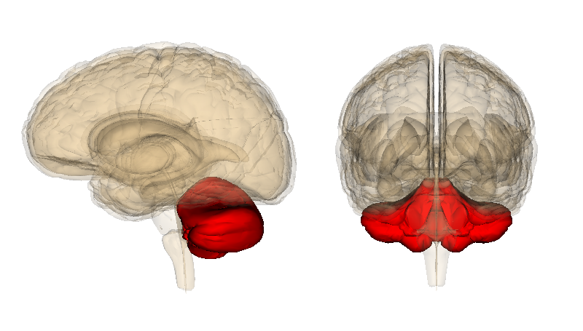
The Cerebellum
Mrs H. Mwale

Slide 2
Brief Development
The lips develop from the dorsolateral portions of the alar plates of the rhombencephalon forming the cerebellar primordia.
Growth causes the 2 rhombic lips to fuse in the midline to form the cerebellar plate which covers the 4th ventricle caudal to the mesencephalon.

Slide 3
Anatomy
Largest part of hindbrain
Occupies most of posterior cranial fossa
Lies behind pons & medulla forming roof of 4th ventricle
Separated from posterior part of cerebrum by tentorium cerebelli

Slide 4
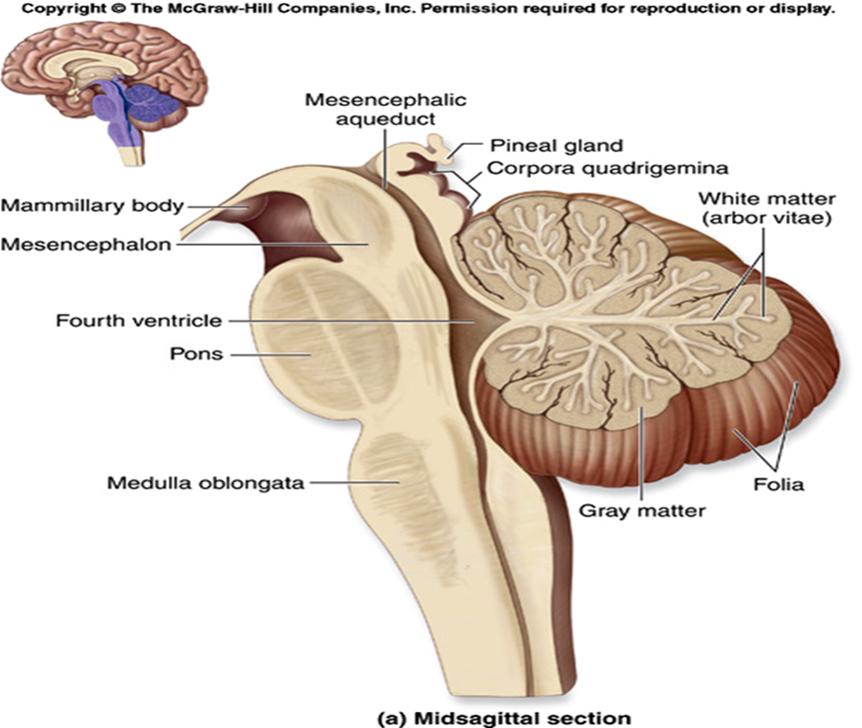

Slide 5
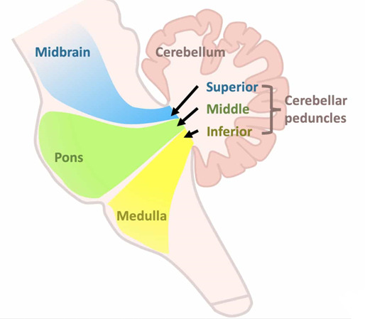
Connection to the Brain

Slide 6
Connection to the Brain
Superior Cerebellar Peduncle (brachium conjunctivum) Connects with midbrain
Middle Cerebellar Peduncle (brachium pontis) Connects with pons
Inferior Cerebellar Peduncle (restiform body) Connects with medulla

Slide 7
Function
The cerebellum has 3 major functional roles including;
Coordination of Movement-the cerebellum controls the timing and pattern of muscle activation during movement.
Maintenance of Equilibrium (in conjunction with the vestibular system)
Regulation of Muscle Tone-modulates spinal cord and brain stem mechanisms involved in posture control.

Slide 8
CONTROL OF VOLUNTARY MOVEMENT:
Act as a “comparator of a servo mechanism”
Cerebellum receives two types of information
  intended plan of movement (direct information from the motor cortex)
  what actual movements result (feedback from periphery)
These two are compared: an error is calculated
Corrective output signals goes to
  motor cortex via thalamus
  brain stem nuclei and then down to the anterior horn cell through extrapyramidal tracts

Slide 9
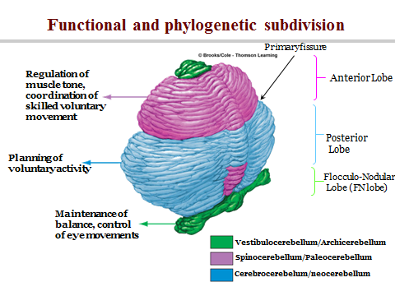

Slide 10
Topography
Two cerebellar hemispheres .
Median vermis.
Two surfaces
  superior and inferior
3 fissures:
  Primary fissure (fissura prima)
  horizontal fissure
  posterolateral fissure

Slide 11
3 lobes in each hemisphere
  Anterior
  Posterior
  Flocculonodular.
The lobes are separated by 2 fissures;
  The primary fissure
  Posterior fissure

Slide 12
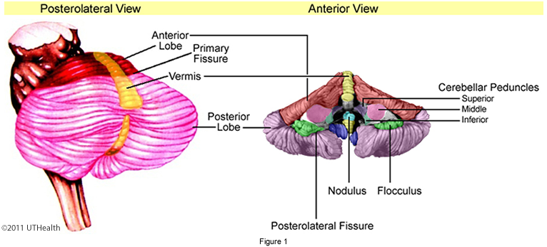

Slide 13
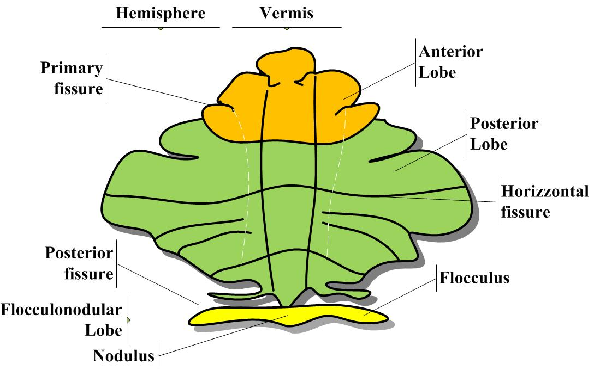

Slide 14
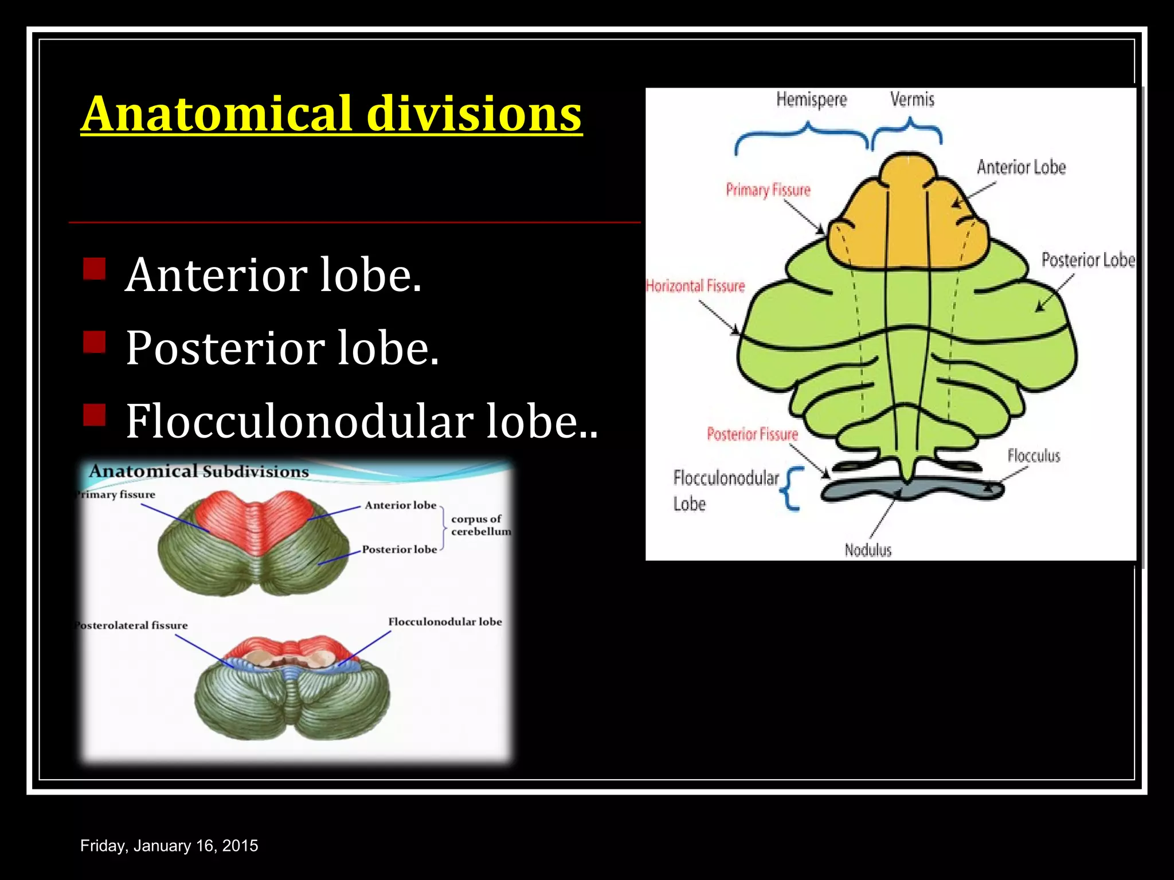

Slide 15
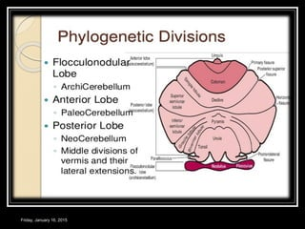

Slide 16
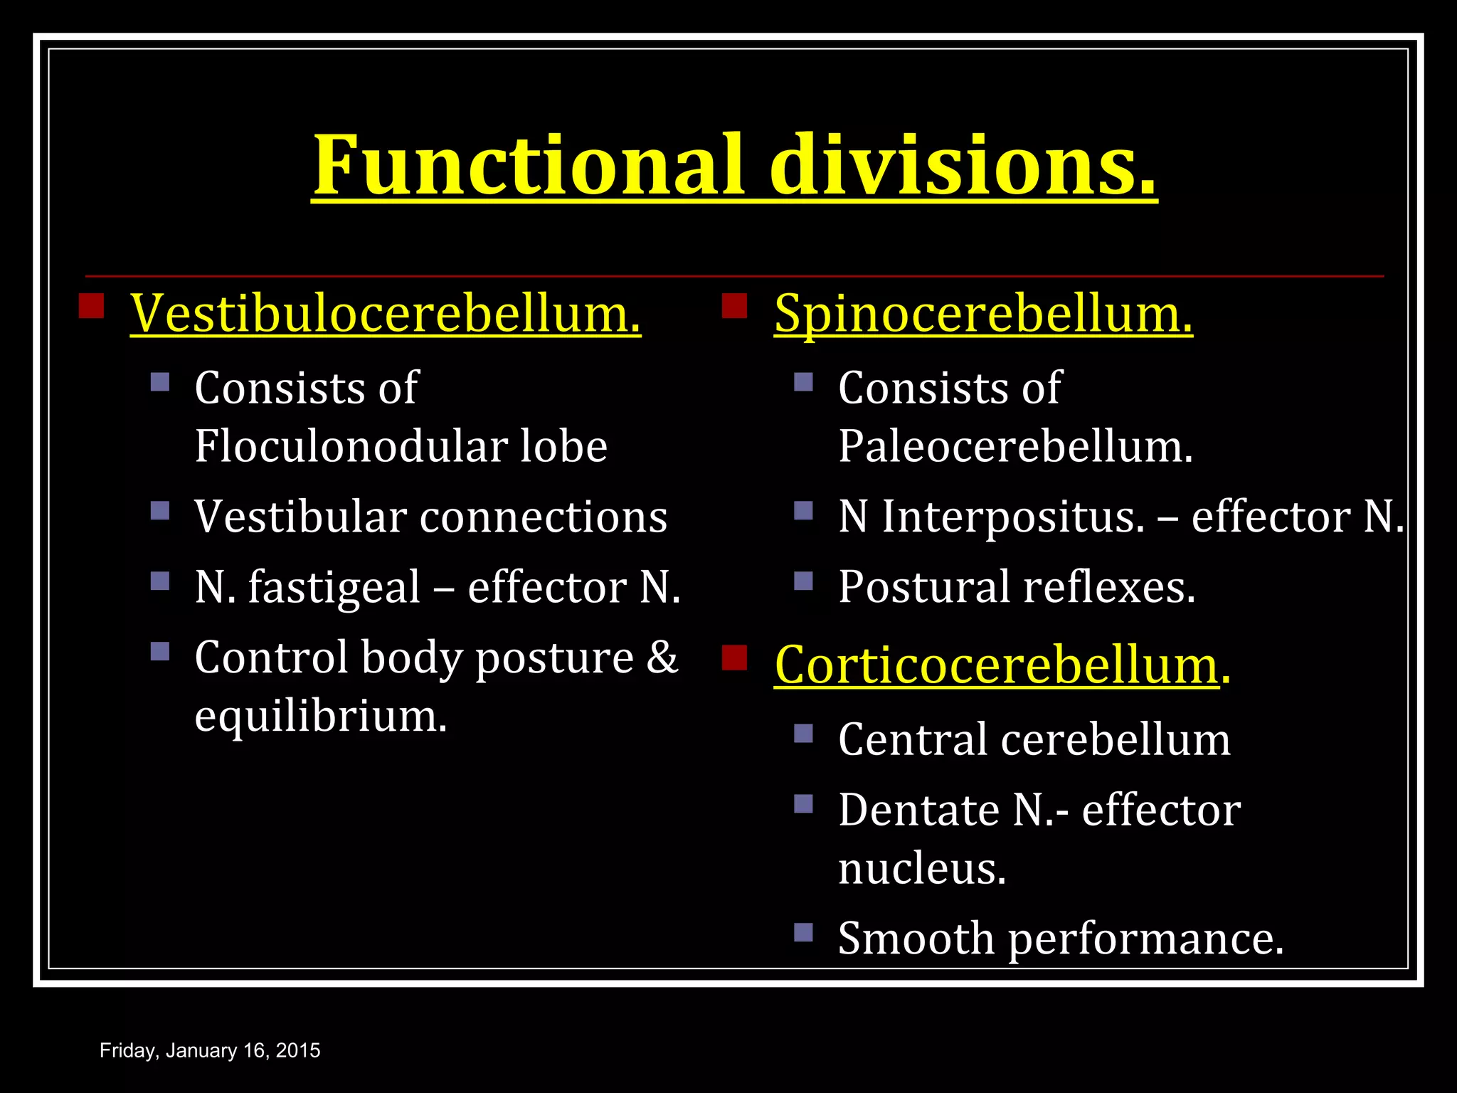

Slide 17
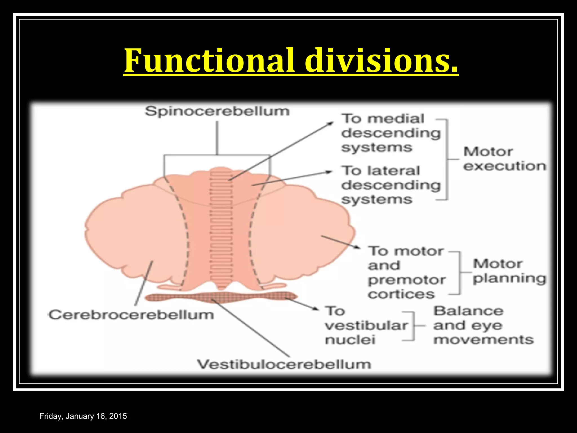

Slide 18
ANATOMICAL LOBE | FUNCTIONAL LOBE | PHYLOGENETIC LOBE | FUNCTION
Floculonudular | Vestibulocerebellum Lobe (Vestibular N-Afferent N) | Archicerebellum | Maintain equilibrium and eye movement coordination N-Fastigeal- effector N
Vermis & their lateral extensions | Spinocerebellum | Paleocerebellum | Muscle tone and truncal posture Maintenance N-Interposed-effector N (Globose N + Emboliform N)
Cerebellar Hemispheres | Cerebrocerebellum | Neocerebellum | Motor Planning and Motor Learning N-Dentate- Effector N

Slide 19
Internal Structures
Outer gray matter called cerebellar cortex, extensively folded
Inner white matter, showing a distinctive treelike pattern called Arbor vitae (tree of life)
4 pairs of nuclei are contained within the white matter ,the deep cerebellar nuclei

Slide 20
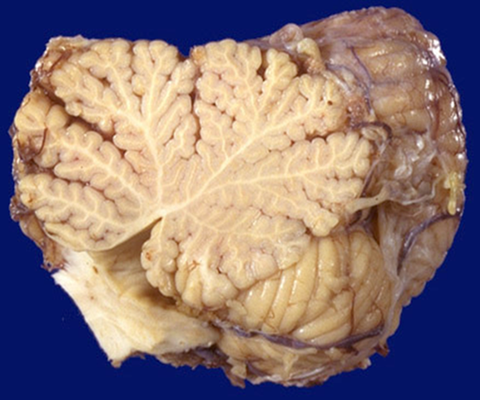

Slide 21
Deep Cerebellar Nuclei
They include,
The dentate nucleus
The Emboliform nucleus
The fastigial nucleus
The globose nucleus
The globose and emboliform are fused into the interposed nuclei

Slide 22
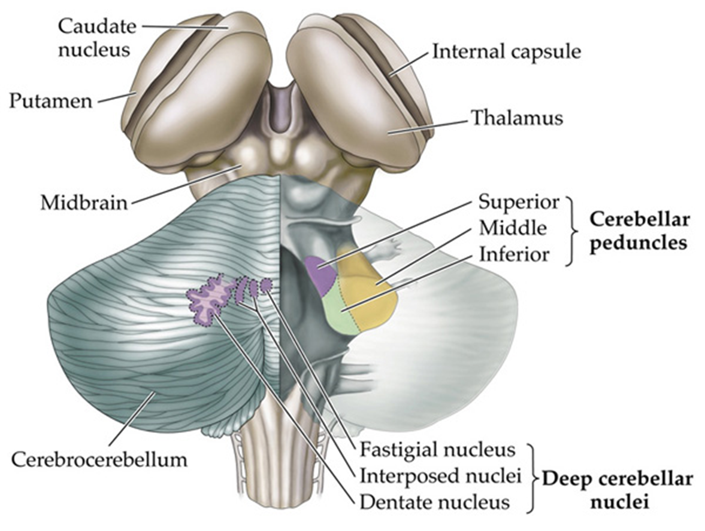
Cerebellar Nuclei

Slide 23
The cerebellar cortex
Microscopically composed of three layers:
  Outer molecular
  Middle, Purkinje cell layer and
  Inner, Granule cell layer
Contains five types of neurons:
  In the molecular layer are the basket and stellate cells
  In the purkinje cell layer are the purkinje cells
  In the granule cell layer are the granule cells and golgi cells
Purkinje cell axons, are the only output from the cerebellar cortex, to the deep nuclei

Slide 24
Purkinje Cells - the only output neuron from the cortex; utilizes GABA to inhibit neurons in deep cerebellar nuclei
Granule Cells- intrinsic cells of cerebellar cortex; use glutamate as an excitatory transmitter; excites Purkinje cells via axonal branches called “parallel fibers”
Basket Cells- inhibitory interneuron; utilizes GABA to inhibit Purkinje cells

Slide 25
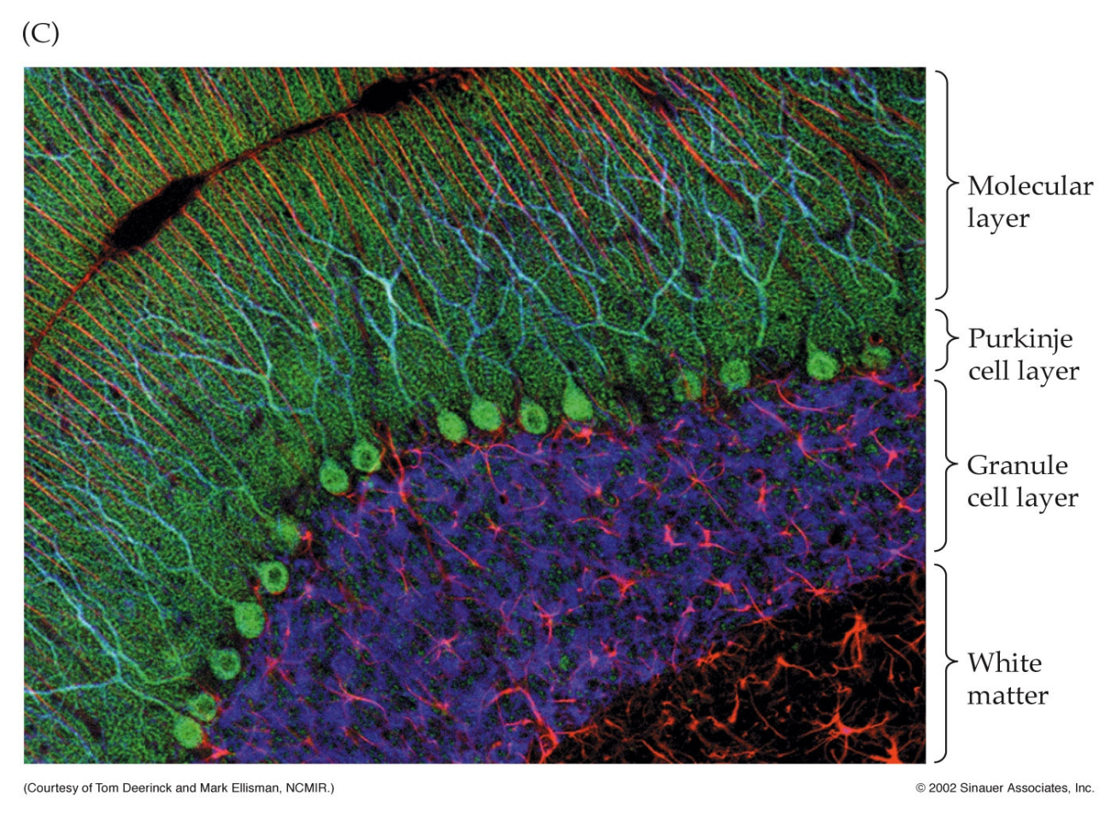
Basket made
By axon of
Basket cell
Basket Cell
basket on
Purkinje cell

Slide 26
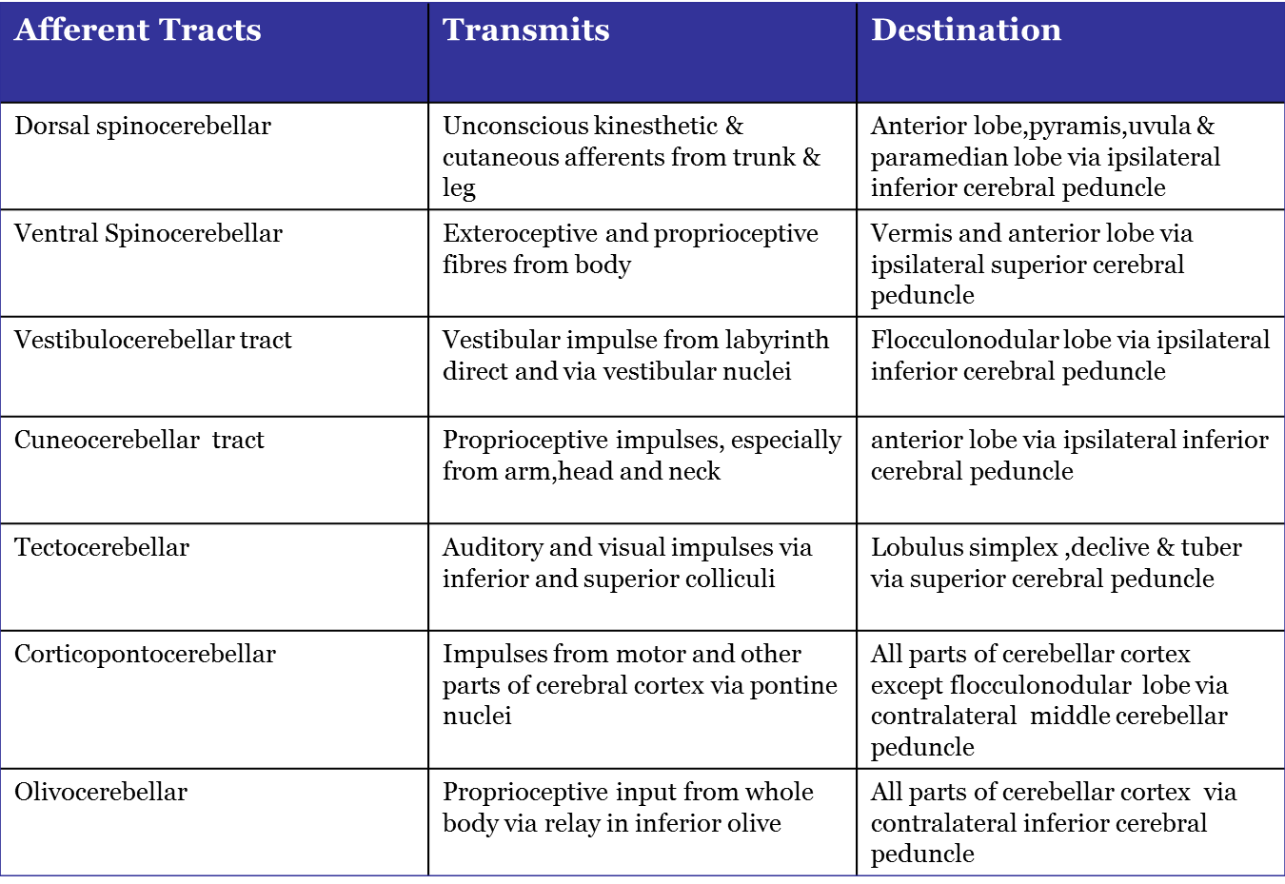
Afferent Pathways

Slide 27
Efferent Pathways
The entire output of the cerebellar cortex is through the axons of the Purkinje cells.
The axons of the Purkinje cells end by synapsing on the neurons of the deep cerebellar nuclei.
The axons of the neurons that form the cerebellar nuclei constitute the efferent outflow from the cerebellum.

Slide 28
A few Purkinje cell axons pass directly out of the cerebellum to the lateral vestibular nucleus.
The efferent fibers from the cerebellum connect with the red nucleus, thalamus, vestibular complex, and reticular formation

Slide 29
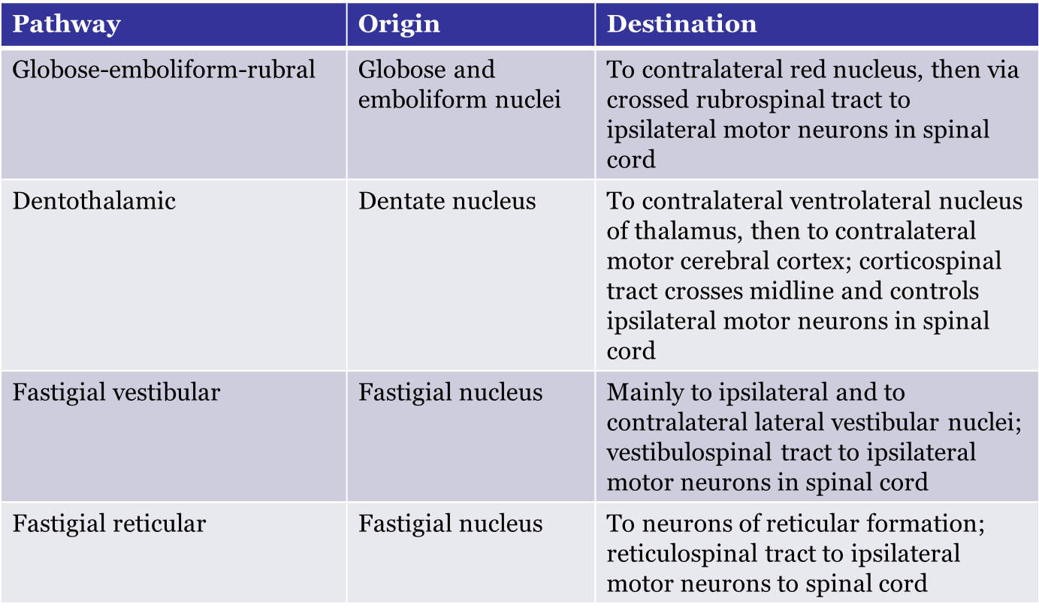

Slide 30
Blood Supply
Three arteries supply blood to the cerebellum
The superior cerebellar artery (SCA)
Anterior inferior cerebellar artery (AICA)
Posterior inferior cerebellar artery (PICA).

Slide 31
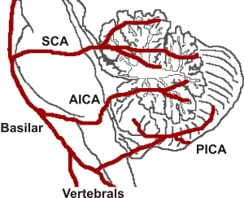

Slide 32
Cerebellar dysfunction
Intention tremors:
  Jerky movements with to and fro motion on reaching an object
  Coarse tremor occuring at 4-6/sec.
Slow and lalling speech.
Drunken gait

Slide 33
Depending on the distribution of cerebellar lesion signs, the following two syndromes are often recognized:
Archicerebellar Syndrome: Incoordination of the muscles of equilibrium; dysequilibrium with wide-based gate; disturbances of stance and gait. Heel-to-toe walking is impaired.
Neocerebellar Syndrome: Incoordination of muscles for voluntary movements. Heel-to-shin movements and rapid alternating movements (diadochokinesis) are impaired.

Slide 34
Cerebellar dysfunction
Characteristics feature
Disturbance of posture
    Hypotonia
    Face rotated towards opposite side
    Body weight thrown on healthy leg,concavity of trunk towards affected side
    nystagmus
Ataxia
    Incoordination of movements
    Decomposition of movements (movement occuring in stages)
    Dysmetria- movement is poorly carried out in direction, range, and force ;past pointing (hypermetria) or falling short (hypometria) occurs

Slide 35
Clinical test to assess cerebellar dysfunction
Finger nose test
Absent Rebound Phenomenon of Holmes
Adiadochokinesia- unable to carry out rapidly alternate and opposite movements
Heel-Knee/shin test

Slide 36
End…

