Slide 1
BLOOD SUPPLY TO THE BRAIN
H.Z.Mwale

Slide 2
Objectives
Discuss the importance of blood circulation to the brain.
Describe major arteries that transport blood to the cerebrum and cerebellum.
Describe region supplied by each major artery.
Discuss clinical application related to arterial circulation of the brain.

Slide 3
Introduction
The central nervous system requires constant oxygenation and nourishment.
The brain has a particularly high oxygen demand – at rest it represents one fifth of the body’s total oxygen consumption.
Oxygen deprivation as with ischemia can cause cell death within minutes.

Slide 4
The blood supply to the brain is derived from the internal carotid and branches of the vertebral arteries which lie in the Subarachnoid space.
These arteries arise in the neck, ascend cranially and enter the skull.
Within the cranium, the terminal branches of these arteries form an anastomotic circle at the base of the brain, called the Circle of Willis.
From this circle, branches arise which supply the majority of the cerebrum.

Slide 5
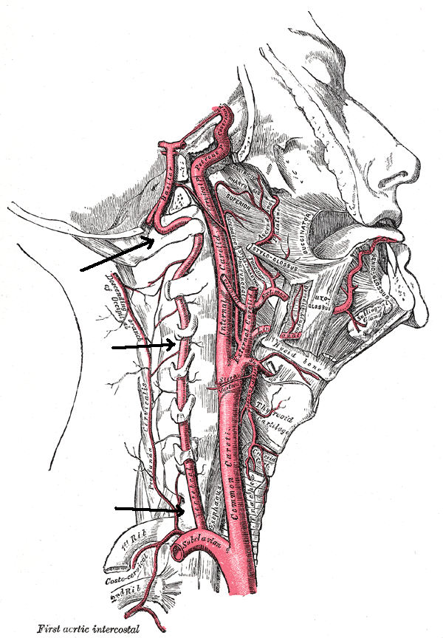

Slide 6
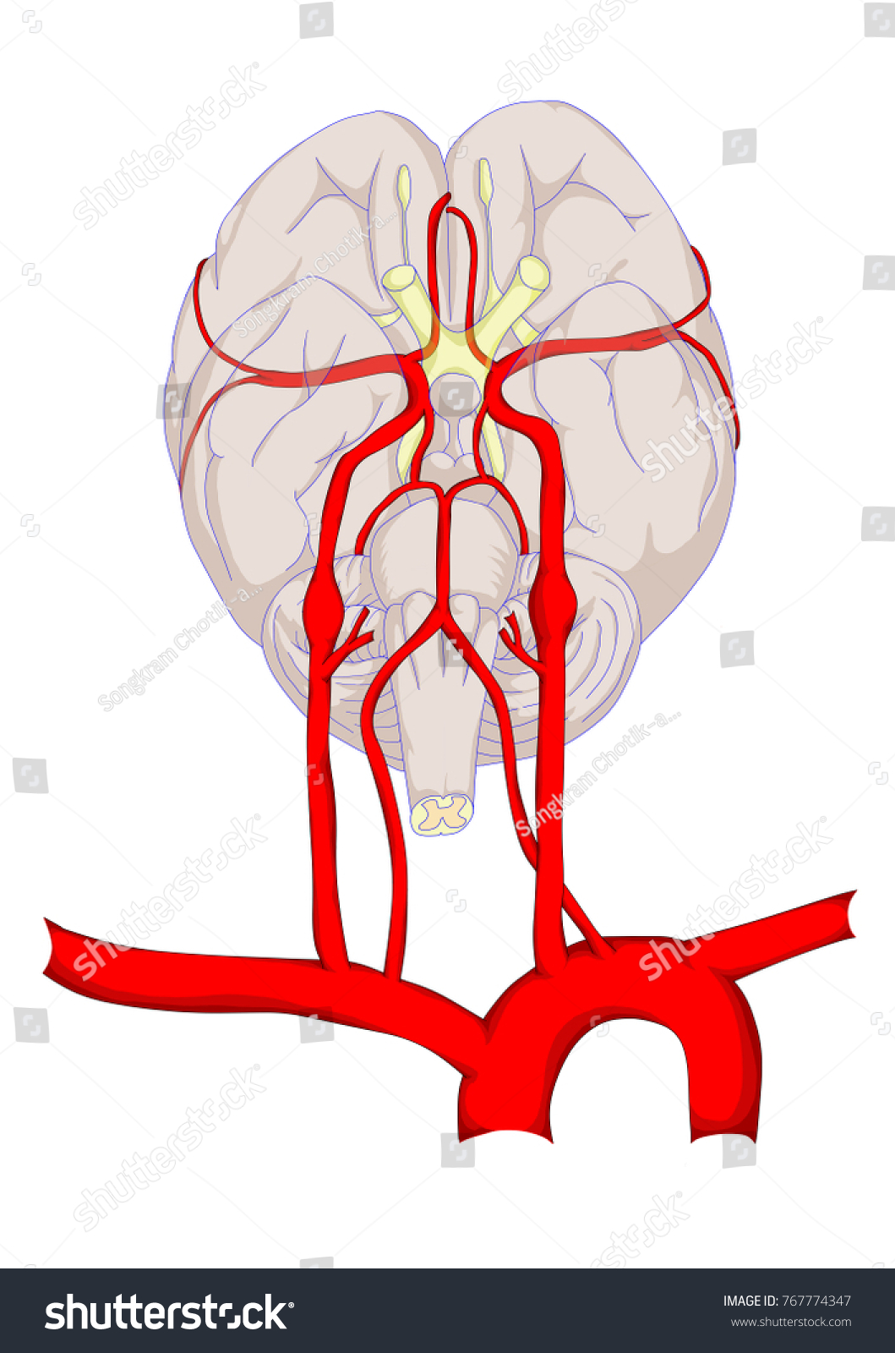

Slide 8
Internal Carotid Arteries
The internal carotid arteries (ICA) originate at the carotid bifurcation of the left and right common carotid arteries, at the level of the fourth or fifth cervical vertebrae C4/C5.
Situated close to the carotid bifurcation are two anatomical structures called carotid sinus and carotid body.

Slide 9
The carotid sinus or bulb is a dilation acting as a baroreceptor for detecting blood pressure changes, while the carotid body acts as a chemoreceptor for acid-base disturbances.
The internal carotid arteries move superiorly, within the carotid sheath, and enter the brain via the carotid canal of the temporal bone.
They do not supply any branches to the face or neck.

Slide 10
Along its course within the skull, the internal carotid artery gives rise to many branches, ultimately dividing into its two terminal ones, the anterior and middle cerebral arteries.
It has about 4 segments corresponding to the related anatomical structure: Cervical, Petrous, Cavernous, Cerebral/intracranial segments.

Slide 11
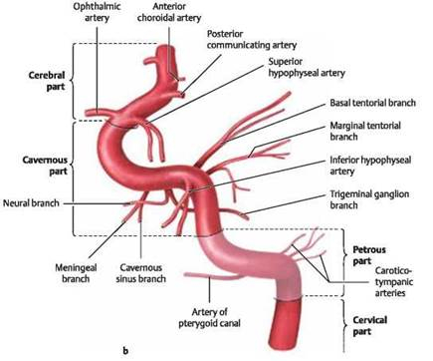

Slide 12
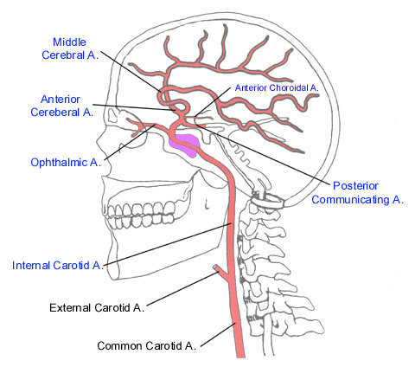

Slide 13
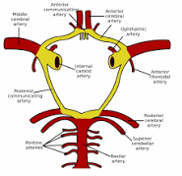

Slide 14
Cervical segment: Situated in the neck from the carotid bifurcation at the level of C4/C5 and ascends passing anterior to the transverse processes of cervical vertebrae C1-C3.
Petrous segment: inside the carotid canal, this segment courses superiorly before taking an anteromedial course; after which it takes a superomedial course advancing towards the foramen lacerum.

Slide 15
It passes over the foramen lacerum (not through it!) and ends at the petrolingual ligament located on the wall of the cavernous sinus.
Cavernous segment: Courses superiorly, within the cavernous sinus, along the posterior clinoid process of the sphenoid bone, towards the anterior clinoid process before finally piercing the roof of the cavernous sinus.

Slide 16
Within the cavernous sinus, the internal carotid artery travels superomedially to the abducens nerve and medially to the oculomotor nerve, trochlear nerve, and the ophthalmic and maxillary divisions of the trigeminal nerve.

Slide 17
Cerebral segment: after exiting the cavernous sinus, this segment travels until the distal dural ring and then parallel and horizontal in an inferolateral position with respect to the optic nerve at which point it gives off the posterior communicating artery.
The terminal part bifurcates into its terminal branches, anterior and middle cerebral arteries, before ending at the anterior perforated substance.

Slide 18
Terminal Branches
The anterior cerebral artery is a terminal branch of the internal carotid artery.
It courses towards the longitudinal cerebral fissure, where it anastomoses with its contralateral counterpart via the short anterior communicating artery.
As a result, they contribute to the formation of the circle of Willis.

Slide 19
The paired arteries then course along the medial surface of the brain through the longitudinal cerebral fissure in a posterior direction along the genu of the corpus callosum.
Eventually, each of these vessels anastomose with the ipsilateral posterior cerebral artery.
The anterior cerebral artery gives off cortical and central branches.
The cortical branches include the parietal, orbital, and frontal branches.

Slide 20
The parietal branches supply the precuneus, while the orbital branches are responsible for the olfactory cortex, medial orbital gyrus, and gyrus rectus of the frontal lobe.
The frontal branches provide blood to the paracentral lobule, medial frontal, cingulate gyri, and the corpus callosum.

Slide 21
The central branches of the anterior cerebral artery supply the rostrum of the corpus callosum, the septum pellucidum, and areas surrounding the anterior part of the putamen (head of the caudate nucleus and local area of the internal capsule).

Slide 22
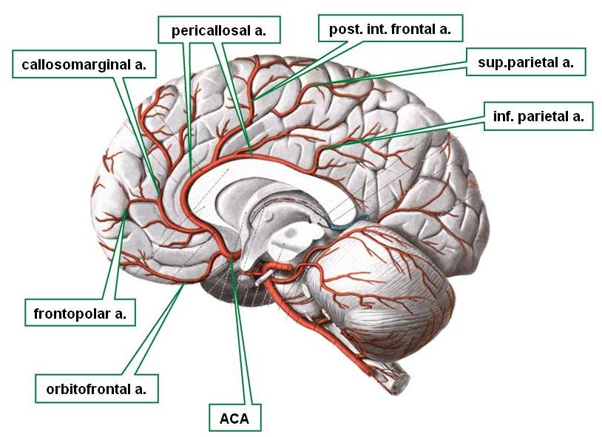

Slide 23
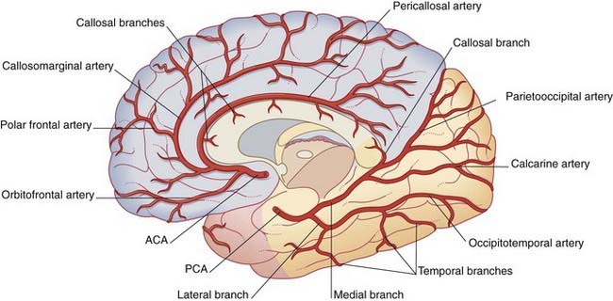

Slide 24
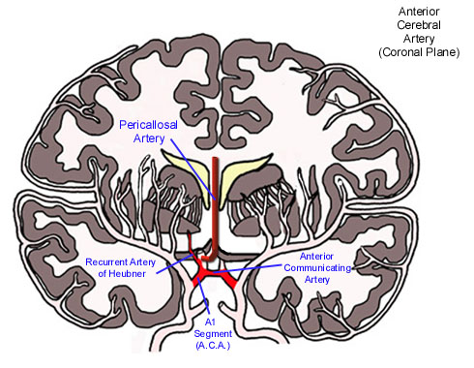

Slide 25
The middle cerebral artery (M) is the second and largest terminal branch of the internal carotid artery.
The middle cerebral artery courses through the lateral fissure before coursing over the insula.
It subsequently divides to supply the lateral cortical surfaces along with the insula.

Slide 26
It also has cortical and central branches, similar to the anterior cerebral artery.
The cortical branches include the frontal, orbital, parietal, and temporal branches.
The frontal arteries perfuse the inferior frontal, middle, and precentral gyri.
The lateral orbital parts of the frontal lobe, as well as the frontal gyrus, are supplied by the orbital branches.

Slide 27
The inferior parietal lobe, and the postcentral gyrus receive blood from the parietal branch.
Several temporal arteries then go on to perfuse the lateral aspect of the temporal lobe.
The central branches are relatively small and include the lenticulostriate arteries that pass through the anterior perforated substance to supply the lentiform nucleus and the posterior limb of the internal capsule.

Slide 28
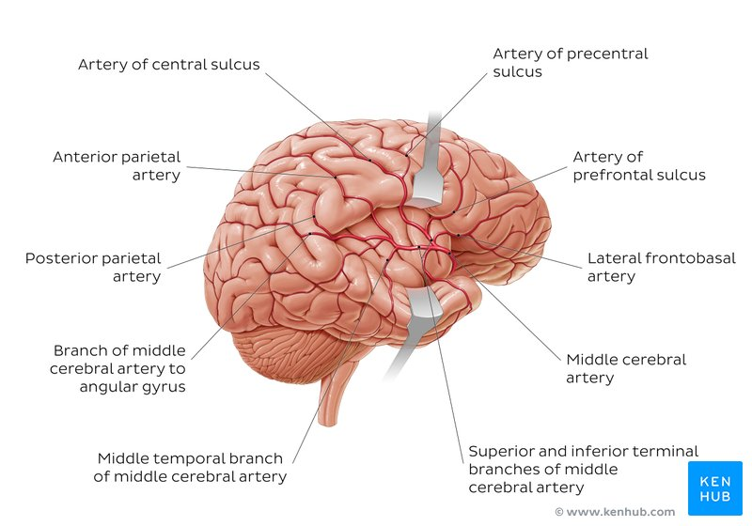

Slide 29
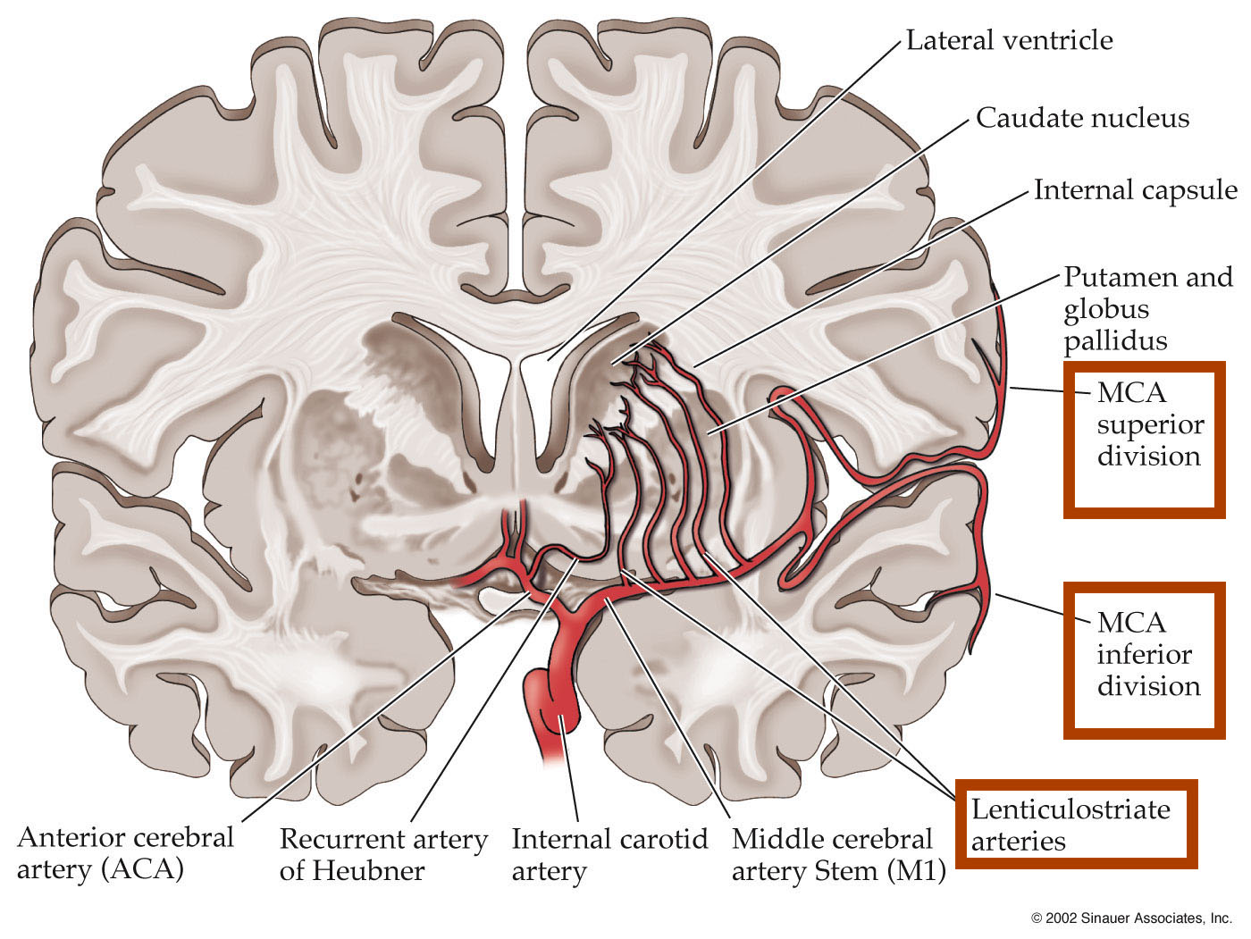

Slide 30
The Vertebral Arteries
Arise from the subclavian artery, and ascend to the brainstem via foramina passing through the transverse processes of the upper 6 cervical vertebrae.
Before they unite to form the basilar artery, they give off a few branches to the spinal cord and cerebellum.
At the level of the lower part of the pons the vertebral arteries unite to form the basilar artery.

Slide 31
The Basilar artery
The basilar artery runs from the lower to the upper end of the pons in the basilar canal giving off the following branches;
The anterior inferior cerebellar artery (AICA).
The artery to the labyrinth.
Pontine branches.

Slide 32
The superior cerebellar artery.
Occlusion of these branches gives a characteristic clinical picture that can be predicted from the anatomy of the structures of the posterior cranial fossa.
The basilar artery ascends before dividing into the two posterior cerebral arteries (PCAs) at the superior border of the pons.

Slide 33
Posterior cerebral arteries
The posterior cerebral arteries have central, posterior/choroidal and cortical branches.
Central or perforating branches include;
Thalamogeniculate branches pierce the posterior perforated substance and supply the medial portion of the thalamus and the walls of the third ventricles .

Slide 34
Peduncular perforating or postero-lateral ganglionic branches: supply the thalamus and cerebral peduncles.
Posterior (choroidal) branches include;
Medial posterior choroidal branches which supply the choroid plexus of the third ventricle.
Lateral posterior choroidal branches: supply the cerebral peduncle, fornix, thalamus, caudate nucleus, and choroid plexus of the lateral ventricle

Slide 35
Cortical branches include;
Anterior temporal branches supplying the uncus and the anterior part of the fusiform gyrus.
Posterior temporal, to the fusiform and the inferior temporal gyri
Lateral occipital, which branches into the anterior, middle and posterior inferior temporal arteries

Slide 36
Medial occipital supplies the posterior part of the occipital lobe upto the calcarine sulcus
Splenial, or the posterior pericallosal branch, sometimes anastomoses with the anterior cerebral artery (ACA).

Slide 37
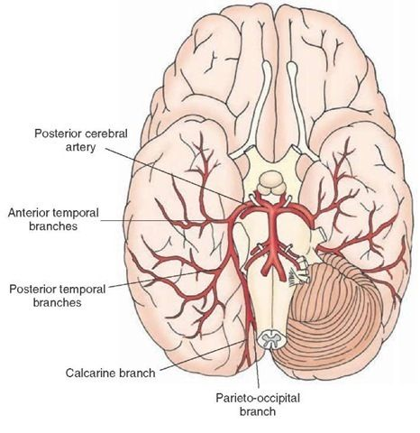

Slide 38
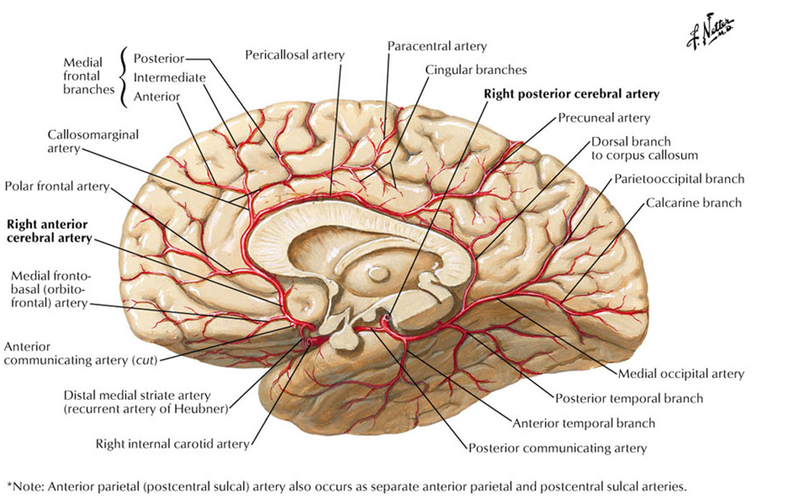

Slide 39
Circle of Willis
The cerebral arterial circle (of Willis) is a roughly pentagon-shaped circle of vessels at the base of the brain.
It is an important anastomosis among the four arteries (two vertebral and two internal carotid arteries) that supply the brain

Slide 40
They then divide and supply blood to the anterior, middle and posterior parts of the cerebral hemispheres (via anterior, middle and posterior cerebral arteries; ACAs, MCAs, PCAs respectively).
In addition, the posterior and anterior cerebral circulations anastomose at the base of the brain in the circle of Willis,
The anterior and posterior communicating arteries offering the potential to maintain cerebral circulation in the event of a major arterial occlusion.

Slide 41
The arterial circle is formed sequentially in an anterior to posterior direction by the:
  Anterior communicating artery.
  Anterior cerebral arteries.
  Internal carotid arteries.
  Posterior communicating arteries.
  Posterior cerebral arteries.
The various components of the cerebral arterial circle give numerous small branches to the brain.

Slide 42
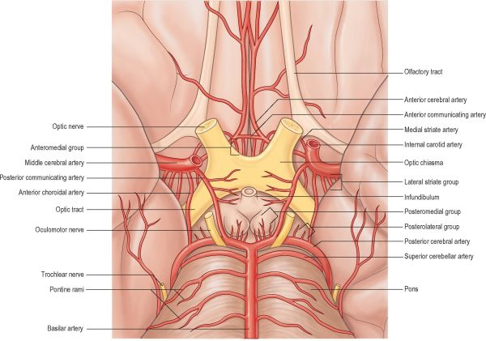

Slide 43
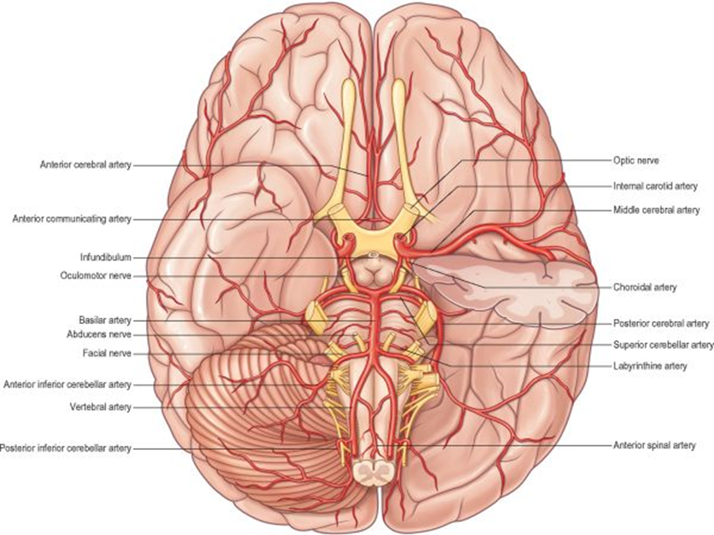

Slide 44
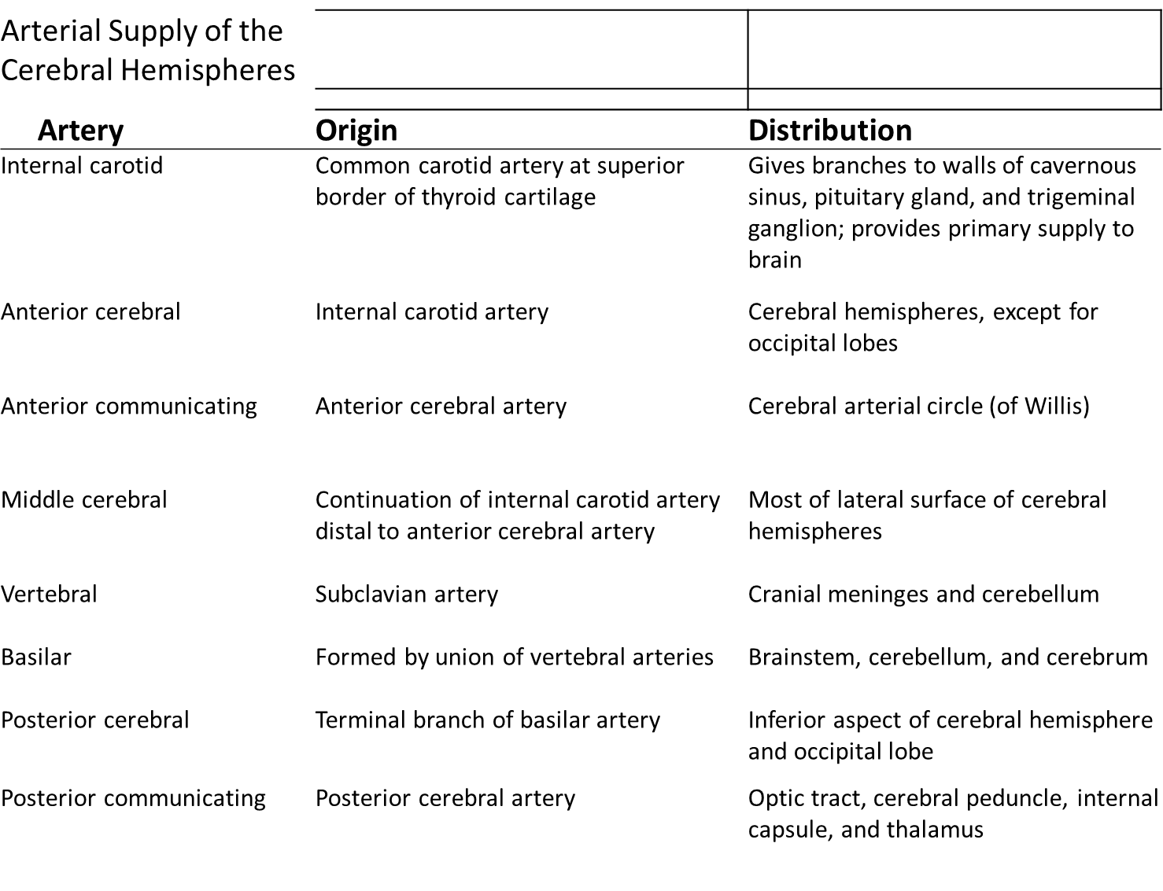

Slide 45
Clinical Application
Occlusion of Posterior Cerebral Artery
(PCA) causes a
visual field defect
amnesic syndromes
disorders of language
occasionally complex visual perceptual abnormalities.

Slide 46
Central perforating branches of the PCA supplying the midbrain, thalamus, subthalamus, posterior internal capsule, optic radiation and cerebral peduncle may occlude and produce midbrain syndromes resulting in
combination of cranial nerve palsies
motor abnormalities (thalamic involvement)
syndrome of pain
dysaesthesia that is hard to treat

Slide 47
Small perforating arteries that arise from both the PCA and MCA are commonly affected in hypertension when their occlusion produces small lacunar infarcts.
Apart from occlusion, haemorrhage from cerebral vessels can occur into the brain substance (intracerebral-bleeding into the parenchyma of the brain)
Haemorrhage can also occur intraventricular (in the Ventricles).

Slide 48
The epidural space: the space between the dura (the outermost membrane covering the brain and spinal cord) and skull, or the bony vertebrae that form the spinal canal.
In the spine, the epidural space contains lymphatics, small arteries, and the epidural venous plexus.

Slide 49
The subdural space: The space between the dura mater and the arachnoid mater, this is a potential space in both the skull and the spine.
The subarachnoid space: between the arachnoid mater and the pia matter, this space contains the cerebrospinal fluid and blood vessels.
Such haemorrhage usually occurs in the context of trauma, hypertension or rupture of congenital aneurysms on the circle of Willis (berry aneurysms).

Slide 50

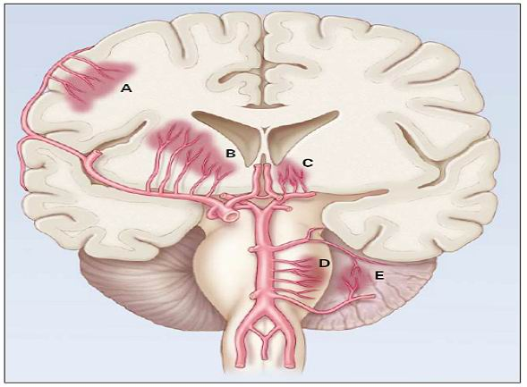

Slide 51
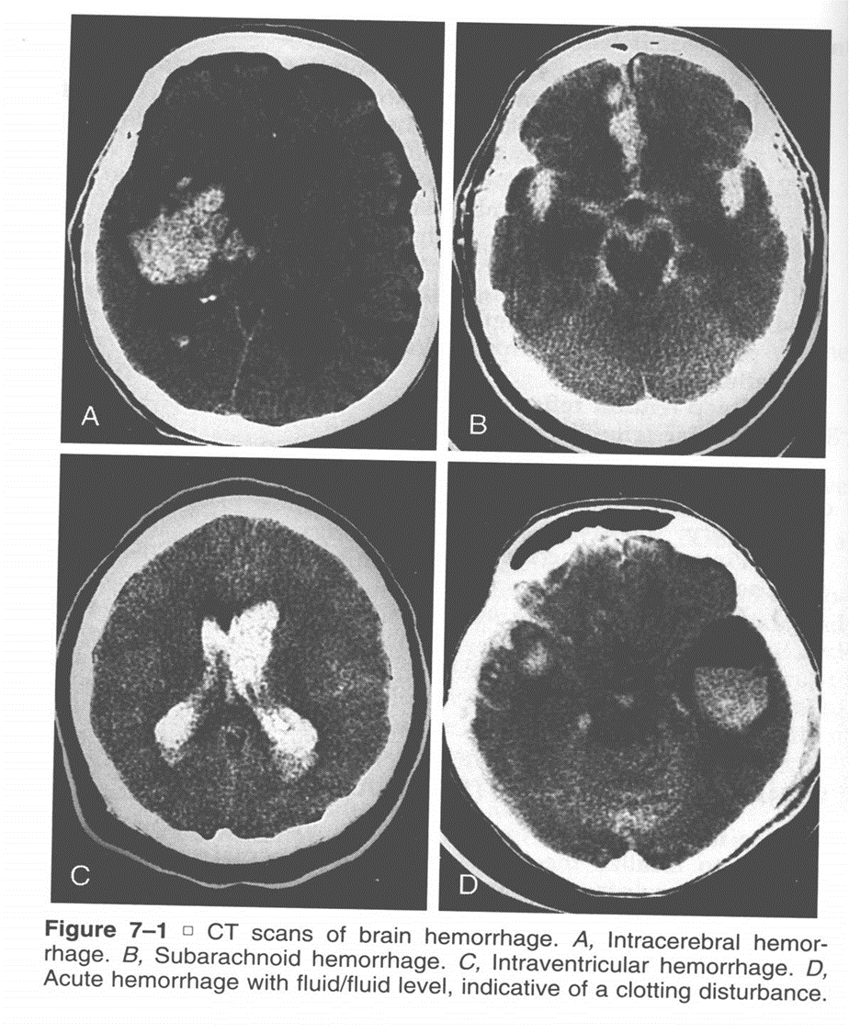

Slide 52
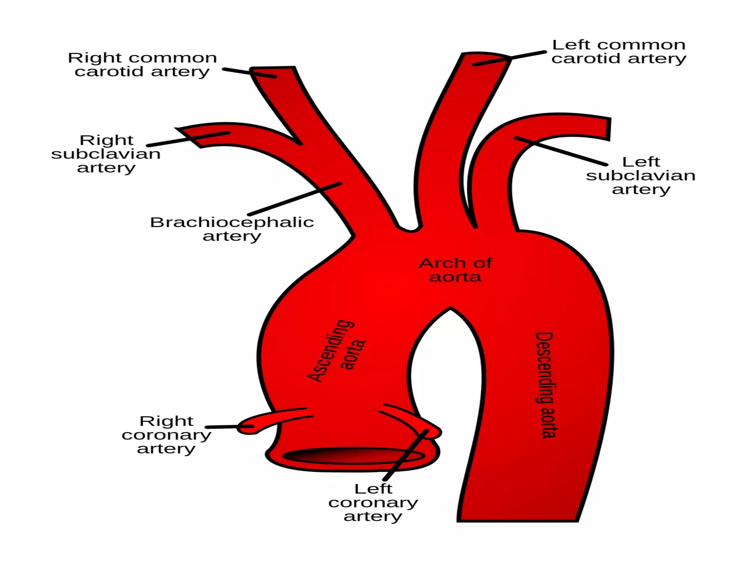

Slide 53
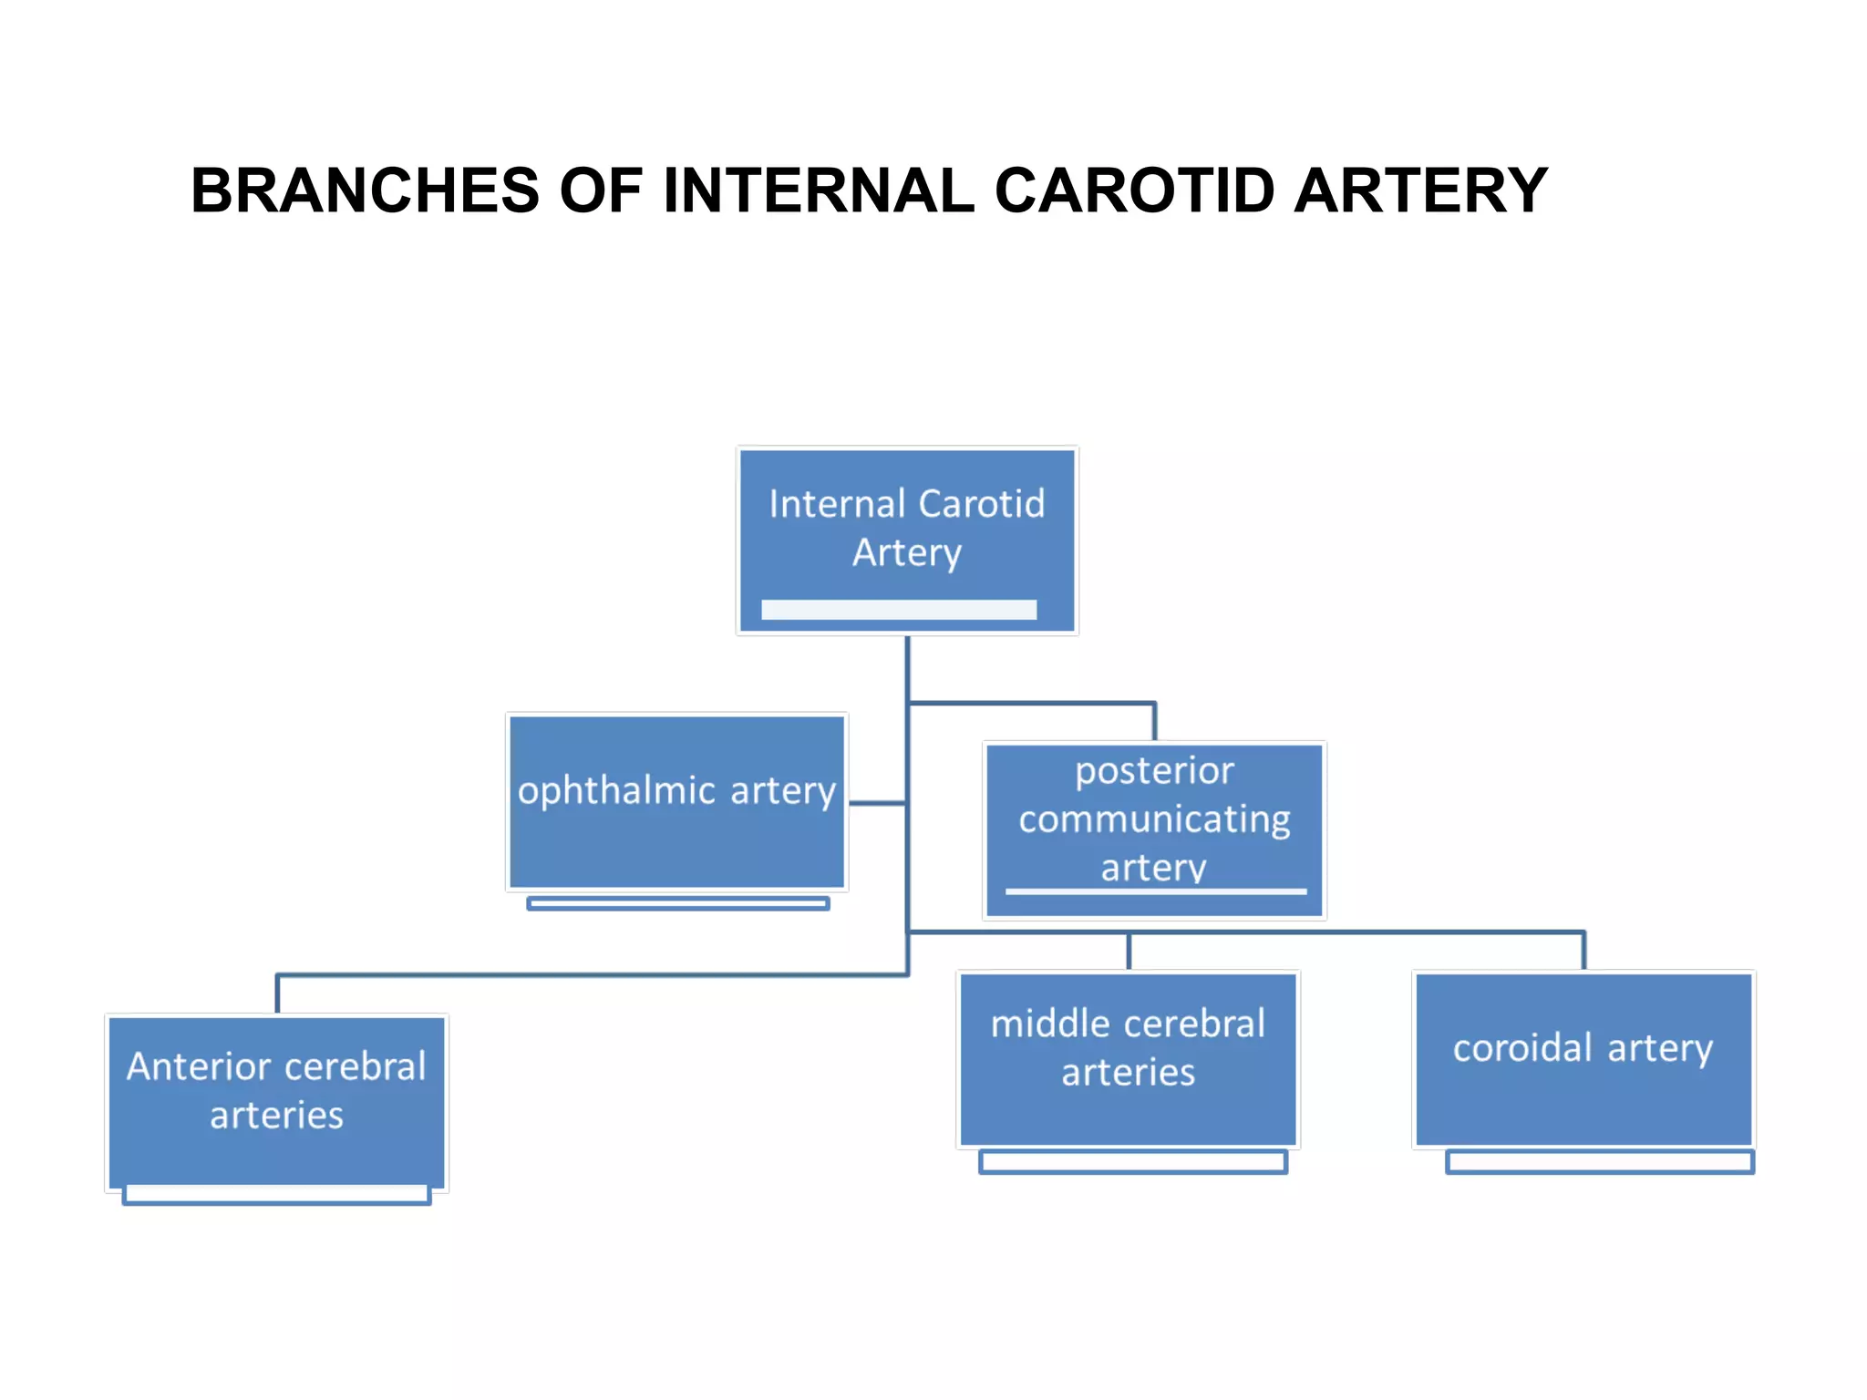

Slide 54
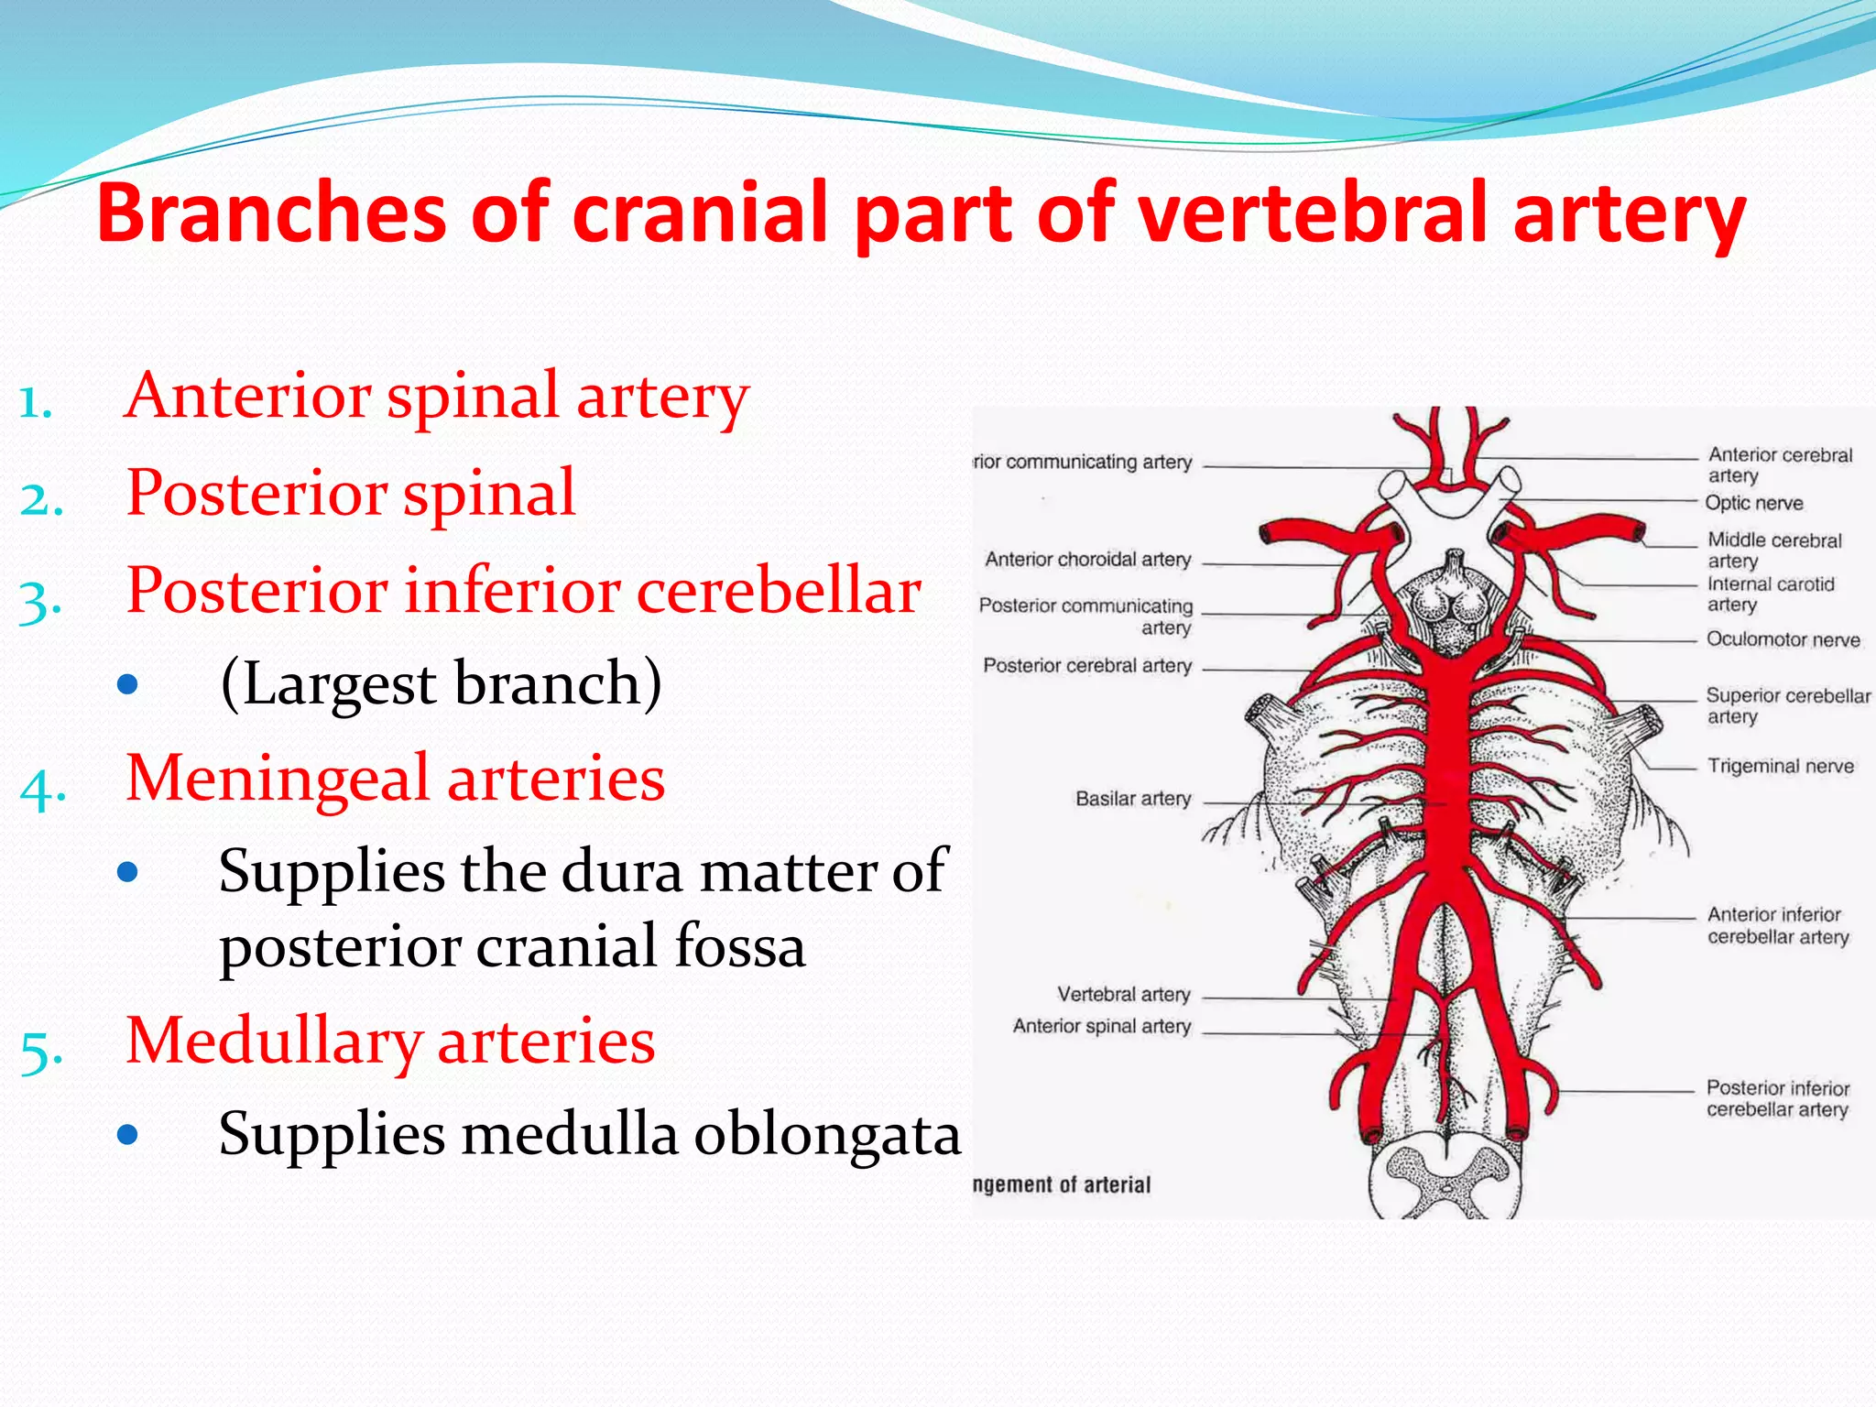

Slide 55
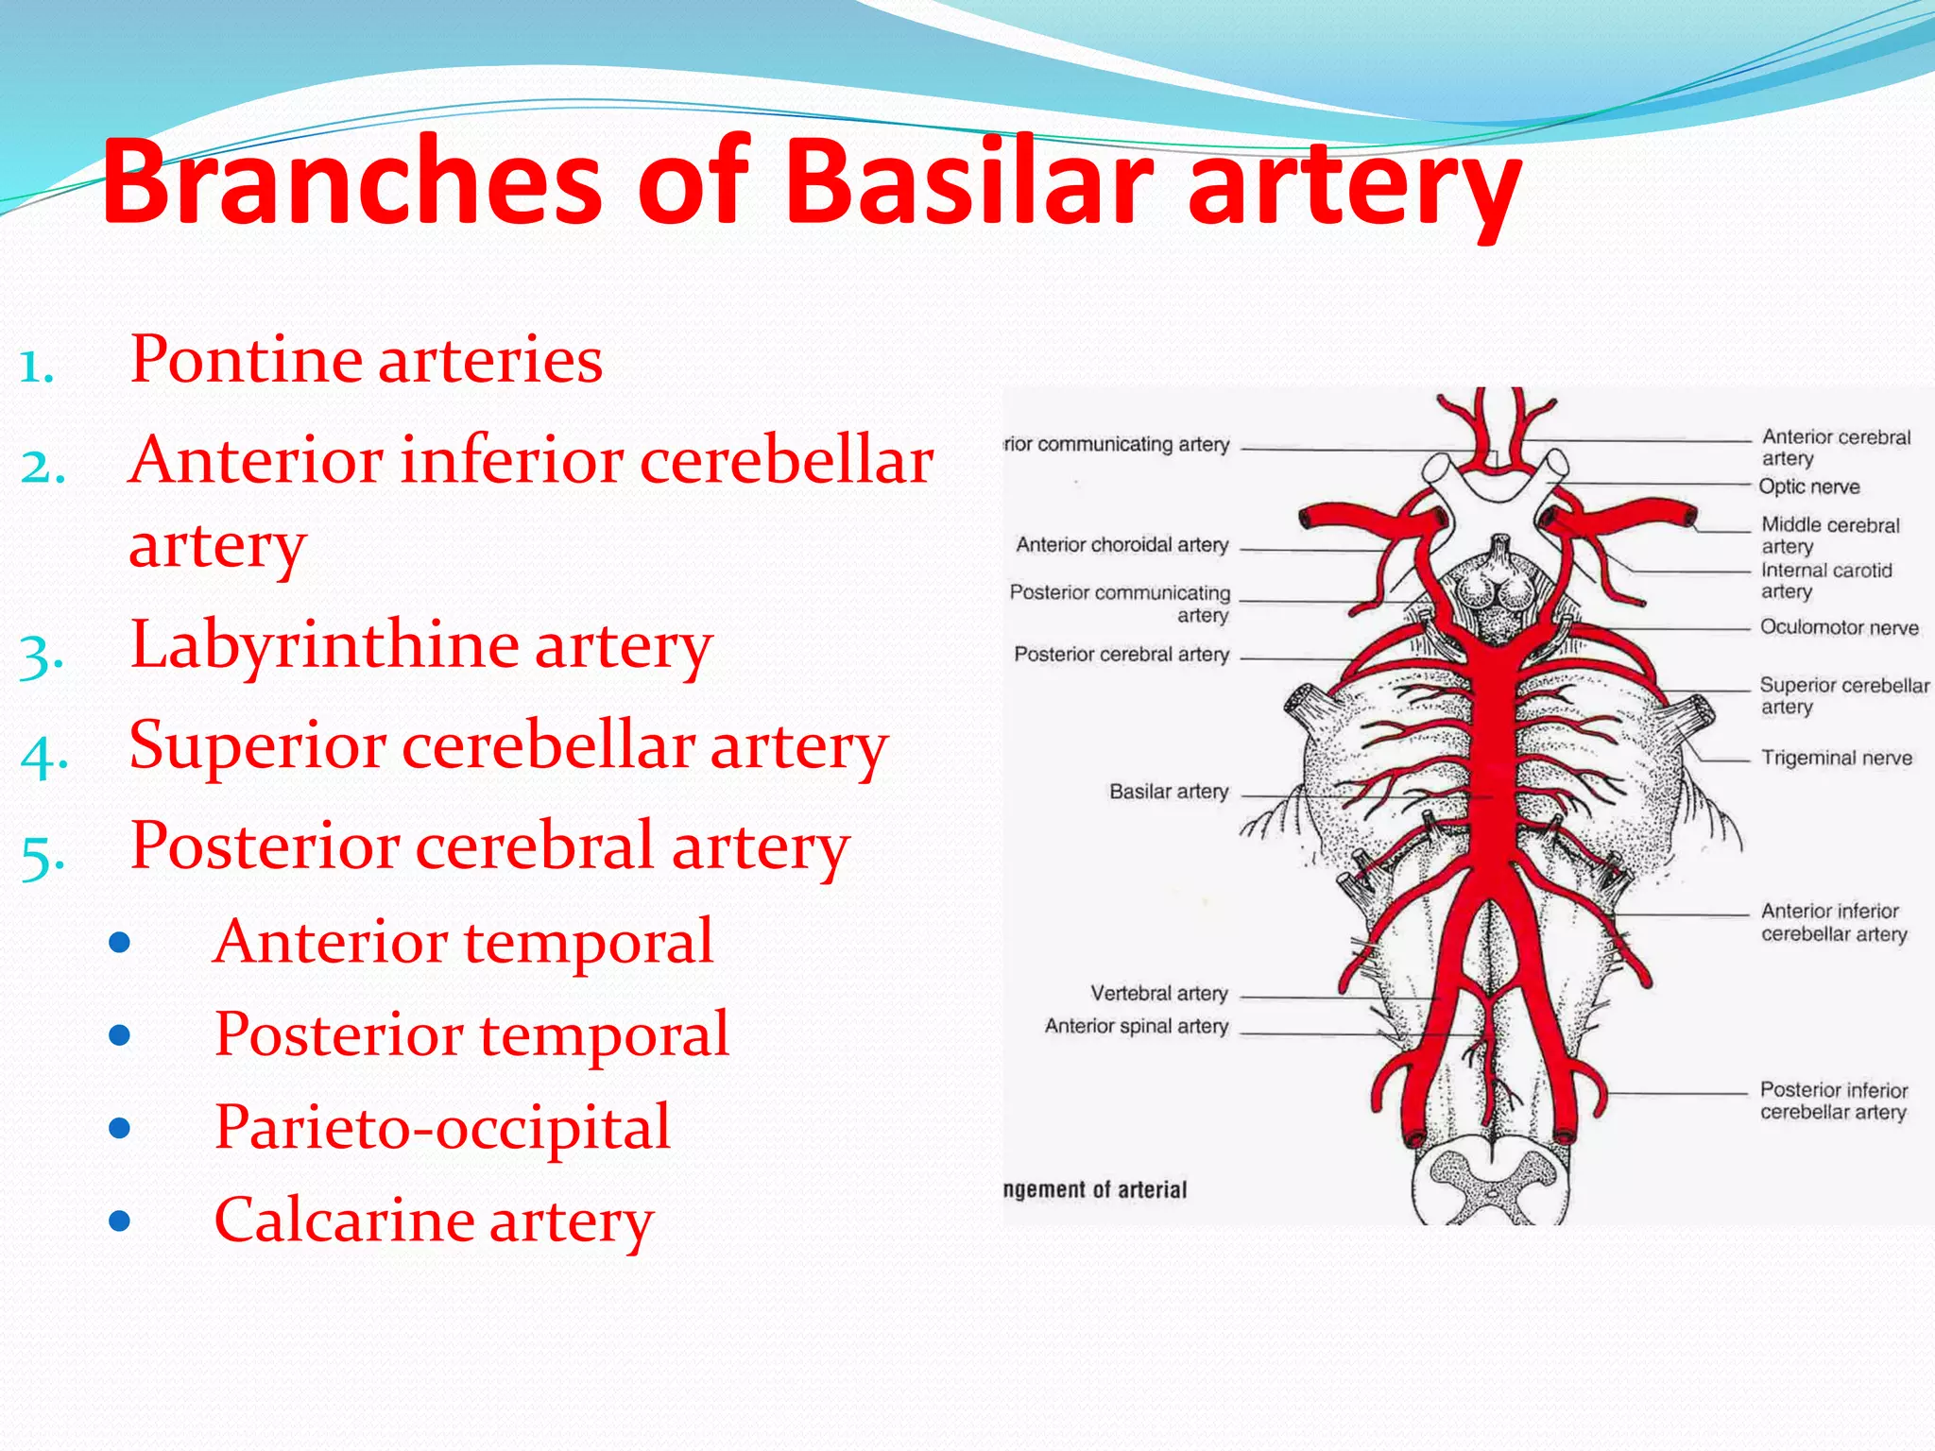

Slide 56
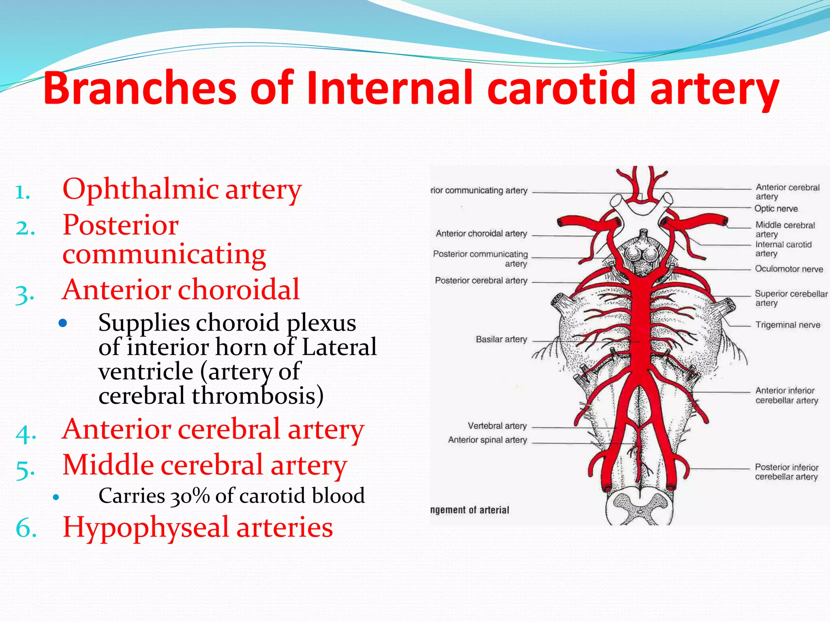

Slide 57
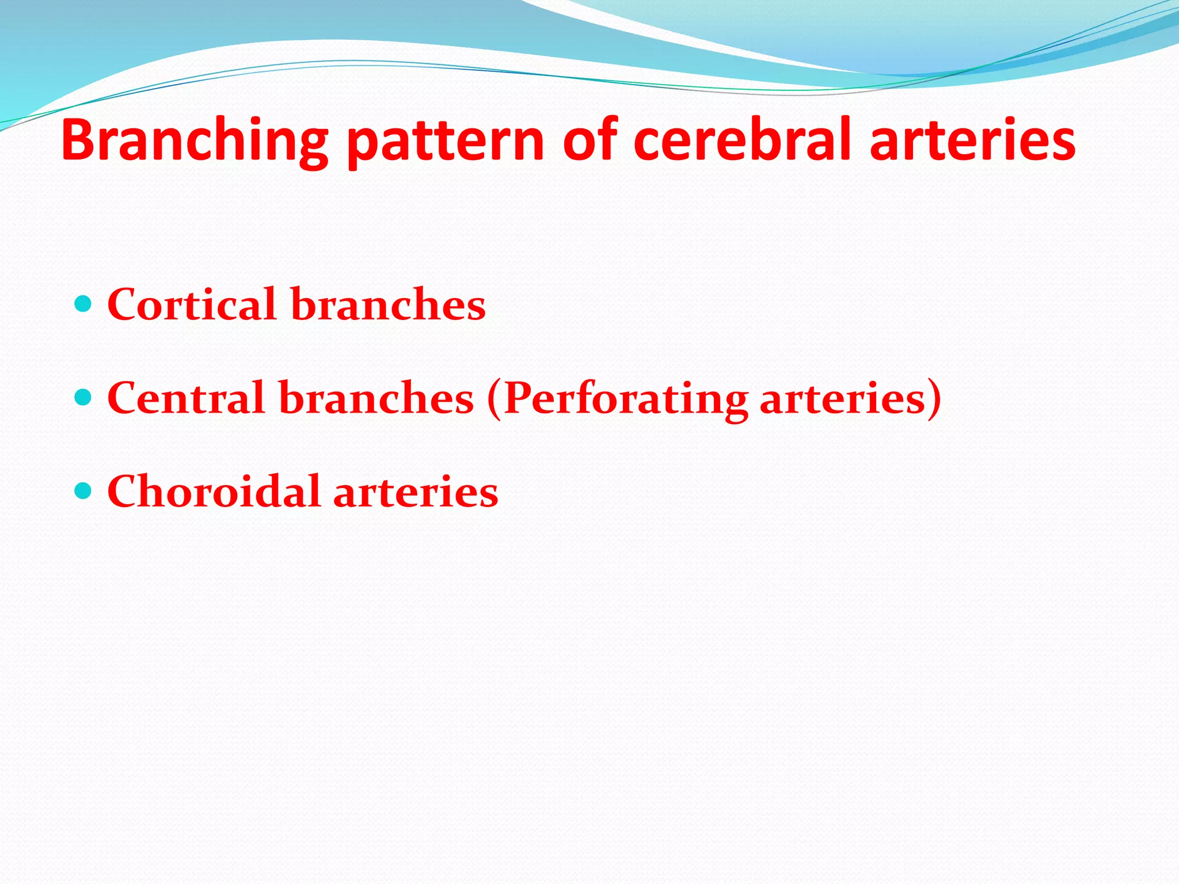

Slide 58
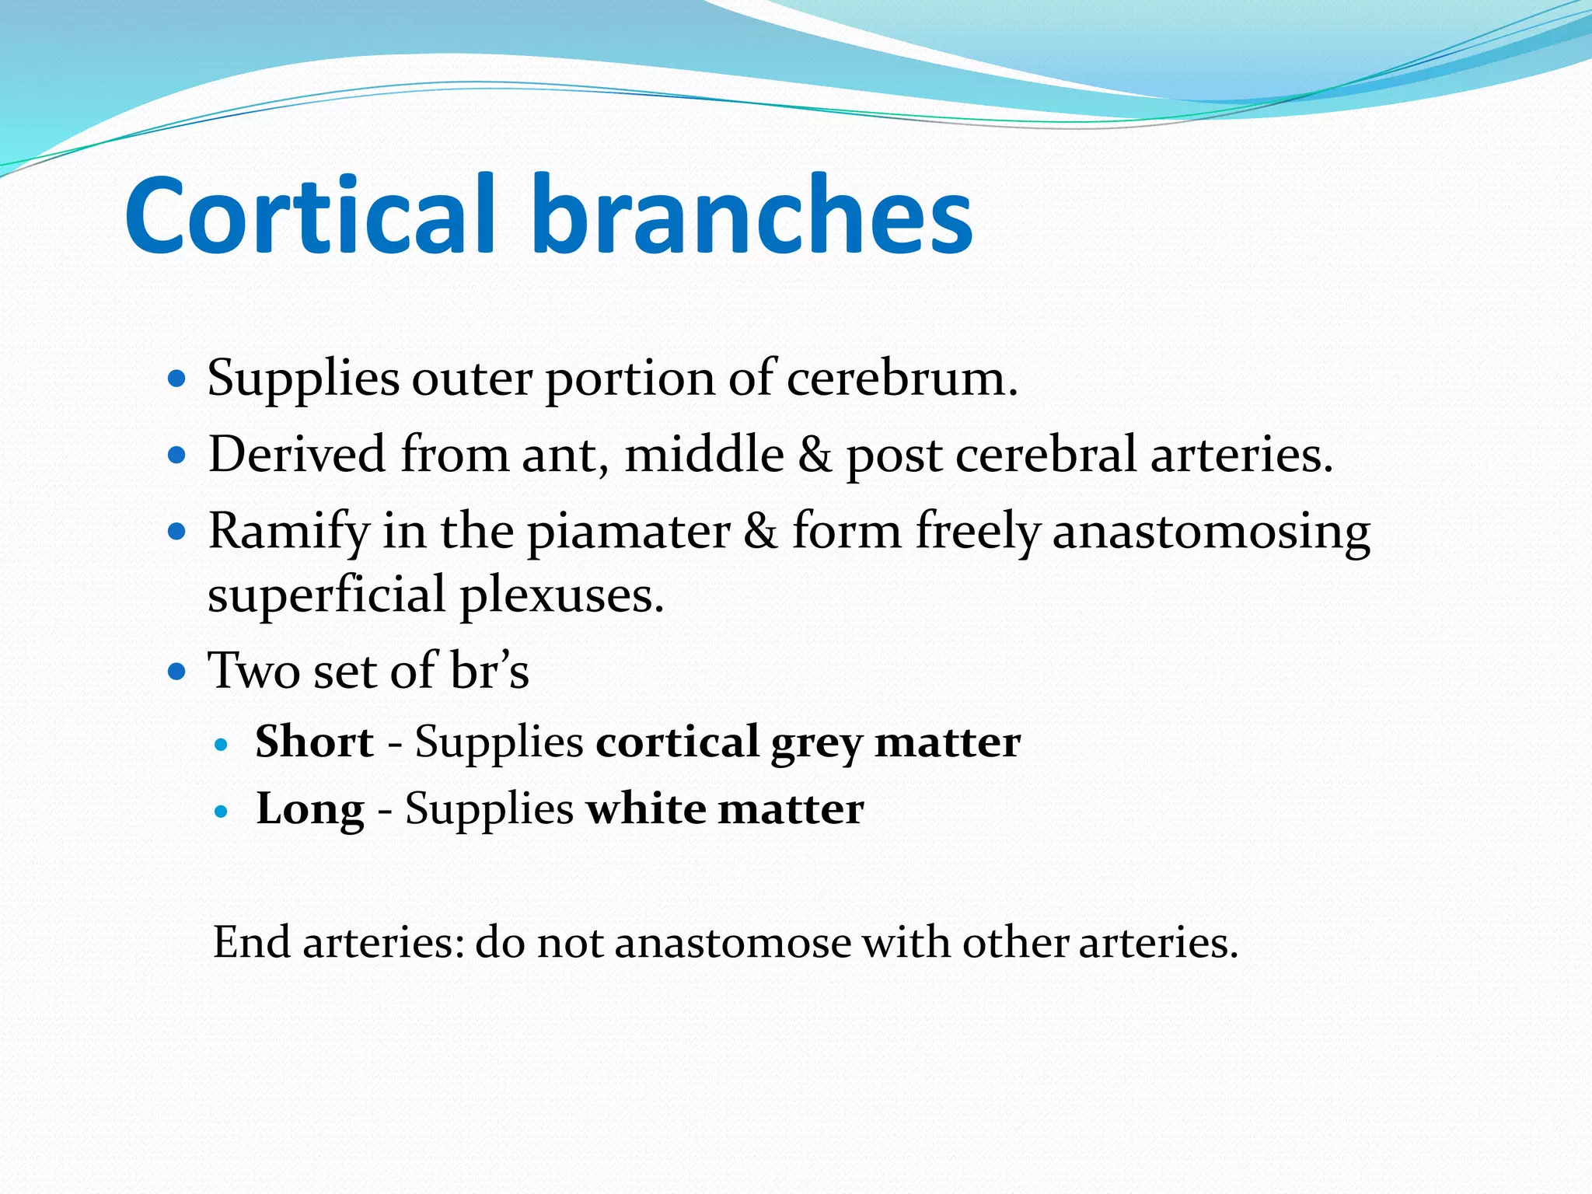

Slide 59
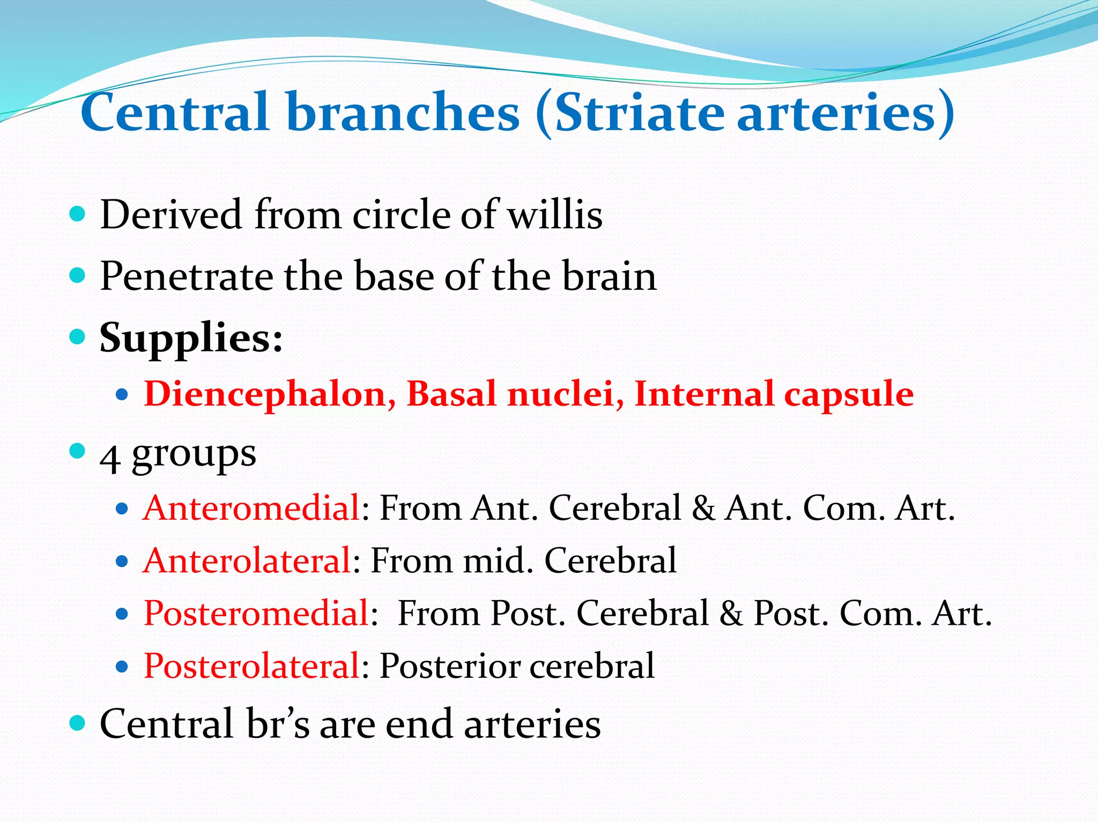

Slide 60
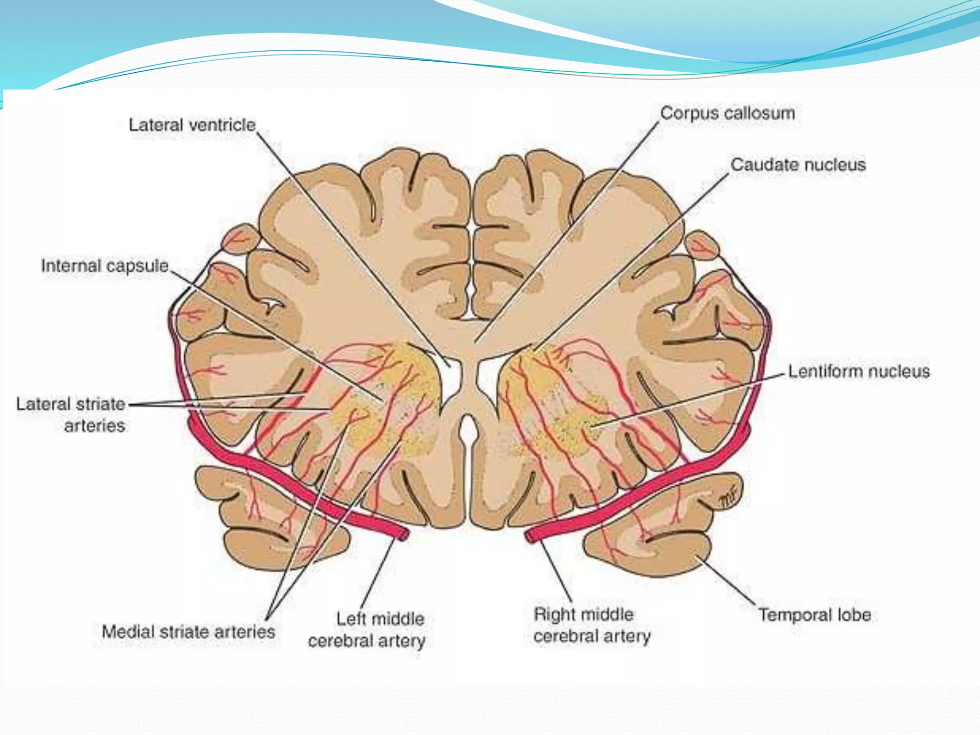

Slide 61
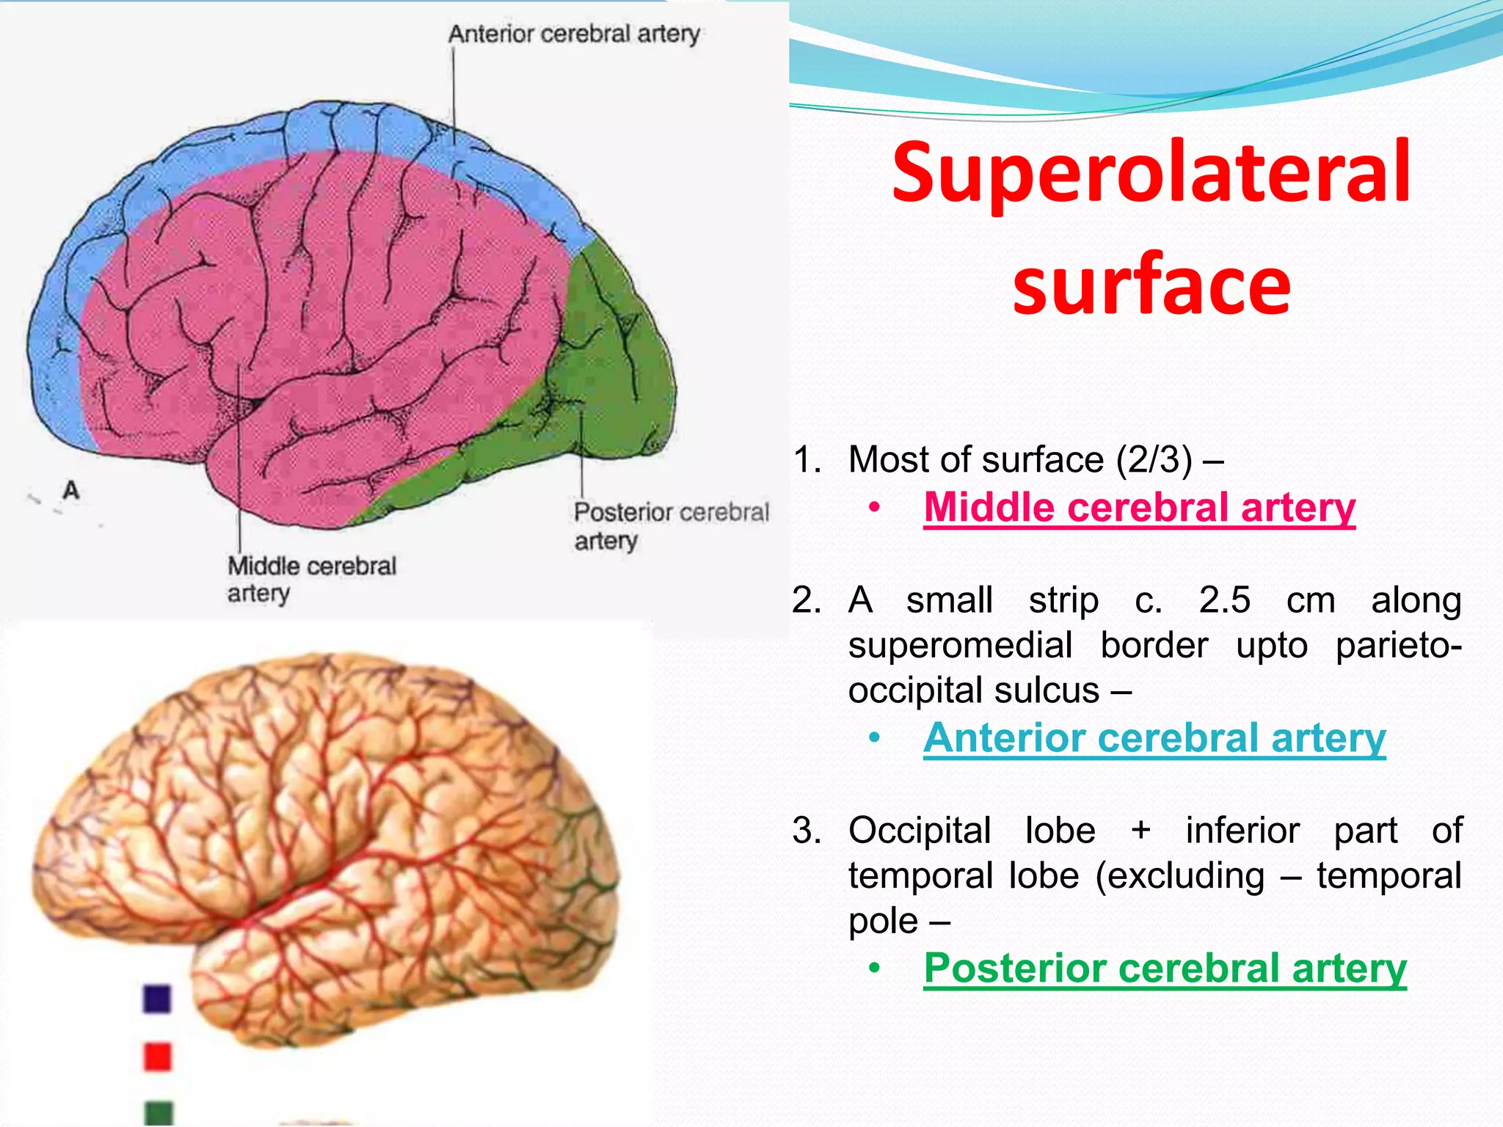

Slide 62
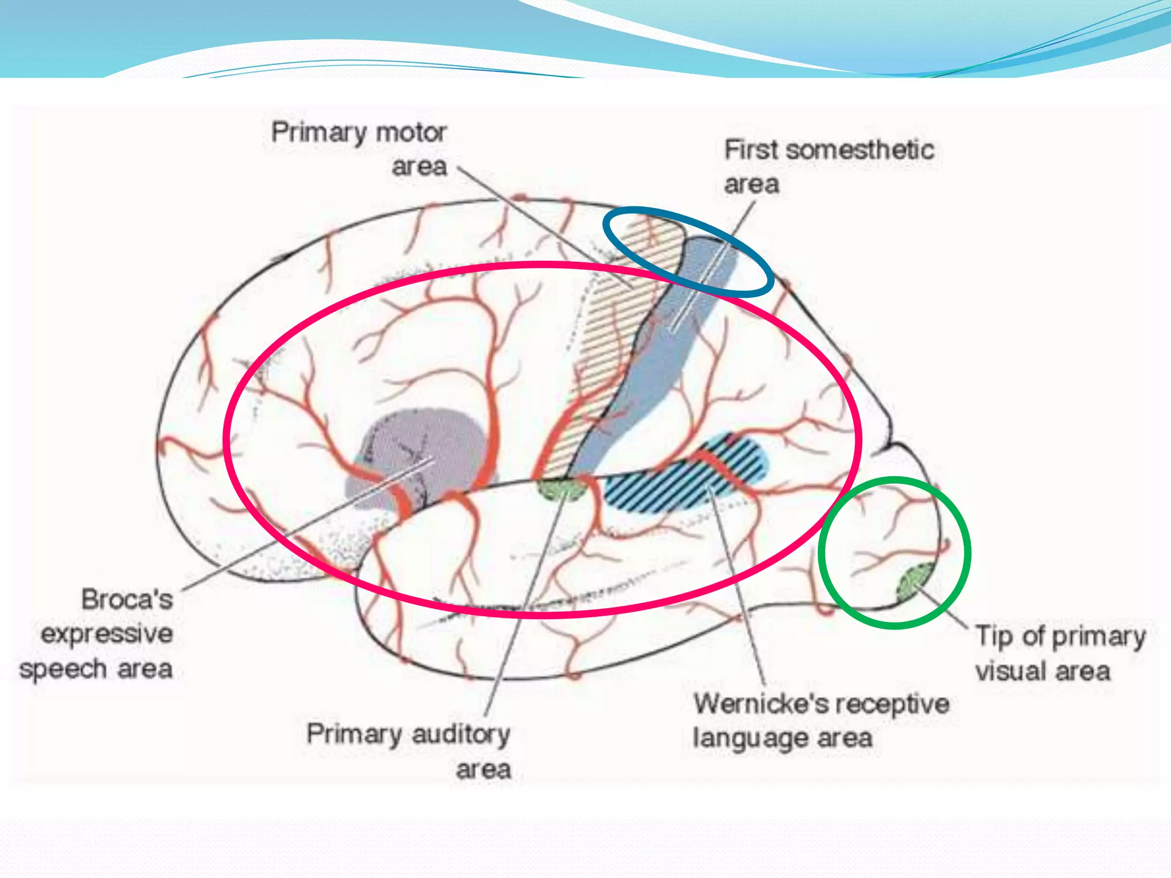

Slide 63
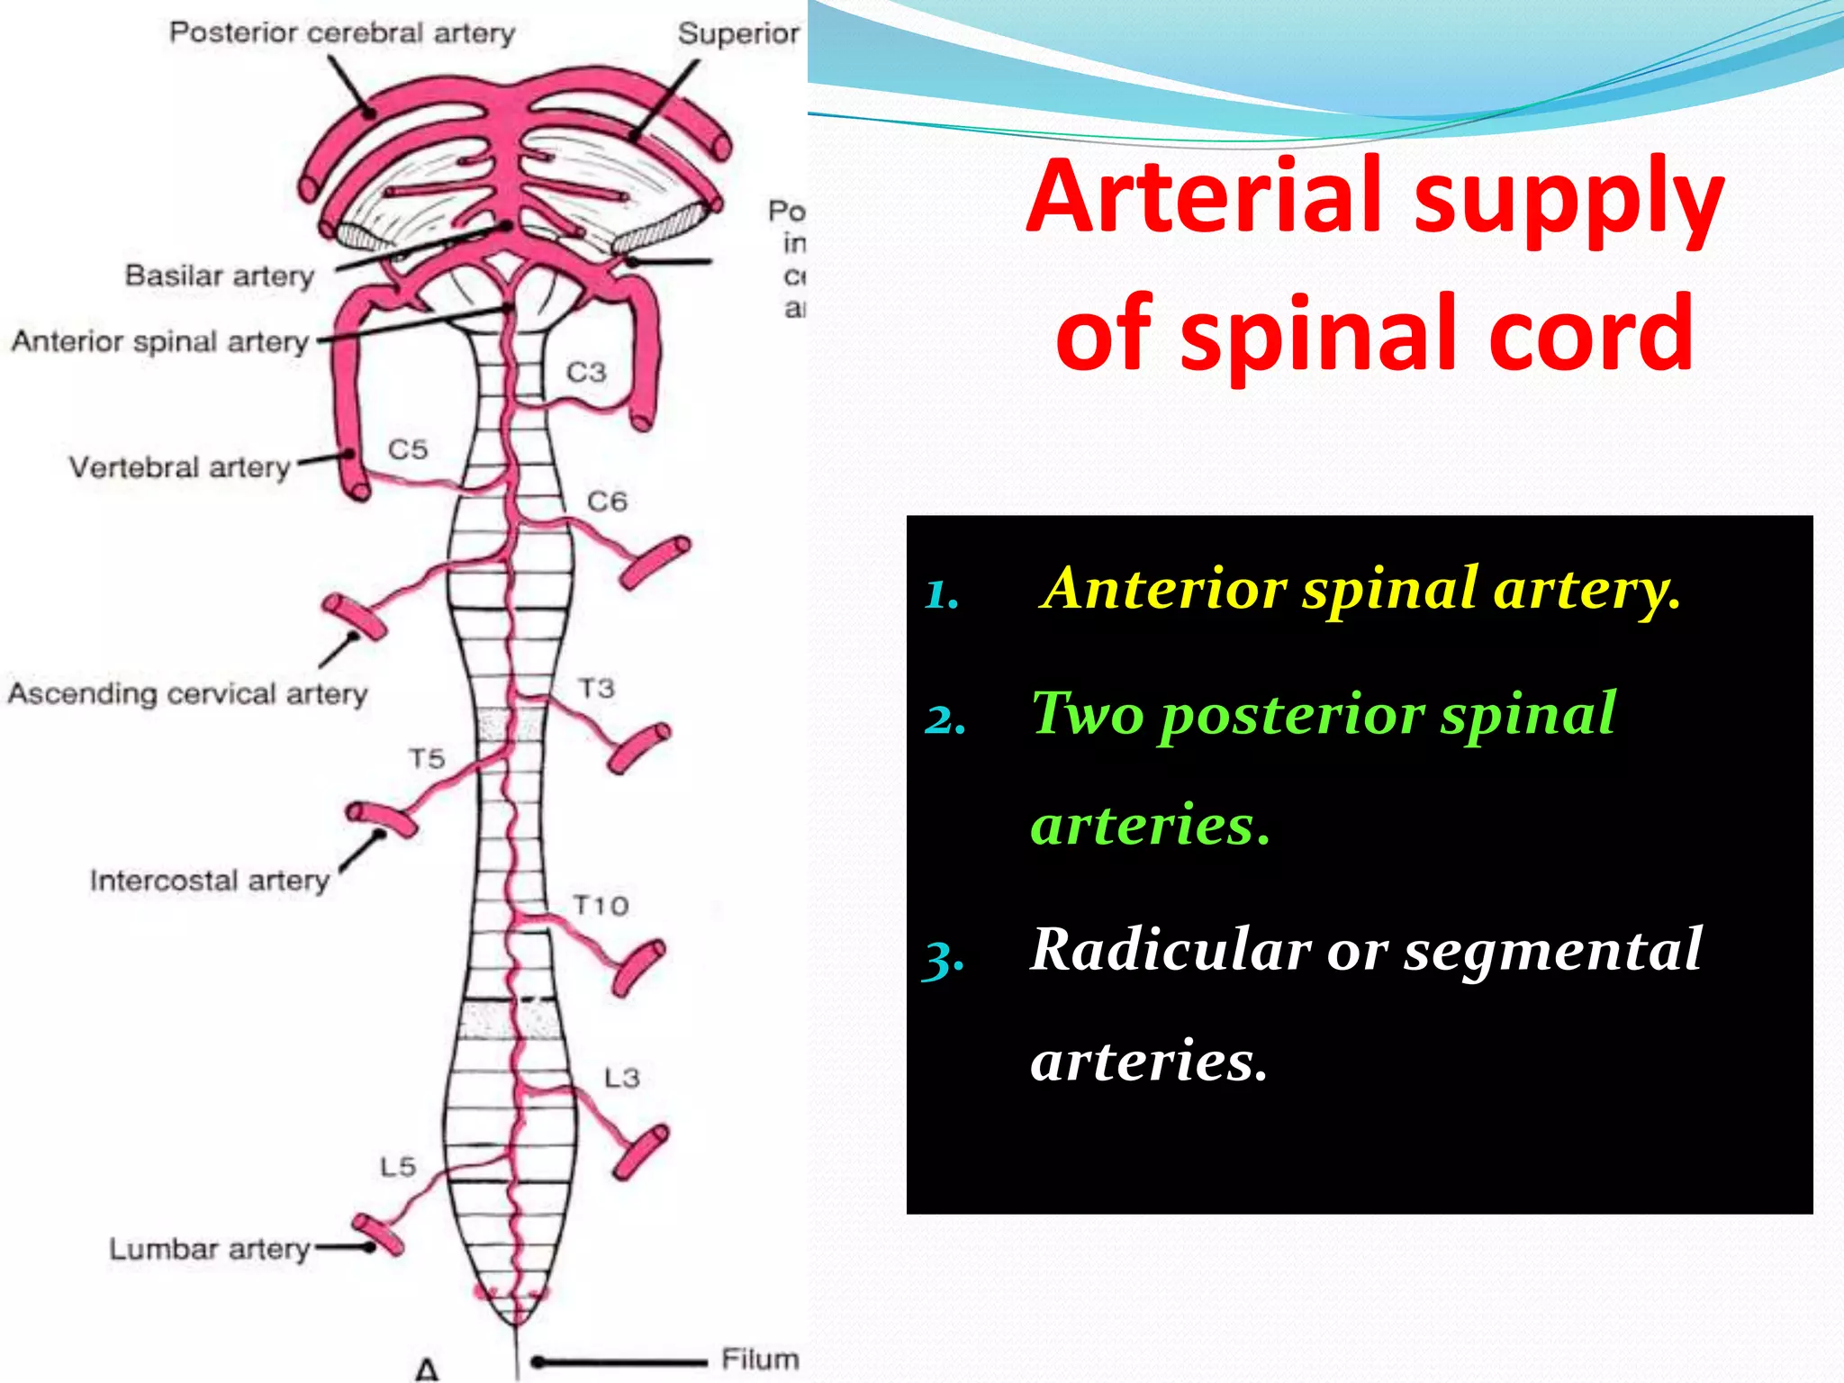

Slide 64
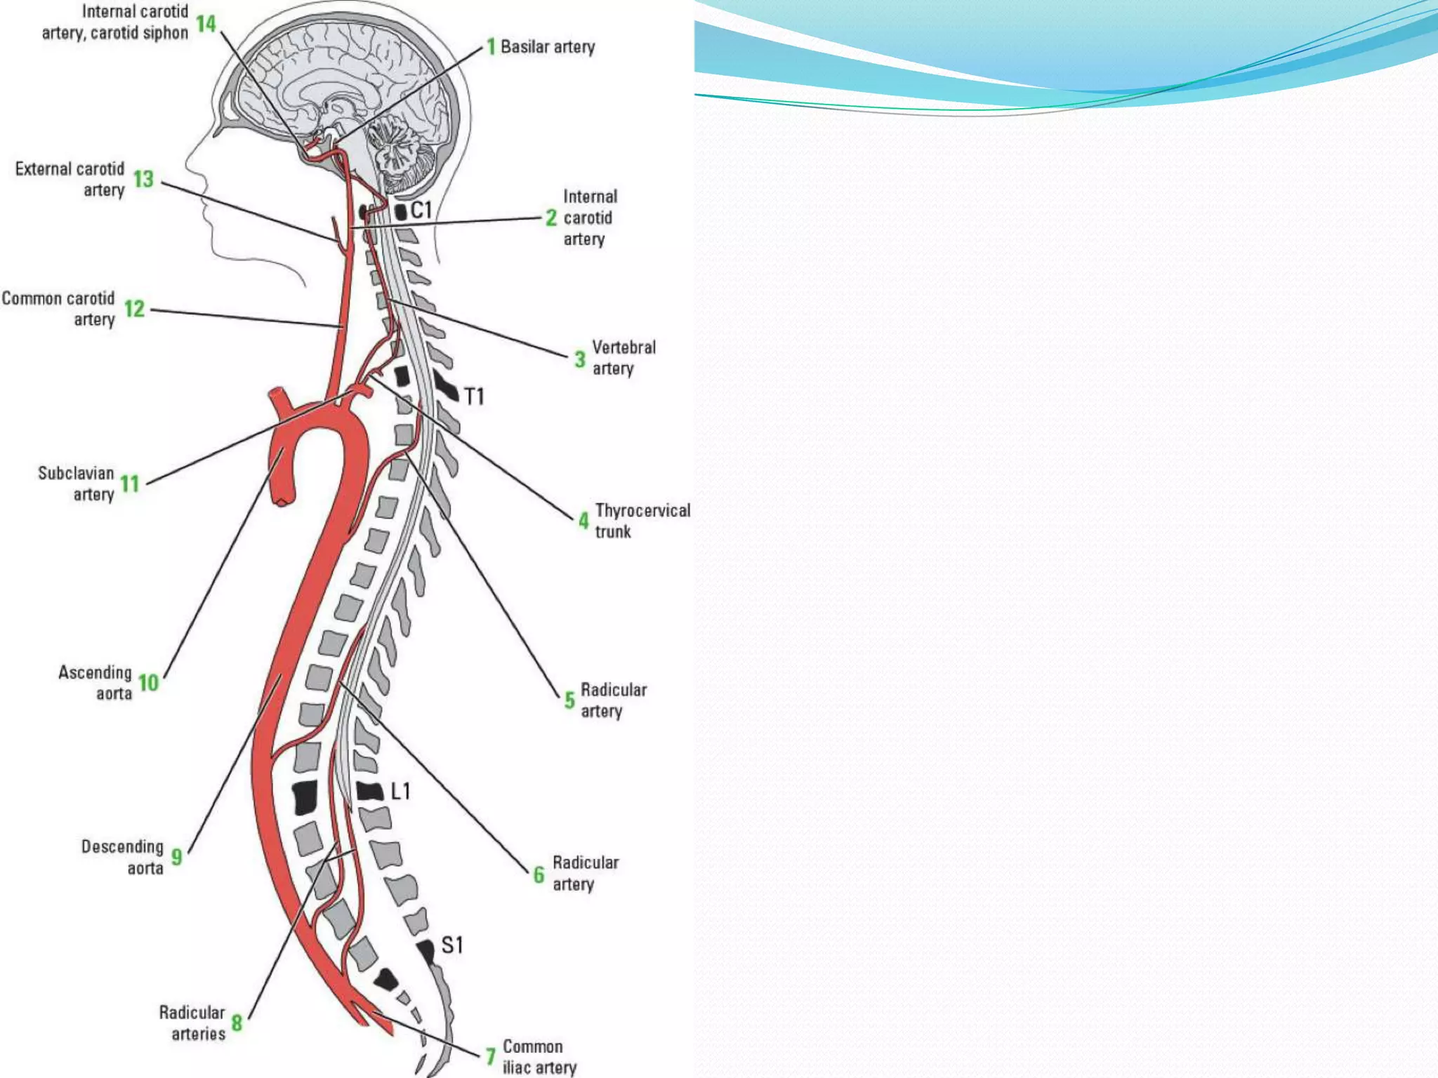

Slide 65
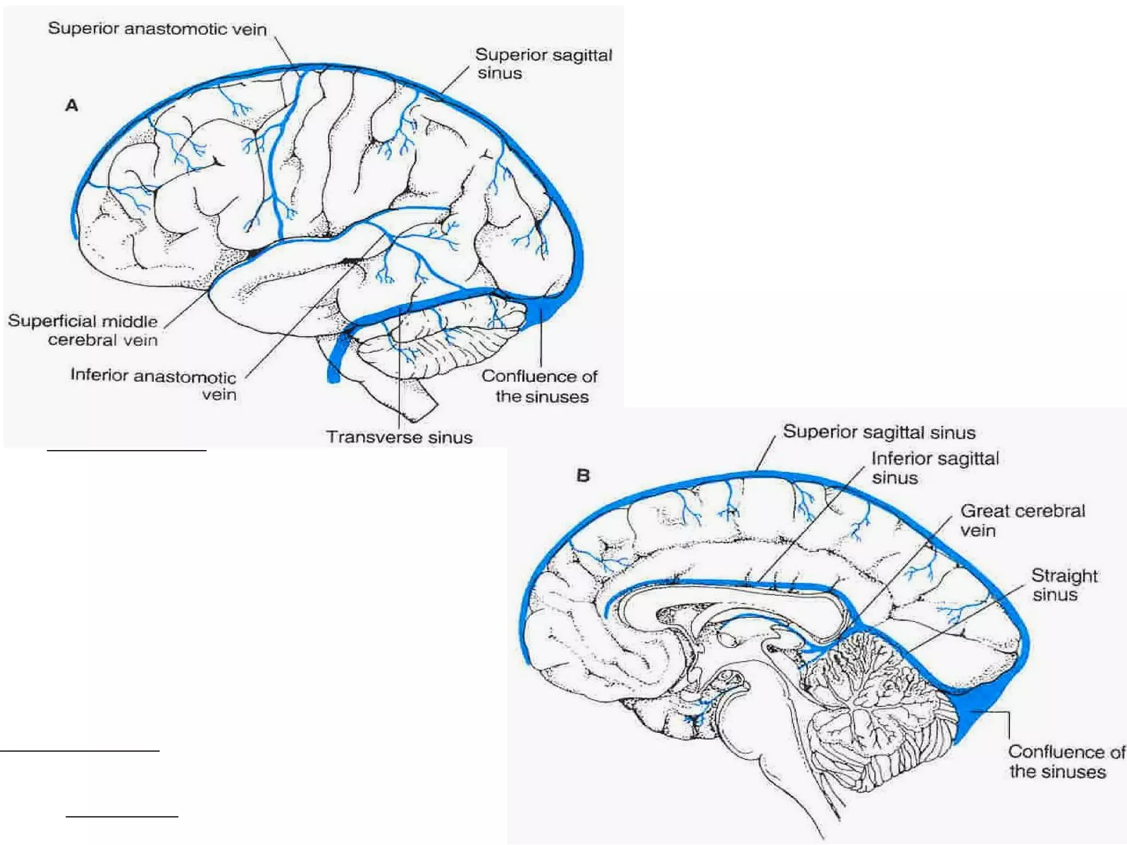

Slide 66
Thank you for listening…

