Slide 1
MOUTH AND TEMPOROMANDIBULAR JOINT
BY MUGUSA

Slide 2
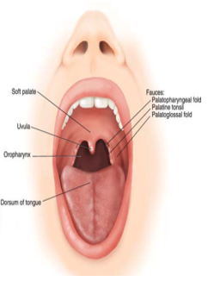
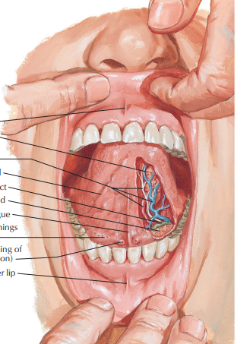
Extends from the lips to the oropharyngeal isthmus
The oropharyngeal isthmus:
Is the junction of mouth and pharynx.
Is bounded:
Above by the soft palate and the palatoglossal folds
Below by the dorsum of the tongue
Subdivided into Vestibule & Oral cavity proper

Slide 3
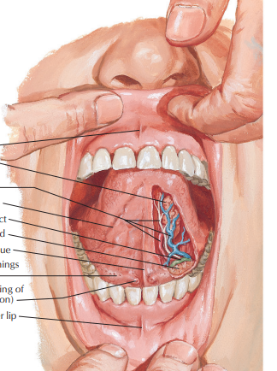
VESTIBULE
Narrow space between teeth and gingival and lip and cheeks
Contains frenula, midline mucosal folds from upper and lower lips to the gums
Size is controlled by orbicularis oris, buccinator,risorius and muscles controlling lips

Slide 4
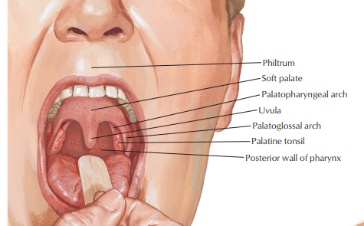
ORAL CAVITY PROPER
Anteriorly: lips
Posteriorly: oropharyngeal isthmus to oropharynx
Roof: hard palate anteriorly and soft palate posteriorly
Floor: mucosa beneath the tongue
Walls

Slide 5
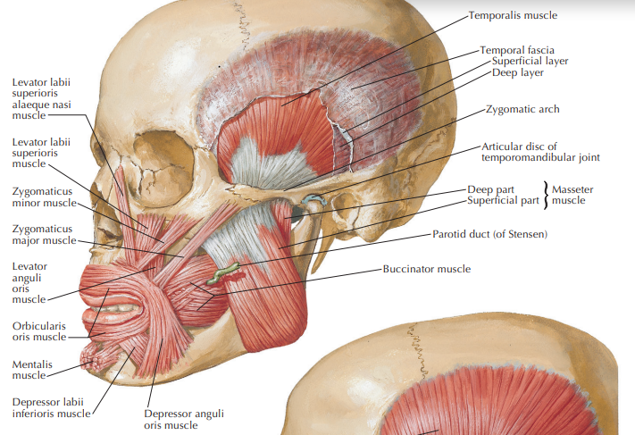
Anterior wall: lips
Orbicularis oris muscle
Fibers of levator labii superioris
Depressor anguli oris
Zygomaticus major.
Blood supply and drainage: Superior and inferior labial arteries and veins
Nerve supply:Branches of V2) superiorly and branches of V3) inferiorly

Slide 6
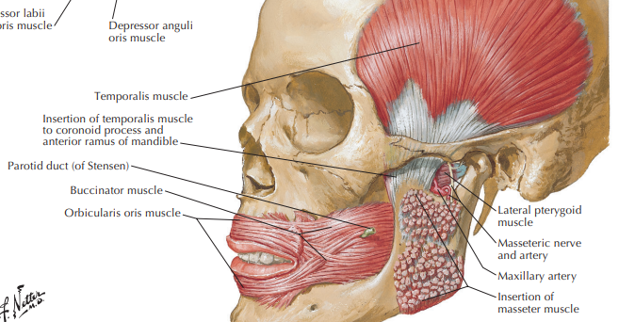
Lateral walls: cheeks
Lateral walls of the oral cavity form zygomatic prominances over zygomatic bones
Principal muscle is buccinators
Buccal fat pad external to buccinators
Suppplied by buccal branches of maxillary artery
Innervated by buccal branches of mandibular nerve (CN V3)

Slide 7
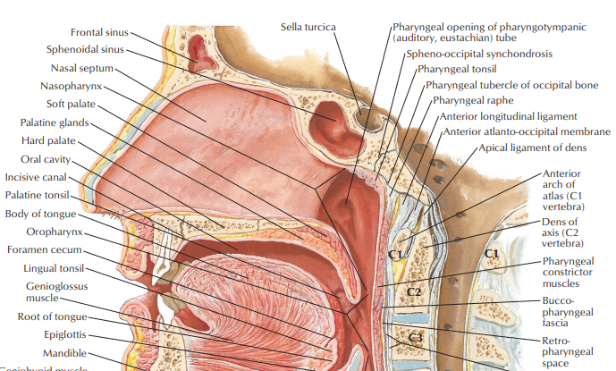
Roof
The roof is formed by the palate.
The palate forms roof of the oral cavity and floor of nasal cavities
Has two parts:
Hard (bony) palate anteriorly
Soft (muscular) palate posteriorly

Slide 8
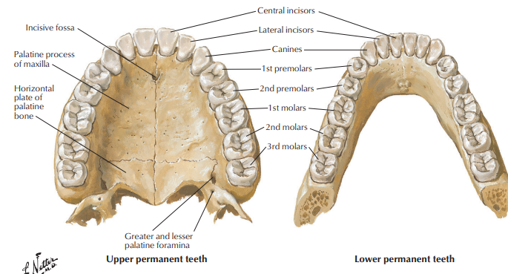
HARD PALATE
Lies in the roof of the oral cavity
Forms the floor of the nasal cavity
Formed by:
Palatine processes of maxillae in front
Horizontal plates of palatine bones behind
Covered with periosteum and oral mucosa (inferiorly) and respiratory mucosa (superiorly)
Bounded by alveolar arches

Slide 9
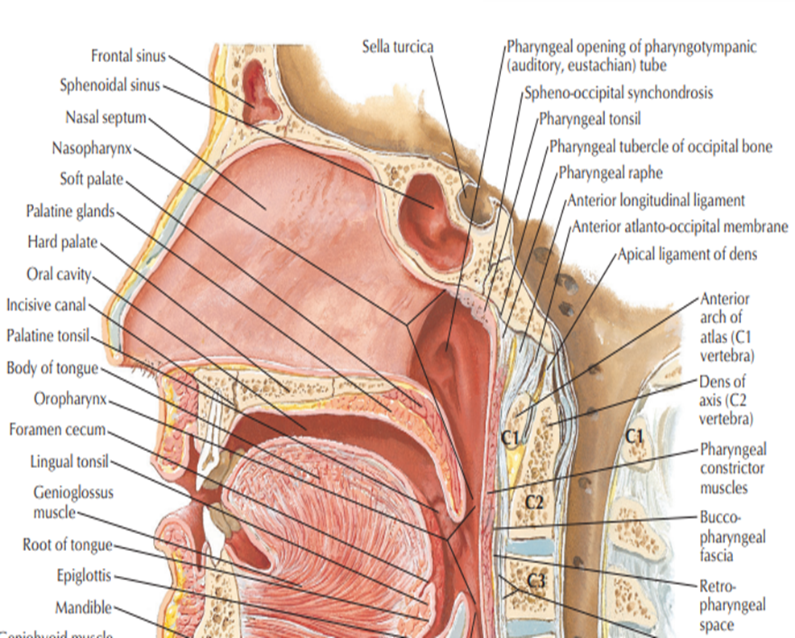
SOFT PALATE
Moveable posterior third suspended from hard palate
No bone skeleton
Attaches to palate via aponeurotic palate
Muscular palate (tensor veli palatine) posteriorly
Posterior curved free margine has conical projection- uvula

Slide 10
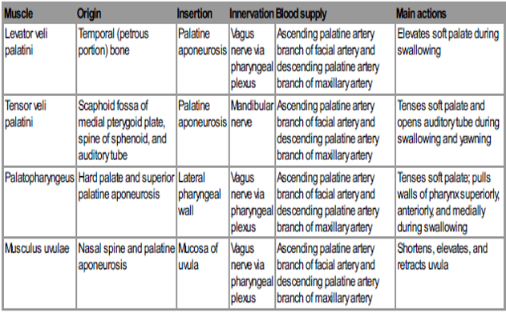

Slide 11
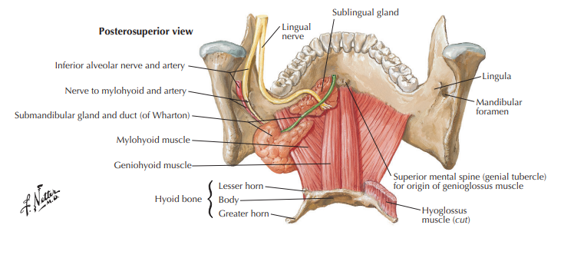
Mylohyoid muscles
Innervation: Nerve to mylohyoid from the inferior alveolar branch of mandibular nerve (V3)
Geniohyoid muscles
Innervation: C1
Functions
Support and elevates floor or oral cavity
Depresses mandible when hyoid is fixed
Elevates and pulls hyoid forward when mandible is fixed

Slide 12
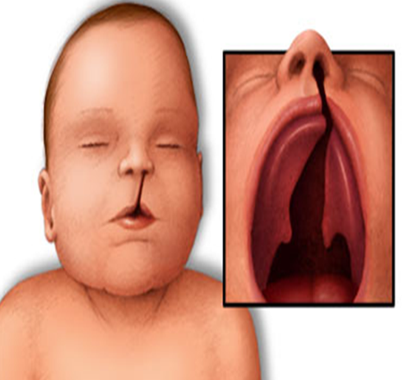
Cleft palate:
Unilateral
Bilateral
Median
Paralysis of the soft palate
The pharyngeal isthmus can not be closed during swallowing and speech

Slide 13
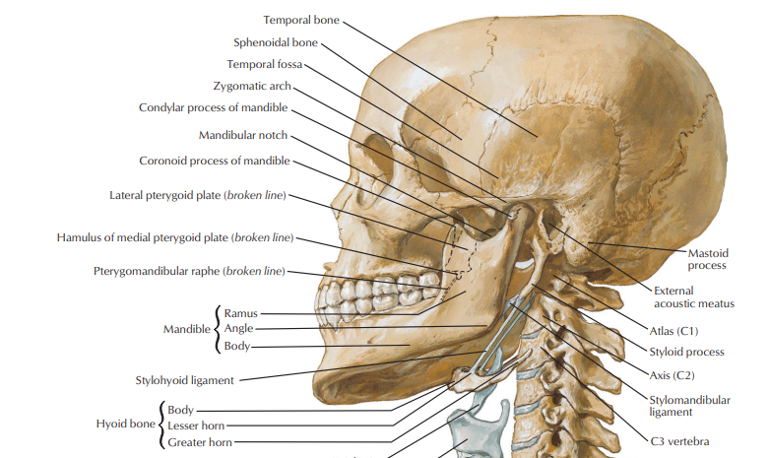
Temporalmandibular joint (TMJ)
1.Joint definition
Is an encapsulated, synovial joint
Classified as a ginglymo-arthroidal joint due to its ability to function as a hinge as well as a gliding type of joint.
2. Bones that make up the joint
Mandible
Maxilla
Zygomatic arch
Temporal bone

Slide 14
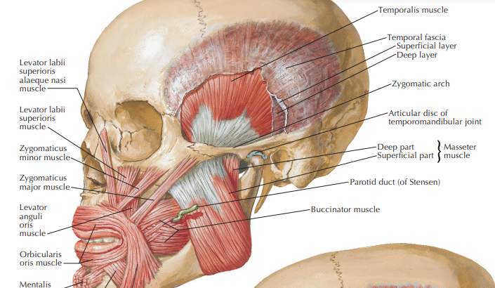
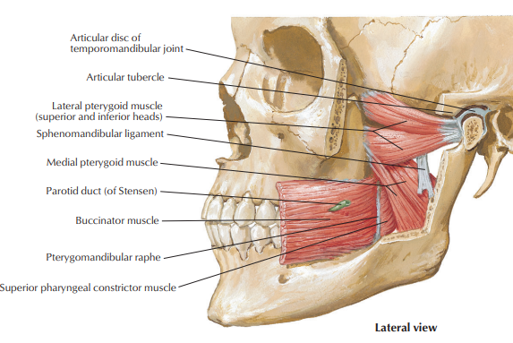
MUSCLES
Tempolaris
Masseter
Medial pterygoid
Lateral pterygoid

Slide 15
Innervation
Vascularisation
Sensory
Auriculo temporal nerve
Messeteric nerve
Motor
Mandibular division of trigeminal nerve
Branches of external carotid artery
Superficial temporal artery
Deep auricular artery
Anterior tympanic artery
Ascending pharyngeal artery
Maxillary artery
The blood supply to TMJ is superficial i.e. there is no blood supply inside the capsule
TMJ takes it nourishment from the synovial fluid

Slide 16
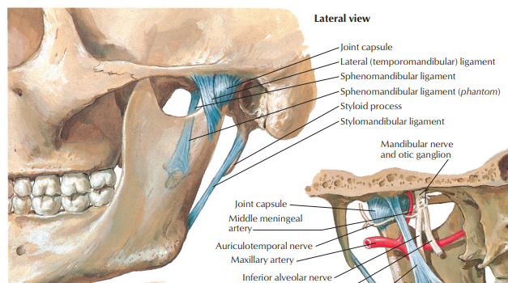
5. Associated ligament
Lateral (Temporomandibular) ligament
Stylomandibular ligament
Sphenomandibular ligament

Slide 17

Movement
Rotational movements in first 20-25 mm of mouth opening
Transitional movement after that the mouth is excessively open.
1. Depression of Mandble
Lateral pterygoid
Digrastric
Geniohyoid
2. Elevation of Mandible
Tempolaris
Masseter
Medial pterygoid

Slide 18
3. Protrusion of Mandible
Medial pterygoid
Lateral pterygoid
4. Retraction of Mandible
- Posterior fibres of tempolaris

Slide 19
CLINICAL CORRELATES
Internal derangement
Degenerative joint disease
Rheumatoid arthritis
Infectious arthritis
Mandibular dislocation

Slide 20
WHAT IS HILTON’S LAW

