Slide 1
FACIAL NERVE AND THE PAROTID GLAND
Mr. M. Banda
University of Zambia

Slide 2

Facial Nerve: Objectives
Origin
Course
Branches
Clinical correlates

Slide 3
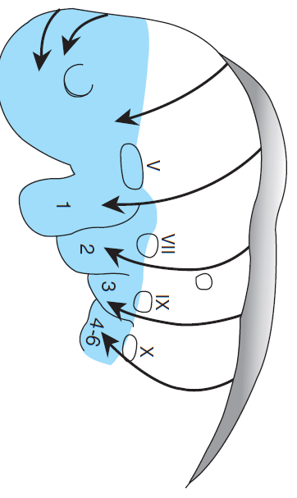
Introduction
CN VII is the nerve of the 2nd pharyngeal arch
Supplies all the muscles that develop from the mesoderm of 2nd pharyngeal arch
CN VII is a mixed nerve

Slide 4
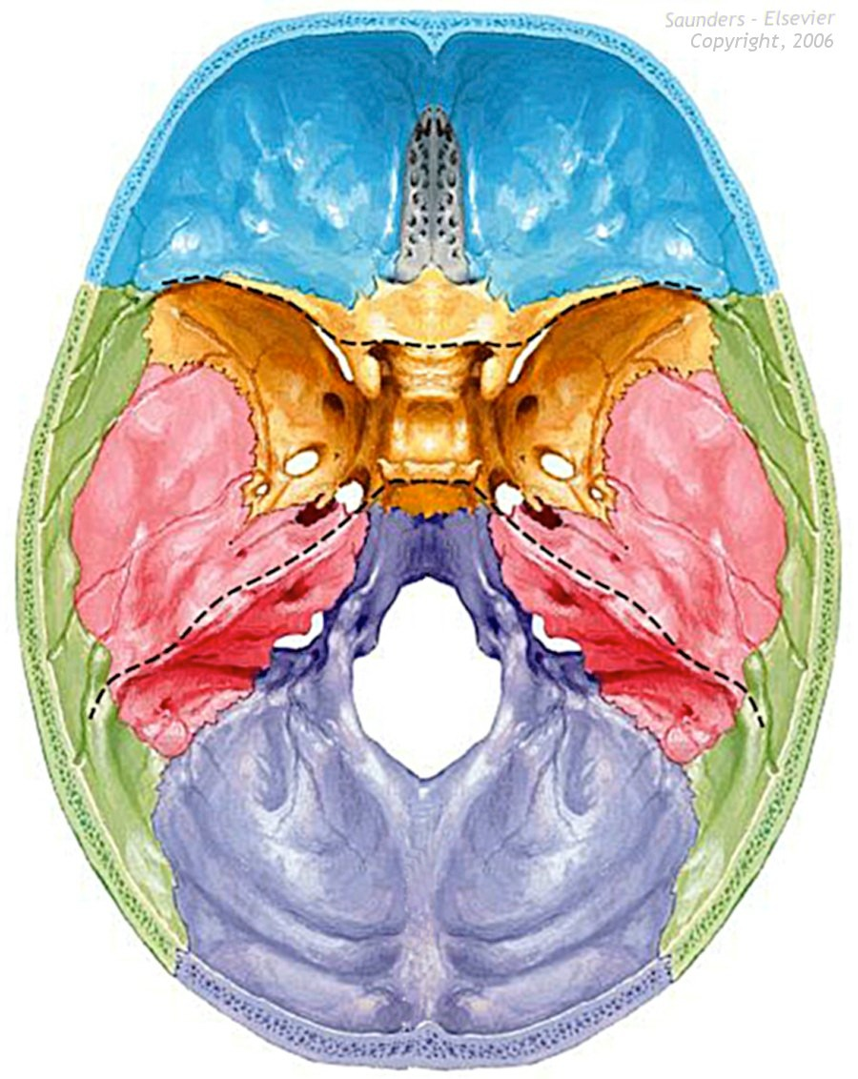
Facial Nerve
Foramen:
Internal Acoustic Meatus
Fiber Type:
Special sensory (taste)
General sensory
Branchiomotor - Parasympathetic motor

Slide 5
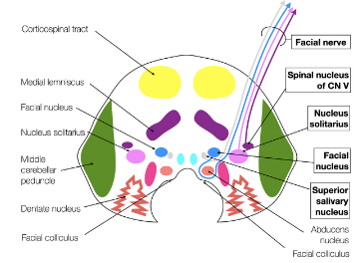
Origin
Facial nucleus:
- muscles of facial expression
- post belly of digastric,
- stylohyoid and stapedius
Parasympathetic nerve fibers:
- Superior salivatory nucleus
- Lacrimal nucleus
Nucleus of tractus solitarius
- Taste sensation for anterior 2/3rd of tongue
Spinal trigiminal nucleus
- General sensations from the skin of the concha of the auricle and the ext auditory meatus

Slide 6
FACIAL NERVE
Internal acoustic meatus
Geniculate ganglion
(taste 1st order cell bodies)
Branchial motor
nucleus
Greater petrosal nerve
Sup. salivary
nucleus
Chorda tympani
nerve
Nerve to stapedius
Nucleus of
Tractus solitarious
Nervous
intermedius
Ear drum
Stylomastoid foramen
VE to submandibular gland and glands on the mouth floor
Pure branchial motor facial nerve
Supply muscles of facial expression
Taste from anterior tongue

Slide 7
MOTOR NUCLEUS OF FACIAL NERVE
Innervation of motor nucleus:
The facial nucleus is subdivided into an upper and lower facial nuclei
The upper facial nucleus recieves bilateral innervation through corticobulbar fibers from the primary motor cortex
The lower facial nucleus recieves only contralateral projections
Notes:
Every motor cranial nerve has a UMN and a LMN
Upper part of the motor nucleus is innervated bilaterally – meaning both motor cortex are supplying it, while the lower part of the motor nucleus is innervated by the contralateral part
Facial nucleus along with the facial nerve is considered LMN
UMN is from the cortex till it synapses in the nucleus
LMN lesion – paralysis of the face – ipsi lateral half of the face is affected – same side lesion
UMN lesion – paralysis of the lower half of the face on the contra lateral side

Slide 8
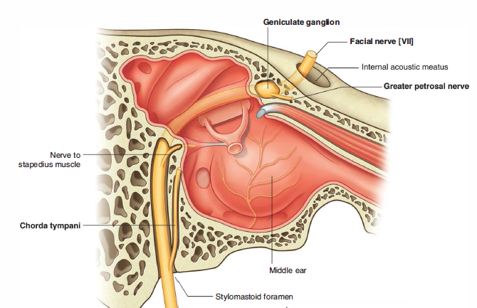
Facial nerve
The facial nerve exits the skull through the stylomastoid foramen and passes into the deep substance of the parotid gland, where it usually divides into upper and lower trunks.
These pass through the substance of the parotid gland, where there may be further branching and anastomosing of the nerves.

Slide 9
FACIAL NERVE
Then, after running the longest intraosseous course of any cranial nerve, CN VII emerges from the cranium via the stylomastoid foramen; gives off the posterior auricular branch; enters the parotid gland; and forms the parotid plexus, which gives rise to the following five terminal motor branches: temporal, zygomatic, buccal, marginal mandibular, and cervical.
Branchial Motor As the nerve of the 2nd pharyngeal arch, the facial nerve supplies striated muscles derived from its mesoderm, mainly the muscles of facial expression and auricular muscles. It also supplies the posterior bellies of the digastric, stylohyoid, and stapedius muscles.

Slide 10
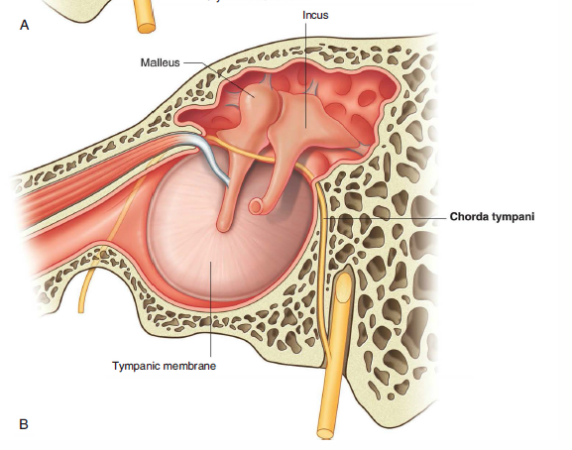

Slide 11
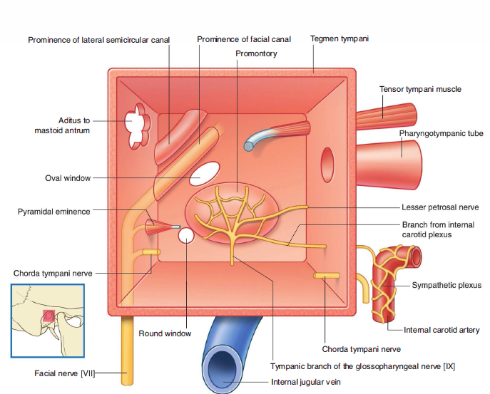
Relations

Slide 12
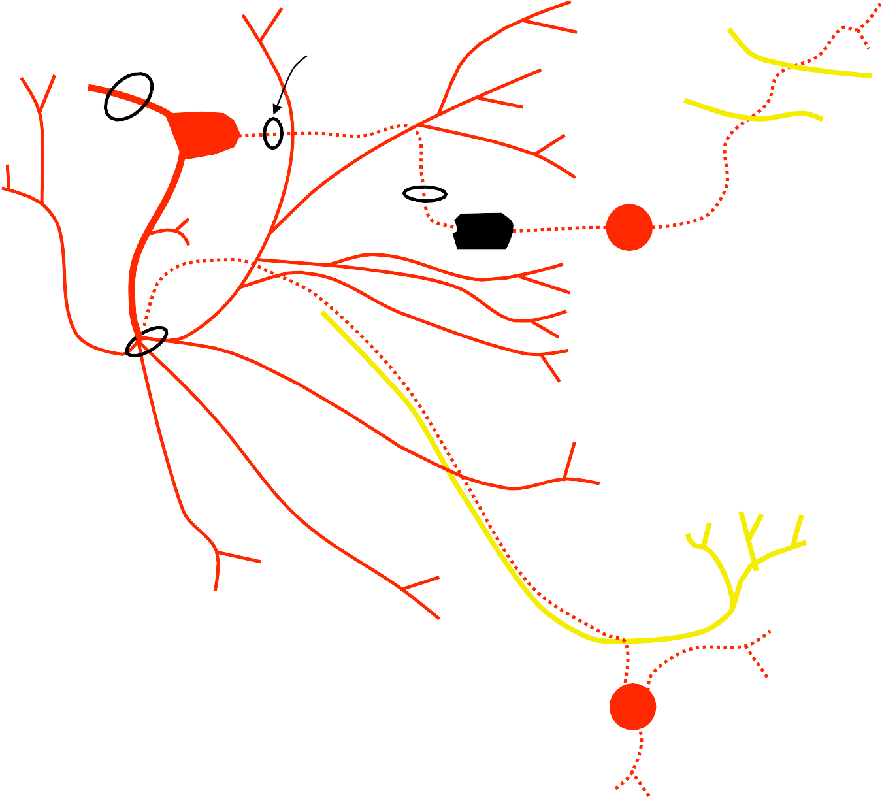
Facial Nerve
temporal branches
internal aucostic meatus
hiatus of facial canal
lacrimal gland
geniculate gang.
zygomatic branches
lacrimal
greater petrosal
maxillary
to stapedius
foramen lacerum
pterygoid
canal nerve of
pter. canal
auricular branch
pterygopalatine gang.
chorda tympani
buccal branches
stylomastoid foramen
mandibular branch
anterior 2/3 of tongue
cervical branch
to post. belly of digastric muscle
sublingual gland
submandibular ganglion
motor to skeletal muscles = parasymp. motor to cardiac and smooth muscle =
sensory (afferent) =
submandibular gland

Slide 13
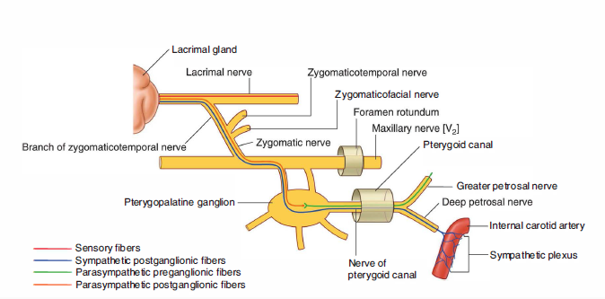
Autonomic Lacrimal Fibers

Slide 14
Facial Nerve
Presynaptic Parasympathetic
CN VII provides presynaptic parasympathetic fibers to the pterygopalatine ganglion for innervation of the lacrimal mucous glands and to the submandibular ganglion for innervation of the sublingual and submandibular salivary glands. The pterygopalatine ganglion is associated with the maxillary nerve (CN V₂), which distributes its postsynaptic fibers, whereas the submandibular ganglion is associated with the mandibular nerve (CN V₃). Parasympathetic fibers synapse in these ganglia, whereas sympathetic and other fibers pass through them.
General Sensory Some fibers from the geniculate ganglion supply a small area of the skin of the concha of the auricle, close to external acoustic meatus.
Taste (Special Sensory) Fibers carried by the chorda tympani join the lingual nerve to convey taste sensation from the anterior two thirds of the tongue and soft palate.

Slide 15
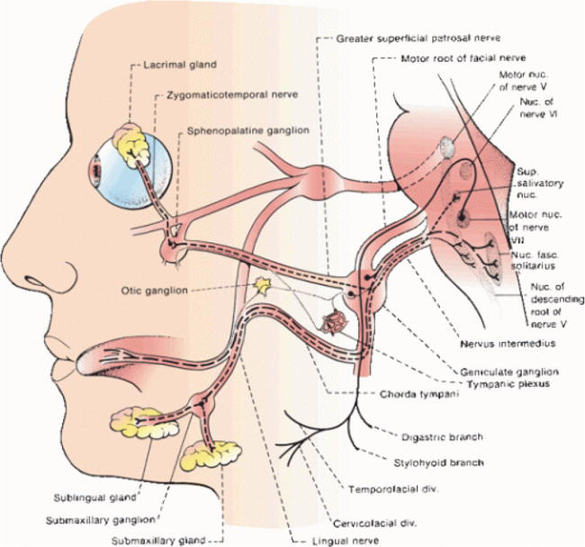
Facial Nerve

Slide 16
The temporal branch ascends to supply the auricular muscles and frontalis.
The zygomatic branch is directed towards the eye and supplies muscles above and below the palpebral fissure.
The buccal runs horizontally forwards to innervate buccinator and the muscles of the upper lip.
The mandibular branch supplies the muscles of the lower lip
The cervical branch descends to supply the platysma

Slide 17
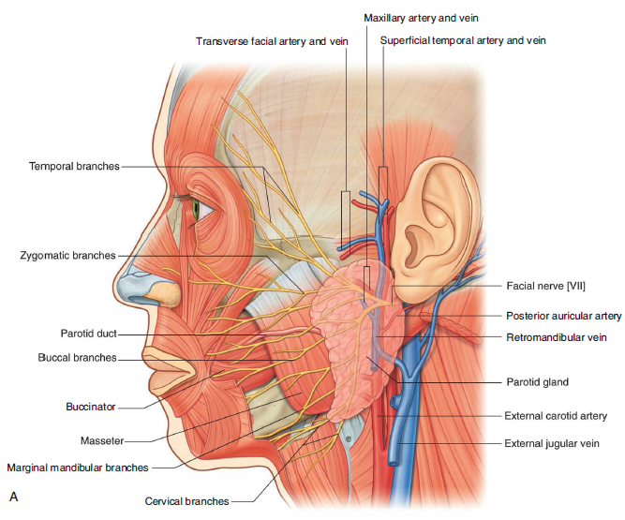
Relationship of the facial nerve and the parotid gland
The intimate relationships between the facial nerve [VII] and the parotid gland mean that surgical removal of the parotid gland is a difficult dissection if all branches of the facial nerve are to be spared.

Slide 18
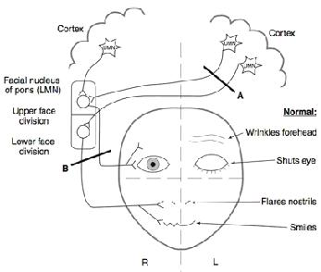
Facial Nerve Lesion
UMN Lesion : Lesion A - Contralateral lower half of the face is affected
LMN Lesion : Lesion B - Ipsilateral complete half of the face is affected
Notes:
LMN lesion – affecting the nucleus or the nerve

Slide 19
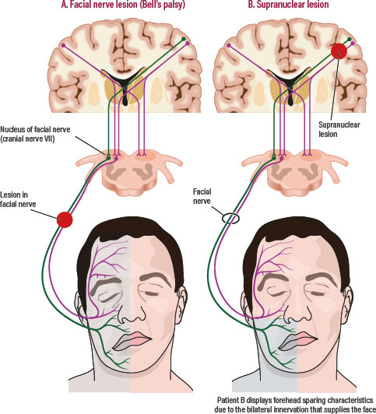

Slide 20
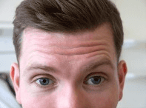
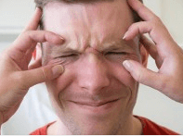

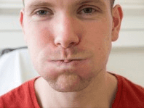
Physical Examination for the Facial Nerve
Forehead wrinkling ( Frontalis muscle )
Closure of eyelids ( Orbicularis oculi )
Look for the Nasolabial fold
Smiling or Showing teeth
Whistling or Blowing ( Buccinator and Orbicularis oris)
Notes:
Puff air – gently pat the cheek, no air should go out?

Slide 21
Parotid Gland
The parotid is the largest of the salivary glands and is pyramidal in shape
It has an average weight of 25 g, is irregular, lobulated and a yellowish mass
Its base faces laterally between the anterior border of sternocleidomastoid and the ramus of the mandible

Slide 22
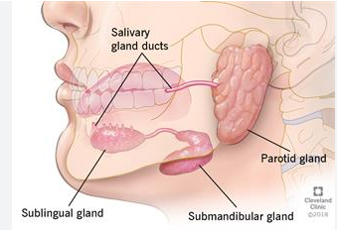
Shape and Outline
The overall shape of the parotid gland is variable.
In 50% of cases it is roughly triangular, 30% is of even width.
The upper and lower poles are rounded.

Slide 23
Boundaries
The concave superior surface is related to the cartilaginous part of the external acoustic meatus and posterior aspect of the temporomandibular joint.
Here the auriculotemporal nerve curves round the neck of the mandible, embedded in the capsule of the gland.
The apex overlaps the posterior belly of digastric and the carotid triangle to a variable extent.

Slide 24
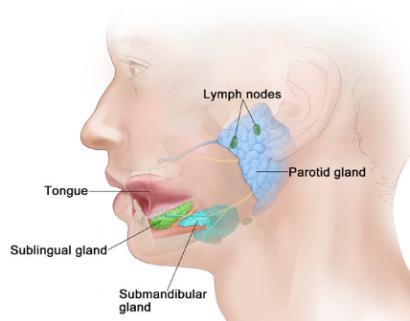
Parotid Gland
The superficial surface is covered by skin and superficial fascia, which contains the facial branches of the great auricular nerve, superficial parotid lymph nodes and the posterior border of platysma.
It extends upwards to the zygomatic arch, backwards to overlap sternocleidomastoid, downwards to its apex posteroinferior to the mandibular angle, and forwards to lie on masseter below the parotid duct

Slide 25
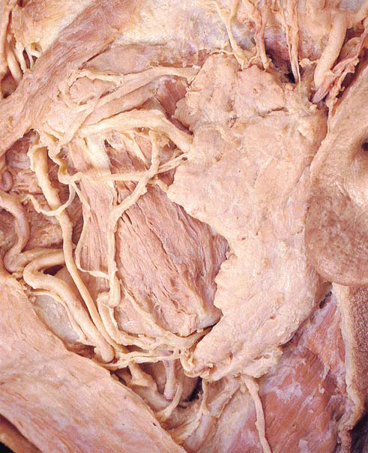
Parotid Gland
The gland may therefore be subdivided into a larger superficial part and a smaller part, the deep ‘lobe', deep to the ramus, the two being joined by an isthmus.
Branches of the facial nerve emerge on the face from the anterior margin of this surface.

Slide 26
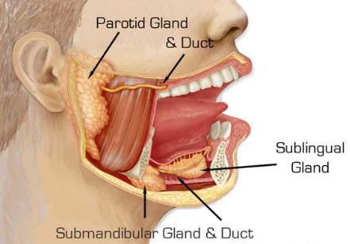
Parotid Capsule
The parotid gland is enclosed within an unyielding parotid capsule, the deep part of which is derived from the investing layer of deep cervical fascia
Any inflammation or tension within the parotid gland can cause an exquisite pain just in front of the temporomandibular joint.

Slide 27
Parotid Capsule
This is caused by stretching of the capsule and stimulation of the great auricular nerve.
The pain is usually exacerbated at mealtimes when the gustatory stimulus to the gland results in further turgor within the capsule, and is seen routinely in patients suffering from mumps or with parotid duct obstruction.

Slide 28
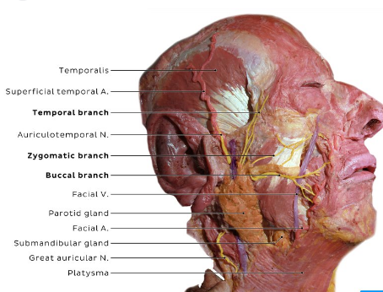
Parotid Duct
The parotid duct leaves the anterior edge of the parotid gland midway between the zygomatic arch and the corner of the mouth.
It crosses the face in a transverse direction and, after crossing the medial border of the masseter muscle, turns deeply into the buccal fat pad and pierces the buccinator muscle.
It enters the inside of the mouth near the second upper molar tooth.

Slide 29
Important relationships
Several major structures enter and pass through or pass just deep to the parotid gland.
These include the facial nerve, the external carotid artery and its branches, and the retro-mandibular vein and its tributaries

Slide 30
The End!
Thank you!

