Slide 1
NASAL CAVITY, PARANASAL SINUSES & LACRIMAL APPARATUS

Slide 2
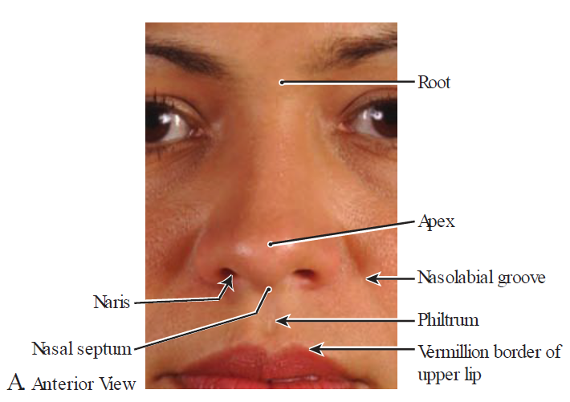
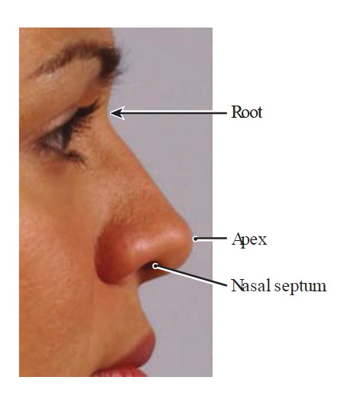

The nose

Slide 3
Introduction
Opens on the face - anterior nasal apertures (nares, or nostrils)
Separated by into 2 by nasal septum
Communicates with the nasopharynx - posterior opening (choanae).
Vestibule
  slight dilatation inside the aperture of each nostril
  lined largely with skin containing hair, sebaceous glands, and sweat glands.
Function - warm, clean, humidify, filter the inhaled air for respiration, and help smell and taste.

Slide 4
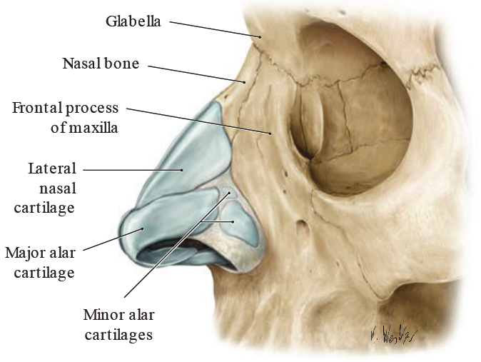
Skeleton of external nose

Slide 5
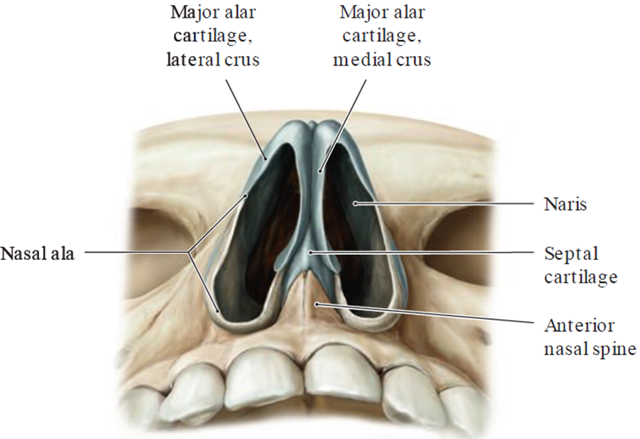
Nasal cartilage

Slide 6
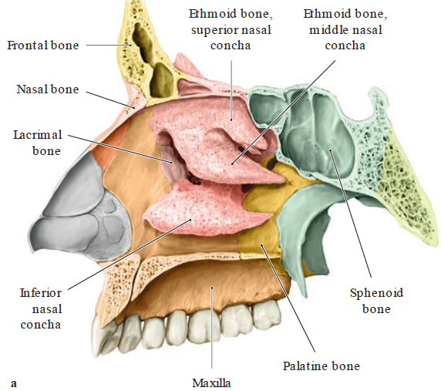
Roof
Formed by:
  Nasal
  Frontal
  Ethmoid (cribriform plate)
  Sphenoid (body) bones
The cribriform plate transmits the olfactory nerves.

Slide 7
Floor
Formed by:
  Palatine process of the maxilla
  Horizontal plate of the palatine bone.
Contains incisive foramen which transmits:
  Nasopalatine nerve
  Terminal branches of the sphenopalatine artery.

Slide 8
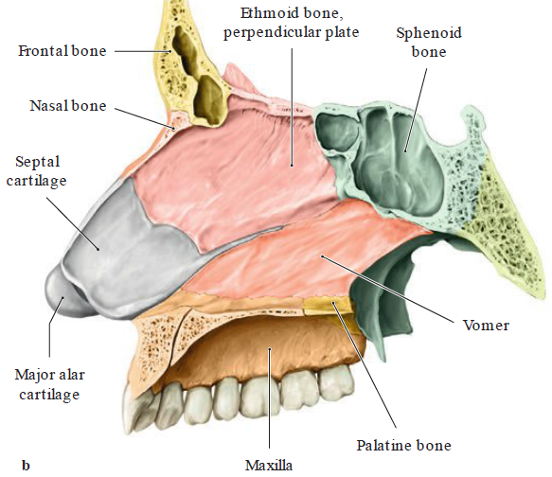
Medial Wall (Nasal Septum)
Primarily formed by:
  Ethmoid bone (perpendicular plate)
  Vomer
  septal cartilage.
Also by:
  Palatine processes
  Maxillary bone
  Nasal bone
  Frontal bone
  Sphenoid bone

Slide 9
Lateral Wall
Formed by:
  Superior & middle nasal conchae ( ethmoid bone)
  Inferior nasal concha.
Also by:
  Nasal bone
  Lacrimal bone
  Frontal process & nasal surface of the maxilla
  Palatine bone
  sphenoid bone (medial pterygoid plate)

Slide 10
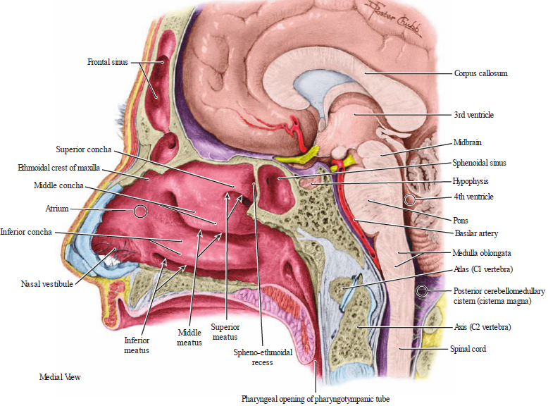
Lateral wall structures
Sphenoethmoidal recess, superior, middle & inferior meatus & sphenopalatine foramen

Slide 11
Sphenoethmoidal recess
Opening of the sphenoid sinus

Slide 12
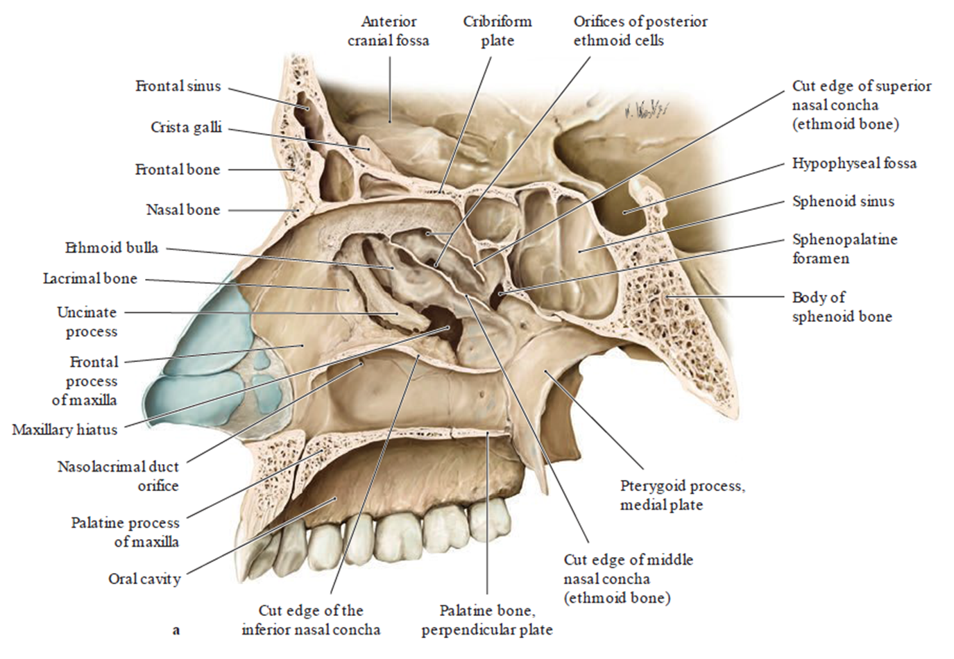
Superior Meatus
Opening of the posterior ethmoidal air cells.

Slide 13
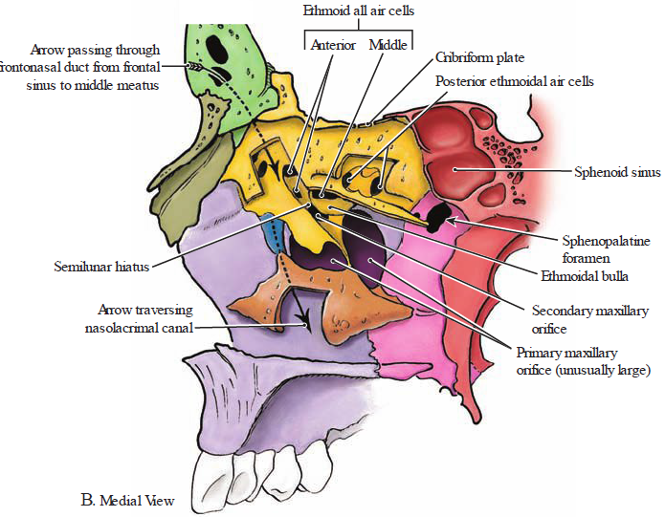
Middle meatus
Opening of frontal sinus into the infundibulum, middle ethmoidal air cells on the ethmoidal bulla, anterior ethmoidal air cells & maxillary sinus in the hiatus semilunaris.

Slide 14

Inferior Meatus
Opening of the nasolacrimal duct.

Slide 15
Sphenopalatine Foramen
Opening into the pterygopalatine fossa; transmits the sphenopalatine artery and nasopalatine nerve.

Slide 16
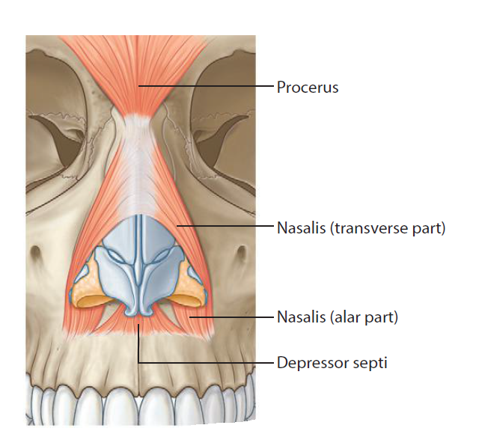
Nasal group of facial muscles

Slide 17
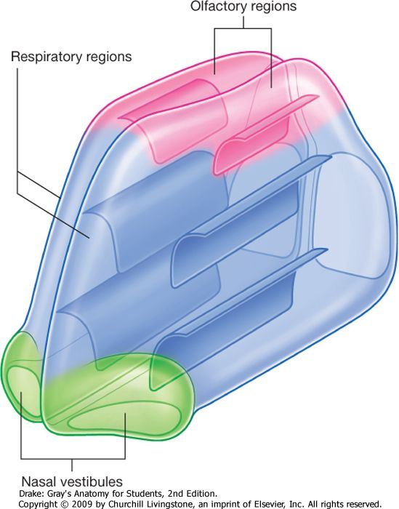
Subdivisions of mucous membrane
Vestibule
Respiratory Region
Olfactory Region

Slide 18
Subdivision of MM cont’d
Vestibule
  Dilated part inside the nostril
  Bound by alar cartilages
  lined by skin with hairs
Respiratory Region
  lower two-thirds of the nasal cavity
  Warms, moistens, and cleans incoming air with its mucous membrane.
Olfactory Region
  superior nasal concha & the upper one-third of the nasal septum.
  Innervation - olfactory nerves

Slide 19
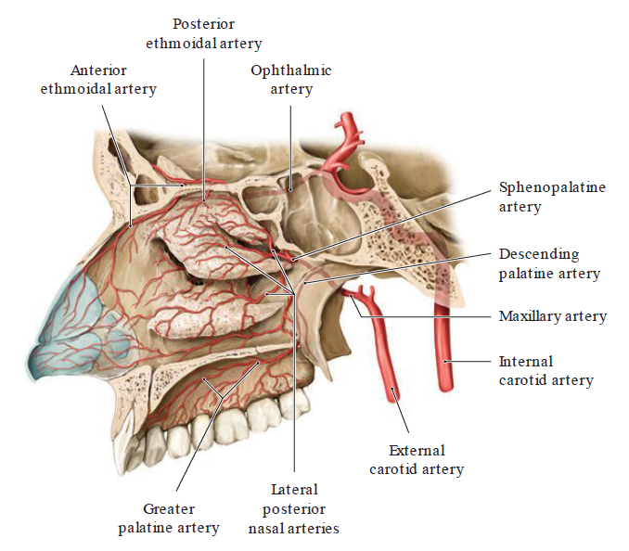
Arteries – right lateral wall

Slide 20
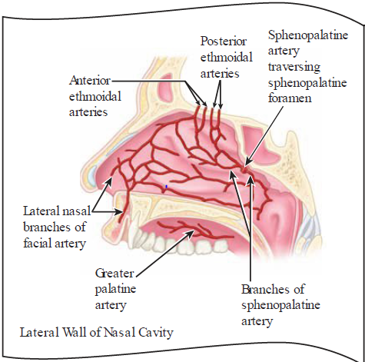
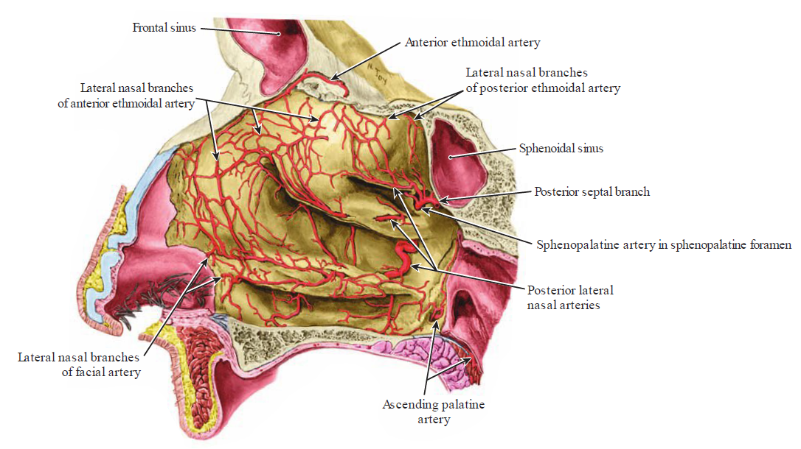
Arteries – right lateral wall

Slide 21
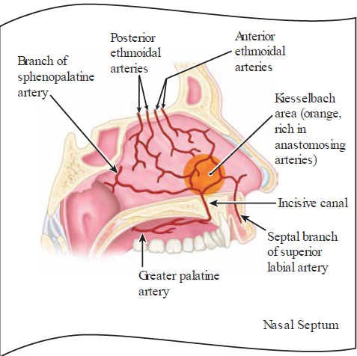
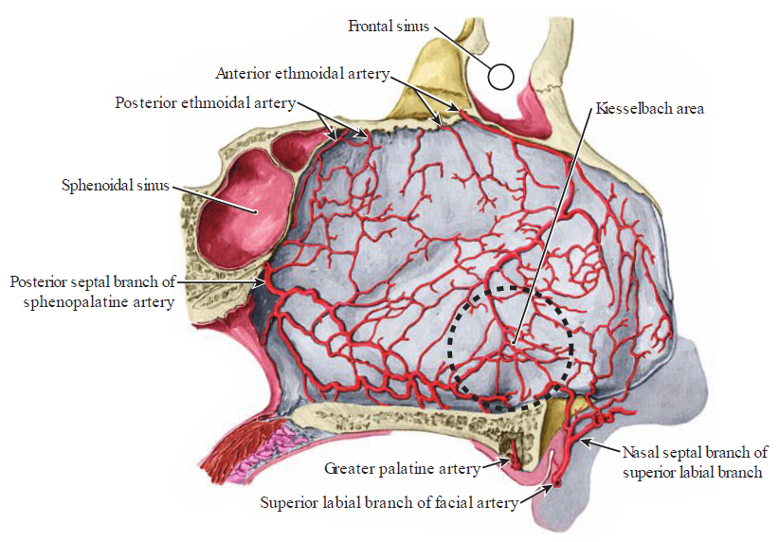
Blood supply – nasal septum
plexus
B. Lateral View of Nasal Septum

Slide 22
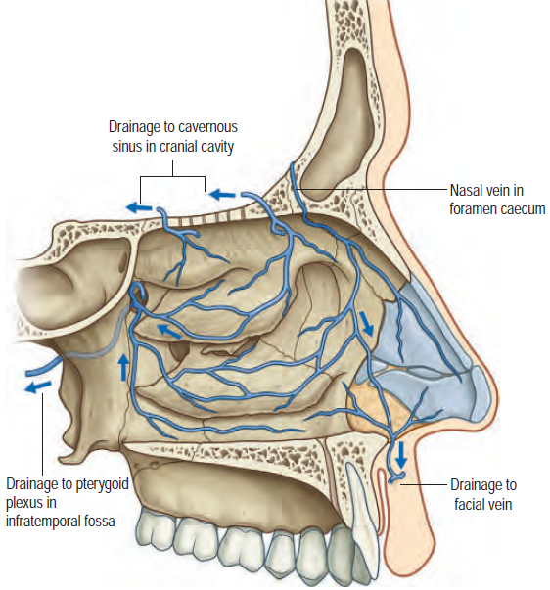
Venous drainage of nasal cavity
A. lateral wall

Slide 23
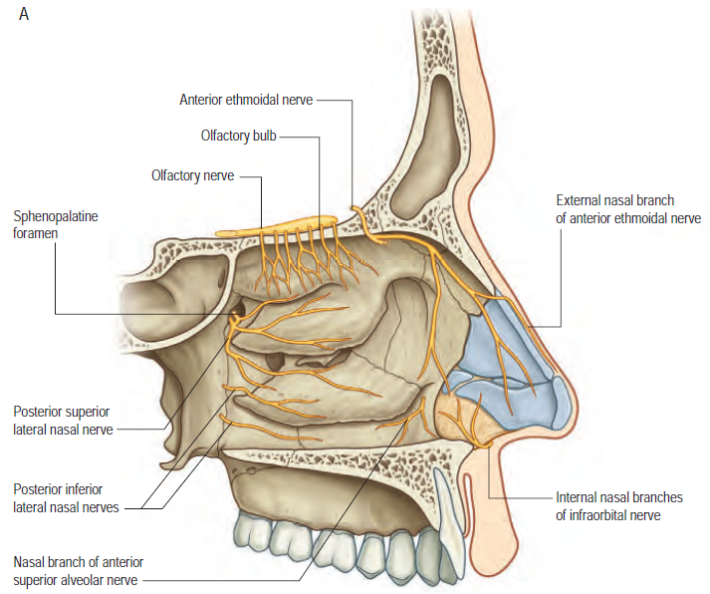
Nerve supply – lateral wall
(From Drake RL, Vogl AW, Mitchell A (eds), Gray’s Anatomy for Students, 2nd ed, Elsevier, Churchill Livingstone. Copyright 2010.)

Slide 24
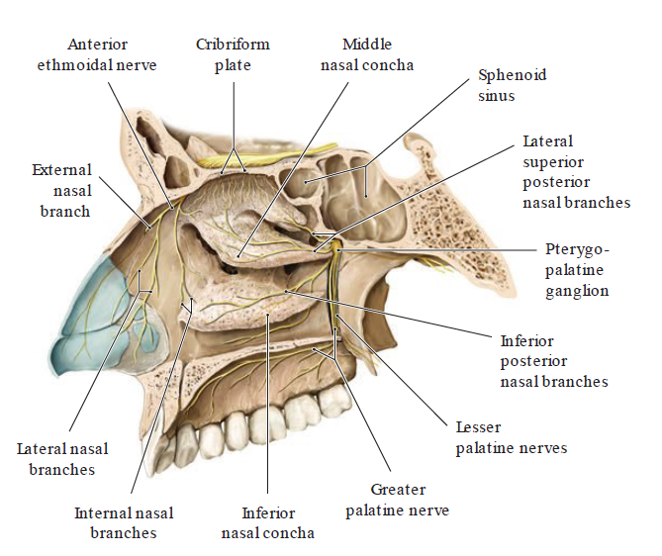
Nerves of the right lateral nasal wall

Slide 25
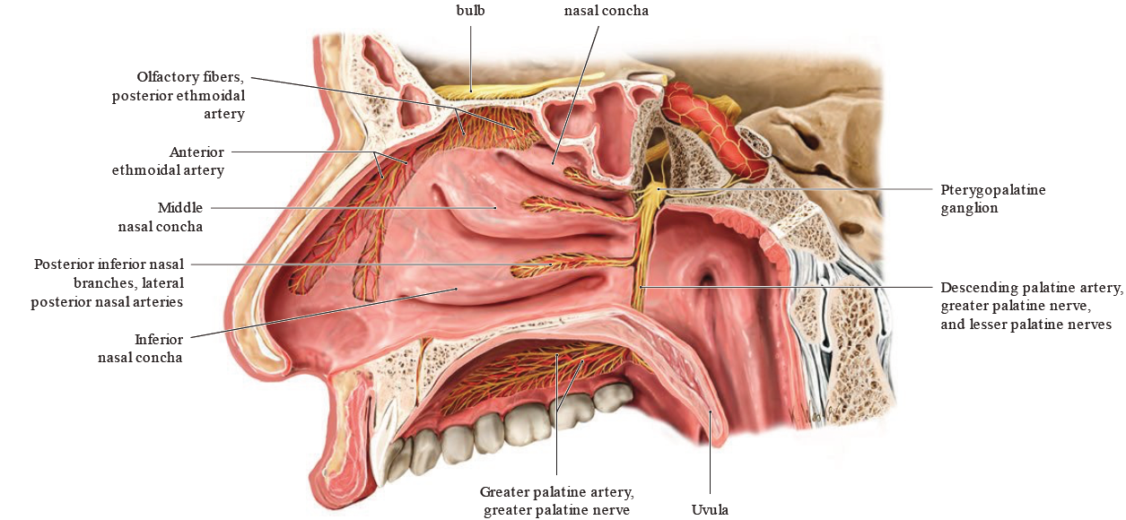
Neurovascular supply – lateral wall

Slide 26
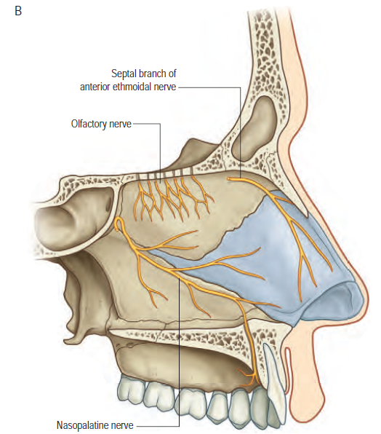
Nerve supply – medial wall
(From Drake RL, Vogl AW, Mitchell A (eds), Gray’s Anatomy for Students, 2nd ed, Elsevier, Churchill Livingstone. Copyright 2010.)

Slide 27
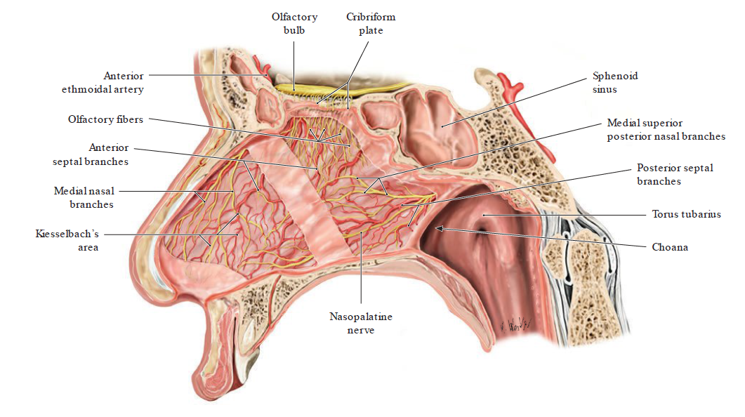
Neurovascular – medial wall

Slide 28
Paranasal air sinuses

Slide 29
Introduction
Cavities in the interior of the maxilla, frontal, sphenoid, & ethmoid bones.
Communicate with the nasal cavity.
Function
  Make the skull lighter (filled with air).
  Act as resonating chambers for the voice.
  Increase the surface area of the nasal mucous membrane - help warming the air before entering the lung

Slide 30
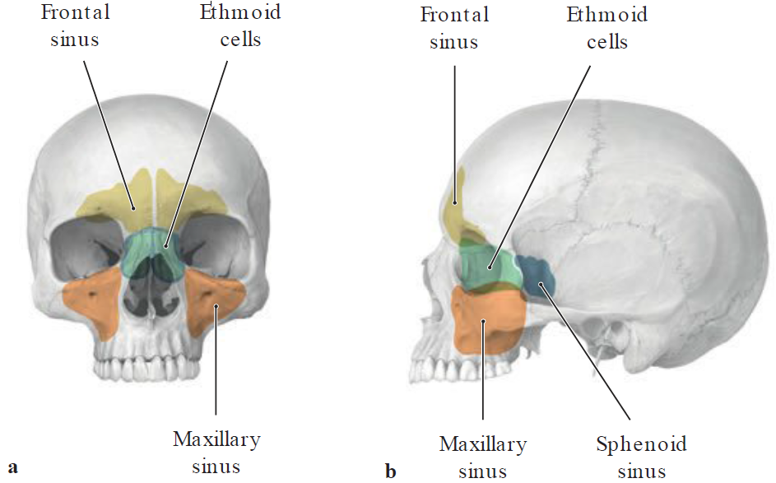
Projection of the paranasal sinuses onto the skull
a Anterior view, b lateral view.
Some of the pain of sinusitis is projected to the skin overlying the sinuses, it is helpful to know the projections of the sinuses onto the surface of the skull.

Slide 31
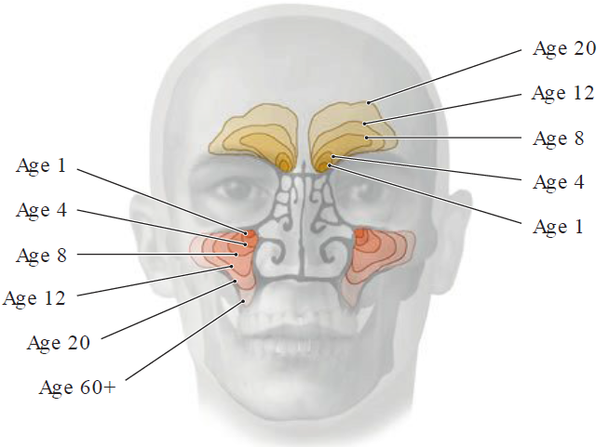
Maxillary & frontal sinuses pneumatization
Develop gradually during the course of cranial growth (pneumatization)
Ethmoid sinuses already pneumatized at birth, hence ethmoidal sinusitis common in children.
Anterior view.

Slide 32
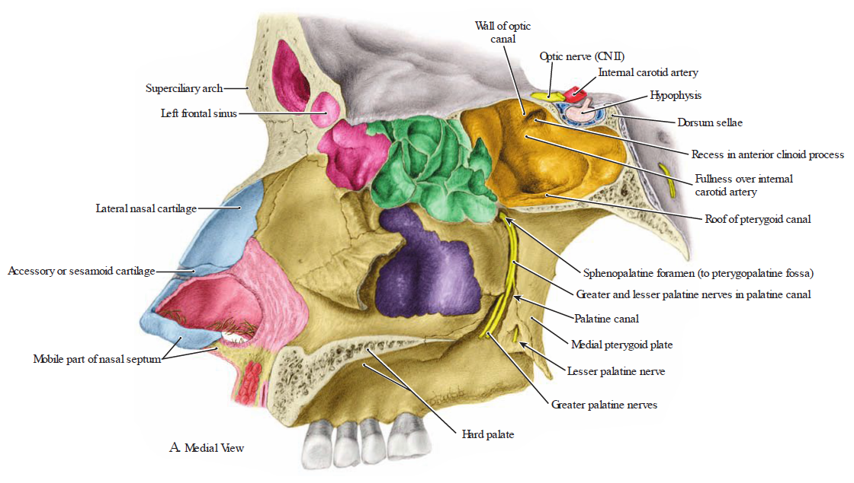
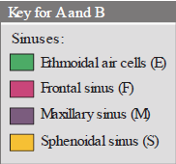

Slide 33
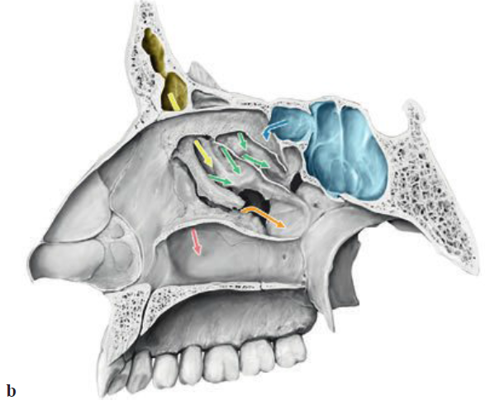
Lateral wall of the right nasal cavity
Colored arrows in b:
Red = nasolacrimal duct,
Yellow = frontal sinus,
Orange = maxillary sinus,
Green = anterior and posterior ethmoid cells,
Blue = sphenoid sinus;
Nasolacrimal duct and paranasal sinuses emptying into the nasal cavity

Slide 34
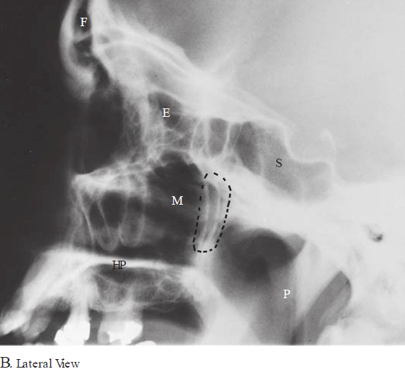
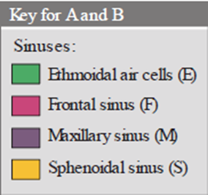
Radiograph of cranium. dotted lines, pterygopalatine fossa; HP, hard palate; P, pharynx.

Slide 35
Ethmoid air cells
Numerous ethmoidal air cells
Its infection may erode through the thin orbital plate of the ethmoid bone (lamina papyracea) into the orbit.
Subdivision
  Posterior ethmoidal air cells - drain into SNM.
  Middle ethmoidal air cells - drain into the summit of the ethmoidal bulla MNM.
  Anterior ethmoidal air cells - drain into the anterior aspect of the hiatus semilunaris in MNM

Slide 36
Frontal Sinus
Lies in the frontal bone
Opens into the hiatus semilunaris of MNC by way of the frontonasal duct (or infundibulum).
Innervation - supraorbital branch of the ophthalmic nerve.
Clinical correlate (Frontal sinusitis)
  Inflammation in the FS
  May erode the thin bone of the ACF, producing meningitis or brain abscess.

Slide 37
Maxillary Sinus
Largest of the paranasal air sinuses
Only paranasal sinus that may be present at birth.
Lies in the maxilla bilaterally, lateral to the lateral wall of the nasal cavity and inferior to the floor of the orbit,
Drains into the posterior aspect of the hiatus semilunaris in the MNM.
Clinical correlate (Maxillary sinusitis)
  Mimics the clinical signs of maxillary tooth abscess
  Related to an infected tooth.
  Infection may spread from the maxillary sinus to the upper teeth and irritate the nerves to these teeth, causing toothache.

Slide 38
Sphenoidal Sinus
Contained within the body of the sphenoid bone.
Opens into the sphenoethmoidal recess of the NC
Innervation
  Branches from the maxillary nerve
  Posterior ethmoidal branch of the nasociliary nerve.
Transsphenoidal approach
  Pituitary gland lies above sphenoidal sinus and can be reached by this method.
  The method follows the nasal septum through the body of the sphenoid.
  Care must be taken not to damage the cavernous sinus & the internal carotid artery.

Slide 39
Lacrimal apparatus

Slide 40
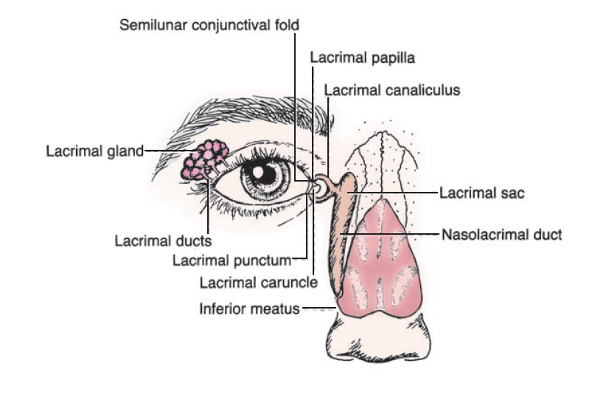
Introduction

Slide 41
Cont’d
Lacrimal Gland
  lies in the upper lateral region of the orbit on the lateral rectus and the levator palpebrae superioris muscles.
  drained by 12 lacrimal ducts, which open into the superior conjunctival fornix.
Lacrimal Canaliculi
  2 curved canals
  begin as a lacrimal punctum (or pore) in the margin of the eyelid
  open into the lacrimal sac.
Lacrimal Sac
  Is the upper dilated end of the nasolacrimal duct
  opens into the inferior meatus of nasal cavity

Slide 42
Cont’d
Tears
  produced by the lacrimal gland.
  pass through excretory ductules into the superior conjunctival fornix
  spread evenly over the eyeball by blinking movements
  accumulate in the area of the lacrimal lake
  enter the lacrimal canaliculi through their lacrimal puncta (on the summit of the lacrimal papilla)
  drain into the lacrimal sac, nasolacrimal duct, & finally, the inferior nasal meatus.

Slide 43
THE END
THANK YOU

