Slide 1
THE PHARYNX
BY Mr. Mwape KABANGASHESHE

Slide 2
THE PHARYNX
Is funnel-shaped
Wider superior end
Origin; Lower surface of the Skull Base
Narrow inferior end
Extend up-to: Level of the 6th Cervical vertebra (C6); Where Esophagus commences posteriorly.

Slide 3
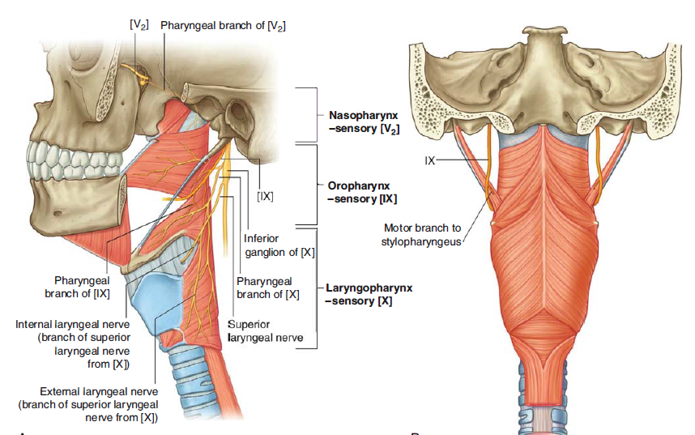
Cont`d
Shared by Digestive & Respiratory System.
The Pharynx is attached above to the Base of the Skull & is continuous below, approximately at the level of 6th Vertebra

Slide 4
Walls of the Pharynx
Mucous coat: Inner lining that produces mucus for lubrication
Fibrous coat: middle layer where muscles of the pharynx attach
Muscular coat: outer layer that contains muscles involved in swallowing. Muscles: There are two primary types of muscles in the pharynx
Nerves: Vagus & Laryngeal Nerve
Vasculature: branches of External. Carotid.

Slide 5
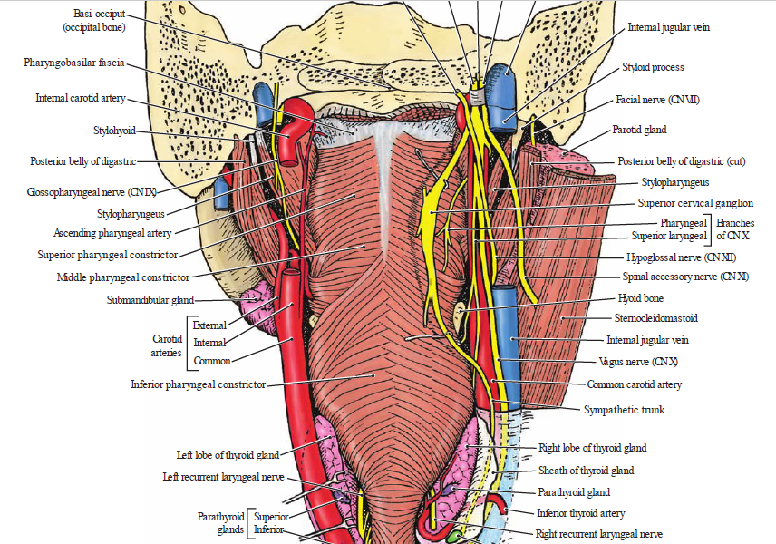
Walls of the Pharynx
Mucous Membrane
Submucosa/Pharyngobasilar Fascia,
Pharyngeal Muscles &
Buccopharyngeal Fascia
NB: Pharyngeal Fascia are separated into 2 layers; pharyngeal muscles are sandwiched between them;
A.Thick Pharyngo-basilar Fascia-Inside B.Thin Bucco-pharyngeal Fascia-Outside
Reinforces the pharyngeal wall of pharyngeal Fascia where muscle is deficient.

Slide 6
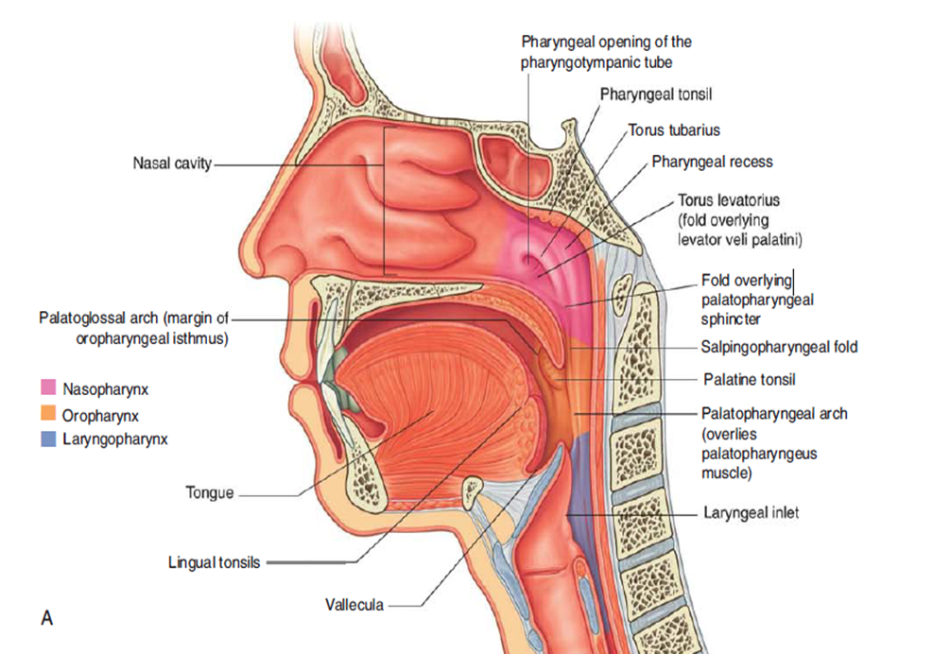
Location
Posterior Nose, Mouth & superior Larynx & Esophagus
It`s a common pathway for Air (Respiration) & Food (Deglutition)
Length: 12–14 cm
Width: 3.5 cm at its Base & 1.5 cm at Pharyngo-esophageal Junction

Slide 7
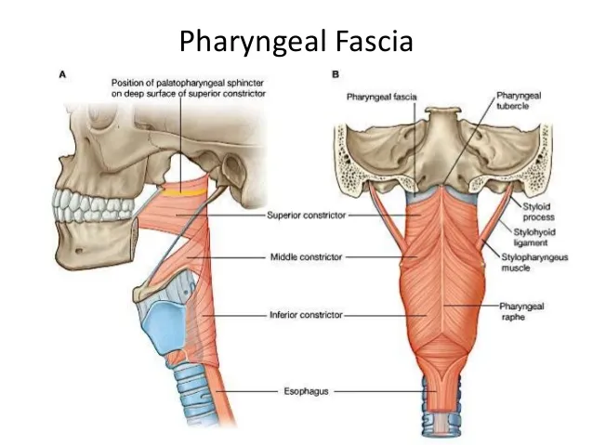
BOUNDARIES
Superior: Base of skull including the Posterior part of body of sphenoid and Basilar part of occipital bone in front of pharyngeal tubercle.
Inferior: Continuous with the Esophagus at the level of lower border of Cricoid Cartilage Anteriorly and
Lower border of C.6 Vertebra Posteriorly.

Slide 8

BOUNDARIES Cont`d
Posterior: Prevertebral Fascia(P.F) in front of Cervical Spine.
Pharynx is separated from P.F only by a layer of Loose Areolar Tissue; Allows pharynx to slide freely on P.F during swallowing.
Anterior: Opens into Nasal, Mouth cavities & Larynx.
Lateral: Neurovascular Bundle of Neck & Styloid Process with its attached Muscles & Ligaments.

Slide 9
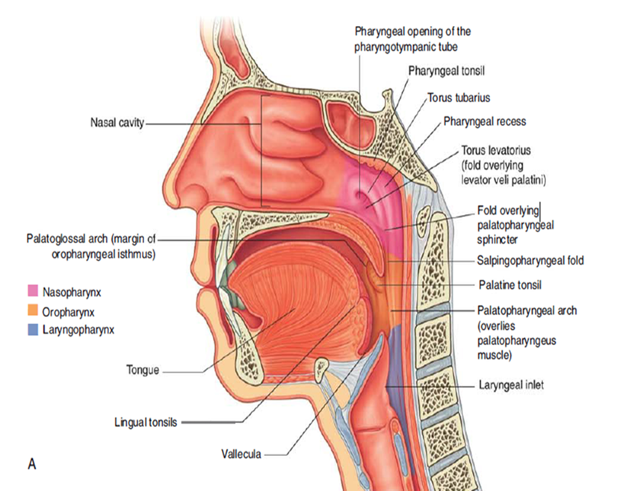
Openings in the Pharynx
2 Auditory Tubes
2 posterior Nares
Larynx
Esophagus

Slide 10
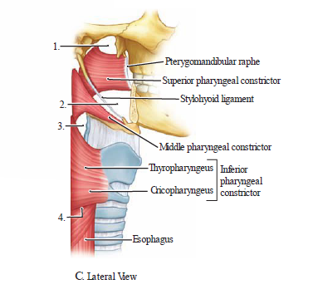
Relations of the pharynx
Medial Pterygoid plate
Pterygo-mandibular raphe
Mandible
Tongue
Hyoid Bone
Thyroid and Cricoid cartilages

Slide 11
Take note in the diagram above
Gaps in the pharyngeal musculature (1 to 4 in C) allowing the entry of structures:
1. Superior to the Superior Constrictor Muscle: Levator Veli palatine muscle & Pharyngotympanic (Auditory) tube
2. Between the Superior & Middle constrictors: Stylopharyngeus Muscle, CN IX & Stylohyoid ligament
3. Between the middle & Inferior constrictors: Internal branch of superior laryngeal nerve and superior laryngeal artery and nerve
4. Inferior to the inferior constrictor muscle: Recurrent laryngeal nerve

Slide 12
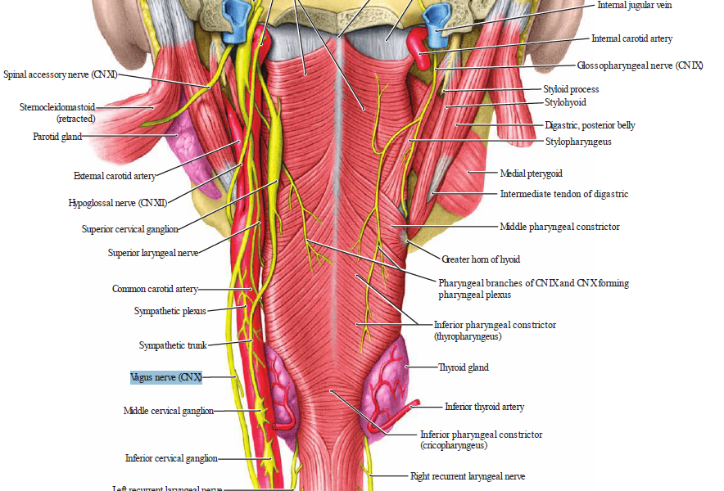
Cont`d
On either side, the Pharynx is related to the styloid process & Muscles Attached to it
Related to common carotid, internal carotid, external carotid arteries and cranial nerves.
Communicates on each side with middle ear through Auditory Tube.

Slide 13
Subdivisions of The Pharynx - 3
From above-downwards :
1. Nasopharynx - posterior apertures (Choanae) open into the nasopharynx.
2. Oropharynx -Posterior opening (oropharyngeal isthmus) opens into oropharynx.
3. Laryngopharynx - superior aperture of the larynx (laryngeal inlet) opens into the Laryngopharynx.

Slide 14
1. Nasopharynx
The Nasopharynx is located between the Base of the Skull & the Soft Palate.
It`s Continuous with the Nasal Cavity & Perform a Respiratory function by conditioning inspired air & propagating it into the Larynx.
The Postero-superior Nasopharynx contains pharyngeal (Adenoid Tonsils), which enlarge between 3-8 years of age & then regress.
Tubal Tonsil are also present near opening of pharyngotympanic Tube.

Slide 15
CLINICAL RELEVANCE
Enlarged Adenoid Tonsils can become pathologically enlarged due to viral infections of the upper respiratory tract.
In the case of recurrent infections, they can become chronically enlarged.
When enlarged, the adenoids can obstruct the opening of the Eustachian tube – which is located close to the adenoid tonsils in the nasopharynx.

Slide 16
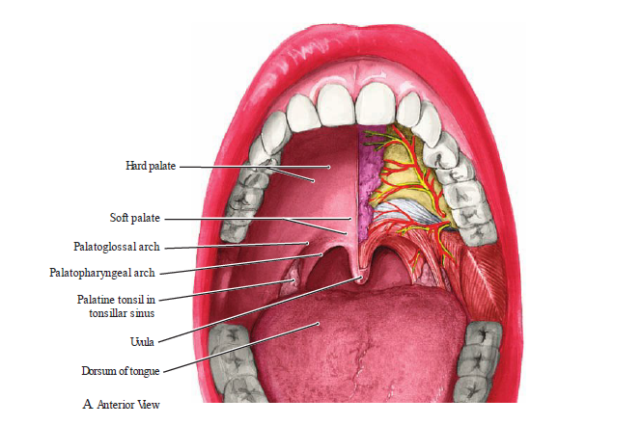
2.Oropharynx - Middle part
Located between Soft Palate & Superior Border of Epiglottis. Contains:
Posterior 1/3 of the Tongue.
Lingual Tonsils – Lymphoid Tissue at the Base of the Tongue.
Palatine Tonsils – Tonsillar Fossa (Between the Palatoglossal & Palato-pharyngeal Arches of the oral cavity)
Superior Constrictor Muscle

Slide 17
Cont`d
The interval between the Two Palatoglossal Arches is called the Oropharyngeal Isthmus.
It marks the boundary between the Mouth & Pharynx
The Oropharynx is involved in the Voluntary & Involuntary phases of swallowing.

Slide 18
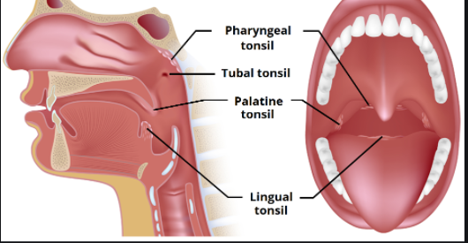
Tonsils found in the Naso & Oral pharynx
Consists of (from top to bottom):
Pharyngeal Tonsil
Tubal Tonsils (x2)
Palatine Tonsils (x2)
Lingual Tonsil

Slide 19
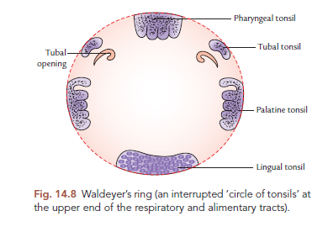
Waldeyer's Tonsillar Ring (pharyngeal lymphoid ring, Waldeyer's lymphatic ring, or Tonsillar ring)
This is a ringed arrangement of lymphoid organs in the pharynx. Waldeyer's ring surrounds the Naso & Oropharynx
With some of its Tonsillar Tissue located above & some below the soft palate (& to the back of the mouth cavity).

Slide 20
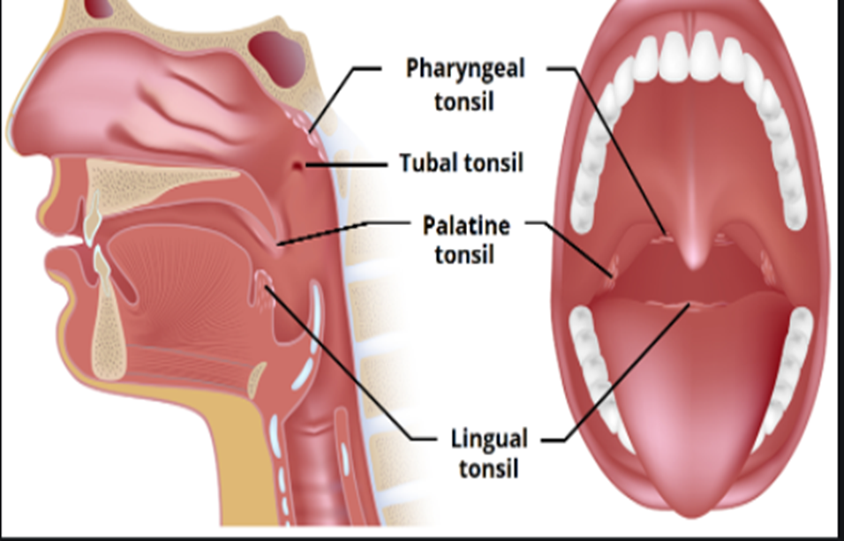
Cont`d
The Tonsils are classified as Mucosa-Associated Lymphoid Tissue (MALT) & Therefore contain T-cells, B-cells & Macrophages.
They have an important role in fighting infection.

Slide 21
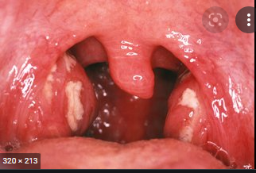
Clinical Application
Tonsillitis refers to inflammation of the palatine tonsils.
A complication of bacterial tonsillitis is a Peritonsillar Abscess (Quinsy); a collection pus in the Peritonsilar Space.
Tonsils can only be removed if they cause respiratory problems especially in pediatrics.

Slide 22

3.Laryngopharynx
The most distal part of the Pharynx.
It is located between the superior border of the epiglottis and inferior border of the cricoid cartilage (C6).
It is continuous inferiorly with the Esophagus.

Slide 23
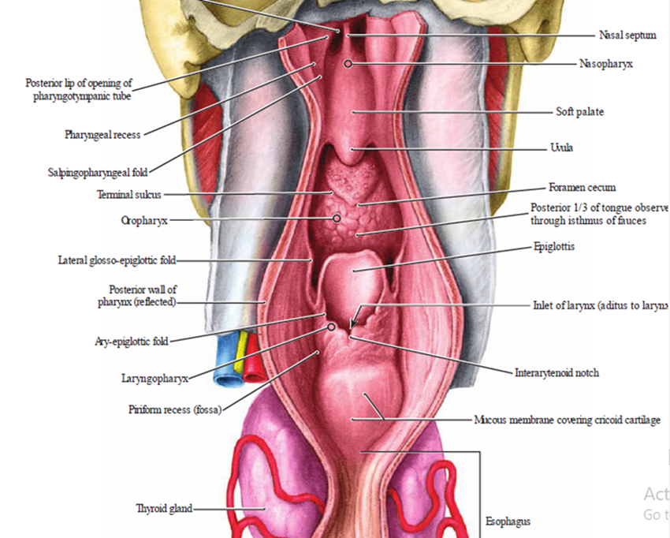
Cont`d
It is found posterior to the larynx and communicates with it via the laryngeal inlet lateral to which one can find the Piriform Fossae.
The laryngopharynx contains the middle and inferior Pharyngeal Constrictors.

Slide 24
CLINICAL ANATOMY
The Piriform Fossae are dangerous sites for perforation by an endoscope.
A malignant tumor of the laryngopharynx (hypopharynx) may grow in the space provided by the piriform fossa without producing symptoms until the patient presents with metastatic lymphadenopathy.
The ingested foreign bodies (for example, fish bones, safety pins) are sometimes lodged into the piriform fossa.
If care is not taken, the removal of foreign bodies may damage the internal laryngeal nerve leading to anesthesia in the supraglottic part of the larynx and subsequent loss of protective cough reflex.

Slide 25
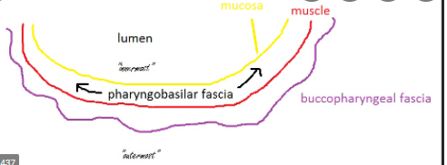
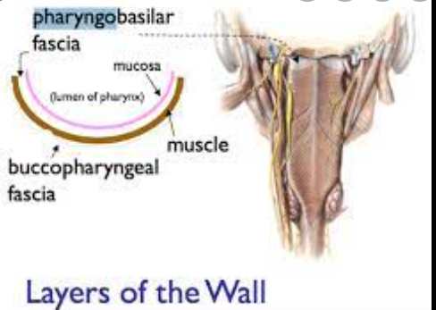
Cont`d
A.Pharyngo-Basilar Fascia – lines internal surfaces of the pharyngeal muscles attaching the pharynx to; the base of the skull to the auditory tubes to the Posterior Nasal Apertures (Choanae)
B. Bucco-Pharyngeal Fascia – covers external surface of Buccinators & Pharyngeal muscles.

Slide 26

Muscles of the Pharynx
Muscles of the Pharynx differ from rest of GIT muscles as Longitudinal muscles are placed inside, while circular muscles (constrictors) are incomplete anteriorly & arranged in 3 layers overlapping each other.
Fibers of these muscles run in a somewhat circular direction.
The 3 Constrictor Muscles extend around the pharyngeal wall to be inserted into a Fibrous Band (Raphe)

Slide 27
Constrictor Muscles – Circular outer muscles
There are three circular pharyngeal constrictor muscles; The Superior, Middle & Inferior Pharyngeal Constrictors.
They are stacked like glasses, which form an incomplete muscular circle as they attach anteriorly to structures in the neck.
Circular constrictor muscles contract Sequentially from superior-to-inferior to constrict the Lumen & Propel the Bolus of food inferiorly into the Esophagus.

Slide 28
Superior Pharyngeal Constrictor
The uppermost pharyngeal constrictor. It is located in the Oropharynx.
  Origin: Pterygo-mandibular ligament, Alveolar process of mandible, Medial Pterygoid Plate & Pterygoid Hamulus of the Sphenoid Bone.
  Insertion: Posteriorly into to the Pharyngeal Tubercle of Occiput & The Median Pharyngeal Raphe.

Slide 29
Middle pharyngeal constrictor
Located in the Laryngopharynx.
Originates from Stylohyoid ligament & Horns of the Hyoid bone.
Inserts posteriorly into Pharyngeal Raphe.
The Raphe extends from Pharyngeal Tubercle on the Basilar part of the Occipital Bone of skull down to the Oesophagus

Slide 30

Inferior Pharyngeal Constrictor
Located in the laryngopharynx. It has two components;
  Superior Component (Thyropharyngeus) has Oblique Fibres that attach to the Thyroid Cartilage.
  Inferior Component (Cricopharyngeus) has Horizontal Fibres that attach to the cricoid cartilage.
The Fibers of the Cricopharyngeus pass Horizontally around the lowest & Narrowest part of the pharynx and act as a Sphincter

Slide 31
Clinical Relevance: Pharyngeal Diverticulum (Pouch)
The inferior pharyngeal constrictor is split into two parts; the thyropharyngeus and the cricopharyngeus. This area between the two is a weak area in the mucosa.
Normally during swallowing, the Thyropharyngeus contracts as the Cricopharyngeus relaxes, allowing the bolus of food to be propelled into the Esophagus & preventing the intrapharyngeal pressure from rising.
If this coordinated relaxation of the cricopharyngeus does not occur, the intrapharyngeal pressure tends to rise and pharyngeal mucosa forms a midline diverticulum in the area between the thyropharyngeus and cricopharyngeus. It is possible for food to accumulate here, leading to dysphagia.

Slide 32
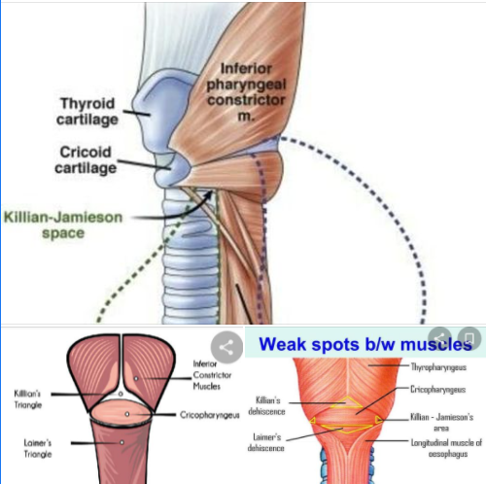
Diverticulum-Killian’s Dehiscence
Is a potential gap between Thyropharyngeus & Cricopharyngeus muscles & it may lead to Dysphagia.

Slide 33
Longitudinal Muscles of the Pharynx – Run Longitundinally
The Longitudinal Muscles are the:
Stylopharyngeus
Palatopharyngeus
Salpingopharyngeus.
They act to Shorten & Widen The Pharynx,
Elevates Larynx During swallowing.
a) Salpingopharyngeus – arises from the Eustachian tube, inserts into the pharynx.
  In addition to contributing to swallowing, it also opens the Eustachian tube to Equalize the pressure in the Middle Ear.

Slide 34
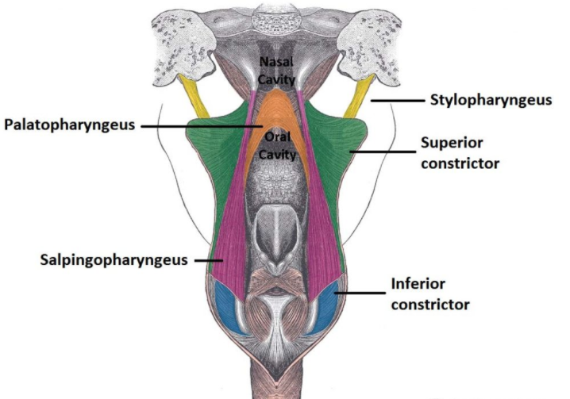
Cont`d
b) Stylopharyngeus
Origin: Styloid Process of the temporal bone,
Insertion: Pharynx.
Innervation: Unlike the other pharyngeal muscles, it is innervated by the Glossopharyngeal Nerve (CN IX).
c)Palatopharyngeus
Origin: Hard Palate of the oral cavity, Insertion: Pharynx.
Innervation: Vagus Nerve (CN X).

Slide 35
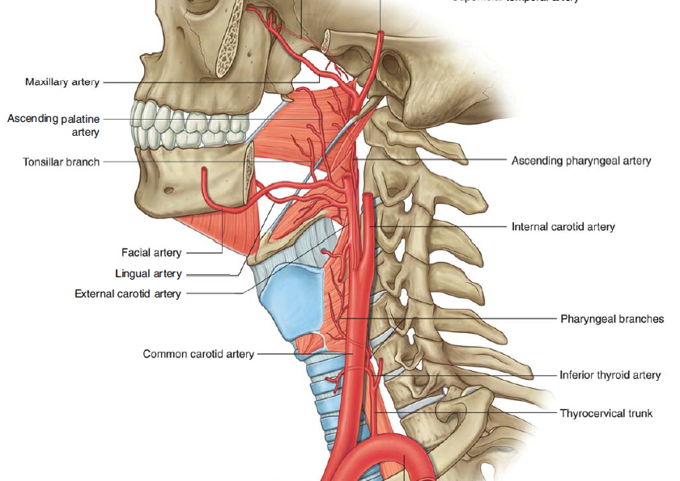
Blood supply to the Pharynx
Arterial supply to the pharynx is via branches of the External Carotid Artery:
Ascending Pharyngeal Artery
Branches Of The Facial Artery
Branches of the Lingual
Branches Maxillary Arteries.

Slide 36
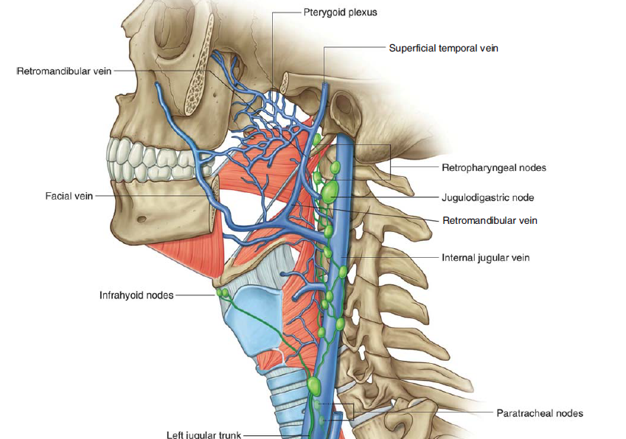
Venous Drainage
Venous drainage is achieved by the pharyngeal venous plexus, which drains into the internal jugular vein.
Lymphatic Drainage
Lymph from pharynx drain into Retropharyngeal & Deep cervical Lymph Nodes

Slide 37
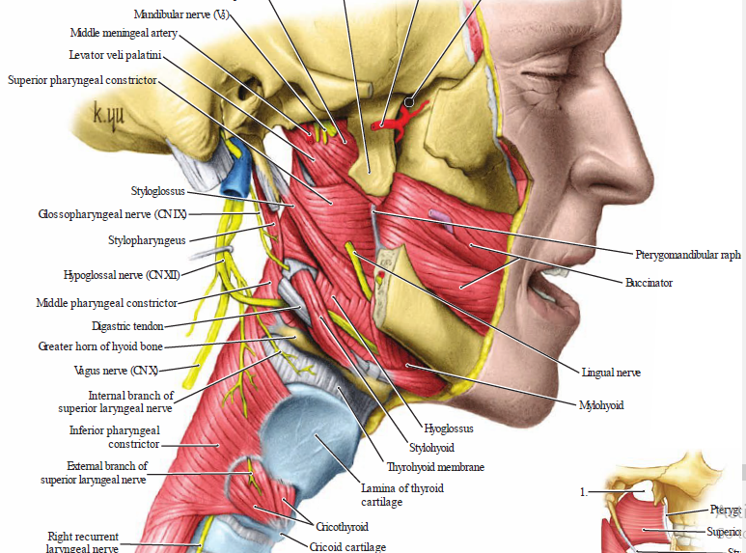
NERVE SUPPLY
Motor; Vagus – CN X
Except: Stylopharyngeus – Glossopharyngeal – CN IX
Sensory;
Nasopharynx: CN V Maxillary Branch
Oropharynx: Glossopharyngeal - CN IX
Laryngopharynx: Internal Laryngeal Branch of the Vagus – CN X

Slide 38
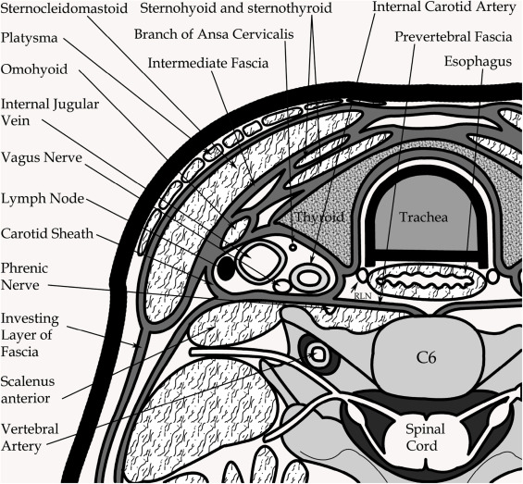
KNOW ME PEASE?

Slide 39
REFERENCES
Atlas of Human Anatomy, 6th Edition. Frank H Netter MD. Philadelphia, 2014
Gray`s Anatomy The Anatomical Basis of Clinical Practice 40th Edition. Susan Standring. 2008.
Grant`s Atlas of Anatomy, 12th Edition. Anne

