Slide 1
SKULL AND CERVICAL VERTEBRAE
Presenter: Richwell HAKACHA Dip PT, BSc PT, PGSM, MSc HAN Candidate

Slide 2
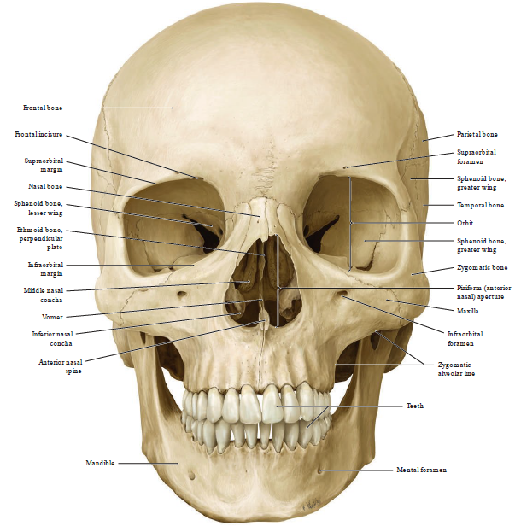

Slide 3
INTRODUCTION
The skull is the most complex arrangement of bones within the body.
The skull protects the central nervous system, the oral cavity and nasal cavity, the ears and the eyes within its inner, outer and directly related structures.
The human skull consists of three components:
  The membranous neurocranium - the flat bones of the skull
  The cartilaginous neurocranium or chondrocranium - forms the majority of the skull base
  The viscerocranium or facial skeleton.

Slide 4
Cont’d
The skull contains 22 bones (not counting the bones of the middle ears) rests on the superior end of the vertebral column.
The bones of the skull are grouped into two categories:
  (8) cranial bones
  (14) facial bones

Slide 5
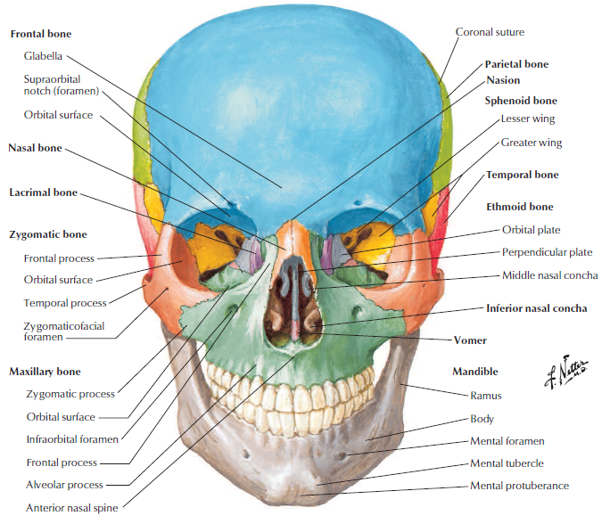

Slide 6
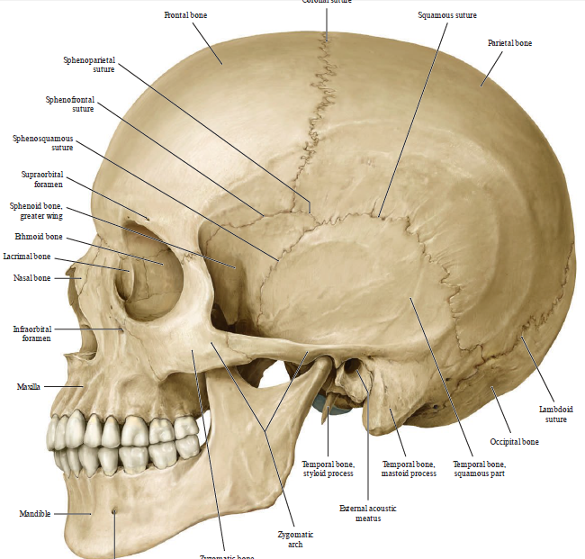

Slide 7
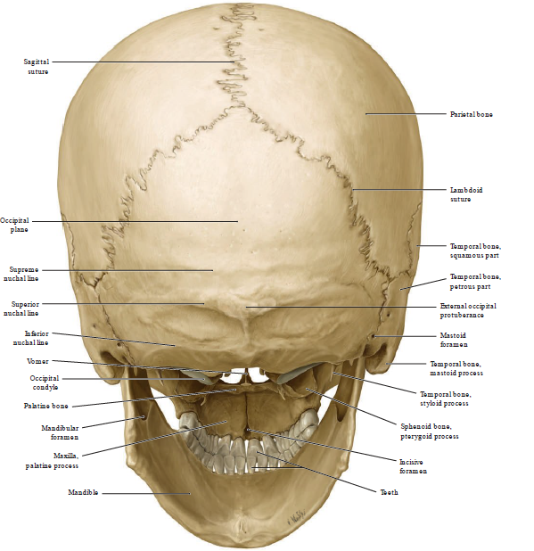

Slide 8
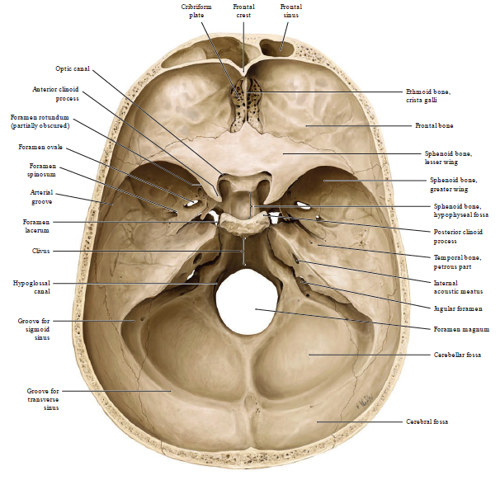

Slide 9
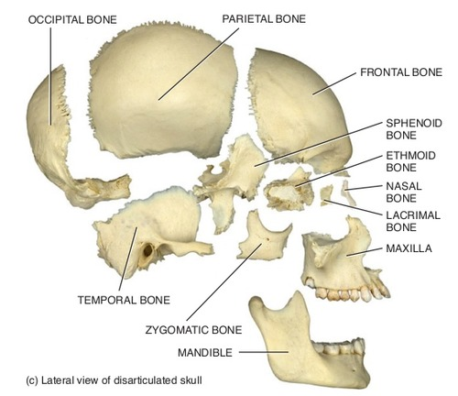

Slide 10
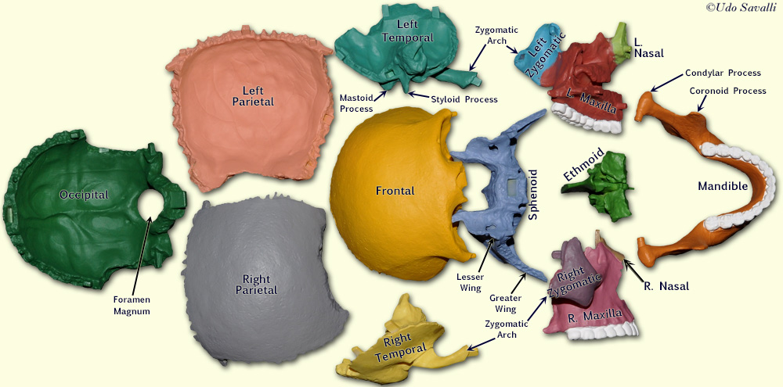

Slide 11
(8) CRANIAL BONES
PAIRED CRAINIAL BONES
UNPAIRED CRAINIAL BONES
Parietal bones (2)
Temporal bones (2)
Frontal bone
Occipital bone
Sphenoid bone
Ethmoid bone.

Slide 12
(14) FACIAL BONES FORM THE FACE
PAIRED
UNPAIRED
Nasal bones (2)
Maxillae (or maxillus) (2)
Zygomatic bones (2)
Lacrimal bones (2)
Palatine bones (2)
Inferior nasal conchae (2)
Mandible
Vomer.

Slide 13
BONES OF THE SKULL
The bones of the skull are attached to each other by sutures, are immobile and can be divided into;
  Calvaria - An upper domed shaped part which covers the cranial cavity containing the brain
  A base that contain the floor of the cranial cavity
  A lower anterior – the facial skeleton (viscerocranium)

Slide 14
EMBRYOLOGICAL BACKGROUND
The lateral plate mesoderm found in the neck region, paraxial mesoderm and neural crest cells all contribute to the development and existence of the skull.
The bones of the skull are formed in two different ways;
  Intramembranous ossification
  Endochondral ossification
These are responsible for creating compact cortical bone or spongy bone

Slide 15
Cont’d
During the maturation of the skull, it is categorically divided into two main parts:
  Viscerocranium (bones of the face)
  Neural cranium (bones of the cranial base and the cranial vault) .
The cranial vault is further divided into membranous and cartilaginous neurocranium.

Slide 16
BONES OF THE CRANIUM
Frontal bone
It is scalelike plate of bone forms the forehead (the anterior part of the cranium), the roofs of the orbits (eye sockets), and most of the anterior part of the cranial floor.
It gradually slopes inferiorly from the coronal suture, on the top of the skull, then angles abruptly and becomes almost vertical above the orbits.
At the superior border of the orbits, the frontal bone thickens, forming the supraorbital margin.

Slide 17
Frontal bone cont’d
  From this margin, the frontal bone extends posteriorly to form the roof of the orbit, which is part of the floor of the cranial cavity
  Soon after birth, the left and right sides of the frontal bone are united by the metopic suture,
  The suture usually disappears between the ages of six and eight.

Slide 18
Cont’d
Frontal paranasal sinuses
  mucous membrane–lined cavities within frontal bones
  lie deep to the frontal squama
Ossification of frontal bone
  Membranous
  2 primary centers
  1 for each half, which appear toward the end of the 2nd month of fetal life

Slide 19
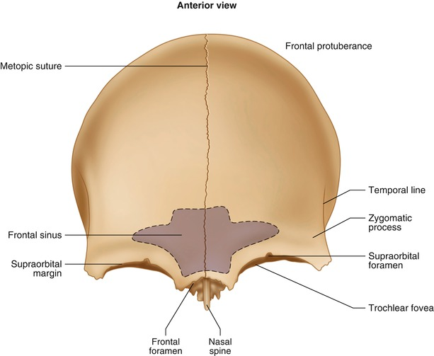

Slide 20
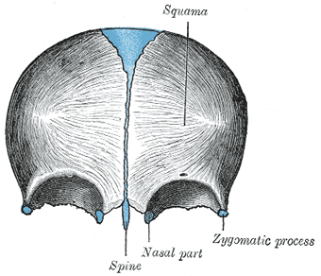

Slide 21
Parietal bone
Paired
form the greater portion of the sides and roof of the cranial cavity.
Their surfaces contain many protrusions and depressions that accommodate the blood vessels supplying the dura mater, the superficial connective tissue (meninx) covering of the brain.
Ossification of Parietal bone
It’s ossified in membrane.
2 centers appear during 7th week near parietal eminence and soon fuse with each other.

Slide 22
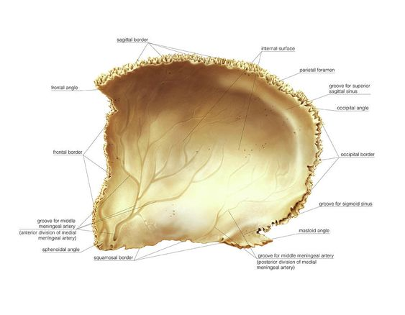
Parietal bone

Slide 23
Temporal bones
Paired
Form the inferior lateral aspects of the cranium and part of the cranial floor.
The temporal squama (scale)
  Thin, flat part of the temporal bone that forms the region of the cranium around the ear
Projecting from the inferior portion of the temporal squama is the zygomatic process, which articulates (forms a joint) with the temporal process of the zygomatic (cheek) bone.
Zygomatic process of the temporal bone and the temporal process of the zygomatic bone form the zygomatic arch

Slide 24
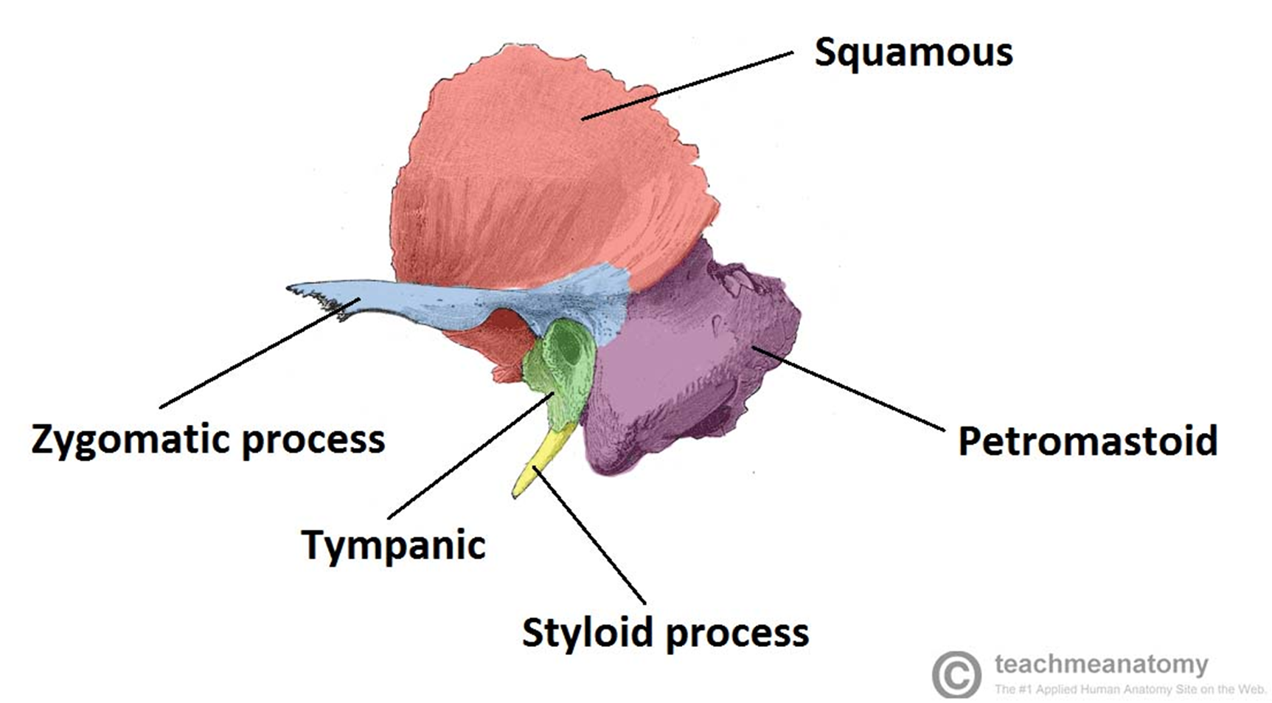
Temporal bone

Slide 25
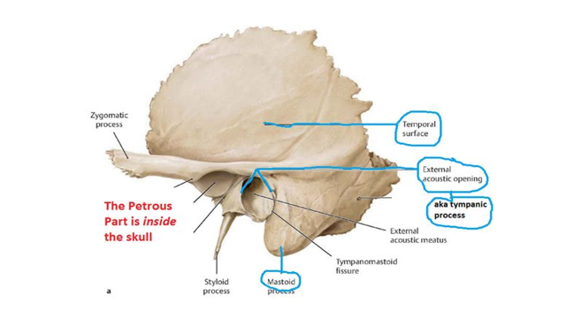
Temporal bone

Slide 26
Cont’d
Ossification of the temporal bones
  The squamous center appear during 7th week while the tympanic center appear in during 3rd month.
  Both squamous and tympanic parts ossify in membranes.
  Petromastoid and styloid parts ossify in cartilage
  Petromastoid part is ossified by several centers which appear in cartilaginous ear capsule during 5th month.
  Styloid process develops from cranial end of 2nd branchial arch cartilage
  Two centers appear in it - Tympanohyal before birth and stylohyal after birth.

Slide 27
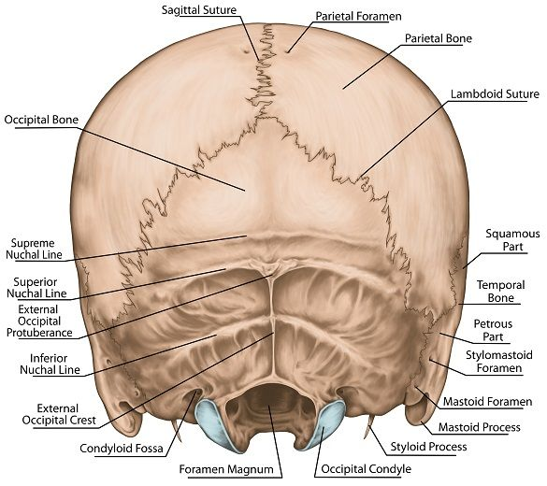
Occipital bone
Forms the posterior part and most of the base of the cranium.
The foramen magnum is in the inferior part of the bone.

Slide 28
Ossification of occipital bone
Partly in the membrane and partly in cartilage.
The part of the bone above highest nuchal line ossifies in membrane by two centers which appear in 2nd month of foetal life.
Centers which appear in cartilage in occipital bone are as follows;
  1 kerkring center for posterior margin of foramen magnum - 6th week.
  One center appears for basilar part - 6th week.
  2 centers for squamous part below highest nuchal line - 7th week.
  2 centers for each lateral parts appear - 8th week.

Slide 29
Sphenoid bone
Wedge-shaped
Lies at the middle part of the base of the skull.
keystone of the cranial floor - it articulates with all the other cranial bones, holding them together.
The sphenoid bone joins
  Anteriorly with the frontal and ethmoid bones,
  Laterally with the temporal bones,
  Posteriorly with the occipital bone.
Lies posterior and slightly superior to the nasal cavity and forms part of the floor, side walls, and rear wall of the orbit.

Slide 30
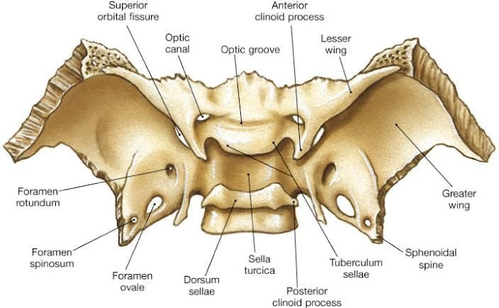
SPHENOID BONE

Slide 31
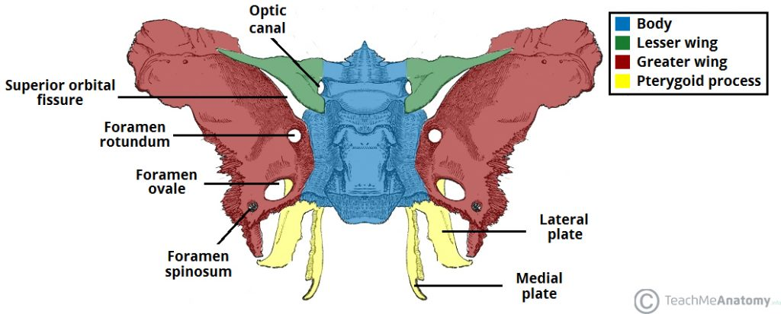
Sphenoid bone

Slide 32
Ossification of sphenoid bone
Ossifies in 2 parts
Presphenoid part (Ant. to tuberculum sellae & lesser wings) -6 centers in cartilage.
  2 for body during of sphenoid - 9th week
  2 for lesser wings – 9th week
  2 for two sphenoidal conchae – 5th month
Post sphenoidal part (post. part of greater wings & pterygoid process) – 8 centers
  2 centers for greater wing – 8th week forming root only
  2 for post sphenoidal part of body during 4th month
  2 centers appear for the Pterygoid Hamulus - 3rd month intrauterine
  Above 6 centers appear in cartilage.
  2 centers for medial pterygoid plates appear - 9th week in membrane
  Remaining portion of greater wings and lateral plates ossifies in membrane from the centers for the root of greater wing only.

Slide 33
Ethimoid bone
Delicate bone & sponge-like in appearance - like a sieve
located in the anterior part of the cranial floor medial to the orbits and is.
It is anterior to the sphenoid and posterior to the nasal bones.
The ethmoid bone forms:
  Part of the anterior portion of the cranial floor
  Medial wall of the orbits
  The superior portion of the nasal septum,
  Most of the superior sidewalls of the nasal cavity.
It is a major superior supporting structure of the nasal cavity and forms an extensive surface area in the nasal cavity

Slide 34
Cont’d
Cribriform plate (cribri- sieve)
  lies in the anterior floor of the cranium and forms the roof of the nasal cavity.
  contains the olfactory foramina (olfact- to smell) through which the olfactory nerves pass.
  Projecting superiorly - triangular process called the crista galli (crista crest; galli cock), which serves as a point of attachment for the falx cerebri
  Projecting inferiorly - perpendicular plate, which forms the superior portion of the nasal septum

Slide 35
BONES OF THE FACE VISCERO-CRANIUM
The shape of the face changes dramatically during the first two years after birth. This is due to:
  Expansion of brain and cranial bones
  The first set of teeth form and erupt (emerge)
  The paranasal sinuses increase in size
Growth of the face ceases at about 16 years of age.
The 14 facial bones include;
Paired - nasal bones, maxillae , zygomatic bones, lacrimal bones, palatine bones, inferior nasal conchae,
Unpaired - mandible & vomer.

Slide 36
Cont’d
All derived from of the neural crest cells.
Also, all of the following structures emerge from the first and second pharyngeal arches.
The maxillary process from the 1st pharyngeal arch contributes to the formation of the maxilla, temporal bone, zygoma (zygomatic bone and arch), the palatine bone, lacrimal bone, nasal bone, vomer and the inferior nasal concha.
All ossify via intramembranous ossification except inferior nasal concha

Slide 37
Nasal Bones
Paired ,small, flattened, rectangular-shaped bones - form the bridge of the nose.
Protect - upper entry to the nasal cavity
Provide attachment for some thin muscles of facial expression.
For those who wear glasses - form the resting place for the bridge of the glasses.
The major structural portion of the nose consists of cartilage.
Ossification - in membrane from 1 center (3rd month of inter-uterine life)

Slide 38
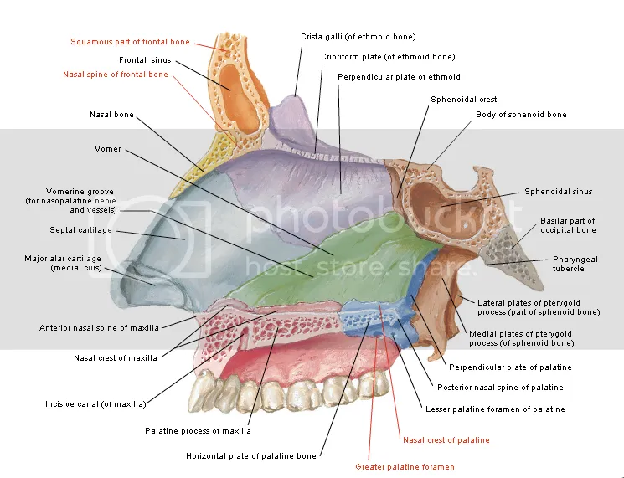
Nasal bone cont’d

Slide 39
Lacrimal Bones
Paired
Thin & roughly resemble a fingernail in size and shape.
Smallest bones of the face
lie posterolateral to the nasal bones & form a part of the medial wall of each orbit.
Each contain a lacrimal fossa, a vertical tunnel formed with the maxilla, that houses the lacrimal sac
Ossification
  Ossifies in membrane.
  1 center appear in 12th week

Slide 40
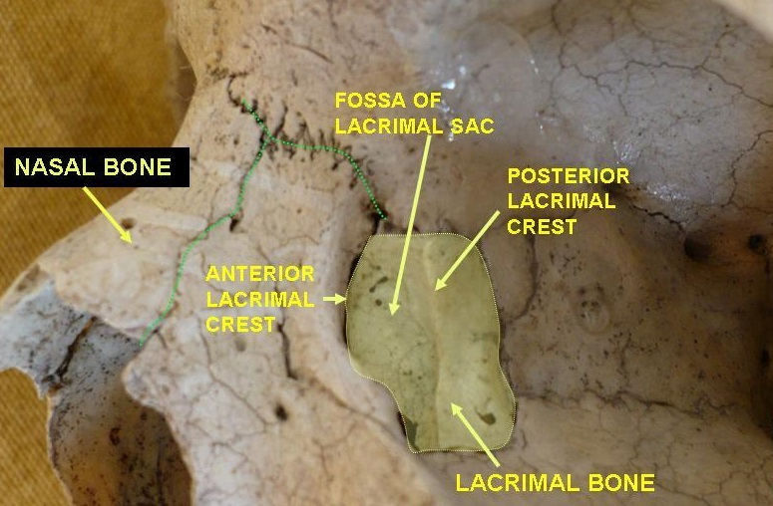
Lacrimal bone

Slide 41
Palatine Bones
Paired L-shaped bones form:
  Posterior portion of the hard palate (horizontal plates)
  Part of the floor & lateral wall of the nasal cavity,
  A small portion of the floors of the orbits.
Ossification
It ossifies in membrane
1 center appears in 8th week in perpendicular plate

Slide 42
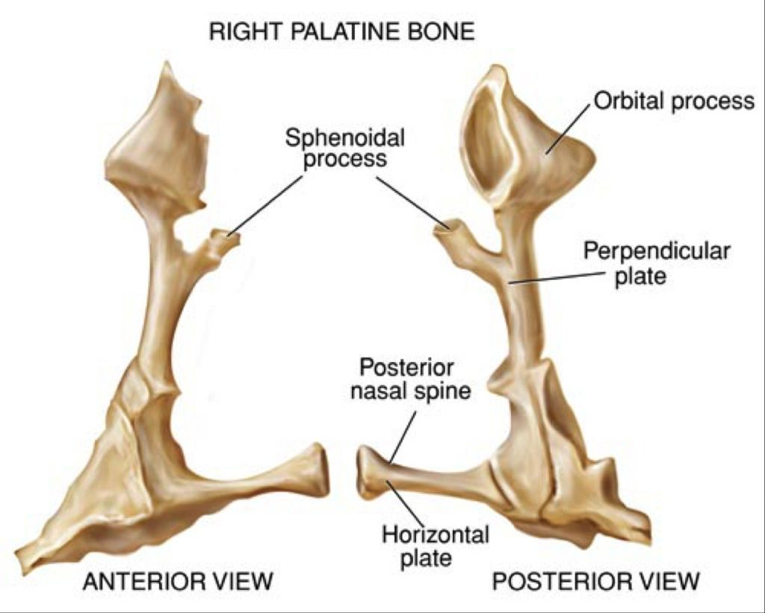
Cont’d

Slide 43
Inferior Nasal Conchae
Paired scroll-like bones
Lie inferior to the middle nasal conchae of the ethmoid bone
Are separate bones - not part of the ethmoid bone.
Form a part of the inferior lateral wall of the nasal cavity and project into the nasal cavity.
Together with other 2 pairs of nasal conchae increase the surface area of the nasal cavity and help swirl and filter air before it passes into the lungs.
However, only the superior nasal conchae of the ethmoid bone are involved in the sense of smell.

Slide 44
Vomer
Roughly triangular bone on the floor of the nasal cavity
Superiorly - articulates with the perpendicular plate of the ethmoid bone and sphenoid bone
Inferiorly with both the maxillae and palatine bones along the midline.
It forms the inferior portion of the bony nasal septum
Ossification
  Ossifies in membrane
  2 centers appear during 8th week on either side of midline

Slide 45
Maxillae
The paired maxillae (jawbones; singular is maxilla) unite to form the upper jawbone.
They articulate with every bone of the face except the mandible.
Form part of the floors of the orbits, lateral walls and floor of the nasal cavity, and most of the hard palate.
The hard palate is the bony roof of the mouth, and is formed by the palatine processes of the maxillae and horizontal plates of the palatine bones.
The hard palate separates the nasal cavity from the oral cavity.

Slide 46
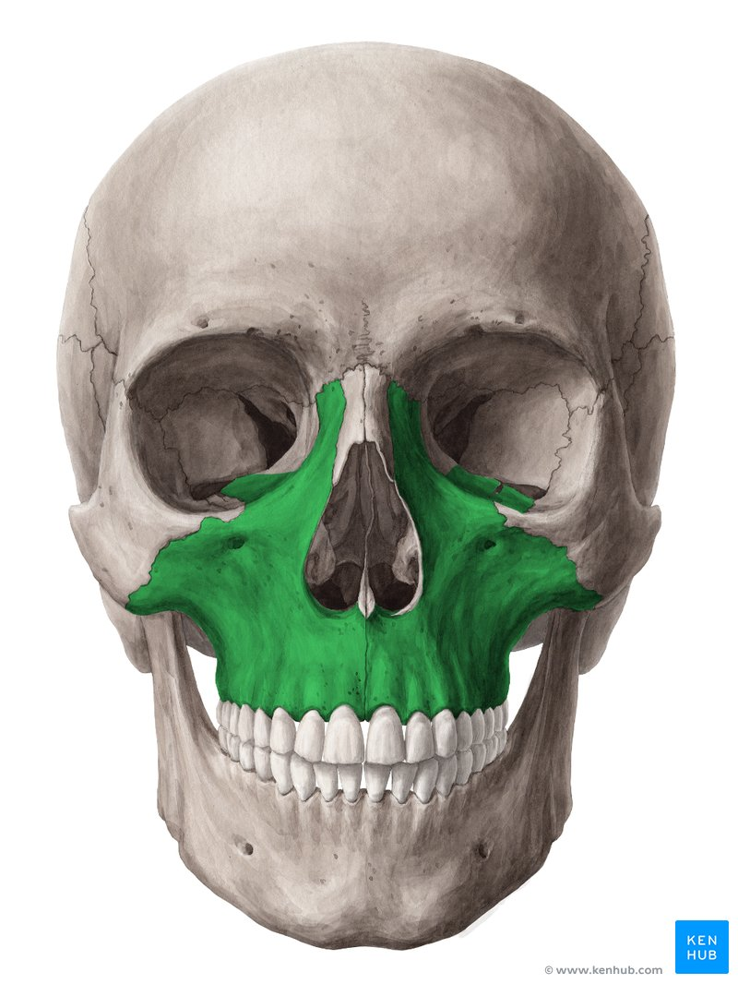
Maxilla bone

Slide 47
Zygomatic bones
The two zygomatic bones, commonly called cheekbones, form the prominences of the cheeks and part of the lateral wall and floor of each orbit.
They articulate with the frontal, maxilla, sphenoid, and temporal bones.
Ossification
Ossifies in the membranes

Slide 48
Mandible
largest, strongest facial bone.
It is the only movable skull bone (other than the auditory ossicles, the small bones of the ear).
The angle of the mandible is the area where each ramus meets the body.
Posterior condylar process that articulates with the mandibular fossa and articular tubercle of the temporal bone to form TMJ)
The depression between the coronoid and condylar processes is called the mandibular notch.
The alveolar process is the ridge like arch containing the alveoli (sockets) for the mandibular (lower) teeth

Slide 49
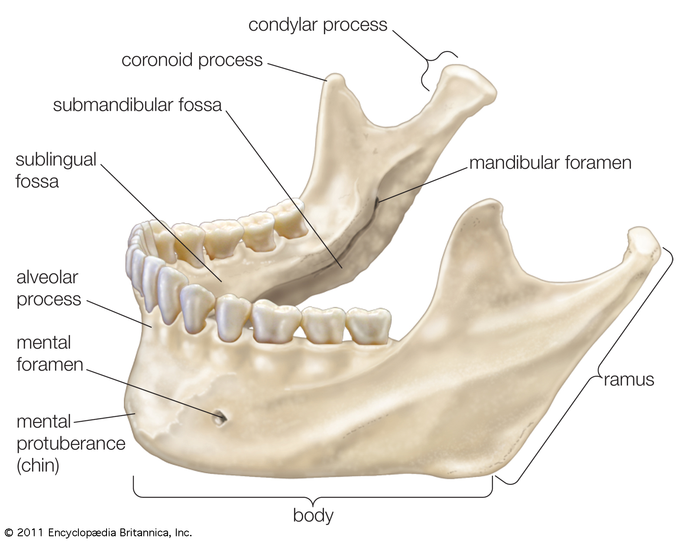
Mandible

Slide 50
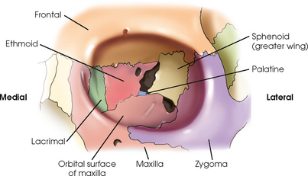
BONES FORMING THE ORBIT

Slide 51
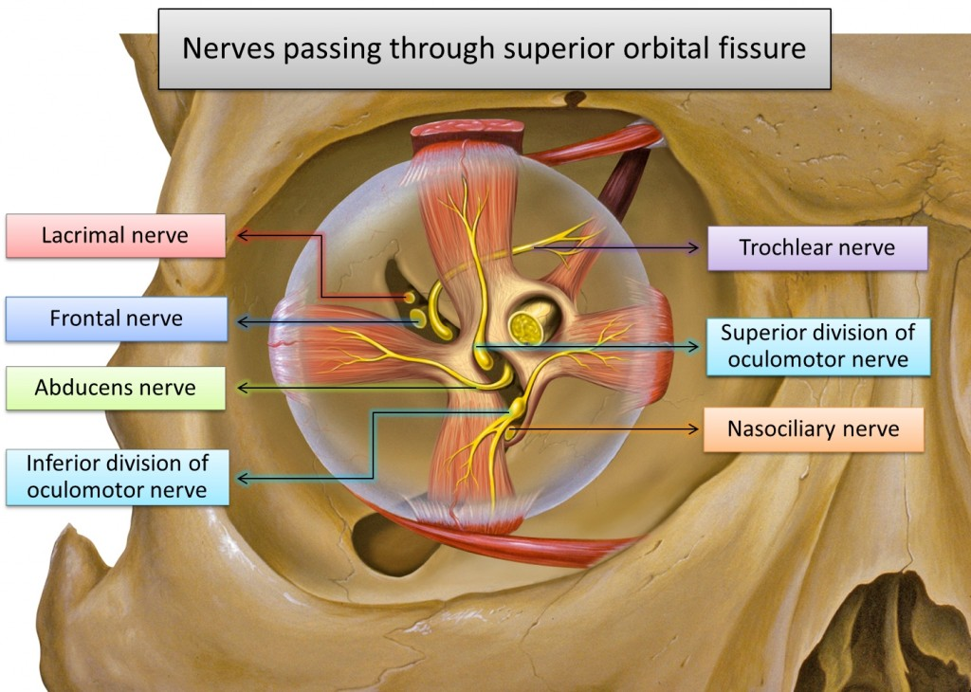

Slide 52
CRANIAL CAVITY
The skull is a crucial osseous structure
  houses a network of neurovascular and lymphatic vessels.
For these networks to traverse and communicate with the entire body, the foramina must provide passage through the skull.
The morphology of the foramina creates a protective enclosure for these neurovascular and lymphatic bundles.
The cranial cavity floor is divided into three distinct recesses:
Anterior fossa,
Middle fossa
Posterior fossa.

Slide 53
FORAMINA
The human skull has numerous openings (foramina), that enable cranial nerves and blood vessels to exit the skull and supply various structures.
These openings are collectively referred to as the cranial foramina.
The cranial cavity floor is divided into three distinct recesses:
  Anterior fossa,
  Middle fossa
  Posterior fossa.
Each fossa contains specific foramina, through which various anatomical structures pass through.

Slide 54
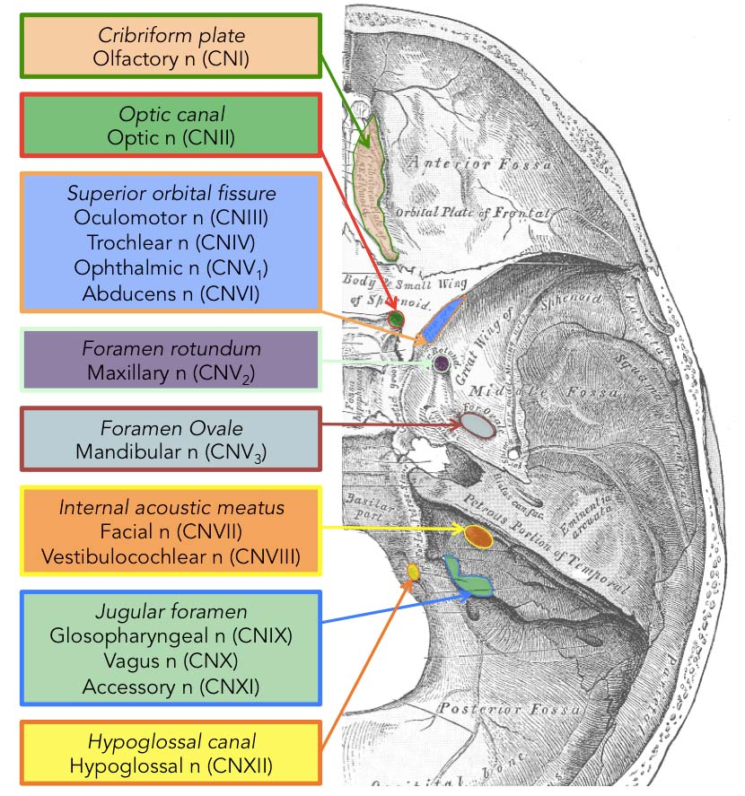

Slide 55
Cribriform foramina
The cribriform foramina refer to numerous perforations in the cribriform plate of the ethmoid bone.
They connect the ACF with the nasal cavity.
These foramina allow the passage of axons of the olfactory nerve from the olfactory epithelium of the nose into the ACF where they communicate with the olfactory bulb.

Slide 56
Optic Canal and Foramen
The optic canal permits the passage of the optic nerve (CN II) and the ophthalmic artery into the bony orbit.
It is bounded medially by the body of the sphenoid, and laterally by the lesser wing of the sphenoid bone.

Slide 57
Superior orbital fissure
Is a cleft that opens anteriorly into the orbit, and enables communication between the cavernous sinus and the apex of the orbit.
It is bordered superiorly by the lesser wing and inferiorly by the greater wing of the sphenoid bone.
It transmits the following from superior to inferior:
  Lacrimal nerve
  Frontal nerve (branch of the ophthalmic nerve, the first division of the trigeminal nerve)
  Superior ophthalmic vein
  Trochlear nerve

Slide 58
Cont’d
  Superior division of the Oculomotor nerve (CN III)
  Nasociliary nerve (branch of the ophthalmic nerve, the first division of the trigeminal nerve)
  Inferior division of the Oculomotor nerve (CN III)
  Abducens nerve (CN VI)
  A branch of the Inferior ophthalmic vein

Slide 59
Foramen Rotundum
Located at the base of the greater wing of the sphenoid, inferior to the superior orbital fissure.
It provides a connection between the middle cranial fossa and the pterygopalatine fossa.
The maxillary nerve (branch of the trigeminal nerve, CN V) passes through this foramen.

Slide 60
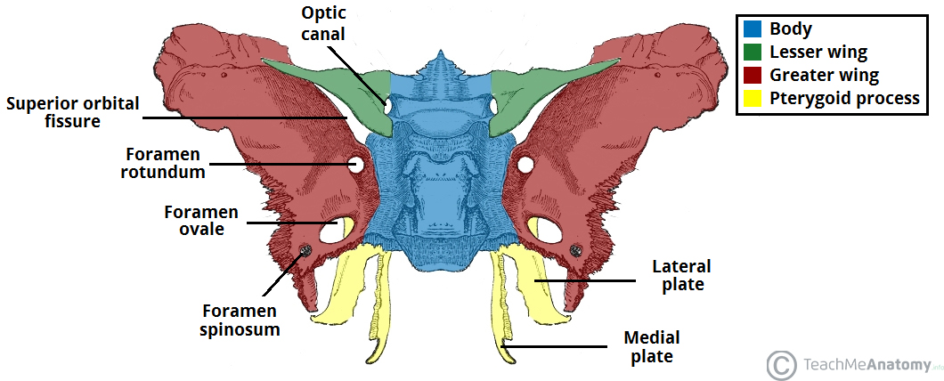

Slide 61
Foramen Ovale
The foramen ovale is another opening located at the base of the greater wing of the sphenoid.
It is positioned posterolateral to the foramen rotundum within the middle cranial fossa.
It conducts the mandibular nerve (branch of the Trigeminal nerve, CN V) and the accessory meningeal artery.

Slide 62
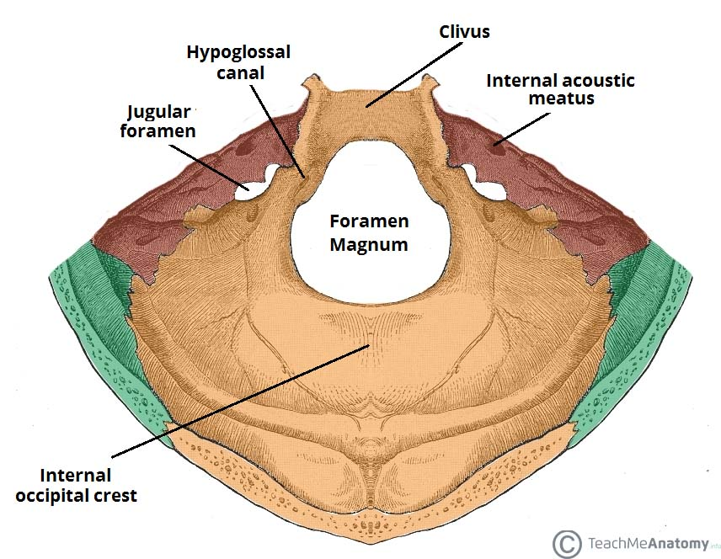
Internal Acoustic Meatus
Bony passage located within the petrous part of the temporal bone.
Connects the PCF and the inner ear, transporting neurovascular structures to the auditory and vestibular apparatus.
The facial and vestibulocochlear nerves pass through the internal acoustic meatus, alongside the vestibular ganglion and labyrinthine artery.

Slide 63

Jugular foramen
Formed anteriorly by the petrous part of the temporal bone and posteriorly by the occipital bone.
3 separate compartments with their respective contents:
  Anterior – contains the inferior petrosal sinus
  Middle – transmits the Glossopharyngeal nerve, Vagus nerve and cranial part of the Accessory nerve.
  Posterior – contains the sigmoid sinus and transmits meningeal branches of occipital and ascending pharyngeal arteries.

Slide 64

Hypoglossal Canal
Located in the occipital bone.
Hypoglossal nerve (CN XII) passes to exit the PCF.

Slide 65

Foramen Magnum
Largest of the cranial foramina.
Lies in the occipital bone within the PCF.
Allows the passage of:
  Spinal cord & meninges except periosteal dura
  Vertebral arteries,
  Anterior and posterior spinal arteries
  Dural veins.
The spinal division of the accessory nerve ascends through the foramen magnum to join the cranial division.
Once combined, the completed nerve exits through the jugular foramen as described above.

Slide 66
Foramen Spinosum
located within the MCF, posterolateral to the foramen Ovale.
It allows the passage of the:
  Middle meningeal Artery,
  Middle meningeal Vein
  Meningeal branch Of CN V₃.

Slide 67
Fontanelles
Growth areas of the skull that are present since before birth up until certain ages in young children. These are;
The anterior fontanelle (bregma) closes between 4 and 26 months.
  diamond-shaped space
  located between the paired frontal and parietal bones of the fetal/neonatal skull
The posterior fontanelle (lambda) closes much earlier than the anterior, at only 1 to 2 months after birth.
  It is located where the two parietal bones meet the occipital bone (also described as the junction of the sagittal and lambdoid sutures).

Slide 68
Cont’d
The sphenoidal fontanelle (anterolateral fontanelle) closes btw 2 and 3 months and is this called Pterion.
  It is located at the junction of the sphenoid, parietal, temporal, and frontal bones.
The Mastoid /Asterion fontanelle.
  closes at 12th to 18 months,
  Takes its name from the area in which it is situated, the mastoid fontanelle, the It is located at the junction of the temporal, occipital, and parietal bones.

Slide 69
Cervical vertebrae
Identified by their foramina transversaria
Seven in number: C1 – C7
TYPICAL C-VETERBRA
Broader from side to side
Superior surface - concave transversely with upward projecting lips
Saddle shaped inferior surface - convex from side to side
Large vertebra foramen than the body/triangular in shape
Pedicles are directed backwards and laterally

Slide 70
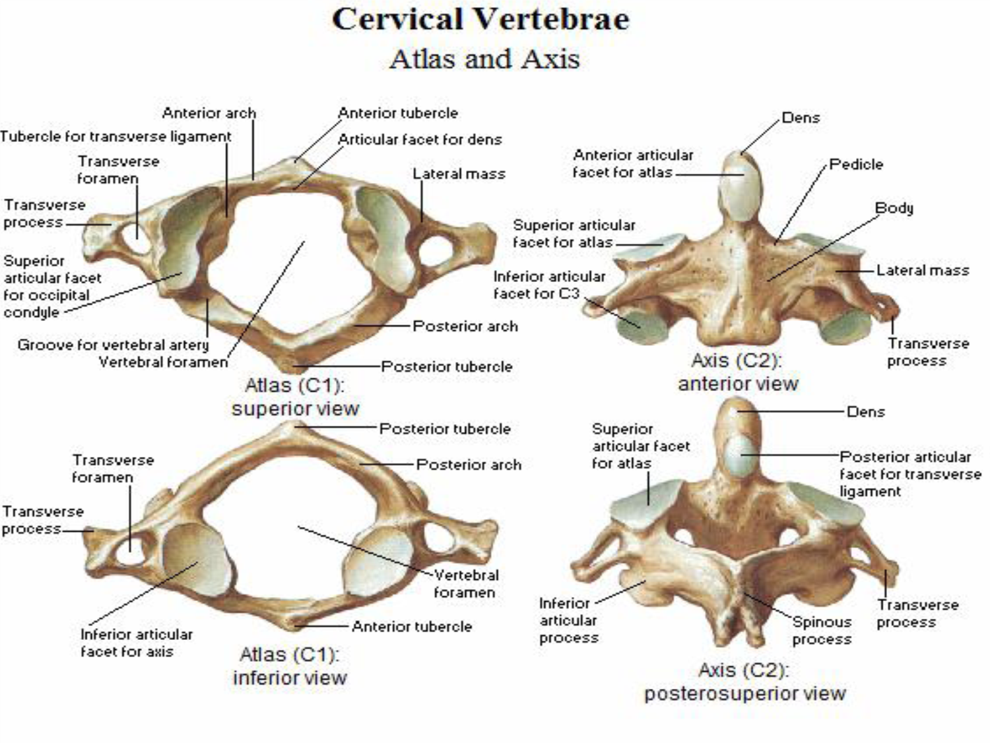

Slide 73
REFERENCES

