Slide 1
FACE & SCALP
Presenter: Richwell HAKACHA Dip PT, BSc PT, PGSM, MSc HAN Candidate

Slide 2
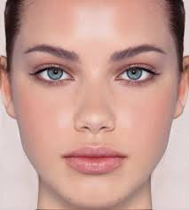
The Face
The face refers to the anterior portion of the head.
Its margins include;
  Superiorly - the superciliary arches
  Inferiorly - the lower edges of the mandible
  Laterally - the ears
Major facial development occurs - 4th and 8th weeks of embryonic development

Slide 3
Intro cont’d
Lower jaw (mandible) is the first to form (4th week)
The facial proportions develop during the fetal period (9th week to birth)
During infancy & childhood, following the development of teeth & paranasal sinuses, the facial skeleton increases in size & contribute to the definitive shape of the face

Slide 4
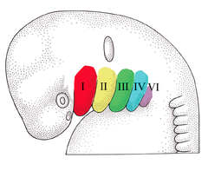

Slide 5
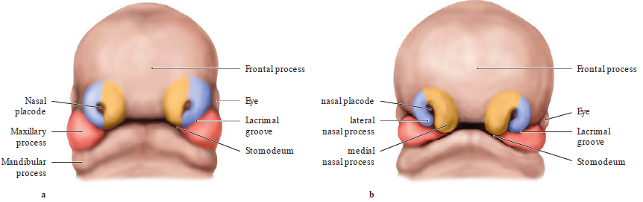
Embryology of face

Slide 6
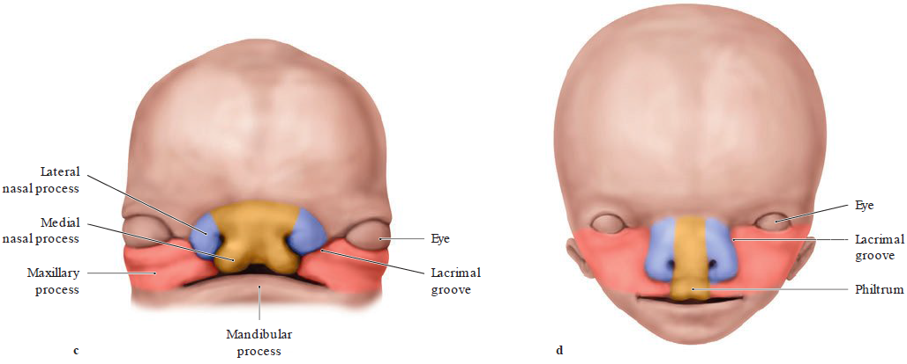
Embryology cont’d

Slide 7
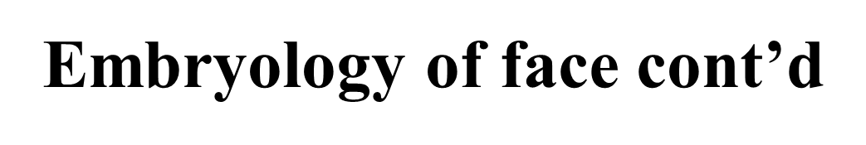
Early in the 4th week, 5 primordial swellings consisting primarily of neural-crest derived mesenchyme appear around the stomodeum
  Single frontonasal prominence – ventral to the forebrain
  Paired maxillary prominences – develop from cranial part of 1st pharyngeal arch
  Paired mandibular prominences – develop from caudal part of the 1st pharyngeal arch
The mesoderm of the 5 prominences is continuous with each other
There is no internal division corresponding to the grooves demarcating the prominences externally

Slide 8
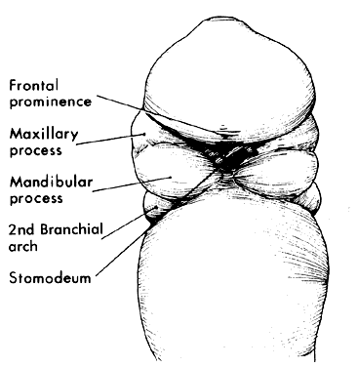
Cont’d
Stomodeum
  ectoderm lined depression
  separated from primitive pharynx by buccopharyngeal membrane
  membrane later breaks down & stomodeum opens into the pharynx
  forms the vestibule of the oral cavity

Slide 9
Embryology cont’d
By the end of 4th week, bilateral oval-shaped ectodermal thickenings called ‘nasal placodes’ appear on each side of the lower part of the frontonasal prominence
Nasal placodes are primordial of nose and nasal cavities.
Mesenchymal cells proliferate at the margins of the placodes and produce horse shoe shaped swellings around these.

Slide 10
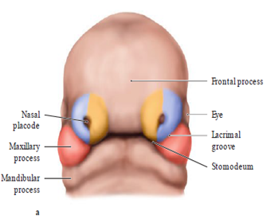
Cont’d
The sides of these swellings are called medial & lateral nasal prominences
The placodes now lie in depressions called ‘nasal pits’ .
Each lateral nasal placode is separated from maxillary swelling by nasolacrimal groove.

Slide 11
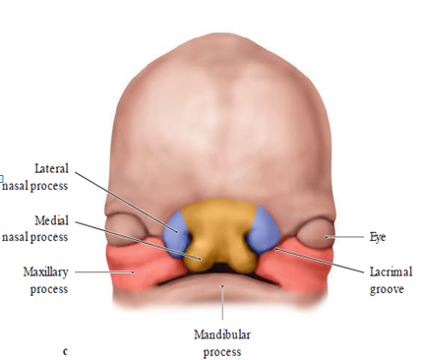
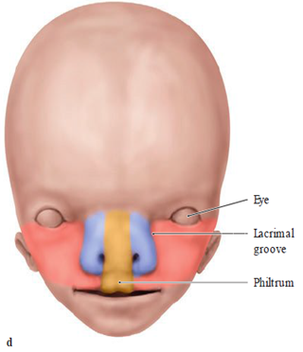
Cont’d
Maxillary processes - continue to increase in size &:
  laterally - merge with mandibular process to form the cheek
  medially - compress the medial nasal prominences towards the midline and finally fuses with these to form upper lip
Upper lip – 2 maxillary process
& 2 medial nasal prominences

Slide 12
2 medial nasal swellings enlarge grow medially & merge with each other in the mid line to form intermaxillary segment.
Intermaxillary segment gives rise to:
  Philtrum of lip
  Premaxillary part of the maxilla that bears the upper 4 incisors & associated gums
  Primary palate (region of hard palate just posterior to the upper incisors

Slide 13
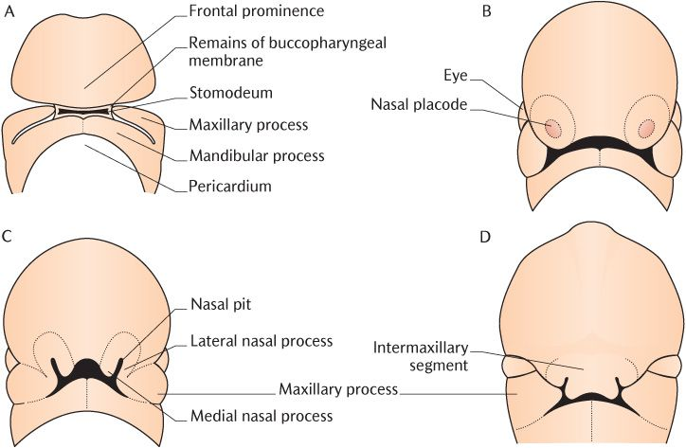

Slide 14
Cont’d
Mesenchyme from 1st & 2nd pairs of pharyngeal arches invade the facial prominences
  1st pharyngeal arch – muscles of mastication
  2nd pharyngeal arch – muscles of facial expression
Besides fleshy derivatives, facial prominences also gives rise to bones of facial skeleton.

Slide 15
Derivatives of facial components
  Maxillary prominence
    Upper cheek regions
    Most of upper lip
    Maxilla bone
    Zygomatic bone
    Secondary palate
  Frontonasal prominence
  Bridge of nose
  Forehead
  Frontal & nasal bones
  Maxillary prominence

Slide 16
Derivatives cont’d
Medial nasal prominence – fuse & form intermaxillary segment
Mandibular prominences fuse & form:
  Chin
  Lower lip
  Lower cheek regions
  Mandible bone
Lateral nasal prominences
  Ala of nose

Slide 17
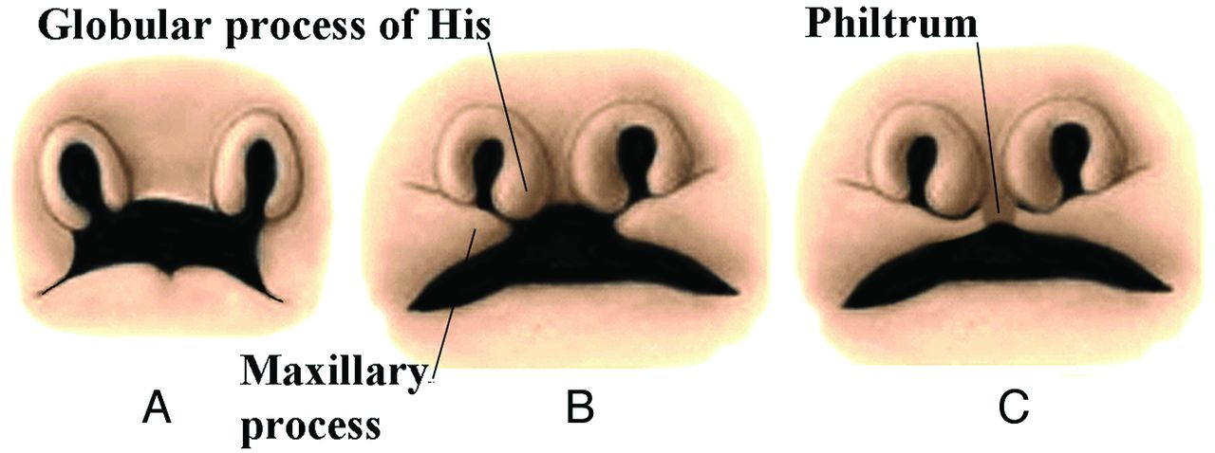

Slide 18
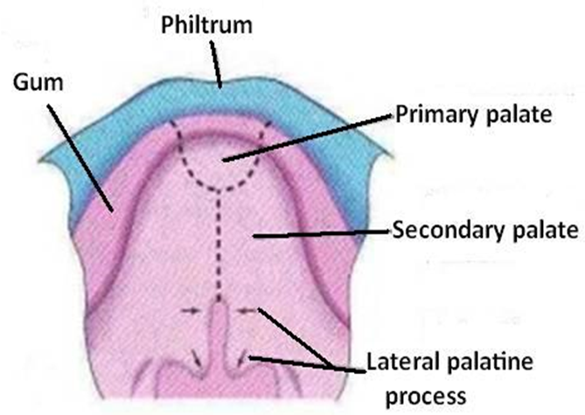

Slide 19
Malformations
Hypotelorism – abnormal decrease in distance between any two organs (between two eyes) (orbit) appear too close
Hypertelorism - is an abnormally increased distance between two organs i.e. increased distance between the orbits (eyes)
Gnathochisis- failure of central fusion of mandibular prominences
Micrognathia-underdevelopment of lower jaw, incorrect positioning of ear.
Agnathia- total lack of development of lower jaw & incorrect positioning of ear.
Failure of maxillary prominence to fuse with median nasal prominence results in unilateral or bilateral cleft palate

Slide 20
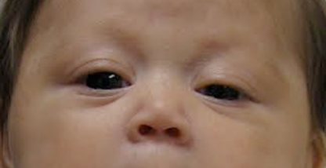
Hypotelorism

Slide 21
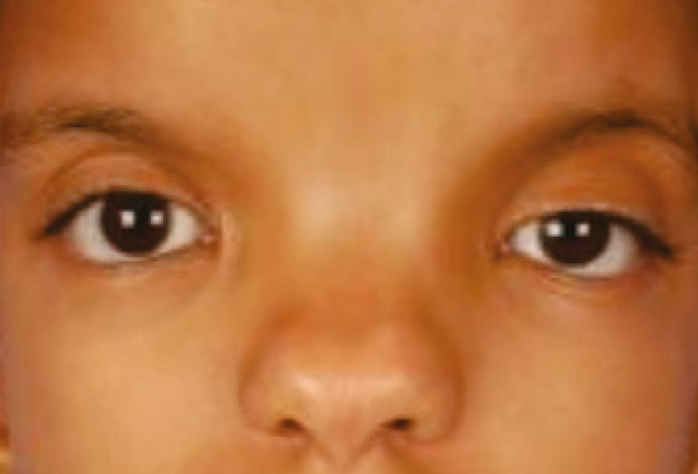
Hypertelorism

Slide 22
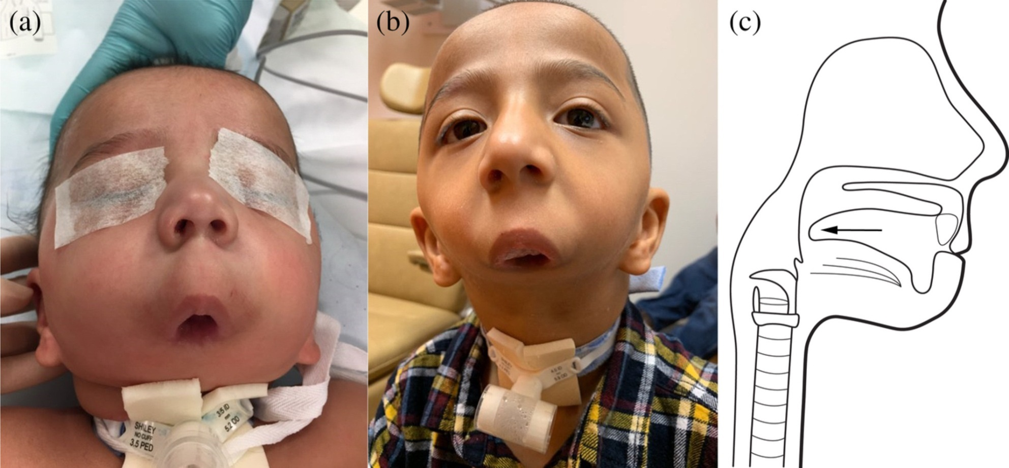
Agnathia

Slide 23
Muscles of Facial expression
Muscles of the face like muscles of facial expression develop from the 2nd pharyngeal arch embryonically
They are in superficial fascia with origin from bone and insertions into skin
They are the only muscles that insert into skin

Slide 24
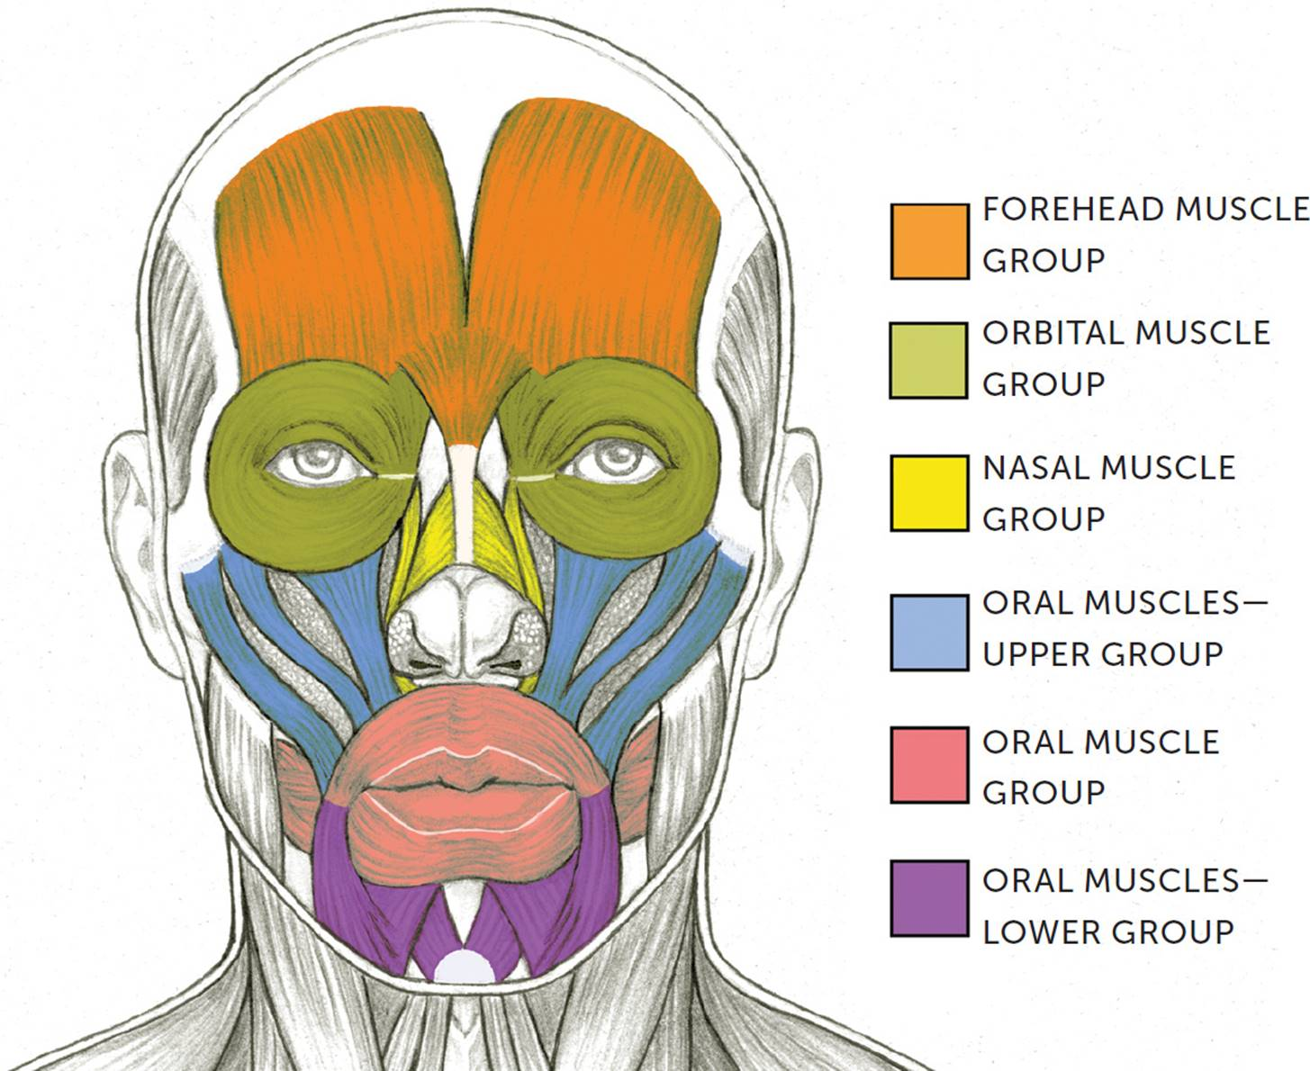
Facial muscles can be grouped into
Orbital group
Nasal group
Oral group
Other muscles

Slide 25
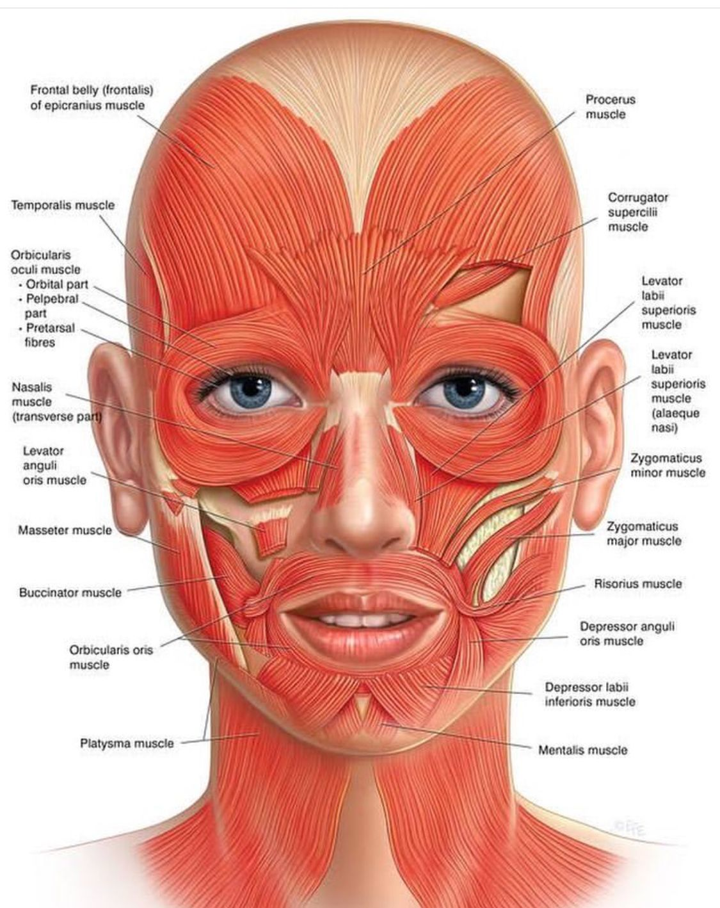

Slide 26
Orbital Group
Consists 2 muscles
Orbicularis oculi which is further divided into; palpebral and orbital parts.
Corrugator supercilii

Slide 27
Nasal Group
Consists 3 muscles
Nasalis which has 2 parts; transverse and alar parts
Procerus
Depressor septi

Slide 28
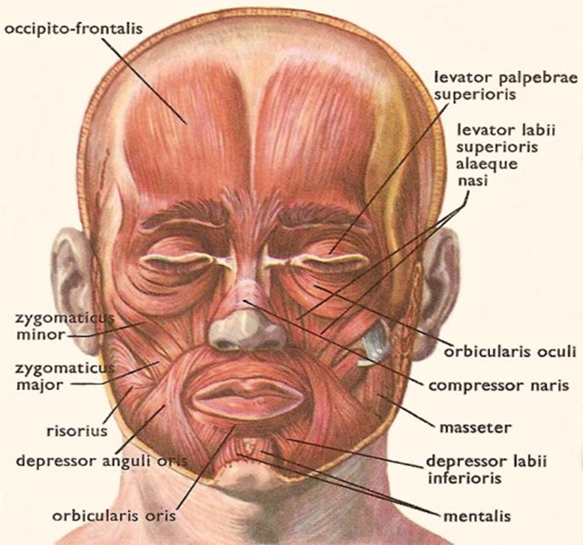
Oral Group
Consist 11 muscles
Depressor anguli oris
Depressor labii inferioris
Mentalis
Risorius
Zygomaticus major
Zygomaticus minor

Slide 29

Levator labii superioris
Levator labii superioris alaeque nasi
Levator anguli oris
Obicularis oris
Buccinator

Slide 30
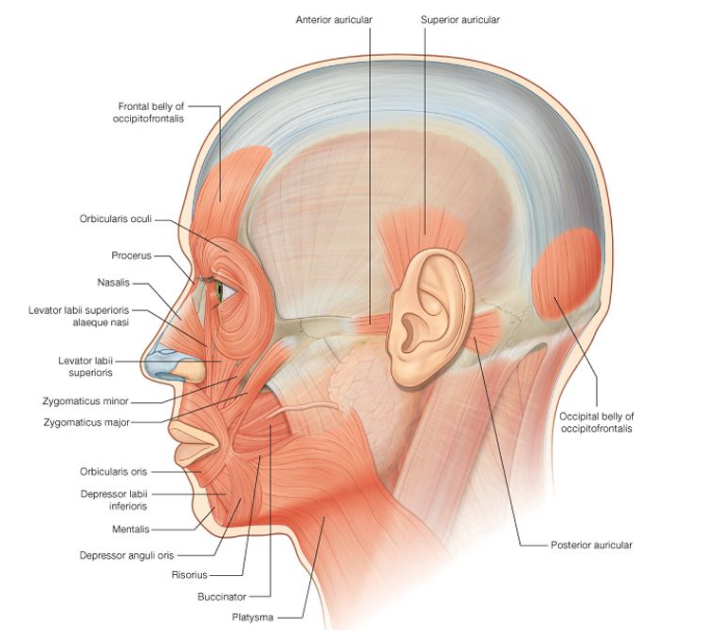
Other muscles
Anterior auricular
Superior auricular
Posterior auricular
Occipitofrontalis

Slide 31
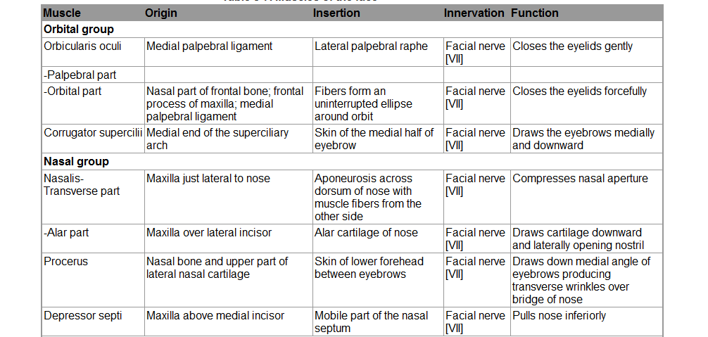

Slide 32
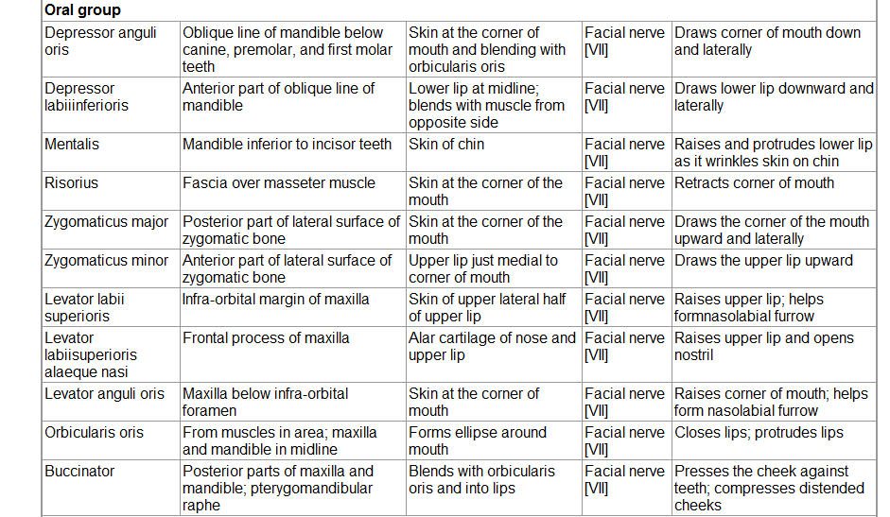

Slide 33
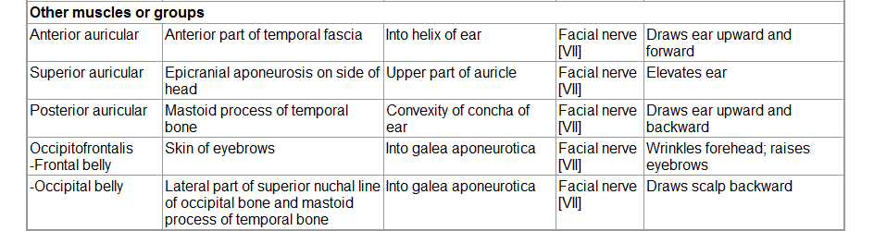

Slide 34
Innervation
Innervation to the muscles of facial expression is by the Facial nerve (CN VII)
It originates from the margin of the pons and medulla
Enters the internal acoustic meatus
Exits the skull via the stylomastoid foramen
Pierces the parotid gland and divides into five (5) branches
  Temporal
  Zygomatic
  Buccal
  Marginal mandibular
  Cervical

Slide 35
Blood Supply
Most arteries of the face are branches of the external carotid artery
facial artery
  provides the major arterial supply to the face
  It arises from the external carotid artery to the inferior border of the masseter all the way to the canthus of the eye
  sends branches to upper and lower lips (superior and inferior labial arteries)

Slide 36
Lateral nasal artery
  supplies the nose
  terminates as the angular artery supplying the medial canthus
Superficial temporal artery
  smaller terminal branch of the external carotid artery
  emerges between the TMJ & ear
  ends in the scalp by dividing into the frontal & parietal branches

Slide 37
Maxillary branch
  small terminal branch of the external carotid artery
Transverse facial artery
  arises from the superficial temporal artery within the parotid gland
  divides into numerous branches which supply; the parotid gland and duct, masseter and skin over the face

Slide 38
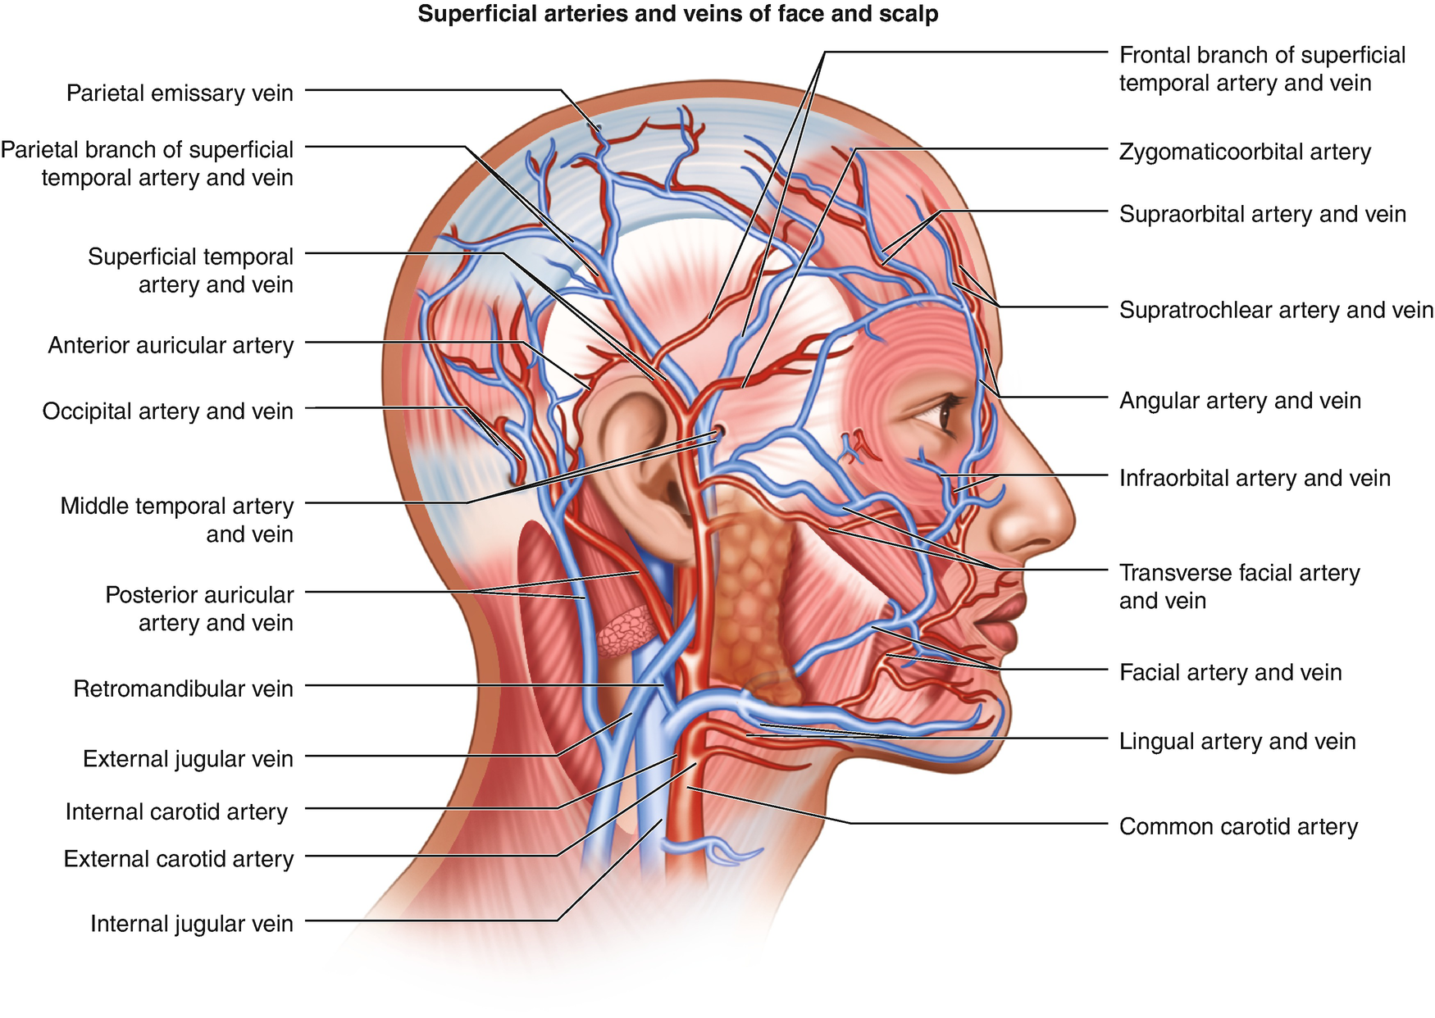

Slide 39
Venous Drainage
Facial vein - major drainage to the face
  It begins at the medial canthus of the eye as the angular vein by union of the supratrochlea and supraorbital veins
  This runs inferoposteriorly through the face posterior to the facial artery
  Inferior to the margin of the mandible, its joined by the anterior branch of the retromandibular vein
  The facial vein drains into the internal jugular vein

Slide 41
Superficial temporal vein
  drains the forehead and scalp
  near the auricule, it enters the parotid glad
  joins maxillary vein to form the retromandibular vein which descends within the parotid gland superficial to the external carotid artery and deep to the facial nerve

Slide 42
It divides
  anterior branch- joins the facial vein
  posterior branch - joins the posterior auricular branch
Posterior auricular & posterior retromadibular veins join to form the external jugular vein which drains into the subclavian vein

Slide 43
Lymphatic Drainage
Lateral part of the face including the eyelids drain inferiorly into the parotic lymph nodes
Lymph from the deep parotid nodes drain into the deep cervical nodes
Lymphatic vessels from the upper lip and lateral parts of the lower lip drain into the sub-mandibula lymph nodes
Lymphatic vessels in the chin and central part of the lower lip drain into the sub-mental lymph nodes.

Slide 44
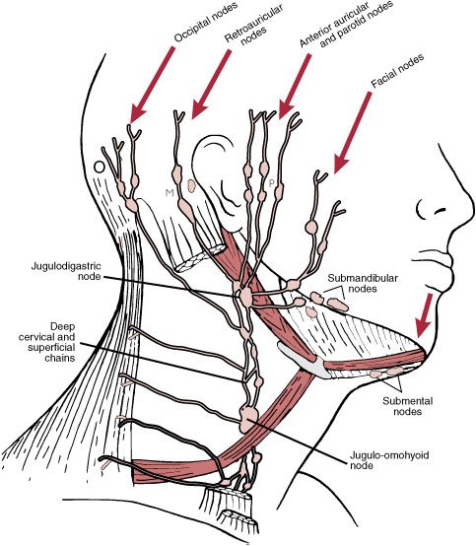

Slide 45
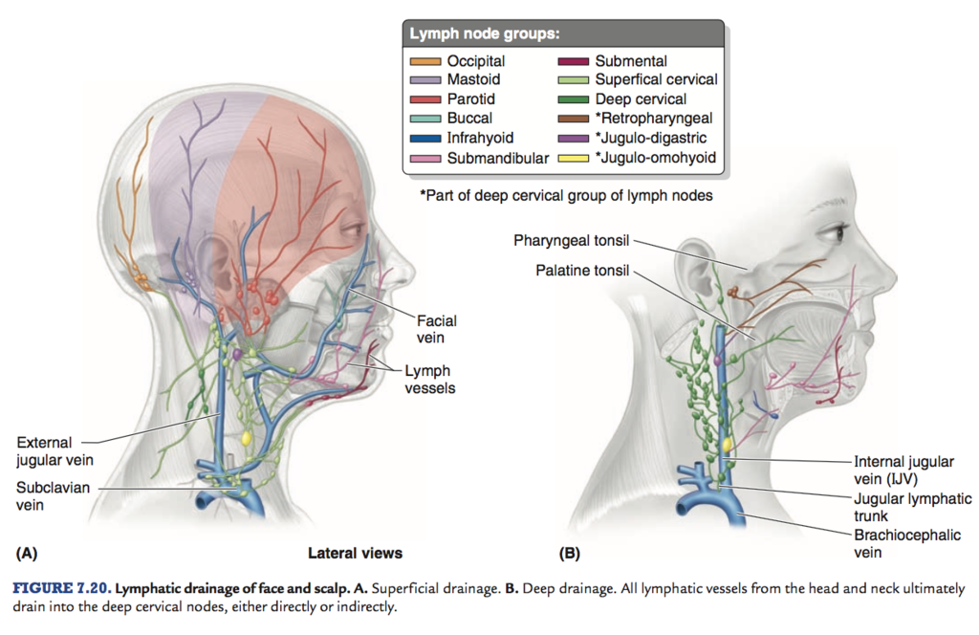

Slide 46
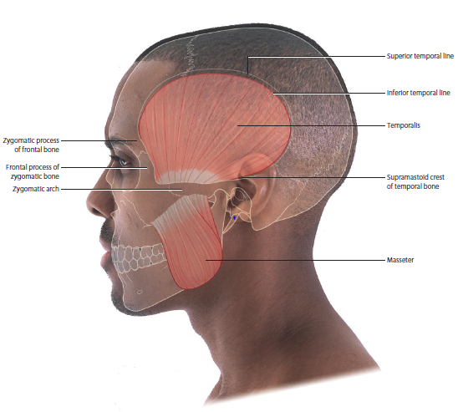
Scalp
This is a part of the head that extends from the supercilliary arches anteriorly to the external occipital protruberance and superior nuchal line posteriorly.
Laterally, it continues inferiorly to the zygomatic arch

Slide 47
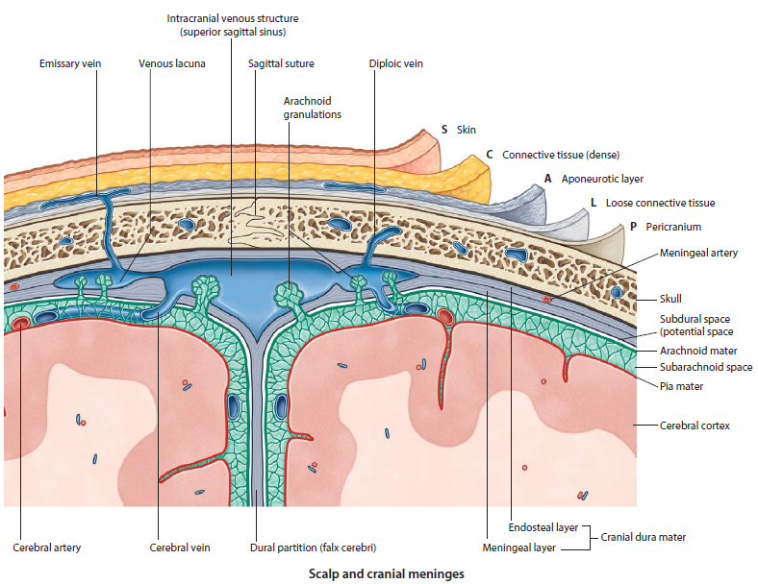
Scalp cont’d

Slide 48
It is a multilayered structure
S-skin
C – dense connective tissue
A – aponeurotic layer
L – loose connective tissue
P - pericranium

Slide 49
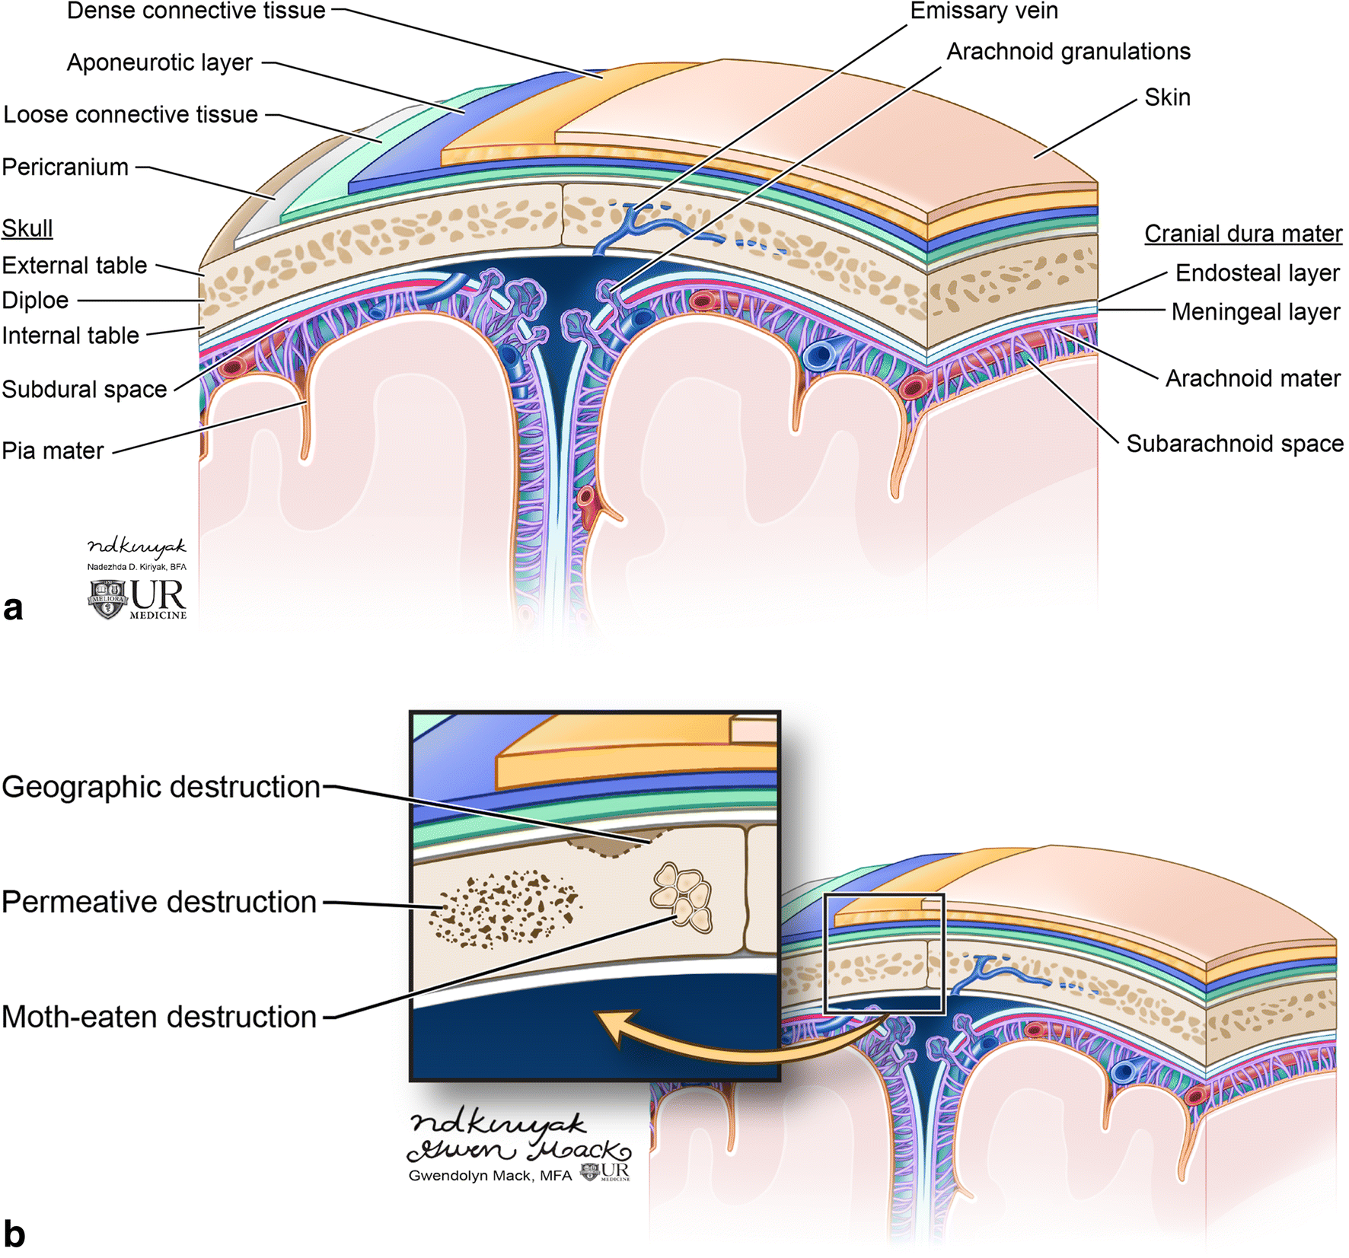

Slide 50
The first three layers are tightly adherent to one another forming a single unit known as the scalp proper
Skin- outermost layer that contains:
  sweat glands
  sebaceous glands
  hair follicles
  abundant arterial supply & venous drainage

Slide 51
Dense connective tissue - deep to the skin
  thick
  anchor the skin to the 3rd layer
  highly vascularized
  contains nerves, arteries and veins supplying the scalp
  when scalp is cut, dense connective tissue holds the cut vessels open and leads to profuse bleeding

Slide 52
Aponeurotic layer - firmly attached to skin by dense connective tissue
  it’s a strong tendinous sheet
  attachment for the frontalis belly anteriorly & Occipitalis belly posteriorly
  forms the aponeurotic tendon that connects the 2 muscles

Slide 53
Loose connective tissue - seperates the aponeurotic layer from the pericranium
  Facilitates movement of the scalp proper over the skull
  It is sponge like because of its many potential spaces, this makes it prone to infection

Slide 54
Pericranium - deepest layer of the scalp
  Comprises a deep layer of connective tissue
  Periostium of the skull attaches firmly to the cranial bones
  Can however be detached with ease except in the areas of the cranial sutures

Slide 55
Innervation
It is supplied by branches of the trigeminal nerve anterior to the ear & vertex of the head
  zygomaticotemporal
  auriculotemporal
  supratemporal
  supraorbital

Slide 56
Posterior to the ear & vertex, the scalp is supplied by the cervical nerves & branches from C2 and C3
  greater auricular
  greater occipital
  lesser occipital

Slide 57
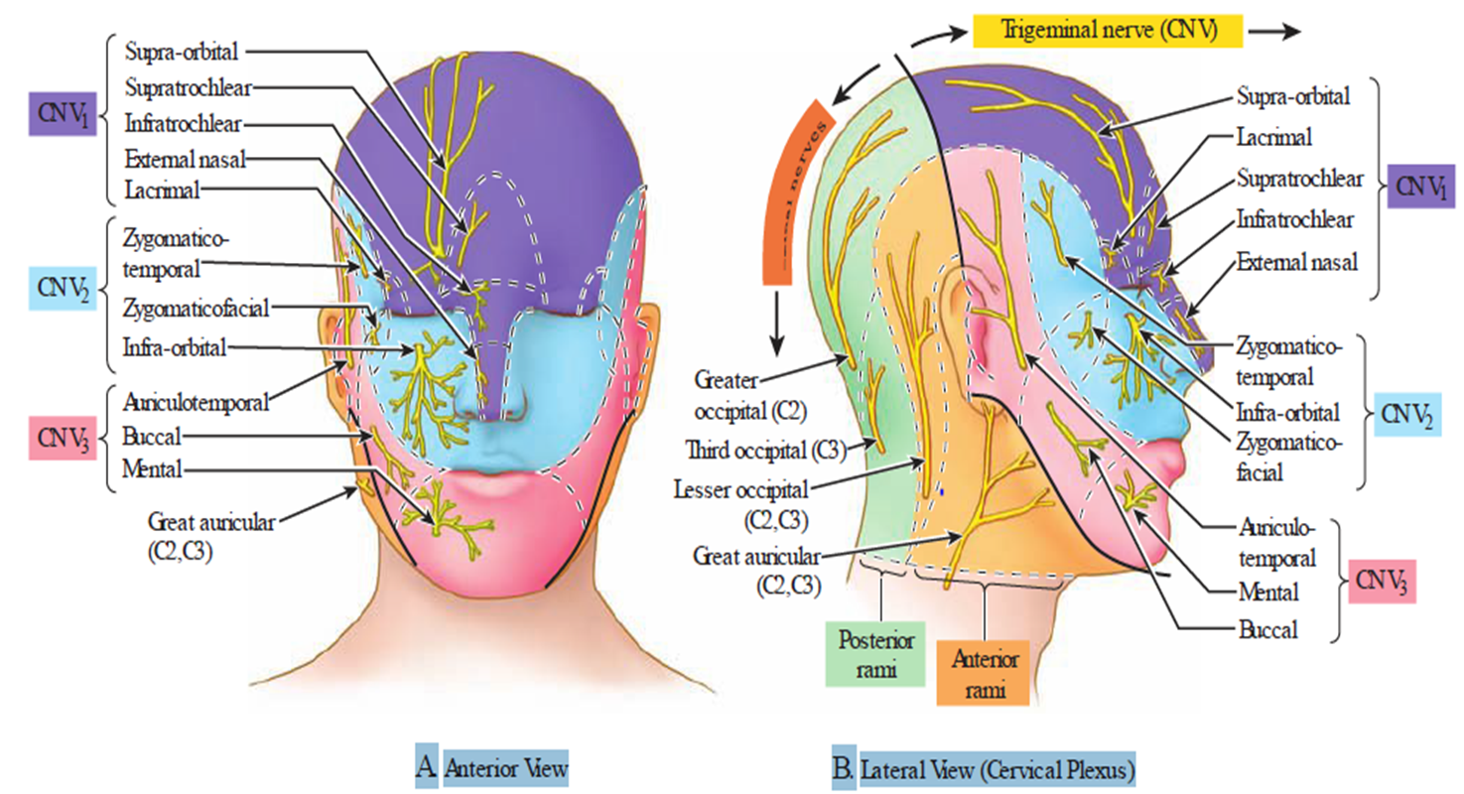
Innervation cont’d

Slide 58
Blood Supply
Branches of the external carotid arteries and opthalmic artery (branch of the internal carotid artery)
Opthalmic artery
  supratrochlear and supraorbital a.
External carotid artery
  Posterior auricular artery
  Occipital artery
  Superficial temporal artery

Slide 59
THE END
THANK YOU

Slide 60
Trigeminal Nerve (CN V)
Originates anteriorly from the upper lateral pons as two roots (motor and sensory)
Originates from 3 sensory nuclei (Mesencephalic,principal sensory, spinal nuclei of trigeminal nerve)
Also originates from 1 motor nucleus (Motor nucleus of trigeminal nerve) extending from the midbrain to the medulla.
At the level of the pons, the sensory nuclei merge to form a sensory root and the motor nucleus continues to form the motor root.
In middle cranial fossa, the sensory root expands into the trigeminal ganglion located near the cavernous sinus in a depression called trigeminal cave (meckel’s cave)

Slide 61
Cont’d
It passes medially near the tentorium cerebelli over the apex of the petrous temporal bone into the middle cranial fossa
Peripheral part gives rise to:
Opthalmic [V1] which runs lateral to cavernous sinus and exit cranium via superior orbital fissure
Maxillary [V2] runs together with opthalmic branch and exits cranium via the foramen rotandum
Mandibular [V3] exists cranium via foramen ovale entering the infratemporal fossa.
It innervates muscles of mastication and mediates general sensation from the face, eye, nasal and oral cavities

Slide 62
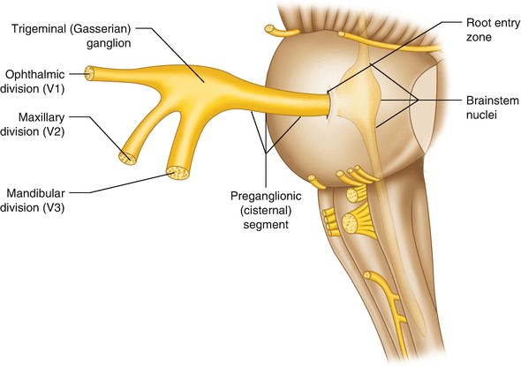

Slide 63
The sensory root passes beneath the tentorium to the trigeminal ganglion.
The motor root does not enter the ganglion, instead, it passes inferiorly to exit the skull through the foramen ovale with the Mandibular division of the ganglion
The Ophthalmic division pierces the wall of the trigeminal cave and runs forward in the lateral wall of the cavernous sinus
Exits the skull through the superior orbital fissure/supra orbital fissure

Slide 64
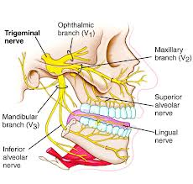

Slide 65
Trigeminal nerve divides into 3 branches;
Ophthalmic division- passes anteriorly through the lateral wall of the cavernous sinus
Innervates the area above the upper eyelid and dorsum of the nose.
Supplies the face as the supraorbital, supratrochlear, infratrochlear, external nasal and lacrimal nerves.

Slide 66
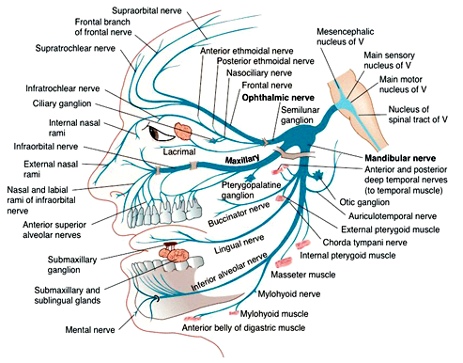

Slide 67
The maxillary nerve [V₂] exits the skull through the foramen rotundum. Branches that innervate the face include:
A small zygomaticotemporal branch
A small zygomaticofacial branch,
large infra-orbital nerve,
Supplies the lower eyelid, cheek, side of the nose, and upper lip

Slide 68
Mandibular division- passes through the foramen ovale into the infratemporal fossa
Innervates the face below the level of the lower lip.
Supplies the face as the auriculotemporal, buccal, and mental nerves.

Slide 69
The trigeminal nerve also supplies motor fibers to the(muscles of mastication) :
Temporalis, Masseter, Medial and lateral Pterygoids
Mylohyoid, Anterior belly of Digastric, Tensor tympani and Tensor palatini

Slide 70
Parasympathetic supply
Post ganglionic fibres from the pterygopalatine ganglion(derived from the facial nerve) travel with the zygomatic branch of V2 and then join the lacrimal branch of V1
These fibres supply the parasympathetic innervation to the lacrimal gland

Slide 71
THE END
THANK YOU

