Slide 1
TEMPORAL, INFRATEMPORAL AND PTERYGOPALATINE FOSSAE
Mr. M. Banda
University of Zambia

Slide 2
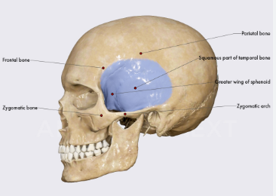
Temporal Fossa
Location
Located on the temporal region
On the lateral aspect of the skull above the zygomatic arch
Extends upto the superior zygomatic line

Slide 3
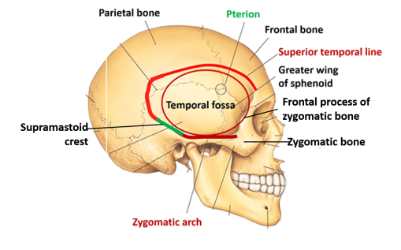
Temporal Fossa
Boundaries
Superiorly: superior temporal line
Inferiorly: zygomatic arch
Anteriorly: zygomatic process of the frontal bone and the frontal process of the zygomatic bone
Posteriorly: superior temporal line and supramastoid crest
Floor: formed by 4 bones (frontal, parietal, shenoid and temporal)

Slide 4
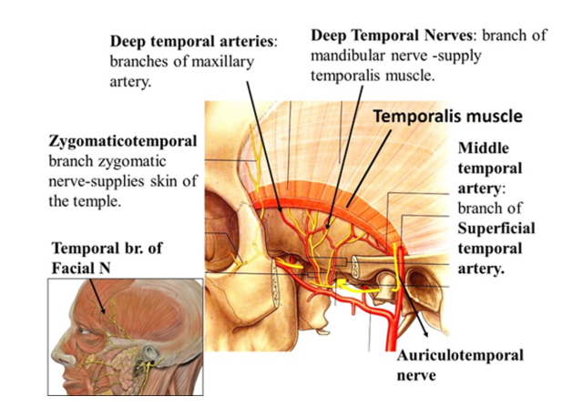
Temporal Fossa
Contents:

Slide 5
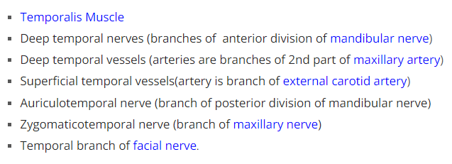
Temporal Fossa
Contents:

Slide 6
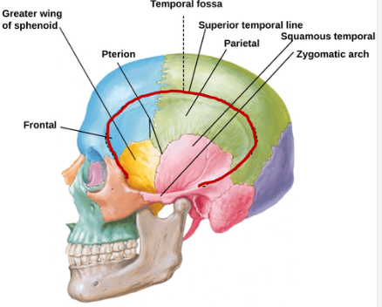
Temporal Fossa
Pterion

Slide 7
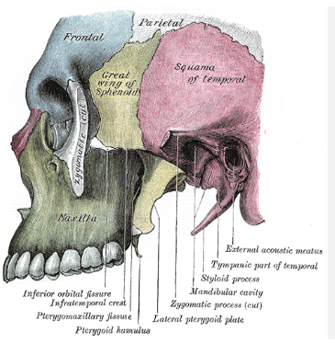
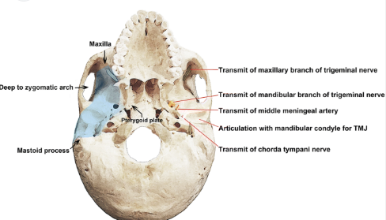
Infratemporal Fossa
It lies deep to the ramus of the mandible.
It communicates with the temporal fossa deep to the zygomatic arch and the pterygopalatine fossa through the pterygomaxillary fissure.

Slide 8
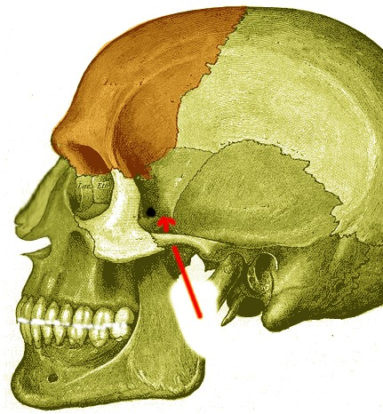
Infratemporal Fossa

Slide 9
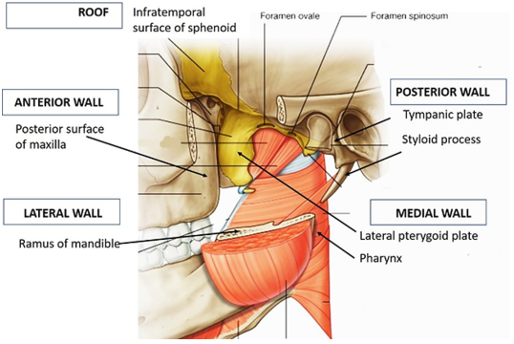
The boundaries of Infratemporal Fossa consists of both bone and muscle:
Lateral – condylar process and ramus of the mandible bone.
Medial – lateral pterygoid plate; tensor veli palatine, levator veli palatine and superior constrictor muscles.
Anterior – posterior border of the maxillary sinus.
Posterior – tympanic plate & styloid process
Roof – greater wing of the sphenoid bone.

Slide 10
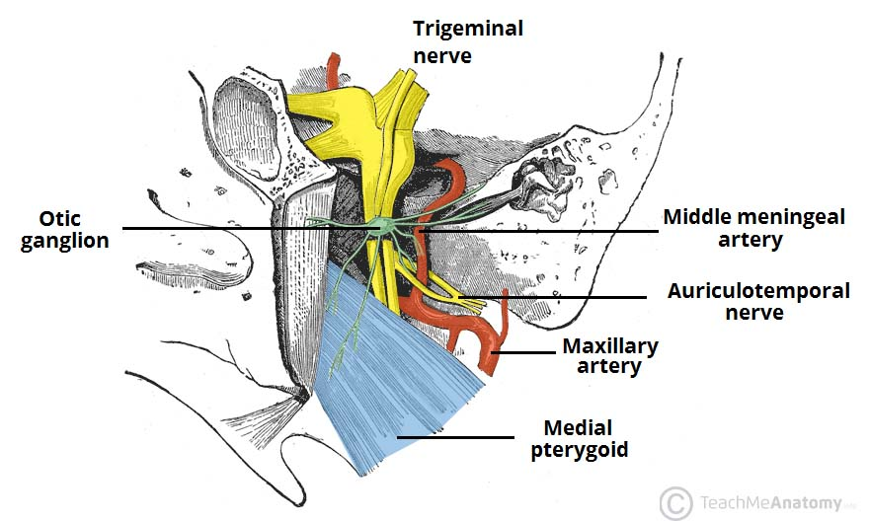
Contents
medial and lateral pterygoid muscles.
temporalis muscle.
maxillary artery and branches.
pterygoid venous plexus.
mandibular nerve and its branches (including lingual nerve)
chorda tympani nerve.
posterior superior alveolar nerve of maxillary nerve

Slide 11
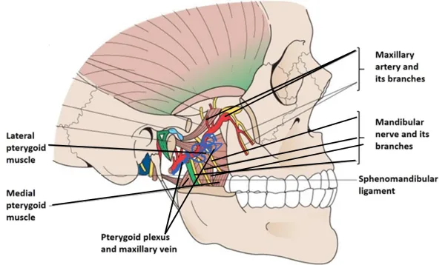
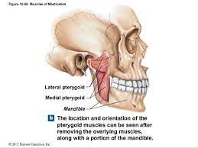
Contents

Slide 12
INFRATEMPORAL FOSSA CONT.
It contains the pterygomaxillary fissure across which structures pass between the infratemporal and pterygopalatine fossae.
The lateral wall is formed by the medial surface of the ramus of the mandible.

Slide 13
INFRATEMPORAL FOSSA CONT.
Lateral pterygoid provides a key to understanding the relationships of structures within the infratemporal fossa.
This muscle lies in the roof of the fossa and runs anteroposteriorly in a more or less horizontal plane from the region of the pterygoid plates to the mandibular condyle.
Branches of the mandibular nerve and the main origin of medial pterygoid are deep relations and the maxillary artery is superficial.

Slide 14
INFRATEMPORAL FOSSA CONT.
The buccal branch of the mandibular nerve passes between the two heads of lateral pterygoid.
Medial pterygoid and the lingual and inferior alveolar nerves emerge below its inferior border and the deep temporal nerves and vessels emerge from its upper border.
A venous network, the pterygoid venous plexus, lies around and within lateral pterygoid and is important in the spread of infection.

Slide 15
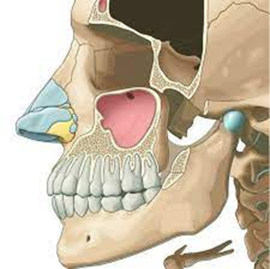
Clinical correlations
facial nerve weakness, temporomandibular joint dysfunction,
dental malocclusion
Normally complications are related to surgical intervention in the infratemporal fossa

Slide 16
Significance of the infratemporal fossa
The roof of the infratemporal fossa, formed by the greater wing of the sphenoid bone, provides an important passage for the neurovascular structures transmitted through the foramen ovale and spinosum. Among these are the mandibular branch of the trigeminal nerve and the middle meningeal artery.

Slide 17
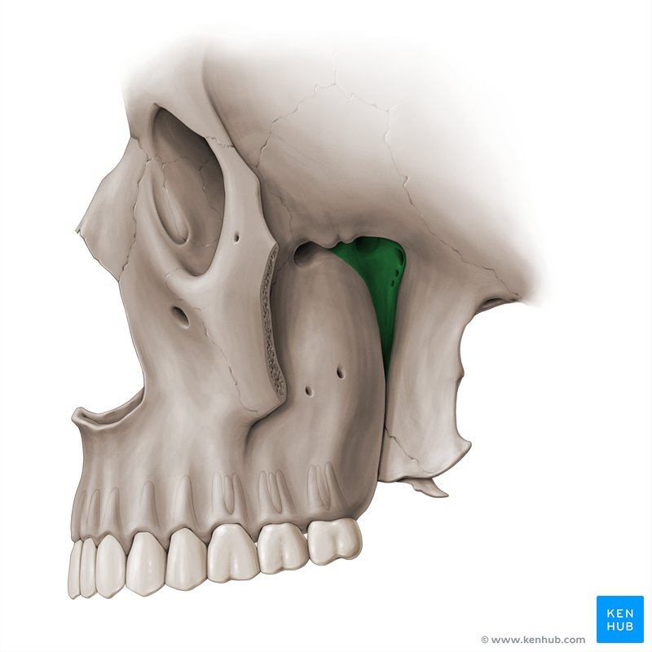
Pterygopalatine Fossa

Slide 18
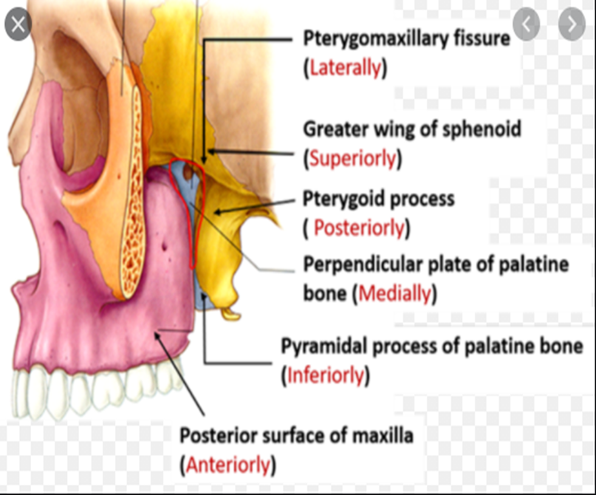
PTERYGOPALATINE FOSSA
Boundaries of the Pterygopalatine Fossa

Slide 19
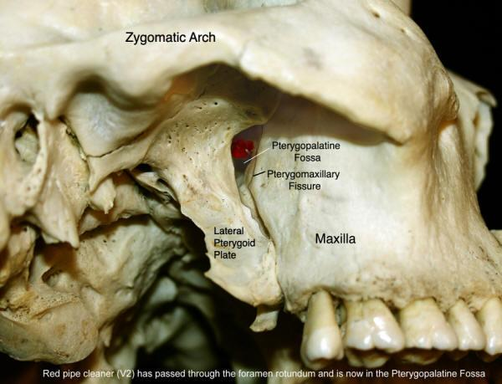
PTERYGOPALATINE FOSSA

Slide 20
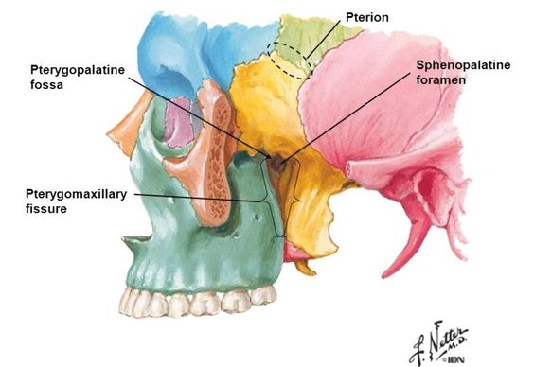
Boundaries –Pterygopalatine Fossa

Slide 21
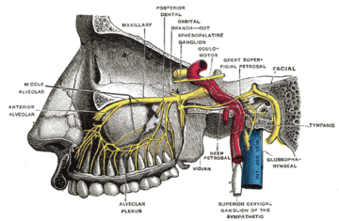
Contents

Slide 22
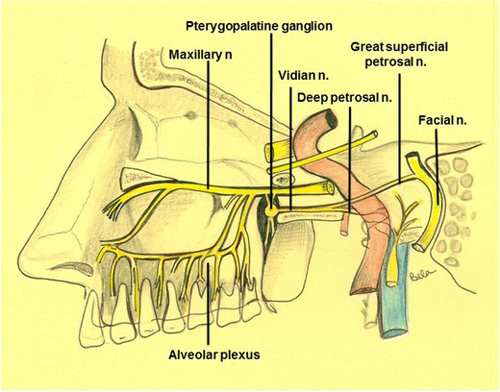

Slide 23
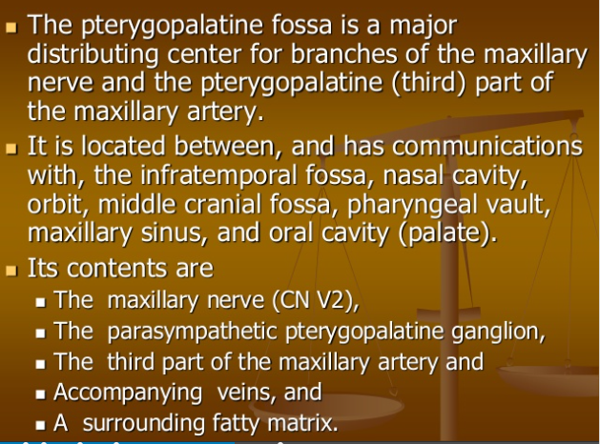
Contents

Slide 24
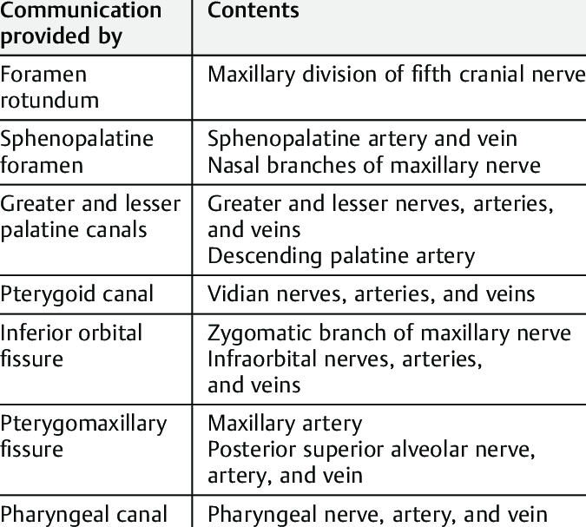

Slide 25
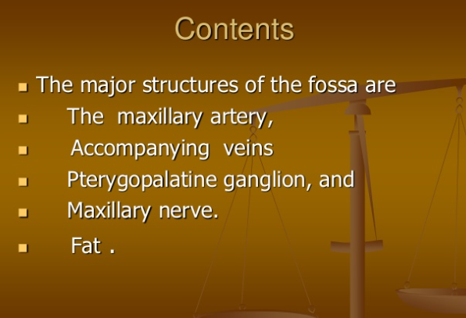

Slide 26
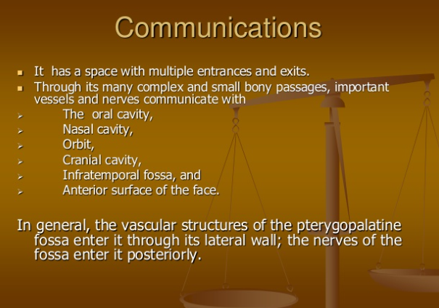

Slide 27
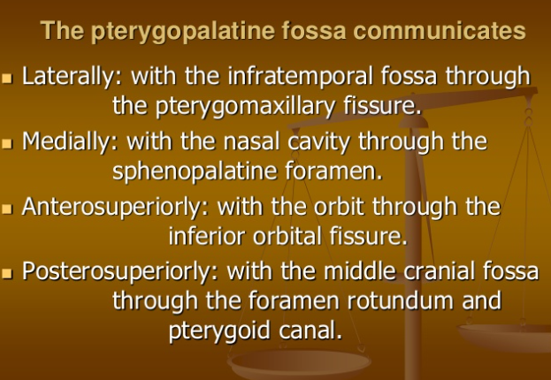

Slide 28
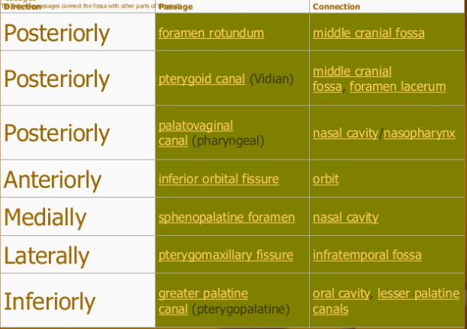

Slide 29
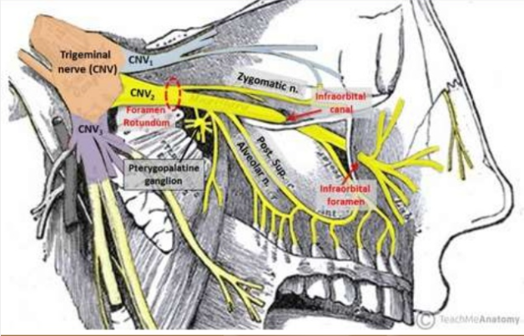

Slide 30
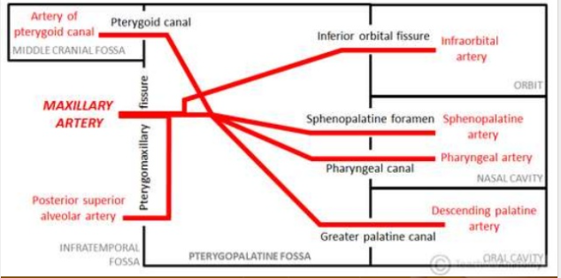
Third part of the maxillary artery in the pterygoid fossa

Slide 31
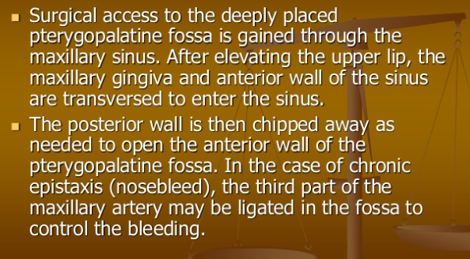
Clinical correlates-Transantral approach of the pterygoid fossa

Slide 32
The End
Thank you

